Slide 1

Layered Architecture
Chapter 10, Fundamentals of Software Architecture (2nd Edition)
Presentation: Blaine Harris

Slide 2
Layered (n-tiered) Architecture
One of the most commonly used “architectures”
Known for its simplicity, familiarity, and low cost
Used in both monolithic and distributed systems

Slide 3
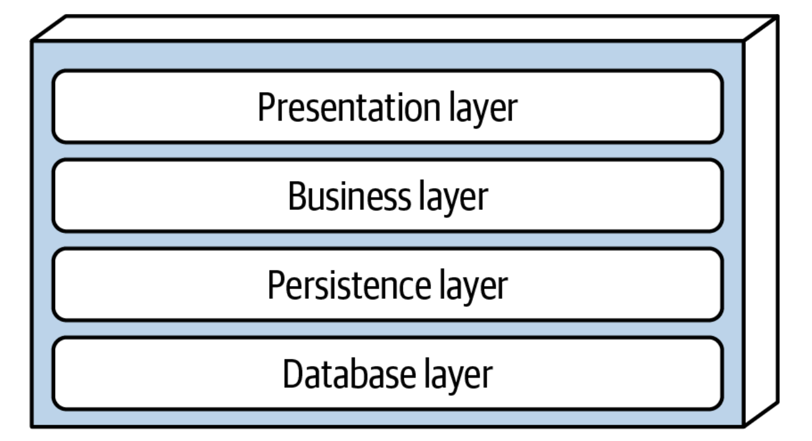
Standard Layers
Presentation
User interface and interaction
Business
Contains business rules and logic
Persistence
Manages data access logic
Database
Stores raw data

Slide 4
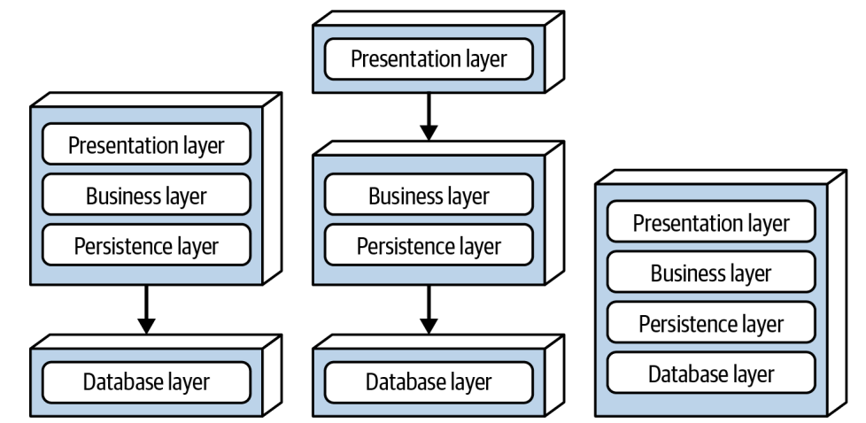
Layered Partitioning
Layers are portioned by technical role in the architecture
Grouped by what the component does rather than what is its domain
Business domain logic can be spread across multiple layers
Domain-driven design does not work well with this style

Slide 5
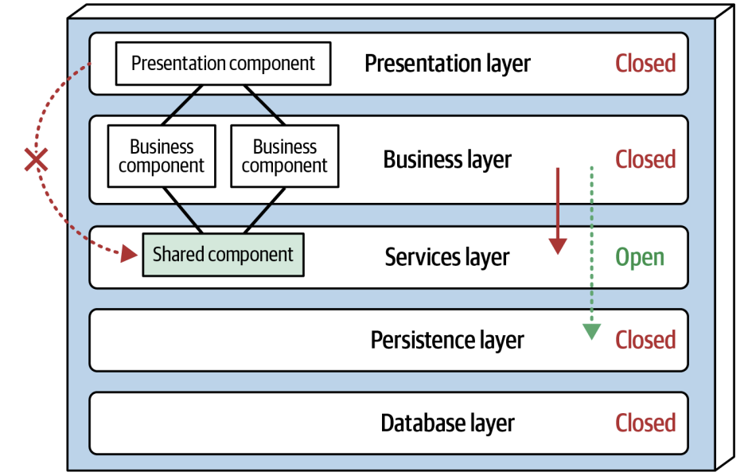
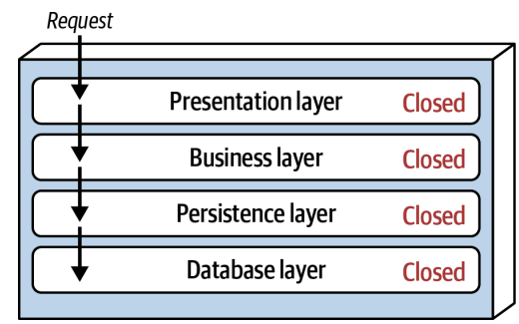
Closed vs. Open Layers
Closed Layers
Enforces a top-down logical flow where layers can not be skipped
Most systems are closed by default
Open Layers
Logical flow can bypass layers
Less common, but typically used for performance optimization

Slide 6
Layer Isolation
Each layer is independent of others
Changes in one layer generally don’t (shouldn’t) impact others
If components are divided by functional in a logical way, replicability between components is achievable
Avoid the sinkhole anti-pattern
Occurs when layers pass requests through with little to no logic
80/20 rule is a good approach to this (no more than 20% of requests can be passed without logic)

Slide 7
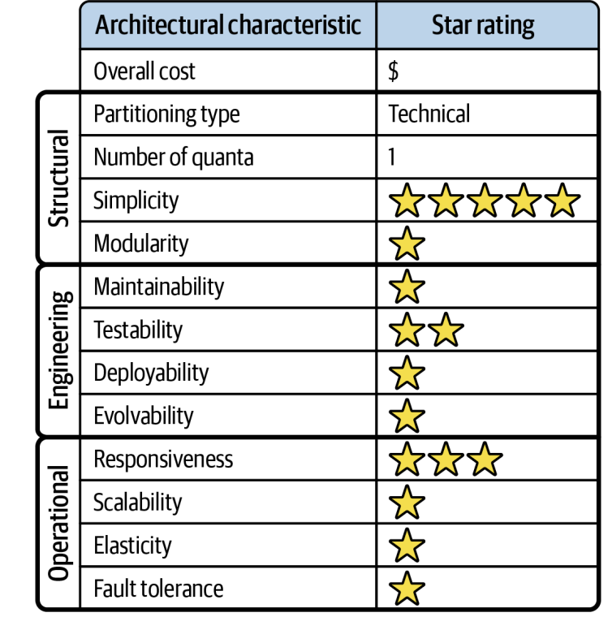
Advantages & Disavantages
Advantages
Simplicity
Familiarity
Low Cost
Responsiveness
Simple testability
Disadvantages
Poor performance (specifically in closed layers)
Poor scalability for large or complex systems
Can become difficult to maintain from layer interdependencies
Not compatible with domain-driven design

Slide 8

Applicability of Layered Architecture
Good starting point when the final system architecture is not known
Best suited for small to medium-sized centralized applications
Not recommended for large or complex distributed systems
Focus reuse on object hierarchies, not on the architecture itself to facilitate moving to a more structured architecture in the future

Slide 9
Conclusion
Layered Architecture:
Very common, low-cost, and simple architectural style
Architecture is structured by technical role -- not domain
Isolation is key, avoid sink-hole antipatterns
Be aware of testing and deployment downsides due to the coupled nature of this architecture

