Slide 1
CSEE5590/CS490-0004: AI for Cybersecurity
Gharib Gharibi
Summer 2019

Slide 2
- Local Differential Privacy: adding noise to the database directly (or letting users add noise to their data –e.g., ). - This technique provides high privacy. - Users do not have to trust the database analysts! Example: Randomized Response (flipping coins)
def query(db, noise):
return torch.sum(db.float() + noise)

Slide 3
Global Differential Privacy: adding noise to the output of the query on the database. - The database includes the information in raw format. - Users need to trust the database owner! - Two types of noise to add to the query output: Gaussian noise, Laplace noise
def query(db, noise):
return torch.sum(db.float()) + noise

Slide 4
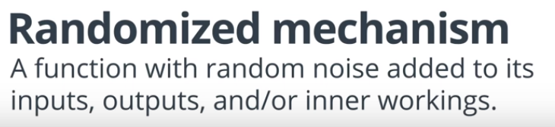
Query
Database
Noise
M
A differential
private query

Slide 5
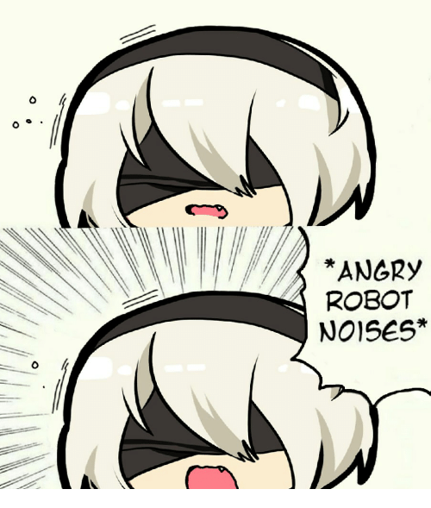
How much noise should we add?

Slide 6
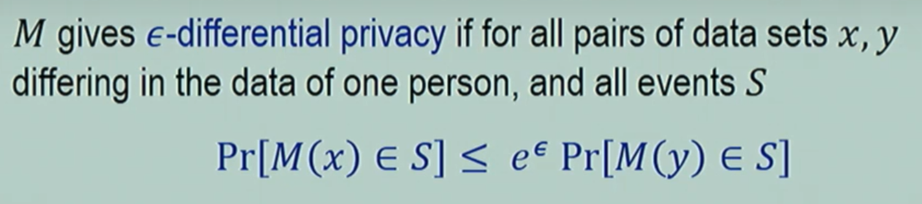
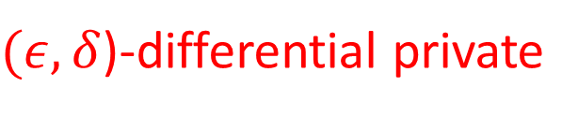

Differential Privacy
The outcome of any analysis is essentially equally likely, independent of whether any individual joins, or refrains from joining, the dataset.
$$+δ$$
$(ε,δ$)-differential private
(YouTube) The Definition of Privacy by Cynthia Dwork: https://www.youtube.com/watch?v=lg-VhHlztqo

Slide 7

Differential Privacy
Q: How different are these two distributions?
The outcome of any analysis is essentially equally likely, independent of whether any individual joins, or refrains from joining, the dataset.
$$+ δ$$
$(ε,δ$)-differential private
(YouTube) The Definition of Privacy by Cynthia Dwork: https://www.youtube.com/watch?v=lg-VhHlztqo

Slide 8
So how much noise should we add?
The minimum level that satisfies a certain level of epsilon and delta
(Privacy Budget)

Slide 9
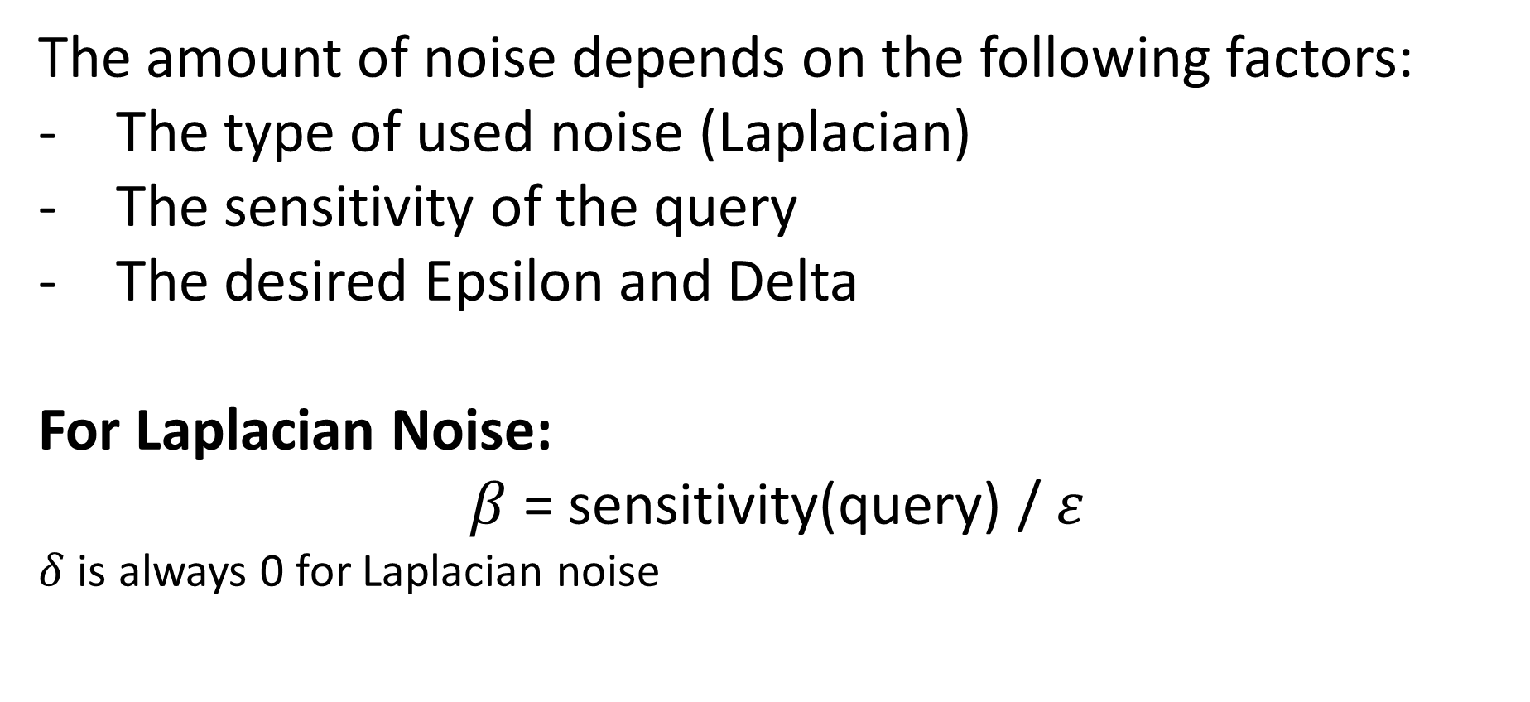
But how much noise should we add?
The amount of noise depends on the following factors:
The type of used noise (Laplacian)
The sensitivity of the query
The desired Epsilon and Delta
For Laplacian Noise:
$β$ = sensitivity(query) / $ε$
$δ$ is always 0 for Laplacian noise

Slide 10
Project: Global DP on sum and mean
Create a Laplacian mechanism that accepts a query, a db, and a sensitivity and adds a certain amount of noise to the query output
Laplace noise requires the Beta variable. Use the following function np.random.laplace(0, beta, 1) to get Laplace noise.

Slide 11
How does changing epsilon value affects the output result?

Slide 12
Differentially Private Deep Learning
Queries = Training
Databases = Datasets
The major issues here with calculating sensitivity is that DL models already produce a high-level of random distribution during the training phase that its very difficult to generate the same model (query result) twice even using the same dataset.

Slide 13
Use DP to train a classifier on your high-sensitive patients data that is missing labels and generate a DP DL model:
Ask n partner hospitals to train models locally on their own data
Use their models to predict on your own dataset, and generate n labels for each data point
Use a DP query to generate a true label (most appeared label!)
Train a new model using the labels in the dataset. Those labels are all DP generated!

