Slide 1


Slide 2

It is hard for apartment residents to compost.
28% of apartment-dwellers compost
50% of apartment-dwellers say space is a barrier to composting.
Only 3,700 community garden plots are accessible to apartment dwellers.
$4.6-million amount spent annually removing compostable waste
60-90 days is needed to complete the composting process.
Greenest City 2020 Target:
Reduce solid waste per capita going to landfill or incinerator by 40 per cent.

Slide 3

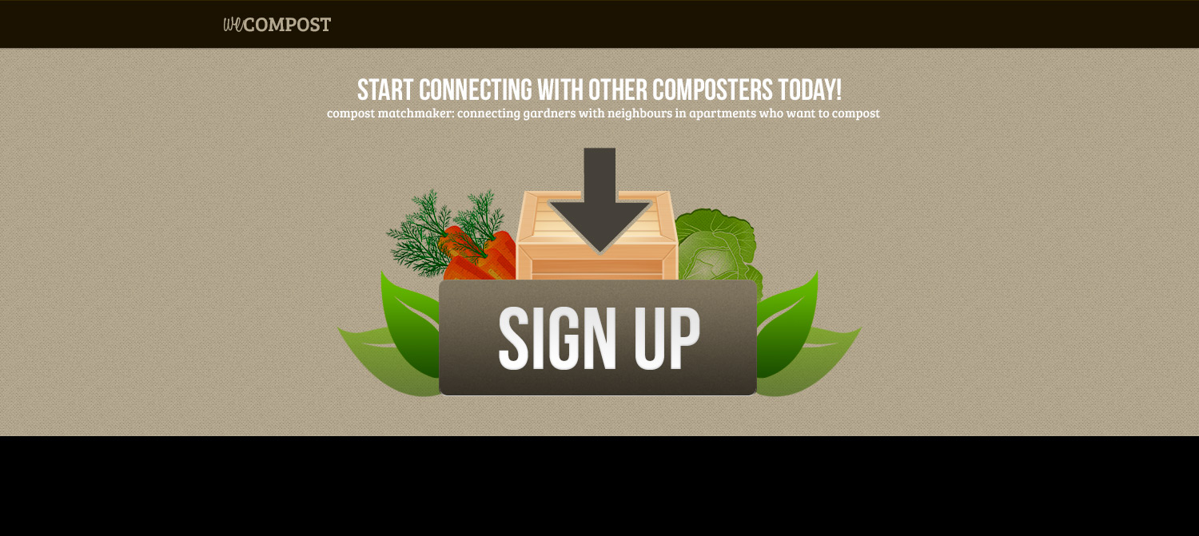
Notes:
Community and compost matchmaker connecting gardeners with neighbours in apartments who want to compost.

Slide 4
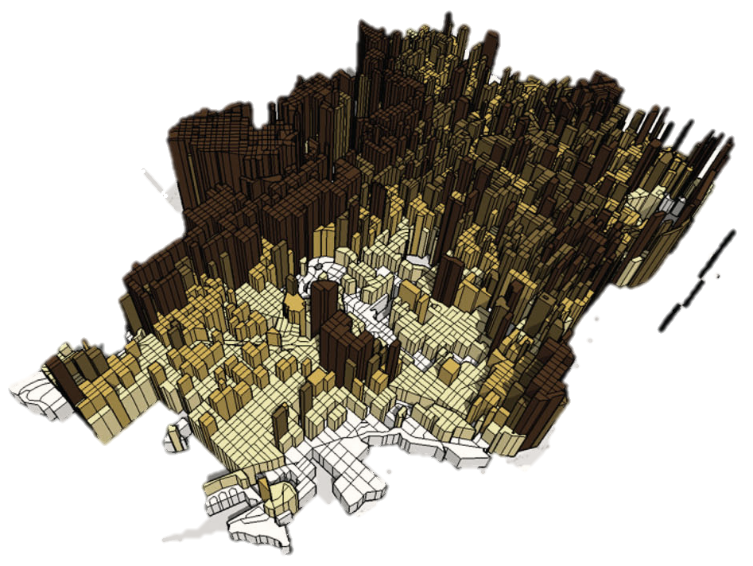
Our Market Size
891,000 homes in Vancouver
55% of Vancouverites live in Apartments or Condominiums
70% of waste stream can be composted or recycled
86% of people surveyed would use a
compost sharing program.
http://spacingvancouver.ca/wp-content/uploads/CoV_densitymap_midi.jpg
Notes:
There are approximately 891,000 homes in Vancouver, with approximately 55% of Vancouverites living in apartments or condos.

Slide 5
Our Customer
The Provider
The Receiver
Apartment-dwelling
485,000 in Vancouver
Interested in a compost sharing product
417,000 in Vancouver
Detached or Semi-detached home dwellers
400,500 in Vancouver
Has space for holding raw food waste for producing compost.
User of compost
Notes:
COV

Slide 6





Competition
Garburators and Garbage Cans
Laziness
Other organizations that are doing something similar:
Private composting systems in apartments
rye.patch.com
www.grn.com
thecompostexchange.com

Slide 7
Market Strategy
Apartment Developers (Cressey, Adera, etc.)
Community Centers & Community Gardens
Social Media, Word of Mouth,
Schools
Feedback & Acquisition

Slide 8
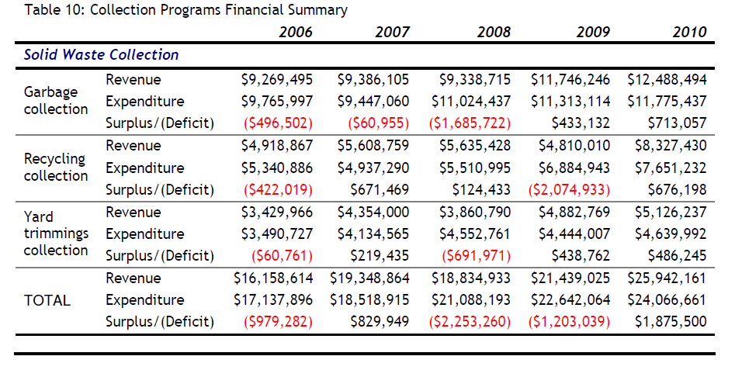
COV Savings
If 70% of residents start to use WeCompost,:
Garbage Collection Expenditure will be reduced by up to 70%
11,775,437 x 70% = $8,242,805
These funds can be reallocated to increase recycling collection and build more community gardens.

Slide 9
About the founders
Brent Whitman | Oliver Read | Sofia Zetina | Lee Nelson
M.B.A., Strategy, Innovation & Entrepreneurship at University of Toronto - Rotman School of Management Founder, Arteku | Software development 20 years | M.B.A. Strategy at University of British Columbia, Sauder School of Business Purchases Manager at Game Express | Freelance Designer Lead Designer at Yardstick Services
Stewart Harper | Kerry Costello | Claude Vessaz
MSc, GIS University of Leeds FME Server Support Manager, Safe Software Developed web-based mapping service | M.B.A. Marketing & Entrepreneurship at the University of British Columbia, Sauder School of Business Multi-Unit Manager, Starbucks Coffee | M.Eng, Geomatic Engineering & Planning GIS Intern, Safe Software

