Slide 1


Data Centre Trade Media Report
Saudi Projects and Gulf Construction articles
NAS Marketing | July 2026

Slide 2

Summary – two data centre articles, July 2026
In July we ran two features on data centre cooling: one with Saudi Projects (TPG Media) and one with Gulf Construction. Both publishers have now sent their results. The main numbers are below; the following two slides show each publisher in more detail.
 | Saudi Projects (TPG Media) | Gulf Construction | Both articles
Article | Advancing Data Centre Efficiency in Saudi Arabia | Smart cooling key to data centre expansion: Grundfos
Email sent to | 212,886 | 37,112 | 249,998
Email open rate | 48% | 16.11% | –
Article page views | 27,857 (website 12,026 + digital issue 15,831) | 188 | 28,045
Unique readers | 10,854 | 173 | 11,027
Click-throughs | 827 (6.9% of page views) | 0.51% click-through rate | –
Social media | 195,700+ LinkedIn followers, 47 engagements | 1,488 views | –
Total reach | 616,752 | 38,788 | 655,540
Note: total reach is the publishers' gross figure – impressions, email recipients and followers added together, not de-duplicated. Saudi Projects accounts for 94% of it.

Slide 3
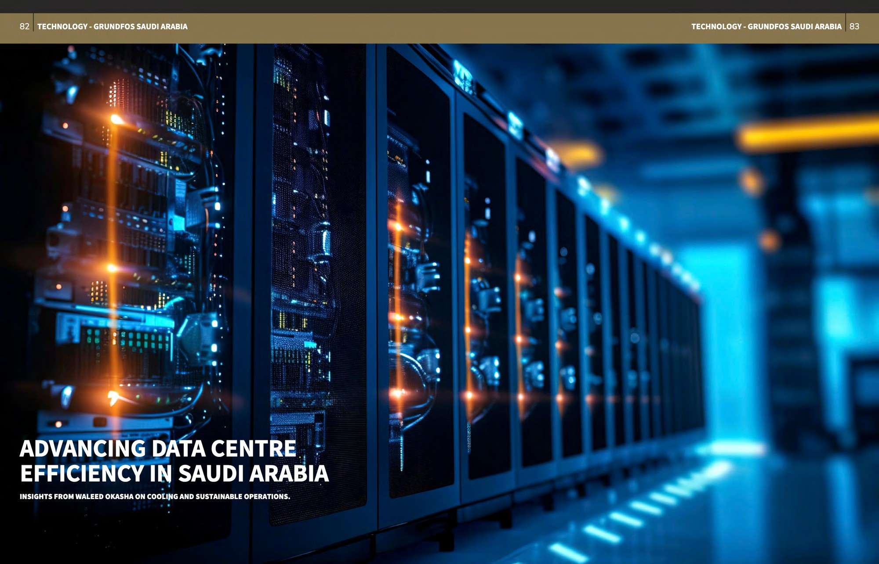
Saudi Projects (TPG Media) – results
“Advancing Data Centre Efficiency in Saudi Arabia” – interview with Waleed Okasha, Grundfos Saudi Arabia. Published in digital issue 67 (July/August 2026), pages 82–85, and promoted on the website, newsletter and LinkedIn.
Channel | Result | Time on page
Digital issue – contents page | 7,992 page impressions | 48 sec
Digital issue – article (2 spreads) | 15,831 page impressions | 23 sec / 1 min 12 sec
Website – article page | 12,026 page views, 10,854 unique visitors, 827 click-throughs | 56 sec
Website – home page carousel | 172,317 page impressions | 19 sec
Email newsletter – content banner | 212,886 recipients, 48% open rate (102,866 unique impressions) | –
LinkedIn – Saudi Projects and Emirates Projects | 195,700+ followers, 47 engagements (31 likes, 2 comments, 14 reposts) | –
Total reach | 616,752
Opening spread of the article, pages 82–83
What stood out
• 827 readers clicked through from the article page – 6.9% of page views.
• Readers spent over a minute (1 min 12 sec) on the main article spread.
• The newsletter banner reached 212,886 recipients with a 48% open rate.

Slide 4
Gulf Construction – results
“Smart cooling key to data centre expansion: Grundfos” – sent by email to Gulf Construction's B2B readers and shared on their website and social channels.
Where the readers are (share of online audience)
Channel | Result
Email (EDM) | 37,112 recipients, 16.11% open rate – about 5,979 opens
Website – article page | 188 page views, 173 unique users, 0.51% click-through rate
Social media | 1,488 views across Gulf Construction channels
Total reach | 38,788
In short
• Small in numbers – 38,788 touchpoints, about 6% of the combined reach.
• But well targeted: 70% of readers are in the MENA region and 57% in the GCC, with Saudi Arabia the largest market at 20%.
• Open rate (16.11%) is roughly a third of Saudi Projects' newsletter (48%).

Slide 5
What we learned and next steps
What we learned
Next steps
• Saudi Projects gave us the scale. It delivered 94% of the total reach and all 827 measured click-throughs. The newsletter (48% open rate) and the home page carousel did most of the work.
• Gulf Construction is small but well targeted. Only 38,788 touchpoints, but 70% of its readers are in MENA, so the article reached the right people.
• Email was the strongest channel for both. Around 108,845 opens from 249,998 recipients. Social media added reach but little measurable engagement.
• Readers stayed with the content. Over a minute on the article spread and close to a minute on the web page – good for a technical topic.
• Share both articles on Grundfos LinkedIn and with the sales teams in Saudi Arabia and the Gulf.
• Ask both publishers for tracked links (UTM) on future features so we can follow clicks through to leads.
• Keep Saudi Projects as the lead title for data centre topics; use Gulf Construction when we need GCC-wide coverage.
• Plan the next feature around the same themes – cooling efficiency, water and energy savings, and Saudi data centre growth.

