Slide 1
Applications of deep learning for computer vision tasks
Bartosz Wieciech,
Photonics Seminar,
15.12.2022

Slide 2
Agenda
Introduction to artificial neural networks;
Convolutional neural networks in typical computer
vision problems;
Chosen algorithms in computer vision (R-CNN, YOLO);
Common challenges;
Transformers in vision.

Slide 3
Introduction to artificial neural networks
Common flow when carrying out supervised machine learning projects:
Define the business problem and agree on metrics;
Collect and label the data or obtain a ready dataset;
Perform exploratory data analysis (EDA);
Feature engineering;
Iteratively train and validate models;
Deploy to production.

Slide 4
Introduction to artificial neural networks
Common flow when carrying out supervised machine learning projects:
Define the business problem and agree on metrics;
Collect and label the data or obtain a ready dataset;
Perform exploratory data analysis (EDA);
Feature engineering;
Iteratively train and validate models;
Deploy to production.

Slide 5
Introduction to artificial neural networks
Feature engineering: process of human-supervized transformation of available data in order to “hint” the model about potentially useful information.
Downside: tedious process and we have no guarantee that the features will in fact be useful to the model. Very hard in cetrain domains (NLP, computer vision).
Question: can we do better?

Slide 6
Introduction to artificial neural networks
Linear regression: addresses the problem of finding weights W for a function f in the form of
so that, given an input vector x, the function produces a number as close as possible to the expected value.
,

Slide 7
Introduction to artificial neural networks
Logistic regression: find weights W so that the function in the form of
when given an input vector x, will produce a number indicating the probability of it belonging to class “1”.
,

Slide 8
Introduction to artificial neural networks
Let’s establish L as the loss funcion indicating how far our predictions are from the ground truth. Example: mean squared error for linear regression.
We can optimize weights w using gradient descent with a learning rate α:
.

Slide 9
Introduction to artificial neural networks
Question: instead of a vector of weights, can we use multiple vectors, combining them into a matrix, and piping the input through a series of such matrices, ensuring that the last operation will produce a single number (for now)?
Answer: there is nothing stopping us from doing so, however this is not enough to learn more complex functions.

Slide 10
Introduction to artificial neural networks
Question: instead of a vector of weights, can we use multiple vectors, combining them into a matrix, and piping the input through a series of such matrices, ensuring that the last operation will produce a single number (for now)?
Answer: there is nothing stopping us from doing so, however this is not enough to learn more complex functions.

Slide 11
Introduction to artificial neural networks
Nonlinearities (activation functions) a allow neural networks to learn dependencies of vastly higher complexity*.
x₁
⋅
w₁
x₂
⋅
w₁
b + Σw_{i}x_{i}
a(b + Σw_{i}x)_{i}
...
x_{n}
⋅
w_{n}
perceptron
b
* David J.C. MacKay, Information Theory, Inference, and Learning Algorithms

Slide 12
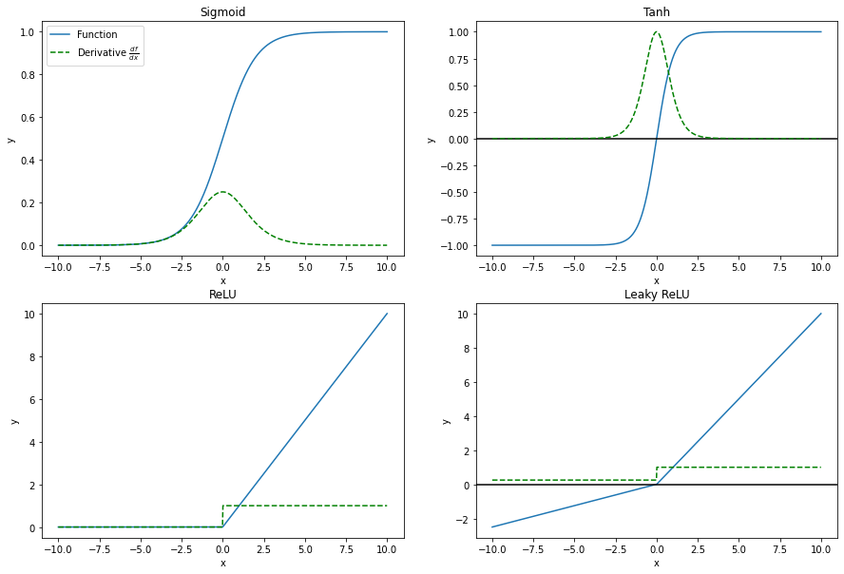
Introduction to artificial neural networks
Nonlinearities (activation functions) allow neural networks to learn dependencies of vastly higher complexity*.
* David J.C. MacKay, Information Theory, Inference, and Learning Algorithms

Slide 13
Introduction to artificial neural networks
Nonlinearities (activation functions) allow neural networks to learn dependencies of vastly higher complexity*.
Thanks to this, ANNs do a good job of “learning” features that would otherwise need to be engineered by the data scientist / ML engineer.
ANNs can be used as “feature extractors”.
* David J.C. MacKay, Information Theory, Inference, and Learning Algorithms

Slide 14
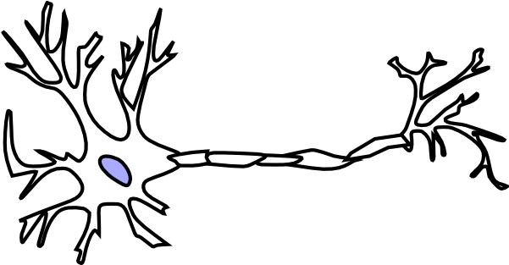
Introduction to artificial neural networks
Input layer Hidden layers Output layer
(hence “deep learning”) (can be a vector in general case)
x₁
x₂
...
x_{n}
Neuron image:
https://www.pngaaa.com/download/2204336

Slide 15
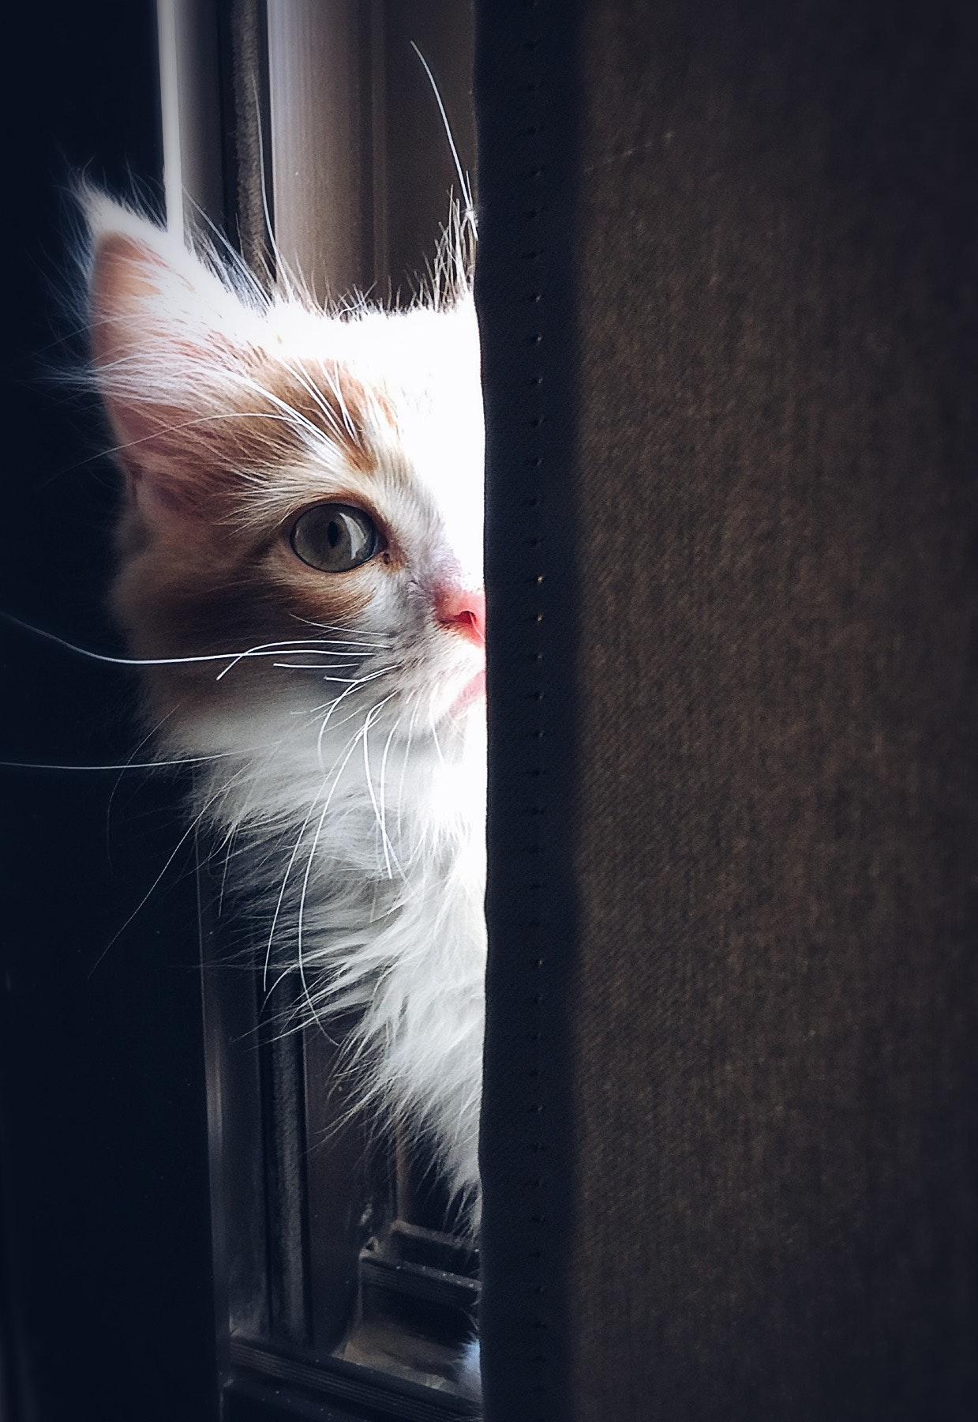
Convolutional neural networks in typical computer vision problems
Problem: we want to identify whether there is a cat in the image. How can we do it?
Cat photo:
https://www.pexels.com/photo/close-up-of-cat-320014/

Slide 16
Convolutional neural networks in typical computer vision problems
Problem: we want to identify whether there is a cat in the image. How can we do it?
Problem: we want to identify whether there is a cat in the image. How can we do it?
Naive approach:
Scan through the image using a sliding
window;
Crop the image and classify the patch;
Return TRUE if cat found, continue
otherwise continue;
Change window size if cat still not found
and start again ...
Cat photo:
https://www.pexels.com/photo/close-up-of-cat-320014/

Slide 17
Convolutional neural networks in typical computer vision problems
Problem: we want to identify whether there is a cat in the image. How can we do it?
Problem: we want to identify whether there is a cat in the image. How can we do it?
Naive approach:
Scan through the image using a sliding
window;
Crop the image and classify the patch;
Return TRUE if cat found, continue
otherwise continue;
Change window size if cat still not found
and start again ...
Cat photo:
https://www.pexels.com/photo/close-up-of-cat-320014/

Slide 18
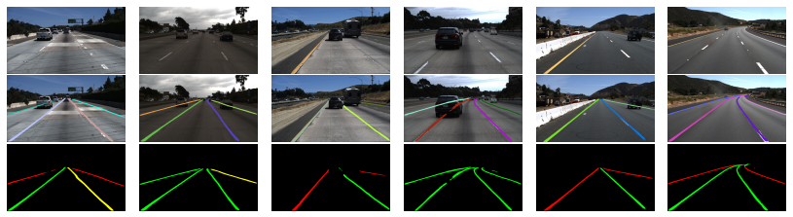
Convolutional neural networks in typical computer vision problems
What if the task is more more complex?
We need the algorithm to work in near real-time;
The algorithm should predict many classes;
Algorithm should return bounding boxes or a mask.
Image: F. Pizzati, M. Allodi, A. Barrera, F. Garcia,
Lane Detection and Classification using Cascaded CNNs

Slide 19
Convolutional neural networks in typical computer vision problems
Solution (?): use neural network;
Problem: let’s assume the input vector contains n entries. We would like to obtain a hidden layer with one column and m rows. What should be the weight matrix size?
Answer: (r₁, c₁) x (r₂, c₂) → (r₁, c₂) and c₁ = r₂,
therefore if c₂ = 1 → W.shape = (m, n);
Challenge: for a 1024 x 768 pixel image with 3 channels, a single layer would have a weight matrix with approx. 2.36 million parameters. And this image size isn’t that big!

Slide 20
Convolutional neural networks in typical computer vision problems
Question #1: Can we change the way the neural network works in order for it to consider only some neighborhood of a considered pixel?
Question #2: Since the same features of an image (edges, curves, shapes) may occur in different regions of the image, can we share weights to detect them?

Slide 21
Convolutional neural networks in typical computer vision problems
Idea: use convolutions.
,
,
where is a patch between [h_{a}, h_{b}], [w_{a}, w_{b}] and with c channels and w_{(n|hwc)} indicates the kernel index that should be applied to the (h, w, c) pixel of the image.

Slide 22
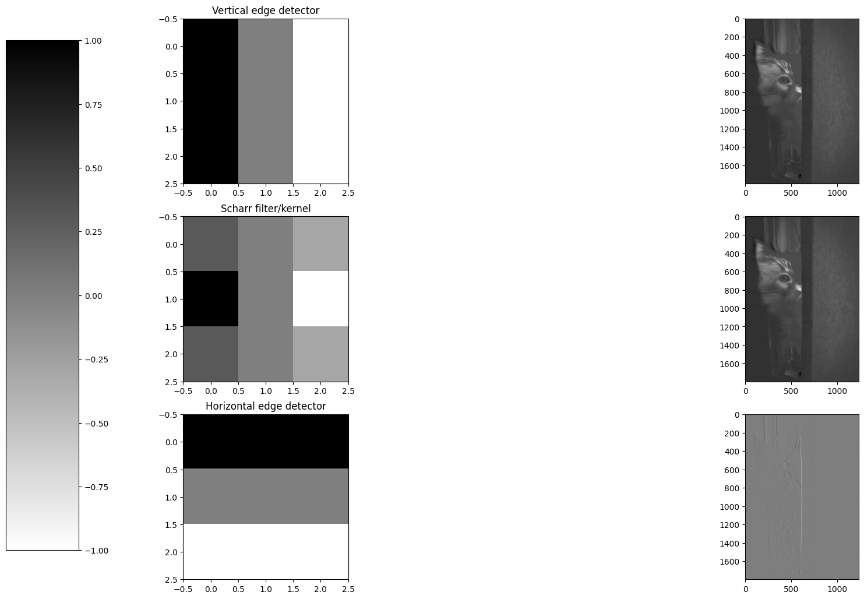
Convolutional neural networks in typical computer vision problems
Idea: use convolutions.
f.shape = (a, b, c₁), where c₁ = c_{input}
*
Cat photo:
https://www.pexels.com/photo/close-up-of-cat-320014/

Slide 23
Convolutional neural networks in typical computer vision problems
Neural networks can learn filters through backpropagation, i.e. they do not need to be human engineered. Filters allow sharing weights and exploit local structure of images.
,
,
where is a patch between [h_{a}, h_{b}], [w_{a}, w_{b}] and with c channels.

Slide 24
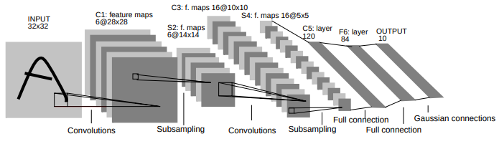
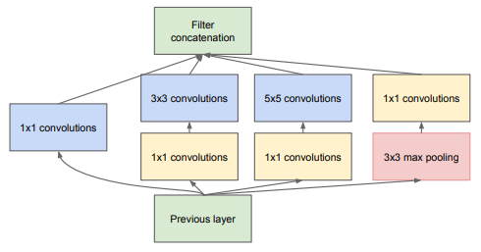
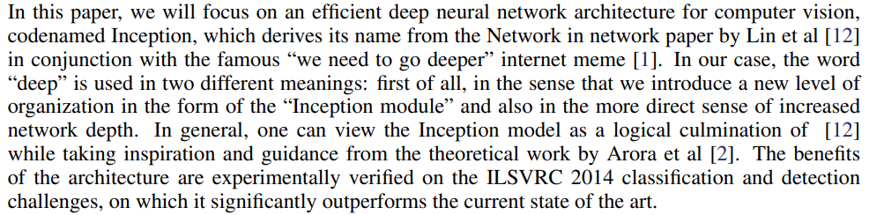
Convolutional neural networks in typical computer vision problems
Y. LeCun, L. Bottou, Y. Bengio, P. Haffner, Gradient-based learning applied to document recognition, Proceedings of the IEEE. 86 (11): 2278–2324, (1998)
C. Szegedy et al., Going deeper with convolutions, 2015 IEEE Conference on Computer Vision and Pattern Recognition (CVPR), 2015, pp. 1-9, doi: 10.1109/CVPR.2015.7298594.

Slide 25

Convolutional neural networks in typical computer vision problems
https://knowyourmeme.com/memes/we-need-to-go-deeper

Slide 26
Convolutional neural networks in typical computer vision problems
Object detection
Computer vision
Semantic segmentation
Segmentation
Instance segmentation
...

Slide 27
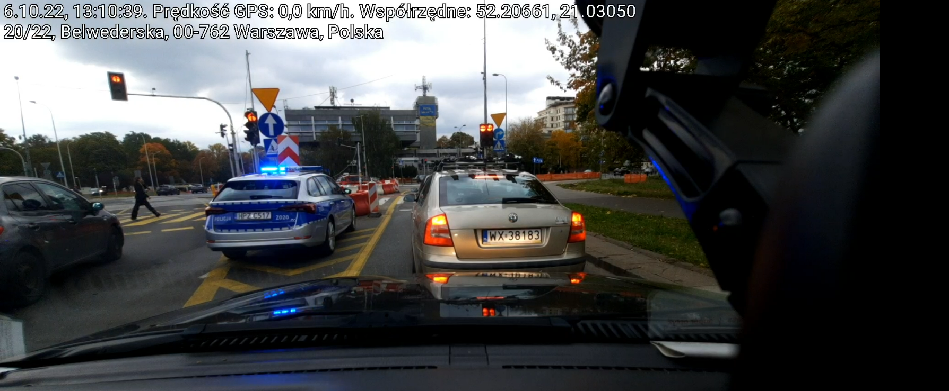
Convolutional neural networks in typical computer vision problems
Example: footage from car camera. Use cases:
Autonomous driving
Incident detection

Slide 28
Convolutional neural networks in typical computer vision problems
Object detection:

Slide 29
Convolutional neural networks in typical computer vision problems
Semantic segmentation:

Slide 30
Convolutional neural networks in typical computer vision problems
Instance segmentation:

Slide 31
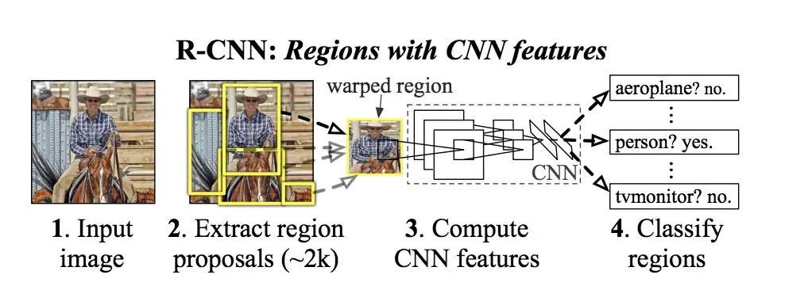
Chosen algorithms in computer vision
(R-CNN, YOLO)
Classification: cat / no cat;
Detection: where is the cat if there is a cat? What if there is more than one cats?
We don’t know how many there are a priori. We need a general mechanism.
R-CNN
Use selective search to generate region proposals;
Merge common regions using a greedy approach;
Run the regions one by one through a CNN to extract features;
Pass features to SVM for classification.
https://towardsdatascience.com/r-cnn-fast-r-cnn-faster-r-cnn-yolo-object-detection-algorithms-36d53571365e

Slide 32
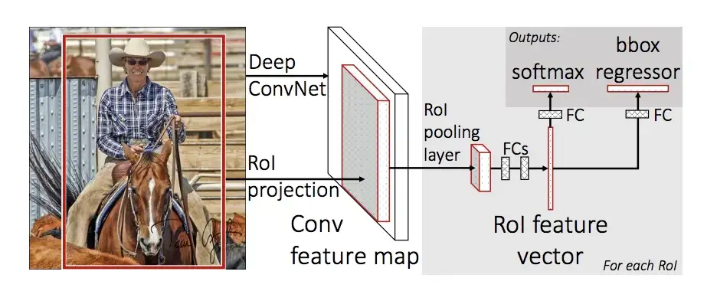
Chosen algorithms in computer vision
(R-CNN, YOLO)
This is slow: for n number of region proposals, we would have to run n patches through the CNN. Cannot be used in near real-time.
Fast R-CNN
Use selective search to generate region proposals;
Generate convolutional feature map;
Use a RoI (region of interest) pooling layer to extract regions;
Pass to fully connected NN for inference.
https://towardsdatascience.com/r-cnn-fast-r-cnn-faster-r-cnn-yolo-object-detection-algorithms-36d53571365e

Slide 33
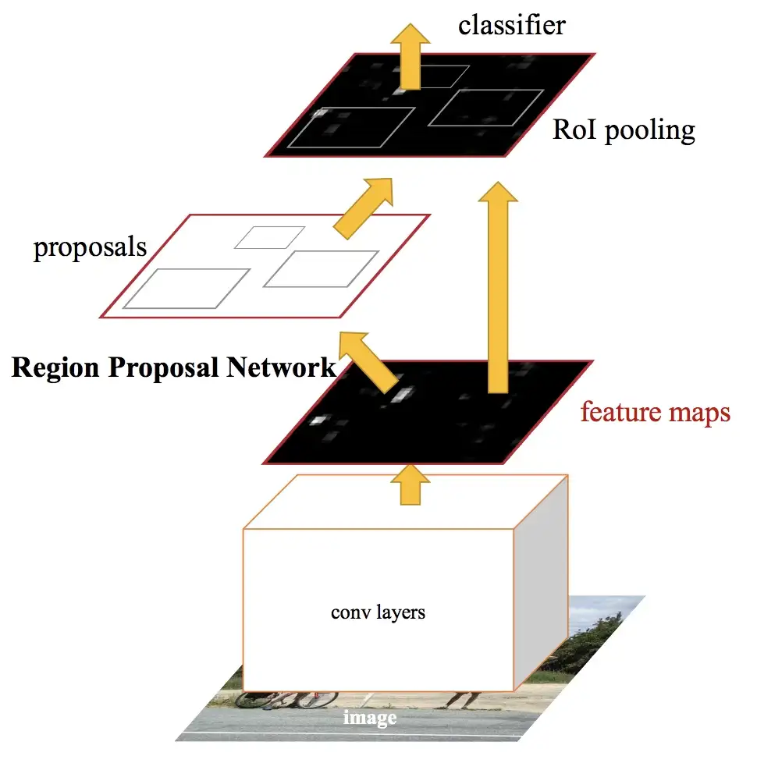
Chosen algorithms in computer vision
(R-CNN, YOLO)
Faster R-CNN
Use selective search to generate region proposals Predict region proposals using a separate neural network;
Generate convolutional feature map;
Use a RoI (region of interest) pooling layer to
extract regions;
Pass to fully connected NN for inference.
Creating a fully convolutional solution significantly
increases inference speed (if inference takes about
1 minute using R-CNN to under 1 second for Faster
R-CNN).
https://towardsdatascience.com/r-cnn-fast-r-cnn-faster-r-cnn-yolo-object-detection-algorithms-36d53571365e

Slide 34
Chosen algorithms in computer vision
(R-CNN, YOLO)
YOLO (You Only Look Once)
Divide image into a grid;
Define a set of anchor boxes for each cell;
For each anchor box, predict the probability and class of it containing an object;
Filter entries with low probability;
Perform NMS (non-max supression) to obtain final result.
https://towardsdatascience.com/r-cnn-fast-r-cnn-faster-r-cnn-yolo-object-detection-algorithms-36d53571365e

Slide 35
Common challenges
ANNs benefit greatly from large datasets;
Obtaining significant volumes of data is easy e.g. for sensor readings but difficult for images (storage, labeling, camera-dependent, weather, light etc.);
Imagenet: “14,197,122 images, 21841 synsets indexed” on 15th of December 2022, (see: https://image-net.org);
Public datasets are fine as benchmarks or for initial training, but obtaining a meaningful volume of data for production CV applications is tedious/costly.

Slide 36

Common challenges
Question: we have this image in the training set. What may be the problem?
Training image
Validation image
https://knowyourmeme.com/memes/smudge-the-cat

Slide 37
Common challenges
Making sure that the validation data resembles data encountered in production is an essential component of a successful ML project;
It is not uncommon to hear about projects that failed spectacularly because of subtle differences in data. This can even be caused by elements such as camera type, differing between phones, if the application is for mobile devices;
EDA and business consultations should be carried out to mitigate this risk;

Slide 38
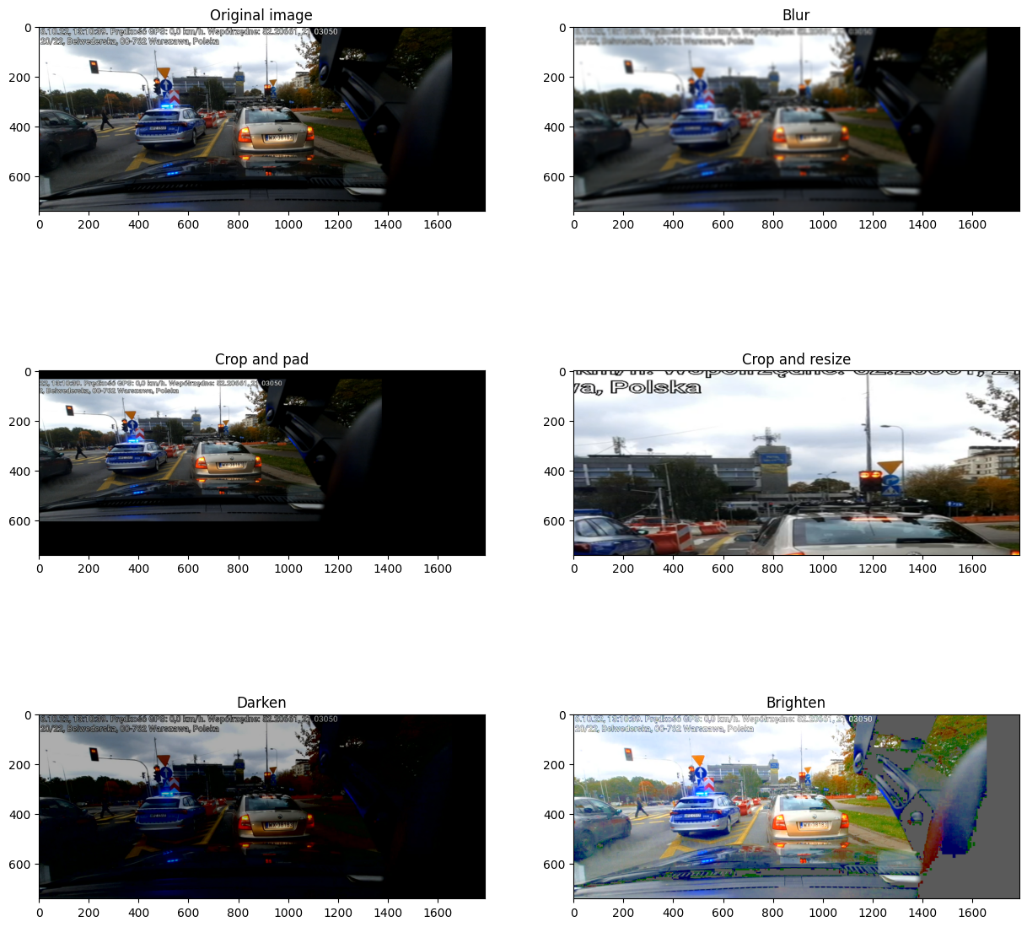
Common challenges
What can be done from a
technical standpoint?
Image augmentation

Slide 39

Thank you for attending!
Feel free to contact me at bartek.wieciech@gmail.com;
I will be grateful for your feedback either personally or at:

