Slide 1
Mathematical Foundations for ML (10-606):
Linear Operators & Matrices
Bryan Wilder
* Slides borrowed from prior offerings by Professors M. Gormley, P. Virtue, & G. Gordon, & H. Heidari.

Slide 2
Announcements
Notes:
Example: functional -> integral, operator -> identity function

Slide 3
Functions on Vector Spaces
f: V → W where V and W are (potentially abstract) vector spaces
Functionals:
f: V → R
Operators:
f: V → V
Linear functions: f(ax + by) = a f(x) + b f(y)
affine=linear + constant
Notes:
Example: functional -> integral, operator -> identity function

Slide 4
Whiteboard: examples of linear functions
+matrix multiplication
+derivative

Slide 5
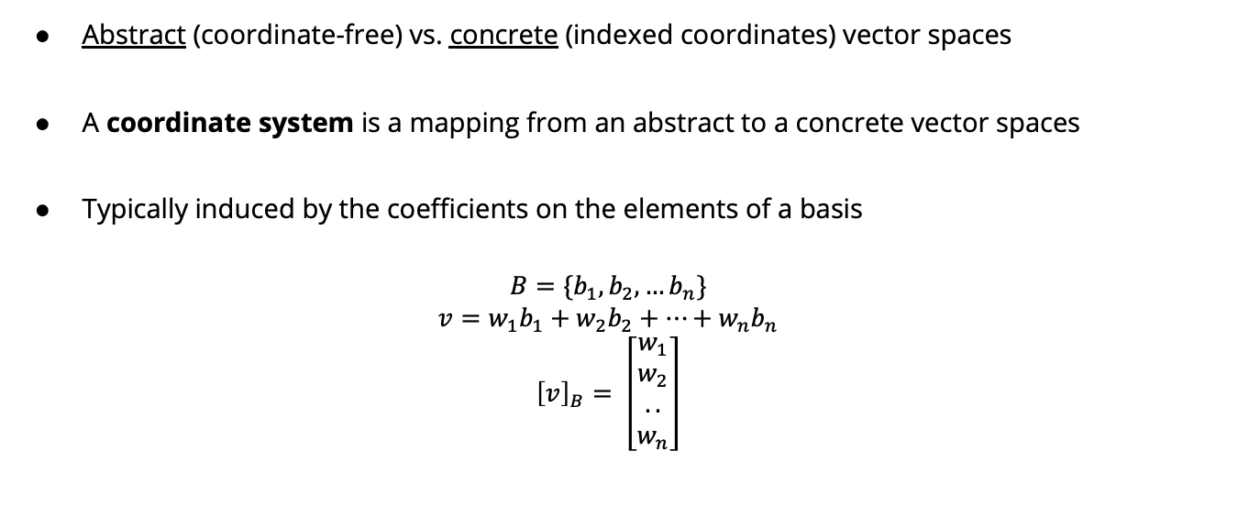
Reminder: Coordinate Systems
Abstract (coordinate-free) vs. concrete (indexed coordinates) vector spaces
A coordinate system is a mapping from an abstract to a concrete vector spaces
Typically induced by the coefficients on the elements of a basis
$$B=\{b_{1}, b_{2},…b_{n}\}$$
$$v=w_{1}b_{1}+w_{2}b_{2}+…+w_{n}b_{n}$$
$${\left[v\right]}_{B}= \left[\begin{matrix}w_{1} \\ w_{2} \\ .. \\ w_{n}\end{matrix}\right]$$

Slide 6

Reminder: Coordinate Systems
$$b_{1}= \left[\begin{matrix}1 \\ 1\end{matrix}\right]b_{2}= \left[\begin{matrix}1 \\ −1\end{matrix}\right]$$
$$v=\left[\begin{matrix}2 \\ 1\end{matrix}\right]$$
= $\frac{3}{2}b_{1}+\frac{1}{2}b_{2}$
$${\left[v\right]}_{B}=\left[\begin{matrix}\frac{3}{2} \\ \frac{1}{2}\end{matrix}\right]$$

Slide 7
Coordinate Representation of Linear Functions
Consider linear function ℓ: X→Y (s.t., ℓ(ax₁+ bx₂) = a ℓ(x₁) + b ℓ(x₂))
X with bases {b₁, …, b_{n}} and Y with basis {c₁, …, c_{m}}
Goal: find a linear representation of ℓ, denoted by matrix L∈R^{m×n}, s.t.
ℓ(x) = y ⇔ L u = v

Slide 8
Rank and Null-space
Recall: for any f: X→ Y, range(f) = {f(x)| x ∈ X}.
Suppose ℓ: X→ Y is a linear transformation represented by matrix L.
rank(ℓ) = dim(range(ℓ))
rank(ℓ) = rank(L) = the dimension of the vector space generated by columns of L.
= the dimension of the vector space generated by rows of L.
Suppose ℓ is a linear operator (i.e., X=Y)
nullity(ℓ) = dim({x | ℓ(x) = 0})

Slide 9
Whiteboard: examples of rank

Slide 10
Systems of equations
Next, we’ll discuss using matrices to represent and solve systems of linear equations

Slide 11
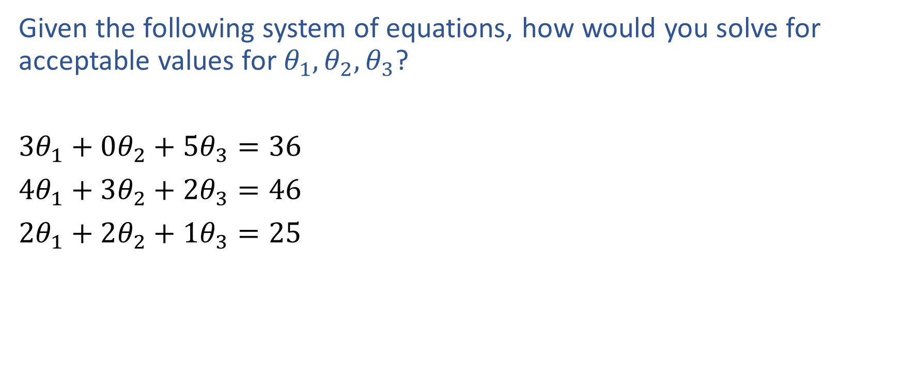
Exercise

Slide 12
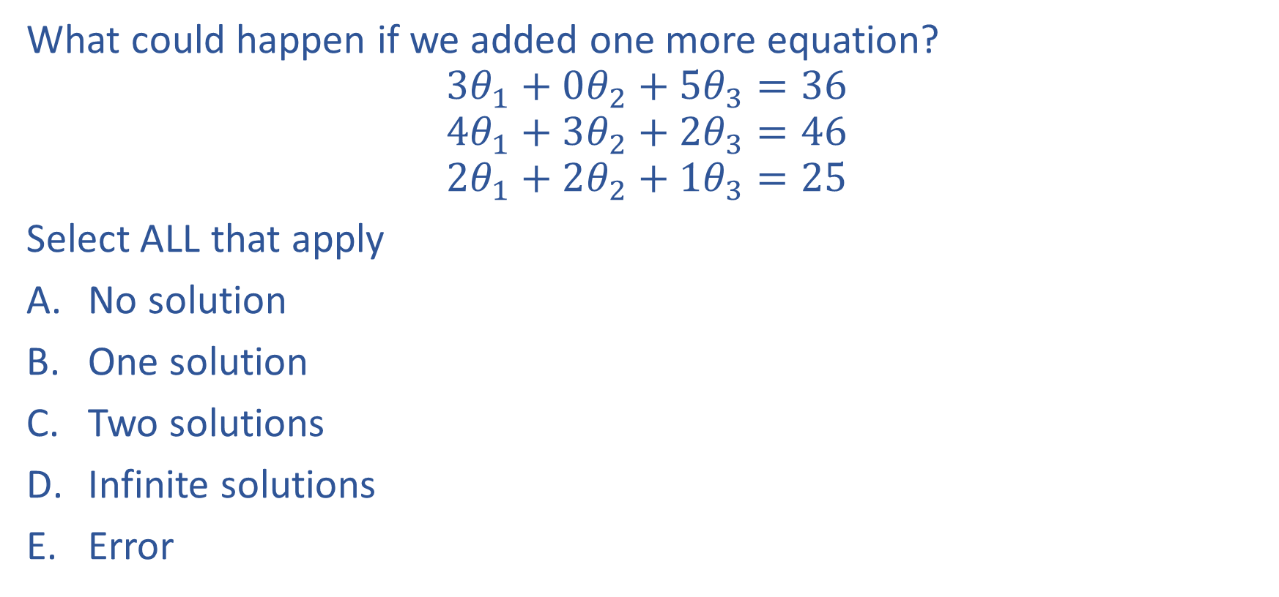
Poll 1

Slide 13
Poll 1

Slide 14
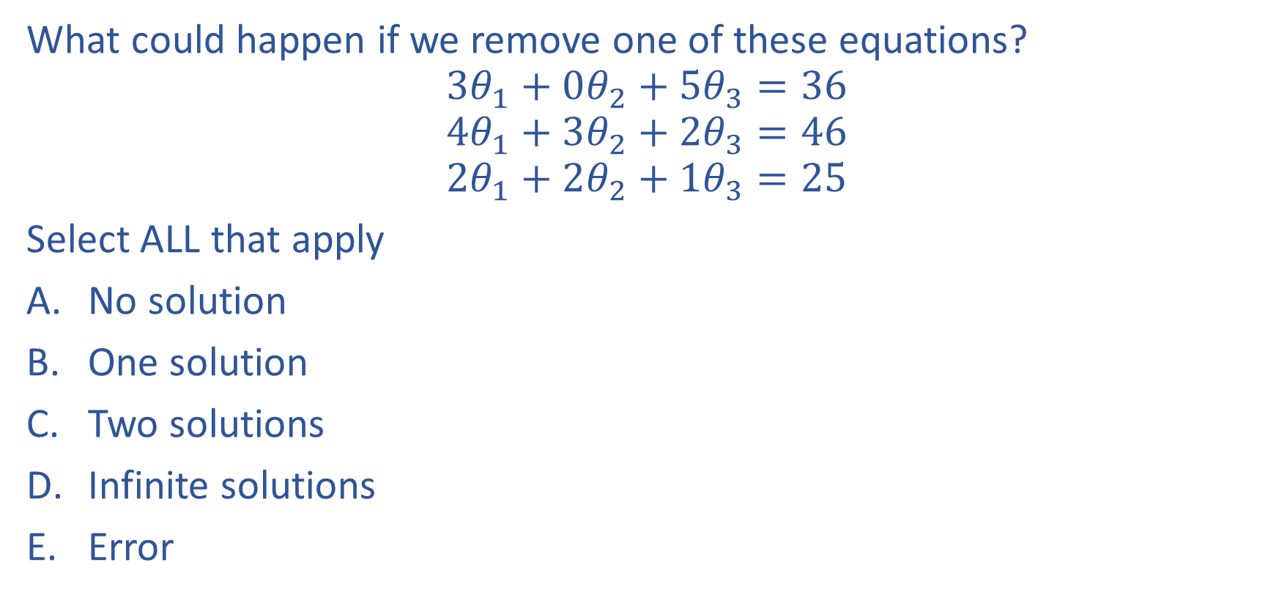
Poll 2

Slide 15
Poll 2

Slide 16
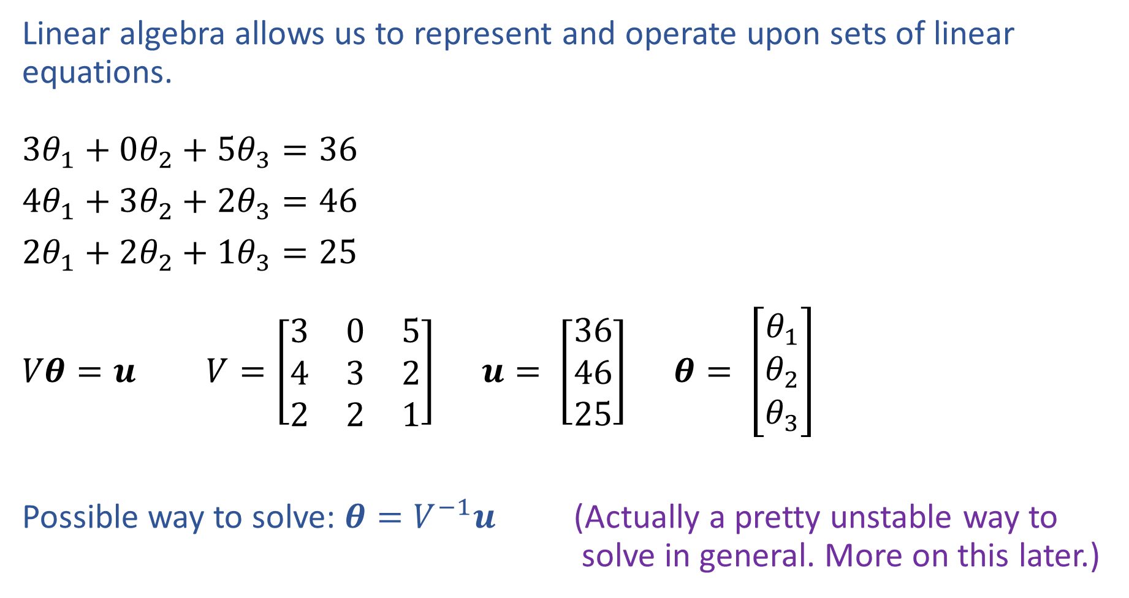
Linear Algebra
Notation alert!

Slide 17
Connection to rank of the matrix
Rank > unknowns: no solution
Rank = unknowns: unique solution
Rank < unknowns: infinite solutions or no solution

Slide 18
Gaussian Elimination
Numerical method to solve linear systems
Convert matrix to row-echelon form
Backsubstitute to solve the system

Slide 19
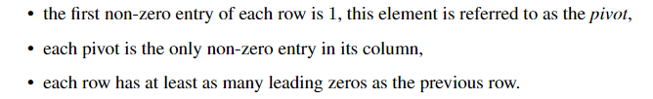
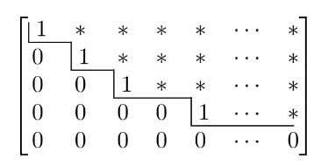
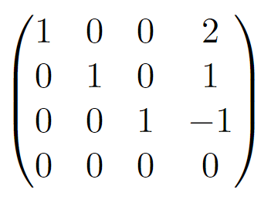
Row-echelon form

Slide 20
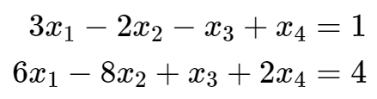
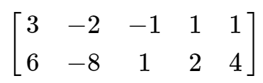

Gaussian elimination
To solve system $Ax=b$, perform Gaussian elimination on augmented matrix $\left(\begin{matrix}A & b\end{matrix}\right)$

Slide 21
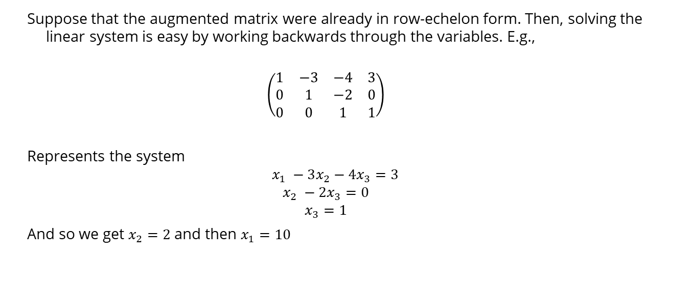
Back substitution
Suppose that the augmented matrix were already in row-echelon form. Then, solving the linear system is easy by working backwards through the variables. E.g.,
$$\left(\begin{matrix}1 & −3 & −4 & 3 \\ 0 & 1 & −2 & 0 \\ 0 & 0 & 1 & 1\end{matrix}\right)$$
Represents the system
$$x_{1} −3x_{2}−4x_{3}=3$$
$$x_{2} −2x_{3}=0$$
$$x_{3}=1$$
And so we get $x_{2}=2$ and then $x_{1}=10$

Slide 22
Gaussian Elimination
Form the row-echelon form using elementary transformations:
Exchange of two equations
Multiplication of an equation with a constant λ ∈ R\{0}
Addition of two equations
Intuition: these are operations that preserve equalities

Slide 23
Whiteboard

Slide 24
Computing ranks
REF also gives an easy way to compute the rank of a matrix: convert to REF and count the number of rows that are not all zeros
Works because REF operations preserve rank, and rank of REF matrices is just number of non-zero rows

Slide 25
Whiteboard
Examples from https://linearalgebra.math.umanitoba.ca/math1220/section-12.html

Slide 26
Inverse Functions and Matrices
ℓ⁻¹ is the inverse function for ℓ iff
ℓ(x) = y ⇔ x = ℓ⁻¹(y).
L⁻¹ is the inverse of matrix L iff
L⁻¹Lu = u and LL⁻¹v = v.

Slide 27
Properties of inverses
Not all matrices have an inverse
Must be square (n x n)
Must be full rank (all columns linearly independent)
If it exists, then $AA^{−1}=I$
Unique solution to linear system $Ax=b$ is $x=A^{−1}b$

Slide 28
Properties of inverses
If A is invertible, unique solution to linear system $Ax=b$ is $x=A^{−1}b$
A is invertible iff A is full rank (iff all columns are linearly independent)
If A is not invertible either no solutions or infinitely many

Slide 29




The Transpose
Definition: Given a matrix $A∈ℝ^{m×n}$ with $m$ rows and $n$ columns, we say its transpose $A^{T}∈ℝ^{n×m}$ is a matrix with $n$ rows and $m$ columns where:
$$A_{j,i}^{T}=A_{i,j}^{}, ∀ i∈\left\{1,…,m\right\}, j∈\{1,…,n\}$$
Example:
$$A$$
$$A^{T}$$
1 | 2
3 | 4
5 | 6
1 | 3 | 5
2 | 4 | 6

Slide 30

The Adjoint Function
Definition: Let $U$ and $V$ be inner product spaces, and let $L∈U→V$ be a linear function. We define the adjoint function $L^{∗}∈V→U$ by the property:
$$\left\langle Lx,y\right\rangle =\left\langle x,L^{∗}y\right\rangle , ∀x∈U, y∈V$$

Slide 31
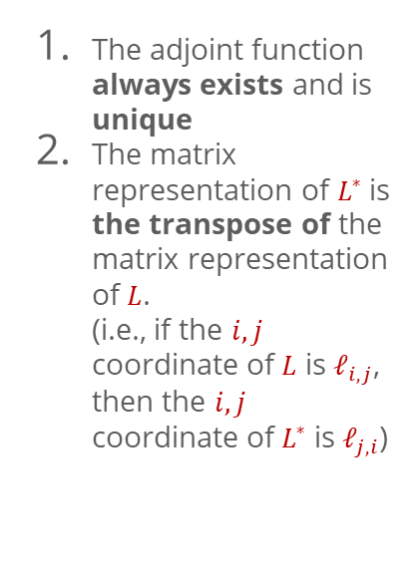
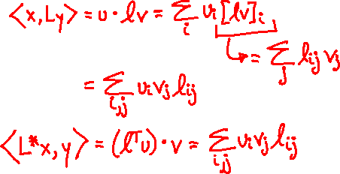

Properties of the Adjoint Function
The adjoint function always exists and is unique
The matrix representation of $L^{∗}$is the transpose of the matrix representation of $L$. (i.e., if the $i,j$ coordinate of $L$ is $ℓ_{i,j}$, then the $i,j$ coordinate of $L^{∗}$ is $ℓ_{j,i}$)
Proof: Let $L$ be linear function with matrix $ℓ$. Let $x,y$ be vectors with concrete coordinates $u,v$, resp.

Slide 32
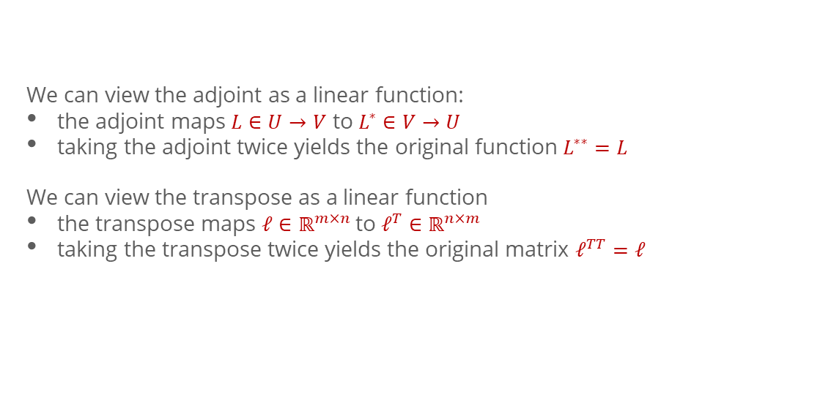
Adjoint and Transpose
We can view the adjoint as a linear function:
the adjoint maps $L∈U→V$ to $L^{∗}∈V→U$
taking the adjoint twice yields the original function $L^{∗∗}=L$
We can view the transpose as a linear function
the transpose maps $ℓ∈ℝ^{m×n}$to $ℓ^{T}∈ℝ^{n×m}$
taking the transpose twice yields the original matrix $ℓ^{TT}=ℓ$

Slide 33
Reminder: Coordinate Representation
Orthonormal basis (preserve length and angles)
Gram-Schmidt orthonormalization

Slide 34
Fundamental Theorem of Linear Algebra
For Linear Functions
For Matrices
the rank and nullity of a linear function are equal to the rank and nullity of its adjoint
the range of a linear function and the nullspace of its adjoint are always orthogonal
the rank and nullity of a matrix are equal to the rank and nullity of its transpose
the rank of a matrix and the nullspace of its transpose are always orthogonal
(i.e. any vector in the range is orthogonal to any vector in the nullspace of the adjoint)

Slide 35
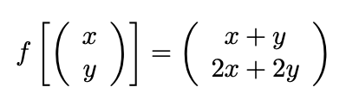
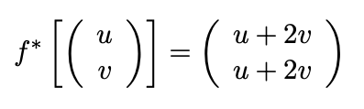
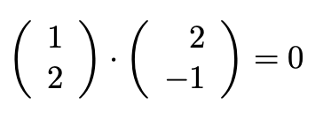


Fundamental Theorem of Linear Algebra
For Linear Functions
Example:
the rank and nullity of a linear function are equal to the rank and nullity of its adjoint
the range of a linear function and the nullspace of its adjoint are always orthogonal
orig. fn.
adjoint
The nullspace of $f^{∗}$ is the span of the vector ${(2, −1)}^{T}$, with dimension one
(i.e. any vector in the range is orthogonal to any vector in the nullspace of the adjoint)
And this vector is orthogonal to the
range of $f$:

Slide 36
Fundamental Theorem of Linear Algebra
For Linear Functions
For Matrices
the rank and nullity of a linear function are equal to the rank and nullity of its adjoint
the range of a linear function and the nullspace of its adjoint are always orthogonal
the rank and nullity of a matrix are equal to the rank and nullity of its transpose
the rank of a matrix and the nullspace of its transpose are always orthogonal
(i.e. any vector in the range is orthogonal to any vector in the nullspace of the adjoint)

