Slide 1
Mathematical Foundations for ML (10-606):
Statistics: moments
Bryan Wilder
* Slides borrowed from prior offerings by Professors M. Gormley, P. Virtue, & G. Gordon, & H. Heidari.

Slide 2
Announcements
Topics for final quiz:
Optimization (first and second order conditions, convexity)
Probability:
Events and sample spaces
Converting between joint, marginal, and conditional distributions
Chain rules and factorization of distributions
Maximum likelihood estimation
Bayes theorem
Calculating expectations, variances, and co-variances
Additional reference: Math for machine learning book in syllabus, chapter 6 (from start until 6.6.1, though it covers a bit more)

Slide 3
More practice problems for this last week
Expectations, variance, factorizations/chain rule
https://www.cs.cmu.edu/~10606-f21/recitations/10606_Fa21_Recitation_6_worksheet_solutions.pdf
Bayes theorem:
https://www2.math.upenn.edu/~mmerling/math107%20docs/practice%20on%20Bayes%20solutions.pdf

Slide 4
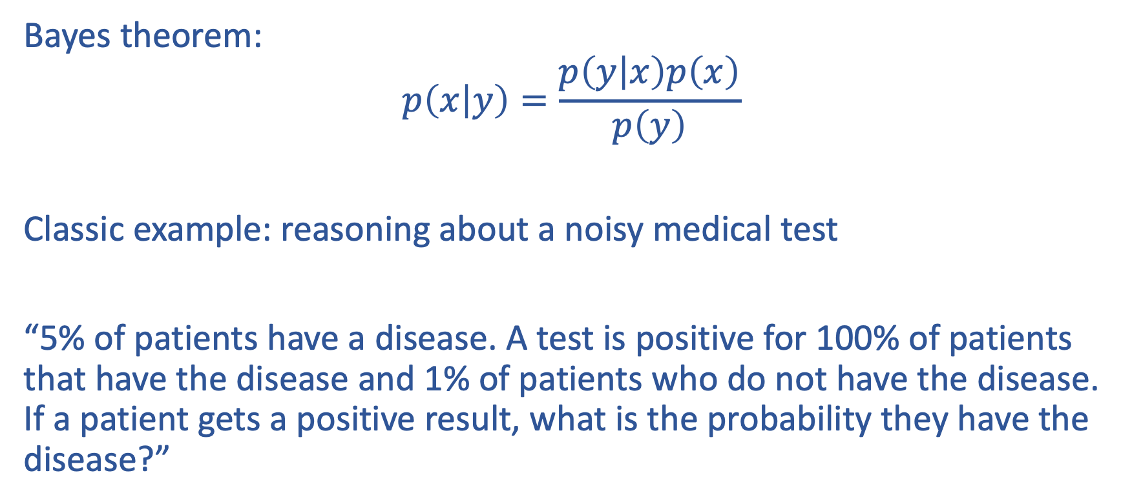
Continuation: Bayes theorem example
Bayes theorem:
$$p\left(x | y\right)=\frac{p\left(y | x\right)p\left(x\right)}{p\left(y\right)}$$
Classic example: reasoning about a noisy medical test
“5% of patients have a disease. A test is positive for 100% of patients that have the disease and 1% of patients who do not have the disease. If a patient gets a positive result, what is the probability they have the disease?”

Slide 5
p(disease | positive) = p(positive|disease)p(disease)/p(positive)
p(positive|disease) = 1
p(disease) = 0.05
p(positive) = p(positive, disease) + p(positive, not disease)
= p(disease)p(positive|disease) + p(not disease)p(positive|not disease)
=0.05*1 + 0.95*0.01
= 0.05+ 0.0095 = 0.0595
p(disease | positive) = 0.84

Slide 6
Calculating moments
X | Y | P(x, y)
1 | 0 | 0.3
1 | 1 | 0.2
1 | 2 | 0.1
10 | 0 | 0.1
10 | 1 | 0.2
10 | 2 | 0.3

Slide 7
Calculating moments
X | Y | P(x, y)
1 | 0 | 0.2
1 | 1 | 0.2
1 | 2 | 0.1
10 | 0 | 0.1
10 | 1 | 0.2
10 | 2 | 0.2
P(X = 1) = 0.2 + 0.2 + 0.1 = 0.5
P(X = 10) = 0.1 + 0.2 + 0.2 = 0.5
E[X] = 0.5*1 + 0.5*10 = 5.5
P(Y = 0) = 0.3 + 0.1 = 0.3
P(Y = 1) = 0.2 + 0.2 = 0.4
P(Y = 2) = 0.1 + 0.2 = 0.3
E[Y] = 0*0.3 + 1*0.4 + 2*0.3 = 1
V[X] = E[X^2] - E[X]^2
E[X^2] = 0.5*1^2 + 0.5*10^2
= 0.5 + 50 = 50.5
V[X] = 50.5 – 5.5^2 = 20.25
Cov[X, Y] = E[XY] – E[X]E[Y]
E[XY] = 0.2*(0*1) + 0.2*(1*1) + 0.1*(1*2) + 0.1*(10*0) + 0.2*(10*1) + 0.2*(10*2) = 6.4
Cov[X, Y] = 6.4 – 5.5*1 = 0.9

