Slide 1
Mathematical Foundations for ML (10-606):
Matrix operations, regression
Bryan Wilder
* Slides borrowed from prior offerings by Professors M. Gormley, P. Virtue, & G. Gordon, & H. Heidari.

Slide 2
Announcements
Quiz 1 grades on Canvas
Mean/median: about 76% (16/21)
There will be a curve in final grades, >= 9%

Slide 3
Announcements
Quiz 2 next Wed (moved from Mon!)
Same format (first 40 min of class)
Covers all topics between last quiz and this Wednesday
Vector spaces, linear equations, matrix inverse and factorizations (today), first part of matrix calculus (Wed)

Slide 4
Today
Positive semi-definite matrices
Matrix factorizations
Singular value decomposition
Linear regression

Slide 5
Positive (Semi-)Definite Operators
An operator ℓ: X→ X is positive semi-definite (PSD) if
<ℓ(x), x> ≥ 0 ∀x∈X
An matrix L∈R^{n×n} is positive semi-definite (PSD) if
u^{T}Lu> ≥ 0 ∀u∈R^{n}
Typically, restrict to symmetric PSD matrices
Notes:
L is positive semi-definite if and only if all of its eigenvalues are non-negative.

Slide 6
Positive (Semi-)Definite Operators
Equivalent characterization: all eigenvalues are non-negative (semi-definite) or strictly positive (definite)

Slide 7
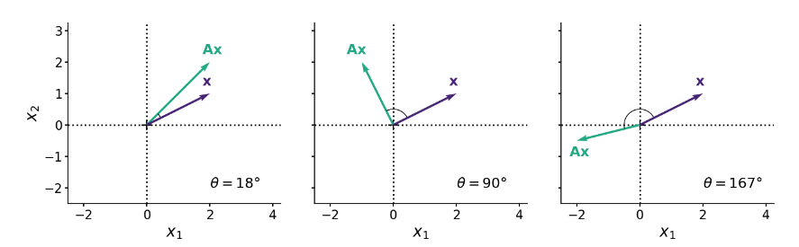
PSD matrices
One interpretation: symmetric PSD matrices stretch/scale vectors but don’t “flip” them
Whiteboard: using eigenvectors as a basis
https://gregorygundersen.com/blog/2022/02/27/positive-definite/

Slide 8
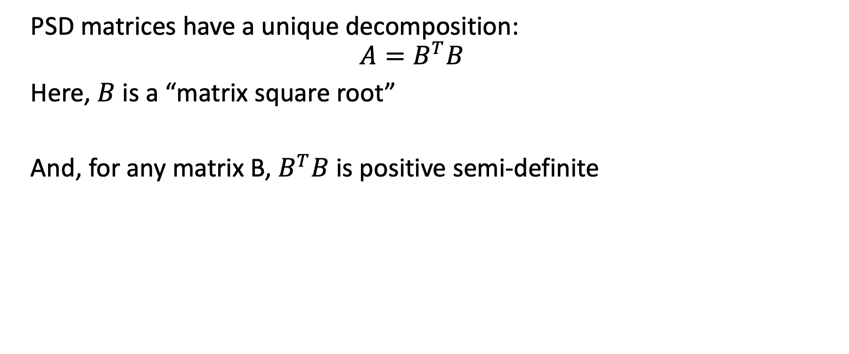
PSD matrices
PSD matrices have a unique decomposition:
$$A=B^{T}B$$
Here, $B$ is a “matrix square root”
And, for any matrix B, $B^{T}B$ is positive semi-definite

Slide 9
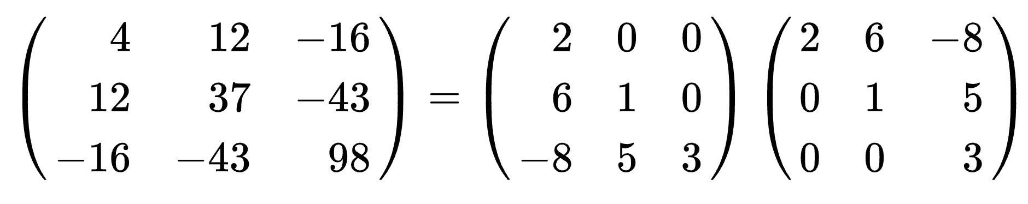
Matrix Factorizations
Cholesky Factorization for symmetric PD matrix K = LL^{T} :
L is a lower triangular matrix with real and positive diagonal entries;
L^{T} its transpose.
One use: sampling from a Gaussian distribution

Slide 10
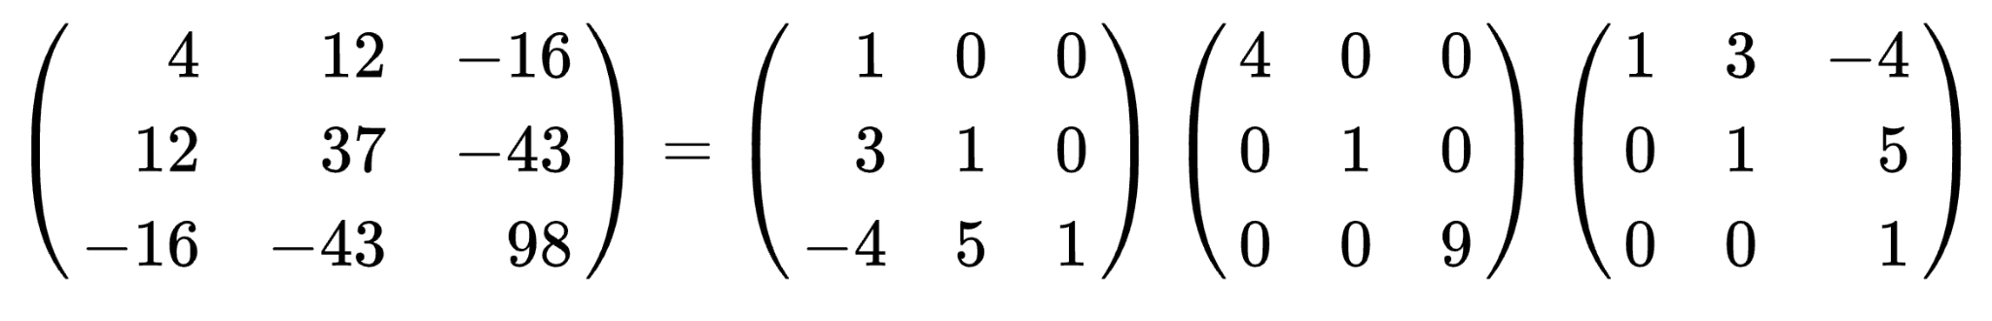
Matrix Factorizations
LDL Factorization for symmetric PSD matrix K = LDL^{T}
L is lower unit triangular matrix;
D is a diagonal matrix.
Notes:
unit triangular: all diagonal elements are 1.

Slide 11
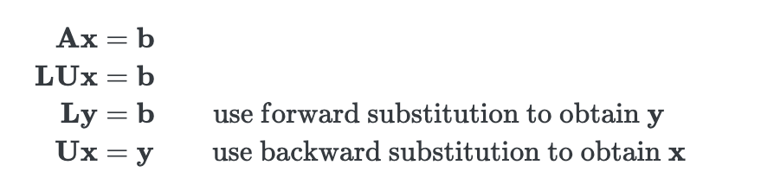
Matrix Factorizations
LU Factorization for matrix K = LU
L is lower triangular;
U is upper triangular.
Connection to linear solves: after finding LU decomposition, solving equations of the form Lx = b or Ux = b is simple (forward/backward substitution)

Slide 12
Singular Value Decomposition
Another very useful matrix factorization; given any matrix $A∈ℝ^{m × n}$, we can always express $A$ as the product of three matrices:
$$A=UΣV^{T}$$
where
$U∈ℝ^{m × m}$ is a unitary matrix: its inverse is $U^{T}$
${Σ∈ℝ}^{m × n}$ is a rectangular diagonal matrix
$V∈ℝ^{n × n}$ is also a unitary matrix

Slide 13
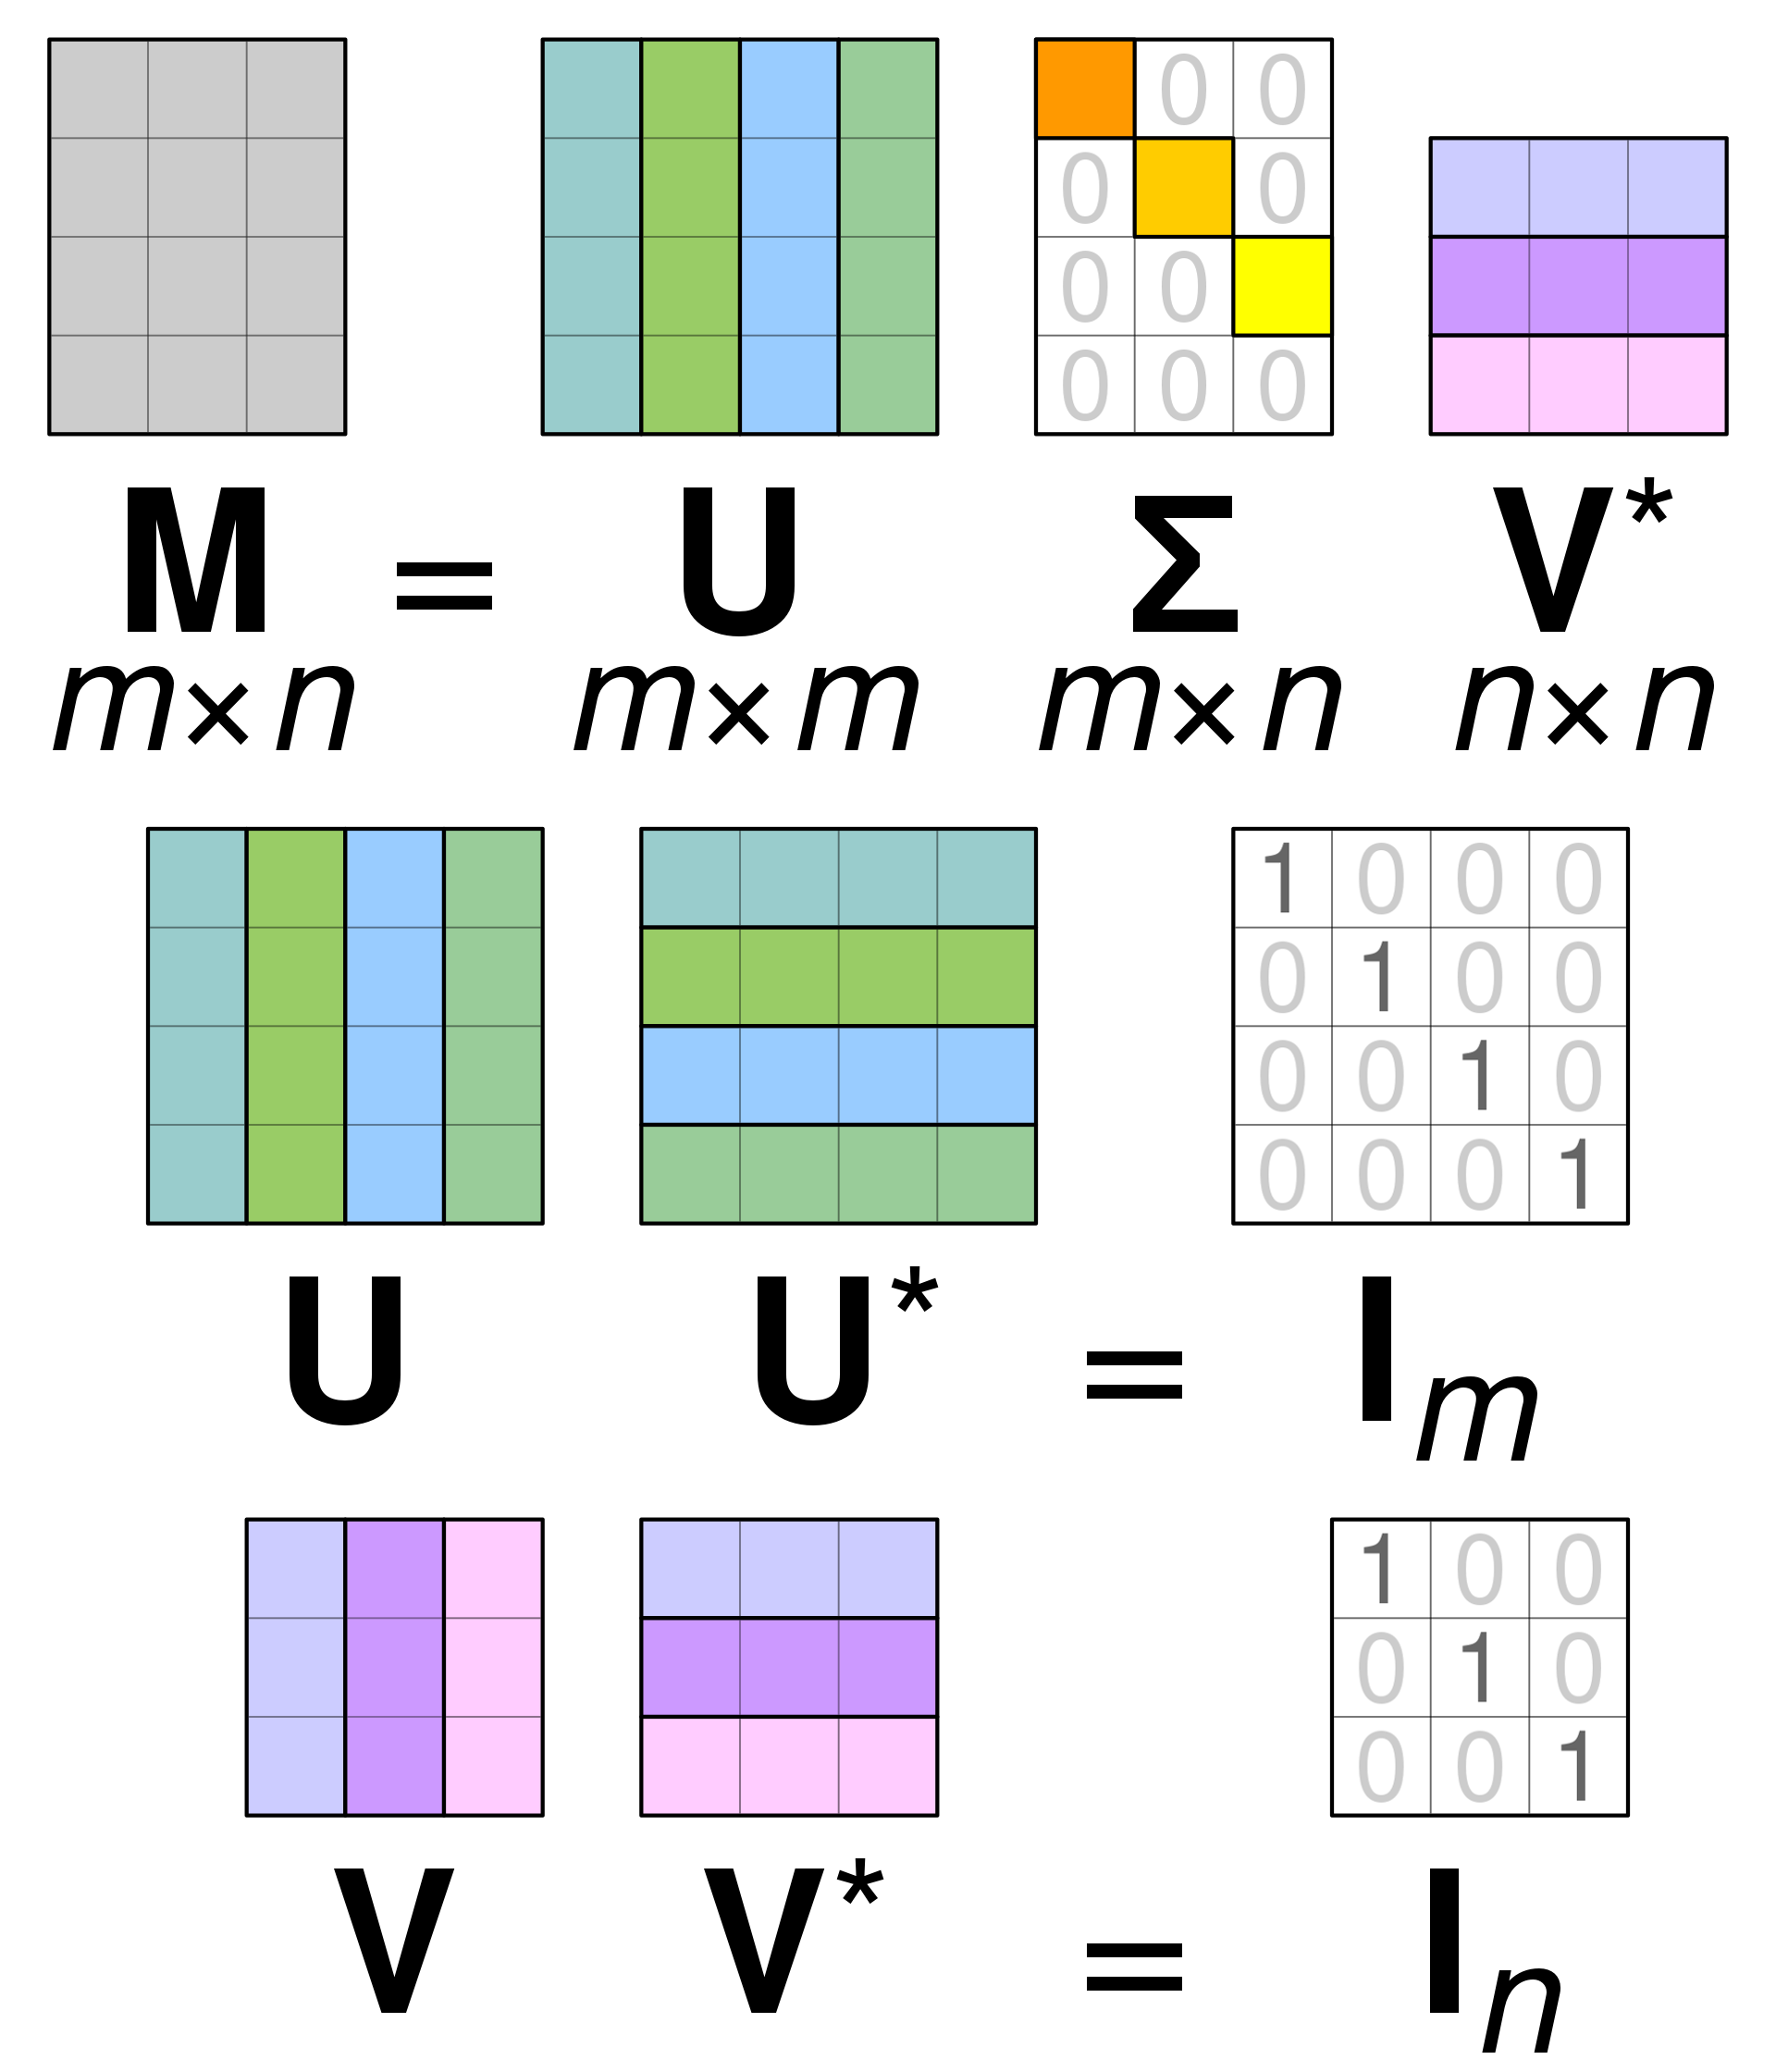
Singular Value Decomposition Pictorially
T
A
T
T
Source: https://en.wikipedia.org/wiki/Singular_value_decomposition#/media/File:Singular_value_decomposition_visualisation.svg

Slide 14
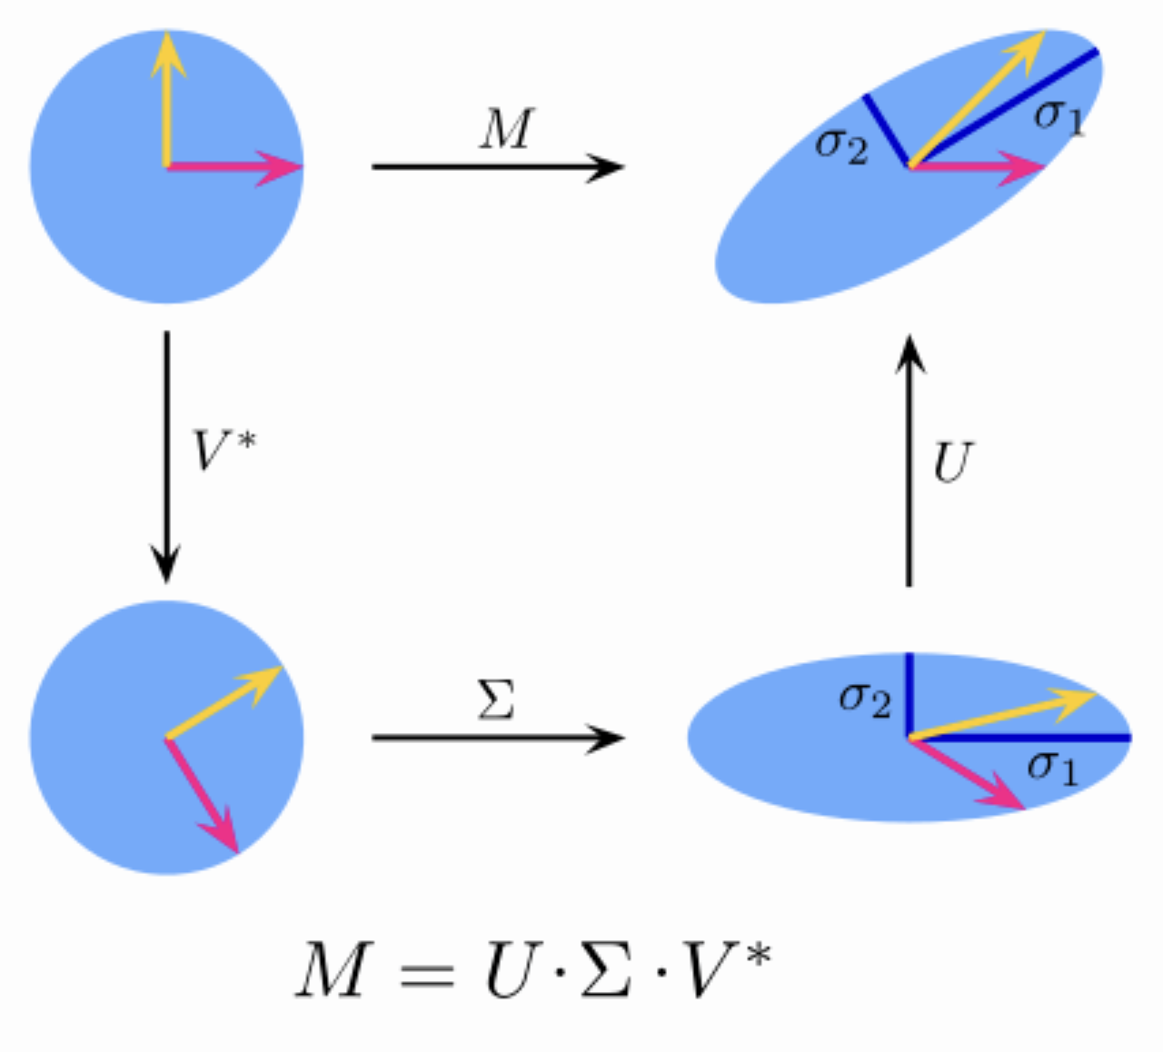
T
T

Slide 15
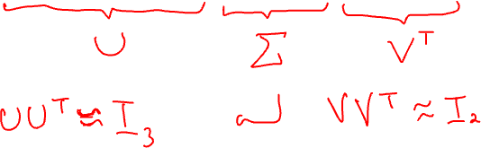
Singular Value Decomposition Example
$$A=\left[\begin{matrix}3 & 1 \\ −1 & 0 \\ 2 & −2\end{matrix}\right]≈\left[\begin{matrix}−0.765 & −0.598 & −0.241 \\ −0.265 & −0.049 & −0.963 \\ −0.588 & −0.800 & −0.120\end{matrix}\right]\left[\begin{matrix}3.756 & 0 \\ 0 & 2.211 \\ 0 & 0\end{matrix}\right]\left[\begin{matrix}−0.994 & 0.109 \\ −0.109 & 0.994\end{matrix}\right]$$

Slide 16

Singular Value Decomposition Interpretation
If $A=UΣV^{T}$, then
$$AA^{T}=$$
$$A^{T}A=$$
The columns of $U$ are the eigenvectors of $AA^{T}$
The columns of $V$ are the eigenvectors of $A^{T}A$
The non-zero elements of $Σ$ are the square roots of the non-zero eigenvalues of $AA^{T}$ and $A^{T}A$

Slide 17
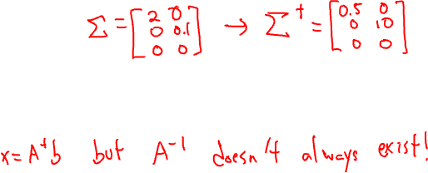
Singular Value Decomposition Uses
If $A=UΣV^{T}$, then the pseudoinverse of a $A$ is
$$A^{†}=VΣ^{†}U^{T}$$
where $Σ^{†}$ is created by replacing every non-zero entry in $Σ$ with its reciprocal, e.g.,
$${Σ= \left[\begin{matrix}2 & 0 \\ 0 & 0.1\end{matrix}\right]→Σ}^{†}=\left[\begin{matrix}0.5 & 0 \\ 0 & 10\end{matrix}\right]$$
The pseudoinverse of a matrix can be used to solve problems of the form $Ax=b$ when $A$ is singular i.e., when the inverse of $A$ does not exist!

Slide 18
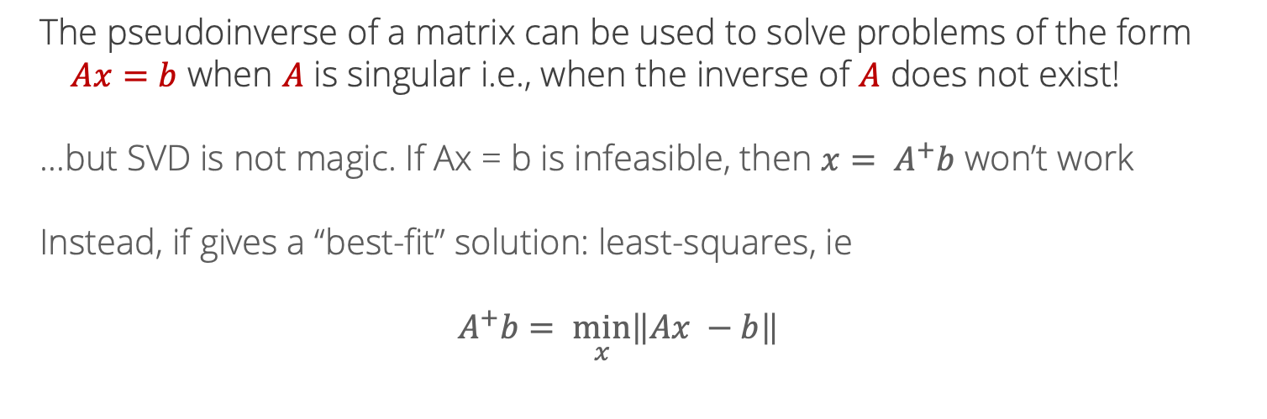
Pseudo-inverse
The pseudoinverse of a matrix can be used to solve problems of the form $Ax=b$ when $A$ is singular i.e., when the inverse of $A$ does not exist!
…but SVD is not magic. If Ax = b is infeasible, then ${x= A}^{+}b$ won’t work
Instead, if gives a “best-fit” solution: least-squares, ie
$$A^{+}b= \min_{x}\left\|Ax −b\right\|$$

Slide 19
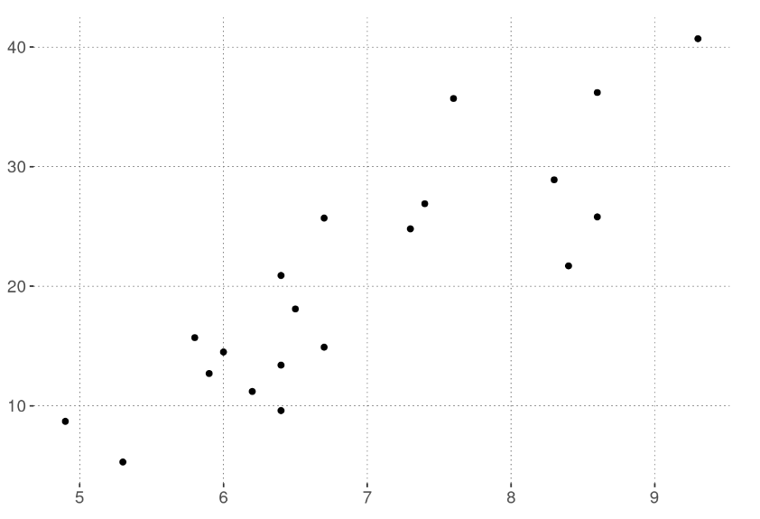
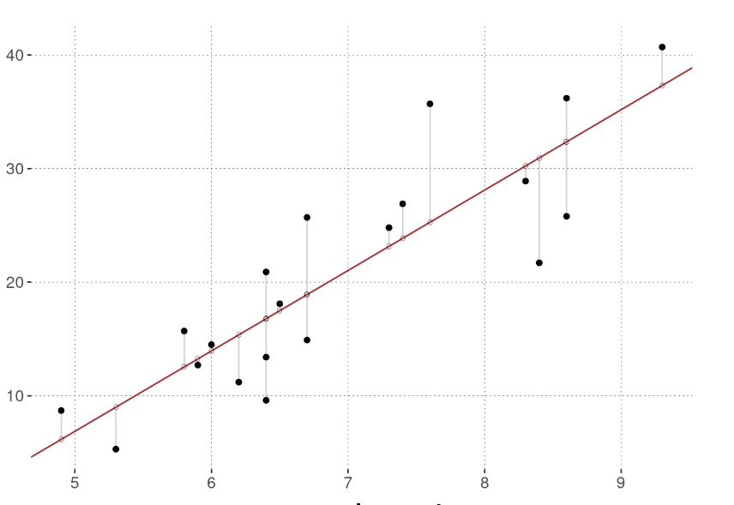

Linear regression
We now have the building blocks to introduce a fundamental ML concept:
Ordinary least squares (OLS) linear regression
Suppose we have data points ${\left\{\left(x_{i}, y_{i}\right)\right\}}_{i=1}^{N}$ and we want to fit a line through them
https://michael-franke.github.io/intro-data-analysis/ordinary-least-squares-regression.html

Slide 20

Linear regression
In 2d, fit a line $y=\hat{β}x+c$. For a new point, predict $\hat{y}=\hat{β}x+c$
With $x∈R^{n}$, coefficients $β∈R^{n}$ as well. $\hat{y}={\hat{β}}^{T}x+c$
Typically, fold $c$ into $β$ by assuming that we add a “1” to the feature vector:
$$x^{′}= \left({x \atop 1}\right)$$
Then, the last entry of $β$ is the intercept, and we just have $\hat{y}={\hat{β}}^{T}x$

Slide 21

Linear regression
What makes for a good set of parameters $β$?
One idea: measure the error on data point $i$ as
$${\left(y_{i} −{\hat{y}}_{i}\right)}^{2}={\left(y_{i} −β^{T}x\right)}^{2}$$
And look for $β$ with the smallest total squared error:
$$\min_{β}{\sum_{i=1}^{N}{{\left(y_{i} −β^{T}x\right)}^{2}}}$$

Slide 22

Ordinary least squares
There is a closed-form expression for the “best” $β$ defined this way. To present it, we introduce some matrix notation.
Let $X= \left[\begin{matrix}x_{1} \\ \begin{aligned}x_{2} \\ … \\ x_{N}\end{aligned}\end{matrix}\right]$ be the matrix obtained by stacking the feature vectors. Then,
$\hat{β}={\left(X^{T}X\right)}^{−1}X^{T}y$
is the set of coefficients that minimize the total squared errors.

Slide 23

Ordinary least squares
$\hat{β}={\left(X^{T}X\right)}^{−1}X^{T}y$
Where does this come from?
We need more tools to derive the solution – covered soon!
Now: a little bit of interpretation

Slide 24

Ordinary least squares
In matrix notation, solves the problem
$$\min_{β}{{\left\|Xβ −y\right\|}_{2}}$$

Slide 25

Ordinary least squares
In matrix notation, solves the problem
$$\min_{β}{{\left\|Xβ −y\right\|}_{2}}$$
$$\left[\begin{matrix}{−x}_{1}− \\ \begin{aligned}−x_{2}− \\ … \\ {−x}_{N}−\end{aligned}\end{matrix}\right]β=\left[\begin{matrix}x_{1}^{T}β \\ \begin{aligned}x_{2}^{T}β \\ … \\ x_{N}^{T}β\end{aligned}\end{matrix}\right]=\left[\begin{matrix}{\hat{y}}_{1} \\ \begin{aligned}{\hat{y}}_{2} \\ … \\ {\hat{y}}_{N}\end{aligned}\end{matrix}\right]$$

Slide 26
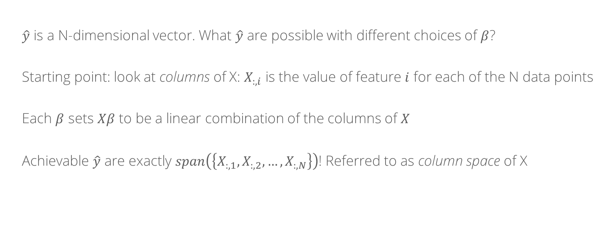
Ordinary least squares: geometric interpretation
$\hat{y}$ is a N-dimensional vector. What $\hat{y}$ are possible with different choices of $β$?
Starting point: look at columns of X: $X_{:, i}$ is the value of feature $i$ for each of the N data points
Each $β$ sets $Xβ$ to be a linear combination of the columns of $X$
Achievable $\hat{y}$ are exactly $span\left(\left\{X_{:, 1},X_{:, 2}, …, X_{:, N}\right\}\right)$! Referred to as column space of X

Slide 27
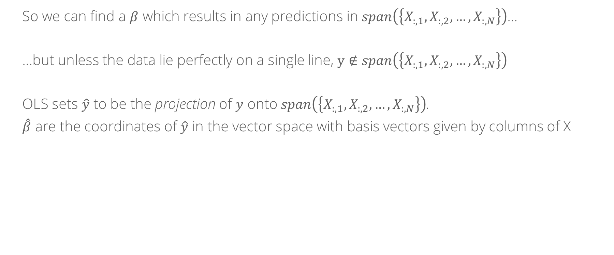
Ordinary least squares: geometric interpretation
So we can find a $β$ which results in any predictions in $span\left(\left\{X_{:, 1},X_{:, 2}, …, X_{:, N}\right\}\right)$…
…but unless the data lie perfectly on a single line, $y∉span\left(\left\{X_{:, 1},X_{:, 2}, …, X_{:, N}\right\}\right)$
OLS sets $\hat{y}$ to be the projection of $y$ onto $span\left(\left\{X_{:, 1},X_{:, 2}, …, X_{:, N}\right\}\right)$.
$\hat{β}$ are the coordinates of $\hat{y}$ in the vector space with basis vectors given by columns of X

Slide 28

Regularization
Natural extension:
$\min_{β}{{\left\|Xβ −y\right\|}_{2}}+λ{\left\|β\right\|}_{p}$ with respect to some p-norm
Penalize “large” coefficients
Common choices: p = 1, 2

Slide 29
Whiteboard: l1 vs l2 regularization

