Slide 1
Mathematical Foundations for ML (10-606):
Convexity and optimization
Bryan Wilder
* Slides borrowed from prior offerings by Professors M. Gormley, P. Virtue, & G. Gordon, & H. Heidari.

Slide 2
Announcements
Quiz 2 on Wednesday; similar format
Covers vector spaces, linear systems, matrix calculus
Warmup for today: a couple of the practice problems from Piazza (and variations thereof)

Slide 3
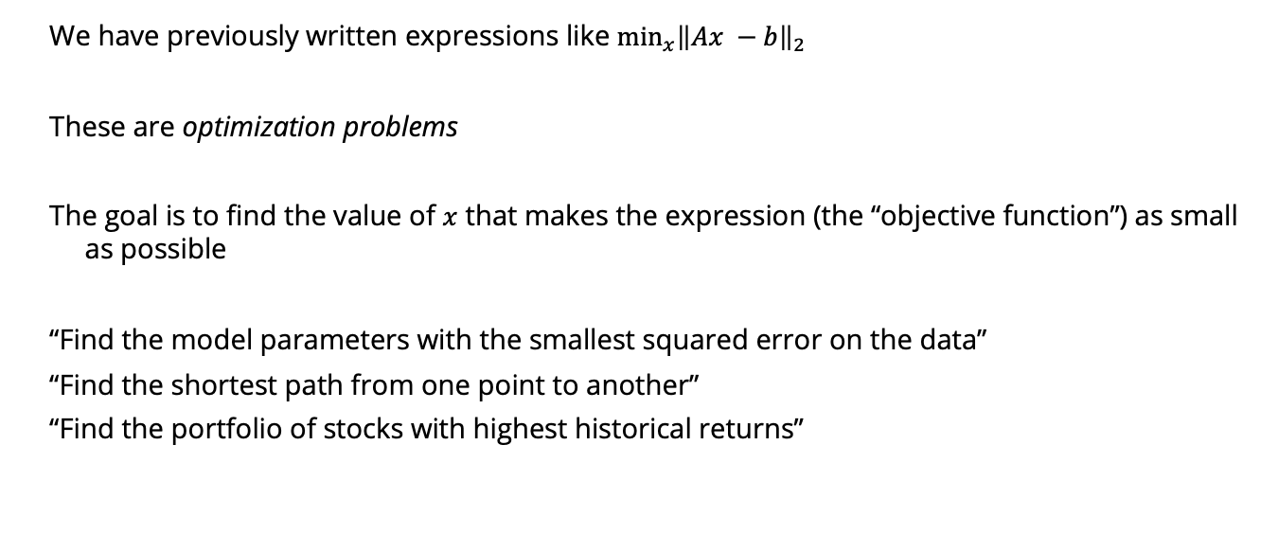
Optimization
We have previously written expressions like $\min_{x}{{\left\|Ax −b\right\|}_{2}}$
These are optimization problems
The goal is to find the value of $x$ that makes the expression (the “objective function”) as small as possible
“Find the model parameters with the smallest squared error on the data”
“Find the shortest path from one point to another”
“Find the portfolio of stocks with highest historical returns”

Slide 4
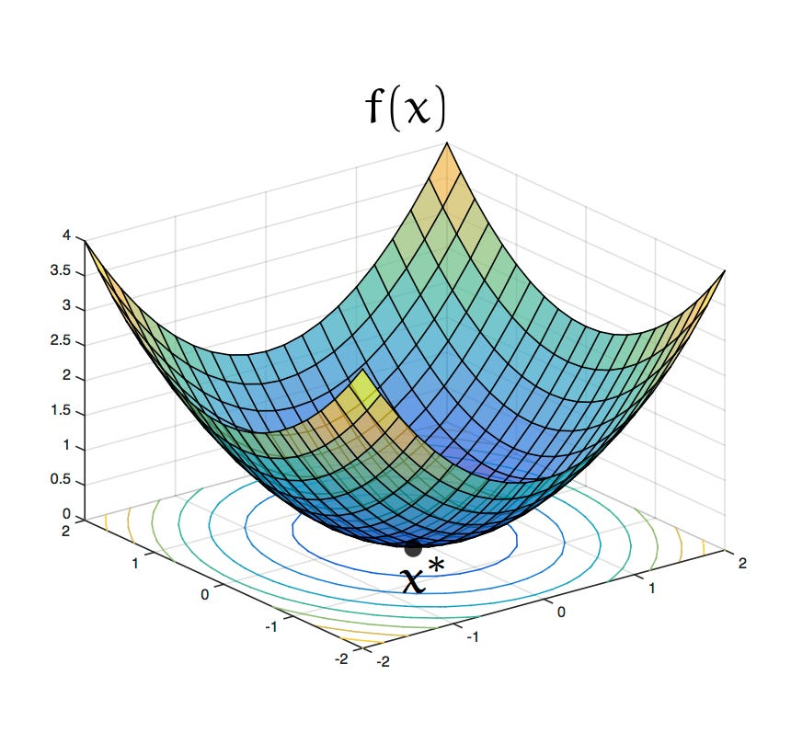
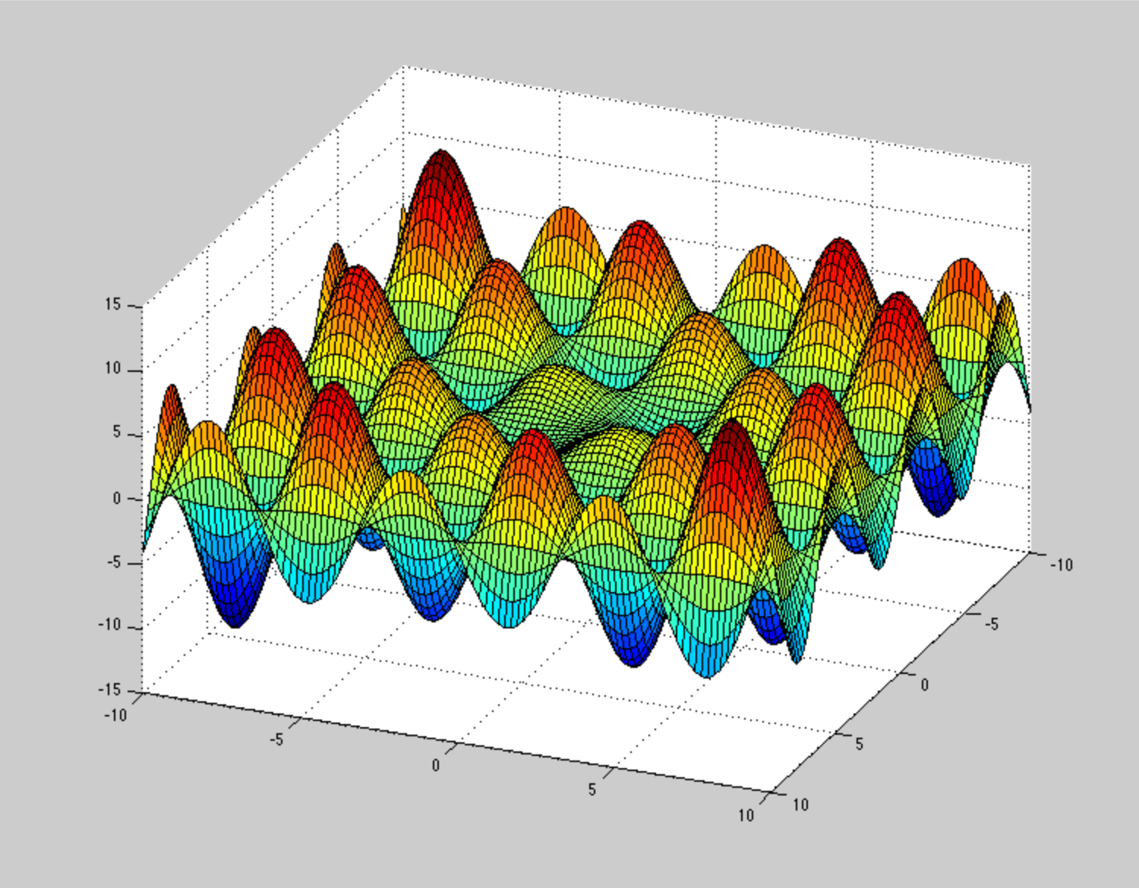
Solving optimization problems
Computationally, much of machine learning is just solving optimization problems
What makes optimization problems easier or harder to solve?

Slide 5
Outline
Critical points, local and global optimizers: what does it mean to be “optimal”?
Finding (local) optima with matrix calculus
Convexity: from local to global optima

Slide 6
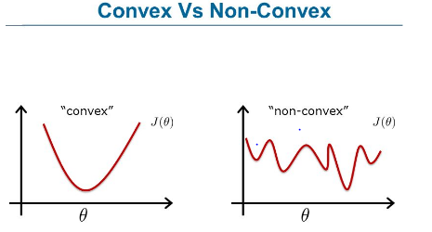
Convexity
Convex functions: class that is “easy” to optimize because all local minima are global

Slide 7
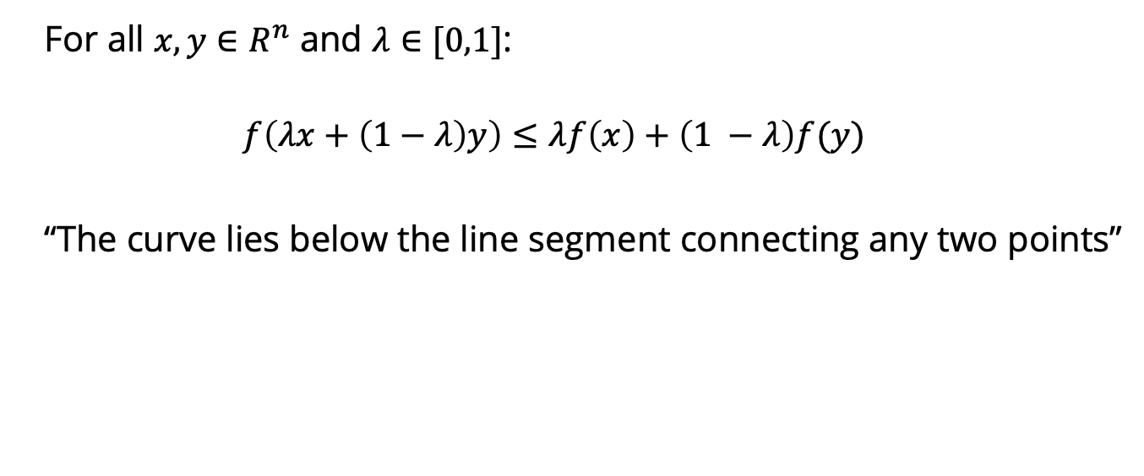
Definitions of convexity
For all $x, y∈R^{n}$ and $λ∈[0,1]$:
$$f\left(λx+\left(1−λ\right)y\right)≤λf\left(x\right)+\left(1 −λ\right)f(y)$$
“The curve lies below the line segment connecting any two points”

Slide 8
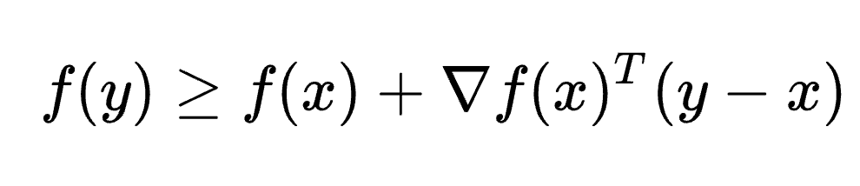
Definitions of convexity
First-order condition for differentiable f:

Slide 9

Definitions of convexity
Second-order condition for twice-differentiable f:
For all x, the Hessian H(x) of f is positive semi-definite
$$H(x)≽0$$

Slide 10
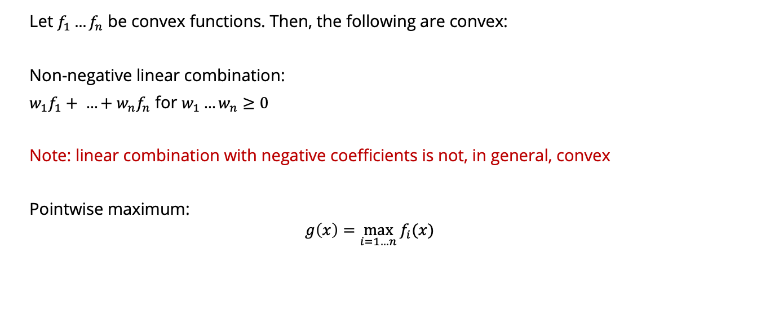
Operations that preserve convexity
Let $f_{1}…f_{n}$ be convex functions. Then, the following are convex:
Non-negative linear combination:
$w_{1}f_{1}+ …+w_{n}f_{n}$ for $w_{1}…w_{n}≥0$
Note: linear combination with negative coefficients is not, in general, convex
Pointwise maximum:
$$g\left(x\right)=\max_{i=1…n}{f_{i}(x)}$$

Slide 11
Taylor expansion
Very common use of (matrix) derivatives
Approximate a function by a low-order polynomial (linear, quadratic)

Slide 12
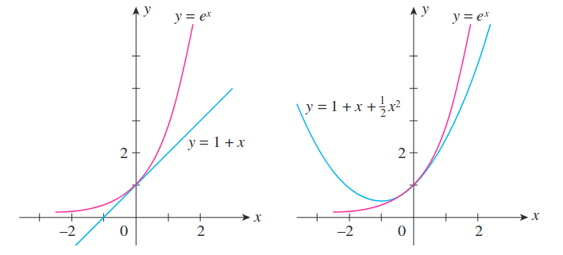

Refresher: scalar function Taylor expansion
$$f\left(x\right):R→R$$
Taylor series expansion around a point $a$:
$$f\left(x\right)= f\left(a\right)+f^{′}\left(a\right)\left(x−a\right)+\frac{1}{2}f^{′′}\left(a\right){\left(x −a\right)}^{2}+\frac{1}{6}f^{′′′}\left(a\right){\left(x −a\right)}^{3}…$$
$$=\sum_{n=0}^{∞}{\frac{1}{n!}f^{\left(n\right)}\left(a\right){\left(x −a\right)}^{n}}$$

Slide 13

Refresher: scalar function Taylor expansion
For well-behaved functions, Taylor series converges to $f\left(x\right)$
Given the right smoothness properties, can prove that $f$ is well-approximated locally by the Taylor series

Slide 14

Multivariate Taylor expansion
Let $f:R^{n}→R$
Taylor expansion to first order:
$$f\left(a\right)+∇f{\left(a\right)}^{T}\left(x −a\right)$$
To second order:
$$f\left(a\right)+∇f{\left(a\right)}^{T}\left(x −a\right)+\frac{1}{2}{\left(x−a\right)}^{T} H(a) (x−a)$$
where $H(a)$ is the Hessian of $f$ evaluated at $a$

Slide 15

Multivariable Taylor expansion
$$f\left(a\right)+∇f{\left(a\right)}^{T}\left(x −a\right)+\frac{1}{2}{\left(x−a\right)}^{T} H\left(a\right)\left(x−a\right)=$$
$$f\left(a\right)+\sum_{i=1}^{n}{{\left(x −a\right)}_{i}∇f{\left(a\right)}_{i}}+\frac{1}{2}\sum_{i=1}^{n}{\sum_{j=1}^{n}{{{H(a)}_{ij}\left(x −a\right)}_{i} {\left(x −a\right)}_{j}}}$$

Slide 16
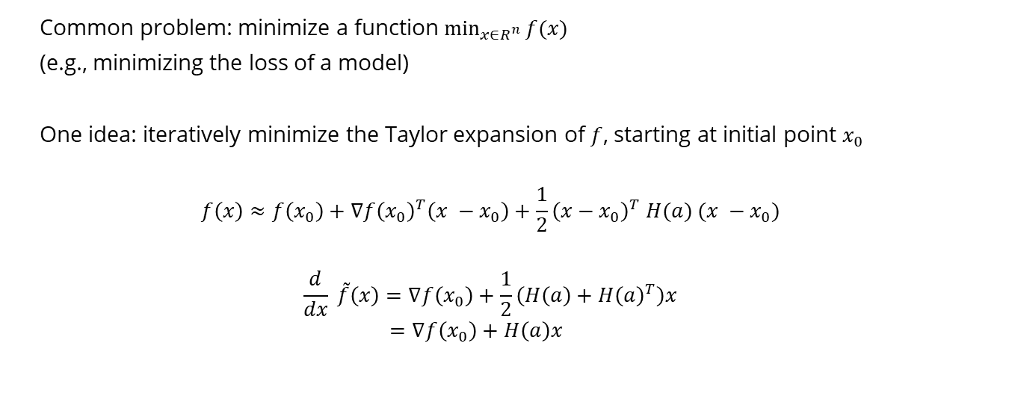
Example application: Newton’s method
Common problem: minimize a function $\min_{x∈R^{n}}{f(x)}$
(e.g., minimizing the loss of a model)
One idea: iteratively minimize the Taylor expansion of $f$, starting at initial point $x_{0}$
$$f\left(x\right)≈f\left(x_{0}\right)+∇f{\left(x_{0}\right)}^{T}\left(x −x_{0}\right)+\frac{1}{2}{\left(x−x_{0}\right)}^{T} H(a) (x −x_{0})$$
$$\frac{d}{dx} \tilde{f}\left(x\right)=∇f\left(x_{0}\right)+\frac{1}{2}\left(H\left(a\right)+H{\left(a\right)}^{T}\right)x$$
$$=∇f\left(x_{0}\right)+H\left(a\right)x$$

Slide 17
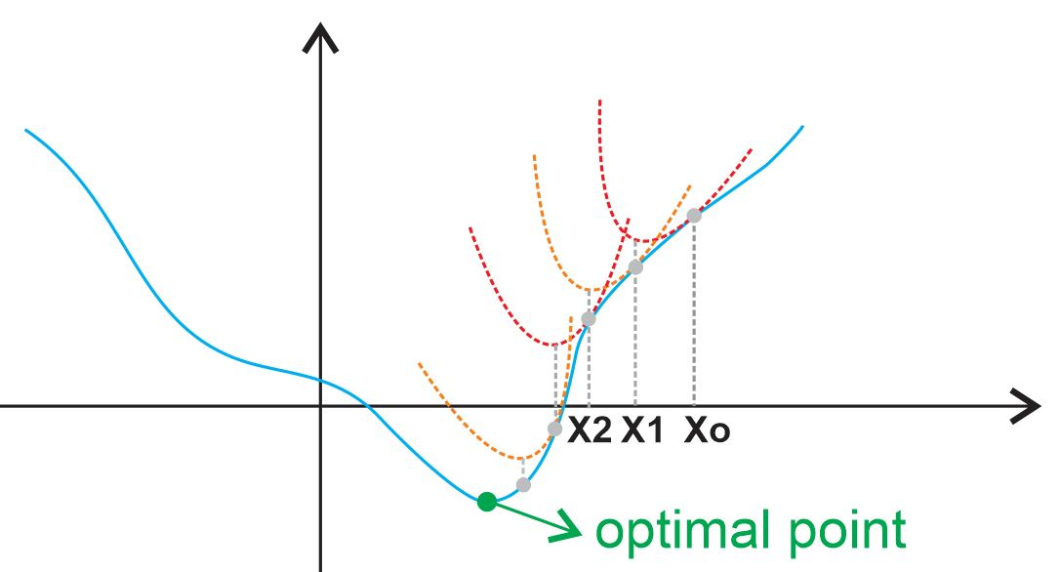
Newton’s method
https://ardianumam.files.wordpress.com/2017/09/newtonmethodforoptim1.jpg

Slide 18

Newton’s method
One idea: iteratively minimize the Taylor expansion of $f$, starting at initial point $x_{0}$
$$f\left(x\right)≈f\left(x_{0}\right)+∇f{\left(x_{0}\right)}^{T}\left(x −x_{0}\right)+\frac{1}{2}{\left(x−x_{0}\right)}^{T} H(x_{0}) (x −x_{0})$$
$$\frac{d}{d(x −x_{0})} \tilde{f}\left(x\right)=∇f\left(x_{0}\right)+\frac{1}{2}\left(H\left(x_{0}\right)+H{\left(x_{0}\right)}^{T}\right)(x −x_{0})$$
$$=∇f\left(x_{0}\right)+H\left(x_{0}\right)(x −x_{0})$$
Set $\frac{d}{dx} \tilde{f}\left(x\right)=0$ → $x−x_{0}=−H{\left(a\right)}^{−1}∇f\left(x_{0}\right)$
$$x=x_{0}−H{\left(a\right)}^{−1}∇f\left(x_{0}\right)$$

