Slide 1
Mathematical Foundations for ML (10-606):
Linear Operators & Matrices
Bryan Wilder
* Slides borrowed from prior offerings by Professors M. Gormley, P. Virtue, & G. Gordon, & H. Heidari.

Slide 2
Announcements
Notes:
Example: functional -> integral, operator -> identity function

Slide 3
Systems of equations
Next, we’ll discuss using matrices to represent and solve systems of linear equations

Slide 4
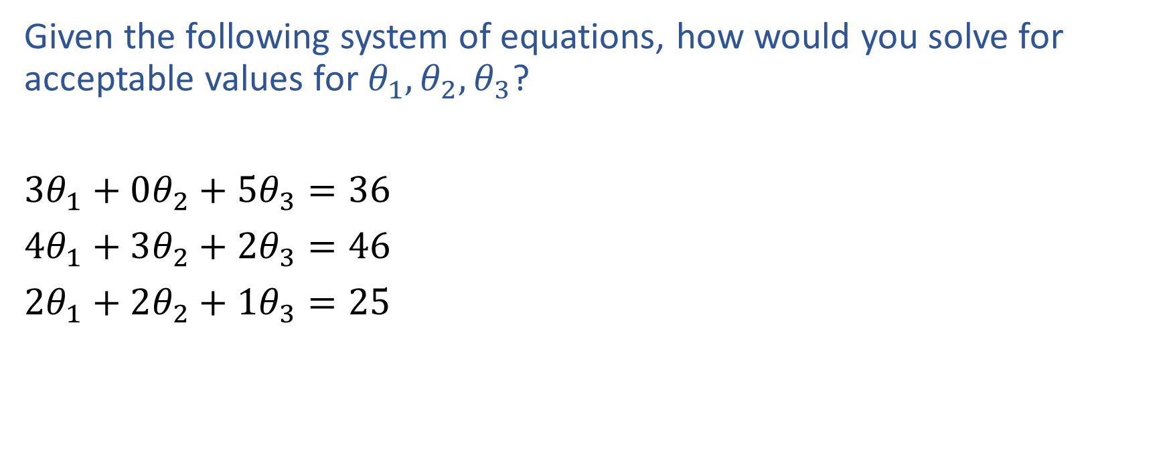
Exercise

Slide 5
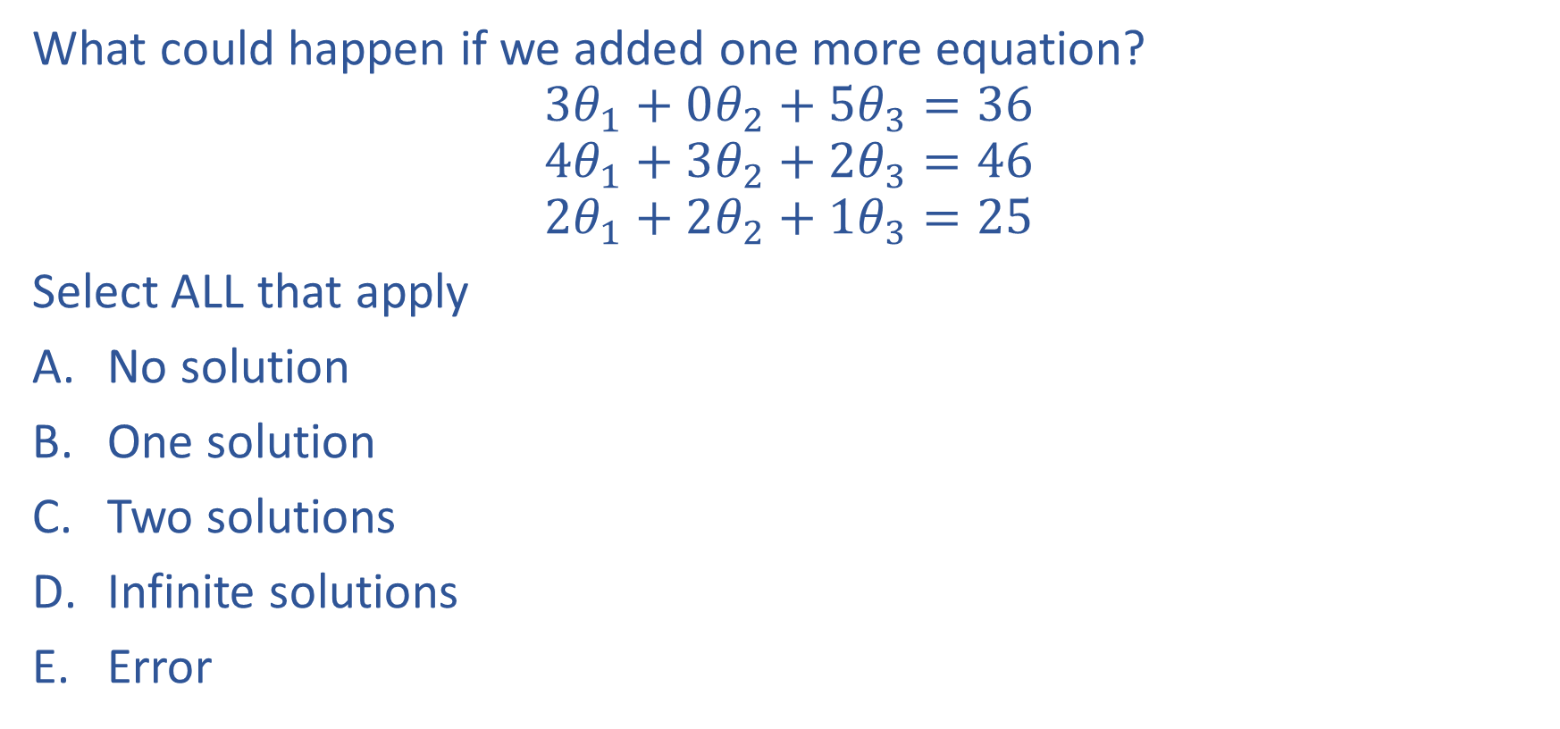
Poll 1

Slide 6
Poll 1

Slide 7
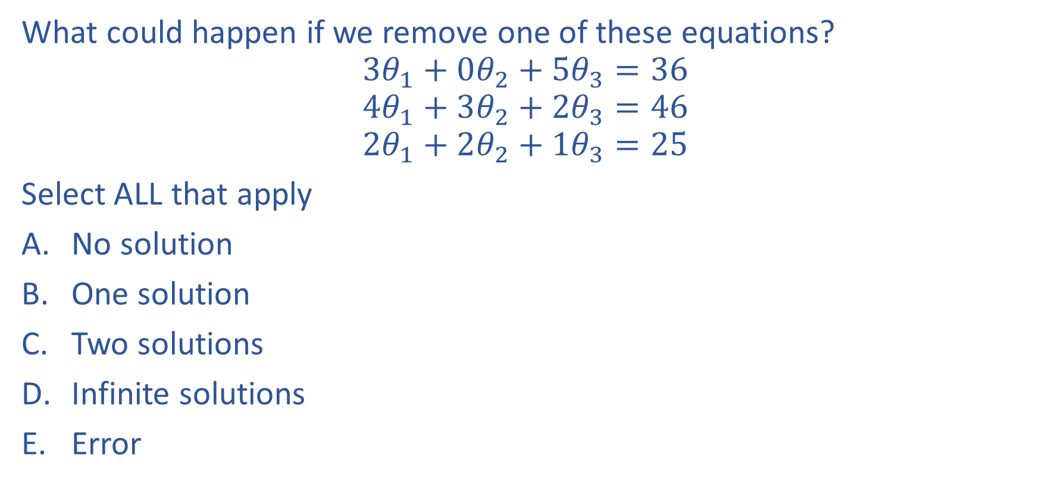
Poll 2

Slide 8
Poll 2

Slide 9
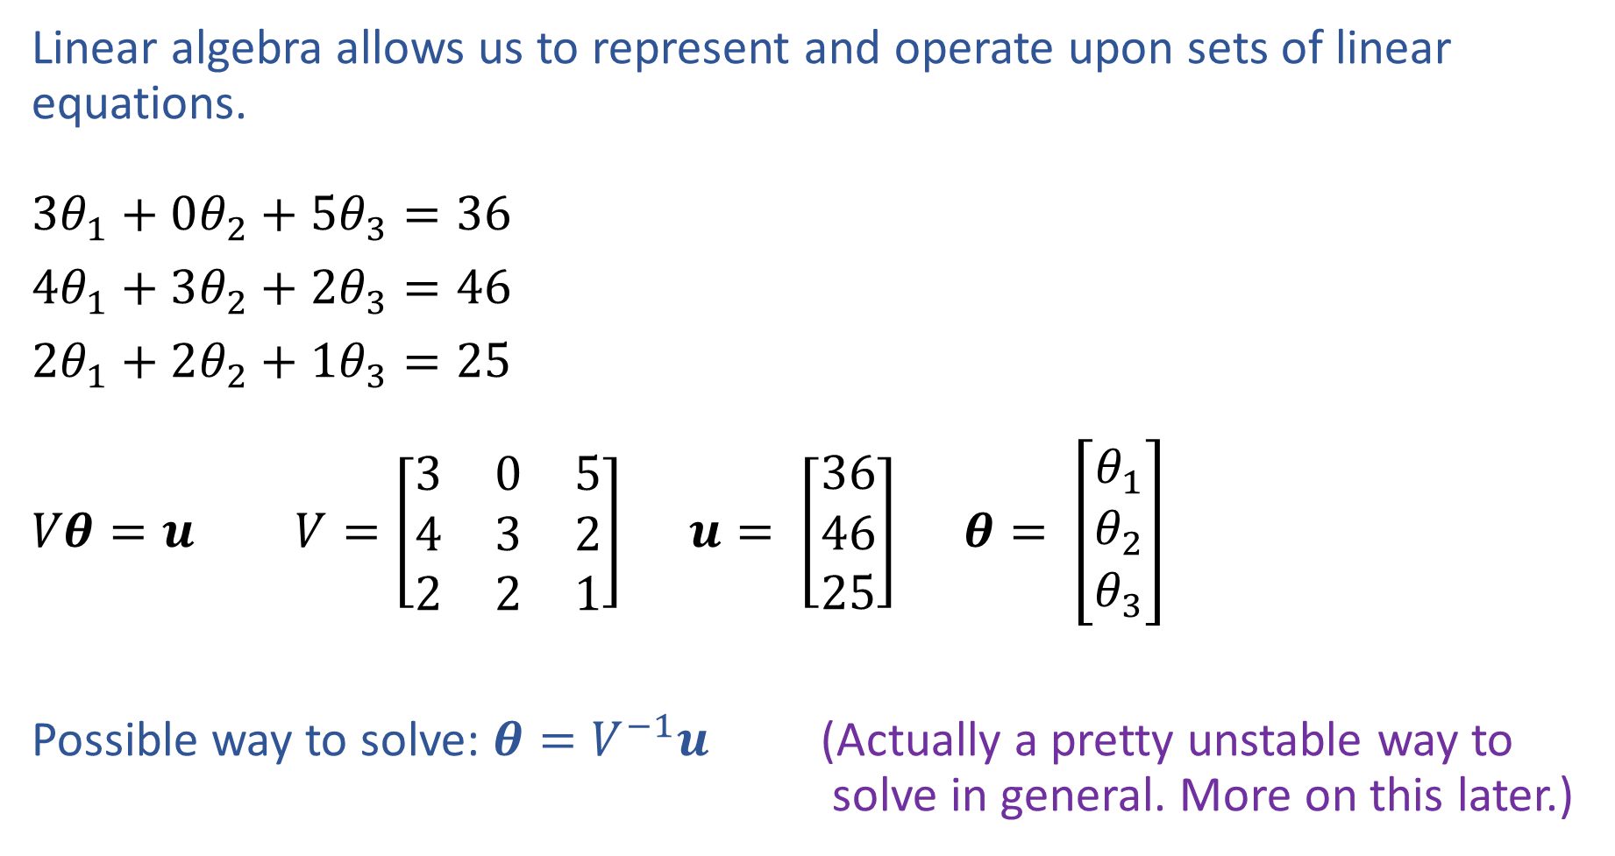
Linear Algebra
Notation alert!

Slide 10
Connection to rank of the matrix
Rank > unknowns: no solution
Rank = unknowns: unique solution
Rank < unknowns: infinite solutions or no solution

Slide 11
Gaussian Elimination
Numerical method to solve linear systems
Convert matrix to row-echelon form
Backsubstitute to solve the system

Slide 12
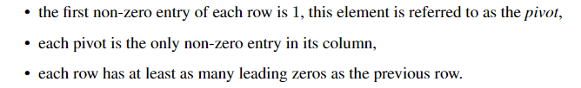
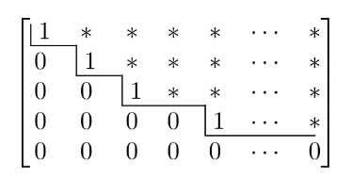
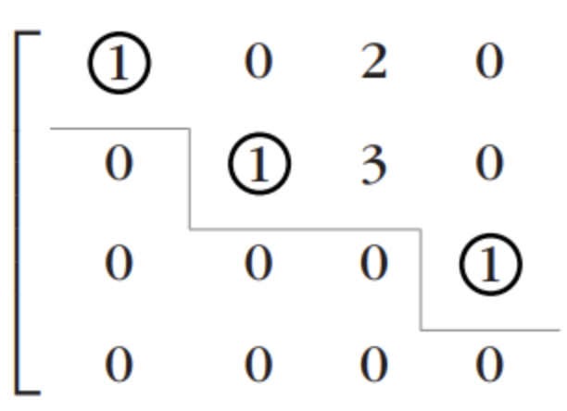
Row-echelon form

Slide 13
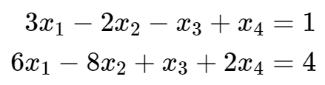
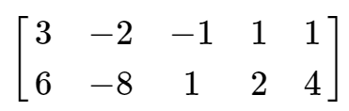

Augmented system
To solve system $Ax=b$, work with augmented matrix $\left(\begin{matrix}A & b\end{matrix}\right)$

Slide 14
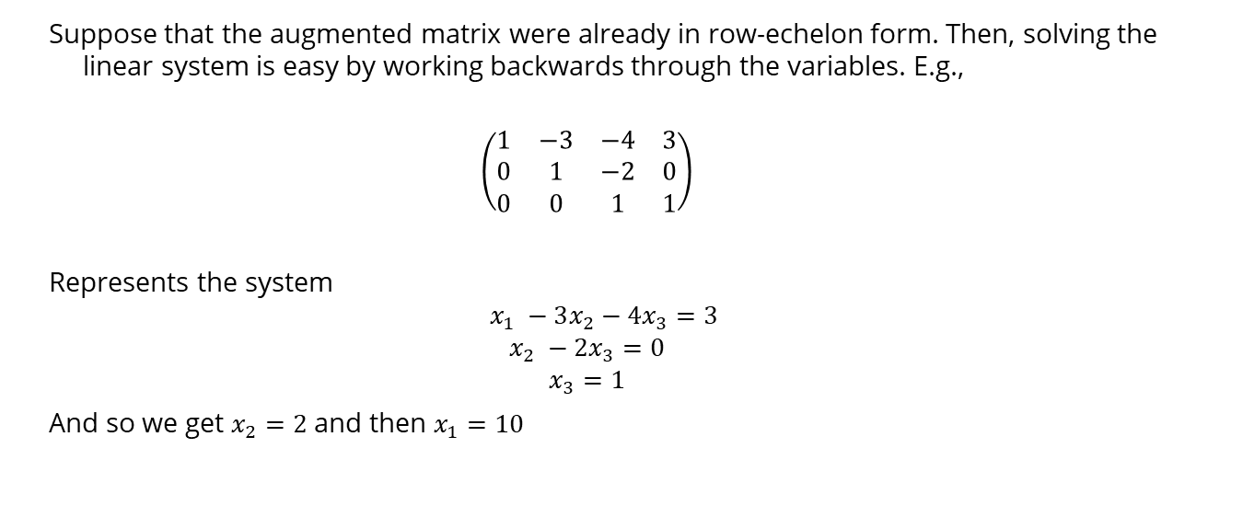
Back substitution
Suppose that the augmented matrix were already in row-echelon form. Then, solving the linear system is easy by working backwards through the variables. E.g.,
$$\left(\begin{matrix}1 & −3 & −4 & 3 \\ 0 & 1 & −2 & 0 \\ 0 & 0 & 1 & 1\end{matrix}\right)$$
Represents the system
$$x_{1} −3x_{2}−4x_{3}=3$$
$$x_{2} −2x_{3}=0$$
$$x_{3}=1$$
And so we get $x_{2}=2$ and then $x_{1}=10$

Slide 15
Gaussian Elimination
Form the row-echelon form using elementary transformations:
Exchange of two equations
Multiplication of an equation with a constant λ ∈ R\{0}
Addition of two equations
Intuition: these are operations that preserve equalities

Slide 16
Whiteboard
Examples from https://linearalgebra.math.umanitoba.ca/math1220/section-12.html

Slide 17
Computing ranks
REF also gives an easy way to compute the rank of a matrix: convert to REF and count the number of rows that are not all zeros
Works because REF operations preserve rank, and rank of REF matrices is just number of non-zero rows

