Slide 1
Mathematical Foundations for ML (10-680):
Linear algebra foundations
Bryan Wilder
bwilder@cmu.edu
* Slides borrowed from prior offerings by Professors M. Gormley, P. Virtue, G. Gordon, & H. Heidari.

Slide 2
Announcements
First homework due Sunday
No class Monday (labor day)

Slide 3
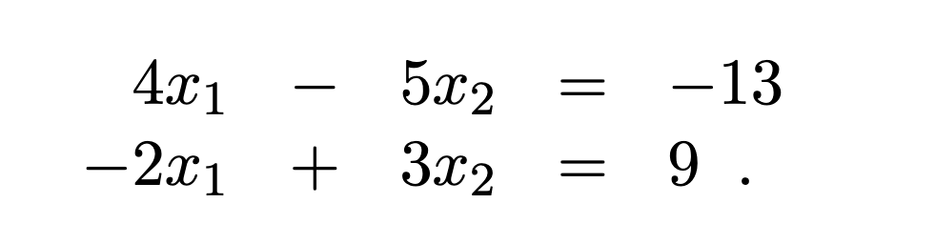
Linear algebra
Provides a means of representing linear functions and solving linear systems of equations
E.g., consider

Slide 4
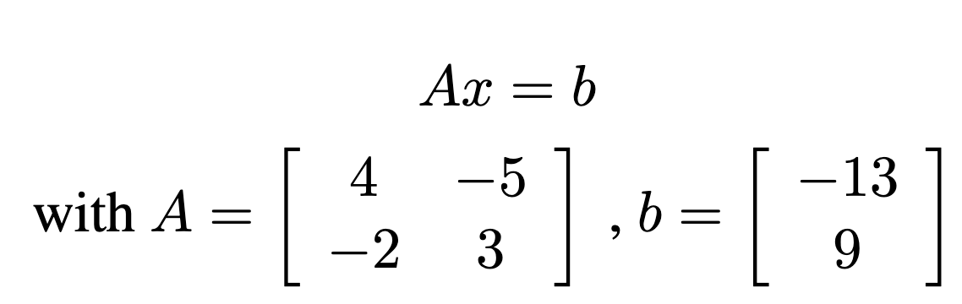
Linear algebra
Provides a means of representing linear functions and solving linear systems of equations
E.g., consider
Conversion to matrix notation.
What can see say about the system? How can we solve it?

Slide 5
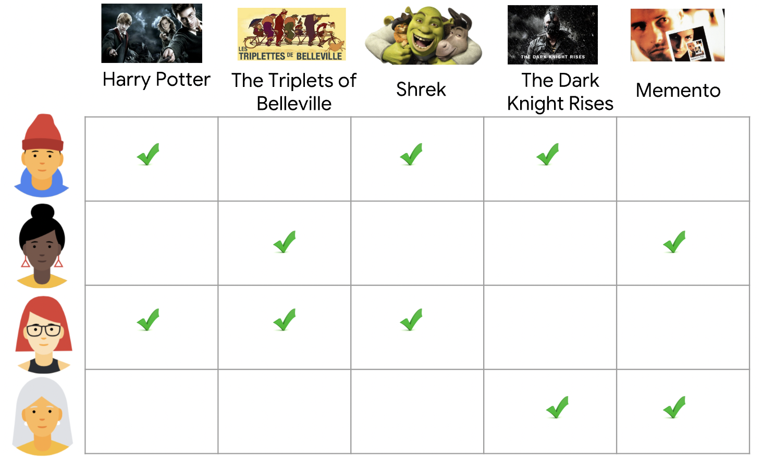
Linear algebra
In machine learning, matrices are the way that we both store and manipulate information
Data: stored in a matrix. Recommendation systems example: matrix of ratings
1
0
1
1
0
0
1
0
0
1
1
1
1
0
0
0
0
0
1
1

Slide 6
Linear algebra
In machine learning, matrices are the way that we both store and manipulate information
Data: stored in a matrix
Prediction/regression: feature matrix
https://www.kaggle.com/datasets/iammustafatz/diabetes-prediction-dataset

Slide 7
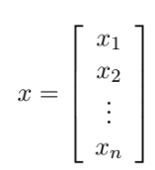

Definitions
$A∈R^{n×m}$: matrix with n rows and m columns, and each entry is a real number
$v∈R^{n}$: a vector with n real numbers. By default, column vector (n rows, 1 column):

Slide 8
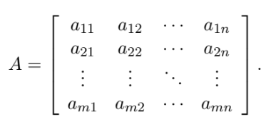
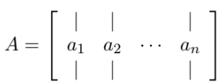

Definitions
Entry of a matrix in row I, column j: $a_{ij}, A_{ij}, A_{i,j}$
jth column of A: $a_{j}$ or $A_{:, j}$
ith row of A: $a_{i}^{T}$ or $A_{i,:}$

Slide 9
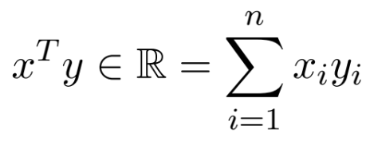

Inner vector product
Also called “dot product”, denoted $x⋅y$ or $<x, y>$

Slide 10
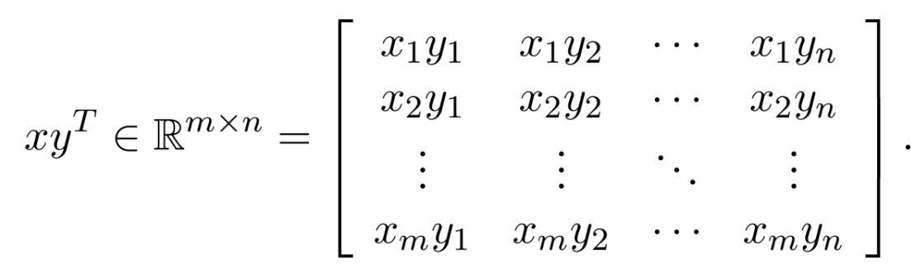


Outer vector product
Denoted $x⊗y$ or $xy^{T}$

Slide 11
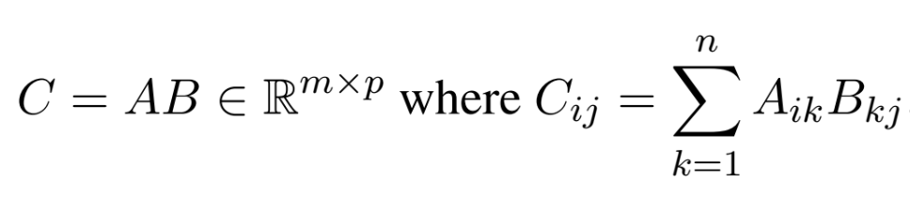

Matrix multiplication
$A_{i, :}⋅B_{:, j}$

Slide 12
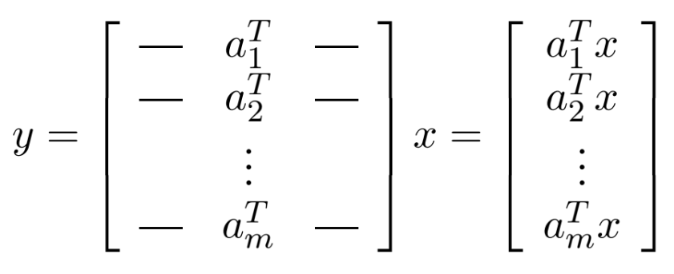

Matrix-vector product
Given a matrix $A∈R^{n×m}$ and vector $x∈R^{m}$, the product $Ax$ is a vector in $R^{m}$
View 1:

Slide 13
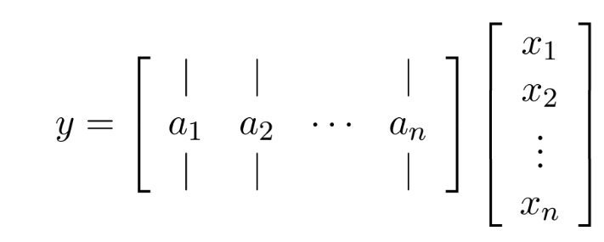
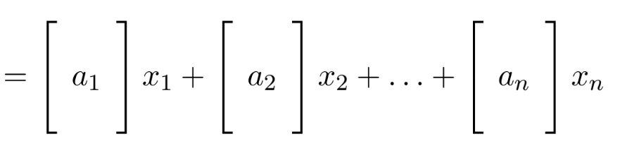
Matrix-vector product
View 2: linear combination of columns

Slide 14
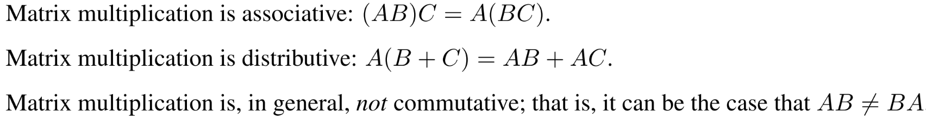
Useful facts about matrix multiplication

Slide 15
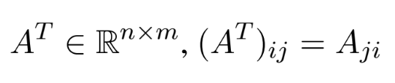
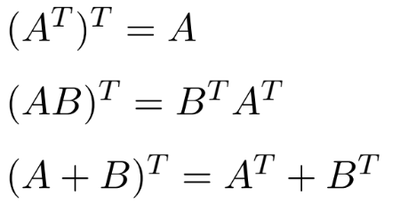

Matrix transpose
Reverses the rows and columns. Given $A∈R^{m×n}$,
Properties:

Slide 16

Matrix trace
Takes the sum of the diagonal elements of a square matrix. Given $A∈R^{n×n},$
$$tr\left(A\right)=\sum_{i=1}^{n}{A_{ii}}$$

Slide 17
Whiteboard
+Calculating products
+Illegal operations

Slide 18
P-norms
Whiteboard: definitions, examples

