Slide 1
Mathematical Foundations for ML (10-606):
Linear Operators, Rank, and Eigenvalues
Bryan Wilder

Slide 2
Announcements
Notes:
Example: functional -> integral, operator -> identity function

Slide 3
Functions on Vector Spaces
f: V → W where V and W are (potentially abstract) vector spaces
Functionals:
f: V → R
Operators:
f: V → V
Linear functions: f(ax + by) = a f(x) + b f(y)
affine=linear + constant
Notes:
Example: functional -> integral, operator -> identity function

Slide 4
Whiteboard: examples of linear functions
+matrix multiplication
+derivative

Slide 5
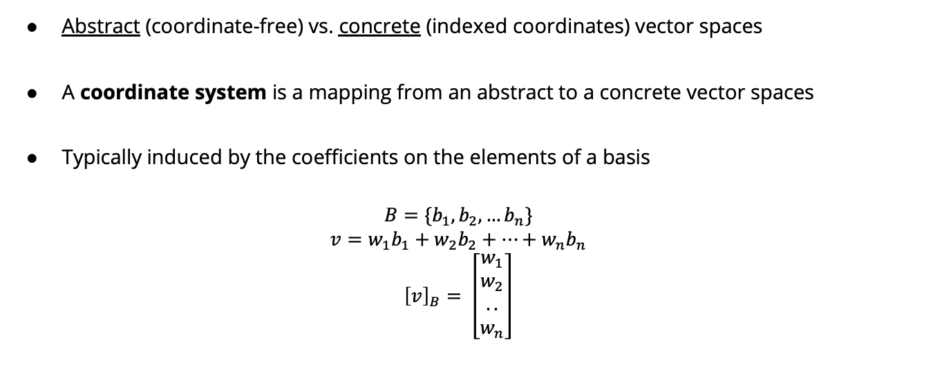
Coordinate Systems
Abstract (coordinate-free) vs. concrete (indexed coordinates) vector spaces
A coordinate system is a mapping from an abstract to a concrete vector spaces
Typically induced by the coefficients on the elements of a basis
$$B=\{b_{1}, b_{2},…b_{n}\}$$
$$v=w_{1}b_{1}+w_{2}b_{2}+…+w_{n}b_{n}$$
$${\left[v\right]}_{B}= \left[\begin{matrix}w_{1} \\ w_{2} \\ .. \\ w_{n}\end{matrix}\right]$$

Slide 6

Coordinate Systems
$$b_{1}= \left[\begin{matrix}1 \\ 1\end{matrix}\right] b_{2}= \left[\begin{matrix}1 \\ −1\end{matrix}\right]$$
$v=\left[\begin{matrix}2 \\ 1\end{matrix}\right]$= $\frac{3}{2}b_{1}+\frac{1}{2}b_{2}$
$${\left[v\right]}_{B}=\left[\begin{matrix}\frac{3}{2} \\ \frac{1}{2}\end{matrix}\right]$$

Slide 7
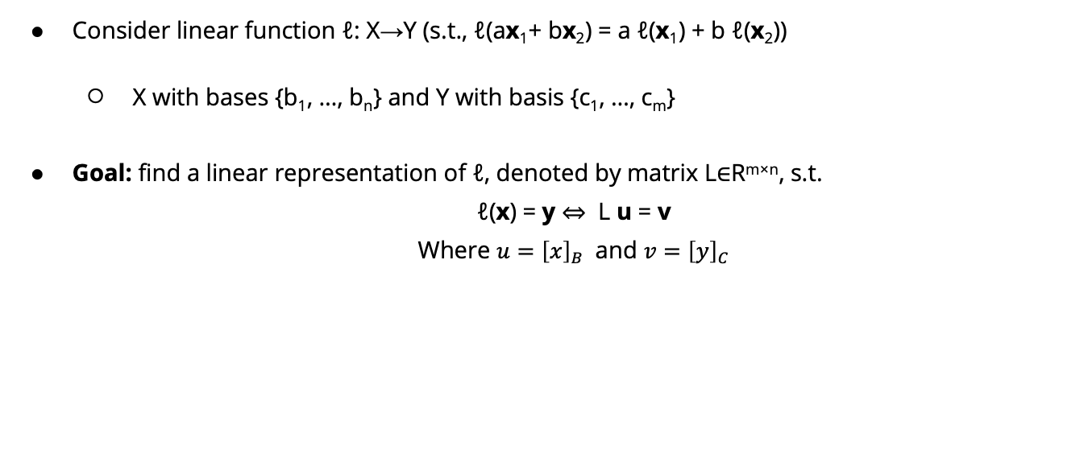
Coordinate Representation of Linear Functions
Consider linear function ℓ: X→Y (s.t., ℓ(ax₁+ bx₂) = a ℓ(x₁) + b ℓ(x₂))
X with bases {b₁, …, b_{n}} and Y with basis {c₁, …, c_{m}}
Goal: find a linear representation of ℓ, denoted by matrix L∈R^{m×n}, s.t.
ℓ(x) = y ⇔ L u = v
Where $u={\left[x\right]}_{B}$ and $v={\left[y\right]}_{C}$
Notes:
https://math.libretexts.org/Bookshelves/Linear_Algebra/A_First_Course_in_Linear_Algebra_(Kuttler)/05%3A_Linear_Transformations/5.02%3A_The_Matrix_of_a_Linear_Transformation_I

Slide 8
Rank of a function or matrix
Recall: for any f: X→ Y, range(f) = {f(x)| x ∈ X}.
Suppose ℓ: X→ Y is a linear transformation represented by matrix L.
rank(ℓ) = dim(range(ℓ))
rank(ℓ) = rank(L) = the dimension of the vector space spanned by columns of L.
= the dimension of the vector space spanned by rows of L.
= the number of linearly independent rows of L
= the number of linearly independent columns of L

Slide 9
Whiteboard: examples of rank
Notes:
Include also a visual example of a linear transformation, diag([1 2]) vs diag([1 0]) and how the low-rank matrix projects to a lower dimensional space

Slide 10

Eigenvalues and eigenvectors
Eigenvectors and eigenvalues are a tool to describe how a matrix acts as a linear function
Recall: matrix multiplication is a linear function $R^{n}→R^{n}$ mapping $x→Ax$
When we multiply by $A$ what happens to $x$? Which directions get bigger, which smaller? Does $x$ get flipped or rotated?
Notes:
Whiteboard: examples of stretching, flipping, etc

Slide 11
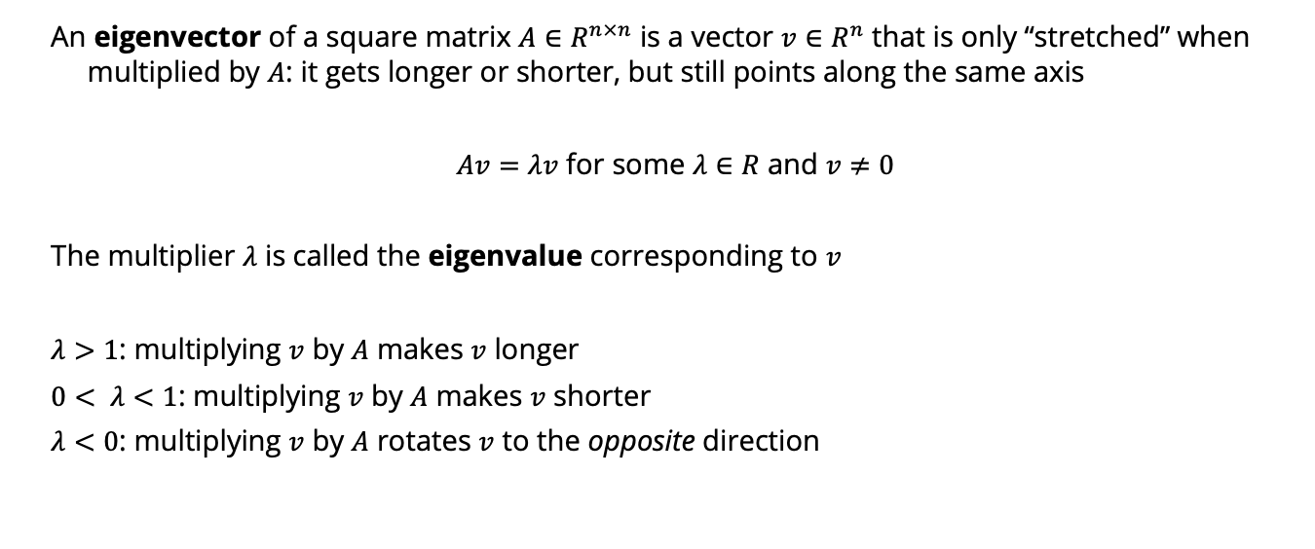
Eigenvalues and eigenvectors
An eigenvector of a square matrix $A∈R^{n×n}$ is a vector $v∈R^{n}$ that is only “stretched” when multiplied by $A$: it gets longer or shorter, but still points along the same axis
$Av=λv$ for some $λ∈R$ and $v≠0$
The multiplier $λ$ is called the eigenvalue corresponding to $v$
$λ>1$: multiplying $v$ by $A$ makes $v$ longer
$0< λ<1$: multiplying $v$ by $A$ makes $v$ shorter
$λ<0$: multiplying $v$ by $A$ rotates $v$ to the opposite direction
Notes:
Whiteboard: examples of stretching, flipping, etc

Slide 12
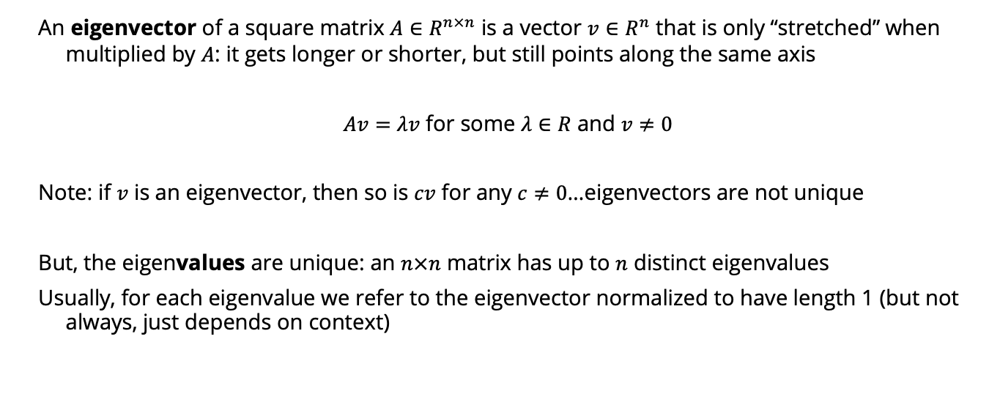
Eigenvalues and eigenvectors
An eigenvector of a square matrix $A∈R^{n×n}$ is a vector $v∈R^{n}$ that is only “stretched” when multiplied by $A$: it gets longer or shorter, but still points along the same axis
$Av=λv$ for some $λ∈R$ and $v≠0$
Note: if $v$ is an eigenvector, then so is $cv$ for any $c≠0$…eigenvectors are not unique
But, the eigenvalues are unique: an $n×n$ matrix has up to $n$ distinct eigenvalues
Usually, for each eigenvalue we refer to the eigenvector normalized to have length 1 (but not always, just depends on context)

Slide 13
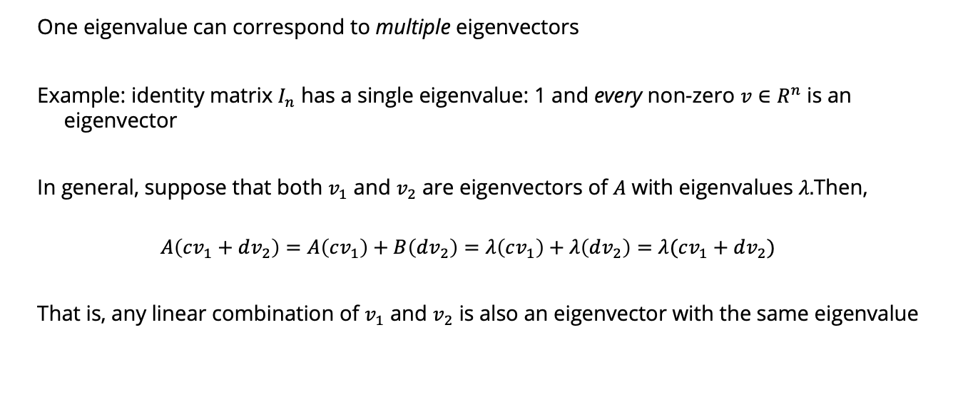
Eigenvalues and eigenvectors
One eigenvalue can correspond to multiple eigenvectors
Example: identity matrix $I_{n}$ has a single eigenvalue: 1 and every non-zero $v∈R^{n}$ is an eigenvector
In general, suppose that both $v_{1}$ and $v_{2}$ are eigenvectors of $A$ with eigenvalues $λ.$Then,
$$A\left(cv_{1}+dv_{2}\right)=A\left(cv_{1}\right)+B\left(dv_{2}\right)=λ\left(cv_{1}\right)+λ\left(dv_{2}\right)=λ(cv_{1}+dv_{2})$$
That is, any linear combination of $v_{1}$ and $v_{2}$ is also an eigenvector with the same eigenvalue

Slide 14
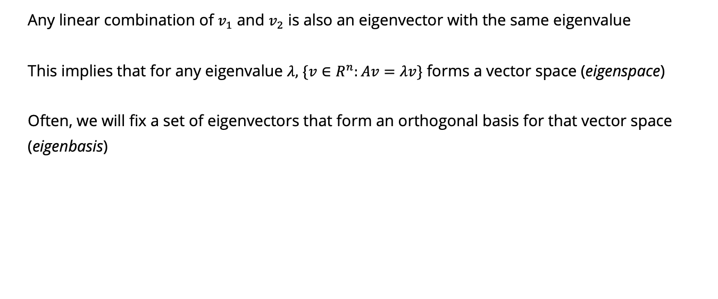
Eigenvalues and eigenvectors
Any linear combination of $v_{1}$ and $v_{2}$ is also an eigenvector with the same eigenvalue
This implies that for any eigenvalue $λ,$ $\{v∈R^{n}:Av=λv\}$ forms a vector space (eigenspace)
Often, we will fix a set of eigenvectors that form an orthogonal basis for that vector space
(eigenbasis)

Slide 15
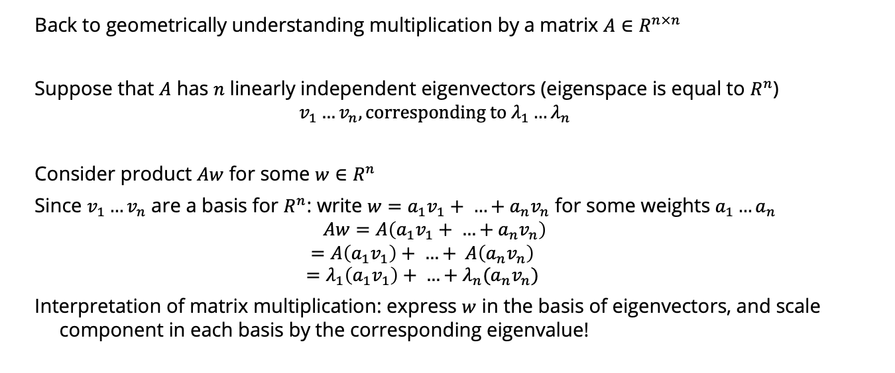
Eigenvalues and eigenvectors
Back to geometrically understanding multiplication by a matrix $A∈R^{n×n}$
Suppose that $A$ has $n$ linearly independent eigenvectors (eigenspace is equal to $R^{n}$)
$$v_{1}…v_{n}, corresponding to λ_{1}…λ_{n}$$
Consider product $Aw$ for some $w∈R^{n}$
Since $v_{1}…v_{n}$ are a basis for $R^{n}$: write $w=a_{1}v_{1}+ …+a_{n}v_{n}$ for some weights $a_{1}…a_{n}$
$$Aw=A\left(a_{1}v_{1}+ …+a_{n}v_{n}\right)$$
$$=A\left(a_{1}v_{1}\right)+ …+ A\left(a_{n}v_{n}\right)$$
$$=λ_{1}\left(a_{1}v_{1}\right)+ …+λ_{n}(a_{n}v_{n})$$
Interpretation of matrix multiplication: express $w$ in the basis of eigenvectors, and scale component in each basis by the corresponding eigenvalue!

Slide 16

Whiteboard examples
$$A=\left[\begin{matrix}3 & 0 \\ 0 & −1\end{matrix}\right]$$
What are eigenvectors and eigenvalues of $A$?

Slide 17

Whiteboard examples
$$A=\left[\begin{matrix}0 & 1 \\ −2 & −3\end{matrix}\right]$$
$$λ_{1}=−1, v_{1}=\left[\begin{matrix}1 \\ −1\end{matrix}\right]$$
$$λ_{2}=−2, v_{1}=\left[\begin{matrix}1 \\ −2\end{matrix}\right]$$
Let $u=\left[\begin{matrix}3 \\ −4\end{matrix}\right]$. What is $Au$?
Notes:
https://lpsa.swarthmore.edu/MtrxVibe/EigMat/MatrixEigen.html

Slide 18

Whiteboard examples
$$A=\left[\begin{matrix}0 & 1 \\ −2 & −3\end{matrix}\right]$$
$$λ_{1}=−1, v_{1}=\left[\begin{matrix}1 \\ −1\end{matrix}\right]$$
$$λ_{2}=−2, v_{1}=\left[\begin{matrix}1 \\ −2\end{matrix}\right]$$
Let $u=\left[\begin{matrix}3 \\ −4\end{matrix}\right]$. What is $Au$?
$$u=2v_{1}+{1v}_{2}$$
$$Au=−2v_{1}−2v_{2}=\left[\begin{matrix}−4 \\ 6\end{matrix}\right]$$

Slide 19
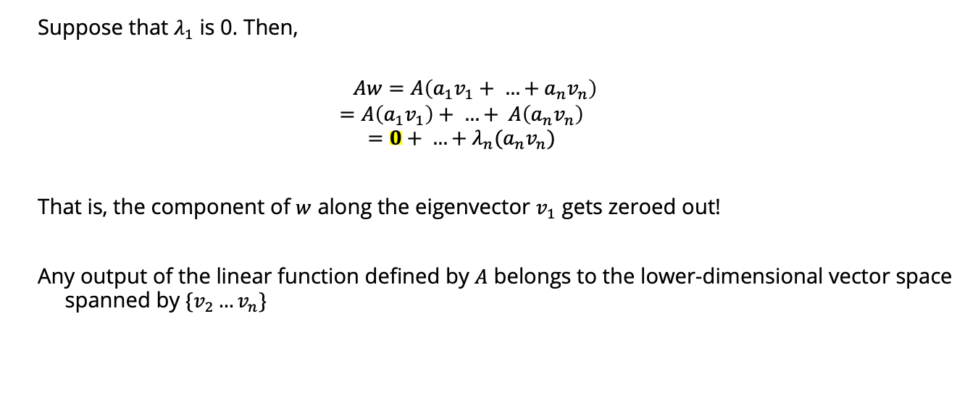
What happens if an eigenvalue is 0?
Suppose that $λ_{1}$ is 0. Then,
$$Aw=A\left(a_{1}v_{1}+ …+a_{n}v_{n}\right)$$
$$=A\left(a_{1}v_{1}\right)+ …+ A\left(a_{n}v_{n}\right)$$
$$=0+ …+λ_{n}(a_{n}v_{n})$$
That is, the component of $w$ along the eigenvector $v_{1}$ gets zeroed out!
Any output of the linear function defined by $A$ belongs to the lower-dimensional vector space spanned by $\{v_{2}…v_{n}\}$

Slide 20
Whiteboard examples
Notes:
Multiplication by diag([1,0])

Slide 21
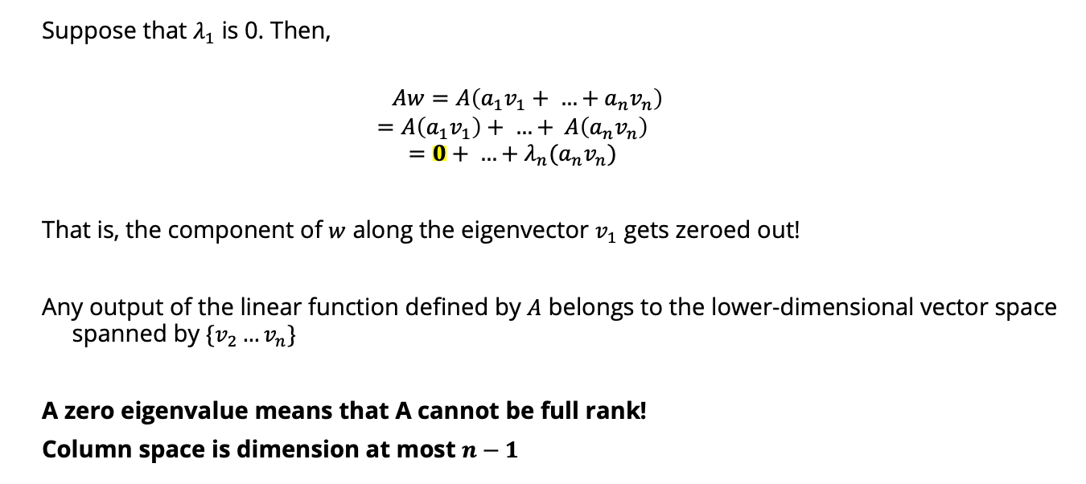
What happens if an eigenvalue is 0?
Suppose that $λ_{1}$ is 0. Then,
$$Aw=A\left(a_{1}v_{1}+ …+a_{n}v_{n}\right)$$
$$=A\left(a_{1}v_{1}\right)+ …+ A\left(a_{n}v_{n}\right)$$
$$=0+ …+λ_{n}(a_{n}v_{n})$$
That is, the component of $w$ along the eigenvector $v_{1}$ gets zeroed out!
Any output of the linear function defined by $A$ belongs to the lower-dimensional vector space spanned by $\{v_{2}…v_{n}\}$
A zero eigenvalue means that A cannot be full rank!
Column space is dimension at most $n−1$

Slide 22
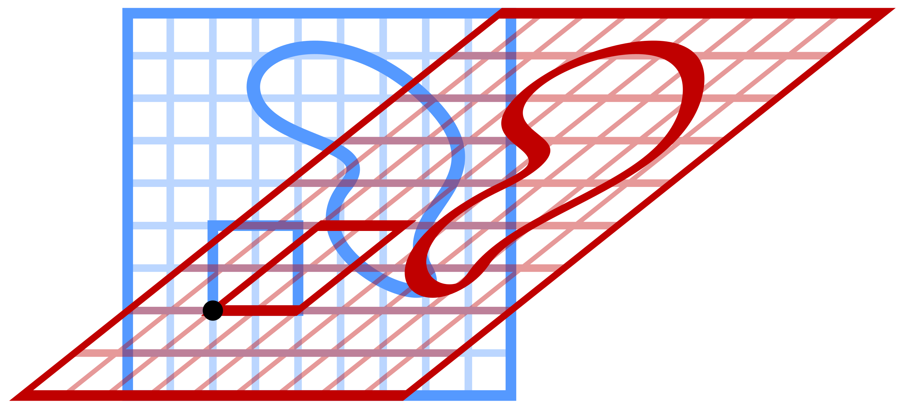
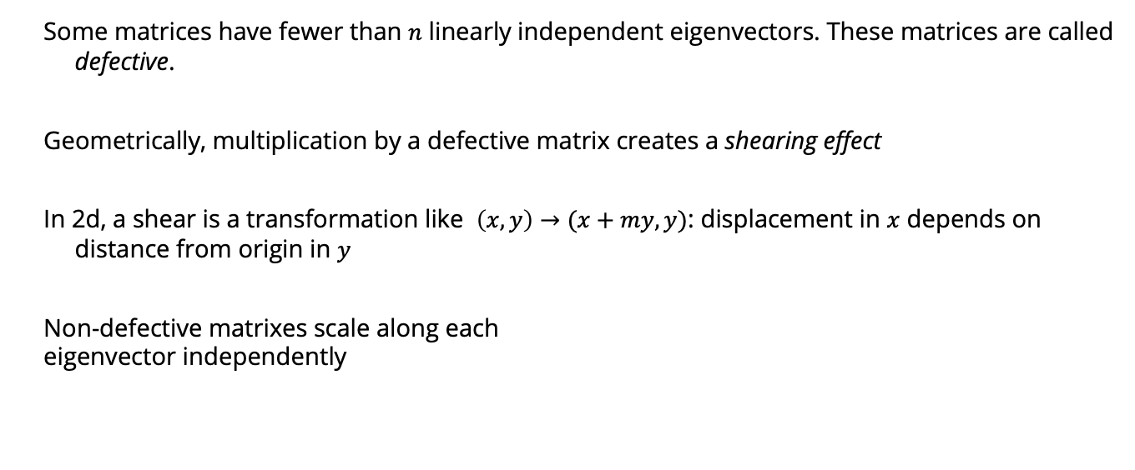
What if $A$ doesn’t have $n$ independent eigenvectors?
Some matrices have fewer than $n$ linearly independent eigenvectors. These matrices are called defective.
Geometrically, multiplication by a defective matrix creates a shearing effect
In 2d, a shear is a transformation like $\left(x,y\right)→(x+my, y)$: displacement in $x$ depends on distance from origin in $y$
Non-defective matrixes scale along each
eigenvector independently

Slide 23
Positive (Semi-)Definite Operators
An operator ℓ: X→ X is positive semi-definite (PSD) if
<ℓ(x), x> ≥ 0 ∀x∈X
An matrix L∈R^{n×n} is positive semi-definite (PSD) if
u^{T}Lu> ≥ 0 ∀u∈R^{n}
Typically, restrict to symmetric PSD matrices
Notes:
L is positive semi-definite if and only if all of its eigenvalues are non-negative.

Slide 24
Positive (Semi-)Definite Operators
Equivalent characterization: all eigenvalues are non-negative (semi-definite) or strictly positive (definite)

Slide 25
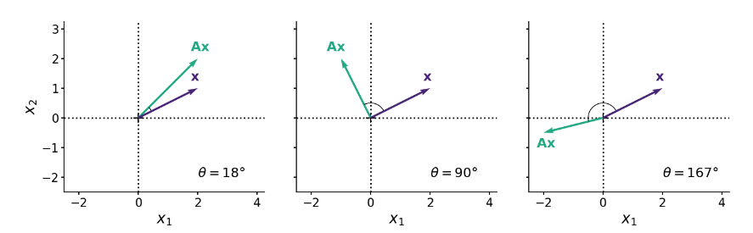
PSD matrices
One interpretation: symmetric PSD matrices stretch/scale vectors but don’t “flip” them
Whiteboard: using eigenvectors as a basis
https://gregorygundersen.com/blog/2022/02/27/positive-definite/

Slide 26
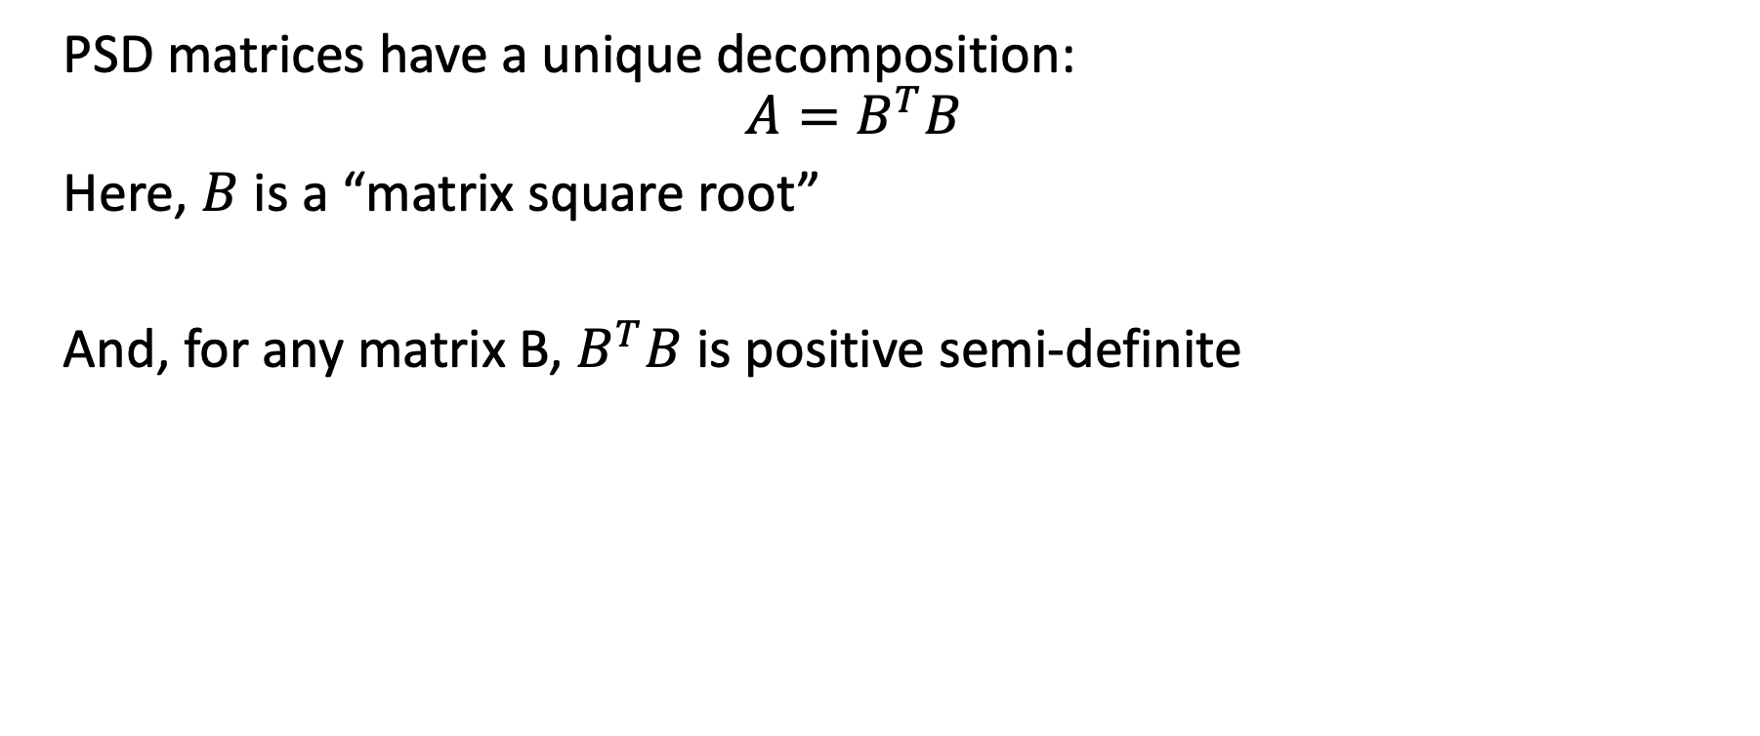
PSD matrices
PSD matrices have a unique decomposition:
$$A=B^{T}B$$
Here, $B$ is a “matrix square root”
And, for any matrix B, $B^{T}B$ is positive semi-definite

