Slide 1
Mathematical Foundations for ML (10-606):
Convexity and optimization
Bryan Wilder
* Slides borrowed from prior offerings by Professors M. Gormley, P. Virtue, & G. Gordon, & H. Heidari.

Slide 2
Announcements

Slide 3
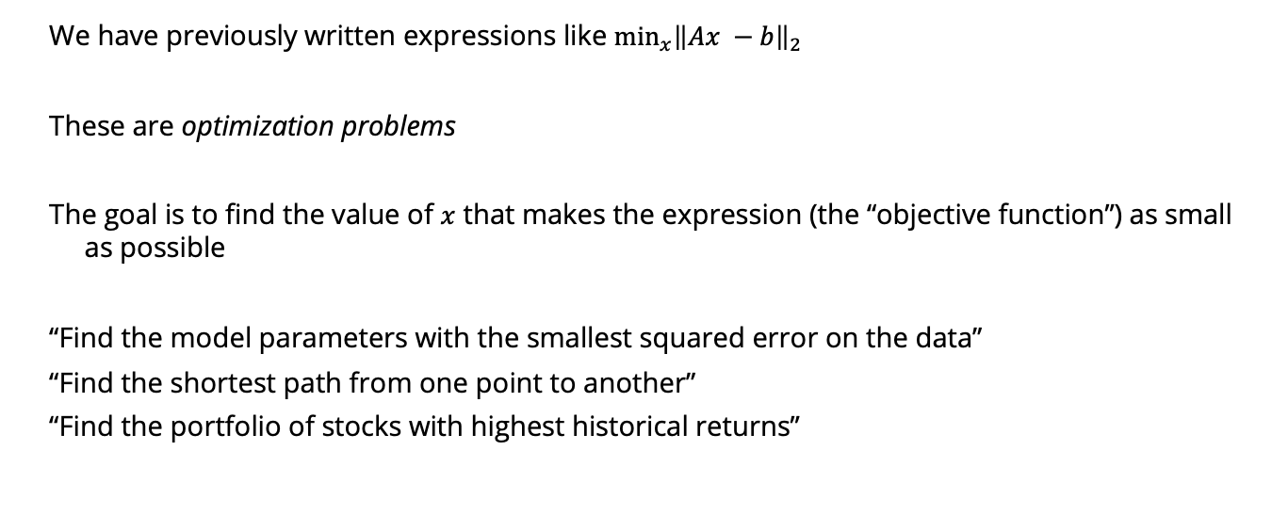
Optimization
We have previously written expressions like $\min_{x}{{\left\|Ax −b\right\|}_{2}}$
These are optimization problems
The goal is to find the value of $x$ that makes the expression (the “objective function”) as small as possible
“Find the model parameters with the smallest squared error on the data”
“Find the shortest path from one point to another”
“Find the portfolio of stocks with highest historical returns”

Slide 4
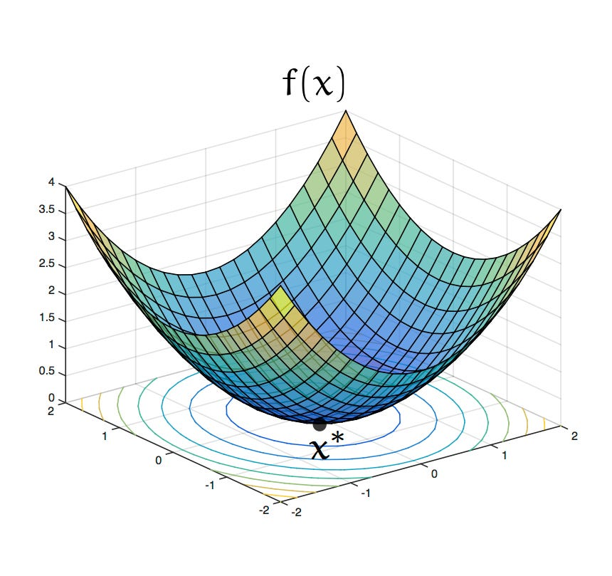
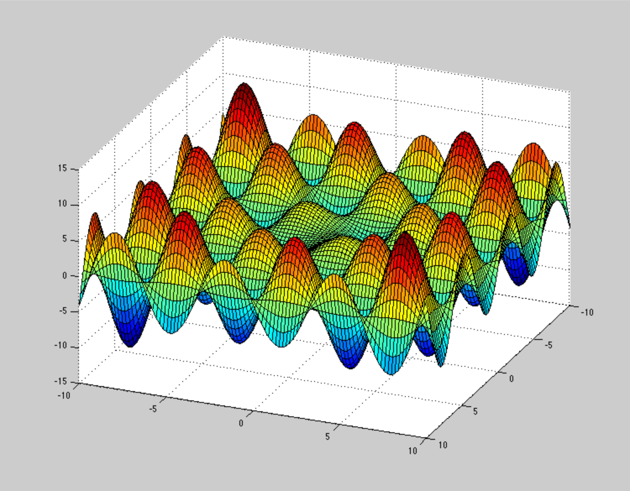
Solving optimization problems
Computationally, much of machine learning is just solving optimization problems
What makes optimization problems easier or harder to solve?

Slide 5
Outline
Critical points, local and global optimizers: what does it mean to be “optimal”?
(Whiteboard)
Finding (local) optima with matrix calculus
(Whiteboard)
Convexity: from local to global optima

Slide 6
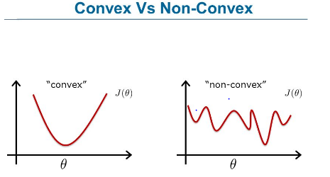
Convexity
Convex functions: class that is “easy” to optimize because all local minima are global

Slide 7
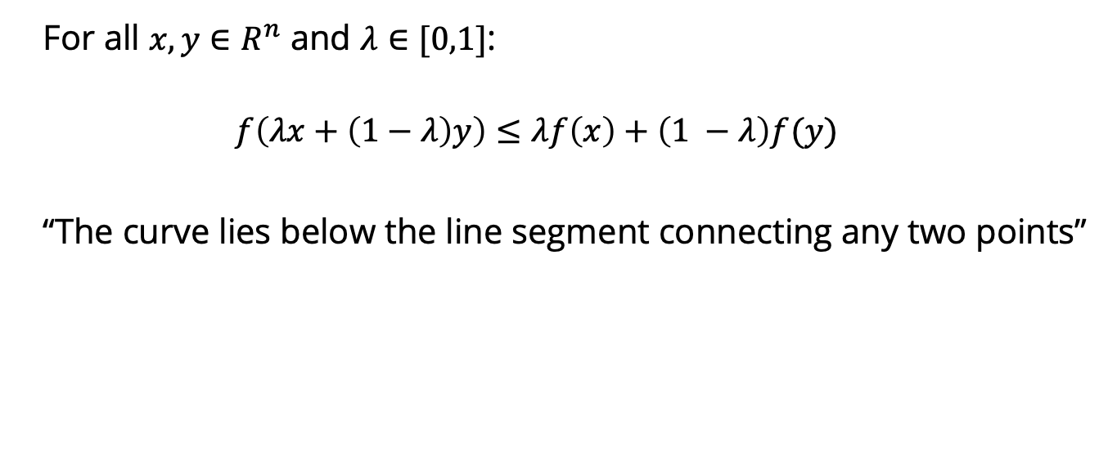
Definitions of convexity
For all $x, y∈R^{n}$ and $λ∈[0,1]$:
$$f\left(λx+\left(1−λ\right)y\right)≤λf\left(x\right)+\left(1 −λ\right)f(y)$$
“The curve lies below the line segment connecting any two points”

Slide 8
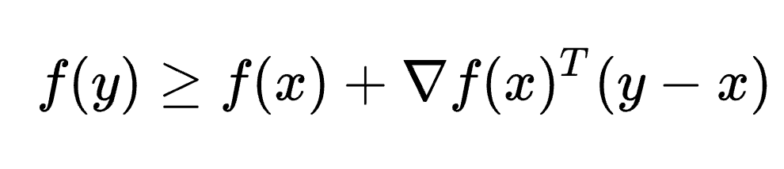
Definitions of convexity
First-order condition for differentiable f:

Slide 9

Definitions of convexity
Second-order condition for twice-differentiable f:
For all x, the Hessian H(x) of f is positive semi-definite
$$H(x)≽0$$

Slide 10

Implications of convexity
Any local minimizer we find is a global minimizer
If these inequalities hold strictly (e.g., $H\left(x\right)≻0$), then no saddle points either (“strictly convex”)
Efficient algorithms to find minimizers
Example: least squares

Slide 11
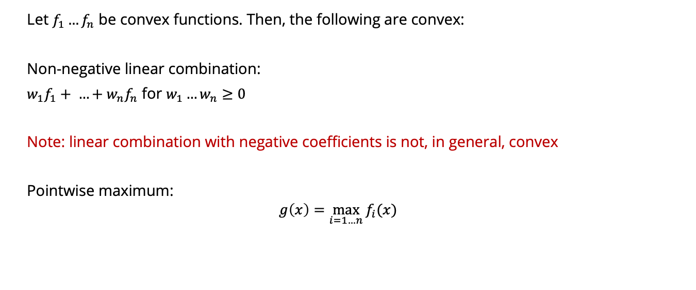
Operations that preserve convexity
Let $f_{1}…f_{n}$ be convex functions. Then, the following are convex:
Non-negative linear combination:
$w_{1}f_{1}+ …+w_{n}f_{n}$ for $w_{1}…w_{n}≥0$
Note: linear combination with negative coefficients is not, in general, convex
Pointwise maximum:
$$g\left(x\right)=\max_{i=1…n}{f_{i}(x)}$$

Slide 12
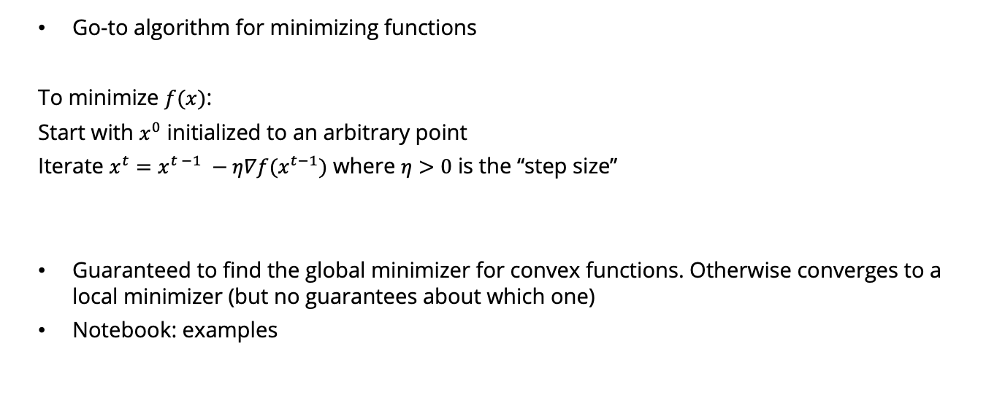
Gradient descent
Go-to algorithm for minimizing functions
To minimize $f(x)$:
Start with $x^{0}$ initialized to an arbitrary point
Iterate $x^{t}=x^{t −1} −η∇f(x^{t−1})$ where $η>0$ is the “step size”
Guaranteed to find the global minimizer for convex functions. Otherwise converges to a local minimizer (but no guarantees about which one)
Notebook: examples

Slide 13
Gradient descent for matrix factorization
One way to efficiently compute a matrix factorization: gradient descent!

Slide 14

Why Math for ML (10-606)? Recommendation systems
https://developers.google.com/machine-learning/recommendation/collaborative/basics

Slide 15
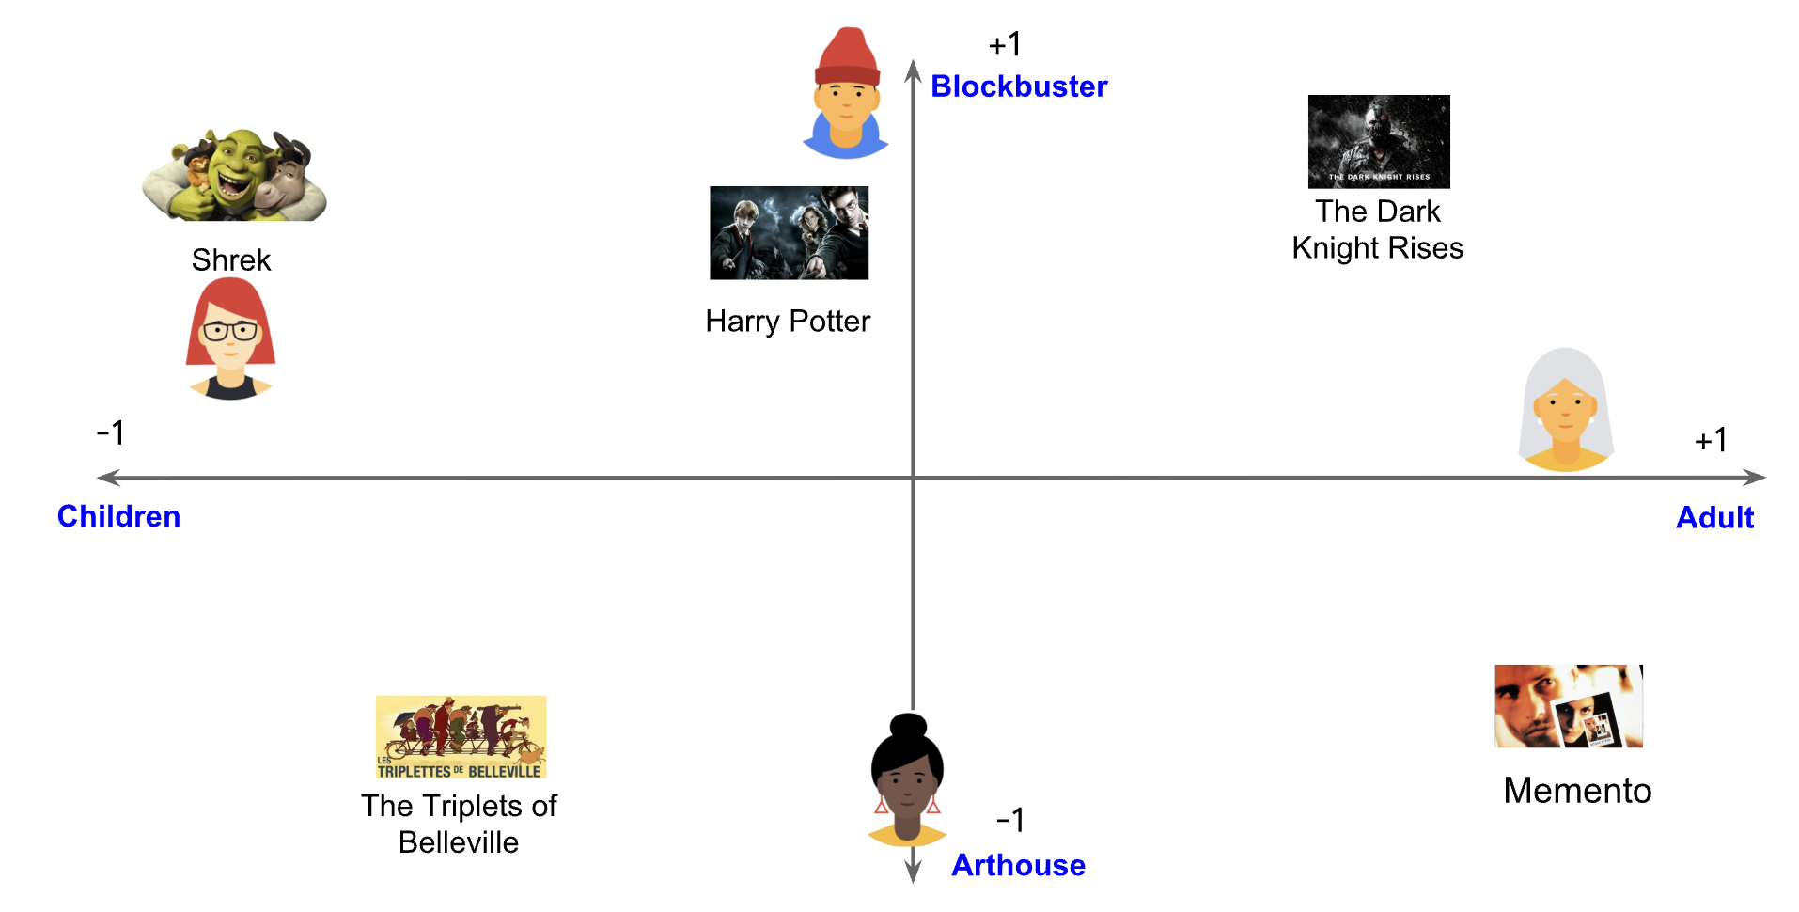
Why Math for ML (10-606)? Recommendation systems

Slide 16
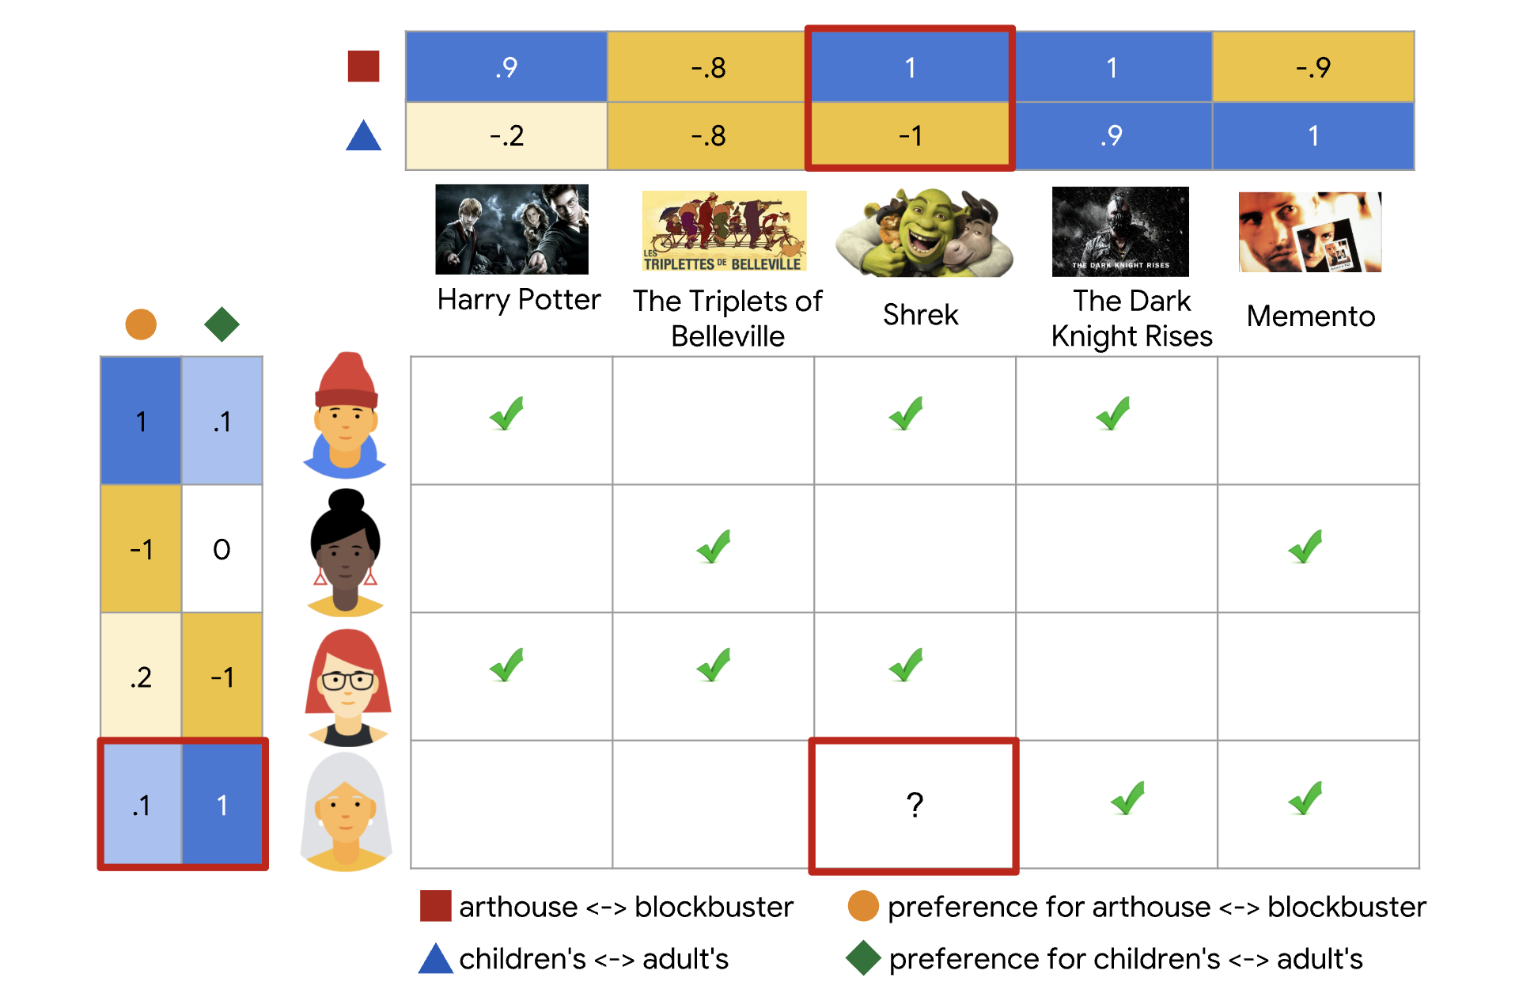
Why Math for ML (10-606)? Recommendation systems

Slide 17
Why Math for ML (10-606)? Recommendation systems

Slide 18
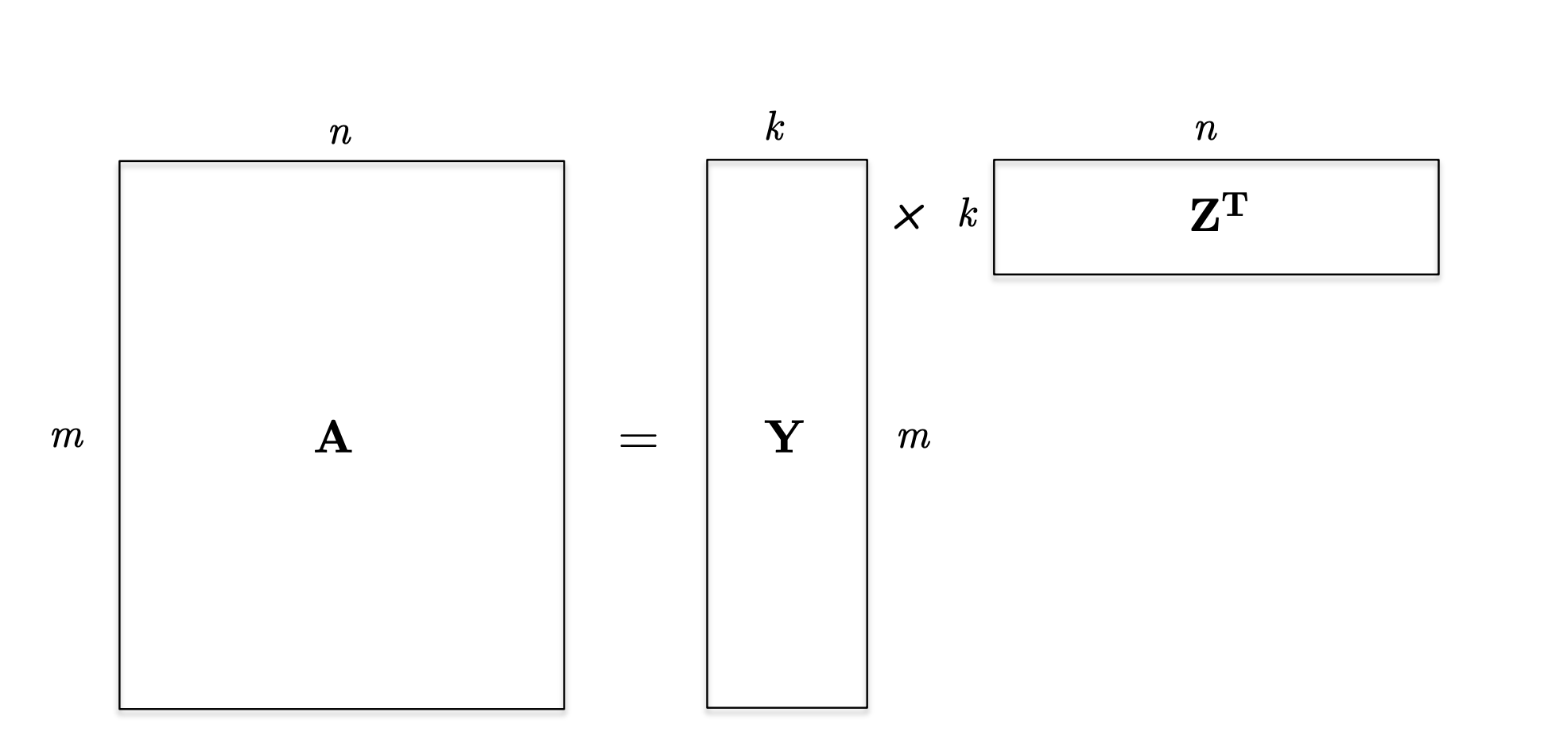
Low-rank matrices
A rank $k$ matrix is the sum of $k$ rank-one matrices, or equivalently the product of a $m×k$ matrix and a $k×n$ matrix!

Slide 19

Low-rank matrices
Let $O$ be the set of entries $(i,j)$ in $A$ that are observed
Goal:
$$\min_{Y, Z}{\sum_{i,j∈O}{{\left(A_{ij} −Y_{i}Z_{j}^{T}\right)}^{2}}}$$

Slide 20
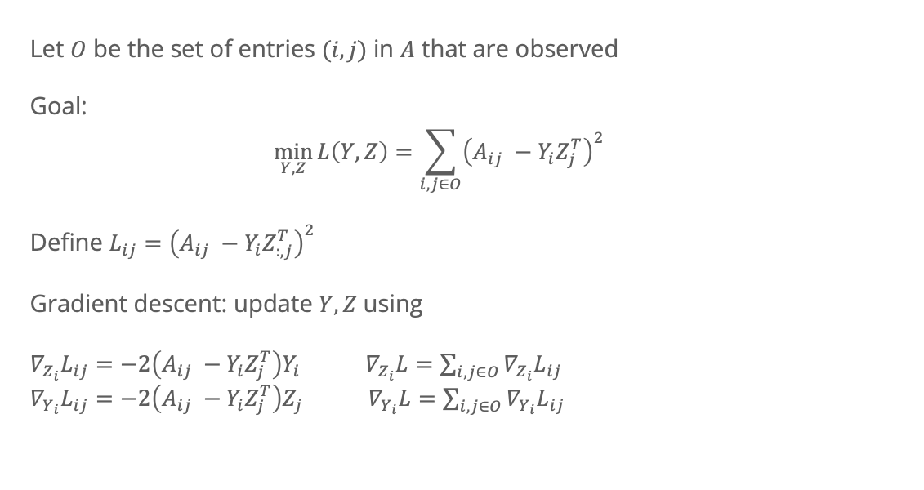
Low-rank matrices
Let $O$ be the set of entries $(i,j)$ in $A$ that are observed
Goal:
$$\min_{Y, Z}{L\left(Y, Z\right)=\sum_{i,j∈O}{{\left(A_{ij} −Y_{i}Z_{j}^{T}\right)}^{2}}}$$
Define $L_{ij}={\left(A_{ij} −Y_{i}Z_{:, j}^{T}\right)}^{2}$
Gradient descent: update $Y, Z$ using
$∇_{Z_{i}}L_{ij}=−2\left(A_{ij} −Y_{i}Z_{j}^{T}\right)Y_{i}$ ${ ∇}_{Z_{i}}L=\sum_{i,j∈O}{∇_{Z_{i}}L_{ij}}$
$∇_{Y_{i}}L_{ij}=−2\left(A_{ij} −Y_{i}Z_{j}^{T}\right)Z_{j}$ ${ ∇}_{Y_{i}}L=\sum_{i,j∈O}{∇_{Y_{i}}L_{ij}}$

Slide 21
Taylor expansion
Very common use of (matrix) derivatives
Approximate a function by a low-order polynomial (linear, quadratic)

Slide 22
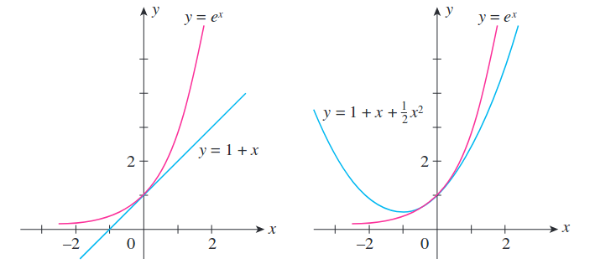

Refresher: scalar function Taylor expansion
$$f\left(x\right):R→R$$
Taylor series expansion around a point $a$:
$$f\left(x\right)= f\left(a\right)+f^{′}\left(a\right)\left(x−a\right)+\frac{1}{2}f^{′′}\left(a\right){\left(x −a\right)}^{2}+\frac{1}{6}f^{′′′}\left(a\right){\left(x −a\right)}^{3}…$$
$$=\sum_{n=0}^{∞}{\frac{1}{n!}f^{\left(n\right)}\left(a\right){\left(x −a\right)}^{n}}$$

Slide 23

Refresher: scalar function Taylor expansion
For well-behaved functions, Taylor series converges to $f\left(x\right)$
Given the right smoothness properties, can prove that $f$ is well-approximated locally by the Taylor series

Slide 24

Multivariate Taylor expansion
Let $f:R^{n}→R$
Taylor expansion to first order:
$$f\left(a\right)+∇f{\left(a\right)}^{T}\left(x −a\right)$$
To second order:
$$f\left(a\right)+∇f{\left(a\right)}^{T}\left(x −a\right)+\frac{1}{2}{\left(x−a\right)}^{T} H(a) (x−a)$$
where $H(a)$ is the Hessian of $f$ evaluated at $a$

Slide 25

Multivariable Taylor expansion
$$f\left(a\right)+∇f{\left(a\right)}^{T}\left(x −a\right)+\frac{1}{2}{\left(x−a\right)}^{T} H\left(a\right)\left(x−a\right)=$$
$$f\left(a\right)+\sum_{i=1}^{n}{{\left(x −a\right)}_{i}∇f{\left(a\right)}_{i}}+\frac{1}{2}\sum_{i=1}^{n}{\sum_{j=1}^{n}{{{H(a)}_{ij}\left(x −a\right)}_{i} {\left(x −a\right)}_{j}}}$$

Slide 26
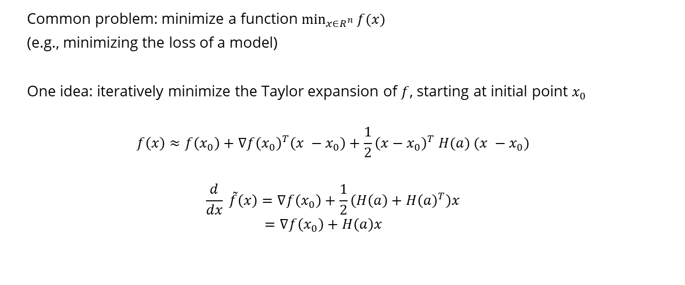
Example application: Newton’s method
Common problem: minimize a function $\min_{x∈R^{n}}{f(x)}$
(e.g., minimizing the loss of a model)
One idea: iteratively minimize the Taylor expansion of $f$, starting at initial point $x_{0}$
$$f\left(x\right)≈f\left(x_{0}\right)+∇f{\left(x_{0}\right)}^{T}\left(x −x_{0}\right)+\frac{1}{2}{\left(x−x_{0}\right)}^{T} H(a) (x −x_{0})$$
$$\frac{d}{dx} \tilde{f}\left(x\right)=∇f\left(x_{0}\right)+\frac{1}{2}\left(H\left(a\right)+H{\left(a\right)}^{T}\right)x$$
$$=∇f\left(x_{0}\right)+H\left(a\right)x$$

Slide 27
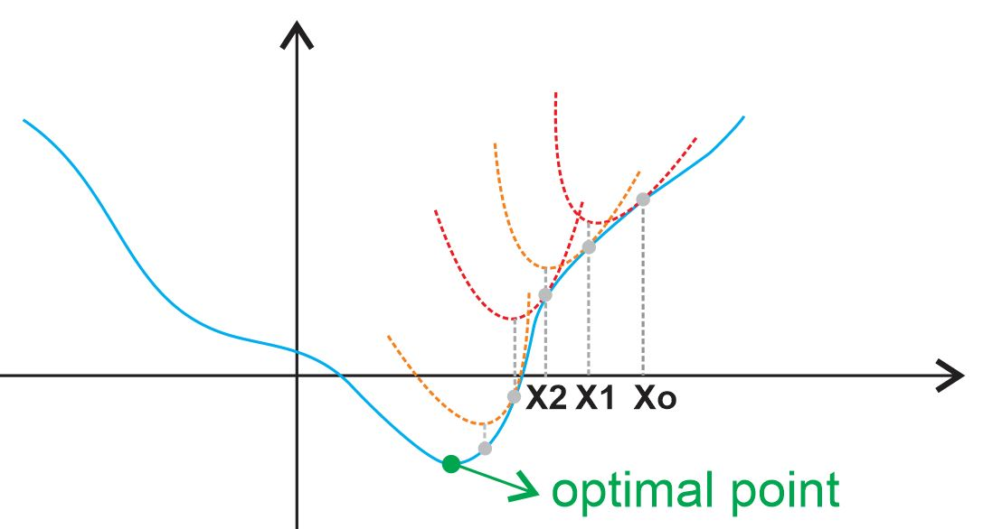
Newton’s method
https://ardianumam.files.wordpress.com/2017/09/newtonmethodforoptim1.jpg

Slide 28

Newton’s method
One idea: iteratively minimize the Taylor expansion of $f$, starting at initial point $x_{0}$
$$f\left(x\right)≈f\left(x_{0}\right)+∇f{\left(x_{0}\right)}^{T}\left(x −x_{0}\right)+\frac{1}{2}{\left(x−x_{0}\right)}^{T} H(x_{0}) (x −x_{0})$$
$$\frac{d}{d(x −x_{0})} \tilde{f}\left(x\right)=∇f\left(x_{0}\right)+\frac{1}{2}\left(H\left(x_{0}\right)+H{\left(x_{0}\right)}^{T}\right)(x −x_{0})$$
$$=∇f\left(x_{0}\right)+H\left(x_{0}\right)(x −x_{0})$$
Set $\frac{d}{dx} \tilde{f}\left(x\right)=0$ → $x−x_{0}=−H{\left(a\right)}^{−1}∇f\left(x_{0}\right)$
$$x=x_{0}−H{\left(a\right)}^{−1}∇f\left(x_{0}\right)$$

