Slide 1
Mathematical Foundations for ML (10-606):
Singular values and low-rank matrices
Bryan Wilder

Slide 2
Announcements
Quiz 1: grades released on Canvas, graded quizzes available for pickup
Mean grade: approx. 84%. Median: approx. 82%
Quiz 2 in one week (next Wed). Covers material through today/HW 4. Not comprehensive (i.e., only material from HW 3-4)

Slide 3
Today
Singular value decomposition
Low-rank decompositions
Application to matrix factorization

Slide 4

Starting point: the eigendecomposition
Suppose that $A$ has $n$ linearly independent eigenvectors
Earlier: interpreted $Ax$ as writing $x$ in coordinate system given by eigenvectors and then scaling

Slide 5
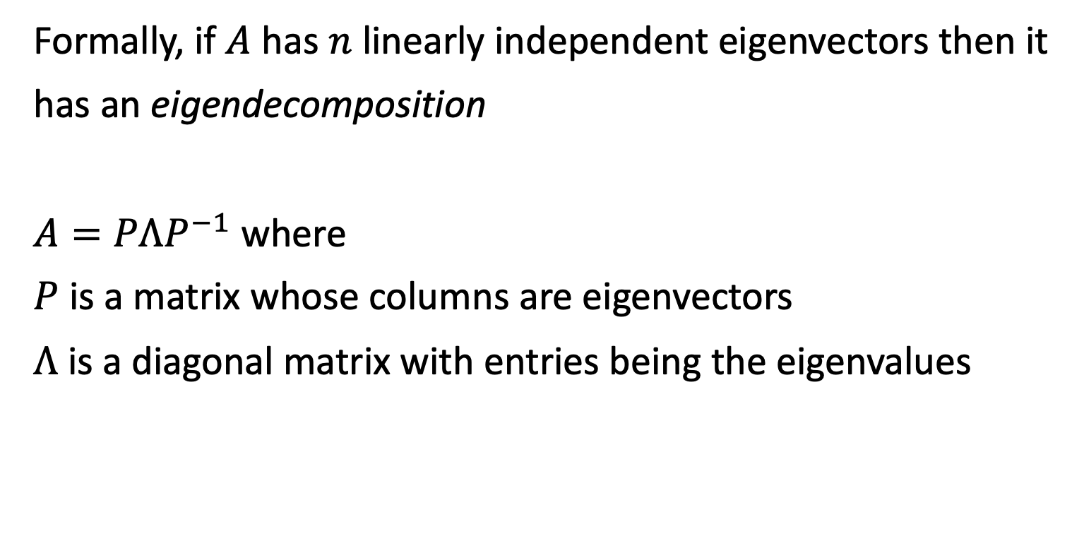
Starting point: the eigendecomposition
Formally, if $A$ has $n$ linearly independent eigenvectors then it has an eigendecomposition
$A=PΛP^{−1}$ where
$P$ is a matrix whose columns are eigenvectors
$Λ$ is a diagonal matrix with entries being the eigenvalues

Slide 6

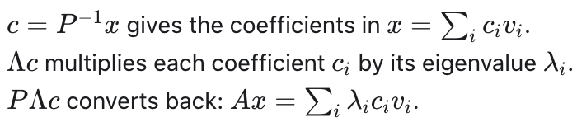

Starting point: the eigendecomposition
$A=PΛP^{−1}$ where
$P$ is a matrix whose columns are eigenvectors
$Λ$ is a diagonal matrix with entries being the eigenvalues
Now, let’s do $Ax=PΛP^{−1}x$

Slide 7
Singular Value Decomposition
So far, we have talked about a lot of concepts that are only defined for square matrices, like inverses, eigenvectors, and eigenvalues. Eigendecompositions only apply for an even more special subset.
Do these concepts have generalizations for non-square matrices?
Yes!

Slide 8
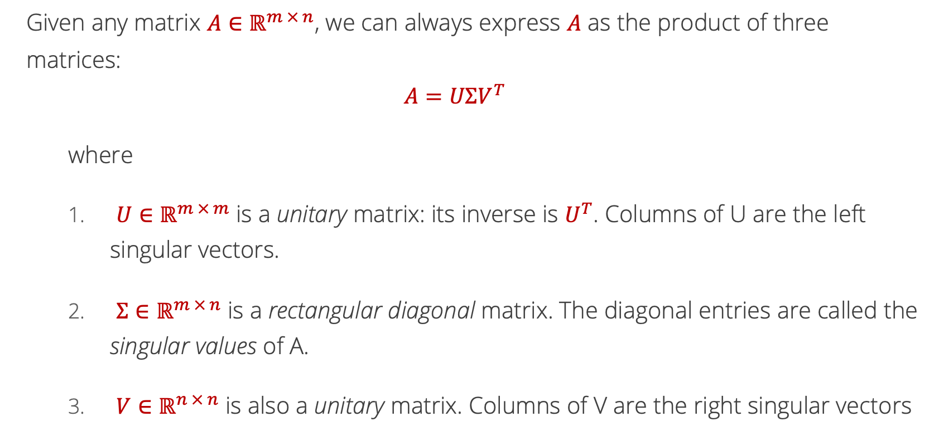
Singular Value Decomposition
Given any matrix $A∈ℝ^{m × n}$, we can always express $A$ as the product of three matrices:
$$A=UΣV^{T}$$
  where
  $U∈ℝ^{m × m}$ is a unitary matrix: its inverse is $U^{T}$. Columns of U are the left singular vectors.
  ${Σ∈ℝ}^{m × n}$ is a rectangular diagonal matrix. The diagonal entries are called the singular values of A.
  $V∈ℝ^{n × n}$ is also a unitary matrix. Columns of V are the right singular vectors

Slide 9
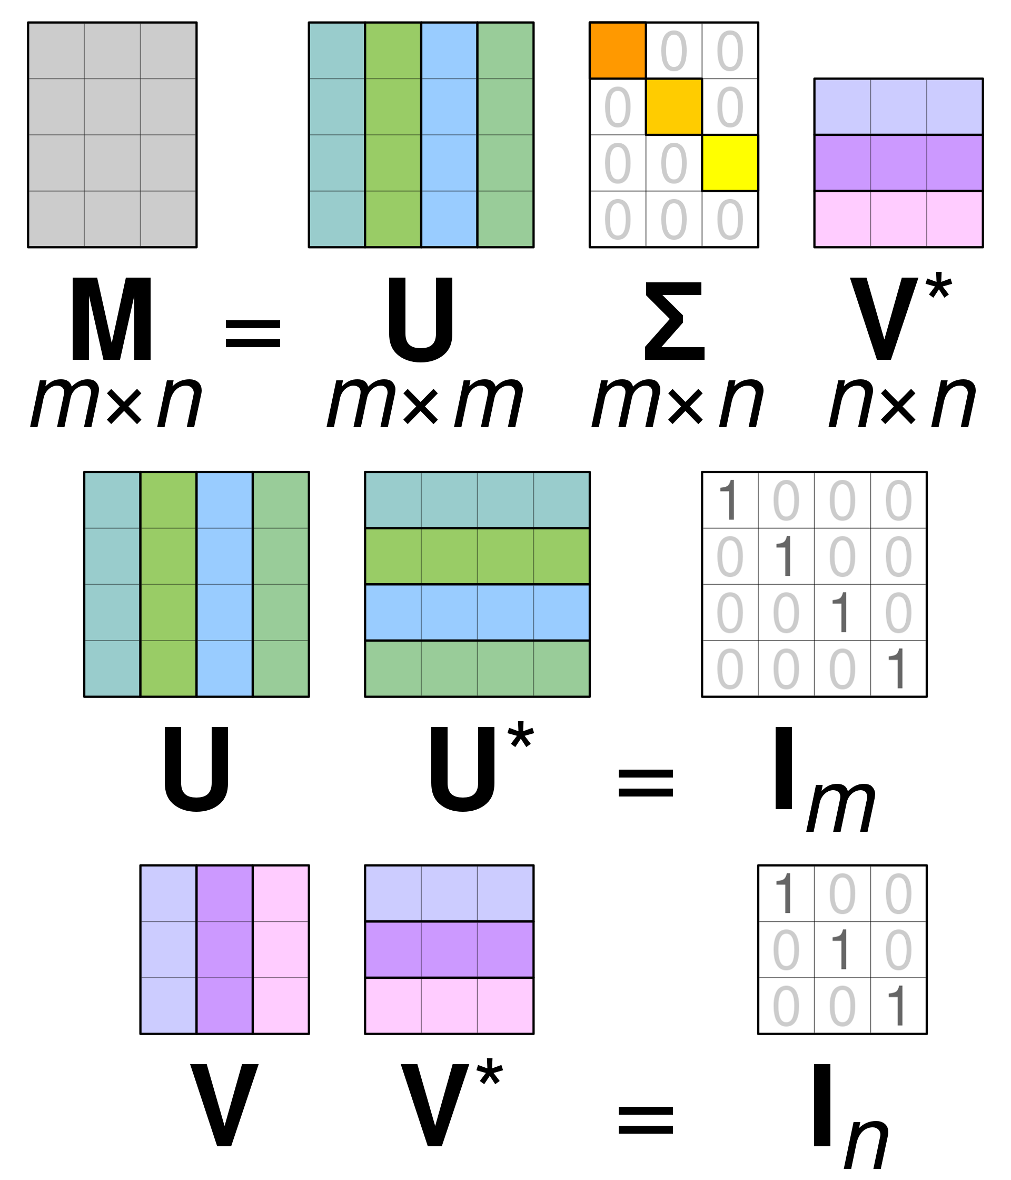
Singular Value Decomposition Pictorially
T
A
T
T
Source: https://en.wikipedia.org/wiki/Singular_value_decomposition#/media/File:Singular_value_decomposition_visualisation.svg

Slide 10
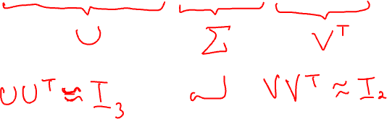
Singular Value Decomposition Example
$$A=\left[\begin{matrix}3 & 1 \\ −1 & 0 \\ 2 & −2\end{matrix}\right]≈\left[\begin{matrix}−0.765 & −0.598 & −0.241 \\ −0.265 & −0.049 & −0.963 \\ −0.588 & −0.800 & −0.120\end{matrix}\right]\left[\begin{matrix}3.756 & 0 \\ 0 & 2.211 \\ 0 & 0\end{matrix}\right]\left[\begin{matrix}−0.994 & 0.109 \\ −0.109 & 0.994\end{matrix}\right]$$

Slide 11
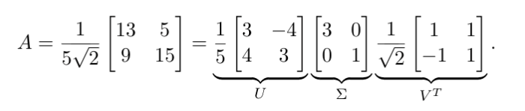
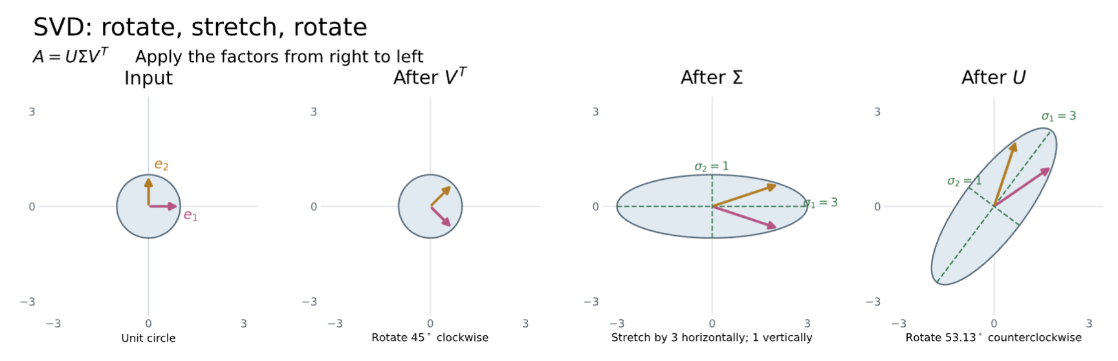

Slide 12

Singular Value Decomposition Interpretation
If $A=UΣV^{T}$, then
  $$AA^{T}=$$
  $$A^{T}A=$$
The columns of $U$ are the eigenvectors of $AA^{T}$
The columns of $V$ are the eigenvectors of $A^{T}A$
The non-zero elements of $Σ$ are the square roots of the non-zero eigenvalues of $AA^{T}$ and $A^{T}A$

Slide 13
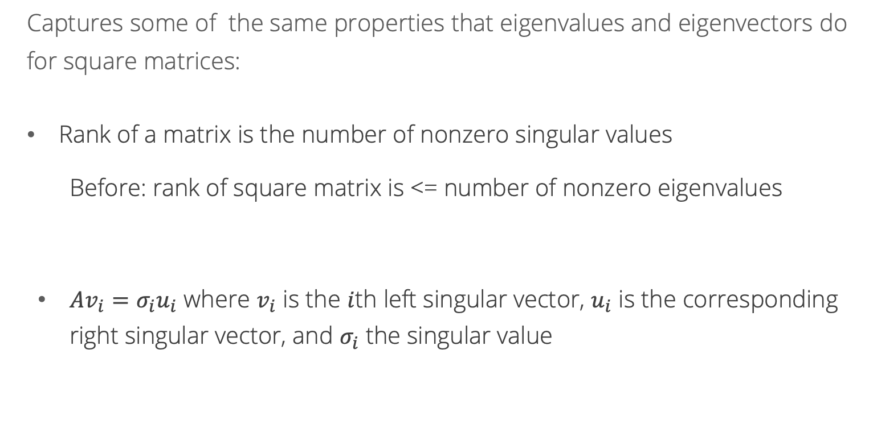
Singular Value Decomposition Interpretation
Captures some of the same properties that eigenvalues and eigenvectors do for square matrices:
Rank of a matrix is the number of nonzero singular values
  Before: rank of square matrix is <= number of nonzero eigenvalues
$Av_{i}=σ_{i}u_{i}$ where $v_{i}$ is the $i$th left singular vector, $u_{i}$ is the corresponding right singular vector, and $σ_{i}$ the singular value

Slide 14
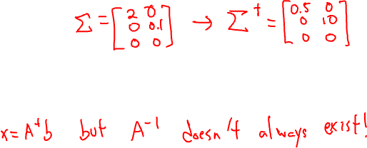
Singular Value Decomposition Uses
If $A=UΣV^{T}$, then the pseudoinverse of a $A$ is
  $$A^{†}=VΣ^{†}U^{T}$$
  where $Σ^{†}$ is created by replacing every non-zero entry in $Σ$ with its reciprocal, e.g.,
  $${Σ= \left[\begin{matrix}2 & 0 \\ 0 & 0.1\end{matrix}\right]→Σ}^{†}=\left[\begin{matrix}0.5 & 0 \\ 0 & 10\end{matrix}\right]$$
The pseudoinverse of a matrix can be used to solve problems of the form $Ax=b$ when $A$ is singular i.e., when the inverse of $A$ does not exist!

Slide 15
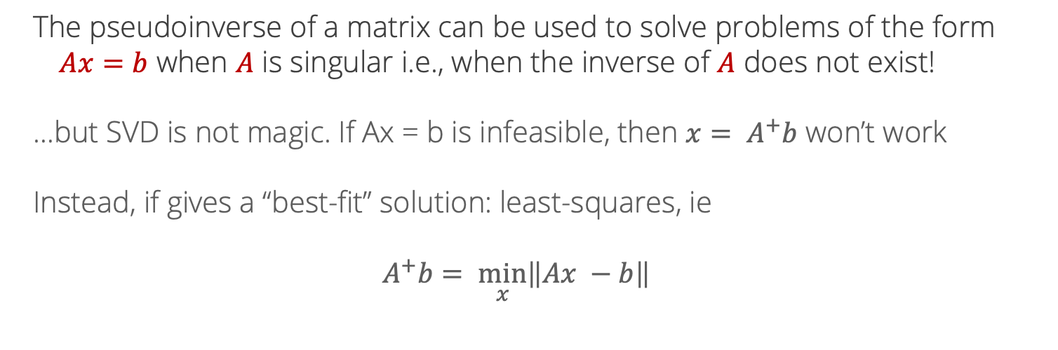
Pseudo-inverse
The pseudoinverse of a matrix can be used to solve problems of the form $Ax=b$ when $A$ is singular i.e., when the inverse of $A$ does not exist!
…but SVD is not magic. If Ax = b is infeasible, then ${x= A}^{+}b$ won’t work
Instead, if gives a “best-fit” solution: least-squares, ie
$$A^{+}b= \min_{x}\left\|Ax −b\right\|$$

Slide 16
Low-rank matrices
So far, focused on nice properties of full-rank matrices:
Inverses
Unique solutions of linear systems
But a lot of the time in machine learning, we hope that matrices aren’t full rank!
Recall: recommendation systems

Slide 17
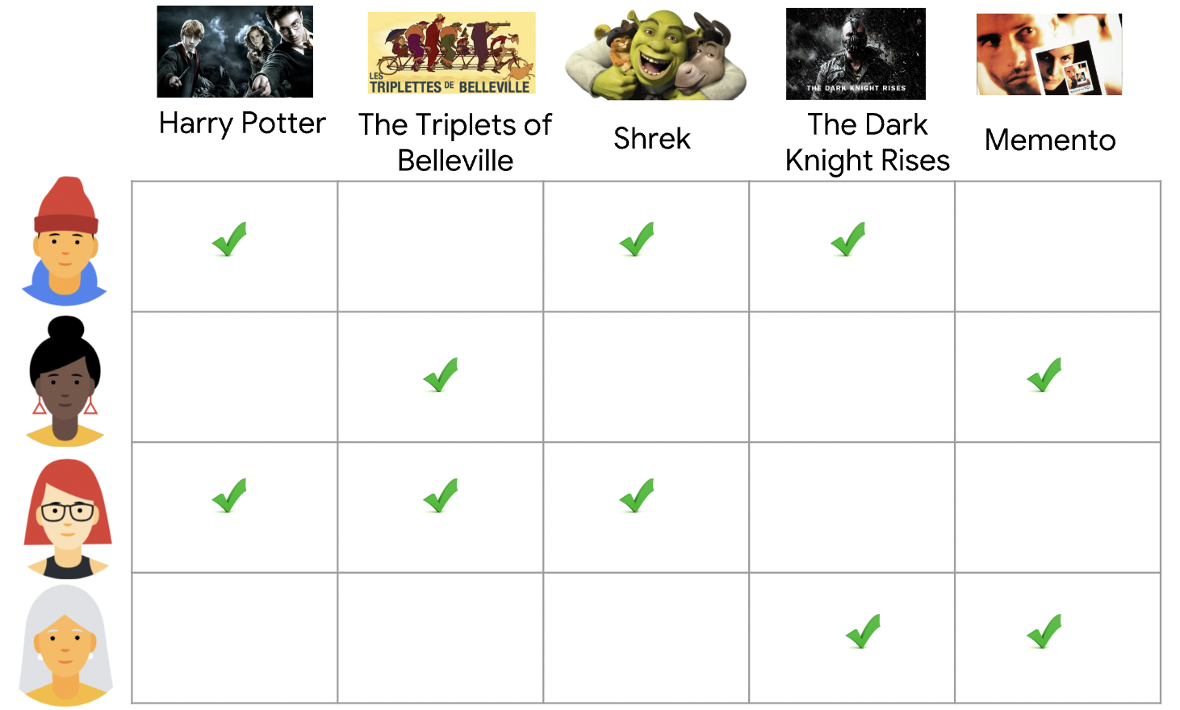
Why Math for ML (10-606)? Recommendation systems
https://developers.google.com/machine-learning/recommendation/collaborative/basics

Slide 18
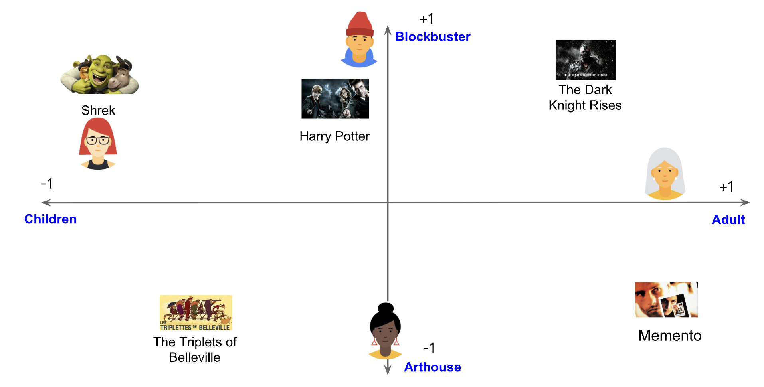
Why Math for ML (10-606)? Recommendation systems

Slide 19
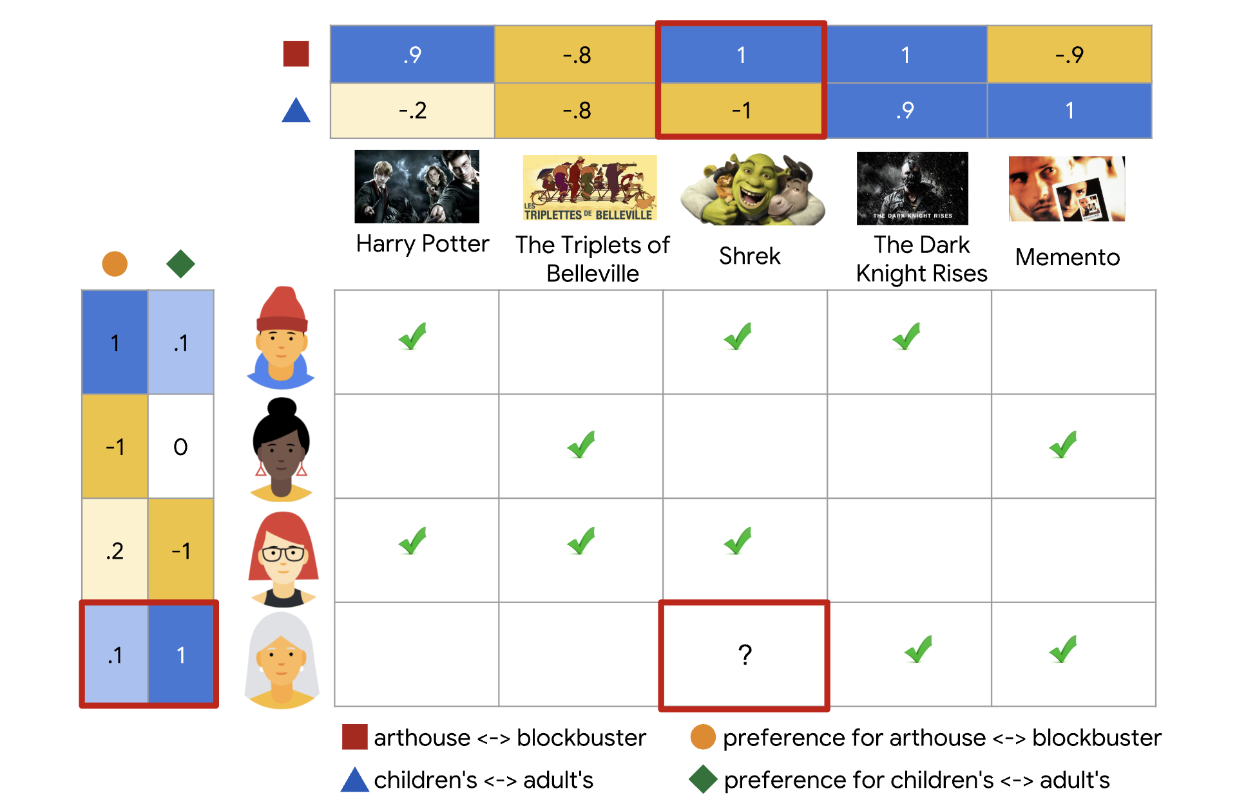
Why Math for ML (10-606)? Recommendation systems
Today: show that
(1) This structure corresponds to a low-rank ratings matrix.
(2) The singular value decomposition can be used to find the best low-rank approximation of a matrix.
1+2 = recommendation systems

Slide 20
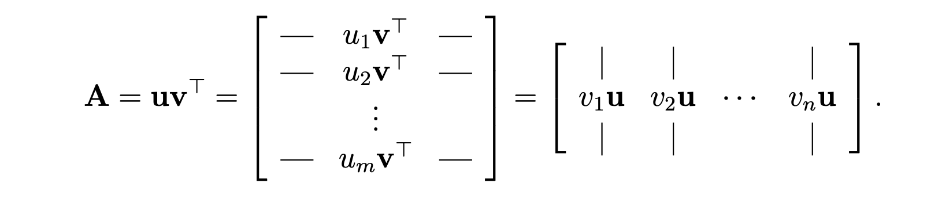
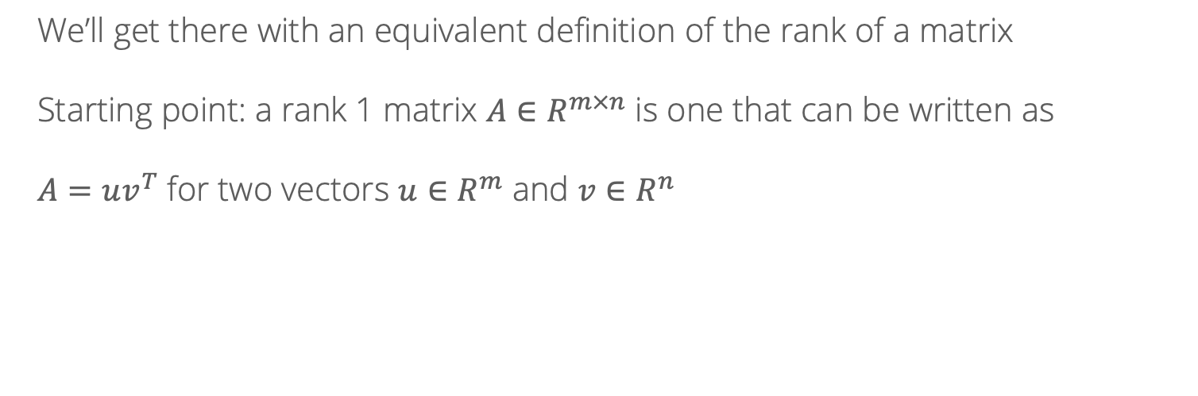
Low-rank matrices
We’ll get there with an equivalent definition of the rank of a matrix
Starting point: a rank 1 matrix $A∈R^{m×n}$ is one that can be written as
$A=uv^{T}$ for two vectors $u∈R^{m}$ and $v∈R^{n}$
Image: https://web.stanford.edu/class/cs168/l/l9.pdf

Slide 21
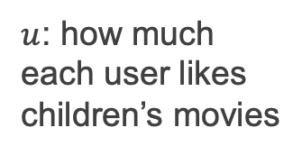
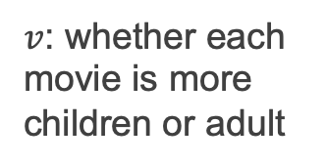
Low-rank matrices
$u$: how much each user likes children’s movies
$v$: whether each movie is more children or adult
$A_{ij}=$ rating of user $i$ for movie $j$ = $u_{i}v_{j}$

Slide 22
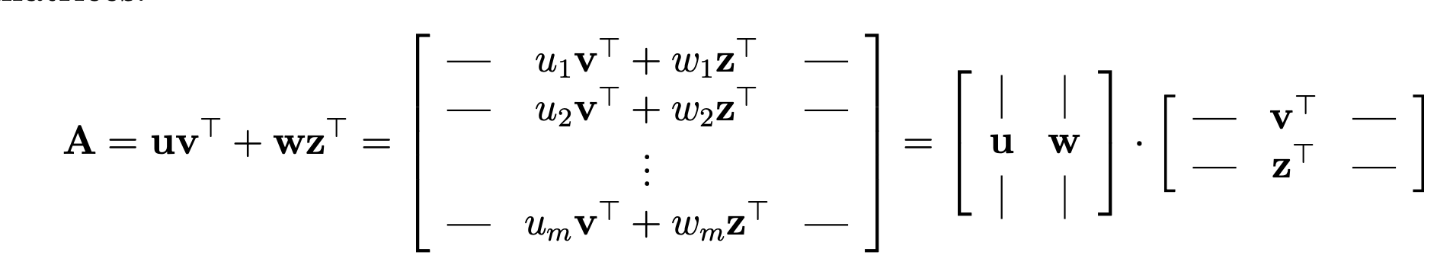
Low-rank matrices
A rank 2 matrix is just the sum of two rank-1 matrices
Children vs adult
Adult vs blockbuster
User characteristics
Item characteristics

Slide 23
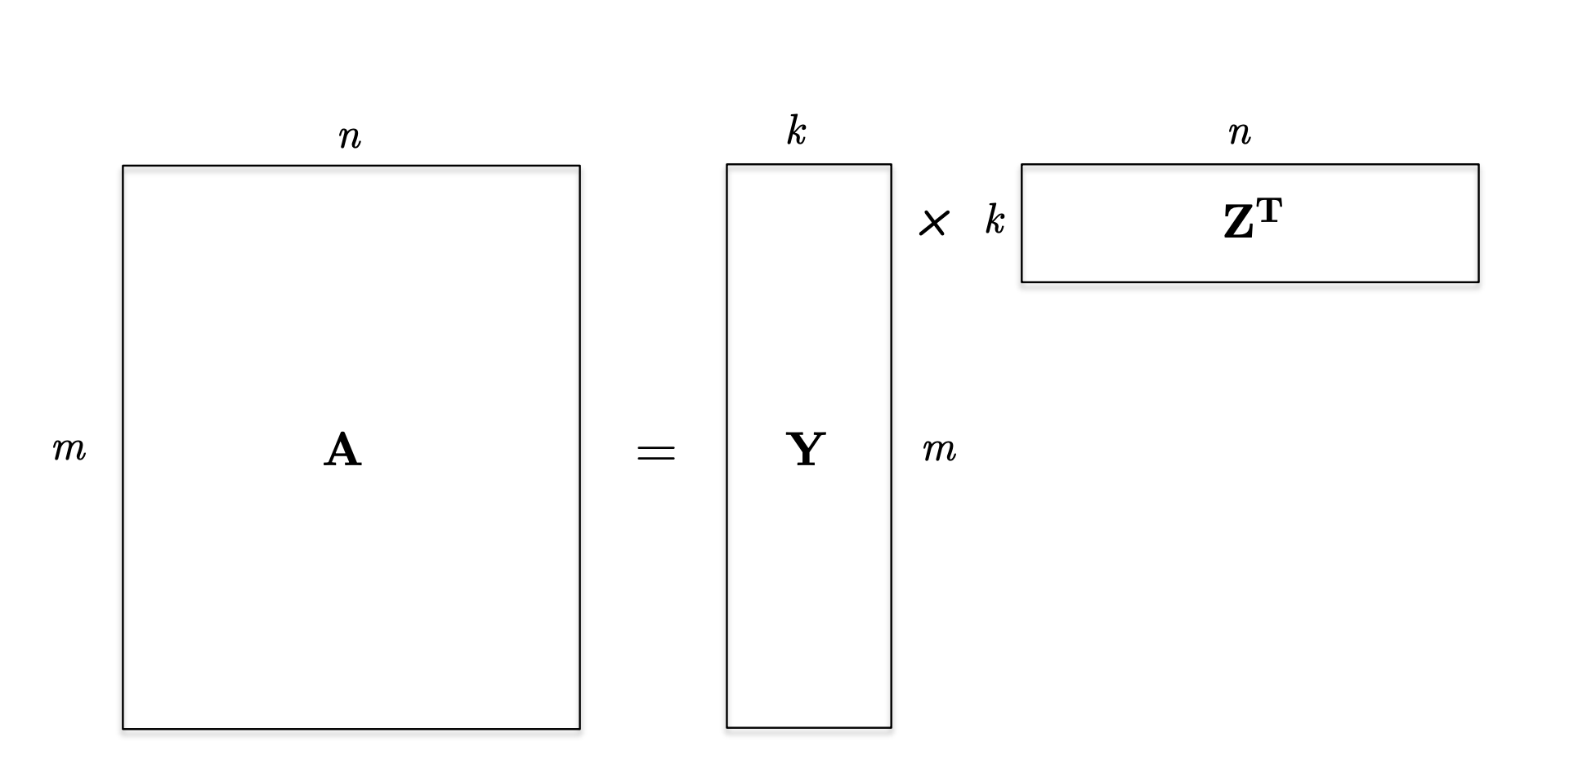
Low-rank matrices
A rank $k$ matrix is the sum of $k$ rank-one matrices, or equivalently the product of a $m×k$ matrix and a $k×n$ matrix!

Slide 24
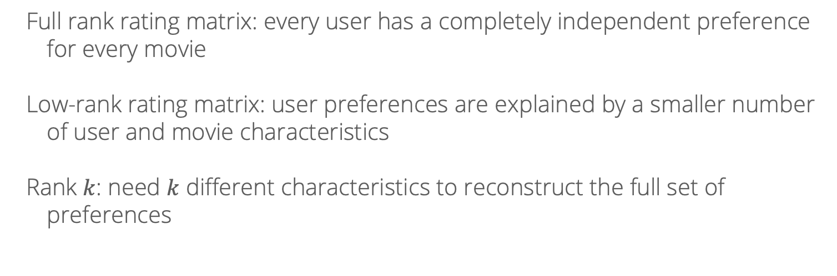
Low-rank matrices
Full rank rating matrix: every user has a completely independent preference for every movie
Low-rank rating matrix: user preferences are explained by a smaller number of user and movie characteristics
Rank $k$: need $k$ different characteristics to reconstruct the full set of preferences

Slide 25
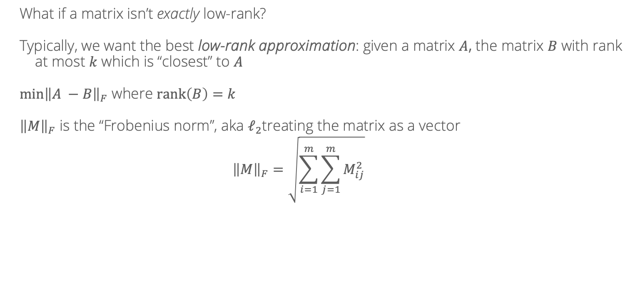
Low-rank matrices
What if a matrix isn’t exactly low-rank?
Typically, we want the best low-rank approximation: given a matrix $A$, the matrix $B$ with rank at most $k$ which is “closest” to $A$
$\min{{\left\|A −B\right\|}_{F}}$ where $rank\left(B\right)=k$
${\left\|M\right\|}_{F}$ is the “Frobenius norm”, aka $ℓ_{2}$treating the matrix as a vector
$${\left\|M\right\|}_{F}=\sqrt{\sum_{i=1}^{m}{\sum_{j=1}^{m}{M_{ij}^{2}}}}$$

Slide 26
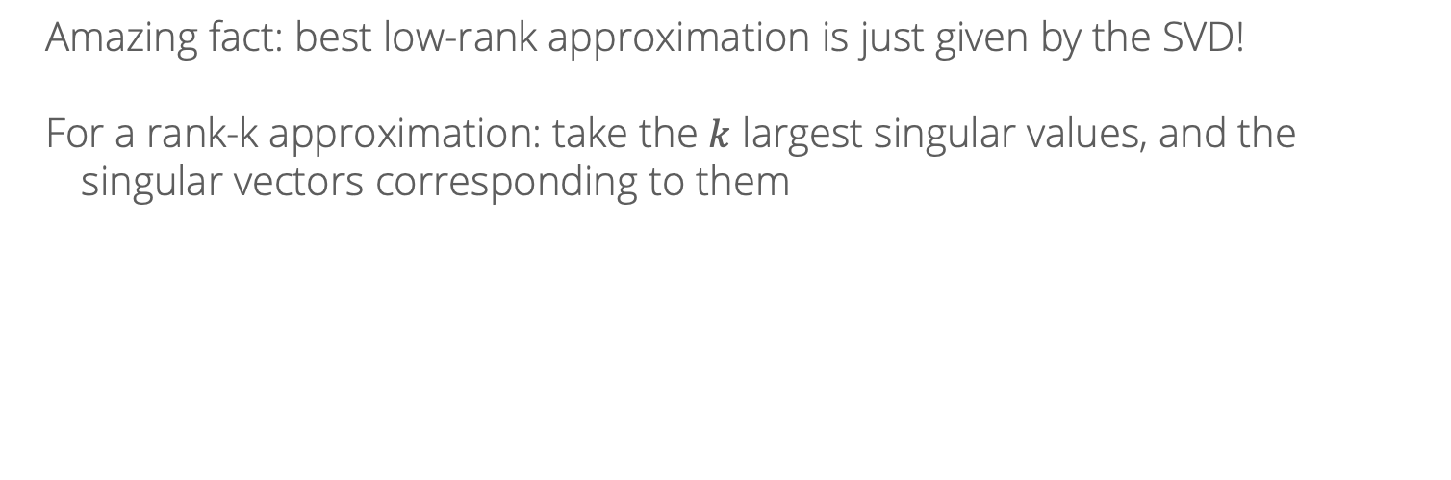
Low-rank matrices
Amazing fact: best low-rank approximation is just given by the SVD!
For a rank-k approximation: take the $k$ largest singular values, and the singular vectors corresponding to them

Slide 27
Singular Value Decomposition Pictorially
A
Source: https://en.wikipedia.org/wiki/Singular_value_decomposition#/media/File:Singular_value_decomposition_visualisation.svg

Slide 28
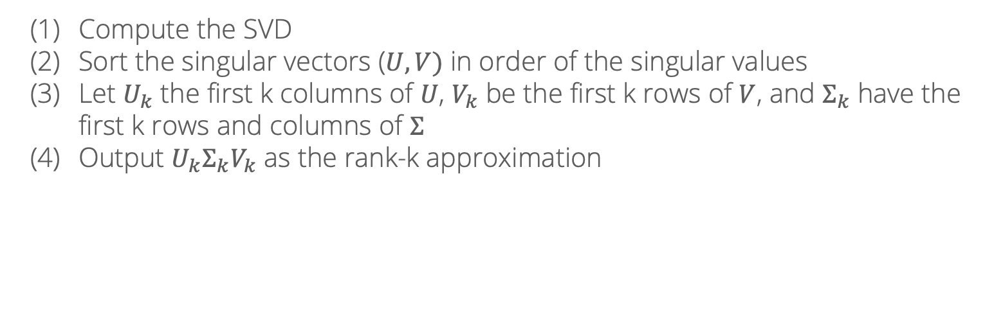
SVD algorithm for matrix completion
Compute the SVD
Sort the singular vectors ($U, V)$ in order of the singular values
Let $U_{k}$ the first k columns of $U$, $V_{k}$ be the first k rows of $V$, and $Σ_{k}$ have the first k rows and columns of $Σ$
Output $U_{k}Σ_{k}V_{k}$ as the rank-k approximation

Slide 29

SVD algorithm for matrix completion
A bit of history: many of these ideas were developed/popularized in a competition Netflix ran, promising a $1 million prize to the team that improved their recommender system by at least 10%
The top solutions all used SVD/matrix factorization (plus other tricks), and similar ideas are widely used today
In another couple weeks: introduce the algorithms to run these methods at Netflix scale!

Slide 30
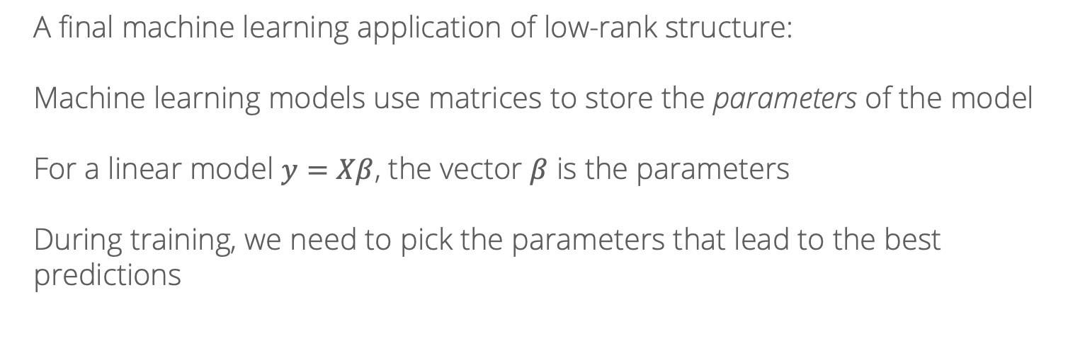
Low-rank updates
A final machine learning application of low-rank structure:
Machine learning models use matrices to store the parameters of the model
For a linear model $y=Xβ$, the vector $β$ is the parameters
During training, we need to pick the parameters that lead to the best predictions

Slide 31
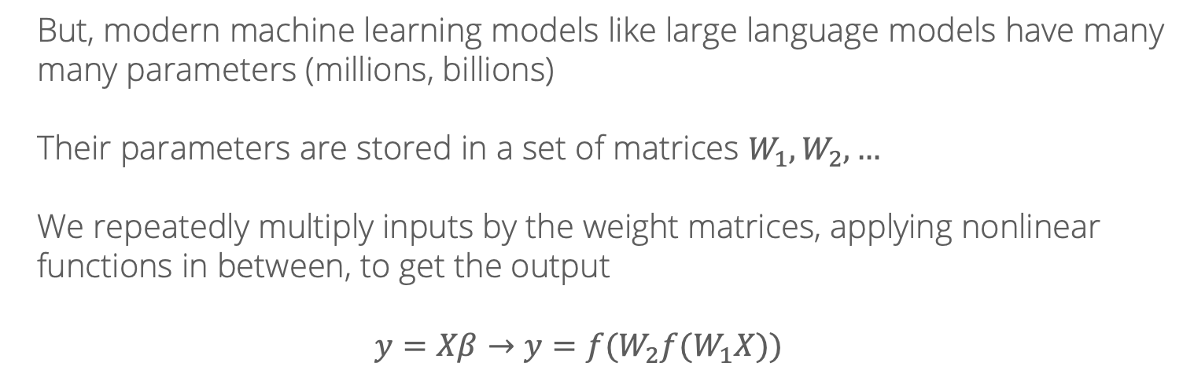
Low-rank updates
But, modern machine learning models like large language models have many many parameters (millions, billions)
Their parameters are stored in a set of matrices $W_{1}, W_{2},…$
We repeatedly multiply inputs by the weight matrices, applying nonlinear functions in between, to get the output
$$y=Xβ→y={f(W}_{2}f(W_{1}X))$$

Slide 32
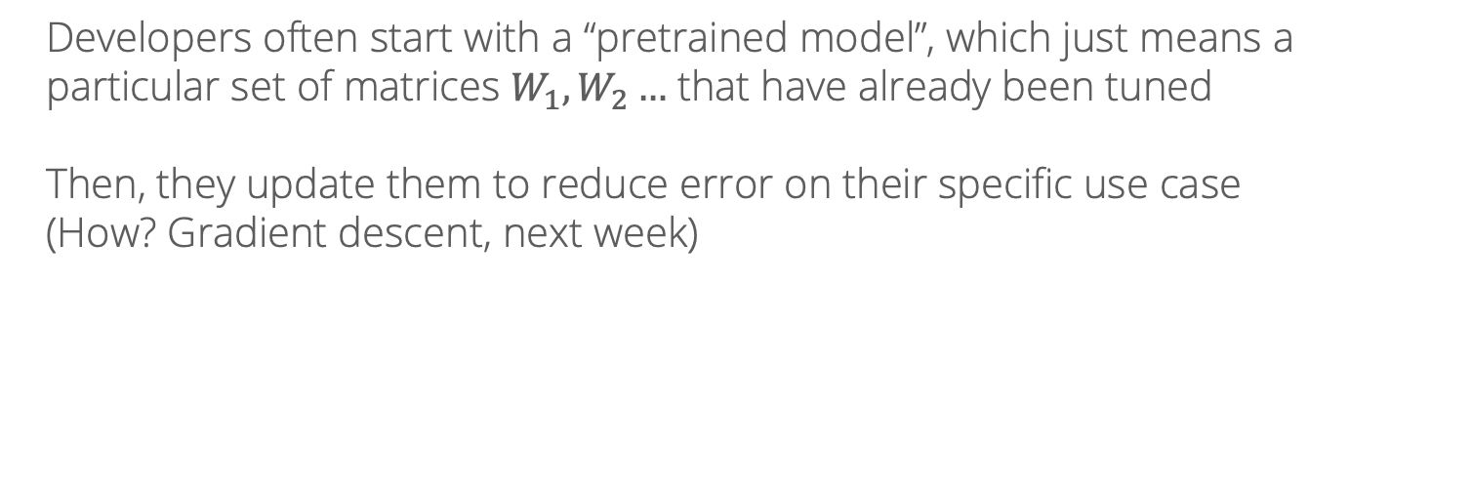
Low-rank updates
Developers often start with a “pretrained model”, which just means a particular set of matrices $W_{1}, W_{2}…$ that have already been tuned
Then, they update them to reduce error on their specific use case
(How? Gradient descent, next week)

Slide 33
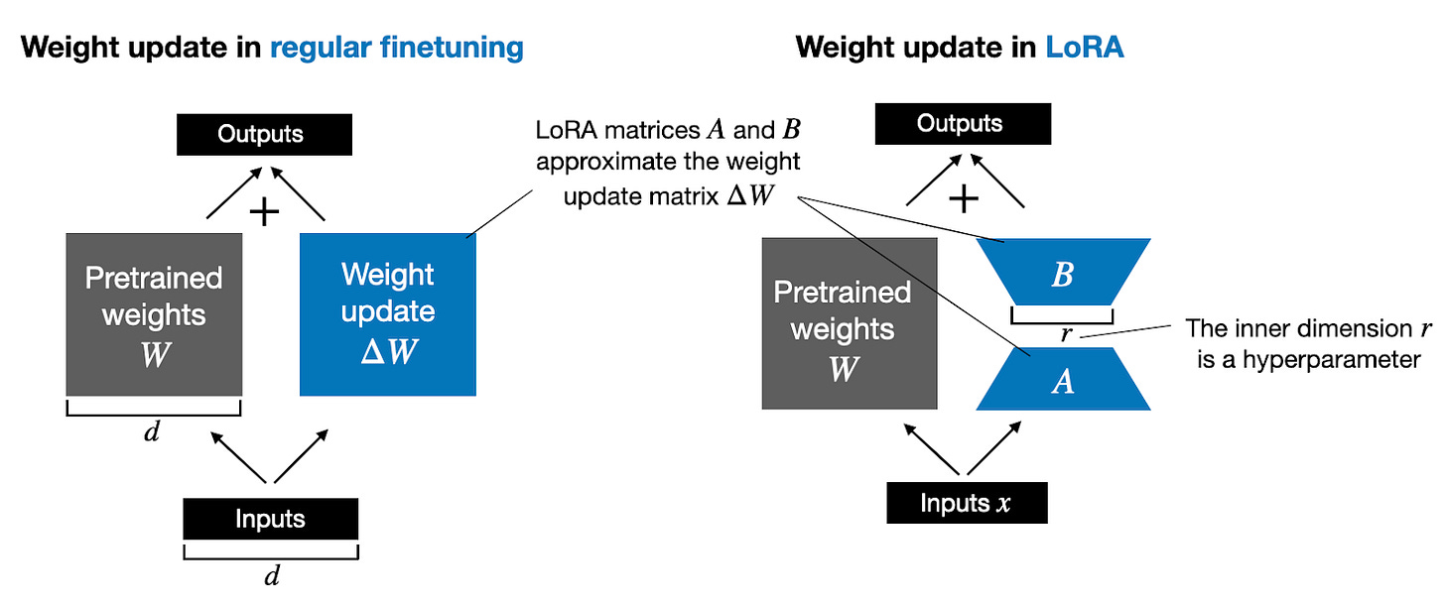
Low-rank updates
But, modifying those billions of parameters directly is super computationally expensive…
What if the updates to the parameters could be approximated as low rank?

Slide 34
Low-rank updates
This idea, called LoRA (Low Rank Adaptation) is now routinely used in finetuning LLMs and other large machine learning models!

