Slide 1
Mathematical Foundations for ML (10-606):
Overview & Preliminaries
Bryan Wilder
bwilder@cmu.edu
* Slides borrowed from prior offerings by Professors M. Gormley, P. Virtue, G. Gordon, & H. Heidari.

Slide 2
Course Overview
Goals:
A formal presentation of mathematics needed to understand Machine Learning
motivated by (carefully chosen) real-world problems that arise in ML applications,
where the broader picture of how those problems arise is treated somewhat informally.
Audience:
students wishing to prepare for future coursework in Machine Learning

Slide 3
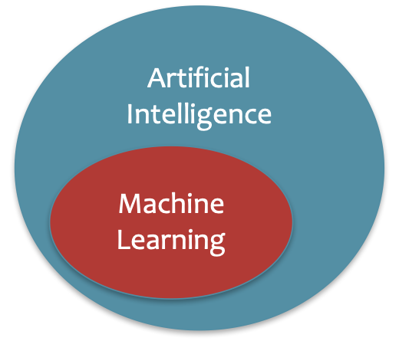
What is Artificial Intelligence?
The basic goal of AI is to develop intelligent machines.
Intelligence is the computational part of the ability to achieve goals in the world.
This consists of many sub-goals:
Perception
Reasoning
Control/Motion/Manipulation
Planning
Communication
Creativity
Learning
…
Notes:
http://www-formal.stanford.edu/jmc/whatisai/whatisai.html

Slide 4
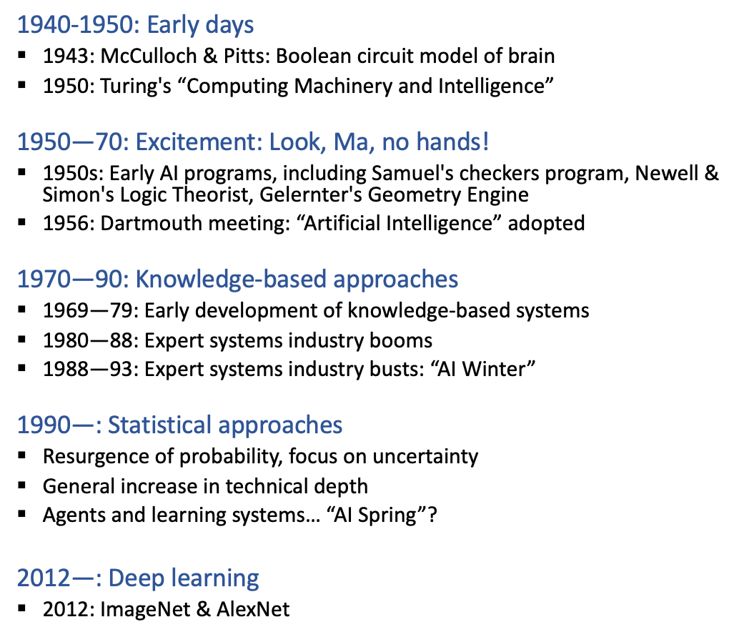
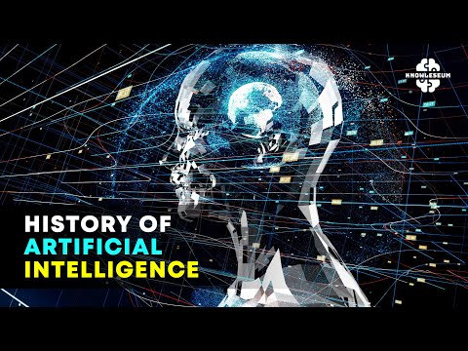
A brief History of AI
Now: LLM-mania

Slide 5
What is Machine Learning?
Machine learning aims to design algorithms that automatically extract valuable information from data by modeling the data-generating process.
Data
Model
Learning

Slide 6
What is Machine Learning?
Machine learning aims to design algorithms that automatically extract valuable information from data by modeling the data-generating process.
Data → Vectors, Matrices
Model → Probability
Learning → Optimization

Slide 7
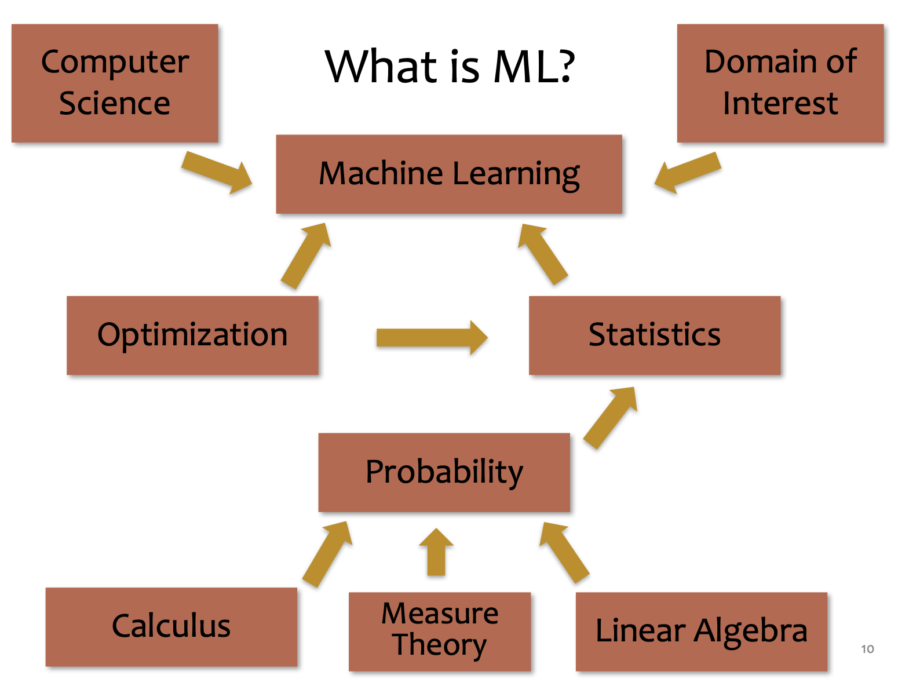
What is Machine Learning?

Slide 8
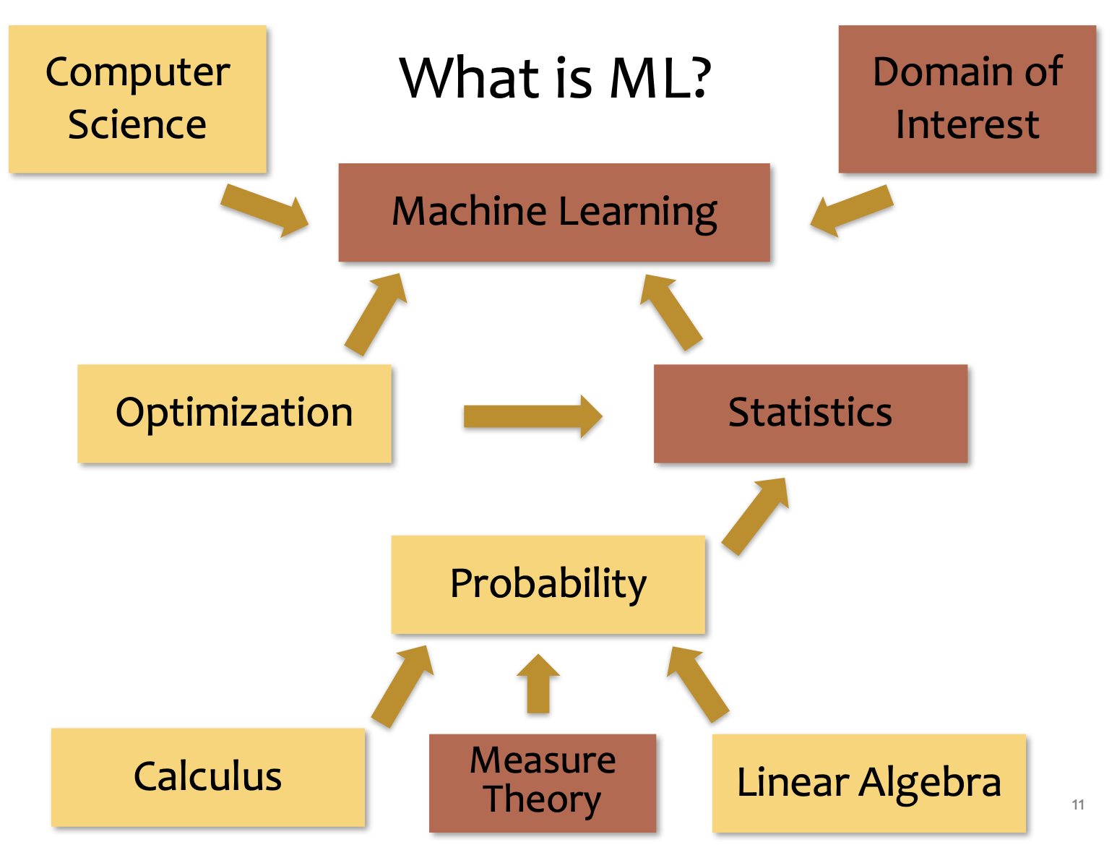
What is Machine Learning?

Slide 9
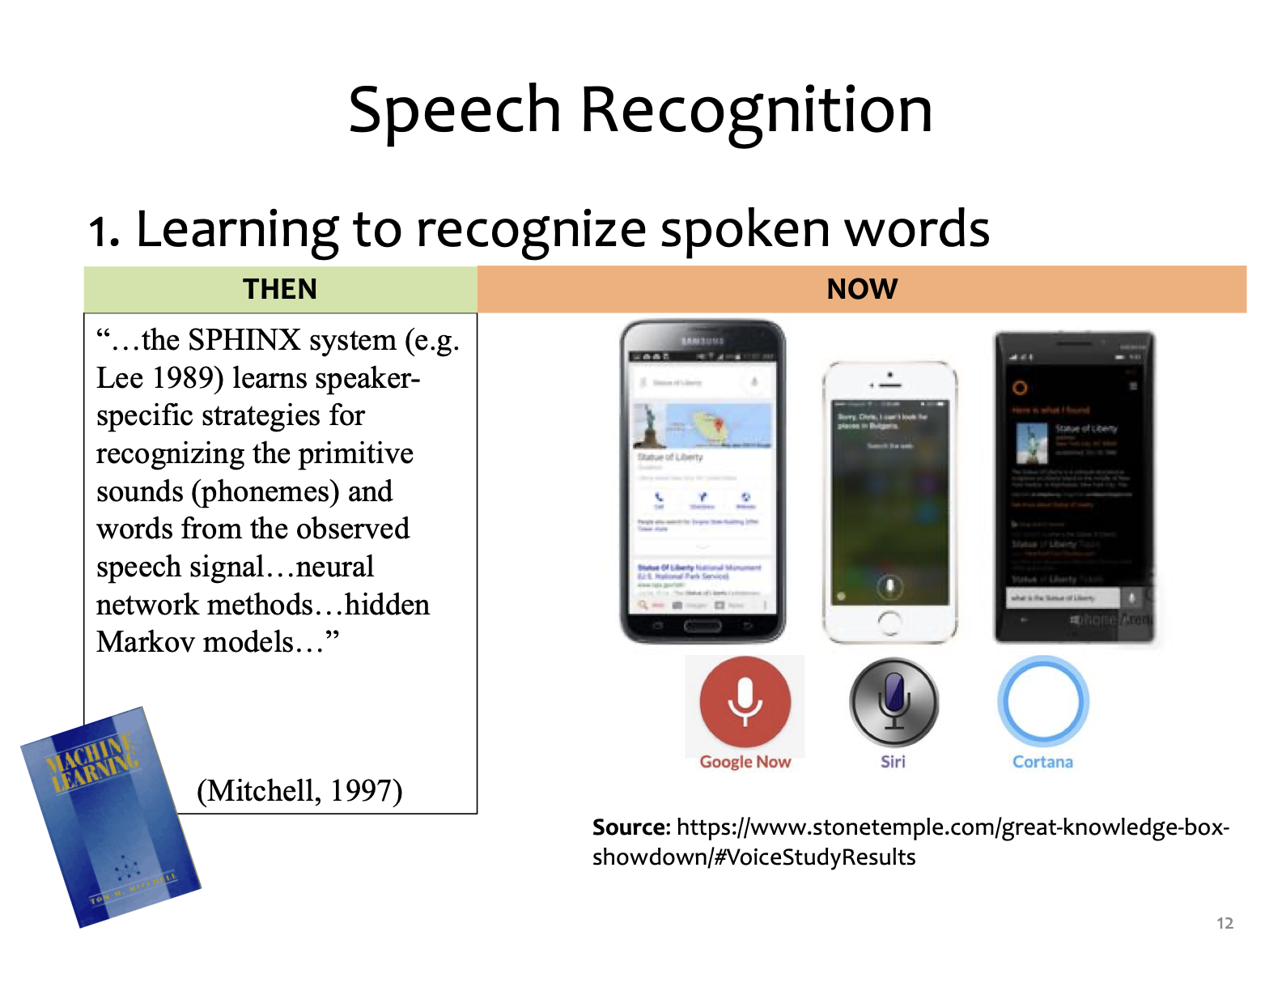
Applications

Slide 10
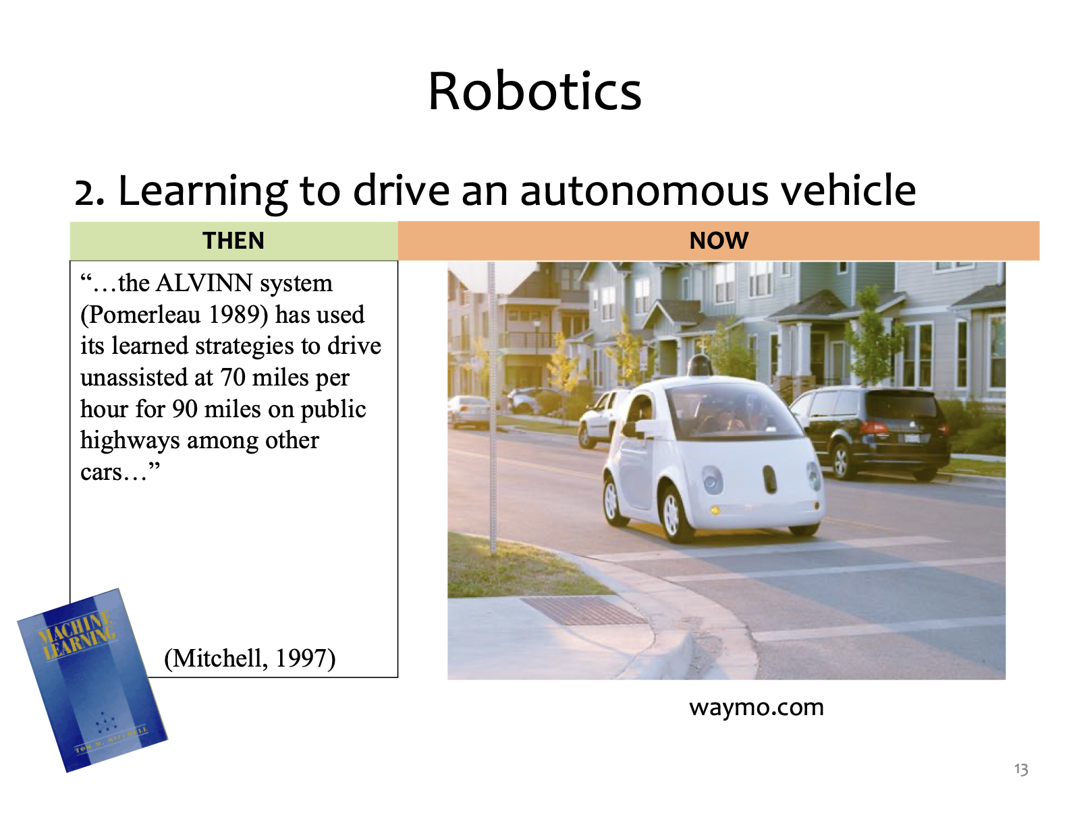
Applications

Slide 11
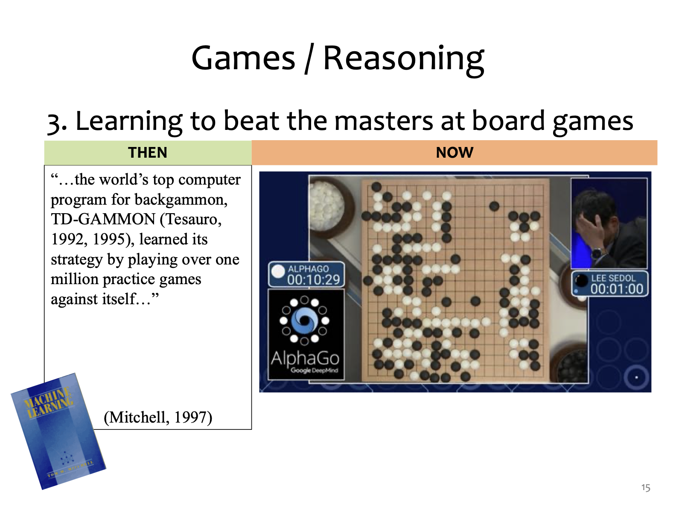
Applications

Slide 12
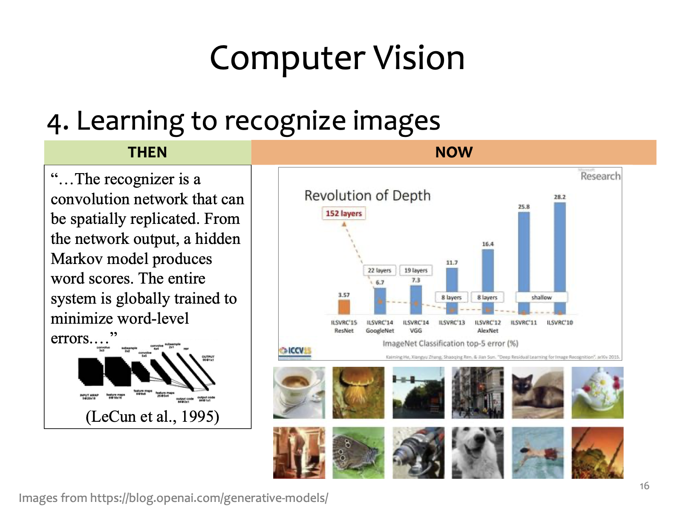
Applications

Slide 13
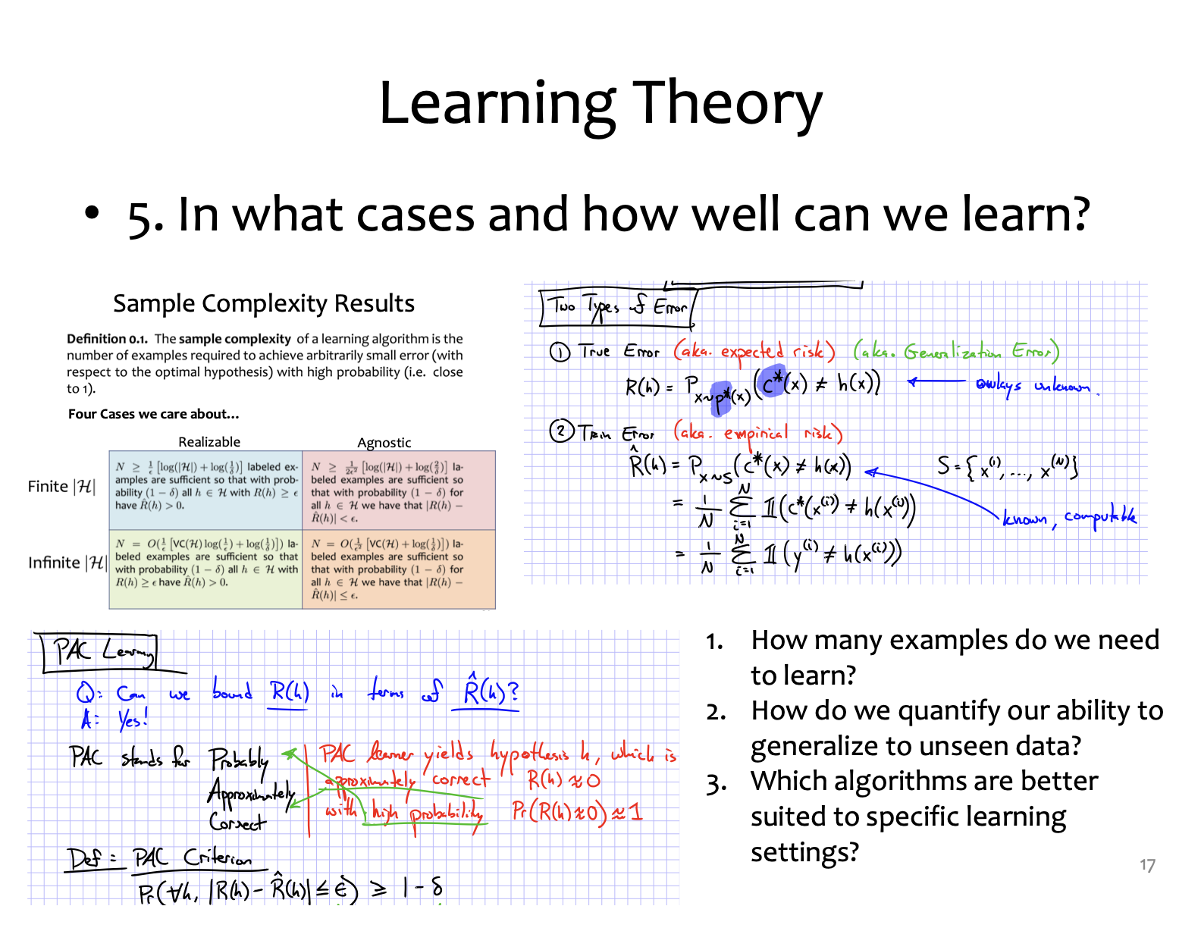
Foundation

Slide 14
Why Math for ML (10-606)?
To understand A, we need B:
A | B
Training a vision model with backpropagation | Multivariate calculus: gradients Probability and statistics: stochastic gradient descent
Recommendation systems | Linear algebra: matrix factorizations Calculus: matrix differentials
Fine-tuning LLMs with LoRA | Linear algebra: rank of a matrix, low-rank updates

Slide 15
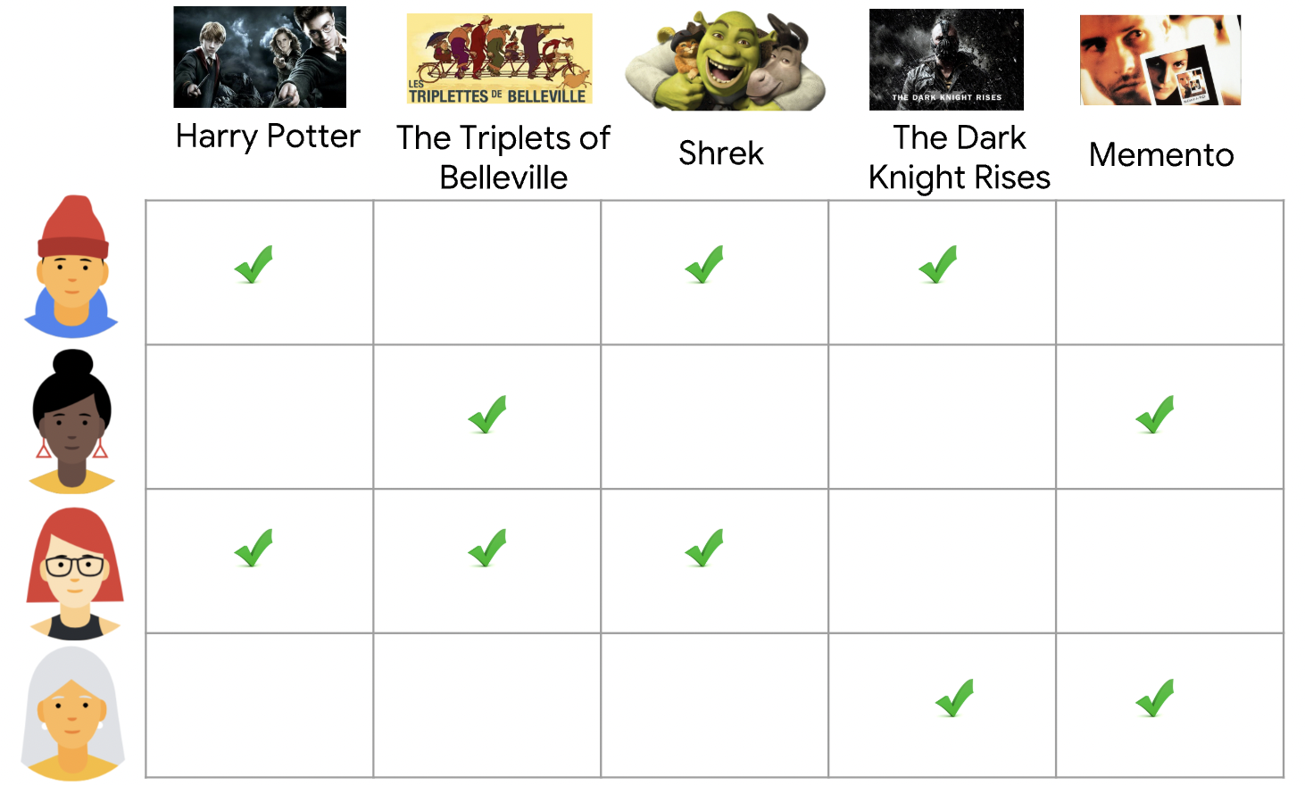
Why Math for ML (10-606)? Recommendation systems
https://developers.google.com/machine-learning/recommendation/collaborative/basics

Slide 16
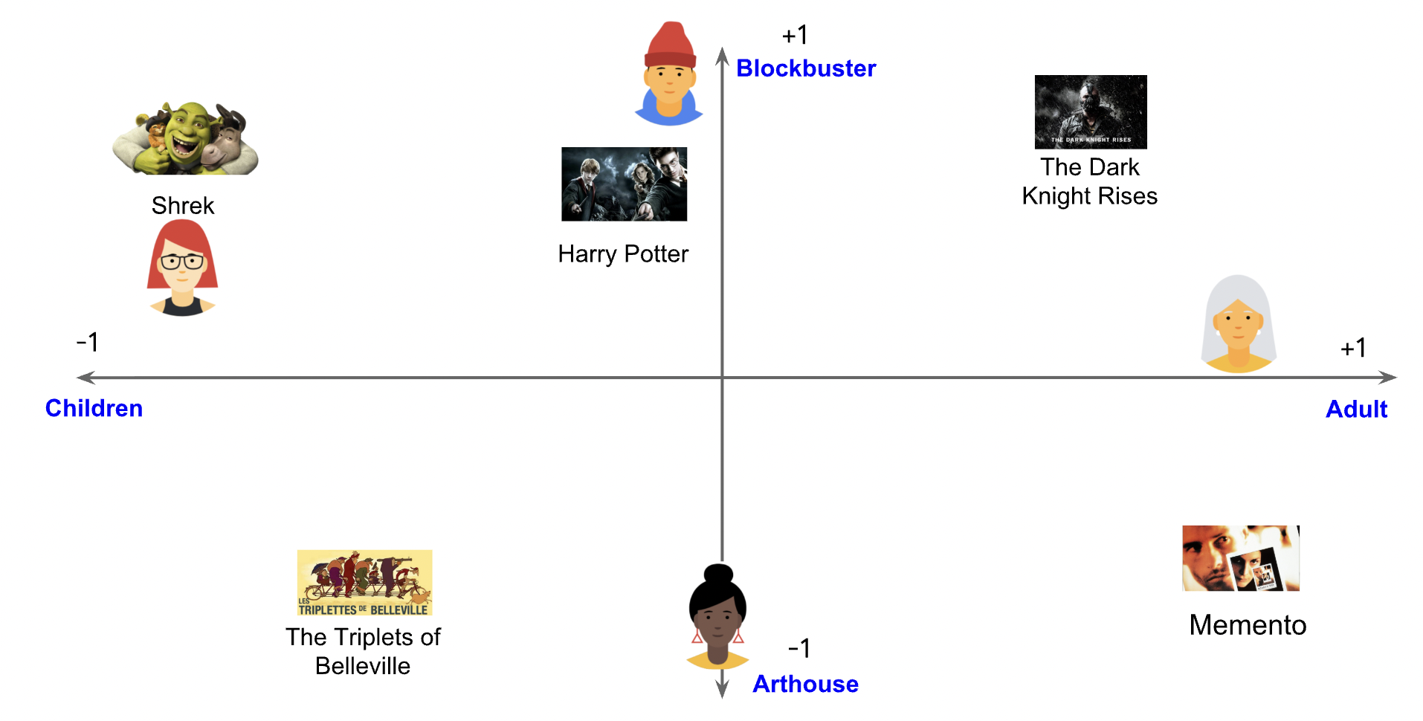
Why Math for ML (10-606)? Recommendation systems

Slide 17
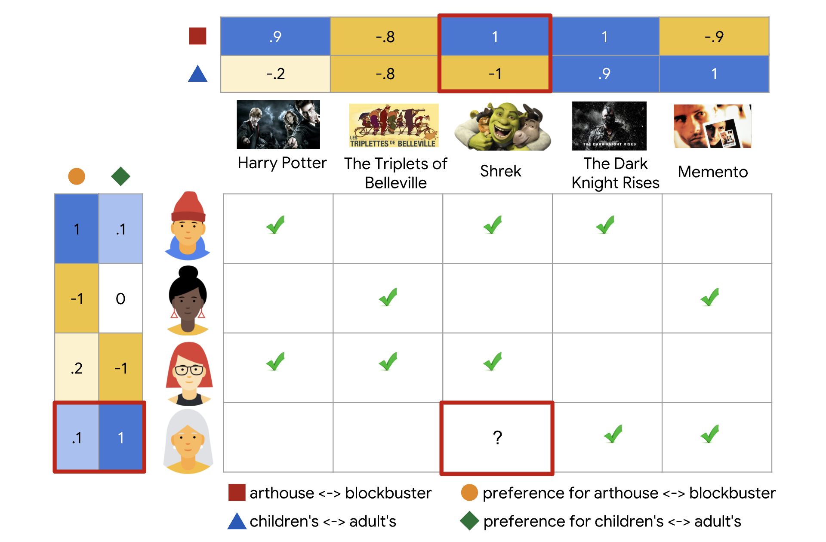
Why Math for ML (10-606)? Recommendation systems

Slide 18
Why Math for ML (10-606)? Recommendation systems
Low rank factorization of the ratings matrix! Backbone of many commercial recsys.
Week 3: learn about the concept of matrix rank
Week 4: return to this example and mathematically describe it!
Week 6: algorithms to compute it!

Slide 19
Why Math for ML (10-606)?
To understand A, we need B:
A | B
Training a vision model with backpropagation | Multivariate calculus: gradients Probability and statistics: stochastic gradient descent
Recommendation systems | Linear algebra: matrix factorizations Calculus: matrix differentials
Fine-tuning LLMs with LoRA | Linear algebra: rank of a matrix, low-rank updates
The core content for this course is the mathematics (Column B), but you will apply what you learn to real problems in machine learning (Column A)

Slide 20
Course website
https://github.com/bwilder0/10606-f2026
(Link also in canvas)
This is where we will maintain the class schedule, post lecture notes, etc. Also has the syllabus and policies.

Slide 21
Grading and policies
50%: Homeworks due each week (gradescope)
First one due Sunday!
50%: 3 in-person quizzes (schedule on course website)

Slide 22
Course structure
Monday/Wednesday: lecture with instructor
Friday: recitation with TA. Cover additional example problems, common mistakes from homework, etc. Starts the second week.
Sunday EOD: homework due
Office hours: google calendar posted on Canvas page
Questions: Piazza. If you have a question, other people probably do too!

Slide 23
Expected Background
This course covers a wide range of topics (linear algebra, matrix calculus, optimization, probability) that are the fundamental building blocks for ML and will be used in later courses
This is a lot of material! Each of these subjects has their own courses at the undergrad level
This course is a refresher and opportunity to fill in the gaps and practice. It is not a good way to learn these topics from scratch.

Slide 24
Expected Background
You should be familiar with some of the following...
Calculus:
can take scalar derivatives
can solve scalar integrals
Linear Algebra:
know basic vector operations
seen matrix multiplication
Probability:
seen the basics: conditioning, Bayes Rule, etc.
Programming:
know some Python OR
have sufficient programming background to pick up the basics of Python

Slide 25
Expected Background
You should be familiar with some of the following...
Calculus:
can take scalar derivatives
can solve scalar integrals
Linear Algebra:
know basic vector operations
seen matrix multiplication
Probability:
seen the basics: conditioning, Bayes Rule, etc.
Programming:
know some Python OR
have sufficient programming background to pick up the basics of Python
If one of these topics is entirely unfamiliar: expect to do a lot of extra work

Slide 26
Preliminaries

Slide 27
Sets
Whiteboard
Set, element of, equality, subset
Example: Sets of sets
Enumeration and set builder notation
Union, intersection, difference, complement
Exercise: Set complement
Tuples and set product
Exercise: Set product
Python list/set comprehensions
Exercise: Set builder notation

