Slide 1
Mathematical Foundations for ML (10-606):
Matrix inverse, regression
Bryan Wilder

Slide 2
Today
Announcement: HW3 deadline extended to wed
Matrix inverses
Linear regression

Slide 3
Inverse Functions and Matrices
ℓ⁻¹ is the inverse function for ℓ iff
ℓ(x) = y ⇔ x = ℓ⁻¹(y).
L⁻¹ is the inverse of matrix L iff
L⁻¹Lu = u and LL⁻¹v = v.

Slide 4
Properties of inverses
Not all matrices have an inverse
Must be square (n x n)
Must be full rank (all columns linearly independent)
If it exists, then $AA^{−1}=I$
Unique solution to linear system $Ax=b$ is $x=A^{−1}b$

Slide 5
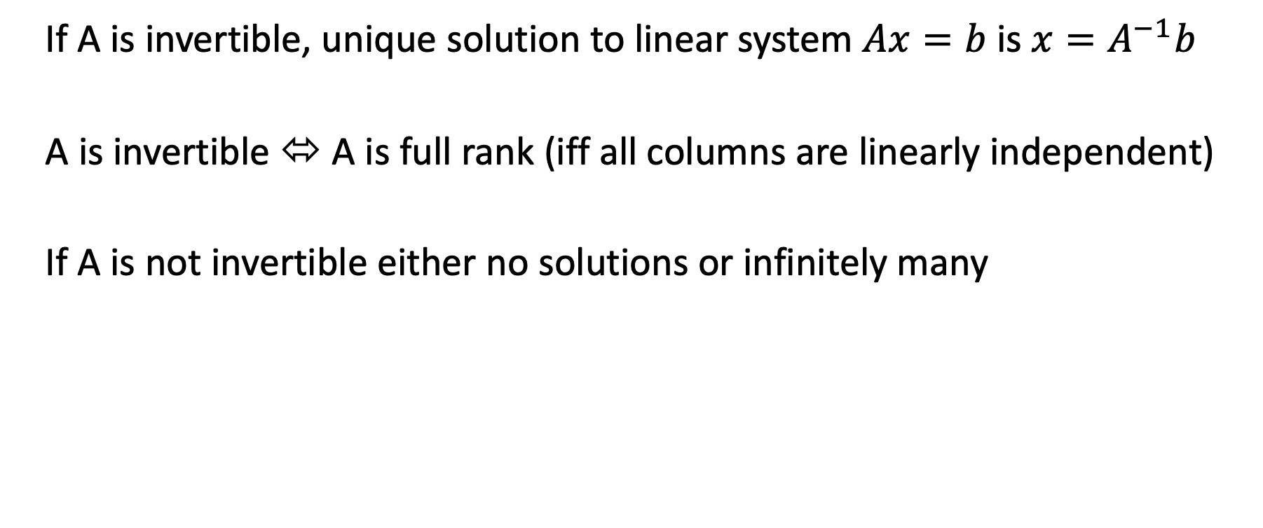
Properties of inverses
If A is invertible, unique solution to linear system $Ax=b$ is $x=A^{−1}b$
A is invertible ⬄ A is full rank (iff all columns are linearly independent)
If A is not invertible either no solutions or infinitely many

Slide 6
Properties of inverses
A is invertible ⬄ none of its eigenvalues are 0
⬄ A is full rank

Slide 7

Analytically solving matrix equations
Inverses give us a tool to write analytical solutions to matrix equations
Warmup: how solve the system $ab = c$for $a$ (all are real numbers)?
Answer: divide both sides by $a$, assuming $a≠0$.

Slide 8
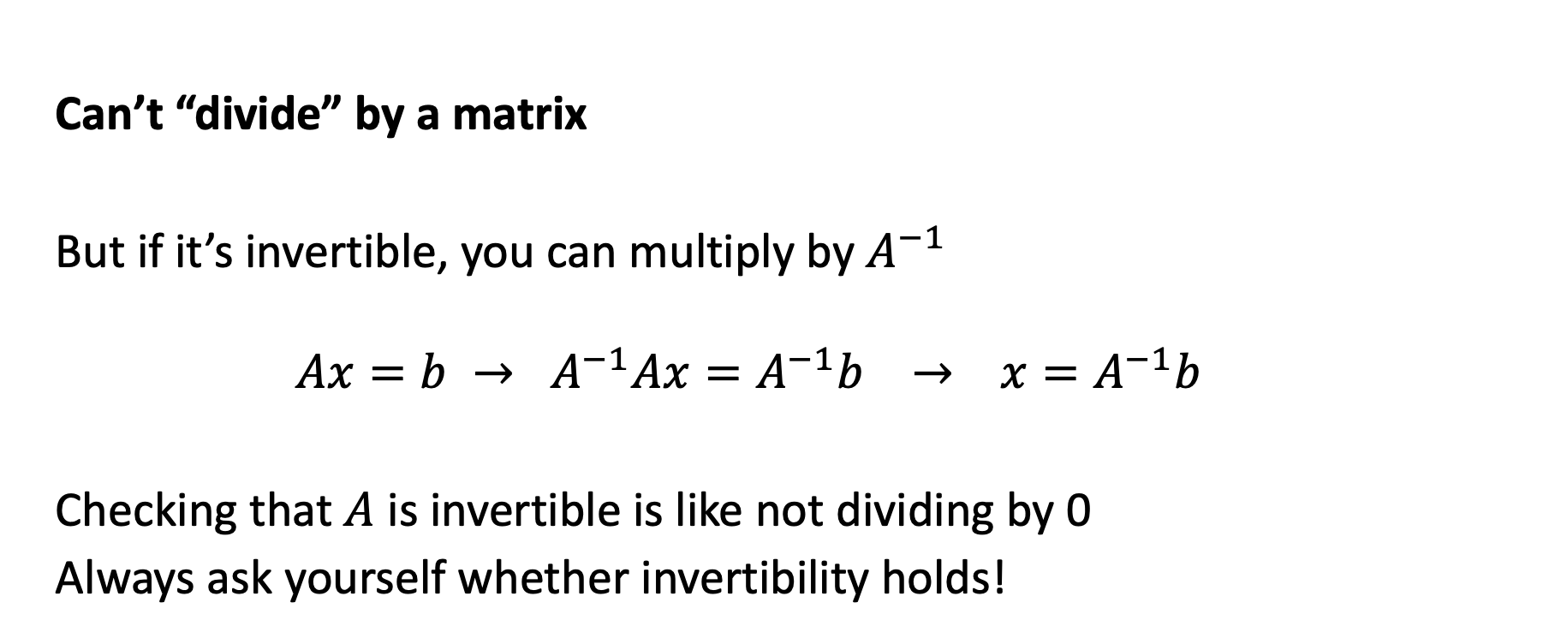
Analytically solving matrix equations
Can’t “divide” by a matrix
But if it’s invertible, you can multiply by $A^{−1}$
$$Ax=b → A^{−1}Ax=A^{−1}b → x=A^{−1}b$$
Checking that $A$ is invertible is like not dividing by 0
Always ask yourself whether invertibility holds!

Slide 9

Analytically solving matrix equations
Example: solve $\left(A+B\right)C=D$ for $C$
For square matrices $A, B, C, D$
Example: solve $AA^{T}B+C=D$ for $B$

Slide 10
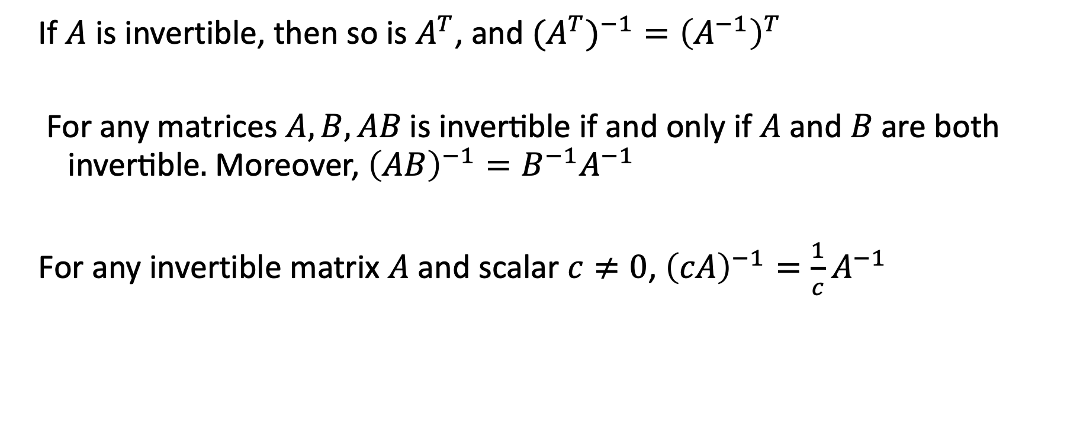
Facts about inverses
If $A$ is invertible, then so is $A^{T}$, and ${{(A}^{T})}^{−1}={\left(A^{−1}\right)}^{T}$
For any matrices $A, B,AB\text{ is invertible if and only if }A\text{ and }B\text{ are both invertible}.$ Moreover, ${\left(AB\right)}^{−1}={B^{−1}A}^{−1}$
For any invertible matrix $A$ and scalar $c≠0$, ${\left(cA\right)}^{−1}=\frac{1}{c}A^{−1}$

Slide 11
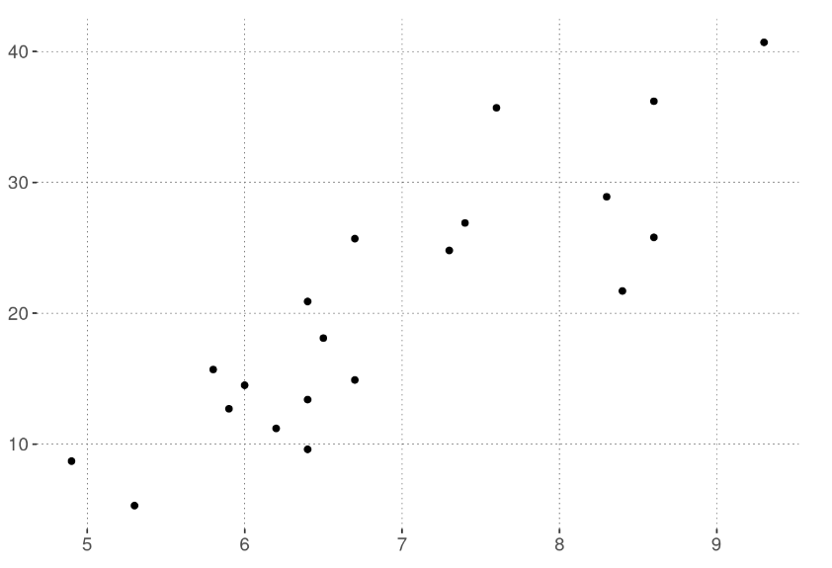
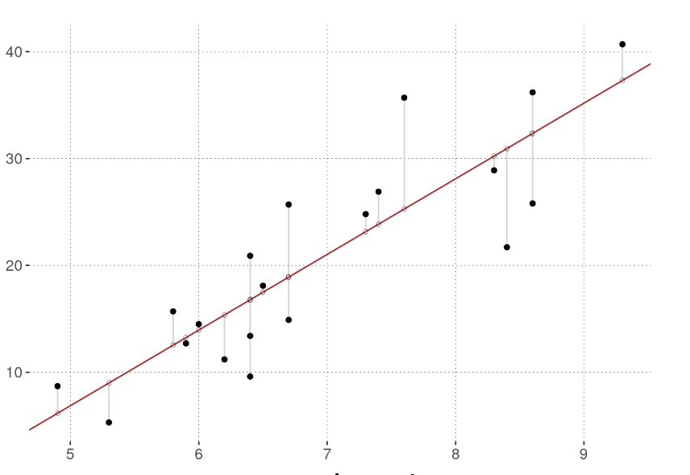

Linear regression
We now have the building blocks to introduce a fundamental ML concept:
Ordinary least squares (OLS) linear regression
Suppose we have data points ${\left\{\left(x_{i}, y_{i}\right)\right\}}_{i=1}^{N}$ and we want to fit a line through them
https://michael-franke.github.io/intro-data-analysis/ordinary-least-squares-regression.html

Slide 12

Linear regression
In 2d, fit a line $y=\hat{β}x+c$. For a new point, predict $\hat{y}=\hat{β}x+c$
With $x∈R^{n}$, coefficients $β∈R^{n}$ as well. $\hat{y}={\hat{β}}^{T}x+c$
Typically, fold $c$ into $β$ by assuming that we add a “1” to the feature vector:
$$x^{′}= \left({x \atop 1}\right)$$
Then, the last entry of $β$ is the intercept, and we just have $\hat{y}={\hat{β}}^{T}x$

Slide 13

Linear regression
What makes for a good set of parameters $β$?
One idea: measure the error on data point $i$ as
$${\left(y_{i} −{\hat{y}}_{i}\right)}^{2}={\left(y_{i} −β^{T}x\right)}^{2}$$
And look for $β$ with the smallest total squared error:
$$\min_{β}{\sum_{i=1}^{N}{{\left(y_{i} −β^{T}x\right)}^{2}}}$$

Slide 14

Ordinary least squares
There is a closed-form expression for the “best” $β$ defined this way. To present it, we introduce some matrix notation.
Let $X= \left[\begin{matrix}x_{1} \\ \begin{aligned}x_{2} \\ … \\ x_{N}\end{aligned}\end{matrix}\right]$ be the matrix obtained by stacking the feature vectors. Then,
$\hat{β}={\left(X^{T}X\right)}^{−1}X^{T}y$
is the set of coefficients that minimize the total squared errors.

Slide 15

Ordinary least squares
$\hat{β}={\left(X^{T}X\right)}^{−1}X^{T}y$
Where does this come from?
We need more tools to derive the solution – covered soon!
Now: a little bit of interpretation

Slide 16

Ordinary least squares
In matrix notation, solves the problem
$$\min_{β}{{\left\|Xβ −y\right\|}_{2}}$$

Slide 17

Ordinary least squares
In matrix notation, solves the problem
$$\min_{β}{{\left\|Xβ −y\right\|}_{2}}$$
$$\left[\begin{matrix}{−x}_{1}− \\ \begin{aligned}−x_{2}− \\ … \\ {−x}_{N}−\end{aligned}\end{matrix}\right]β=\left[\begin{matrix}x_{1}^{T}β \\ \begin{aligned}x_{2}^{T}β \\ … \\ x_{N}^{T}β\end{aligned}\end{matrix}\right]=\left[\begin{matrix}{\hat{y}}_{1} \\ \begin{aligned}{\hat{y}}_{2} \\ … \\ {\hat{y}}_{N}\end{aligned}\end{matrix}\right]$$

Slide 18
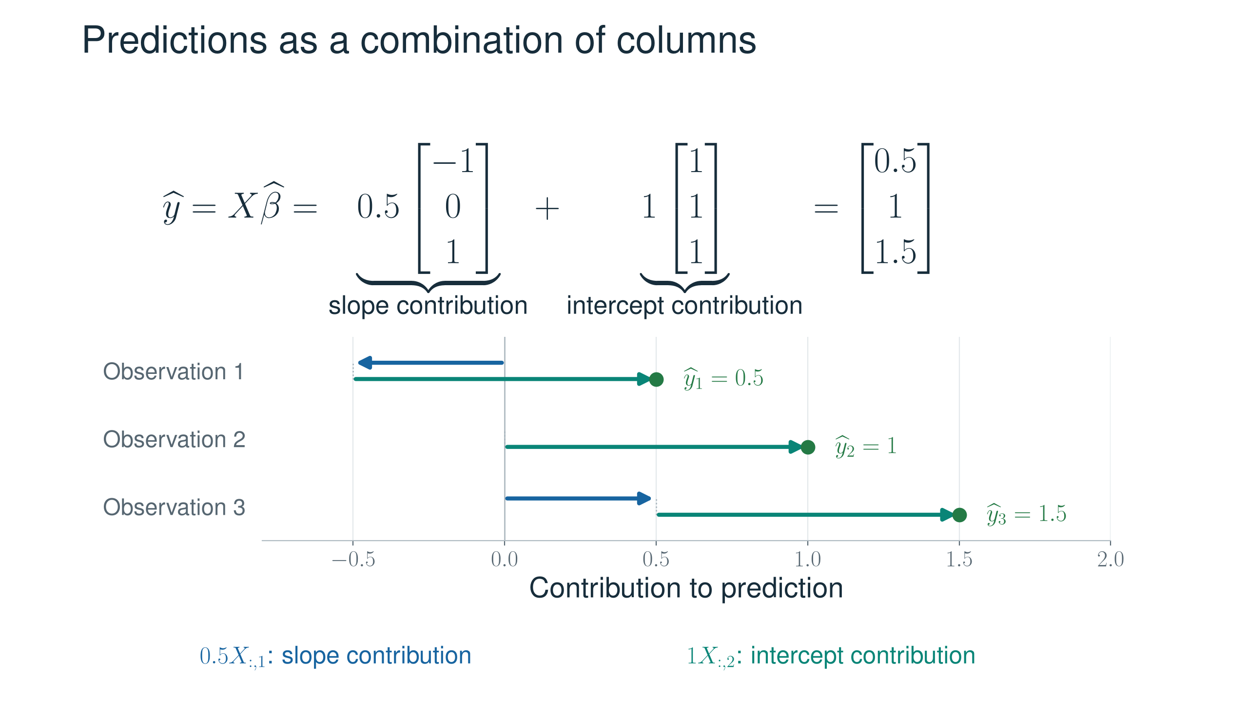

Slide 19
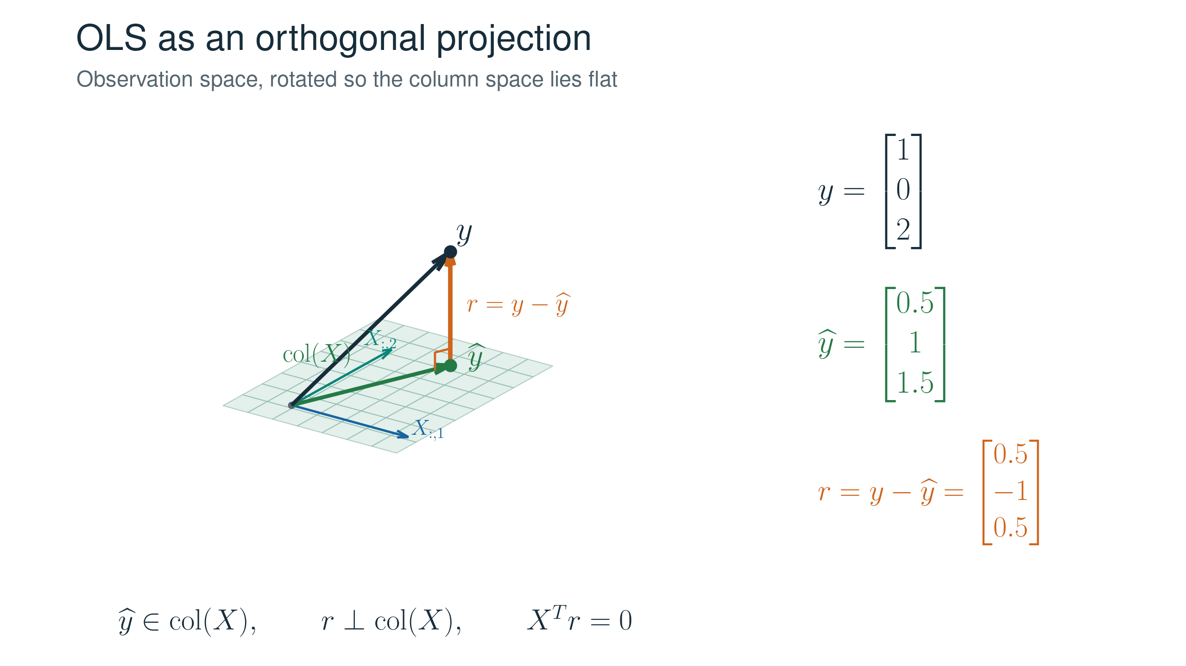
Ordinary least squares: geometric interpretation

Slide 20
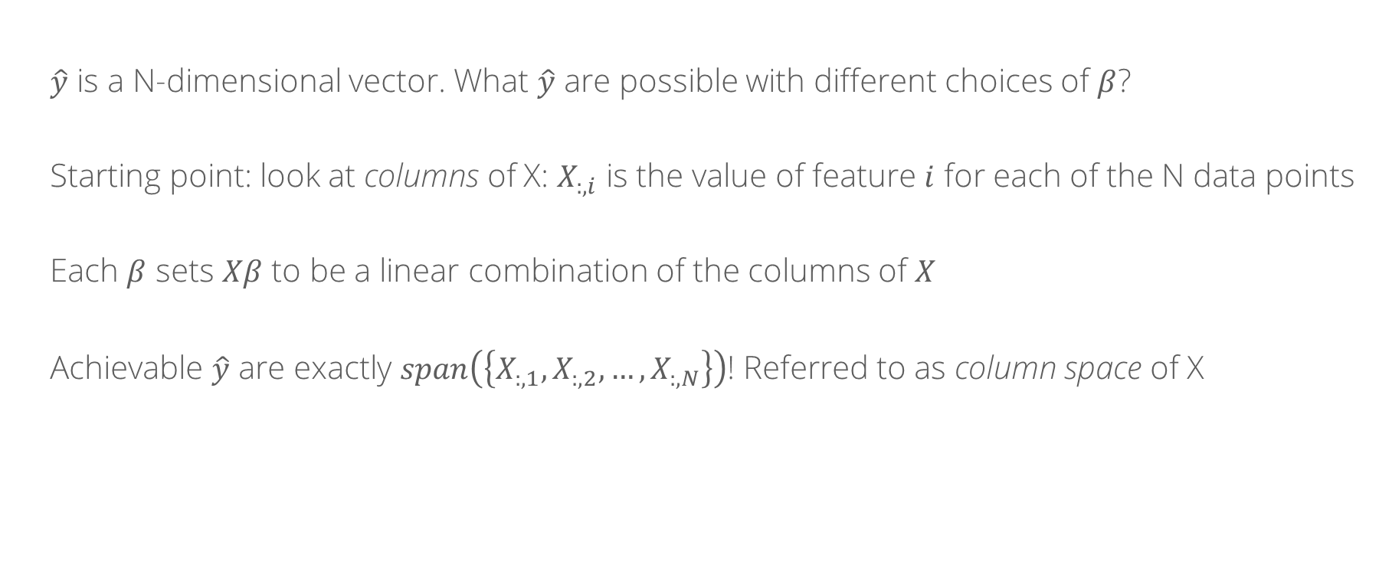
Ordinary least squares: geometric interpretation
$\hat{y}$ is a N-dimensional vector. What $\hat{y}$ are possible with different choices of $β$?
Starting point: look at columns of X: $X_{:, i}$ is the value of feature $i$ for each of the N data points
Each $β$ sets $Xβ$ to be a linear combination of the columns of $X$
Achievable $\hat{y}$ are exactly $span\left(\left\{X_{:, 1},X_{:, 2}, …, X_{:, N}\right\}\right)$! Referred to as column space of X

Slide 21
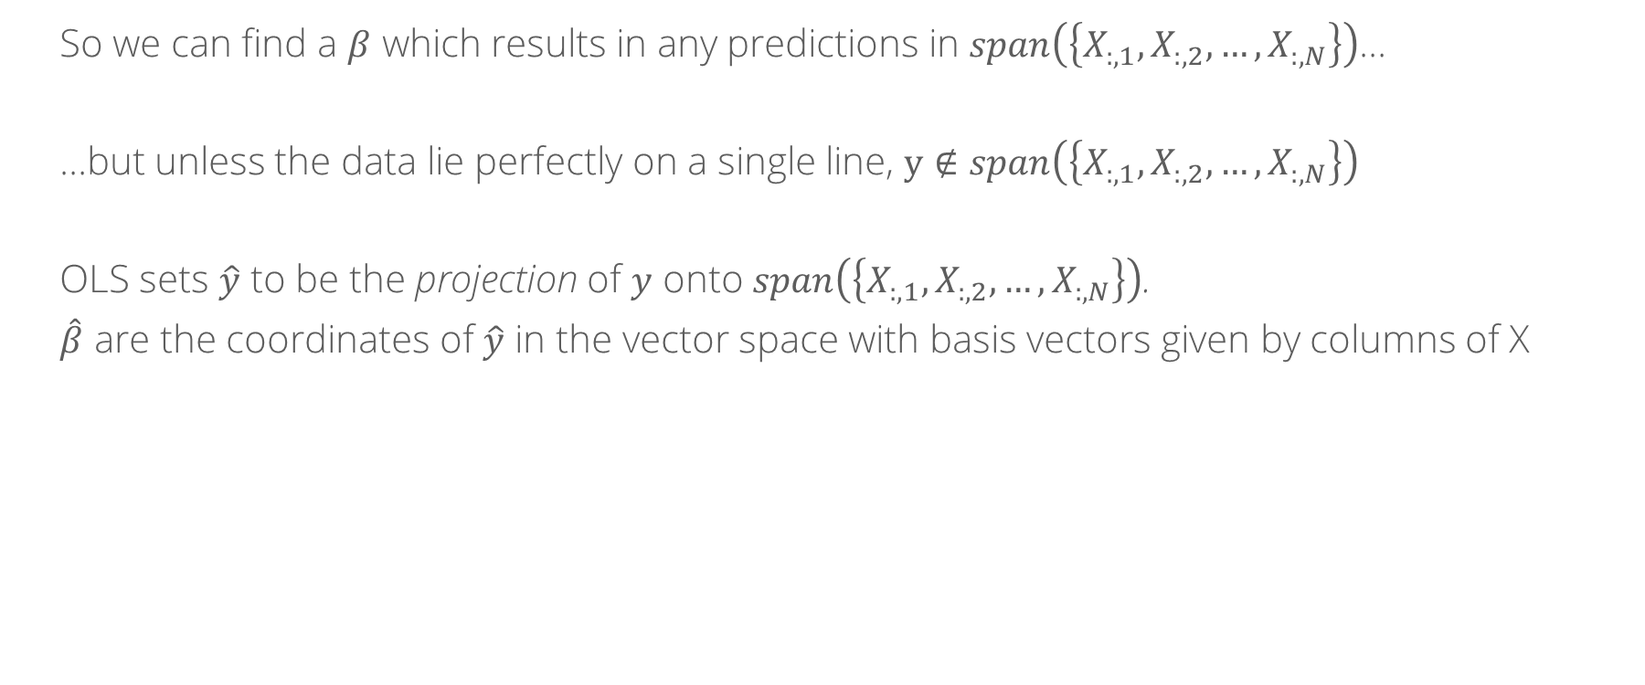
Ordinary least squares: geometric interpretation
So we can find a $β$ which results in any predictions in $span\left(\left\{X_{:, 1},X_{:, 2}, …, X_{:, N}\right\}\right)$…
…but unless the data lie perfectly on a single line, $y∉span\left(\left\{X_{:, 1},X_{:, 2}, …, X_{:, N}\right\}\right)$
OLS sets $\hat{y}$ to be the projection of $y$ onto $span\left(\left\{X_{:, 1},X_{:, 2}, …, X_{:, N}\right\}\right)$.
$\hat{β}$ are the coordinates of $\hat{y}$ in the vector space with basis vectors given by columns of X

Slide 22
Ordinary least squares: geometric interpretation

Slide 23

Regularization
Natural extension:
$\min_{β}{{\left\|Xβ −y\right\|}_{2}}+λ{\left\|β\right\|}_{p}$ with respect to some p-norm
Penalize “large” coefficients
Common choices: p = 1, 2

Slide 24
Whiteboard: l1 vs l2 regularization

