Slide 1
Mathematical Foundations for ML (10-680):
Overview & Preliminaries
Bryan Wilder
bwilder@cmu.edu
* Slides borrowed from prior offerings by Professors M. Gormley, P. Virtue, G. Gordon, & H. Heidari.

Slide 2
Announcements
Next Monday (9/11): Quiz 1.
Questions will be based on material through today, and generally similar to HW 1 and 2a.
We will ensure that HW1 solutions are released in Gradescope before then. Also recommend OH/Friday’s recitation.
First 40 minutes of class, please arrive on time
On homeworks: please assign pages of the PDF to questions (as Gradescope asks you to). We will start to take more points off for this in future HWs.

Slide 3

Linear algebra
Provides a means of representing linear functions and solving linear systems of equations
E.g., consider

Slide 4
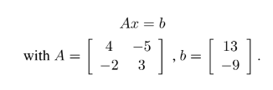
Linear algebra
Provides a means of representing linear functions and solving linear systems of equations
E.g., consider
Conversion to matrix notation.
What can see say about the system? How can we solve it?

Slide 5
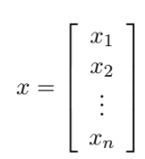

Definitions
$A∈R^{n×m}$: matrix with n rows and m columns, and each entry is a real number
$v∈R^{n}$: a vector with n real numbers. By default, column vector (n rows, 1 column):

Slide 6
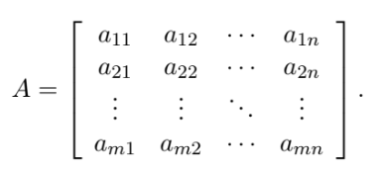
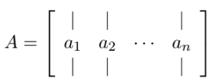

Definitions
Entry of a matrix in row I, column j: $a_{ij}, A_{ij}, A_{i,j}$
jth column of A: $a_{j}$ or $A_{:, j}$
ith row of A: $a_{i}^{T}$ or $A_{i,:}$

Slide 7
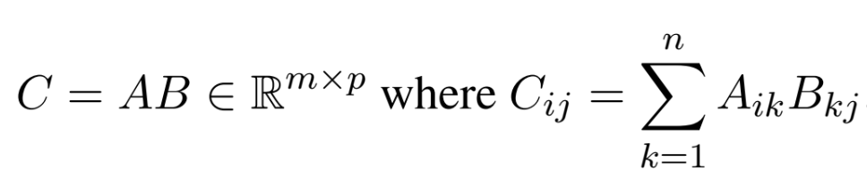

Matrix multiplication
$A_{i, :}⋅B_{:, j}$

Slide 8
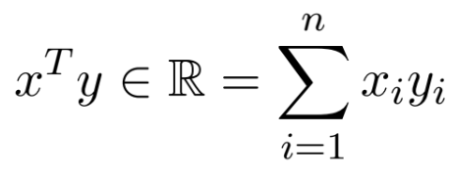

Inner vector product
Also called “dot product”, denoted $x⋅y$ or $<x, y>$

Slide 9
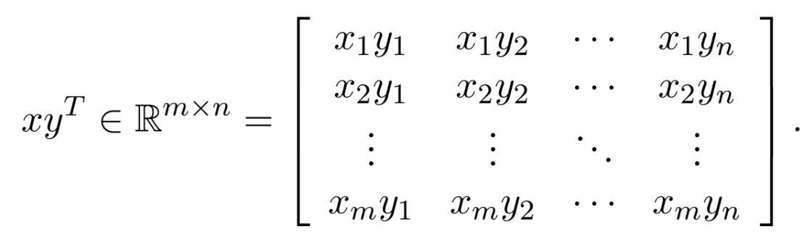


Outer vector product
Denoted $x⊗y$ or $xy^{T}$

Slide 10
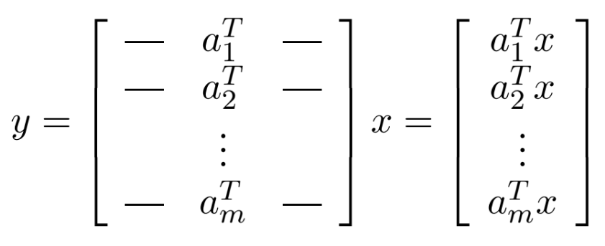

Matrix-vector product
Given a matrix $A∈R^{n×m}$ and vector $x∈R^{m}$, the product $Ax$ is a vector in $R^{m}$
View 1:

Slide 11
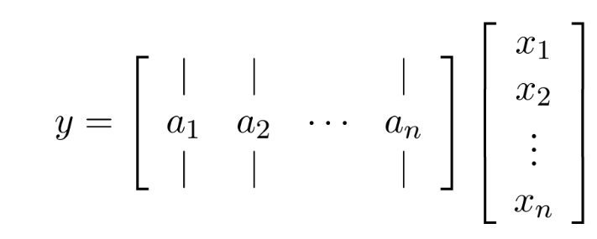
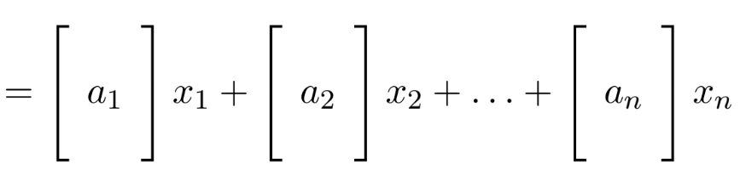
Matrix-vector product
View 2: linear combination of columns

Slide 12
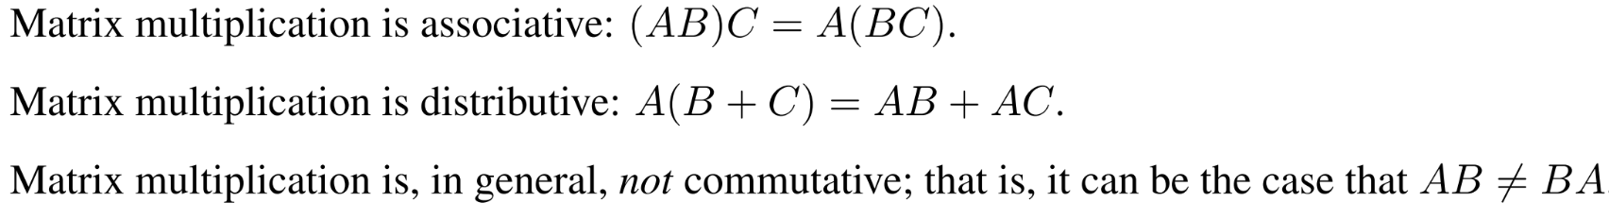
Useful facts about matrix multiplication

Slide 13
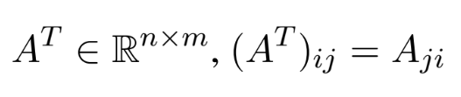
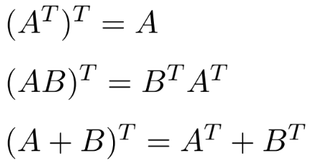

Matrix transpose
Reverses the rows and columns. Given $A∈R^{m×n}$,
Properties:

Slide 14
Whiteboard
+Calculating products
+Illegal operations

Slide 15






Eigenvector & Eigenvalue
Definition #1: Given a square matrix $A∈ℝ^{n×n}$, we say that $λ∈ℂ$is an eigenvalue of $A$ and $x∈ℂ^{n}$ is the corresponding eigenvector if
$$Ax=λx, x≠0$$
$$Ax=λx$$
The linear transformation $A$ is only stretching vector $x$.
That is, $λx$ is a scalar multiple of $x$.
$$x$$

Slide 16



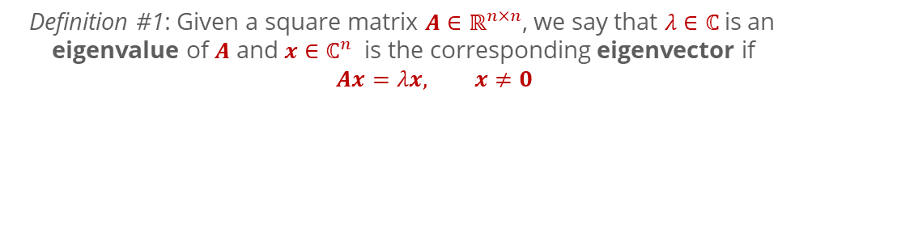


How many eigenvectors are there?
Definition #1: Given a square matrix $A∈ℝ^{n×n}$, we say that $λ∈ℂ$is an eigenvalue of $A$ and $x∈ℂ^{n}$ is the corresponding eigenvector if
$$Ax=λx, x≠0$$
For any eigenvector $x∈ℂ^{n}$ and scalar $c∈ℂ$,
$$A\left(cx\right)=cAx=cλx=λ(cx)$$
So $cx$ is also an eigenvector with eigenvalue $λ$.
If we talk about “the eigenvector” associated with an eigenvalue $λ$, we usually assume that the eigenvector is normalized to have length 1.0.
But there’s still ambiguity because both $x$ and $−x$ will be eigenvectors of $λ$, but we will have to live with this.

Slide 17
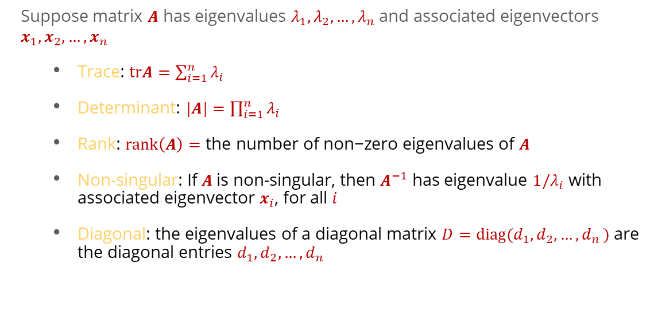
Properties of eigenvectors / eigenvalues
Suppose matrix $A$ has eigenvalues $λ_{1},λ_{2}{,…,λ}_{n}$ and associated eigenvectors $x_{1},x_{2}{,…,x}_{n}$
Trace: $trA=\sum_{i=1}^{n}{λ_{i}}$
Determinant: $|A|=\prod_{i=1}^{n}{λ_{i}}$
Rank: $rank\left(A\right)=\text{the} \text{number} \text{of} \text{non}\text{−}\text{zero} \text{eigenvalues} \text{of} A$
Non-singular: If $A$is non-singular, then $A^{−1}$ has eigenvalue ${1/λ}_{i}$ with associated eigenvector $x_{i}$, for all $i$
Diagonal: the eigenvalues of a diagonal matrix ${D=diag(d}_{1},d_{2}{,…,d}_{n})$ are the diagonal entries $d_{1},d_{2}{,…,d}_{n}$

Slide 18

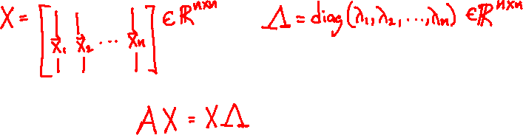
Eigen{vectors,values} in Matrix Form
Suppose matrix $A$ has eigenvalues $λ_{1},λ_{2}{,…,λ}_{n}$ and associated eigenvectors $x_{1},x_{2}{,…,x}_{n}$
We can write all the eigenvectors / eigenvalues simultaneously as:

Slide 19
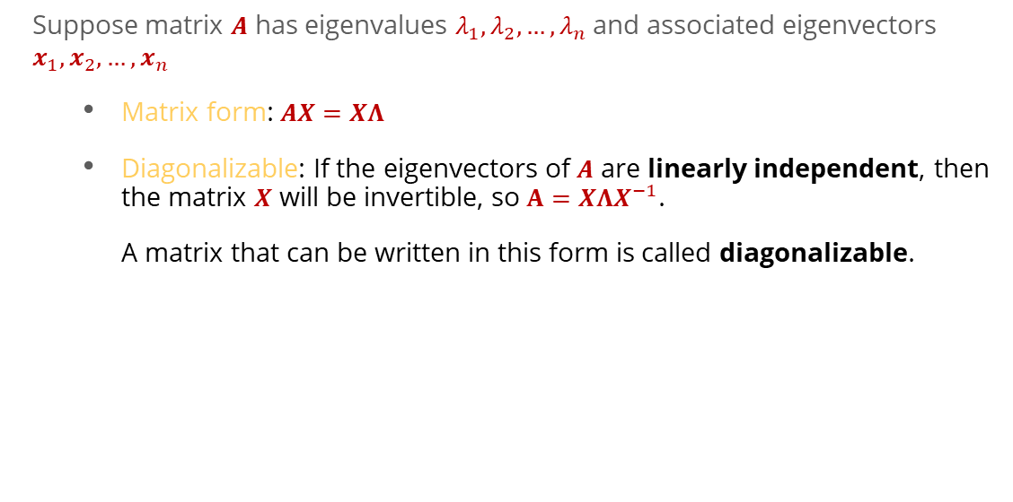
Properties of eigenvectors / eigenvalues
Suppose matrix $A$ has eigenvalues $λ_{1},λ_{2}{,…,λ}_{n}$ and associated eigenvectors $x_{1},x_{2}{,…,x}_{n}$
Matrix form: $AX=XΛ$
Diagonalizable: If the eigenvectors of $A$ are linearly independent, then the matrix $X$ will be invertible, so $A=XΛX^{−1}$. A matrix that can be written in this form is called diagonalizable.

Slide 20
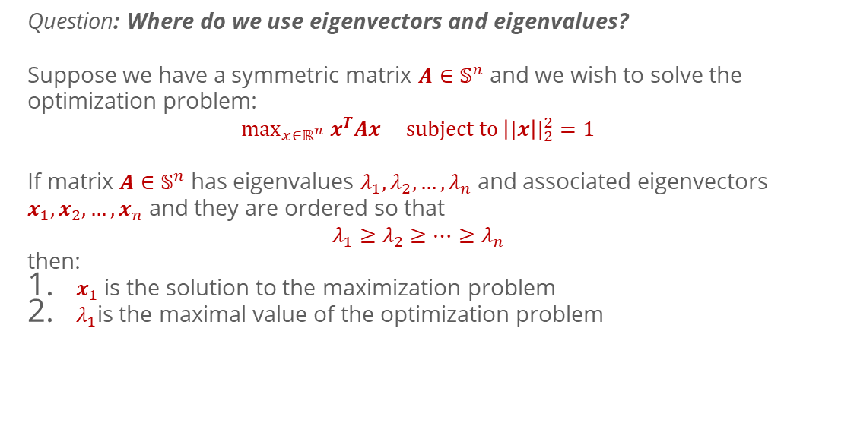
Eigen{vectors,values} of a Symmetric Matrix
Question: Where do we use eigenvectors and eigenvalues?
Suppose we have a symmetric matrix $A∈𝕊^{n}$ and we wish to solve the optimization problem:
$$\max_{x∈ℝ^{n}} x^{T}Ax subject to {\left||x\right||}_{2}^{2}=1$$
If matrix $A∈𝕊^{n}$ has eigenvalues $λ_{1},λ_{2}{,…,λ}_{n}$ and associated eigenvectors $x_{1},x_{2}{,…,x}_{n}$ and they are ordered so that
$$λ_{1}≥λ_{2}{≥…≥λ}_{n}$$
then:
$x_{1}$ is the solution to the maximization problem
$λ_{1}$is the maximal value of the optimization problem

Slide 21
P-norms
Whiteboard: definitions, examples

