Slide 1
Mathematical Foundations for ML (10-606):
Matrix calculus
Bryan Wilder
* Slides borrowed from prior offerings by Professors M. Gormley, P. Virtue, & G. Gordon, & H. Heidari.

Slide 2
Calculus
So far: introduced matrices, the linear regression problem, and its solution
Deriving the solution requires optimization, which in turn requires calculus
Today: introduction to matrix derivatives and related concepts

Slide 3
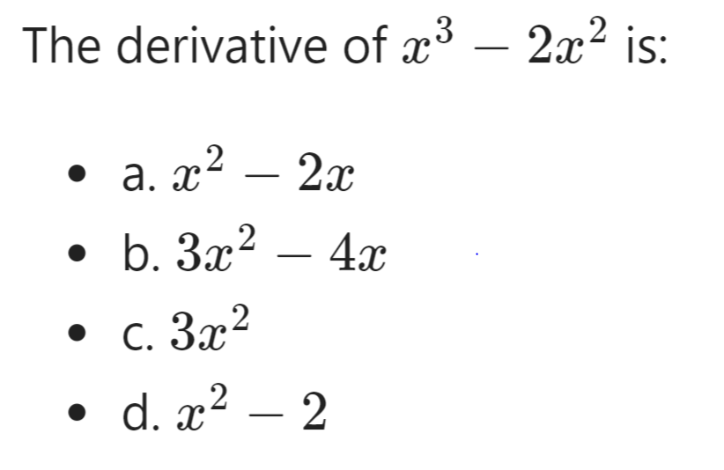
Calculus warmup

Slide 4

Calculus warmup
The derivative of ${\left(x+3x^{2}\right)}^{3}$ is
a. $3{\left(x+3x^{2}\right)}^{2}$
b. $3{\left(x+3x^{2}\right)}^{2}+6x$
c.${3\left(x+3x^{2}\right)}^{2}(6x+1)$
d. ${18x}^{3}$

Slide 5

Partial derivatives
The partial derivative $\frac{∂}{∂z}(x^{2}+yz+\frac{1}{z^{2}})$ is
a. $2x+y −\frac{2}{z^{3}}$
b. $x^{2}+y −\frac{1}{z}$
c.$x^{2}+yz −\frac{2}{z^{3}}$
d. $y −\frac{2}{z^{3}}$

Slide 6

Gradients
Given a function $f$ that takes a vector $x∈ℝ^{n}$ as input and returns a scalar (so $f:ℝ^{n}→ℝ$), recall that the gradient of $f$ is a vector the same size as $x$:
$$∇_{x}f\left(x\right)=\left[\begin{matrix}\frac{∂f\left(x\right)}{∂x_{1}} \\ \begin{aligned}\frac{∂f\left(x\right)}{∂x_{2}} \\ ⋮ \\ \frac{∂f\left(x\right)}{∂x_{n}}\end{aligned}\end{matrix}\right]$$

Slide 7
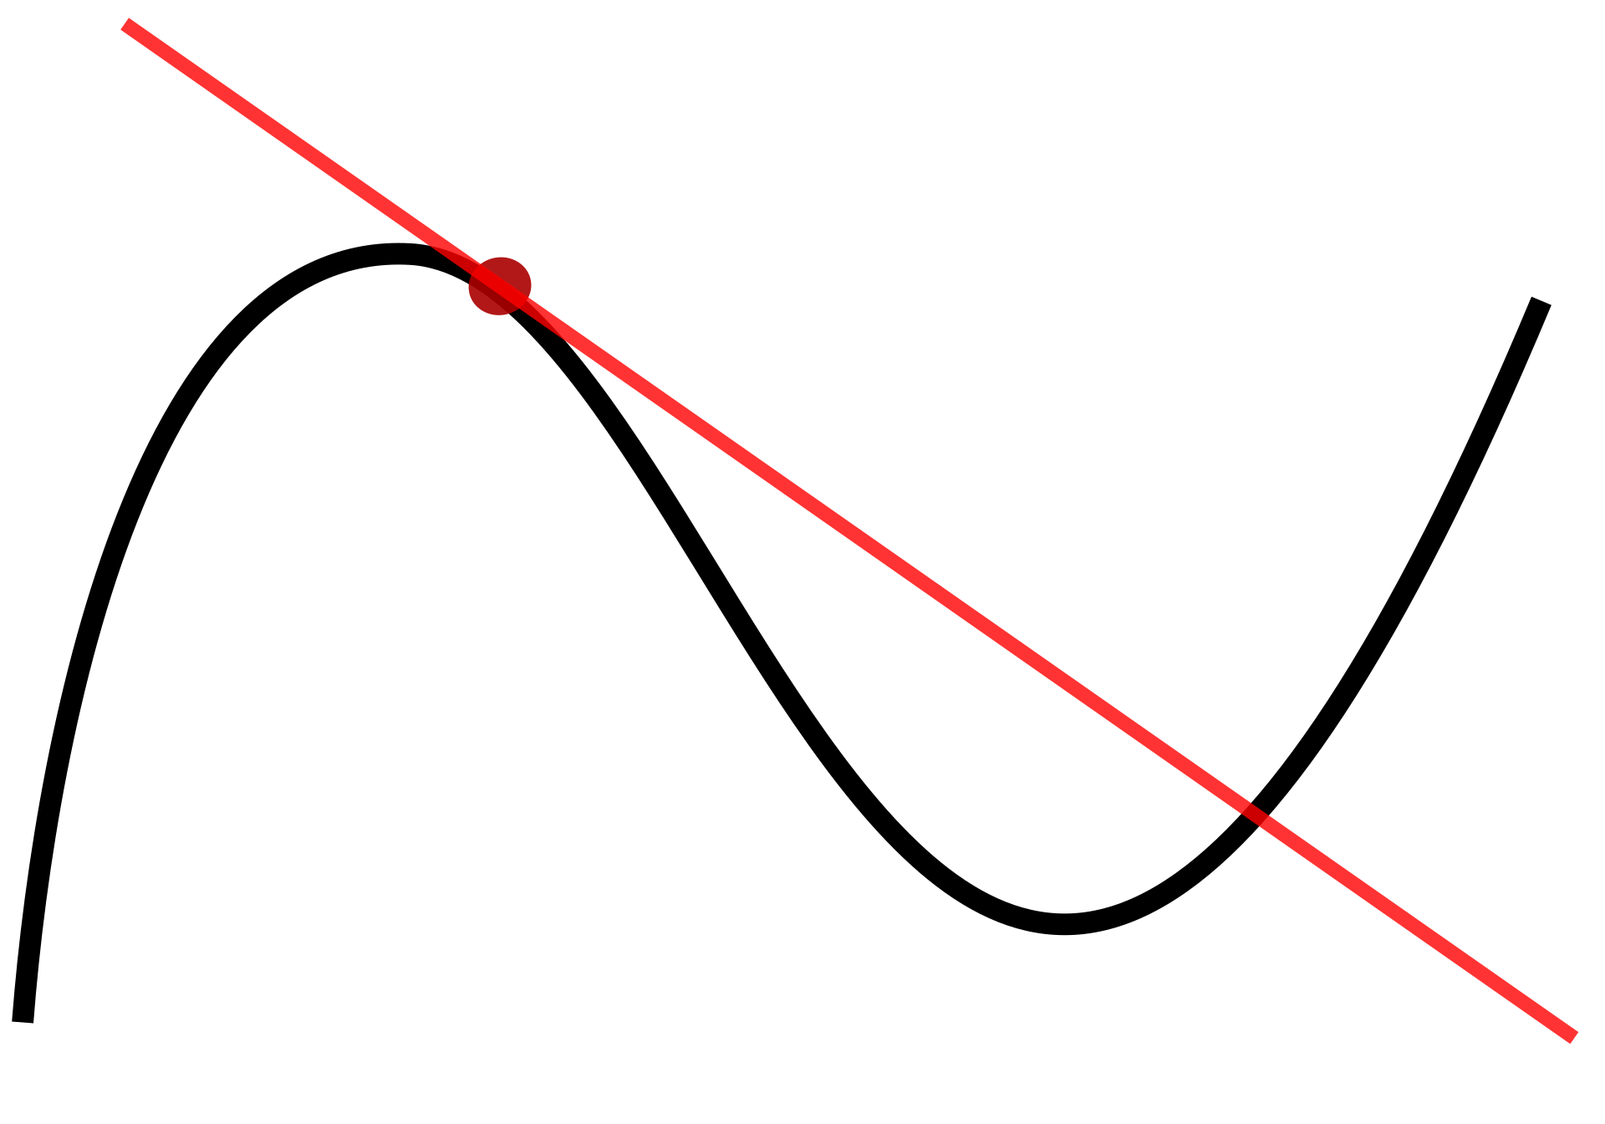
Derivative
“slope of the tangent line”

Slide 8
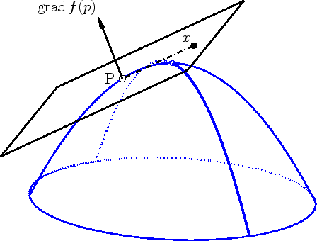



Gradients
$$∇_{x}f(x)$$
$$v$$
$∇_{x}{ f(x)}^{T}v$ gives the change in $f$ as you move in direction $v$ from $x$
The plane shown is the function $g\left(v\right)= f\left(x\right)+∇f{\left(x\right)}^{T}(v −x)$
x
https://math.stackexchange.com/questions/2643798/why-is-any-arbitrary-directional-derivative-always-recoverable-from-the-gradient

Slide 9
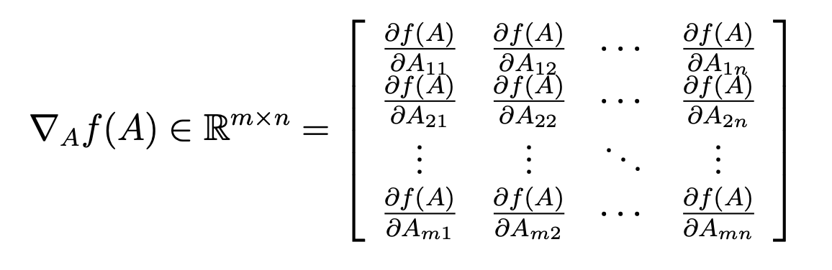
Gradient
f: R^{mxn} → R

Slide 10

Jacobian
$$f:R^{n}→R^{m}$$
$$f\left(x\right) = \left[\begin{matrix}f_{1}(x) \\ f_{2}\left(x\right) \\ .. \\ f_{m}(x)\end{matrix}\right]$$
$$J\left(x\right)= \left[\begin{matrix}| & | \\ ∇f_{1}(x) & ∇f_{2}(x) \\ | & |\end{matrix} ...\right]$$
$= \left[\begin{matrix}\frac{∂f_{1}\left(x\right)}{∂x_{1}} & \frac{∂f_{2}\left(x\right)}{∂x_{1}} \\ \frac{∂f_{1}\left(x\right)}{∂x_{2}} & \frac{∂f_{2}\left(x\right)}{∂x_{2}} \\ … & …\end{matrix} ...\right]$ i.e., $J{\left(x\right)}_{ij}=\frac{∂f{\left(x\right)}_{i}}{∂x_{j}}$

Slide 11

Gradient example
$$f\left(x\right)=x_{1}x_{2}^{2}x_{3}^{3}$$
Note that $f:R^{3}→R$, so $∇_{x}f\left(x\right)∈R^{3}$

Slide 12
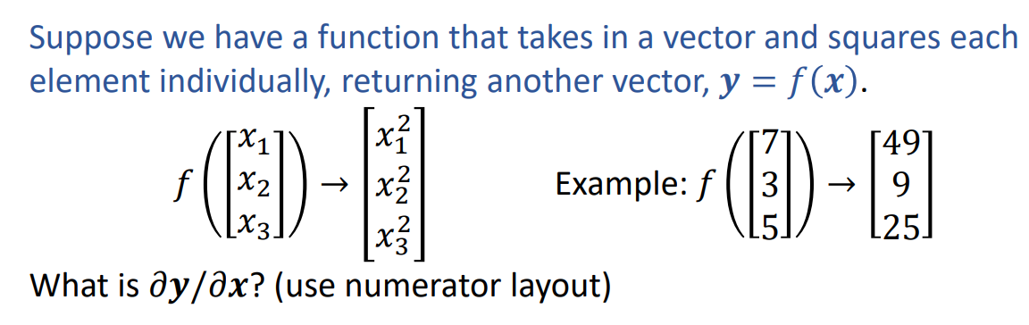
Jacobian example

Slide 13

Matrix calculus
Instead of calculating derivatives element-by-element, we can often save a lot of time by using rules for derivatives at the level of vectors and matrices
For example, just like $\frac{∂}{∂x}yx=y$ with scalars $x$ and $y$, for vectors $x, y∈R^{n}$
$\frac{∂}{∂x} y^{T}x=y$

Slide 14
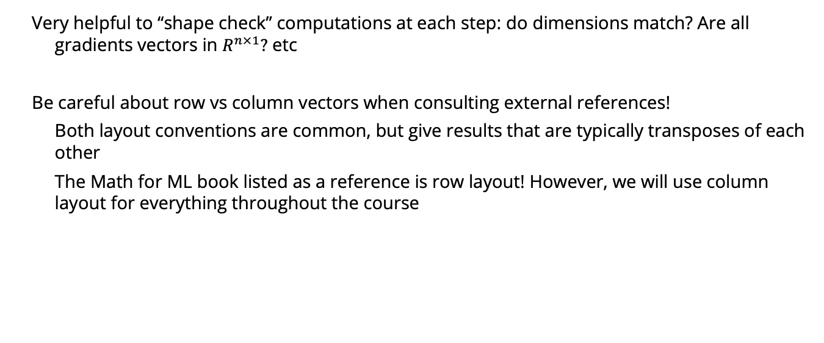
Matrix calculus
Very helpful to “shape check” computations at each step: do dimensions match? Are all gradients vectors in $R^{n×1}?$ etc
Be careful about row vs column vectors when consulting external references!
Both layout conventions are common, but give results that are typically transposes of each other
The Math for ML book listed as a reference is row layout! However, we will use column layout for everything throughout the course

Slide 15
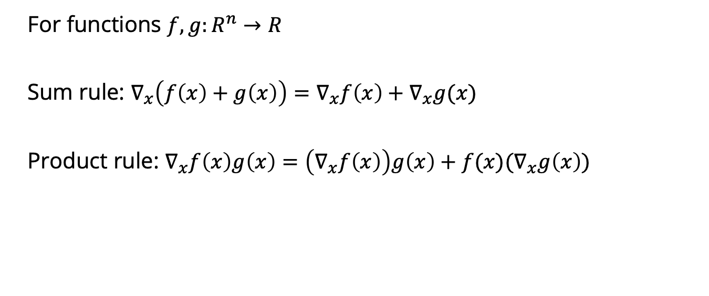
Matrix derivative rules
For functions $f, g:R^{n}→R$
Sum rule: $∇_{x}\left(f\left(x\right)+g\left(x\right)\right)=∇_{x}f\left(x\right)+∇_{x}g(x)$
Product rule: $∇_{x}f\left(x\right)g\left(x\right)=\left(∇_{x}f\left(x\right)\right)g\left(x\right)+f(x)(∇_{x}g\left(x\right))$

Slide 16
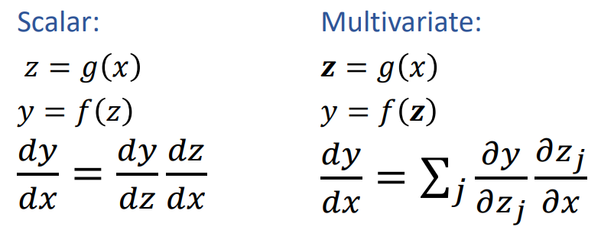
Chain rule

Slide 17

Helpful matrix calculus identities
$∇_{a}a^{T}b=b$
$$∇_{b}a^{T}b=a$$
$$∇_{X} a^{T}Xb=ab^{T}$$
$$∇_{X} a^{T}X^{T}b=ba^{T}$$
$$∇_{a} a^{T}Xa=\left(X+X^{T}\right)a$$
(survival guide: The Matrix Cookbook)

Slide 18
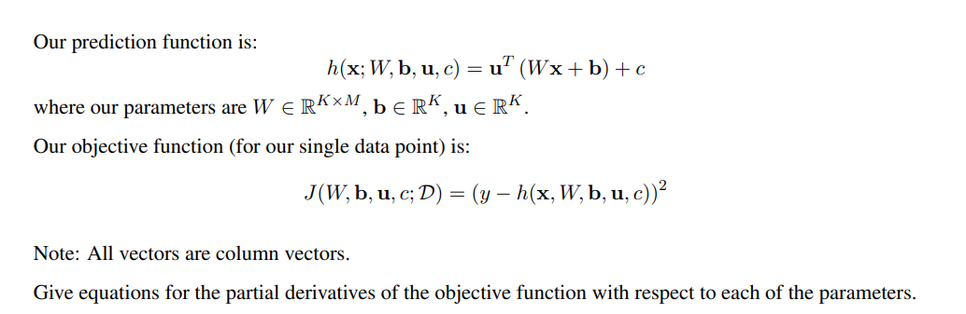
Notes:
https://www.cs.cmu.edu/~10606-f21/assignments/written/hw2_blank.pdf

Slide 19
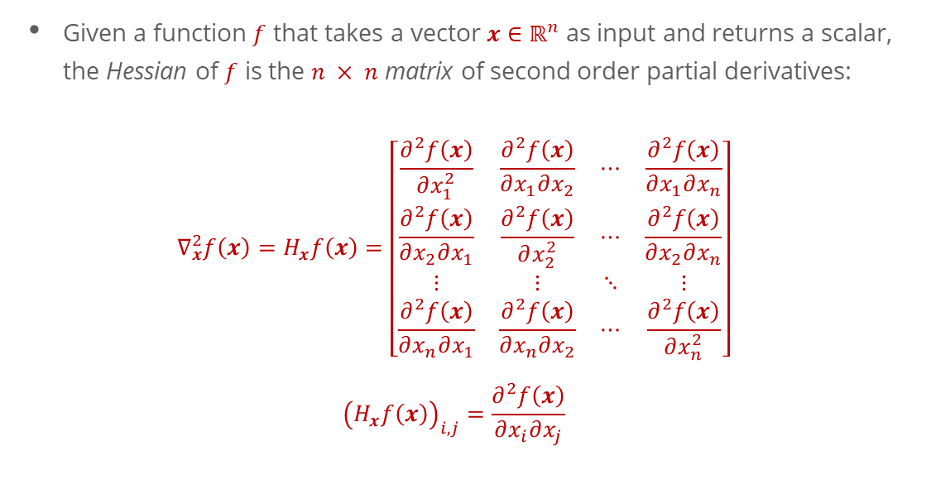
Hessians
Given a function $f$ that takes a vector $x∈ℝ^{n}$ as input and returns a scalar, the Hessian of $f$ is the $n × n$ matrix of second order partial derivatives:
$$∇_{x}^{2}f\left(x\right)=H_{x}f\left(x\right)=\left[\begin{matrix}\frac{∂^{2}f\left(x\right)}{∂x_{1}^{2}} & \frac{∂^{2}f\left(x\right)}{∂x_{1}∂x_{2}} & ⋯ & \frac{∂^{2}f\left(x\right)}{∂x_{1}∂x_{n}} \\ \frac{∂^{2}f\left(x\right)}{∂x_{2}∂x_{1}} & \frac{∂^{2}f\left(x\right)}{∂x_{2}^{2}} & ⋯ & \frac{∂^{2}f\left(x\right)}{∂x_{2}∂x_{n}} \\ ⋮ & ⋮ & ⋱ & ⋮ \\ \frac{∂^{2}f\left(x\right)}{∂x_{n}∂x_{1}} & \frac{∂^{2}f\left(x\right)}{∂x_{n}∂x_{2}} & ⋯ & \frac{∂^{2}f\left(x\right)}{∂x_{n}^{2}}\end{matrix}\right]$$
$${\left(H_{x}f\left(x\right)\right)}_{i,j}=\frac{∂^{2}f\left(x\right)}{∂x_{i}∂x_{j}}$$

Slide 20
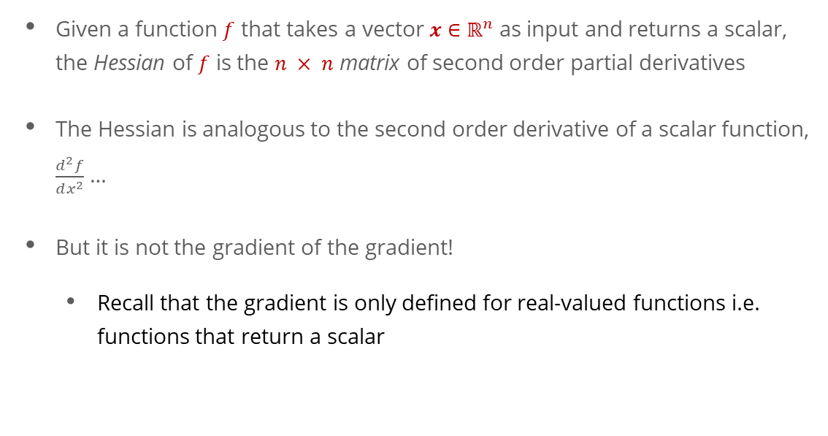
Hessians
Given a function $f$ that takes a vector $x∈ℝ^{n}$ as input and returns a scalar, the Hessian of $f$ is the $n × n$ matrix of second order partial derivatives
The Hessian is analogous to the second order derivative of a scalar function, $\frac{d^{2}f}{dx^{2}}$ …
But it is not the gradient of the gradient!
Recall that the gradient is only defined for real-valued functions i.e. functions that return a scalar

Slide 21
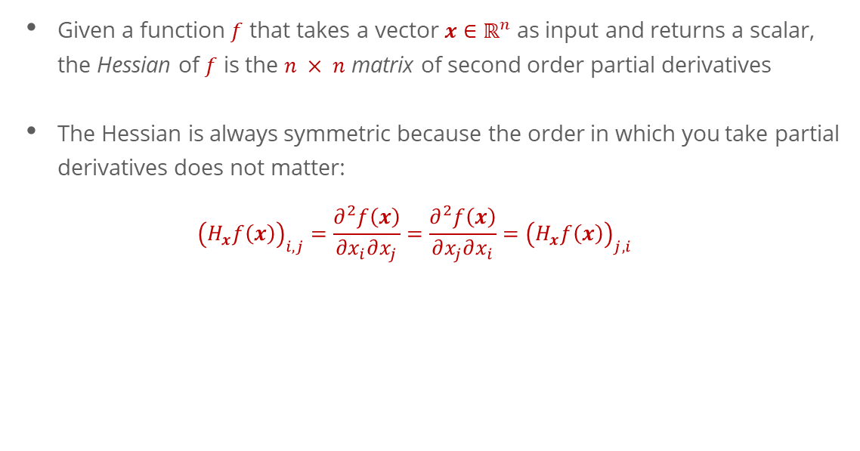
Hessians
Given a function $f$ that takes a vector $x∈ℝ^{n}$ as input and returns a scalar, the Hessian of $f$ is the $n × n$ matrix of second order partial derivatives
The Hessian is always symmetric because the order in which you take partial derivatives does not matter:
$${\left(H_{x}f\left(x\right)\right)}_{i,j}=\frac{∂^{2}f\left(x\right)}{∂x_{i}∂x_{j}}=\frac{∂^{2}f\left(x\right)}{∂x_{j}∂x_{i}}={\left(H_{x}f\left(x\right)\right)}_{j,i}$$

Slide 22

Hessians - Example
Example function: $f\left(x\right)=x_{1}x_{2}^{2}x_{3}^{3}$
What is the Hessian of $f$?
$$H_{x}f\left(x\right)=\left[\begin{matrix}0 & 2x_{2}x_{3} & 3x_{2}^{2}x_{3}^{2} \\ 2x_{2}x_{3} & 2x_{1}x_{3}^{3} & 6x_{1}x_{2}x_{3}^{2} \\ 3x_{2}^{2}x_{3}^{2} & 6x_{1}x_{2}x_{3}^{2} & 6x_{1}x_{2}^{2}x_{3}\end{matrix}\right]$$

Slide 23

Hessians - Example
Recall the example function from the reading: $f\left(x\right)=x_{1}x_{2}^{2}x_{3}^{3}$
What is the Hessian of $f$?

Slide 24

Consider functions $f\left(x\right):R^{n}→R^{m}$ and $g\left(x\right): R^{n}→R^{m}$
What is $\frac{d}{dx}f{\left(x\right)}^{T}g(x)$?

Slide 25
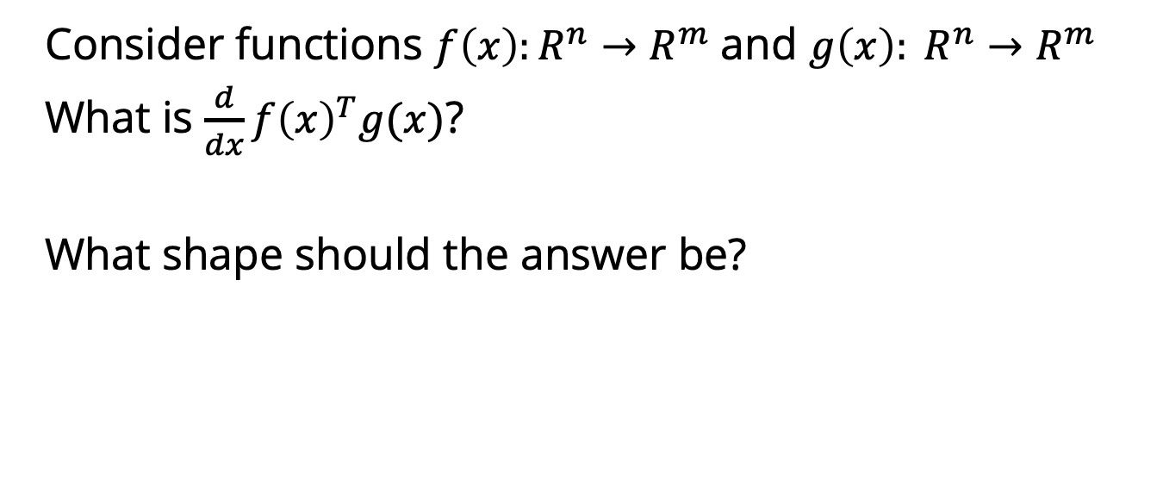
Consider functions $f\left(x\right):R^{n}→R^{m}$ and $g\left(x\right): R^{n}→R^{m}$
What is $\frac{d}{dx}f{\left(x\right)}^{T}g(x)$?
What shape should the answer be?

Slide 26
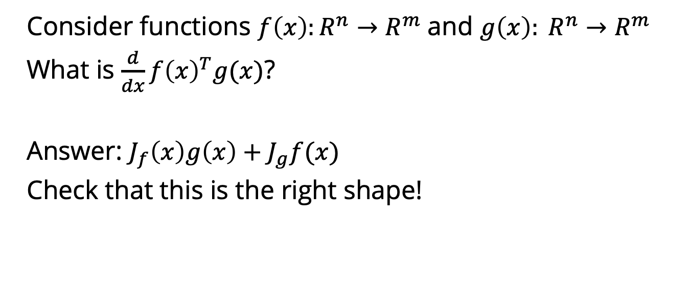
Consider functions $f\left(x\right):R^{n}→R^{m}$ and $g\left(x\right): R^{n}→R^{m}$
What is $\frac{d}{dx}f{\left(x\right)}^{T}g(x)$?
Answer: $J_{f}\left(x\right)g\left(x\right)+J_{g}f(x)$
Check that this is the right shape!

Slide 27
Taylor expansion
Very common use of (matrix) derivatives
Approximate a function by a low-order polynomial (linear, quadratic)

Slide 28
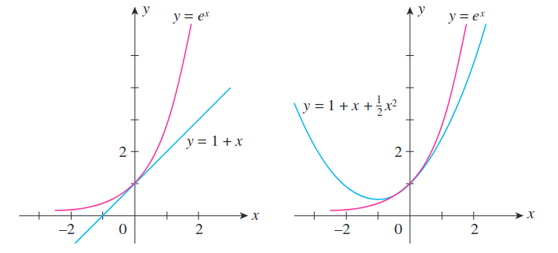

Refresher: scalar function Taylor expansion
$$f\left(x\right):R→R$$
Taylor series expansion around a point $a$:
$$f\left(x\right)= f\left(a\right)+f^{′}\left(a\right)\left(x−a\right)+\frac{1}{2}f^{′′}\left(a\right){\left(x −a\right)}^{2}+\frac{1}{6}f^{′′′}\left(a\right){\left(x −a\right)}^{3}…$$
$$=\sum_{n=0}^{∞}{\frac{1}{n!}f^{\left(n\right)}\left(a\right){\left(x −a\right)}^{n}}$$

Slide 29

Refresher: scalar function Taylor expansion
For well-behaved functions, Taylor series converges to $f\left(x\right)$
Given the right smoothness properties, can prove that $f$ is well-approximated locally by the Taylor series

Slide 30

Multivariate Taylor expansion
Let $f:R^{n}→R$
Taylor expansion to first order:
$$f\left(a\right)+∇f{\left(a\right)}^{T}\left(x −a\right)$$
To second order:
$$f\left(a\right)+∇f{\left(a\right)}^{T}\left(x −a\right)+\frac{1}{2}{\left(x−a\right)}^{T} H(a) (x−a)$$
where $H(a)$ is the Hessian of $f$ evaluated at $a$

Slide 31

Multivariable Taylor expansion
$$f\left(a\right)+∇f{\left(a\right)}^{T}\left(x −a\right)+\frac{1}{2}{\left(x−a\right)}^{T} H\left(a\right)\left(x−a\right)=$$
$$f\left(a\right)+\sum_{i=1}^{n}{{\left(x −a\right)}_{i}∇f{\left(a\right)}_{i}}+\frac{1}{2}\sum_{i=1}^{n}{\sum_{j=1}^{n}{{{H(a)}_{ij}\left(x −a\right)}_{i} {\left(x −a\right)}_{j}}}$$

Slide 32
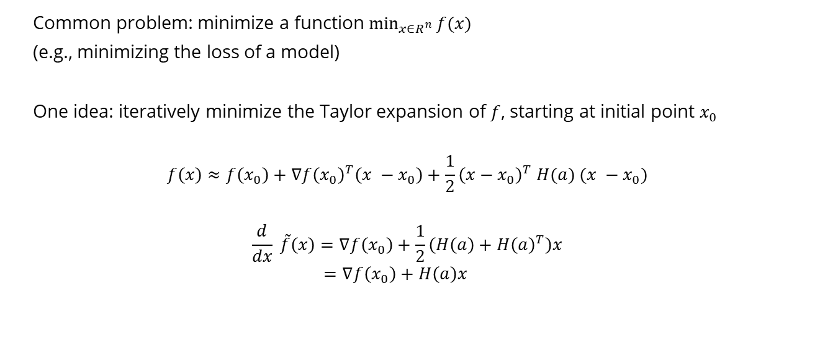
Example application: Newton’s method
Common problem: minimize a function $\min_{x∈R^{n}}{f(x)}$
(e.g., minimizing the loss of a model)
One idea: iteratively minimize the Taylor expansion of $f$, starting at initial point $x_{0}$
$$f\left(x\right)≈f\left(x_{0}\right)+∇f{\left(x_{0}\right)}^{T}\left(x −x_{0}\right)+\frac{1}{2}{\left(x−x_{0}\right)}^{T} H(a) (x −x_{0})$$
$$\frac{d}{dx} \tilde{f}\left(x\right)=∇f\left(x_{0}\right)+\frac{1}{2}\left(H\left(a\right)+H{\left(a\right)}^{T}\right)x$$
$$=∇f\left(x_{0}\right)+H\left(a\right)x$$

Slide 33
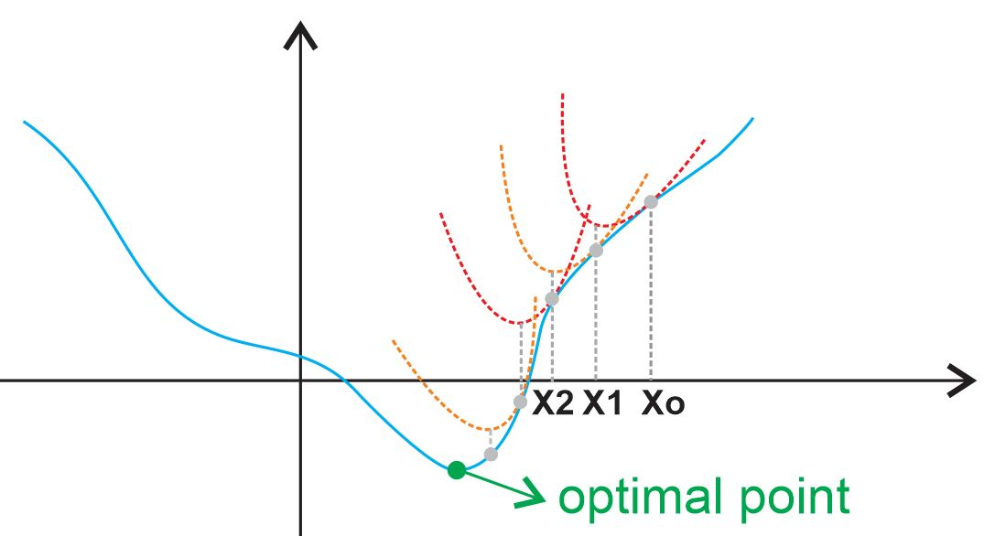
Newton’s method
https://ardianumam.files.wordpress.com/2017/09/newtonmethodforoptim1.jpg

Slide 34

Newton’s method
One idea: iteratively minimize the Taylor expansion of $f$, starting at initial point $x_{0}$
$$f\left(x\right)≈f\left(x_{0}\right)+∇f{\left(x_{0}\right)}^{T}\left(x −x_{0}\right)+\frac{1}{2}{\left(x−x_{0}\right)}^{T} H(x_{0}) (x −x_{0})$$
$$\frac{d}{d(x −x_{0})} \tilde{f}\left(x\right)=∇f\left(x_{0}\right)+\frac{1}{2}\left(H\left(x_{0}\right)+H{\left(x_{0}\right)}^{T}\right)(x −x_{0})$$
$$=∇f\left(x_{0}\right)+H\left(x_{0}\right)(x −x_{0})$$
Set $\frac{d}{dx} \tilde{f}\left(x\right)=0$ → $x−x_{0}=−H{\left(a\right)}^{−1}∇f\left(x_{0}\right)$
$$x=x_{0}−H{\left(a\right)}^{−1}∇f\left(x_{0}\right)$$

