Slide 1
Mathematical Foundations for ML (10-606):
Matrix operations, regression
Bryan Wilder
* Slides borrowed from prior offerings by Professors M. Gormley, P. Virtue, & G. Gordon, & H. Heidari.

Slide 2
Announcements
Quiz 2 next Monday. Same format (first 40 min of class)
Covers all topics between last quiz and this Wednesday
Vector spaces, linear equations, matrix inverse and factorizations (today), first part of matrix calculus (Wed)
Update from last HW: “Matrices can be used to represent any rotation or translation on the vector space R^n”
This is true, but we didn’t cover it in class/lecture notes
Going to give this point for free

Slide 3
Today
Inverses
Positive semi-definite matrices
Singular value decomposition
Linear regression

Slide 4
Slicing and Stacking Matrices
Suppose L∈R^{m×n}
Slice L_{I×J} for I ⊆ {1,...,n} and J ⊆ {1,...,m}
Stacking L
horizontally with G∈R^{m×p}
vertically with H∈R^{q×n}
diagonally with K∈R^{q×p}

Slide 5
Whiteboard
Stack notation
Examples of block matrix notation

Slide 6
Useful Matrix Patterns
Identity matrices
Diagonal matrices
Upper- and lower-triangular matrices

Slide 7
Inverse Functions and Matrices
ℓ⁻¹ is the inverse function for ℓ iff
ℓ(x) = y ⇔ x = ℓ⁻¹(y).
L⁻¹ is the inverse of matrix L iff
L⁻¹Lu = u and LL⁻¹v = v.

Slide 8
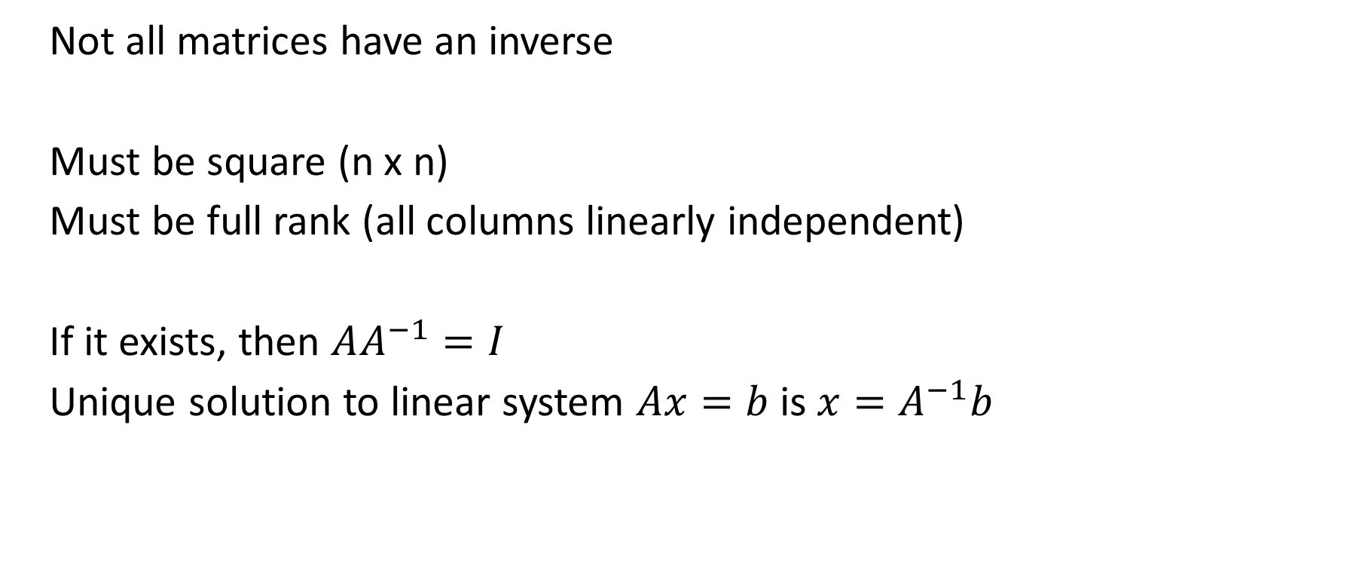
Properties of inverses
Not all matrices have an inverse
Must be square (n x n)
Must be full rank (all columns linearly independent)
If it exists, then $AA^{−1}=I$
Unique solution to linear system $Ax=b$ is $x=A^{−1}b$

Slide 9
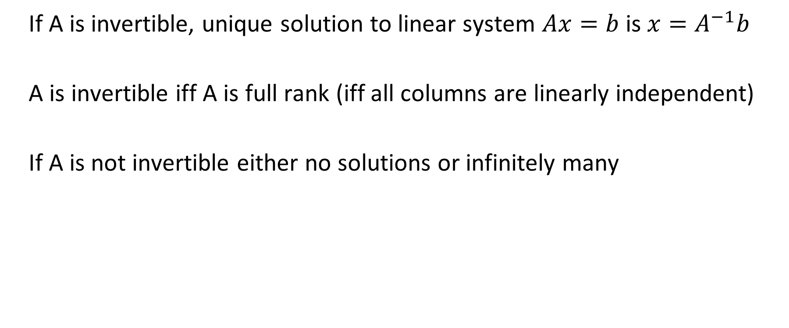
Properties of inverses
If A is invertible, unique solution to linear system $Ax=b$ is $x=A^{−1}b$
A is invertible iff A is full rank (iff all columns are linearly independent)
If A is not invertible either no solutions or infinitely many

Slide 10
Positive (Semi-)Definite Operators
An operator ℓ: X→ X is positive semi-definite (PSD) if
<ℓ(x), x> ≥ 0 ∀x∈X
An matrix L∈R^{n×n} is positive semi-definite (PSD) if
u^{T}Lu> ≥ 0 ∀u∈R^{n}
Theorem: L is PSD iff L+L^{T} is PSD.
Notes:
L is positive semi-definite if and only if all of its eigenvalues are non-negative.

Slide 11
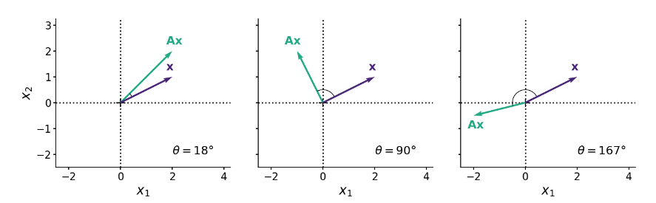
PSD matrices
One interpretation: symmetric PSD matrices stretch/scale vectors but don’t “flip” them
Whiteboard: using eigenvectors as a basis
https://gregorygundersen.com/blog/2022/02/27/positive-definite/

Slide 12
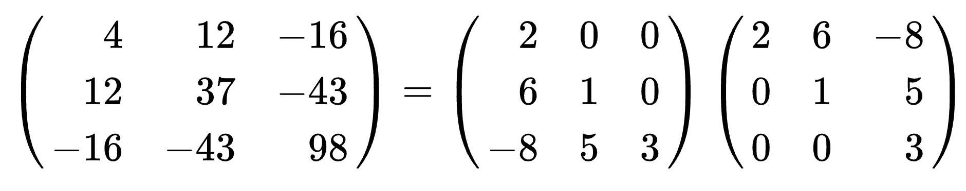
Matrix Factorizations
Cholesky Factorization for symmetric PD matrix K = LL^{T} :
L is a lower triangular matrix with real and positive diagonal entries;
L^{T} its transpose.

Slide 13
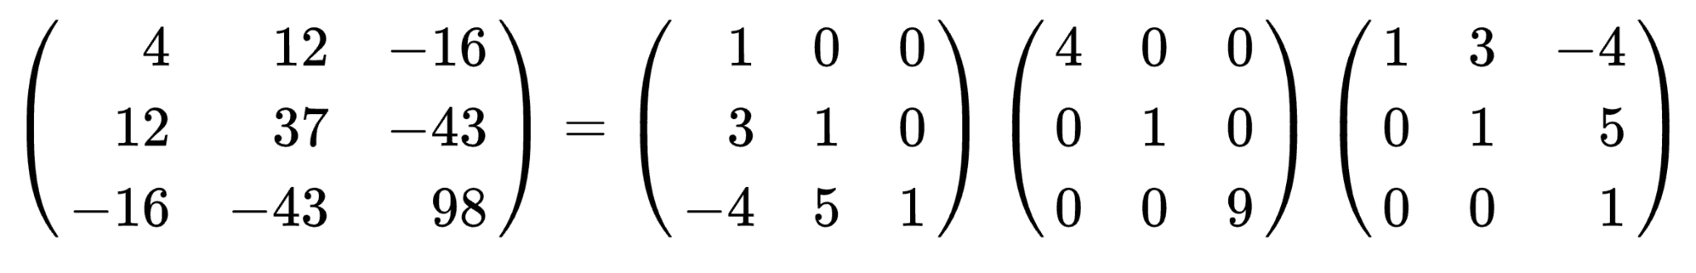
Matrix Factorizations
LDL Factorization for symmetric PSD matrix K = LDL^{T}
L is lower unit triangular matrix;
D is a diagonal matrix.
Notes:
unit triangular: all diagonal elements are 1.

Slide 14
Matrix Factorizations
LU Factorization for matrix K = LU
L is lower triangular;
U is upper triangular.
Connection to linear solves: after finding LU decomposition, solving equations of the form Lx = b is simple (forward substitution)

Slide 15
Singular Value Decomposition
Another very useful matrix factorization; given any matrix $A∈ℝ^{m × n}$, we can always express $A$ as the product of three matrices:
$$A=UΣV^{T}$$
where
$U∈ℝ^{m × m}$ is a unitary matrix: its inverse is $U^{T}$
${Σ∈ℝ}^{m × n}$ is a rectangular diagonal matrix
$V∈ℝ^{n × n}$ is also a unitary matrix

Slide 16
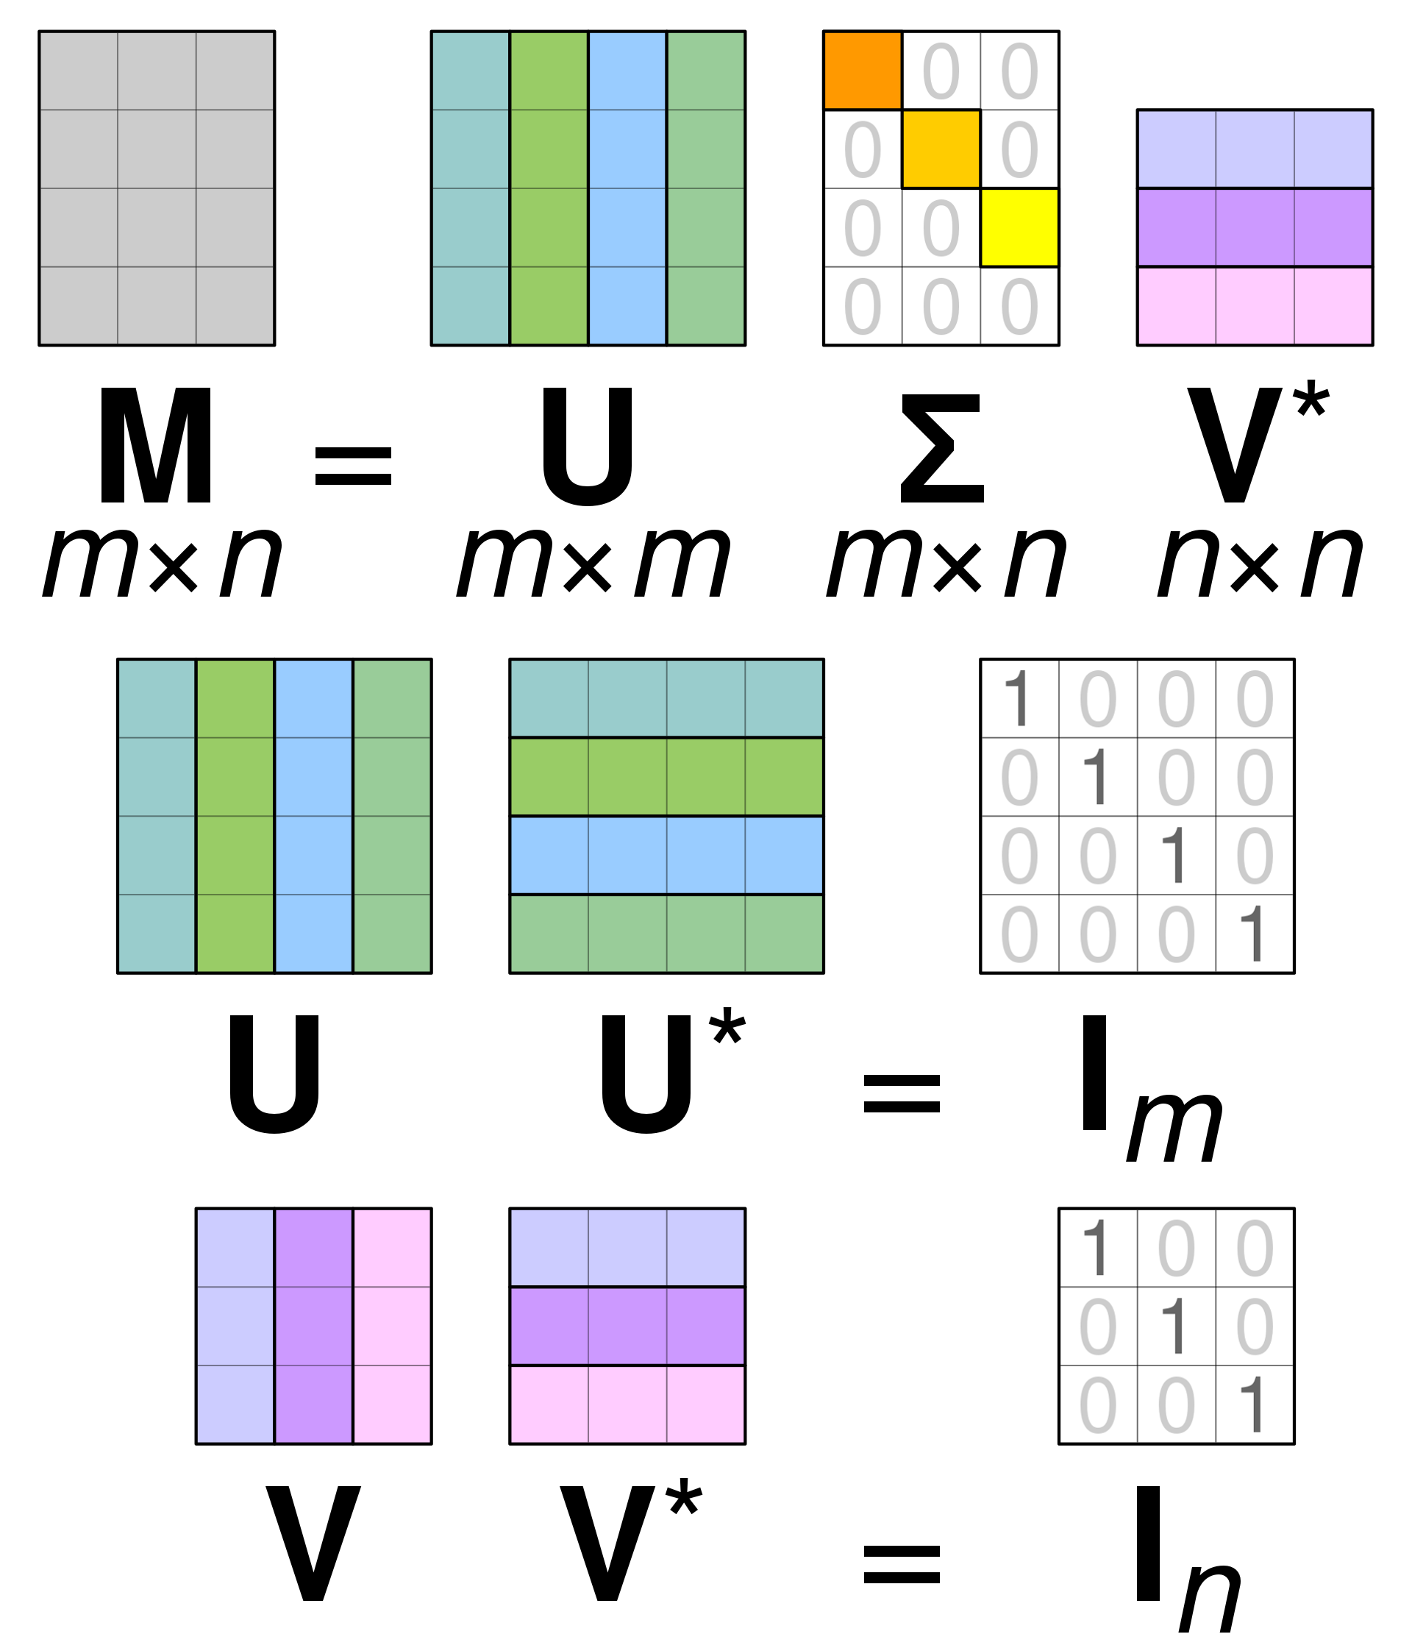
Singular Value Decomposition Pictorially
T
A
T
T
Source: https://en.wikipedia.org/wiki/Singular_value_decomposition#/media/File:Singular_value_decomposition_visualisation.svg

Slide 17

Singular Value Decomposition Example
$$A=\left[\begin{matrix}3 & 1 \\ −1 & 0 \\ 2 & −2\end{matrix}\right]≈\left[\begin{matrix}−0.765 & −0.598 & −0.241 \\ −0.265 & −0.049 & −0.963 \\ −0.588 & −0.800 & −0.120\end{matrix}\right]\left[\begin{matrix}3.756 & 0 \\ 0 & 2.211 \\ 0 & 0\end{matrix}\right]\left[\begin{matrix}−0.994 & 0.109 \\ −0.109 & 0.994\end{matrix}\right]$$

Slide 18

Singular Value Decomposition Interpretation
If $A=UΣV^{T}$, then
$$AA^{T}=$$
$$A^{T}A=$$
The columns of $U$ are the eigenvectors of $AA^{T}$
The columns of $V$ are the eigenvectors of $A^{T}A$
The non-zero elements of $Σ$ are the square roots of the non-zero eigenvalues of $AA^{T}$ and $A^{T}A$

Slide 19
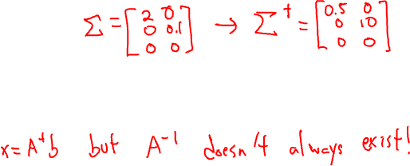
Singular Value Decomposition Uses
If $A=UΣV^{T}$, then the pseudoinverse of a $A$ is
$$A^{†}=VΣ^{†}U^{T}$$
where $Σ^{†}$ is created by replacing every non-zero entry in $Σ$ with its reciprocal, e.g.,
$${Σ= \left[\begin{matrix}2 & 0 \\ 0 & 0.1\end{matrix}\right]→Σ}^{†}=\left[\begin{matrix}0.5 & 0 \\ 0 & 10\end{matrix}\right]$$
The pseudoinverse of a matrix can be used to solve problems of the form $Ax=b$ when $A$ is singular i.e., when the inverse of $A$ does not exist!

Slide 20
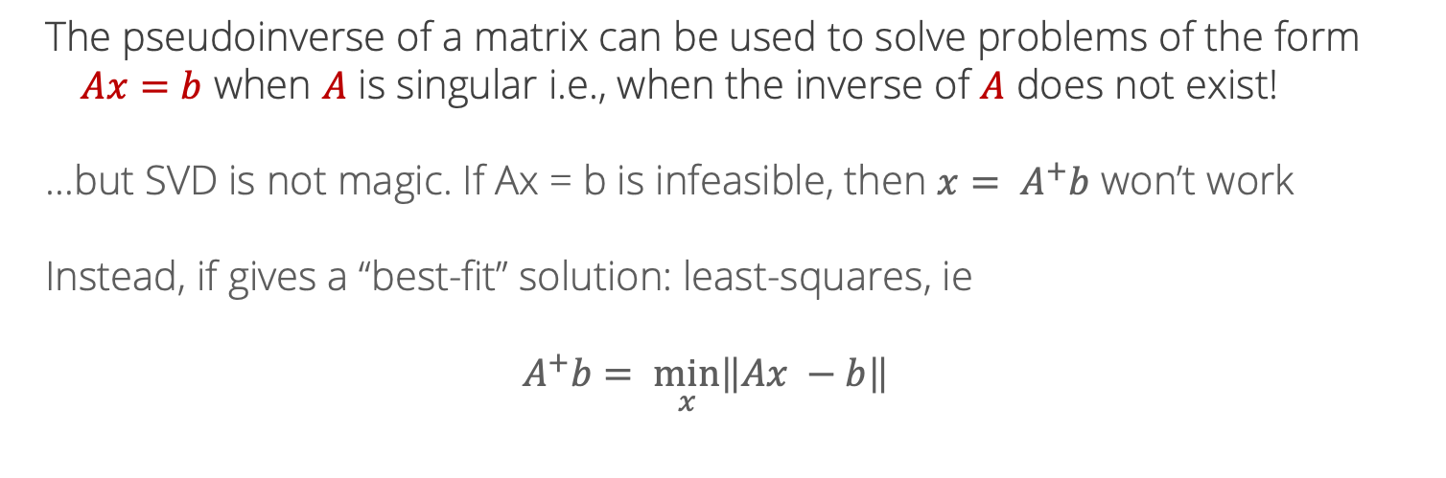
Pseudo-inverse
The pseudoinverse of a matrix can be used to solve problems of the form $Ax=b$ when $A$ is singular i.e., when the inverse of $A$ does not exist!
…but SVD is not magic. If Ax = b is infeasible, then ${x= A}^{+}b$ won’t work
Instead, if gives a “best-fit” solution: least-squares, ie
$$A^{+}b= \min_{x}\left\|Ax −b\right\|$$

Slide 21
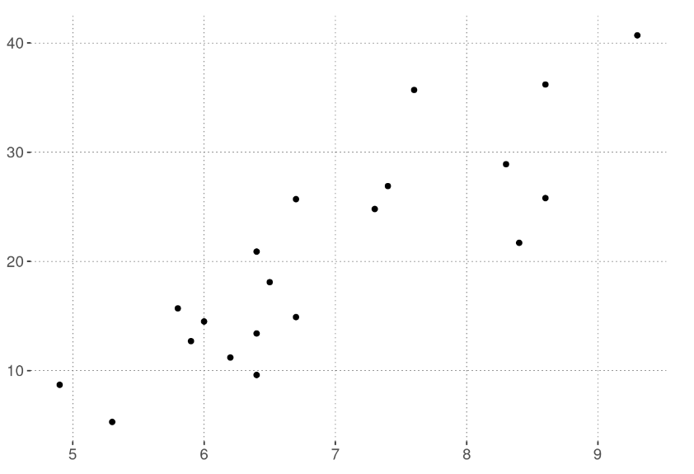
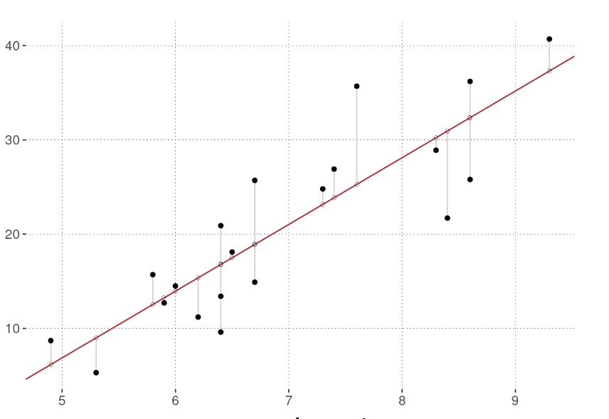

Linear regression
We now have the building blocks to introduce a fundamental ML concept:
Ordinary least squares (OLS) linear regression
Suppose we have data points ${\left\{\left(x_{i}, y_{i}\right)\right\}}_{i=1}^{N}$ and we want to fit a line through them
https://michael-franke.github.io/intro-data-analysis/ordinary-least-squares-regression.html

Slide 22

Linear regression
In 2d, fit a line $y=\hat{β}x+c$. For a new point, predict $\hat{y}=\hat{β}x+c$
With $x∈R^{n}$, coefficients $β∈R^{n}$ as well. $\hat{y}={\hat{β}}^{T}x+c$
Typically, fold $c$ into $β$ by assuming that we add a “1” to the feature vector:
$$x^{′}= \left({x \atop 1}\right)$$
Then, the last entry of $β$ is the intercept, and we just have $\hat{y}={\hat{β}}^{T}x$

Slide 23

Linear regression
What makes for a good set of parameters $β$?
One idea: measure the error on data point $i$ as
$${\left(y_{i} −{\hat{y}}_{i}\right)}^{2}={\left(y_{i} −β^{T}x\right)}^{2}$$
And look for $β$ with the smallest total squared error:
$$\min_{β}{\sum_{i=1}^{N}{{\left(y_{i} −β^{T}x\right)}^{2}}}$$

Slide 24

Ordinary least squares
There is a closed-form expression for the “best” $β$ defined this way. To present it, we introduce some matrix notation.
Let $X= \left[\begin{matrix}x_{1} \\ \begin{aligned}x_{2} \\ … \\ x_{N}\end{aligned}\end{matrix}\right]$ be the matrix obtained by stacking the feature vectors. Then,
$\hat{β}={\left(X^{T}X\right)}^{−1}X^{T}y$
is the set of coefficients that minimize the total squared errors.

Slide 25

Ordinary least squares
$\hat{β}={\left(X^{T}X\right)}^{−1}X^{T}y$
Where does this come from?
We need more tools to derive the solution – covered soon!
Now: a little bit of interpretation

Slide 26

Ordinary least squares
In matrix notation, solves the problem
$$\min_{β}{{\left\|Xβ −y\right\|}_{2}}$$

Slide 27

Ordinary least squares
In matrix notation, solves the problem
$$\min_{β}{{\left\|Xβ −y\right\|}_{2}}$$
$$\left[\begin{matrix}{−x}_{1}− \\ \begin{aligned}−x_{2}− \\ … \\ {−x}_{N}−\end{aligned}\end{matrix}\right]β=\left[\begin{matrix}x_{1}^{T}β \\ \begin{aligned}x_{2}^{T}β \\ … \\ x_{N}^{T}β\end{aligned}\end{matrix}\right]=\left[\begin{matrix}{\hat{y}}_{1} \\ \begin{aligned}{\hat{y}}_{2} \\ … \\ {\hat{y}}_{N}\end{aligned}\end{matrix}\right]$$

Slide 28
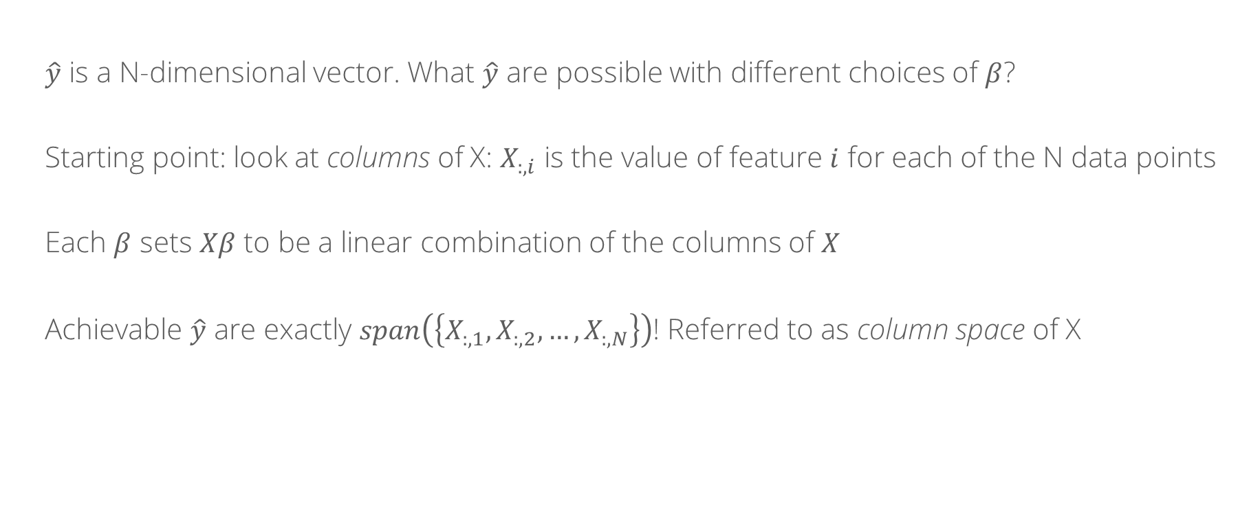
Ordinary least squares: geometric interpretation
$\hat{y}$ is a N-dimensional vector. What $\hat{y}$ are possible with different choices of $β$?
Starting point: look at columns of X: $X_{:, i}$ is the value of feature $i$ for each of the N data points
Each $β$ sets $Xβ$ to be a linear combination of the columns of $X$
Achievable $\hat{y}$ are exactly $span\left(\left\{X_{:, 1},X_{:, 2}, …, X_{:, N}\right\}\right)$! Referred to as column space of X

Slide 29
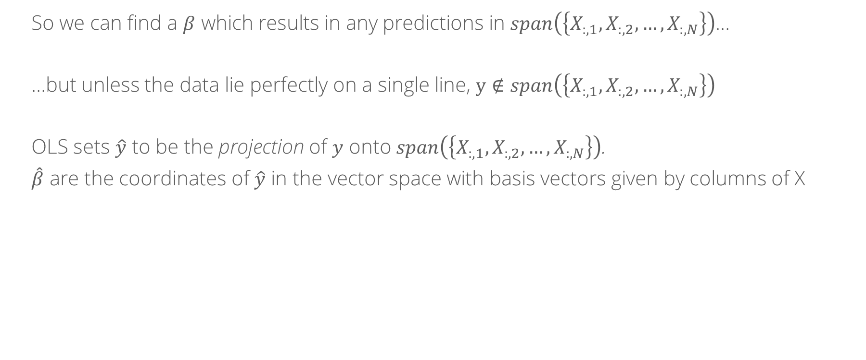
Ordinary least squares: geometric interpretation
So we can find a $β$ which results in any predictions in $span\left(\left\{X_{:, 1},X_{:, 2}, …, X_{:, N}\right\}\right)$…
…but unless the data lie perfectly on a single line, $y∉span\left(\left\{X_{:, 1},X_{:, 2}, …, X_{:, N}\right\}\right)$
OLS sets $\hat{y}$ to be the projection of $y$ onto $span\left(\left\{X_{:, 1},X_{:, 2}, …, X_{:, N}\right\}\right)$.
$\hat{β}$ are the coordinates of $\hat{y}$ in the vector space with basis vectors given by columns of X

Slide 30

Regularization
Natural extension:
$\min_{β}{{\left\|Xβ −y\right\|}_{2}}+λ{\left\|β\right\|}_{p}$ with respect to some p-norm
Penalize “large” coefficients
Common choices: p = 1, 2

Slide 31
Whiteboard: l1 vs l2 regularization

