Slide 1
Mathematical Foundations for ML (10-606):
Optimization
Bryan Wilder
* Slides borrowed from prior offerings by Professors M. Gormley, P. Virtue, & G. Gordon, & H. Heidari.

Slide 2

Constrained optimization and Lagrange multipliers
Consider a constrained optimization problem:
$$\min{f\left(x\right)}$$
$$g_{i}\left(x\right)=0, i=1…N$$
$$h_{j}\left(x\right)≤0, j=1…M$$
Today: one general method for solving such problems

Slide 3

Lagrangian
The Lagrangian folds the constraints into the objective function:
$${L\left(x, y, λ\right)= f\left(x\right)+\sum_{i=1}^{n}{λ_{i}g_{i}\left(x\right)}+\sum_{j=n+1}^{m+n}{λ_{j}h_{j}\left(x\right)}}$$
Interpretation: allow violations of the constraint but pay “penalties” $λ$

Slide 4
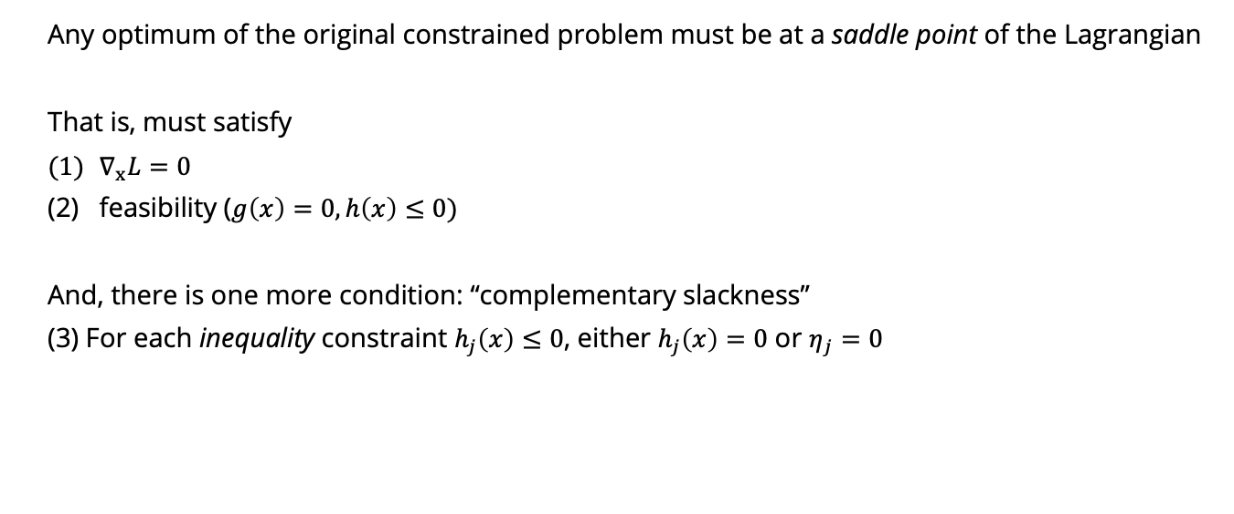
Lagrangian
Any optimum of the original constrained problem must be at a saddle point of the Lagrangian
That is, must satisfy
$∇_{x}L=0$
feasibility ($g\left(x\right)=0, h\left(x\right)≤0)$
And, there is one more condition: “complementary slackness”
(3) For each inequality constraint $h_{j}\left(x\right)≤0$, either $h_{j}\left(x\right)=0$ or $η_{j}=0$

Slide 5

Intuition
Lagrange multipliers correspond to the implied “prices” for each constraint: if the optimal Lagrange multiplier is $λ_{i}$, you would be willing to pay at a rate $λ_{i}$ to infinitesimally relax the constraint
Complementary slackness: if an inequality constraint is not tight at the solution, no price for it!

Slide 6

Strategy
Form a system of equations by differentiating the Lagrangian
Solve for all $x$ which satisfy first-order criticality, feasibility, and complementary slackness
Optimum must be in this set of solutions

Slide 7
Whiteboard
Examples of method of Lagrange multipliers

Slide 8
Wrap up: convexity
Alternate definitions
Analysis of the OLS solution

