Slide 1
Mathematical Foundations for ML (10-606):
Linear Operators & Matrices
Bryan Wilder
* Slides borrowed from prior offerings by Professors M. Gormley, P. Virtue, & G. Gordon, & H. Heidari.

Slide 2
Announcements
Quiz 1 back today
Solutions: recitation on Friday
Also office hours, etc. For regrades: Nandini and Meghana
Notes:
Example: functional -> integral, operator -> identity function

Slide 3
Functions on Vector Spaces
f: V → W where V and W are (potentially abstract) vector spaces
Functionals:
f: V → R
Operators:
f: V → V
Linear functions: f(ax + by) = a f(x) + b f(y)
affine=linear + constant
Notes:
Example: functional -> integral, operator -> identity function

Slide 4
Whiteboard: examples of linear functions
+matrix multiplication
+derivative

Slide 5
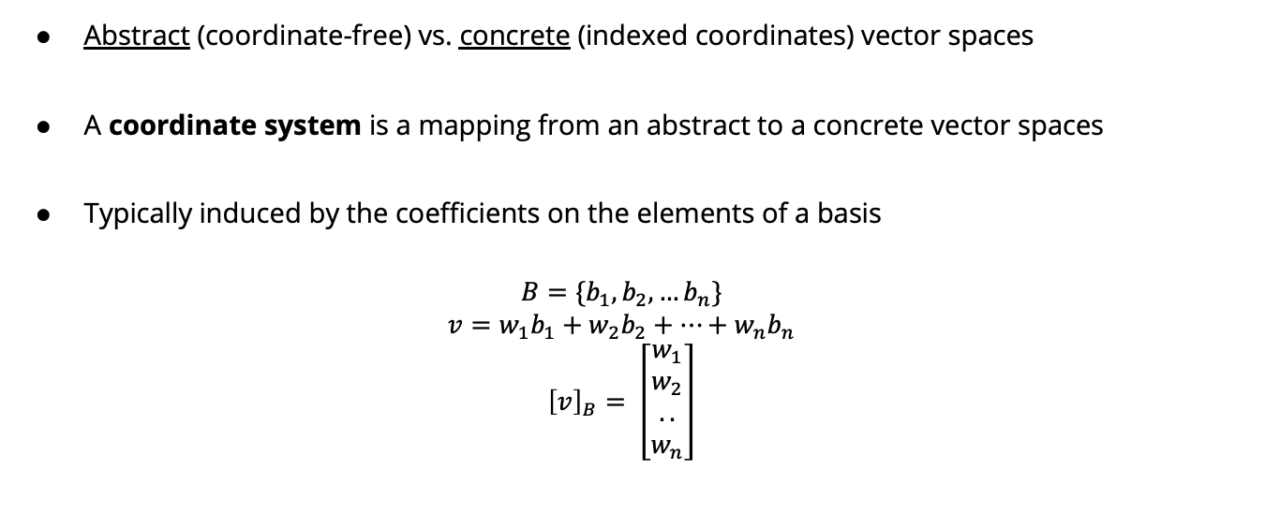
Reminder: Coordinate Systems
Abstract (coordinate-free) vs. concrete (indexed coordinates) vector spaces
A coordinate system is a mapping from an abstract to a concrete vector spaces
Typically induced by the coefficients on the elements of a basis
$$B=\{b_{1}, b_{2},…b_{n}\}$$
$$v=w_{1}b_{1}+w_{2}b_{2}+…+w_{n}b_{n}$$
$${\left[v\right]}_{B}= \left[\begin{matrix}w_{1} \\ w_{2} \\ .. \\ w_{n}\end{matrix}\right]$$

Slide 6

Reminder: Coordinate Systems
$$b_{1}= \left[\begin{matrix}1 \\ 1\end{matrix}\right]b_{2}= \left[\begin{matrix}1 \\ −1\end{matrix}\right]$$
$$v=\left[\begin{matrix}2 \\ 1\end{matrix}\right]$$
= $\frac{3}{2}b_{1}+\frac{1}{2}b_{2}$
$${\left[v\right]}_{B}=\left[\begin{matrix}\frac{3}{2} \\ \frac{1}{2}\end{matrix}\right]$$

Slide 7
Coordinate Representation of Linear Functions
Consider linear function ℓ: X→Y (s.t., ℓ(ax₁+ bx₂) = a ℓ(x₁) + b ℓ(x₂))
X with bases {b₁, …, b_{n}} and Y with basis {c₁, …, c_{m}}
Goal: find a linear representation of ℓ, denoted by matrix L∈R^{m×n}, s.t.
ℓ(x) = y ⇔ L u = v

Slide 8
Rank and Null-space
Recall: for any f: X→ Y, range(f) = {f(x)| x ∈ X}.
Suppose ℓ: X→ Y is a linear transformation represented by matrix L.
rank(ℓ) = dim(range(ℓ))
rank(ℓ) = rank(L) = the dimension of the vector space generated by columns of L.
= the dimension of the vector space generated by rows of L.
Suppose ℓ is a linear operator (i.e., X=Y)
nullity(ℓ) = dim({x | ℓ(x) = 0})

Slide 9
Whiteboard: examples of rank

Slide 10
Systems of equations
Next, we’ll discuss using matrices to represent and solve systems of linear equations

Slide 11
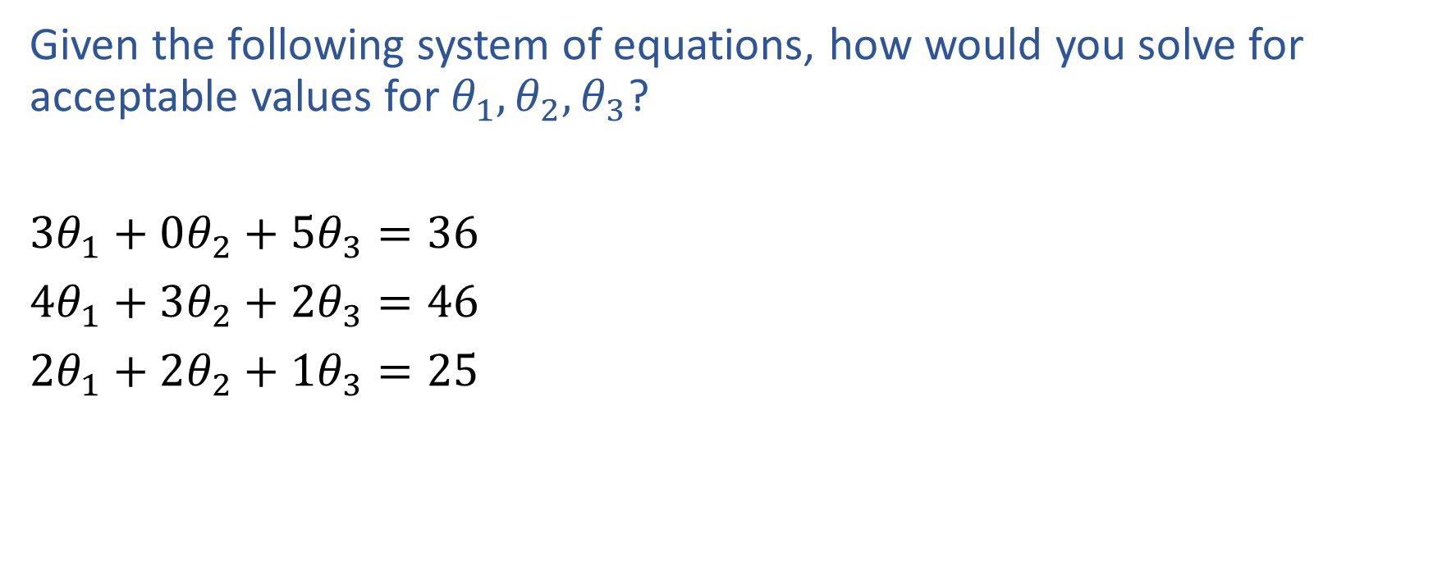
Exercise

Slide 12
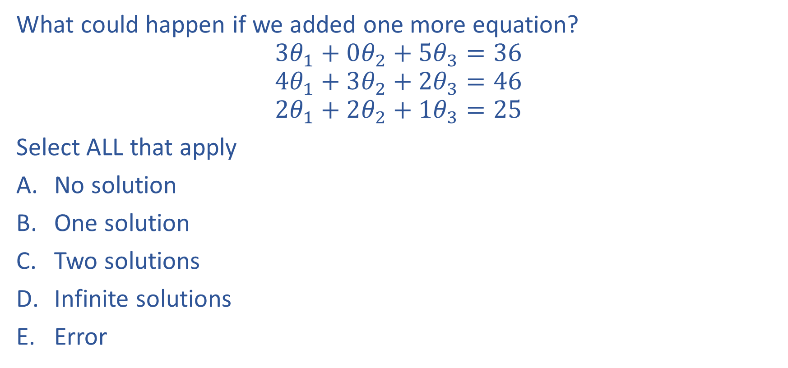
Poll 1

Slide 13
Poll 1

Slide 14
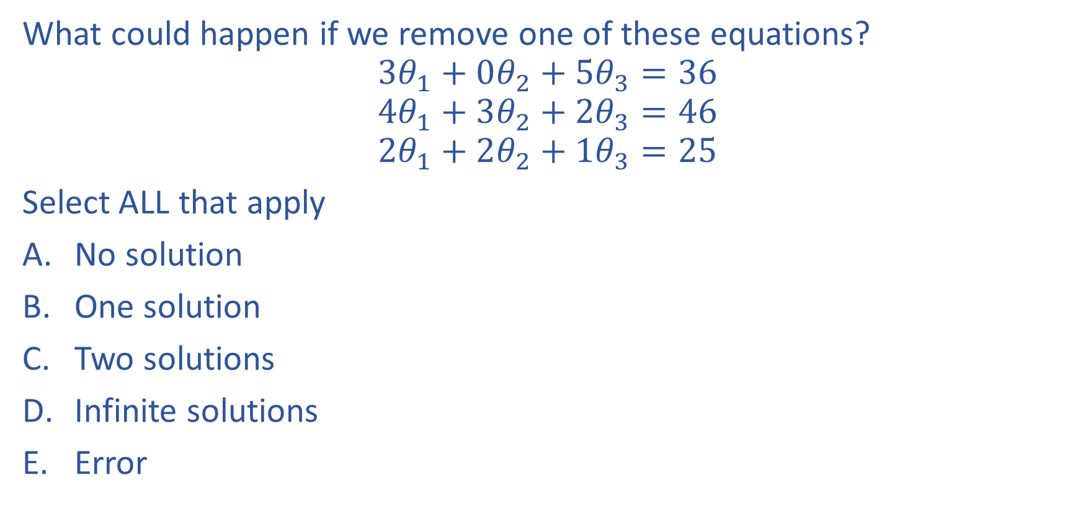
Poll 2

Slide 15
Poll 2

Slide 16
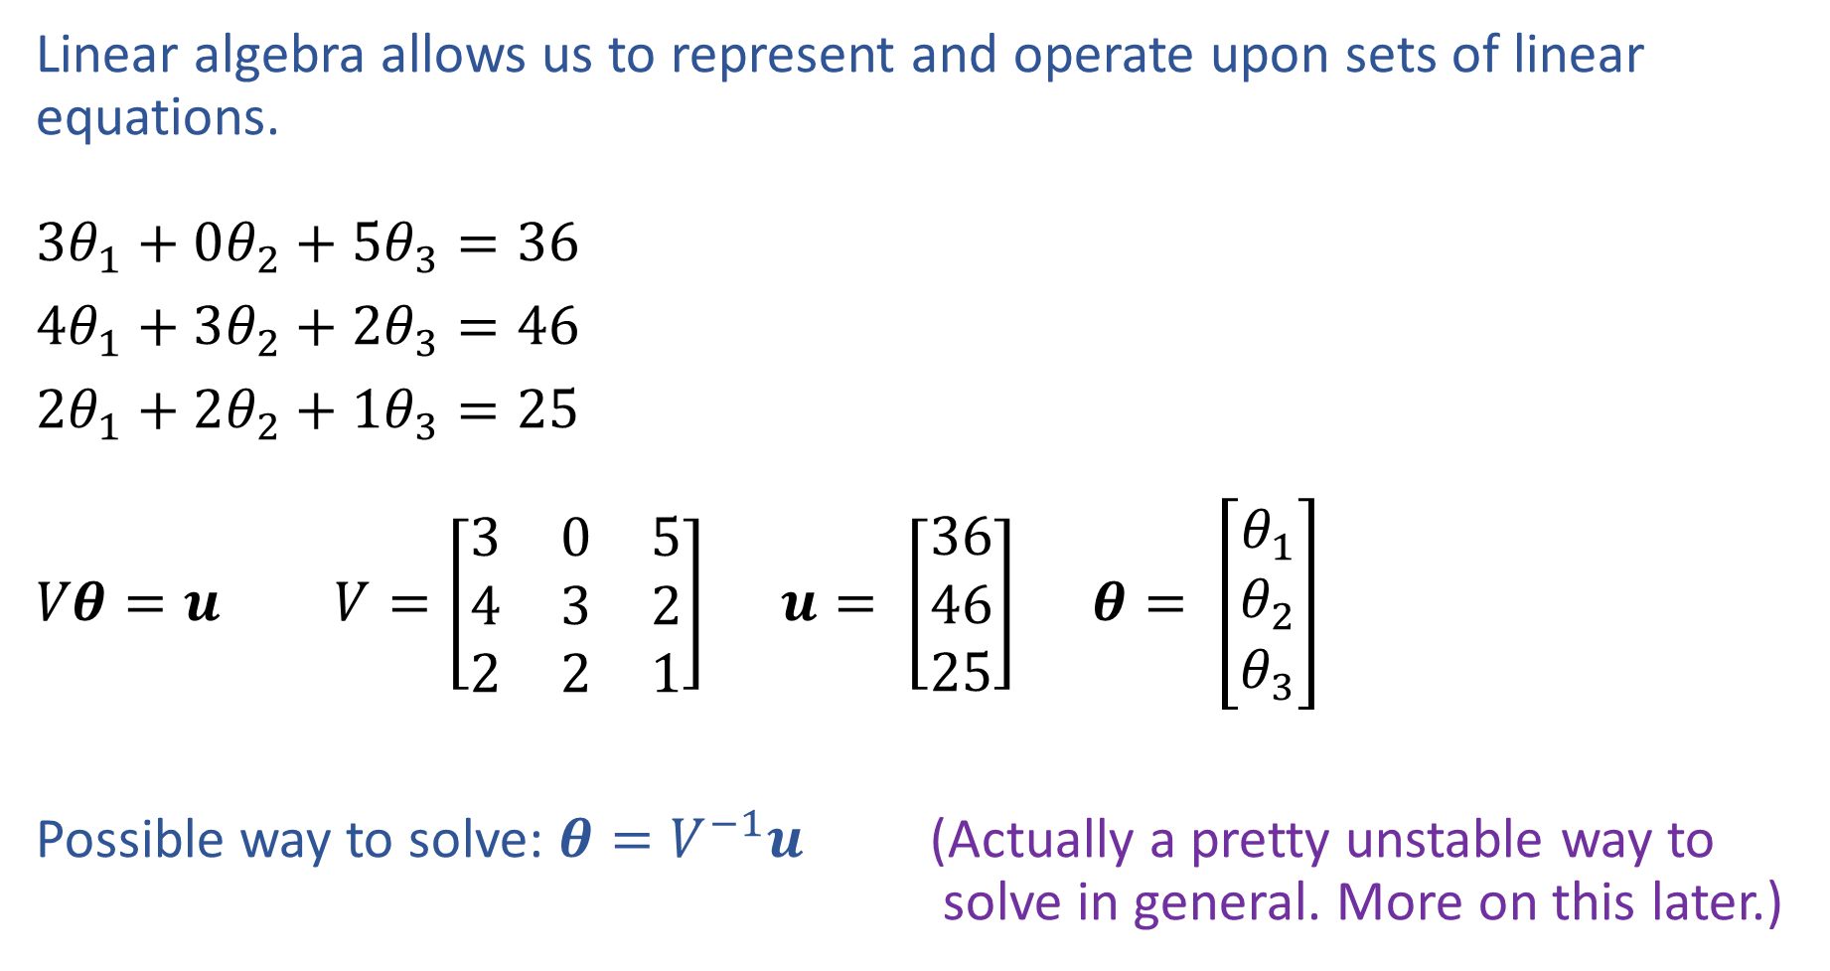
Linear Algebra
Notation alert!

Slide 17
Connection to rank of the matrix
Rank > unknowns: no solution
Rank = unknowns: unique solution
Rank < unknowns: infinite solutions or no solution

Slide 18
Gaussian Elimination
Numerical method to solve linear systems
Convert matrix to row-echelon form
Backsubstitute to solve the system

Slide 19
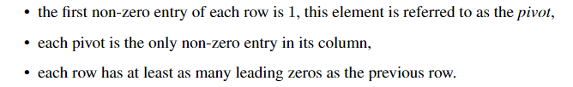
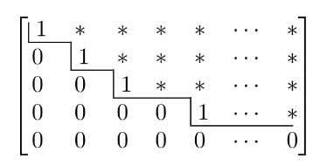
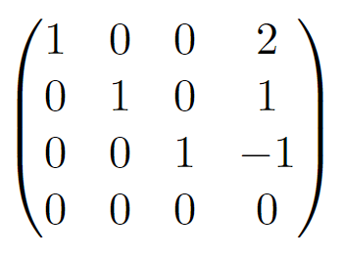
Row-echelon form

Slide 20
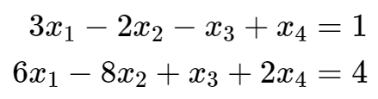
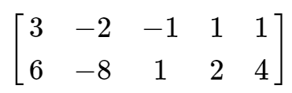

Gaussian elimination
To solve system $Ax=b$, perform Gaussian elimination on augmented matrix $\left(\begin{matrix}A & b\end{matrix}\right)$

Slide 21
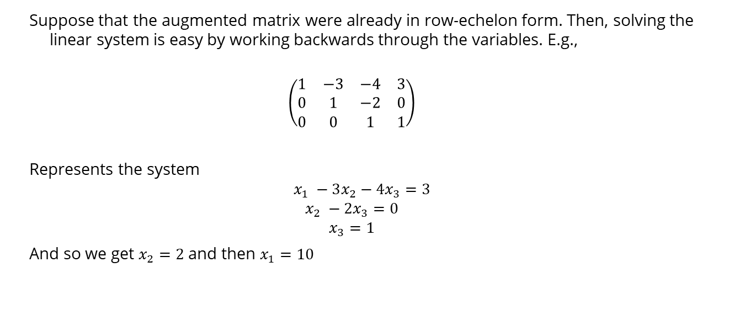
Back substitution
Suppose that the augmented matrix were already in row-echelon form. Then, solving the linear system is easy by working backwards through the variables. E.g.,
$$\left(\begin{matrix}1 & −3 & −4 & 3 \\ 0 & 1 & −2 & 0 \\ 0 & 0 & 1 & 1\end{matrix}\right)$$
Represents the system
$$x_{1} −3x_{2}−4x_{3}=3$$
$$x_{2} −2x_{3}=0$$
$$x_{3}=1$$
And so we get $x_{2}=2$ and then $x_{1}=10$

Slide 22
Gaussian Elimination
Form the row-echelon form using elementary transformations:
Exchange of two equations
Multiplication of an equation with a constant λ ∈ R\{0}
Addition of two equations
Intuition: these are operations that preserve equalities

Slide 23
Whiteboard

Slide 24
Computing ranks
REF also gives an easy way to compute the rank of a matrix: convert to REF and count the number of rows that are not all zeros
Works because REF operations preserve rank, and rank of REF matrices is just number of non-zero rows

Slide 25
Fundamental Theorem of Linear Algebra
For Linear Functions
For Matrices
the rank and nullity of a linear function are equal to the rank and nullity of its adjoint
the range of a linear function and the nullspace of its adjoint are always orthogonal
the rank and nullity of a matrix are equal to the rank and nullity of its transpose
the rank of a matrix and the nullspace of its transpose are always orthogonal
(i.e. any vector in the range is orthogonal to any vector in the nullspace of the adjoint)

