Slide 1
Computational Foundations for ML (10-607):
Overview & Propositional Logic
Bryan Wilder
* Slides borrowed from prior offerings of the course by Professors M. Gormley, P. Virtue, & G. Gordon.

Slide 2
Course Overview
Goals:
A formal presentation of computational background needed to understand ML
Motivated by (carefully chosen) real-world problems that arise in ML applications,
Audience:
students wishing to prepare for future coursework in Machine Learning

Slide 3
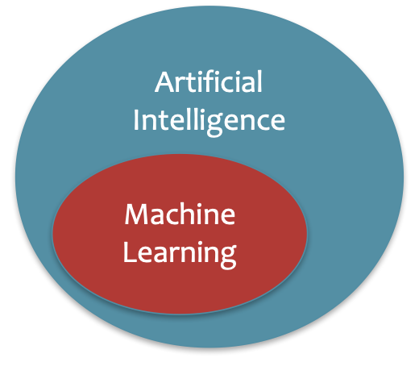
What is Artificial Intelligence?
The basic goal of AI is to develop intelligent machines.
Intelligence is the computational part of the ability to achieve goals in the world.
This consists of many sub-goals:
Perception
Reasoning
Control/Motion/Manipulation
Planning
Communication
Creativity
Learning
…
Notes:
http://www-formal.stanford.edu/jmc/whatisai/whatisai.html

Slide 4
What is Machine Learning?
Machine learning aims to design algorithms that automatically extract valuable information from data by modeling the data-generating process.
Data
Model
Learning

Slide 5
What is Machine Learning?
Machine learning aims to design algorithms that automatically extract valuable information from data by modeling the data-generating process.
Data → Vectors, Matrices, Data Structures
Model → Probability
Learning → Optimization, Algorithm Design and Analysis

Slide 6
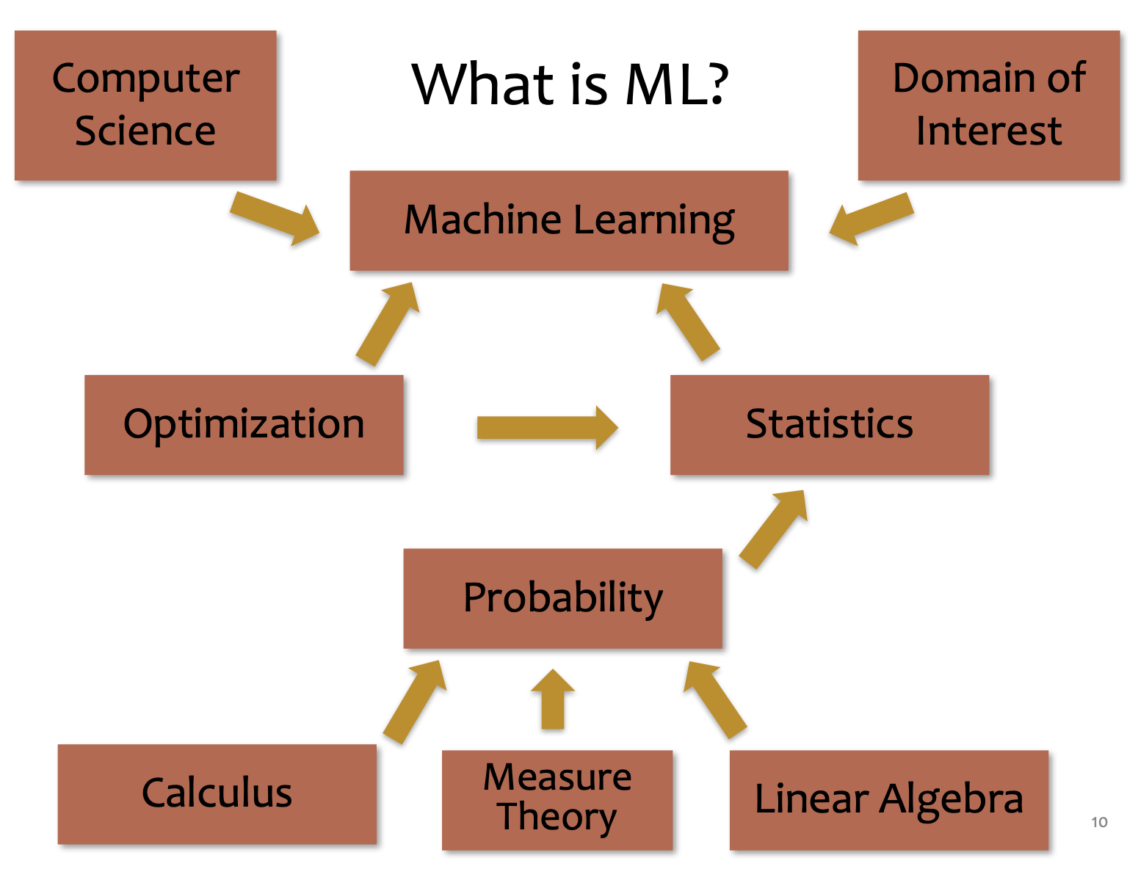
What is Machine Learning?

Slide 7
This course
Writing formal proofs
Propositional logic
Proof strategies
Computational complexity
Data structures
Algorithms

Slide 8
Course website
https://github.com/bwilder0/10607-f2025(Link also in canvas)
This is where we will maintain the class schedule, post lecture notes, etc. Also has the syllabus and policies.
Assignments: submitted via Gradescope
OH Schedule: Canvas

Slide 9
Grading and policies
50%: Homeworks due each week (gradescope)
First one due Sunday!
50%: 3 in-person quizzes
All information is on the course website

Slide 10
Course structure
Monday/Wednesday: lecture with instructor
Friday: recitation with TA (starting this week)
Sunday EOD: homework due

Slide 11
Expected Background
We’re assuming mathematical maturity: you should be familiar with the idea of derivations and proofs, and of building formal representations for objects given their English­ description.
We’ll assume that you can take scalar derivatives.
We’ll assume that you’ve seen real vector spaces and matrices (linear operators) and know how to reason about things like matrix multiplication and solving systems of linear equations.
We’ll assume that you’ve seen sets and data types.
We’ll assume that you’ve worked with probabilities (e.g., conditioning, Bayes rule).
We will also assume familiarity with coding. The assignments and in-class activities will include some Python.

Slide 12
Why Computer Science for ML?
10-607
To best understand A we need B
A | B
Analysis of Exact Inference in Graphical Models | Computation Computational Complexity Recursion; Dynamic Programming Data Structures for ML Algorithms
Implementation Design of a Deep Learning Library | Programming & Efficiency Debugging for Machine Learning Efficient Implementation / Profiling ML Algorithms
Optimization for Support Vector Machines (SVMs) | Optimization Unconstrained Optimization Preconditioning Constrained Optimization
Slide credit: CMU MLD Matt Gormley

Slide 13
Why Computer Science for ML?
10-607
To best understand A we need B
A | B
Analysis of Exact Inference in Graphical Models | Computation Computational Complexity Recursion; Dynamic Programming Data Structures for ML Algorithms
Implementation Design of a Deep Learning Library | Programming & Efficiency Debugging for Machine Learning Efficient Implementation / Profiling ML Algorithms
Optimization for Support Vector Machines (SVMs) | Optimization Unconstrained Optimization Preconditioning Constrained Optimization
Slide credit: CMU MLD Matt Gormley

Slide 14
Backpropagation
Training
Automatic Differentiation – Reverse Mode (aka. Backpropagation)
Forward Computation
Write an algorithm for evaluating the function y = f(x). The algorithm defines a directed acyclic graph, where each variable is a node (i.e. the “computation graph”)
Visit each node in topological order. For variable u_{i} with inputs v₁,…, v_{N}
Compute u_{i} = g_{i}(v₁,…, v_{N})
Store the result at the node
Backward Computation
Initialize all partial derivatives dy/du_{j} to 0 and dy/dy = 1.
Visit each node in reverse topological order. For variable u_{i} = g_{i}(v₁,…, v_{N})
We already know dy/du_{i}
Increment dy/dv_{j} by (dy/du_{i})(du_{i}/dv_{j}) (Choice of algorithm ensures computing (du_{i}/dv_{j}) is easy)
Slide credit: CMU MLD Matt Gormley
Note: This is just motivation – we’ll cover the math need to understand these topics later!
Return partial derivatives dy/du_{i} for all variables

Slide 15
Propositional Logic and Proofs

Slide 16
Which of the following are valid arguments?
If a meal is a sandwich, it has bread
This meal is a sandwich
Therefore, it has bread
If a bird is a swan, it has white feathers
This bird has white features
Therefore, it is a swan
If the dog is hungry, it will bark
The dog has not barked
Therefore, it is not hungry

Slide 17
Propositional Logic
Symbol:
Variable that can be true or false
Denoted using letters (a, b, p, q, etc)
Often include True and False (T and F)
Operators/connectives:
¬ A: not A
A ∧ B: A and B (conjunction)
A ∨ B: A or B (disjunction) Note: this is not an “exclusive or”
A ⇒ B: A implies B (implication). If A then B
A ⇔ B: A if and only if B (biconditional)

Slide 18
Propositional Logic
Translate to propositional logic:
“You cannot ride the roller coaster if you are under 4 feet tall unless you are older than 16 years old.”

Slide 19
Propositional Logic
Determine whether these system specifications are consistent:
“The diagnostic message is stored in the buffer or it is retransmitted.”
“The diagnostic message is not stored in the buffer.”
“If the diagnostic message is stored in the buffer, then it is retransmitted.”

Slide 20
Propositional Logic
Determine whether these system specifications are consistent:
“The diagnostic message is stored in the buffer or it is retransmitted.”
“The diagnostic message is not stored in the buffer.”
“If the diagnostic message is stored in the buffer, then it is retransmitted.”
Do the system specifications remain consistent if the specification “The diagnostic message is not retransmitted” is added?

Slide 21
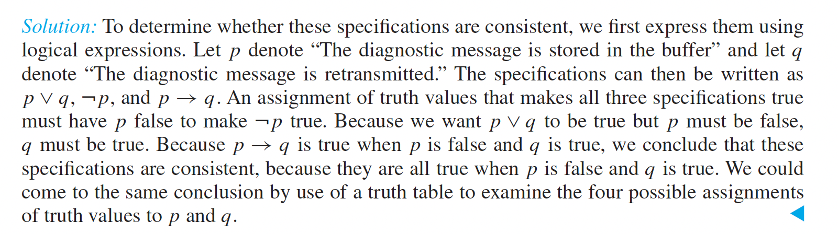
Propositional Logic
Determine whether these system specifications are consistent:
“The diagnostic message is stored in the buffer or it is retransmitted.”
“The diagnostic message is not stored in the buffer.”
“If the diagnostic message is stored in the buffer, then it is retransmitted.”

Slide 22
Propositional Logic Semantics
Truth Tables for ∧ and ∨
𝛂 | 𝛃 | 𝛂 ∧ 𝛃
F | F | F
F | T | F
T | F | F
T | T | T
𝛂 | 𝛃 | 𝛂 ∨ 𝛃
F | F | F
F | T | T
T | F | T
T | T | T

Slide 23
Notes on Operators
𝛂 ∨ 𝛃 is inclusive or, not exclusive

Slide 24
Notes on Operators
𝛂 ∨ 𝛃 is inclusive or, not exclusive
𝛂 ⇒ 𝛃 is equivalent to ¬𝛂 ∨ 𝛃
Says who?

Slide 25
Truth Tables
𝛂 ⇒ 𝛃 is equivalent to ¬𝛂 ∨ 𝛃
𝛂 | 𝛃 | 𝛂 ⇒ 𝛃 | ¬𝛂 | ¬𝛂 ∨ 𝛃
F | F | T | T | T
F | T | T | T | T
T | F | F | F | F
T | T | T | F | T

Slide 26
One interesting consequence:
If a is always false, then a ⇒ b is true for any b!
(i.e., ¬a ∨ b is always true)
“If pigs can fly, then 1 + 2 = 5” is true!

Slide 27
Notes on Operators
𝛂 ∨ 𝛃 is inclusive or, not exclusive
𝛂 ⇒ 𝛃 is equivalent to ¬𝛂 ∨ 𝛃
Says who?
𝛂 ⇔ 𝛃 is equivalent to (𝛂 ⇒ 𝛃) ∧ (𝛃 ⇒ 𝛂)
Prove it!

Slide 28
Truth Tables
𝛂 ⇔ 𝛃 is equivalent to (𝛂 ⇒ 𝛃) ∧ (𝛃 ⇒ 𝛂)
𝛂 | 𝛃 | 𝛂 ⇔ 𝛃 | 𝛂 ⇒ 𝛃 | 𝛃 ⇒ 𝛂 | (𝛂⇒𝛃) ∧ (𝛃⇒𝛂)
F | F | T | T | T | T
F | T | F | T | F | F
T | F | F | F | T | F
T | T | T | T | T | T
Equivalence: it’s true in all models. Expressed as a logical sentence:
(𝛂 ⇔ 𝛃) ⇔ [(𝛂 ⇒ 𝛃) ∧ (𝛃 ⇒ 𝛂)]

Slide 29
Truth tables
Exercise: use a truth table to prove that (p ⇔ q) ⇔ (p ∧ q) ∨ (¬p ∧ ¬q)

Slide 30
Exercise 1
If we know that 𝐴 ∨ 𝐵 and ¬𝐵 ∨ 𝐶 are true, what do we know about 𝐴 ∨ 𝐶?
𝐴 ∨ 𝐶 is guaranteed to be true
𝐴 ∨ 𝐶 is guaranteed to be false
We don’t have enough information to say anything definitive about 𝐴 ∨ 𝐶

Slide 31
Exercise 2
If we know that 𝐴 ∨ 𝐵 and ¬𝐵 ∨ 𝐶 are true, what do we know about 𝐴?
𝐴 is guaranteed to be true
𝐴 is guaranteed to be false
We don’t have enough information to say anything definitive about 𝐴

Slide 32
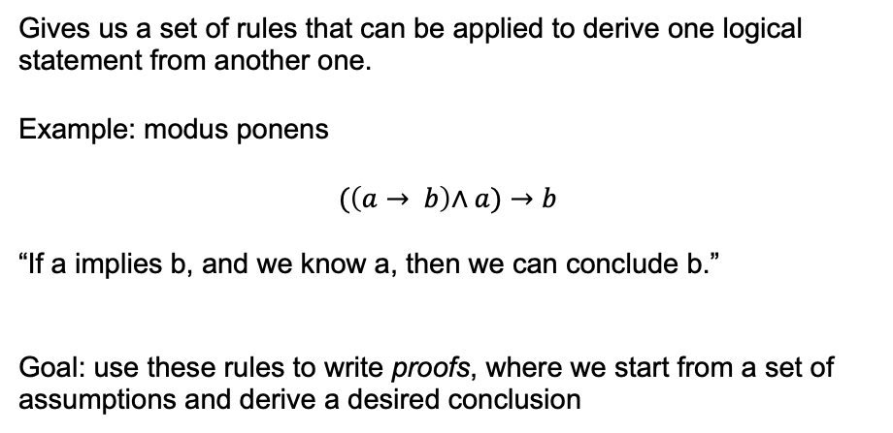
Inference rules
Gives us a set of rules that can be applied to derive one logical statement from another one.
Example: modus ponens
$$(\left(a→ b\right)\text{∧} a)→b$$
“If a implies b, and we know a, then we can conclude b.”
Goal: use these rules to write proofs, where we start from a set of assumptions and derive a desired conclusion

Slide 33
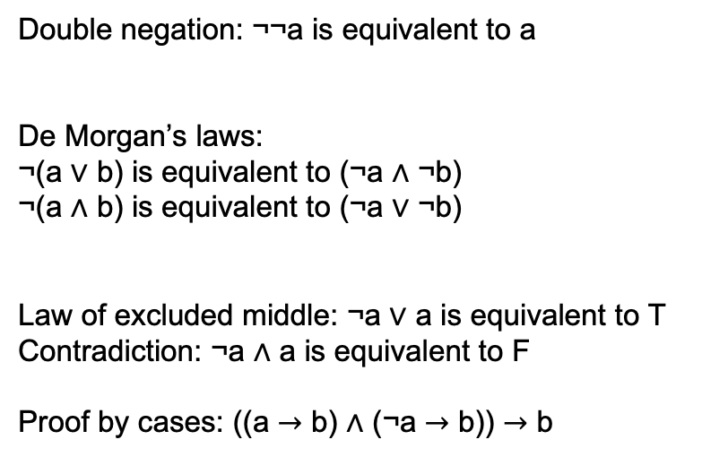
Inference rules
Double negation: ¬¬a is equivalent to a
De Morgan’s laws:
¬(a ∨ b) is equivalent to (¬a ∧ ¬b)
¬(a ∧ b) is equivalent to (¬a ∨ ¬b)
Law of excluded middle: ¬a ∨ a is equivalent to T
Contradiction: ¬a ∧ a is equivalent to F
Proof by cases: ((a $→$ b) ∧ (¬a $→$ b)) $→$ b

Slide 34

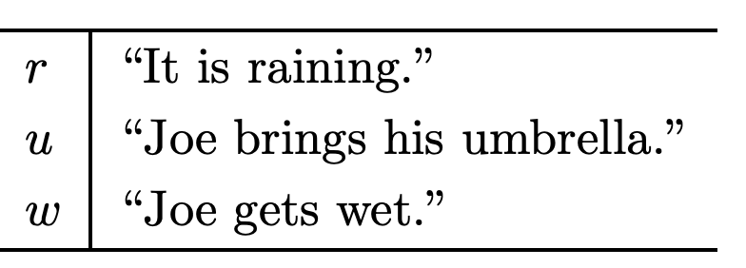
Assumptions:
(a1)
(a2)
(a3)
Prove: ¬w
http://infolab.stanford.edu/~ullman/focs/ch12.pdf
Notes:
Introduce r or not r with excluded middle. Then, proof by cases. R: go r -> u, then u to not w. not R: conclude (r or not r) -> not w, so T -> not w and conclude not w by MP

Slide 35
Predicates
Often, we want to make logical statements about any member of a set
Let P(x) denote a statement about a single x
E.g. P(x) = “x is even”
P(1): False
P(2): True

Slide 36
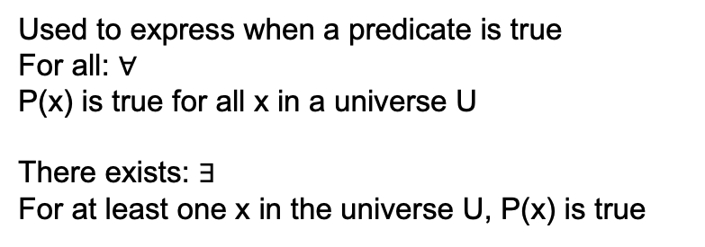
Quantifiers
Used to express when a predicate is true
For all: $∀$
P(x) is true for all x in a universe U
There exists: $∃$
For at least one x in the universe U, P(x) is true

Slide 37
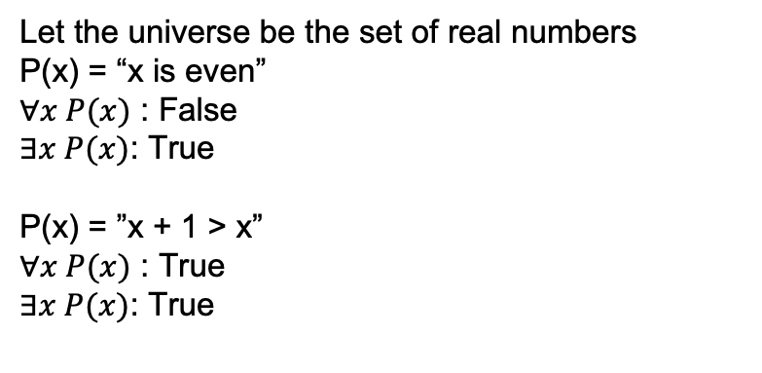
Quantifiers
Let the universe be the set of real numbers
P(x) = “x is even”
$∀x P(x)$ : False
$∃x P(x)$: True
P(x) = ”x + 1 > x”
$∀x P(x)$ : True
$∃x P(x)$: True

Slide 38
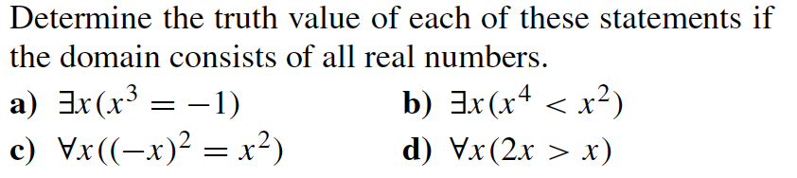
Quantifiers

Slide 39
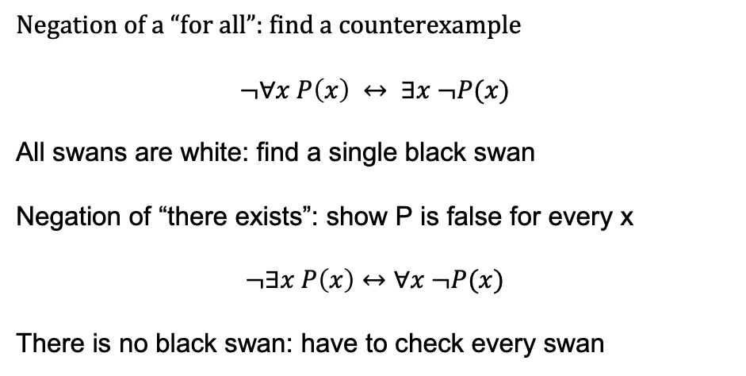
Negations of quantifiers
Negation of a “for all”: find a counterexample
$$¬∀x P\left(x\right) ↔ ∃x ¬P(x)$$
All swans are white: find a single black swan
Negation of “there exists”: show P is false for every x
$$¬∃x P\left(x\right)↔∀x ¬P(x)$$
There is no black swan: have to check every swan

