Slide 1
Computational Foundations for ML (10-607):
Proof Techniques
Bryan Wilder
* Slides borrowed from prior offerings of the course by Professors M. Gormley, P. Virtue, & G. Gordon.

Slide 2
Lecture Overview
Today:
Proof by Construction
Proof by Cases
Disproof by Example
Next week:
Proof by Contradiction
Proof by Contraposition
Proof by Induction

Slide 3
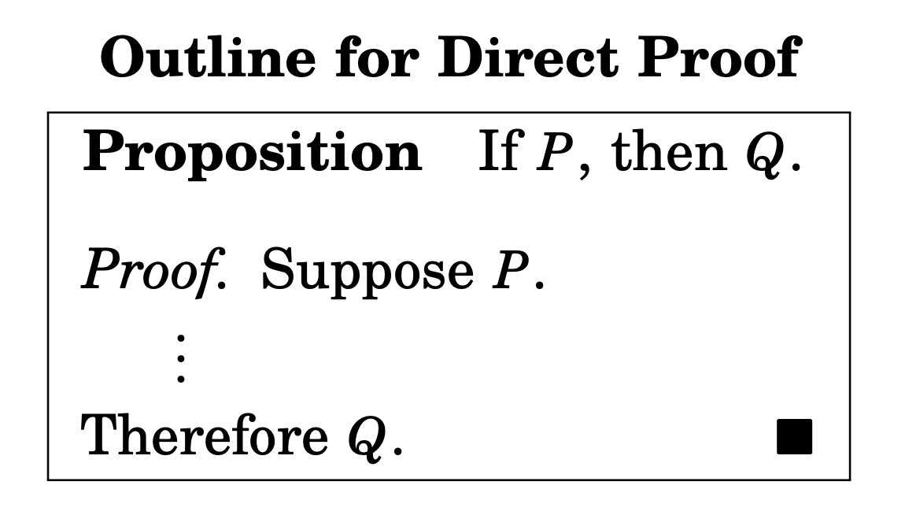
Proof by Construction
Also called a “direct proof”: establish P ⇒ Q directly.
Assume that P is true.
Use P to show that Q must be true.
Notes:
Also called direct proof

Slide 4
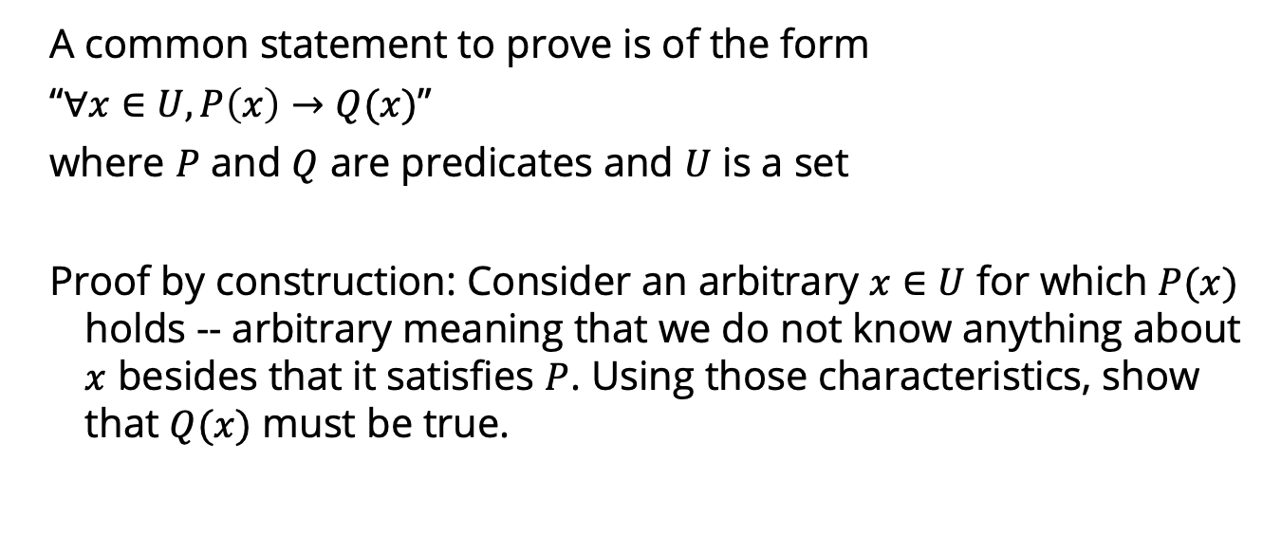
Proof by Construction
A common statement to prove is of the form
“$∀x∈U, P\left(x\right)→Q(x)$”
where $P$ and $Q$ are predicates and $U$ is a set
Proof by construction: Consider an arbitrary $x∈U$ for which $P(x)$ holds -- arbitrary meaning that we do not know anything about $x$ besides that it satisfies $P$. Using those characteristics, show that $Q(x)$ must be true.

Slide 5
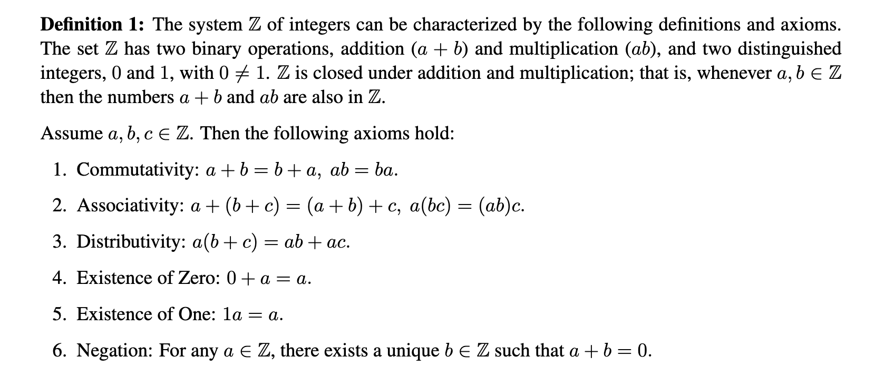
Setting: proving things about integers

Slide 6
Proof by construction
Example: If a, b ∈ Z are consecutive (i.e., b = a+1), then the sum a + b is odd.
Definition 1: An integer a is odd if there exists another integer k such that a = 2k + 1.
Definition 2: An integer a is even if there exists another integer k such that a = 2k.

Slide 7
Proof by construction
Example: Let a,b and c be integers. If a | b and b | c, then a | c.
Definition 3: a | b means “b is divisible by a”, i.e., there exists an integer k such that b = ak.
Notes:
b = k_1 a, c = k_2 b. c = k_2 k_1 a. Since k_2 k_1 \in N, a | c

Slide 8
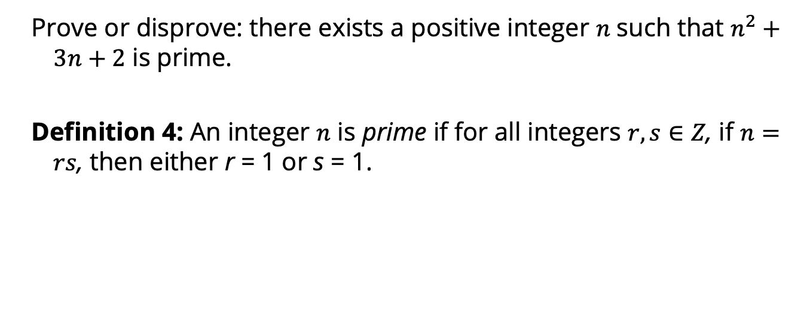
Proof by construction
Prove or disprove: there exists a positive integer 𝑛 such that $n^{2}+3n+2$ is prime.
Definition 4: An integer $n$ is prime if for all integers $r, s∈Z$, if $n=rs$, then either r = 1 or s = 1.
Notes:
https://runestone.academy/ns/books/published/DiscreteMathText/directproof4-1.html

Slide 9
Common mistakes
Proving only a specific example
Proving the wrong direction
Not being precise: about definitions, types/dimensions of objects, what various symbols refer to, …

Slide 10
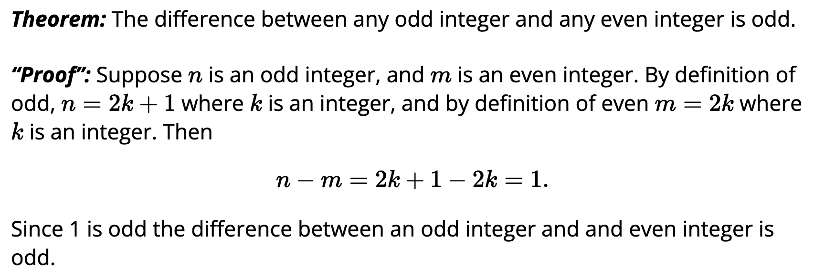
Common mistakes
What is wrong with the following “proof”?

Slide 11
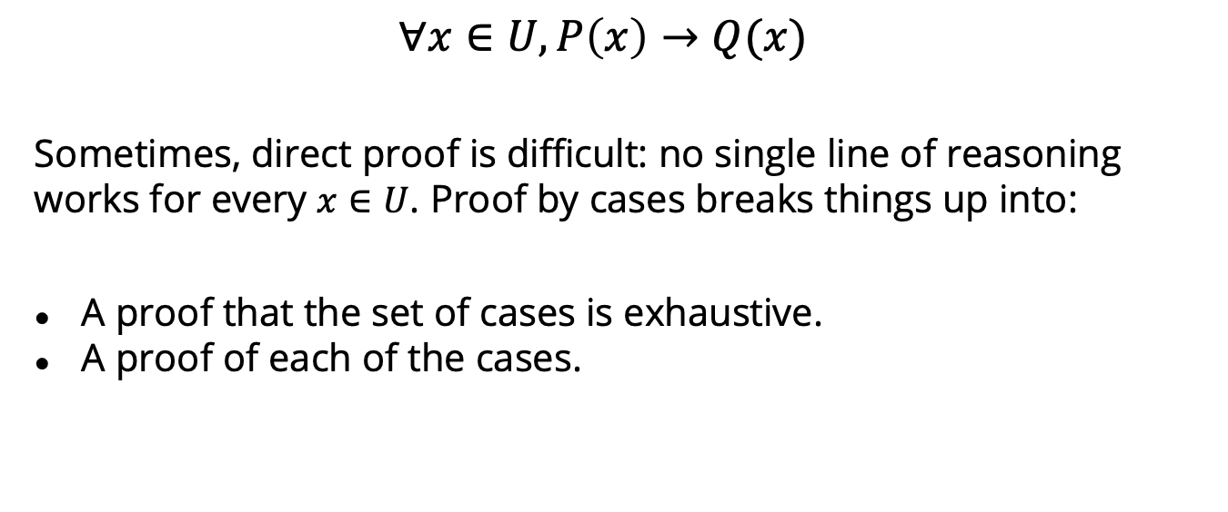
Proof by Cases
$$∀x∈U, P\left(x\right)→Q(x)$$
Sometimes, direct proof is difficult: no single line of reasoning works for every $x∈U$. Proof by cases breaks things up into:
A proof that the set of cases is exhaustive.
A proof of each of the cases.
Notes:
Also called proof by exhaustion

Slide 12
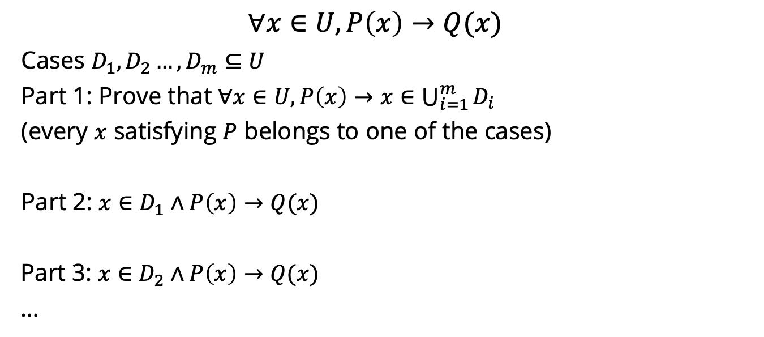
Proof by Cases
$$∀x∈U, P\left(x\right)→Q(x)$$
Cases $D_{1}, D_{2}…, D_{m}⊆U$
Part 1: Prove that $∀x∈U, P\left(x\right)→x∈\bigcup_{i=1}^{m}{D_{i}}$
(every $x$ satisfying $P$ belongs to one of the cases)
Part 2: $x∈D_{1}∧P\left(x\right)→Q(x)$
Part 3: $x∈D_{2}∧P\left(x\right)→Q(x)$
…
Notes:
Also called proof by exhaustion

Slide 13
Proof by Cases
Exercise: For any n ∈ Z, n and n² have the same parity (both even or both odd).
Lemma 2: every integer is either even or odd (but not both).

Slide 14

Proof by cases
For any integers $m, n$, $m+n$ are either both even or both odd
Notes:
https://runestone.academy/ns/books/published/DiscreteMathText/cases4-4.html

Slide 15
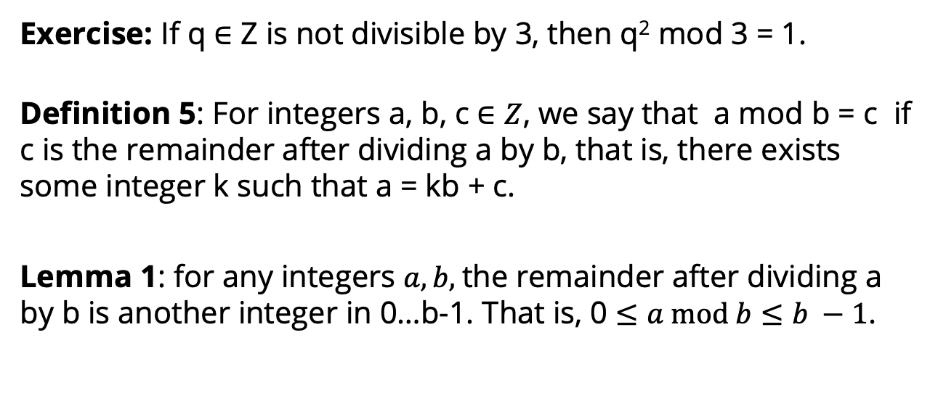
Proof by Cases
Exercise: If q ∈ Z is not divisible by 3, then q² mod 3 = 1.
Definition 5: For integers a, b, c $∈Z$, we say that $\text{a} \text{mod} \text{b}\text{ = }\text{c}$ if c is the remainder after dividing a by b, that is, there exists some integer k such that a = kb + c.
Lemma 1: for any integers $a, b,$the remainder after dividing a by b is another integer in 0…b-1. That is, 0 $≤a mod b≤b −1$.
Notes:
Proof by cases on q mod 3. q mod 3 = 0 ruled out by assumption. If q mod 3 = 1, then q^2 = (3k+1)^2 = 9k^2 + 6k + 1 = 3(3k^2 + 2k) + 1. If q mod 3 = 2, then q^2 = (3k+2)^2 = 9k^2 + 12k + 4 = 3(3k^2 + 4k + 1) + 1.

Slide 16

Proof by cases
Consider the absolute value function, defined as
Prove that for any x, |x| = |-x|.
Notes:
https://runestone.academy/ns/books/published/DiscreteMathText/cases4-4.html

Slide 17
Disproof by example
One example is not sufficient to prove a statement.
One counterexample is sufficient to disprove it.

Slide 18
Disproof by example
Example: Let a, b ∈ Z. If a is odd and b is odd, then a+b is odd.
Exercise: For every n ∈ Z, the integer f (n) = n² − n+11 is prime.

