Slide 1
Computational Foundations for ML (10-607):
Dynamic Programming
Bryan Wilder
* Slides borrowed from prior offerings by Professors H. Heidari, M. Gormley, P. Virtue, & G. Gordon.

Slide 2
Warmup: Fibonacci sequence
def fibonacci(n):
if (n = 1):
return 1
else:
return fibonacci(n-1) + fibonacci(n-2)
What does the tree of recursive calls look like?
What is the runtime of this algorithm?

Slide 3
Warmup: Fibonacci sequence
def fibonacci(n):
A = int[n+1]
A[1] = 1
A[2] = 1
for(int i = 3; i <= n; i++){
A[i] = A[i-1] + A[i-2]
}
return A[n]

Slide 4
Dynamic programming
Motivation: problems that have recursive structure…
…but where the subproblems will overlap, creating wasted effort
Solution: create a data structure to store intermediate solutions as they’re computed

Slide 5
General Procedure for Dynamic Programming
Define the quantity of interest recursively
  Specify the basis cases
  Determine the inductive relationship
Construct a data structure (typically a matrix or an array) to hold solutions to subproblems
Working from the basis cases to the desired result, solve and store subproblems.

Slide 6
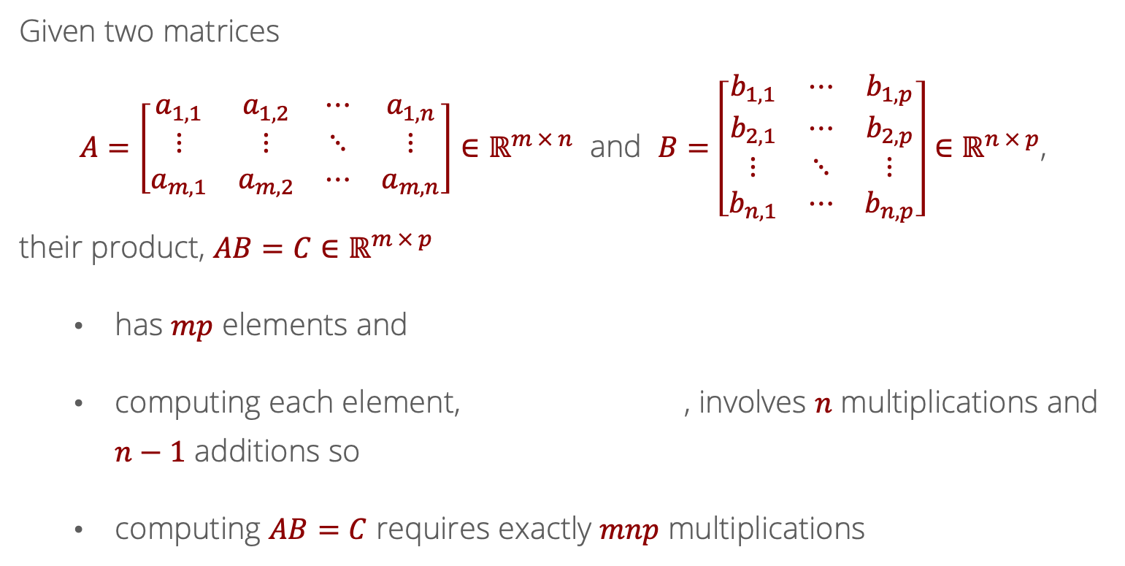
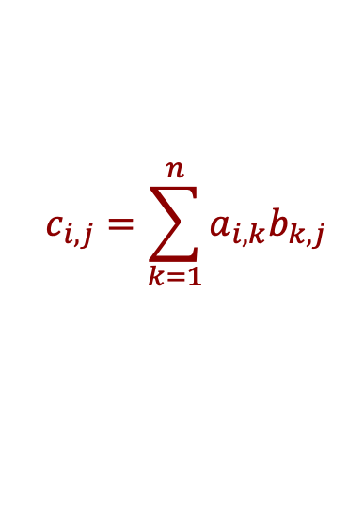
Recall: Computational cost of computing $AB$?
Given two matrices
$A=\left[\begin{matrix}a_{1,1} & a_{1,2} & ⋯ & a_{1,n} \\ ⋮ & ⋮ & ⋱ & ⋮ \\ a_{m,1} & a_{m,2} & ⋯ & a_{m,n}\end{matrix}\right]∈ℝ^{m × n}$ and $B=\left[\begin{matrix}b_{1,1} & ⋯ & b_{1,p} \\ b_{2,1} & ⋯ & b_{2,p} \\ ⋮ & ⋱ & ⋮ \\ b_{n,1} & ⋯ & b_{n,p}\end{matrix}\right]∈ℝ^{n × p}$,
their product, $AB=C∈ℝ^{m × p}$
  has $mp$ elements and
  computing each element, , involves $n$ multiplications and $n−1$ additions so
  computing $AB=C$ requires exactly $mnp$ multiplications
$$c_{i,j}=\sum_{k=1}^{n}{a_{i,k}b_{k,j}}$$

Slide 7
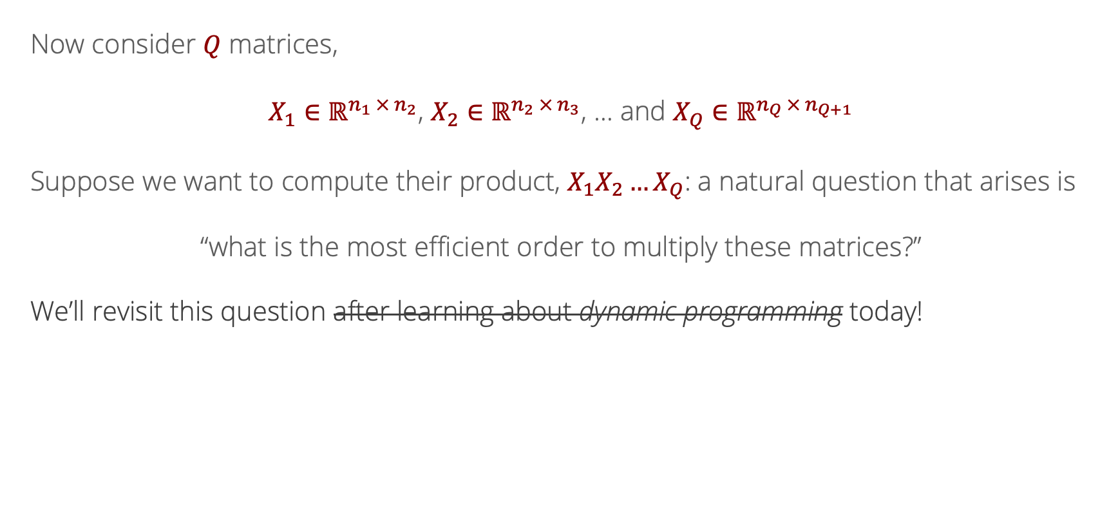
Likelihood
Recall: Multiple Matrix Multiplications
Now consider $Q$ matrices,
$X_{1}∈ℝ^{n_{1} × n_{2}}$, $X_{2}∈ℝ^{n_{2} × n_{3}}$, … and $X_{Q}∈ℝ^{n_{Q} × n_{Q+1}}$
Suppose we want to compute their product, $X_{1}X_{2}…X_{Q}$: a natural question that arises is
“what is the most efficient order to multiply these matrices?”
We’ll revisit this question after learning about dynamic programming today!

Slide 8
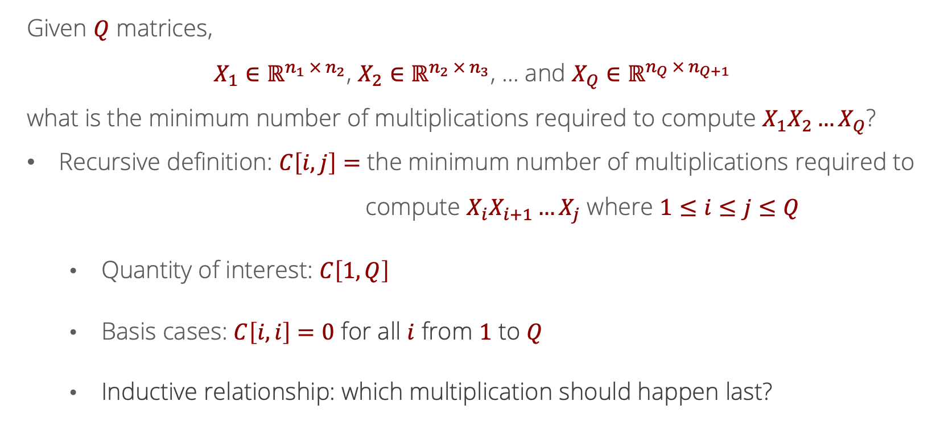

Recurrence Relation for Matrix Multiplication
Given $Q$ matrices,
$X_{1}∈ℝ^{n_{1} × n_{2}}$, $X_{2}∈ℝ^{n_{2} × n_{3}}$, … and $X_{Q}∈ℝ^{n_{Q} × n_{Q+1}}$
what is the minimum number of multiplications required to compute $X_{1}X_{2}…X_{Q}$?
Recursive definition: $C\left[i,j\right]=$ the minimum number of multiplications required to
compute $X_{i}X_{i+1}…X_{j}$ where $1≤i≤j≤Q$
  Quantity of interest: $C\left[1,Q\right]$
  Basis cases: $C\left[i,i\right]=0$ for all $i$ from $1$ to $Q$
  Inductive relationship: which multiplication should happen last?

Slide 9
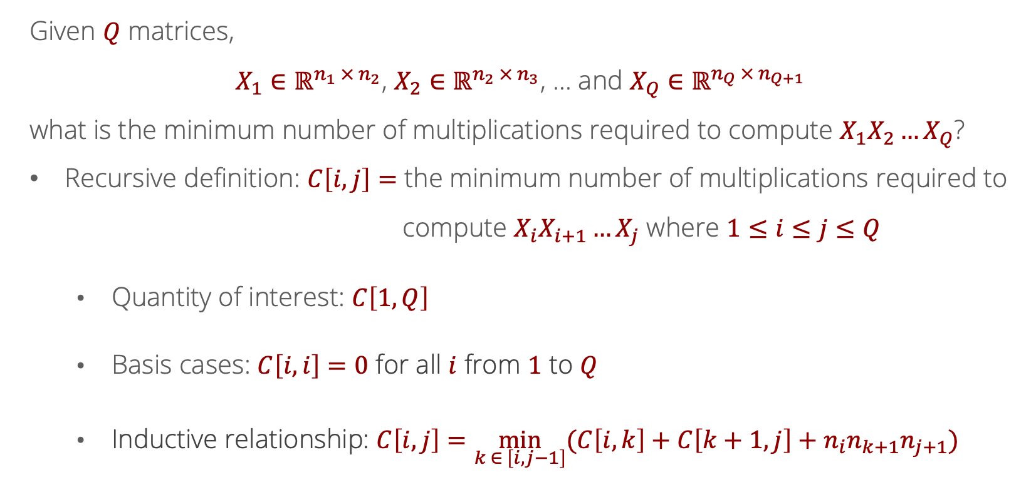

Recurrence Relation for Matrix Multiplication
Given $Q$ matrices,
$X_{1}∈ℝ^{n_{1} × n_{2}}$, $X_{2}∈ℝ^{n_{2} × n_{3}}$, … and $X_{Q}∈ℝ^{n_{Q} × n_{Q+1}}$
what is the minimum number of multiplications required to compute $X_{1}X_{2}…X_{Q}$?
Recursive definition: $C\left[i,j\right]=$ the minimum number of multiplications required to
compute $X_{i}X_{i+1}…X_{j}$ where $1≤i≤j≤Q$
  Quantity of interest: $C\left[1,Q\right]$
  Basis cases: $C\left[i,i\right]=0$ for all $i$ from $1$ to $Q$
  Inductive relationship: $C\left[i,j\right]=\min_{k ∈ \left[i,j−1\right]}{(C\left[i,k\right]+C\left[k+1,j\right]}+n_{i}n_{k+1}n_{j+1})$

Slide 10

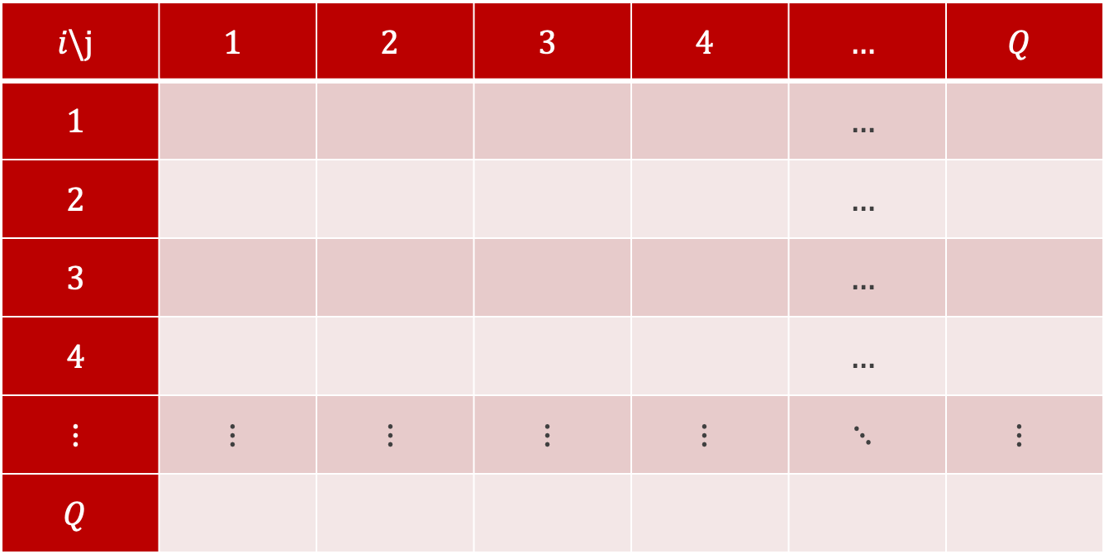

Defining a Data Structure
$$i\backslash j$$ | $$1$$ | $$2$$ | $$3$$ | $$4$$ | $$…$$ | $$Q$$
$$1$$ |  |  |  |  | $$…$$
$$2$$ |  |  |  |  | $$…$$
$$3$$ |  |  |  |  | $$…$$
$$4$$ |  |  |  |  | $$…$$
$$⋮$$ | $$⋮$$ | $$⋮$$ | $$⋮$$ | $$⋮$$ | $$⋱$$ | $$⋮$$
$$Q$$
$$C=$$

Slide 11

Defining a Data Structure
$$i\backslash j$$ | $$1$$ | $$2$$ | $$3$$ | $$4$$ | $$…$$ | $$Q$$
$$1$$ |  |  |  |  | $$…$$ | GOAL
$$2$$ |  |  |  |  | $$…$$
$$3$$ |  |  |  |  | $$…$$
$$4$$ |  |  |  |  | $$…$$
$$⋮$$ | $$⋮$$ | $$⋮$$ | $$⋮$$ | $$⋮$$ | $$⋱$$ | $$⋮$$
$$Q$$
$$C=$$

Slide 12

Defining a Data Structure
$$i\backslash j$$ | $$1$$ | $$2$$ | $$3$$ | $$4$$ | $$…$$ | $$Q$$
$$1$$ | $$0$$ |  |  |  | $$…$$ | GOAL
$$2$$ |  | $$0$$ |  |  | $$…$$
$$3$$ |  |  | $$0$$ |  | $$…$$
$$4$$ |  |  |  | $$0$$ | $$…$$
$$⋮$$ | $$⋮$$ | $$⋮$$ | $$⋮$$ | $$⋮$$ | $$⋱$$ | $$⋮$$
$$Q$$ |  |  |  |  |  | $$0$$
$$C=$$

Slide 13
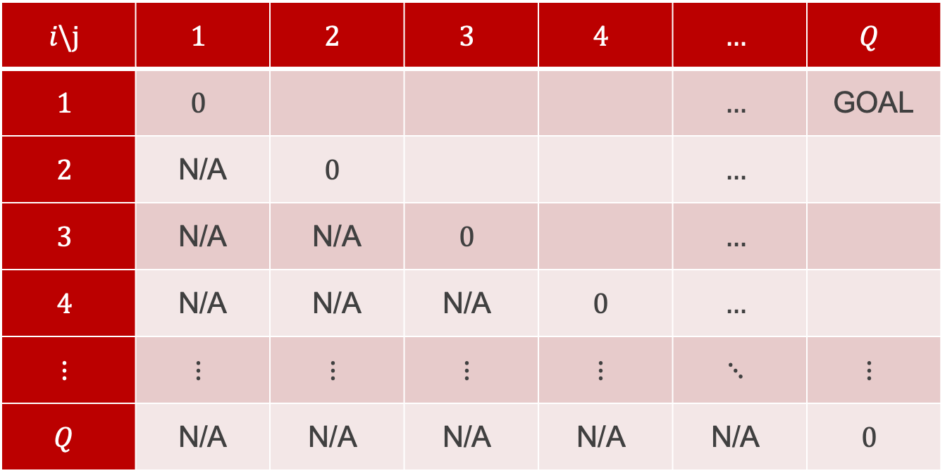

Defining a Data Structure
$$i\backslash j$$ | $$1$$ | $$2$$ | $$3$$ | $$4$$ | $$…$$ | $$Q$$
$$1$$ | $$0$$ |  |  |  | $$…$$ | GOAL
$$2$$ | N/A | $$0$$ |  |  | $$…$$
$$3$$ | N/A | N/A | $$0$$ |  | $$…$$
$$4$$ | N/A | N/A | $$\text{N}\text{/}\text{A}$$ | $$0$$ | $$…$$
$$⋮$$ | $$⋮$$ | $$⋮$$ | $$⋮$$ | $$⋮$$ | $$⋱$$ | $$⋮$$
$$Q$$ | N/A | $$\text{N}\text{/}\text{A}$$ | $$\text{N}\text{/}\text{A}$$ | $$\text{N}\text{/}\text{A}$$ | $$\text{N}\text{/}\text{A}$$ | $$0$$
$$C=$$

Slide 14
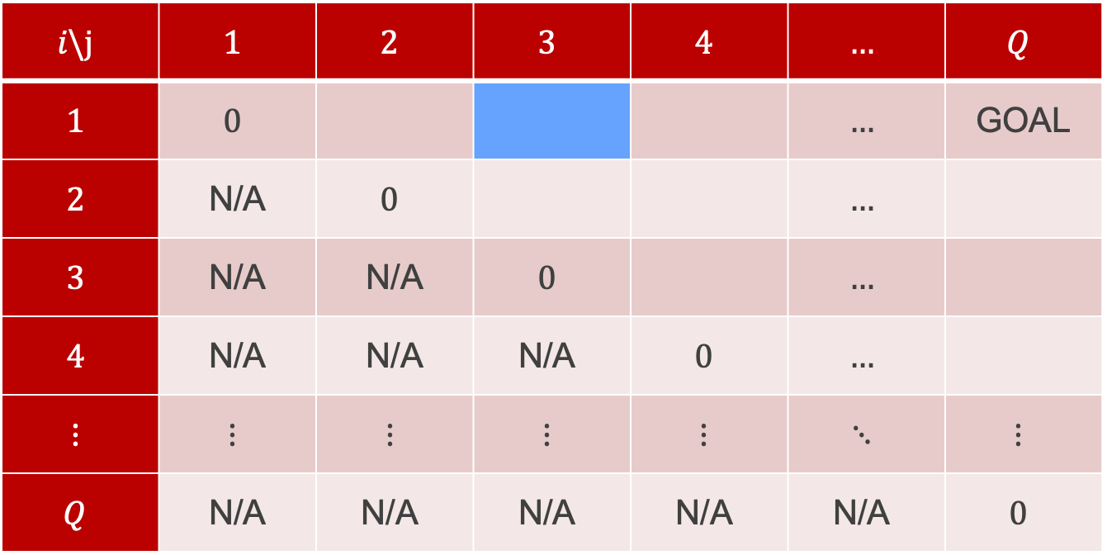
Defining a Data Structure
What is the best way to multiply $X_{1}X_{2}X_{3}$?
$$i\backslash j$$ | $$1$$ | $$2$$ | $$3$$ | $$4$$ | $$…$$ | $$Q$$
$$1$$ | $$0$$ |  |  |  | $$…$$ | GOAL
$$2$$ | N/A | $$0$$ |  |  | $$…$$
$$3$$ | N/A | N/A | $$0$$ |  | $$…$$
$$4$$ | N/A | N/A | $$\text{N}\text{/}\text{A}$$ | $$0$$ | $$…$$
$$⋮$$ | $$⋮$$ | $$⋮$$ | $$⋮$$ | $$⋮$$ | $$⋱$$ | $$⋮$$
$$Q$$ | N/A | $$\text{N}\text{/}\text{A}$$ | $$\text{N}\text{/}\text{A}$$ | $$\text{N}\text{/}\text{A}$$ | $$\text{N}\text{/}\text{A}$$ | $$0$$
$$C=$$

Slide 15
Defining a Data Structure
Either $\left(X_{1}X_{2}\right)X_{3}$ or $X_{1}\left(X_{2}X_{3}\right)$
$$i\backslash j$$ | $$1$$ | $$2$$ | $$3$$ | $$4$$ | $$…$$ | $$Q$$
$$1$$ | $$0$$ |  |  |  | $$…$$ | GOAL
$$2$$ | N/A | $$0$$ |  |  | $$…$$
$$3$$ | N/A | N/A | $$0$$ |  | $$…$$
$$4$$ | N/A | N/A | $$\text{N}\text{/}\text{A}$$ | $$0$$ | $$…$$
$$⋮$$ | $$⋮$$ | $$⋮$$ | $$⋮$$ | $$⋮$$ | $$⋱$$ | $$⋮$$
$$Q$$ | N/A | $$\text{N}\text{/}\text{A}$$ | $$\text{N}\text{/}\text{A}$$ | $$\text{N}\text{/}\text{A}$$ | $$\text{N}\text{/}\text{A}$$ | $$0$$
$$C=$$

Slide 16
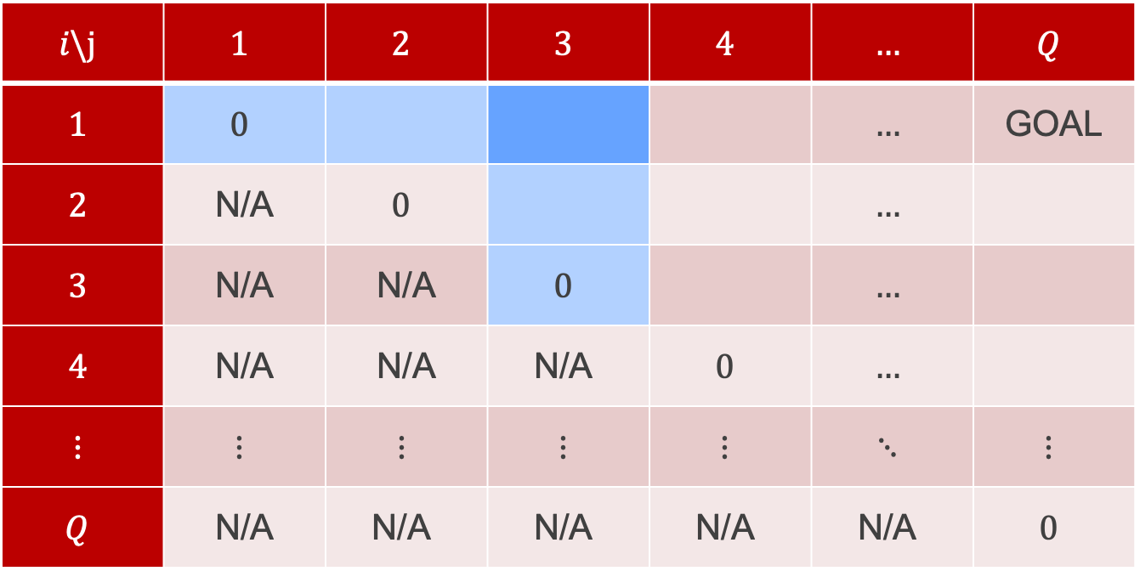
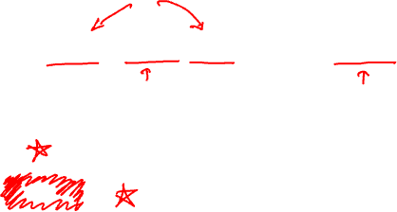
Defining a Data Structure
$$C\left[1, 3\right]=\min{(C\left[1,1\right]+C\left[2,3\right]+n_{1}n_{2}n_{4},C\left[1,2\right]+C\left[3,3\right]+n_{1}n_{3}n_{4}})$$
$$i\backslash j$$ | $$1$$ | $$2$$ | $$3$$ | $$4$$ | $$…$$ | $$Q$$
$$1$$ | $$0$$ |  |  |  | $$…$$ | GOAL
$$2$$ | N/A | $$0$$ |  |  | $$…$$
$$3$$ | N/A | N/A | $$0$$ |  | $$…$$
$$4$$ | N/A | N/A | $$\text{N}\text{/}\text{A}$$ | $$0$$ | $$…$$
$$⋮$$ | $$⋮$$ | $$⋮$$ | $$⋮$$ | $$⋮$$ | $$⋱$$ | $$⋮$$
$$Q$$ | N/A | $$\text{N}\text{/}\text{A}$$ | $$\text{N}\text{/}\text{A}$$ | $$\text{N}\text{/}\text{A}$$ | $$\text{N}\text{/}\text{A}$$ | $$0$$
$$C=$$

Slide 17
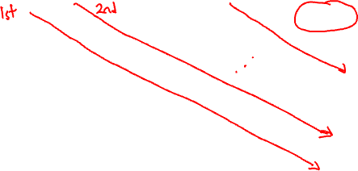
Defining a Data Structure
  $$C\left[i,j\right]=\min_{k ∈ \left[i,j−1\right]}{(C\left[i,k\right]+C\left[k+1,j\right]}+n_{i}n_{k+1}n_{j+1})$$
$$i\backslash j$$ | $$1$$ | $$2$$ | $$3$$ | $$4$$ | $$…$$ | $$Q$$
$$1$$ | $$0$$ |  |  |  | $$…$$ | GOAL
$$2$$ | N/A | $$0$$ |  |  | $$…$$
$$3$$ | N/A | N/A | $$0$$ |  | $$…$$
$$4$$ | N/A | N/A | $$\text{N}\text{/}\text{A}$$ | $$0$$ | $$…$$
$$⋮$$ | $$⋮$$ | $$⋮$$ | $$⋮$$ | $$⋮$$ | $$⋱$$ | $$⋮$$
$$Q$$ | N/A | $$\text{N}\text{/}\text{A}$$ | $$\text{N}\text{/}\text{A}$$ | $$\text{N}\text{/}\text{A}$$ | $$\text{N}\text{/}\text{A}$$ | $$0$$
$$C=$$

Slide 18
Backtracking
So far, we only computed the value of the optimal solution
(what is the smallest number of operations we can use to multiply the matrices)
What we wanted to know was the optimal ordering itself
How to recover this?

Slide 19
Defining a Data Structure
  $$C\left[i,j\right]=\min_{k ∈ \left[i,j−1\right]}{(C\left[i,k\right]+C\left[k+1,j\right]}+n_{i}n_{k+1}n_{j+1})$$
$$i\backslash j$$ | $$1$$ | $$2$$ | $$3$$ | $$4$$ | $$…$$ | $$Q$$
$$1$$ | $$0$$ |  |  |  | $$…$$ | GOAL
$$2$$ | N/A | $$0$$ |  |  | $$…$$
$$3$$ | N/A | N/A | $$0$$ |  | $$…$$
$$4$$ | N/A | N/A | $$\text{N}\text{/}\text{A}$$ | $$0$$ | $$…$$
$$⋮$$ | $$⋮$$ | $$⋮$$ | $$⋮$$ | $$⋮$$ | $$⋱$$ | $$⋮$$
$$Q$$ | N/A | $$\text{N}\text{/}\text{A}$$ | $$\text{N}\text{/}\text{A}$$ | $$\text{N}\text{/}\text{A}$$ | $$\text{N}\text{/}\text{A}$$ | $$0$$
What was the optimal k?
$$C=$$

Slide 20
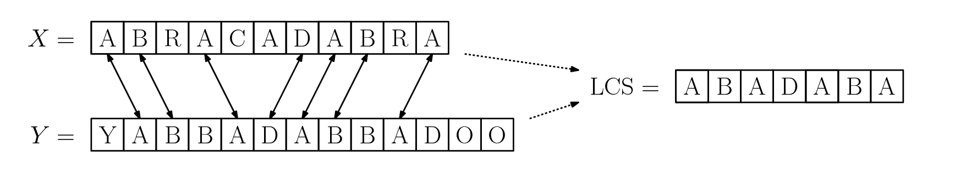
Longest common subsequence

Slide 21
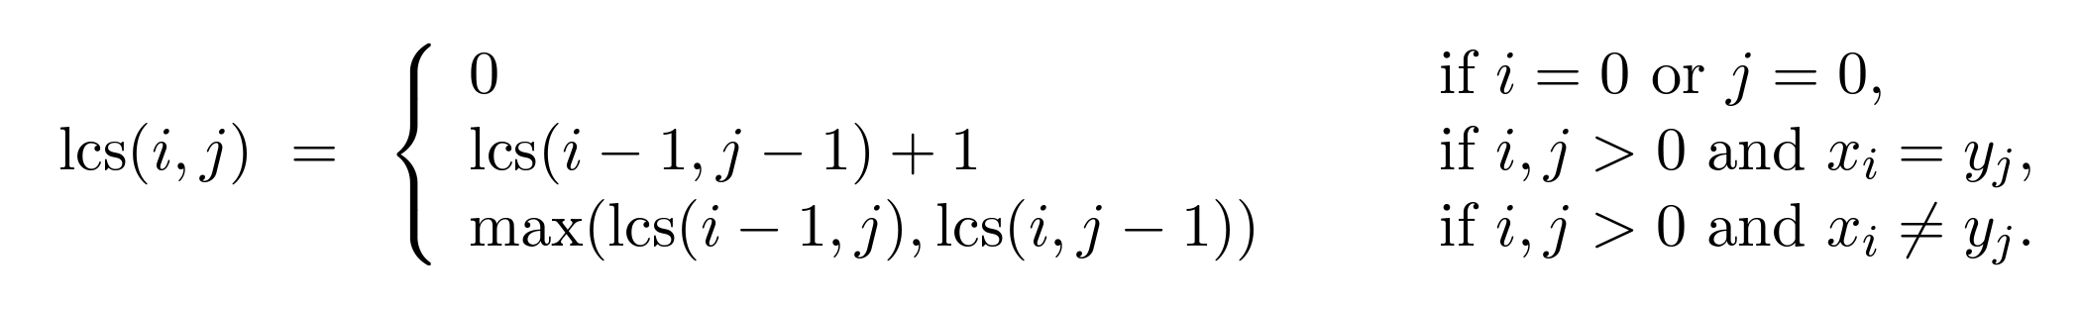
Longest common subsequence
Dynamic programming solution: subproblems are the LCS between X[1:i] and Y[1:j] (the first i letters of X and the first j letters of Y)

Slide 22
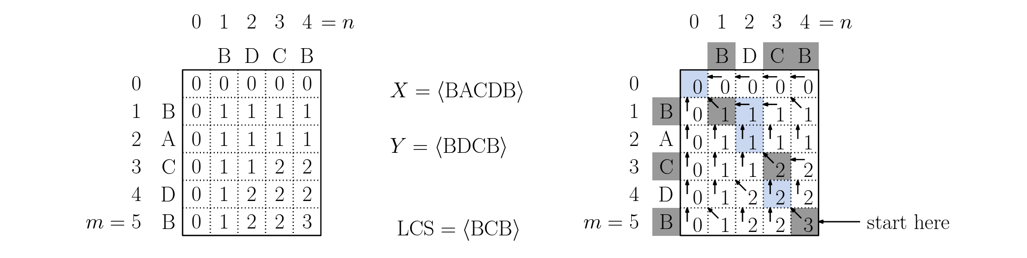
Longest common subsequence
Backtracking to extract the sequence: navigate backwards through the table
If X[i] == X[j]: print out that letter, move to (i-1, j-1)
Otherwise, move to whichever previous entry (i-1, j) or (i, j-1) has a bigger entry

Slide 23
Memoization
So far, we have implemented “sweeping” algorithms that iteratively “sweep” an index or pair of indices forward
Alternative: add an extra data structure to a recursive algorithm to act as memory when we encounter a subproblem we’ve seen before

Slide 24
Memoization
def fibonacci_memo(n, A):
if(A[n] != -1):
return A[n]
if (n = 1):
A[n] = 1
return 1
else:
A[n] = fibonacci(n-1) + fibonacci(n-2)
return A[n]
def fibonacci(n):
A = int[n+1];
for(int i = 0; i <= n; i++)
A[i] = -1;
return fibonacci_memo(n, A)

Slide 25
Memoization
def lcs(x, y):
A = int[len(x)+1, len(y)+1];
<initialize A with -1s>
return lcs_memo(x, y, len(x), len(y), A)

Slide 26
Memoization
def lcs_memo(x, y, i, j, A):
if(A[i,j] != -1):
return A[i,j]
if(i ==0 or j == 0):
A[i,j] = 0
elif x[i] == y[j]:
A[i,j] = 1 + lcs_memo(x, y, i-1, j-1, A)
else:
A[i,j] = max(lcs_memo(x,y,i-1,j,A), lcs_memo(x,y,i,j-1,A))
return A[i,j]

Slide 27
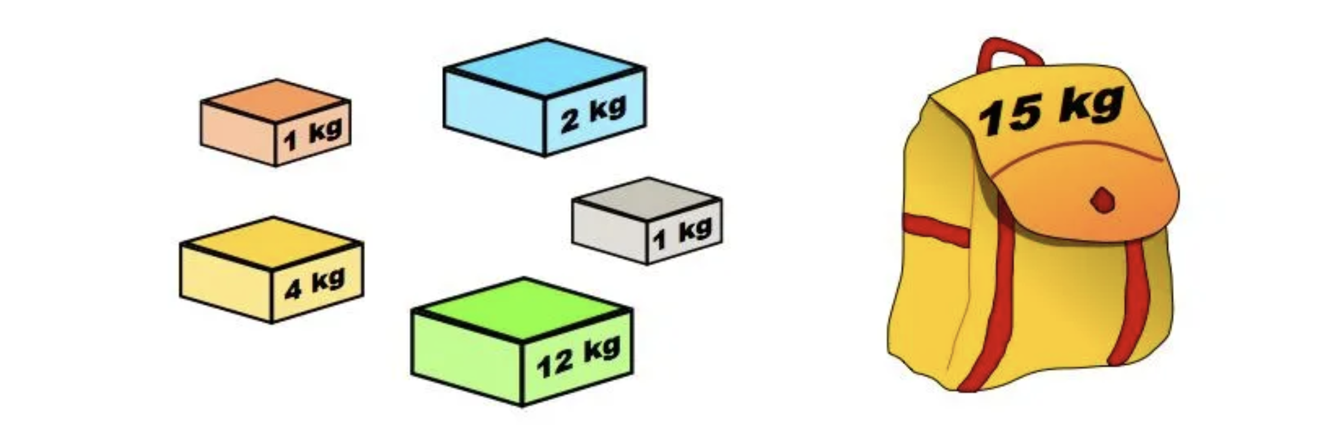
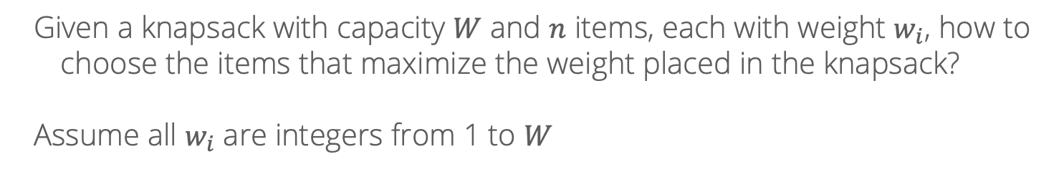
Knapsack problem
Given a knapsack with capacity $W$ and $n$ items, each with weight $w_{i}$, how to choose the items that maximize the weight placed in the knapsack?
Assume all $w_{i}$ are integers from 1 to $W$

Slide 28
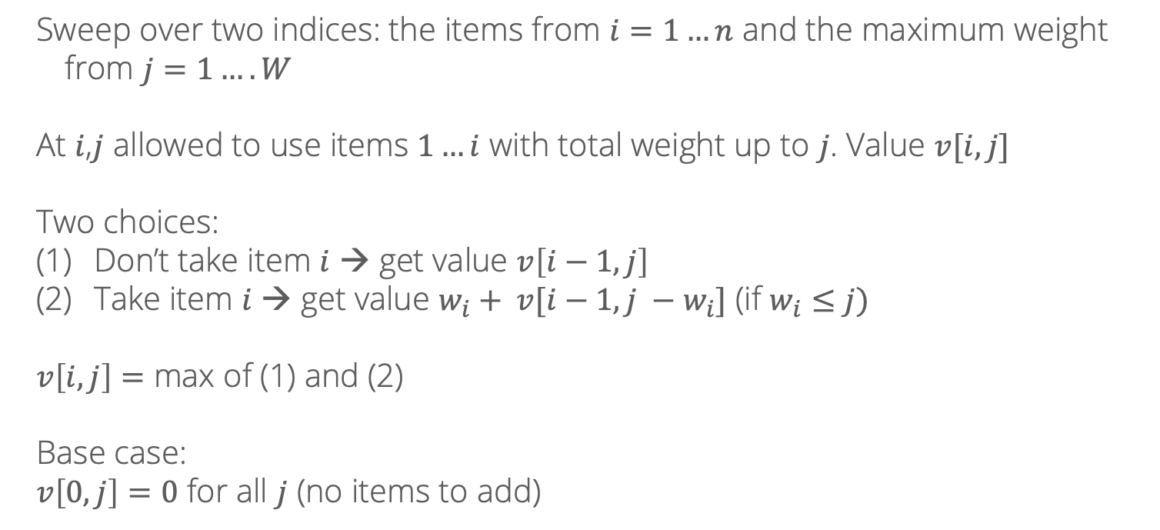
DP solution
Sweep over two indices: the items from $i=1…n$ and the maximum weight from $j=1….W$
At $i$,$j$ allowed to use items $1…i$ with total weight up to $j$. Value $v[i,j]$
Two choices:
Don’t take item $i$ → get value $v\left[i−1, j\right]$
Take item $i$ → get value $w_{i}+ v[i−1, j −w_{i}]$ (if $w_{i}≤j)$
$v\left[i,j\right]=$ max of (1) and (2)
Base case:
$v\left[0, j\right]=0$ for all $j$ (no items to add)

Slide 29
Rounding
What if the items don’t have integer weights?
0.5 kg
1.33 kg
9.843 kg
0.7 kg
2.78 kg
10.16 kg

Slide 30
Rounding
Idea: round weights up to the nearest 0.1 and the total capacity down
0.5 kg
1.4 kg
9.8 kg
0.7 kg
2.8 kg
10.2 kg

Slide 31
Rounding
Idea: round weights up to the nearest 0.1 and the total capacity down
5 kg
14 kg
98 kg
7 kg
28 kg
102 kg
Now, rescale everything by multiplying by 10

Slide 32
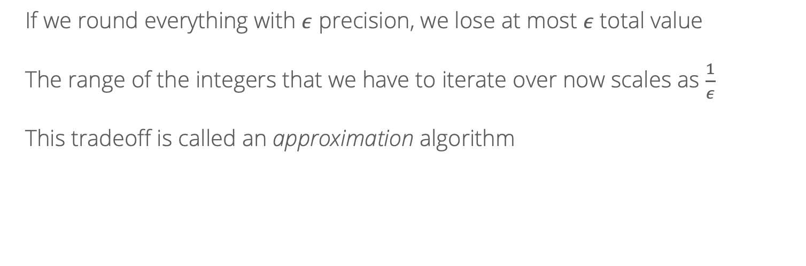
Rounding
If we round everything with $ε$ precision, we lose at most $ε$ total value
The range of the integers that we have to iterate over now scales as $\frac{1}{ε}$
This tradeoff is called an approximation algorithm

