Slide 1
Computational Foundations for ML (10-607):
Proof Techniques
Bryan Wilder
* Slides borrowed from prior offerings of the course by Professors M. Gormley, P. Virtue, & G. Gordon.

Slide 2
Lecture Overview
Disproof by Example
Proof by Contradiction
Proof by Contraposition

Slide 3
Disproof by example
One example is not sufficient to prove a statement.
One counterexample is sufficient to disprove it.

Slide 4
Disproof by example
Example: Let a, b ∈ Z. If a is odd and b is odd, then a+b is odd.
Exercise: For every n ∈ Z, the integer f (n) = n² − n+11 is prime.

Slide 5
Disproof by example
Example: Let a, b ∈ Z. If a is odd and b is odd, then a+b is odd.
Exercise: For every n ∈ Z, the integer f (n) = n² − n+11 is prime.
11, 13, 17, 23, 31, 41, 53, 67, 83, 101, 121

Slide 6
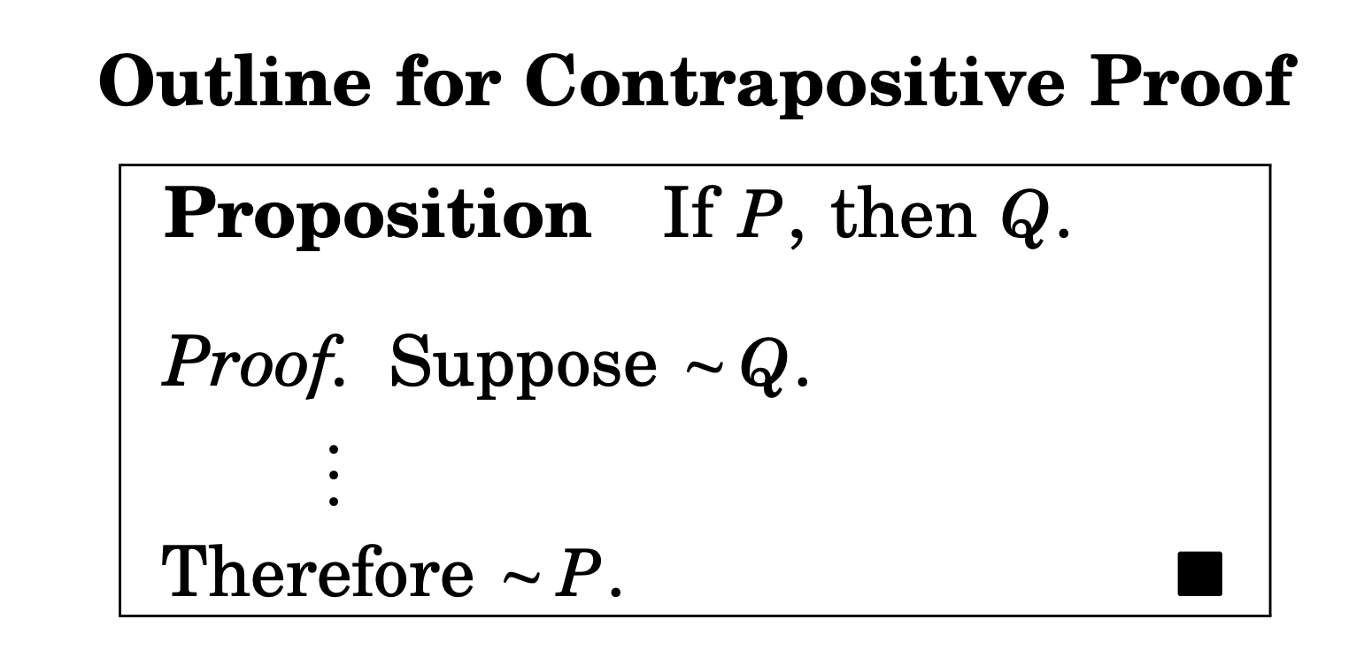
Proof by Contraposition
Law of contrapositive (A⇒B)⇔(¬B⇒¬A)
Show (¬B⇒¬A) and conclude (A⇒B)

Slide 7
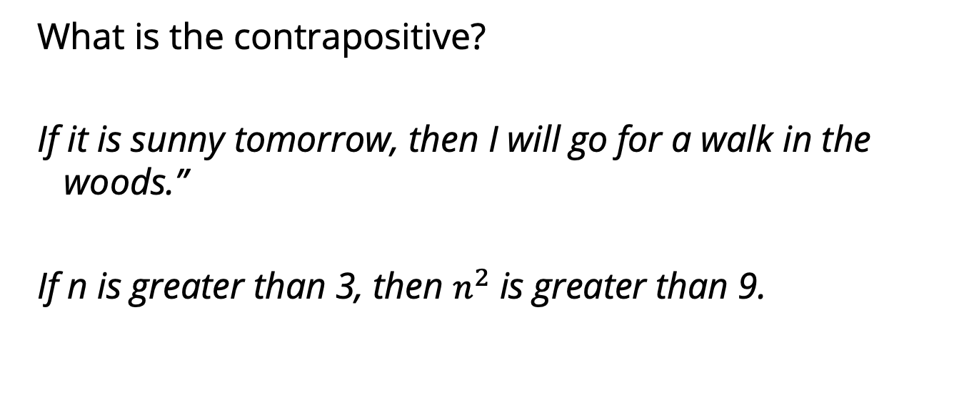
Proof by contraposition
What is the contrapositive?
If it is sunny tomorrow, then I will go for a walk in the woods.”
If n is greater than 3, then $n^{2}$ is greater than 9.

Slide 8
A more complex contrapositive
n is an even number if there exists an integer k such that n = 2k
What is the contrapositive?

Slide 9
Proof by Contraposition
Example: Let a, b ∈ Z. If ab is even, then either a is even or b is even (or both).
Notes:
Suppose both a and b are odd. (2k_1 + 1)(2k_2 + 1) = 4k_1k_2+2k_1+2k_2 + 1 -> ab is odd.

Slide 10
Proof by Contraposition
Example: If a, b ∈ Z s.t. a+b is even, then a and b have the same parity (both even or both odd).
Notes:
Suppose a and b have different parity, so one is even and one is odd. Without loss of generality, let a be even. a + b = 2k_1 + 2k_2 +1 = 2(k_1 + k_2) + 1, so a+b is odd

Slide 11

Proof by Contraposition
Prove that if n = ab for positive integers a, b, then either $a≤√n$ or $b≤√n$
Notes:
A > sqrt(n), b > sqrt(n)
Ab > A sqrt(n) > n -> ab != n

Slide 12
Proof by Contraposition
Example: Suppose x, y ∈ R. If y³ + yx² ≤ 2x³, then y ≤ x.
Notes:
suppose y > x. Then, y^3 > x^3 (by multiplying by y^2 and x^2, respectively – note that these are guaranteed to be positive!).
Also, yx^2 > x^3 (multiplying both sides by x^2)
So, y³ + yx² > x³+ yx² > x³+ x³

Slide 13
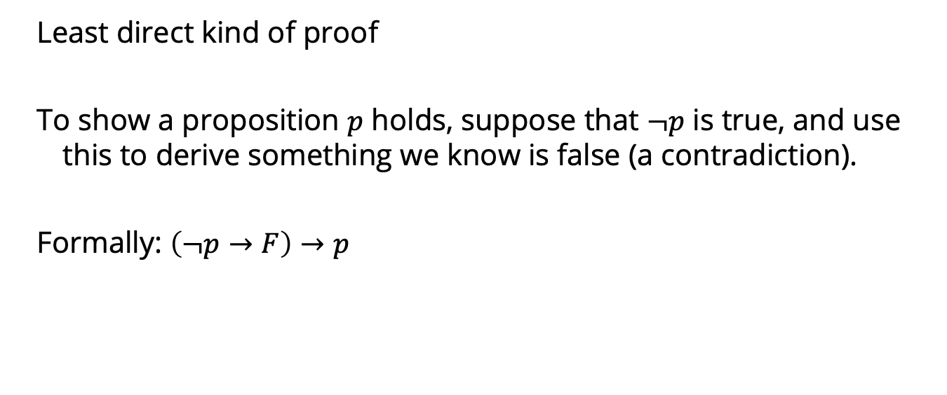
Proof by contradiction
Least direct kind of proof
To show a proposition $p$ holds, suppose that $¬p$ is true, and use this to derive something we know is false (a contradiction).
Formally: $\left(¬p→F\right)→p$

Slide 14

Proof by contradiction
Exercise: Prove that there are infinitely many prime numbers.
Lemma: any integer p has a unique prime factorization (a set of numbers $q_{1}…q_{n}$ for some $n≥1$ such that $p=q_{1}⋅q_{2}⋅…⋅q_{n}$)
Notes:
https://discrete.openmathbooks.org/dmoi3/sec_logic-proofs.html
Suppose that there is a largest prime p, and consider p! + 1. Since every number <= p divides p!, none of them divide p! + 1 (all must have remainder one after division). Accordingly, every number in the prime factorization of p! + 1 must be > p → any one of them is a prime larger than p, contradicting the assumption.

Slide 15

Proof by contradiction
Exercise: Prove the number √2 is irrational.
A real number r is rational if there exist integers a,b with $b≠0$ such that $r=\frac{a}{b}$
Notes:
https://math.stackexchange.com/questions/
1020278/understanding-the-proof-of-sqrt2-is-irrational-by-contradiction#:~:text=The%20proof%20starts%20with%20assuming,cannot%20be%20a%20rational%20number.
Lemma 1: any rational number r can be written as r = a/b for a, b integers that do not have any common factors
Proof: Consider a rational r, with r = a/b where a and b have common factors. Let k be the product of all of their common factors. Then r = (a/k)/(b/k) where (a/k) and (b/k) no longer have any common factors except 1.
Lemma 2: if a^2 is even, then a is even as well.
Proof: by contraposition

Slide 16

Proof by contradiction
Prove that there are no integers $x, y$ such that $x^{2}=4y+2$
Notes:
X^2 is even, so x is even as well. X = 2k, x^2 = 4k^2, and 2k^2 = 2y + 1. This implies that 2k^2 is odd, but 2k^2 is even. Contradiction

