Slide 1
Computational Foundations for ML (10-607):
Continuous optimization
Bryan Wilder
* Slides borrowed from prior offerings by Professors H. Heidari, M. Gormley, P. Virtue, & G. Gordon.

Slide 2
Announcements
Final quiz: Friday during recitation period
Covers material since quiz 2 through today
Trees: various tree traversals, binary search trees
Lists, stacks, queues, and heaps: operations and implementations
Graphs: data structures, BFS/DFS, Kruskal’s and Dijkstra’s algorithms
Today: (stochastic) gradient descent algorithms

Slide 3
Today
Last week of the class is devoted to optimization
Seen various examples so far: shortest paths, knapsack problems, minimum spanning trees…
This week, two broad families of approaches:
Gradient descent algorithms for continuous optimization
Search and discrete optimization

Slide 4
Continuous optimization
So far, we’ve dealt primarily with discrete optimization
What do we mean by discrete? Solutions can take only one of a finite set of values
An item is in the knapsack or not, an edge is in the MST or not, etc.
Most common optimization problem in ML is over the parameters of a model: often continuous
Coefficients of a linear or logistic regression model
Parameters of a neural network

Slide 5
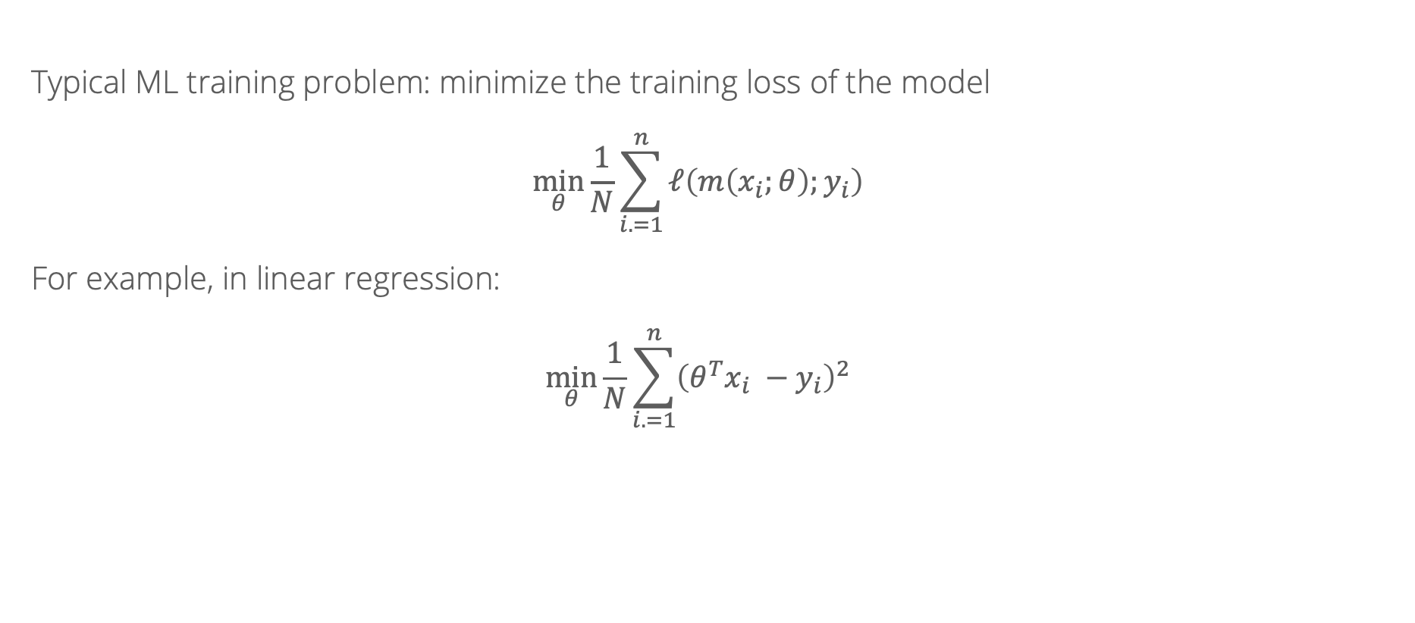
Empirical risk minimization
Typical ML training problem: minimize the training loss of the model
$$\min_{θ}{\frac{1}{N}\sum_{i. =1}^{n}{ℓ\left(m\left(x_{i};θ\right);y_{i}\right)}}$$
For example, in linear regression:
$$\min_{θ}{\frac{1}{N}\sum_{i. =1}^{n}{{\left({θ^{T}x}_{i} −y_{i}\right)}^{2}}}$$

Slide 6

Gradient descent: review
For a function $f(θ)$, solves the problem $\min_{θ}{f(θ)}$ by iterating
$$θ_{t}= θ_{t−1} −γ∇_{θ}f(θ)$$
where $γ$ is called the learning rate

Slide 7
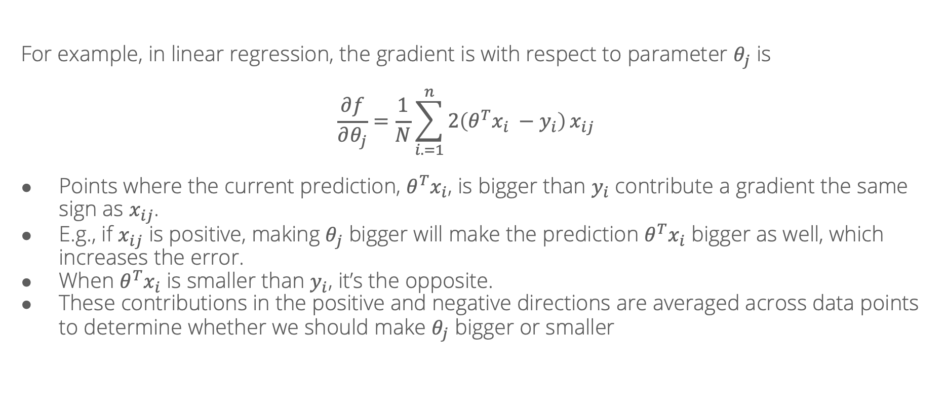
Gradient descent: review
For example, in linear regression, the gradient is with respect to parameter $θ_{j}$ is
$$\frac{∂f}{∂θ_{j}}=\frac{1}{N}\sum_{i. =1}^{n}{2\left({θ^{T}x}_{i} −y_{i}\right)}x_{ij}$$
Points where the current prediction, ${θ^{T}x}_{i}$, is bigger than $y_{i}$ contribute a gradient the same sign as $x_{ij}$.
E.g., if $x_{ij}$ is positive, making $θ_{j}$ bigger will make the prediction ${θ^{T}x}_{i}$ bigger as well, which increases the error.
When ${θ^{T}x}_{i}$ is smaller than $y_{i}$, it’s the opposite.
These contributions in the positive and negative directions are averaged across data points to determine whether we should make $θ_{j}$ bigger or smaller

Slide 8
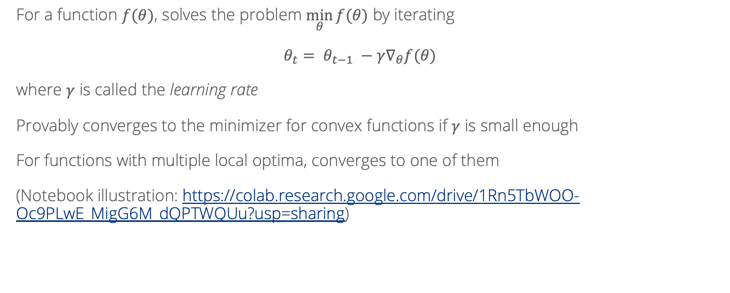
Gradient descent: review
For a function $f(θ)$, solves the problem $\min_{θ}{f(θ)}$ by iterating
$$θ_{t}= θ_{t−1} −γ∇_{θ}f(θ)$$
where $γ$ is called the learning rate
Provably converges to the minimizer for convex functions if $γ$ is small enough
For functions with multiple local optima, converges to one of them
(Notebook illustration: https://colab.research.google.com/drive/1Rn5TbWOO-Oc9PLwE_MigG6M_dQPTWQUu?usp=sharing)

Slide 9
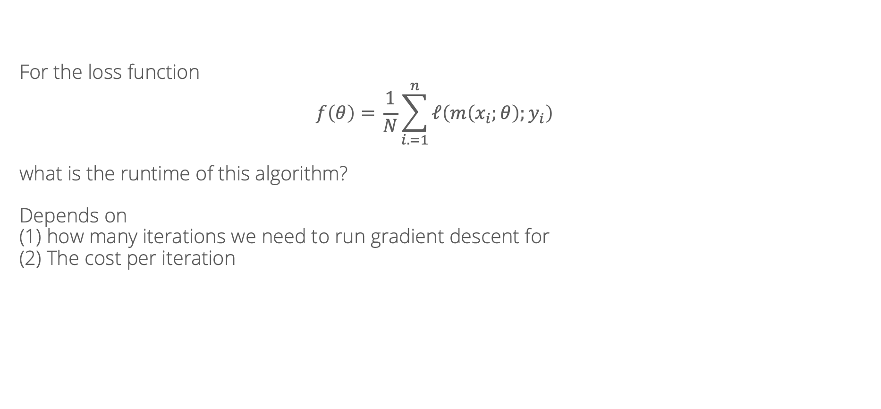
Algorithmic properties of gradient descent
For the loss function
$$f\left(θ\right)={\frac{1}{N}\sum_{i. =1}^{n}{ℓ\left(m\left(x_{i};θ\right);y_{i}\right)}}$$
what is the runtime of this algorithm?
Depends on
(1) how many iterations we need to run gradient descent for
(2) The cost per iteration

Slide 10
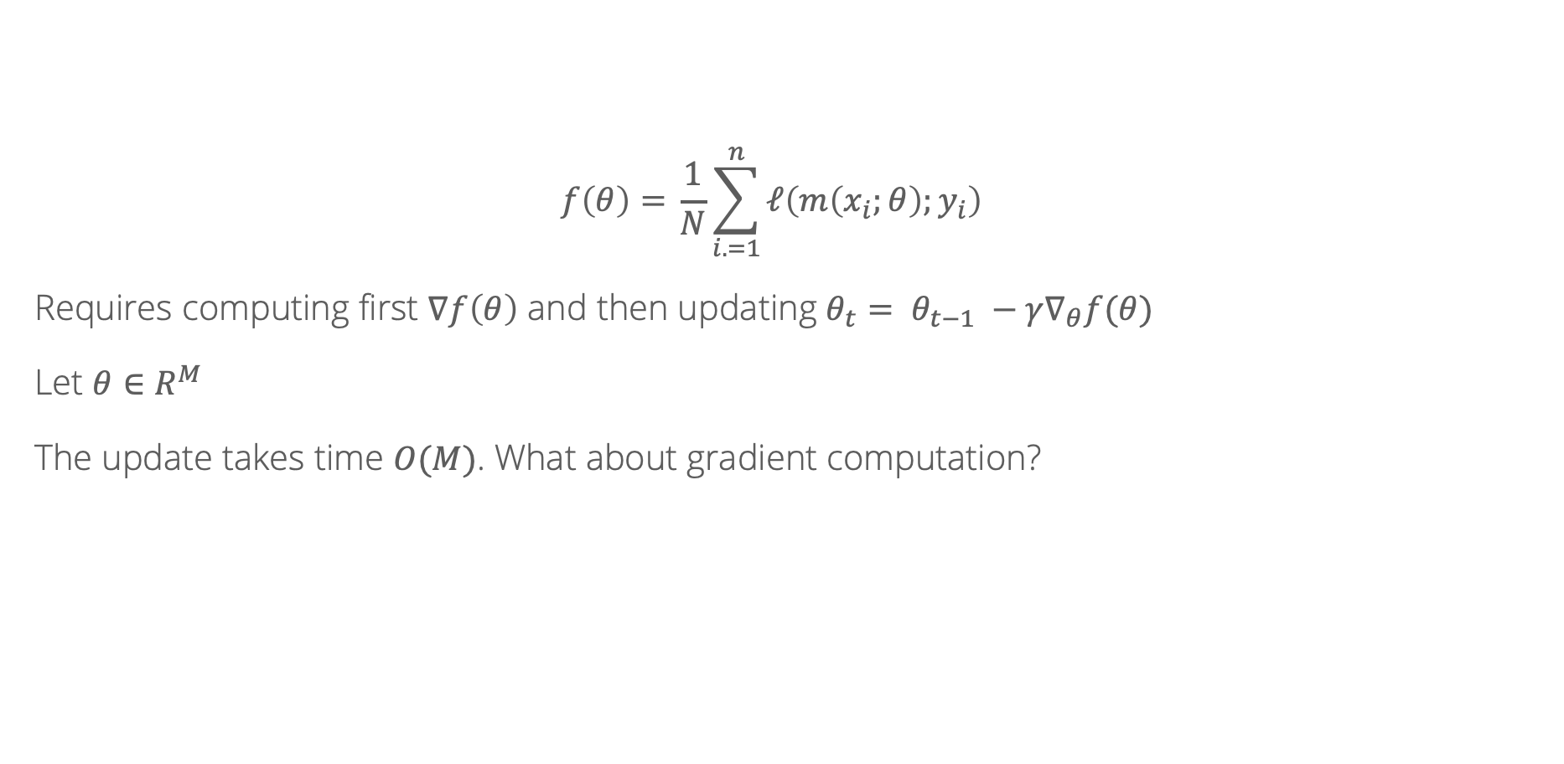
Cost per iteration
$$f\left(θ\right)={\frac{1}{N}\sum_{i. =1}^{n}{ℓ\left(m\left(x_{i};θ\right);y_{i}\right)}}$$
Requires computing first $∇f\left(θ\right)$ and then updating $θ_{t}= θ_{t−1} −γ∇_{θ}f(θ)$
Let $θ∈R^{M}$
The update takes time $O(M)$. What about gradient computation?

Slide 11
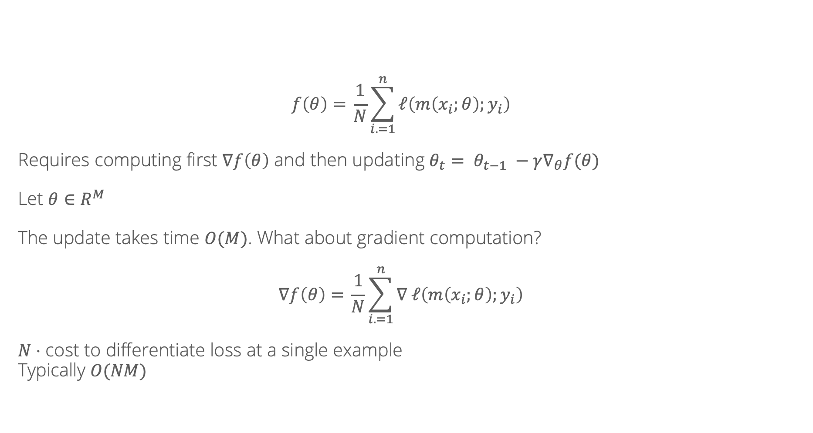
Cost per iteration
$$f\left(θ\right)={\frac{1}{N}\sum_{i. =1}^{n}{ℓ\left(m\left(x_{i};θ\right);y_{i}\right)}}$$
Requires computing first $∇f\left(θ\right)$ and then updating $θ_{t}= θ_{t−1} −γ∇_{θ}f(θ)$
Let $θ∈R^{M}$
The update takes time $O(M)$. What about gradient computation?
$$∇f\left(θ\right)={\frac{1}{N}\sum_{i. =1}^{n}{∇ ℓ\left(m\left(x_{i};θ\right);y_{i}\right)}}$$
$N⋅$ cost to differentiate loss at a single example
Typically $O(NM)$

Slide 12

Cost per iteration
What can we do to bring down the cost per iteration?
Doing work proportional to $M$ seems unavoidable
But what about $N$?

Slide 13

Stochastic gradient descent
Main idea: can view $\frac{1}{N}\sum_{i=1}^{n}{∇ ℓ\left(m\left(x_{i};θ\right);y_{i}\right)}$ as an expectation over a particular distribution
$$\frac{1}{N}\sum_{i=1}^{n}{∇ ℓ\left(m\left(x_{i};θ\right);y_{i}\right)}=E_{x, y∼P_{N}}\left[∇ ℓ\left(m\left(x;θ\right);y\right)\right]$$
We can approximate expectations by samples – even a single sample is unbiased!

Slide 14
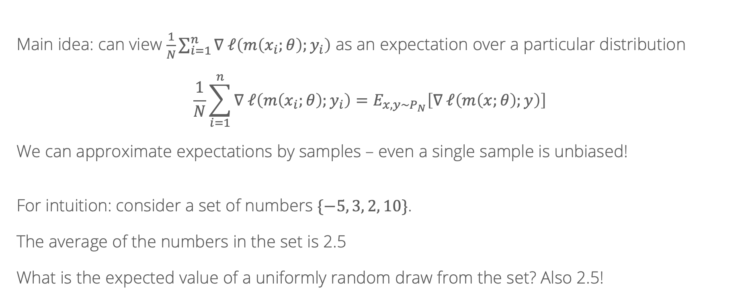
Stochastic gradient descent
Main idea: can view $\frac{1}{N}\sum_{i=1}^{n}{∇ ℓ\left(m\left(x_{i};θ\right);y_{i}\right)}$ as an expectation over a particular distribution
$$\frac{1}{N}\sum_{i=1}^{n}{∇ ℓ\left(m\left(x_{i};θ\right);y_{i}\right)}=E_{x, y∼P_{N}}\left[∇ ℓ\left(m\left(x;θ\right);y\right)\right]$$
We can approximate expectations by samples – even a single sample is unbiased!
For intuition: consider a set of numbers $\{−5, 3, 2, 10\}$.
The average of the numbers in the set is 2.5
What is the expected value of a uniformly random draw from the set? Also 2.5!

Slide 15
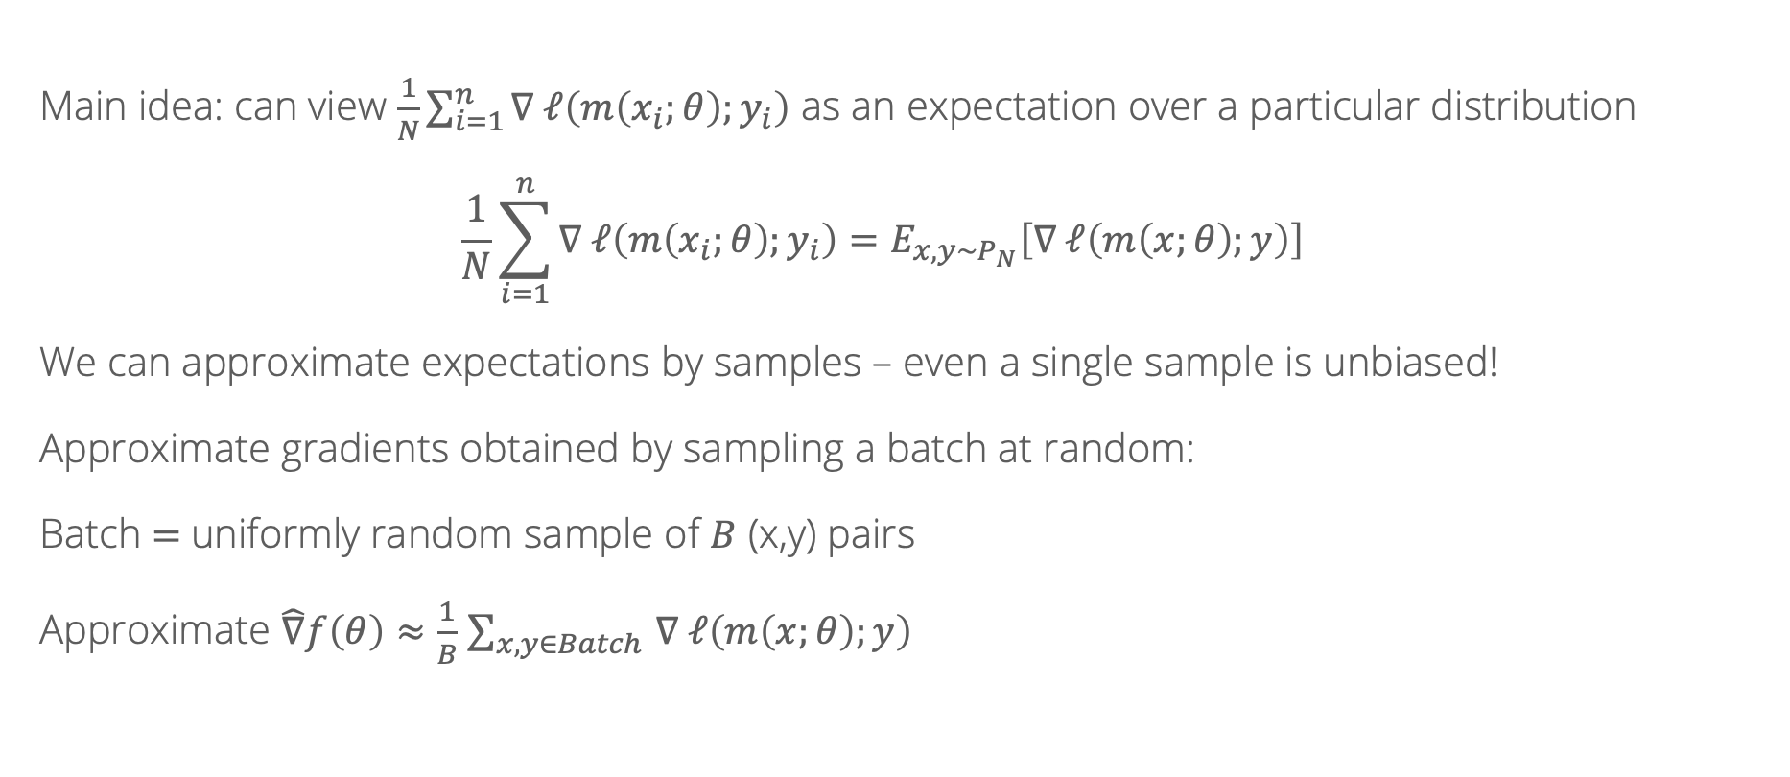
Stochastic gradient descent
Main idea: can view $\frac{1}{N}\sum_{i=1}^{n}{∇ ℓ\left(m\left(x_{i};θ\right);y_{i}\right)}$ as an expectation over a particular distribution
$$\frac{1}{N}\sum_{i=1}^{n}{∇ ℓ\left(m\left(x_{i};θ\right);y_{i}\right)}=E_{x, y∼P_{N}}\left[∇ ℓ\left(m\left(x;θ\right);y\right)\right]$$
We can approximate expectations by samples – even a single sample is unbiased!
Approximate gradients obtained by sampling a batch at random:
Batch $=$uniformly random sample of $B$ (x,y) pairs
Approximate $\hat{∇}f\left(θ\right)≈\frac{1}{B}$ $\sum_{x, y∈Batch }{∇ ℓ\left(m\left(x;θ\right);y\right)}$

Slide 16

Stochastic gradient descent
Always have that $E\left[\hat{∇}f\left(θ\right)\right]=∇f(θ)$
(unbiased)
Therefore, $E\left[{\left(\hat{∇}f\left(θ\right) − ∇f\left(θ\right)\right)}^{2}\right]$ = $Var\left[\hat{∇}f\left(θ\right)\right]$
Can be shown that $Var\left[\hat{∇}f\left(θ\right)\right]= \frac{Var\left[∇f\left(x_{i}, y_{i}\right)\right]}{B}$
Bigger batch: lower variance, better approximate gradients
But, runtime scales as $O(BM)$

Slide 17
Number of iterations
What can we do to make the number of iterations better?
Where does gradient descent sometimes waste effort?
(Notebook)

Slide 18
Hard cases for gradient descent: Local minima
Local minimum
Local minimum
Global minimum

Slide 19
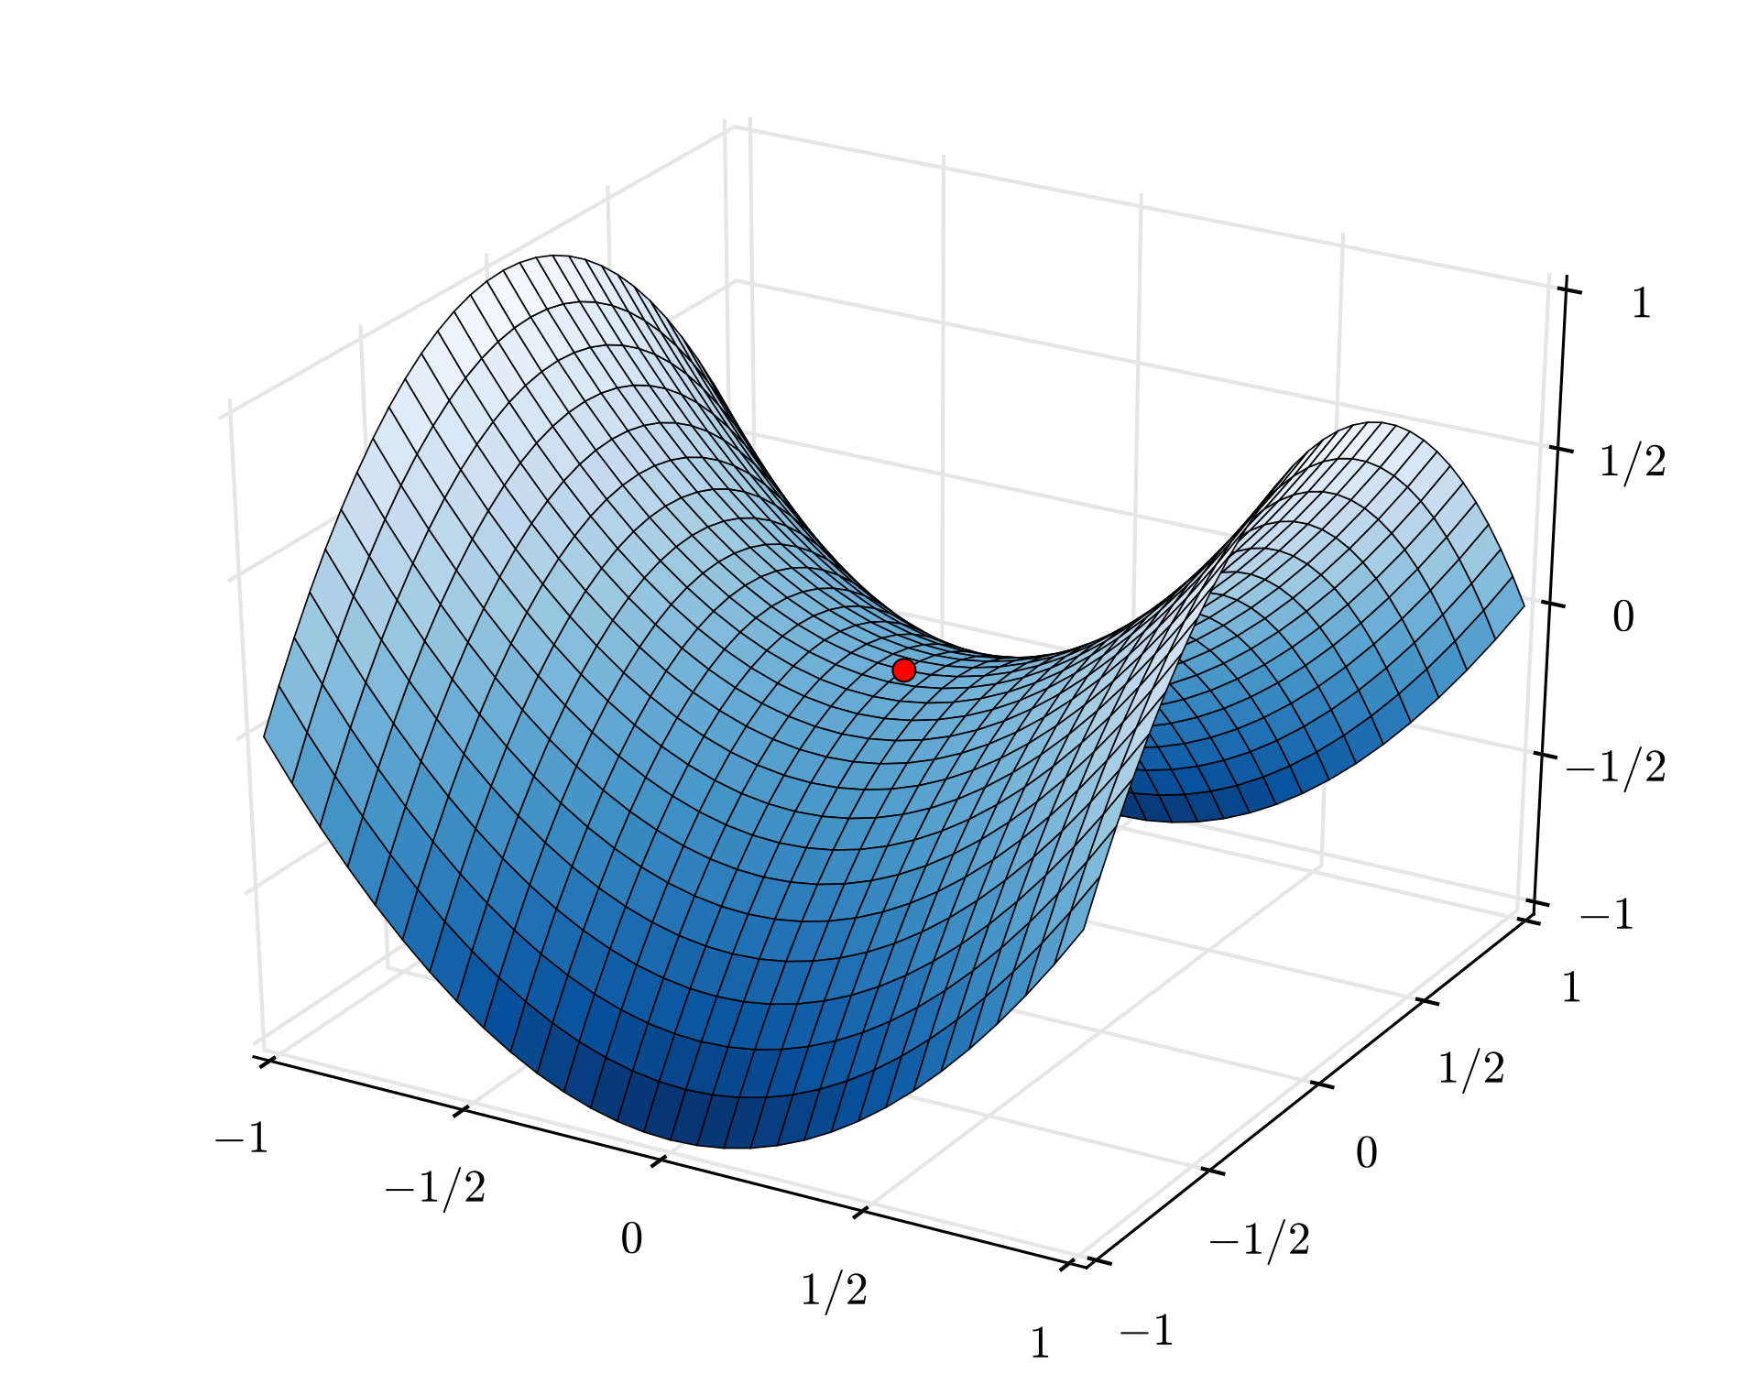
Hard cases for gradient descent: saddle points
https://en.wikipedia.org/wiki/Saddle_point

Slide 20

Momentum
Idea: building in momentum from previous steps helps reduce oscillation caused by sudden changes
Introduce a new quantity $g_{t}$ and parameter $η<1.$Update as
$$g_{t}={η⋅g}_{t−1}+∇f(θ_{t})$$
And change the main update to $θ_{t}= θ_{t−1} −γg_{t}$

Slide 21
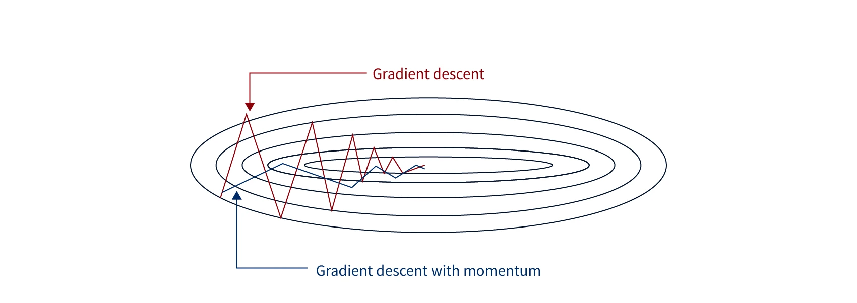
Image source: https://www.scaler.com/topics/momentum-based-gradient-descent/

Slide 22
Recall: Stochastic Gradient Descent w/ Momentum

Slide 23
Recall: Stochastic Gradient Descent w/ Momentum

Slide 24
Recall: Stochastic Gradient Descent w/ Momentum

Slide 25
Adaptive learning rates
Oftentimes, different parameters are “differently scaled”, making it hard to use a single learning rate/step size across all of them
We’d like to move fast in parameters with gentle but consistent gradients. When gradients are large and rapidly changing, move more slowly
Modern neural networks are usually trained with adaptive learning rate methods which change the learning rate for each parameter individually based on how large the gradients are

Slide 26
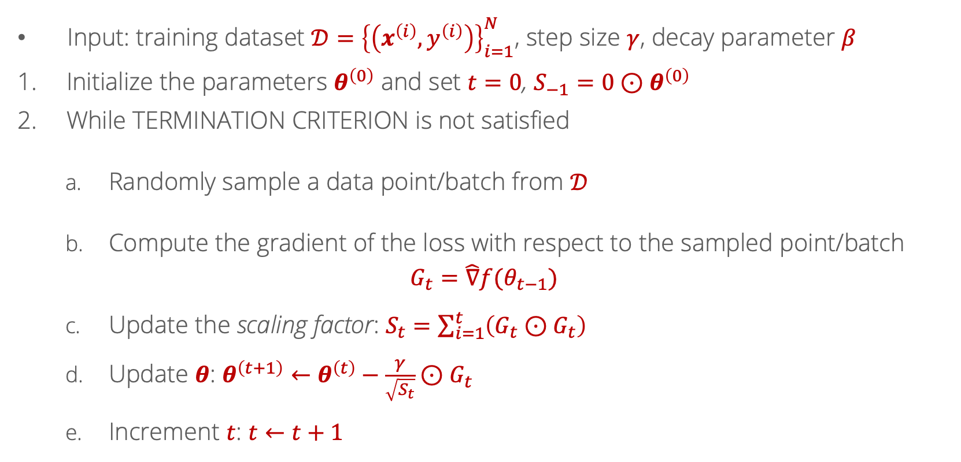


Adagrad
Input: training dataset $𝒟={\left\{\left(x^{\left(i\right)},y^{\left(i\right)}\right)\right\}}_{i=1}^{N}$, step size $γ$, decay parameter $β$
Initialize the parameters $θ^{\left(0\right)}$ and set $t=0$, $S_{−1}=0⊙θ^{\left(0\right)}$
While TERMINATION CRITERION is not satisfied
Randomly sample a data point/batch from $𝒟$
Compute the gradient of the loss with respect to the sampled point/batch
$$G_{t}=\hat{∇}f(θ_{t−1})$$
Update the scaling factor: $S_{t}=\sum_{i=1}^{t}{\left(G_{t}⊙G_{t}\right)}$
Update $θ$: $θ^{\left(t+1\right)}←θ^{\left(t\right)}−\frac{γ}{\sqrt{S_{t}}}⊙G_{t}$
Increment $t$: $t←t+1$
$⊙$ = elementwise product between two vectors
$S_{t}$ in denominator: if squared gradients have been large, scale update down

Slide 27
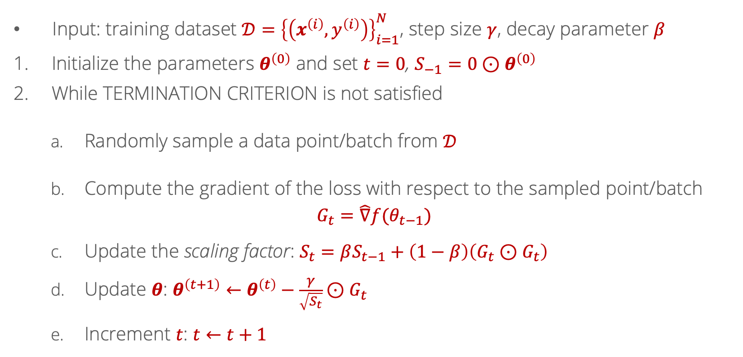
Root Mean Square Propagation (RMSProp)
Input: training dataset $𝒟={\left\{\left(x^{\left(i\right)},y^{\left(i\right)}\right)\right\}}_{i=1}^{N}$, step size $γ$, decay parameter $β$
Initialize the parameters $θ^{\left(0\right)}$ and set $t=0$, $S_{−1}=0⊙θ^{\left(0\right)}$
While TERMINATION CRITERION is not satisfied
Randomly sample a data point/batch from $𝒟$
Compute the gradient of the loss with respect to the sampled point/batch
$$G_{t}=\hat{∇}f(θ_{t−1})$$
Update the scaling factor: $S_{t}=βS_{t−1}+\left(1−β\right)\left(G_{t}⊙G_{t}\right)$
Update $θ$: $θ^{\left(t+1\right)}←θ^{\left(t\right)}−\frac{γ}{\sqrt{S_{t}}}⊙G_{t}$
Increment $t$: $t←t+1$
Moving average of squared gradients, instead of the sum: sum only gets bigger so the updates become small

Slide 28
Visualization
Source: https://imgur.com/a/Hqolp#2dKCQHh

Slide 29
Why not both?
Two techniques to improve performance: adaptive learning rates and momentum
Are these mutually exclusive? No!
The Adam optimizer combines RMSProp with momentum and is probably the most commonly used in practice

Slide 30
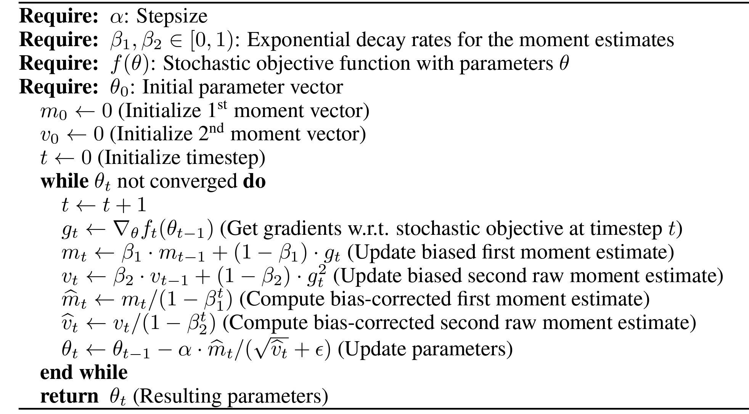
Adam

