Slide 1
Computational Foundations for ML (10-607):
Search and decoding
Bryan Wilder

Slide 2
Announcements
Final quiz: Friday during recitation period
Covers material since quiz 2 through Mon
Trees: various tree traversals, binary search trees
Lists, stacks, queues, and heaps: operations and implementations
Graphs: data structures, BFS/DFS, Kruskal’s and Dijkstra’s algorithms
Today: (stochastic) gradient descent algorithms

Slide 3
Search continued
So far, we’ve seen BFS/DFS, and then Dijkstra’s for computing shortest paths
Algorithms that we have are guaranteed to find the shortest path between two points eventually (BFS for unweighted graphs, Dijkstra’s for weighted)

Slide 4
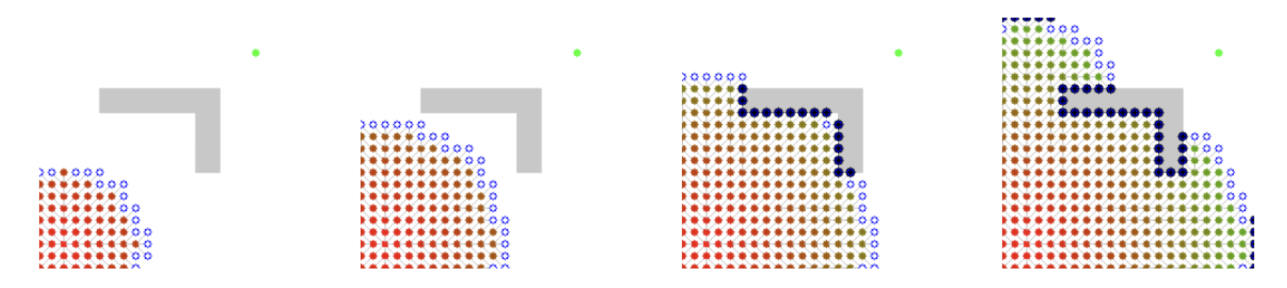
Example of Dijkstra’s algorithm
Notes:
def factorial(int n):
if ___________:
return ___________
return ___________________

Slide 5
When can we do better?
Dijkstra’s is an uninformed search algorithm: it makes no assumptions about the structure of the graph
An informed algorithm makes more assumptions, and does better if those assumptions are correct

Slide 6
Informed search with heuristics
Dijkstra’s explores nodes in order of their minimum distance so far
What if we add a heuristic which provides an estimate of the distance to the destination:
Common example of a heuristic on graphs representing locations: the straight-line distance
What could we do with a heuristic?

Slide 7
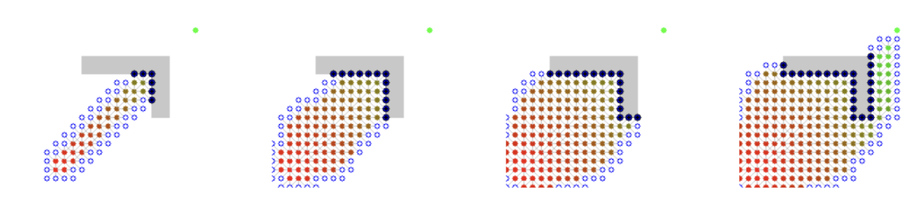
Greedy search
What if we just took the “best” node in every step?
Simply expanding the node with the best value of the heuristic
Doesn’t seem to work very well…

Slide 8
A* search
Combine Dijkstra’s algorithm with a heuristic
Track distances-so-far as in Dijkstra’s algorithm
Estimate distance to destination for a path going through node v:
Distance to get from source to v: dist[v]
Distance to get from v to destination: heuristic(v)
Final rule: explore the node with the minimum combined value of
dist[v] + heuristic(v)

Slide 9
Top: Dijkstra. Bottom: A*

Slide 10
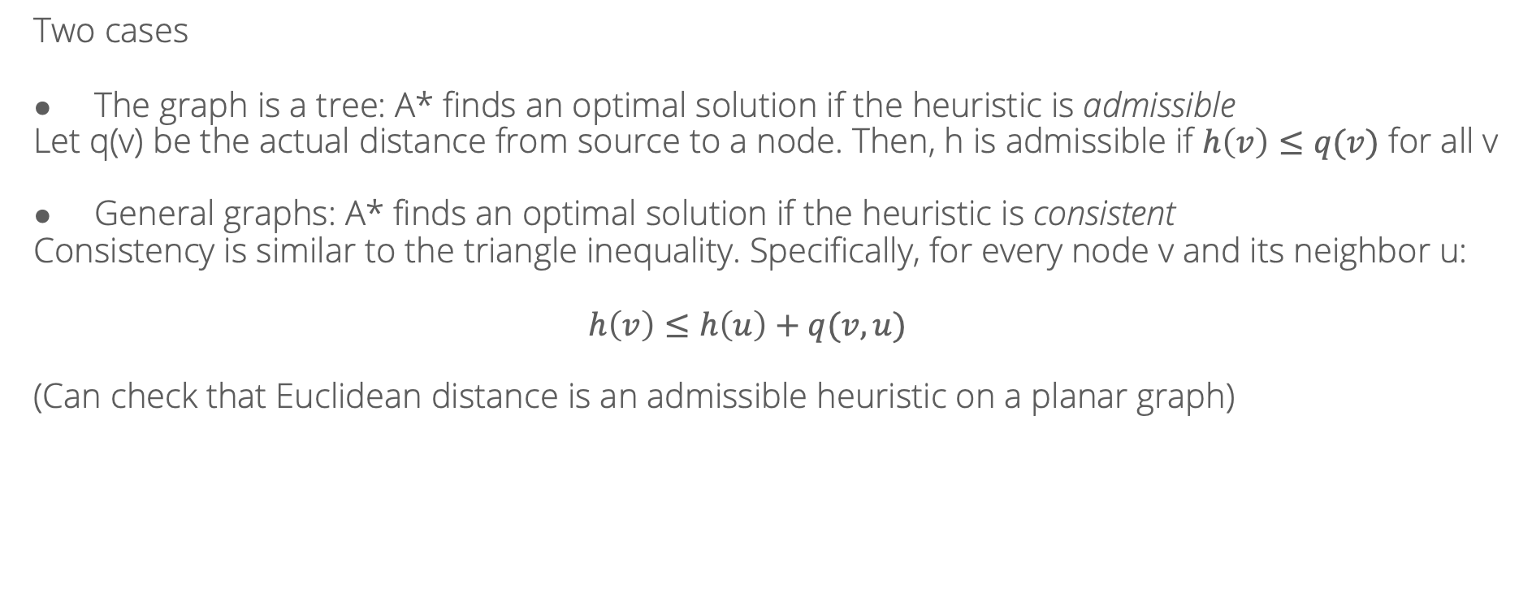
When does A* find an optimal solution?
Two cases
The graph is a tree: A* finds an optimal solution if the heuristic is admissible
Let q(v) be the actual distance from source to a node. Then, h is admissible if $h\left(v\right)≤q(v)$ for all v
General graphs: A* finds an optimal solution if the heuristic is consistent
Consistency is similar to the triangle inequality. Specifically, for every node v and its neighbor u:
$$h\left(v\right)≤h\left(u\right)+q(v, u)$$
(Can check that Euclidean distance is an admissible heuristic on a planar graph)

Slide 11
Search
So far: many search strategies (BFS, DFS, Dijkstra’s algorithm, A*)
In weighted graphs, Dijkstra’s will always find shortest paths
A* will do so with an admissible/consistent heuristic
Now: controllable tradeoff between computation and optimality

Slide 12
Beam search
Key idea: only process the most promising k nodes in each step; discard the others
“Promising” defined via a heuristic as in A*
Q = [source]
while Q is not empty:
new_Q = []
for node v in Q:
for u in neighbors(v):
if u == goal:
return
if not visited[u]:
visited[u] = True
new_Q.append(u)
Q = select_top_k(new_Q, heuristic)

Slide 13
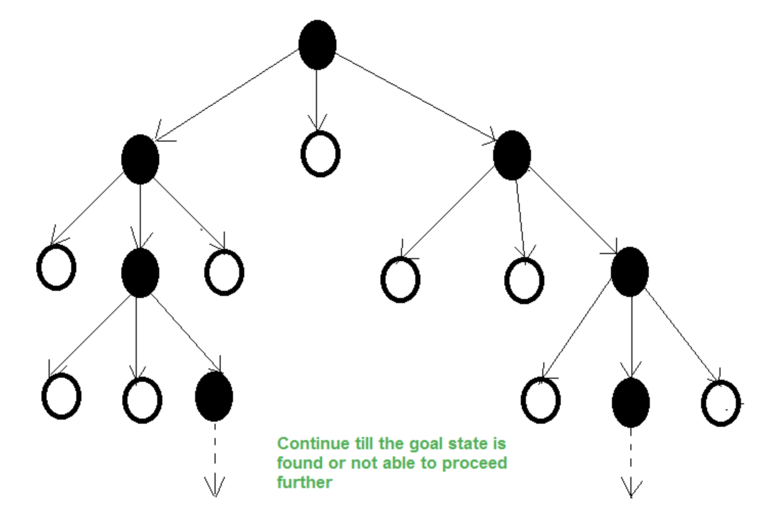

Slide 14
Beam search
Sacrifices worst-case optimality: the nodes on the optimal path might get pruned away due to the beam width limit
Improves memory usage
Works well if the heuristic is well-aligned with nodes that will actually appear on the optimal path

Slide 15
Beam search: applications
Motivated as a decoding step for language models
Model has a next-word probability distribution given previous words:
p(word 3 = ”chased”|word 1 = “the”, word 2 = “dog”)
In generation, the goal is to find the sequence with the largest overall probability

Slide 16
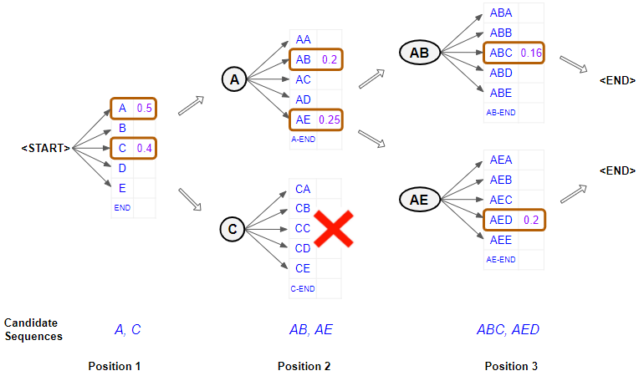
Beam search in language models
Heuristic = joint probability of sequence so far
Greedy search: choose the highest-probability token one at a time
Beam search: select the k best sequences to continue at each step

Slide 17
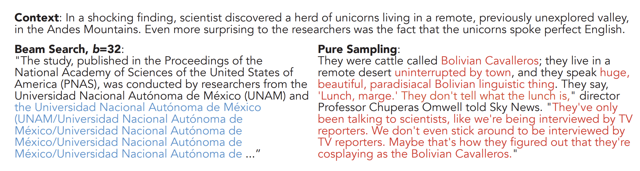
Practical problems with beam search
Holtzman et al. The curious case of neural text degeneration. ICLR 2020.

Slide 18
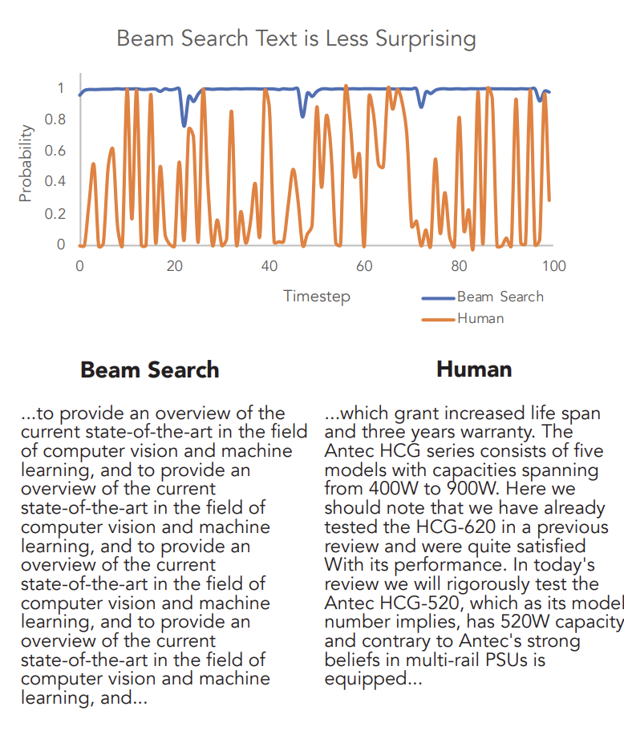
What happened?
Holtzman et al. The curious case of neural text degeneration. ICLR 2020.

Slide 19
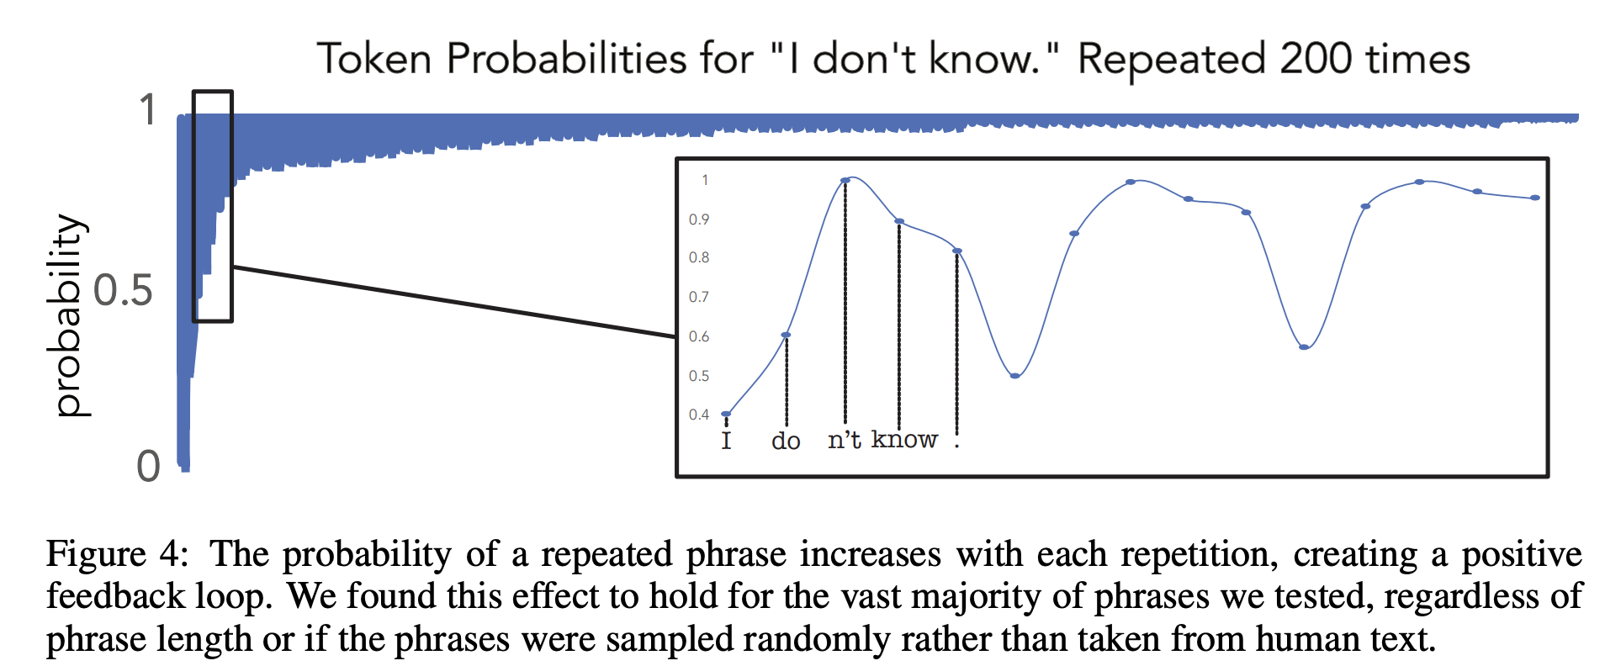
Issues in decoding
LLMs seem to assign high probability to well-formed text but the highest probability to repetitive/uninteresting sequences
Human text uses more low-probability next words
But, pure sampling from the model doesn’t work well either: there are lots of possible words and rare ones are cumulatively overweighted.

Slide 20
Potential fix: top-k decoding
Restrict possible next tokens to top k most-probable
Renormalize probability distribution over those tokens
Sample
Introduces randomness, removes overly rare next tokens
But what value of k to use?

Slide 21
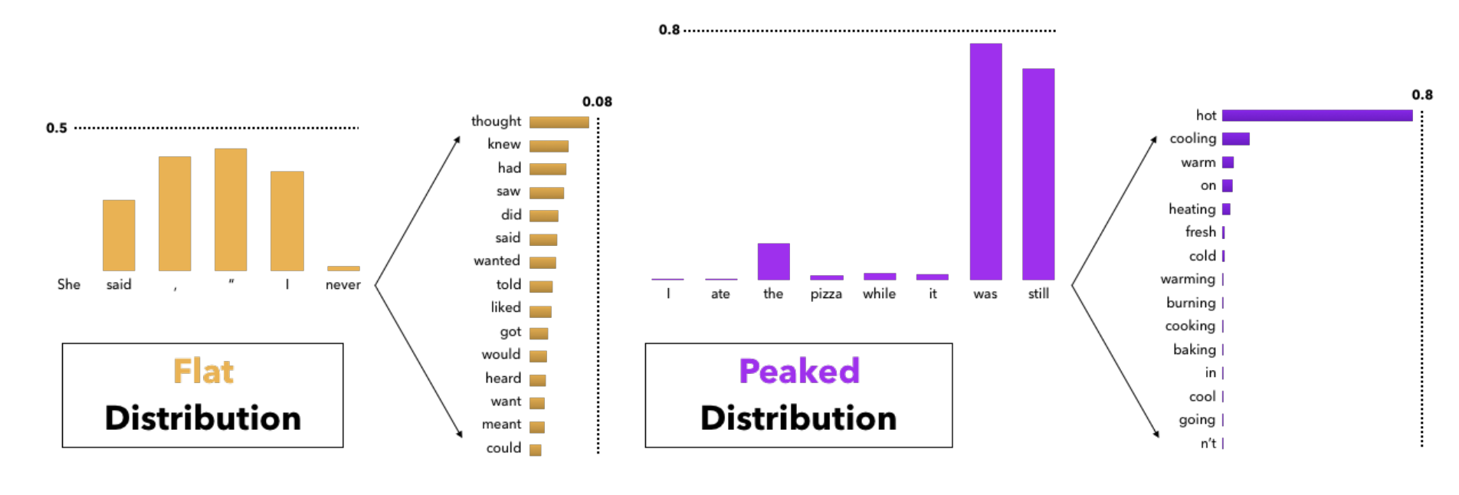
Potential fix: top-k decoding
Restrict possible next tokens to top k most-probable
Renormalize probability distribution over those tokens
Sample

Slide 22
Nucleus sampling/top-p
Sort tokens by predicted probability
Include tokens in the set until cumulative probability exceeds p
Renormalize and sample from that set
Size of set adapts to model confidence!

Slide 23

Temperature
Another parameter that can be added on to most other methods
Background: what the LLM outputs is actually the logits of the distribution:
LLM produces $z_{1}…z_{|V|}$
Probability is softmax($z)$, ie
$$P\left(token i\right)= \frac{e^{z_{i}}}{\sum_{j=1}^{|V|}{e^{z_{j}}}}$$

Slide 24
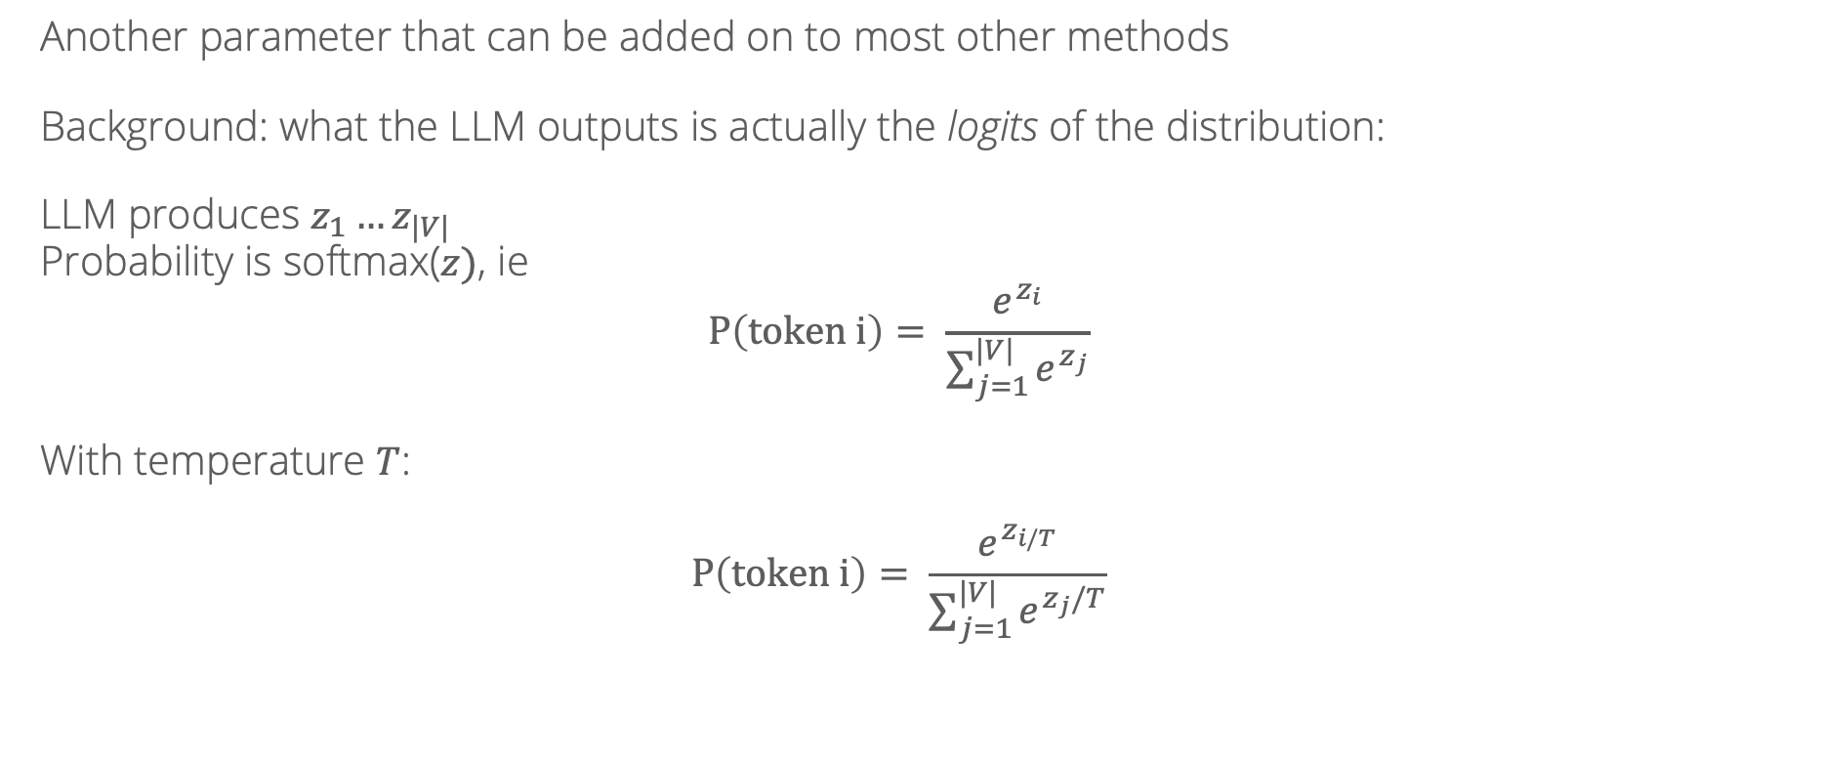
Temperature
Another parameter that can be added on to most other methods
Background: what the LLM outputs is actually the logits of the distribution:
LLM produces $z_{1}…z_{|V|}$
Probability is softmax($z)$, ie
$$P\left(token i\right)= \frac{e^{z_{i}}}{\sum_{j=1}^{|V|}{e^{z_{j}}}}$$
With temperature $T$:
$$P\left(token i\right)= \frac{e^{z_{i/T}}}{\sum_{j=1}^{|V|}{e^{z_{j}/T}}}$$

Slide 25
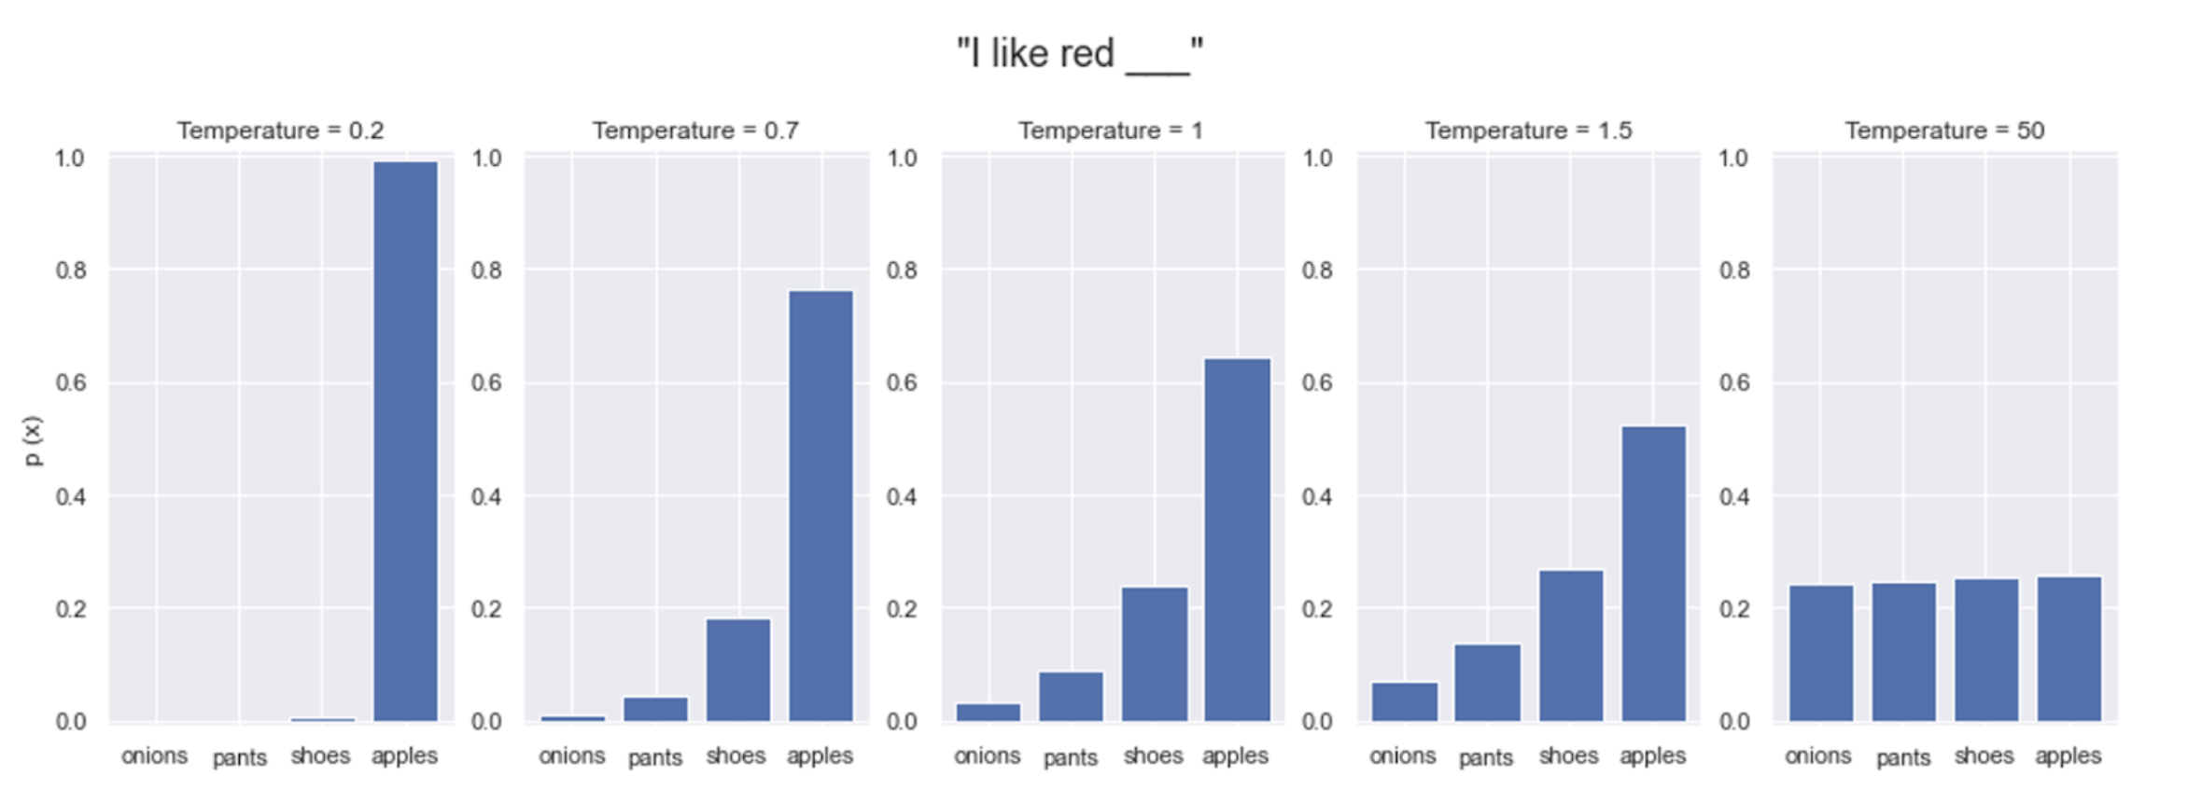
Temperature
Image credit:
https://www.hopsworks.ai/dictionary/llm-temperature

Slide 26
Temperature
Lower temperature: more coherence…but also less diversity

Slide 27


Slide 28
What is the objective?
Max probability turned out to be a bad goal for open-ended generation
Beam search is more likely to be used for machine translation or other close-ended domains
In generation, our goal is closer to sampling (but naïve sampling still exposes problems with the language model)

