Slide 1
Computational Foundations for ML (10-607):
Dynamic Programming
Bryan Wilder
* Slides borrowed from prior offerings by Professors H. Heidari, M. Gormley, P. Virtue, & G. Gordon.

Slide 2
Reminders
Quiz 2: next Wed (Nov 18)
Not cumulative: material from weeks 3-4
(Computational complexity, recursion, dynamic programming)

Slide 3
Warmup: Fibonacci sequence
def fibonacci(n):
if (n = 1):
return 1
else:
return fibonacci(n-1) + fibonacci(n-2)
What does the tree of recursive calls look like?
What is the runtime of this algorithm?

Slide 4
Warmup: Fibonacci sequence
def fibonacci(n):
A = int[n+1]
A[1] = 1
A[2] = 1
for(int i = 3; i <= n; i++){
A[i] = A[i-1] + A[i-2]
}
return A[n]

Slide 5
Dynamic programming
Motivation: problems that have recursive structure…
…but where the subproblems will overlap, creating wasted effort
Solution: create a data structure to store intermediate solutions as they’re computed

Slide 6
General Procedure for Dynamic Programming
Define the quantity of interest recursively
  Specify the basis cases
  Determine the inductive relationship
Construct a data structure (typically a matrix or an array) to hold solutions to subproblems
Working from the basis cases to the desired result, solve and store subproblems.

Slide 7
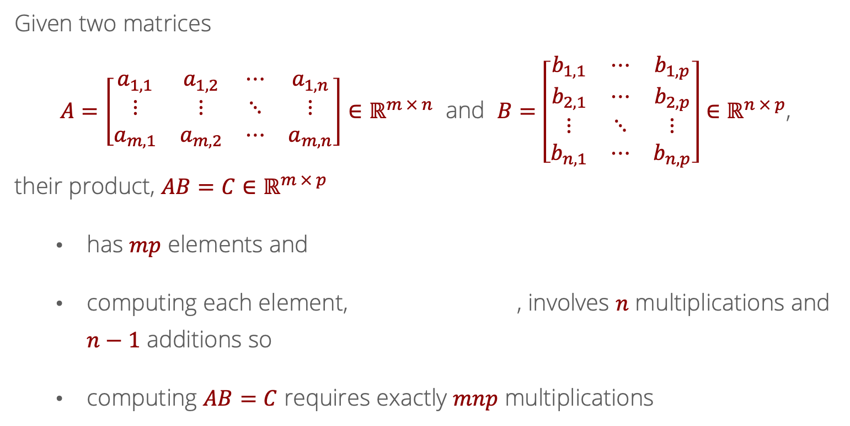
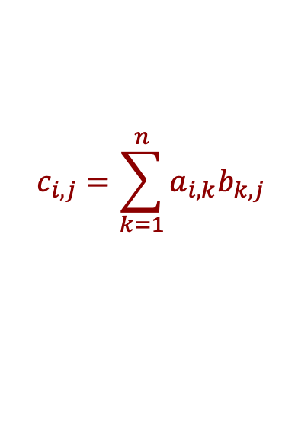
Recall: Computational cost of computing $AB$?
Given two matrices
$A=\left[\begin{matrix}a_{1,1} & a_{1,2} & ⋯ & a_{1,n} \\ ⋮ & ⋮ & ⋱ & ⋮ \\ a_{m,1} & a_{m,2} & ⋯ & a_{m,n}\end{matrix}\right]∈ℝ^{m × n}$ and $B=\left[\begin{matrix}b_{1,1} & ⋯ & b_{1,p} \\ b_{2,1} & ⋯ & b_{2,p} \\ ⋮ & ⋱ & ⋮ \\ b_{n,1} & ⋯ & b_{n,p}\end{matrix}\right]∈ℝ^{n × p}$,
their product, $AB=C∈ℝ^{m × p}$
  has $mp$ elements and
  computing each element, , involves $n$ multiplications and $n−1$ additions so
  computing $AB=C$ requires exactly $mnp$ multiplications
$$c_{i,j}=\sum_{k=1}^{n}{a_{i,k}b_{k,j}}$$

Slide 8
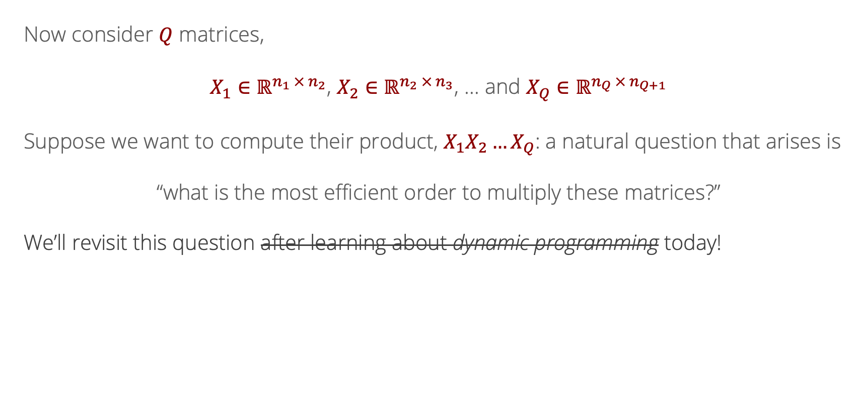
Likelihood
Recall: Multiple Matrix Multiplications
Now consider $Q$ matrices,
$X_{1}∈ℝ^{n_{1} × n_{2}}$, $X_{2}∈ℝ^{n_{2} × n_{3}}$, … and $X_{Q}∈ℝ^{n_{Q} × n_{Q+1}}$
Suppose we want to compute their product, $X_{1}X_{2}…X_{Q}$: a natural question that arises is
“what is the most efficient order to multiply these matrices?”
We’ll revisit this question after learning about dynamic programming today!

Slide 9
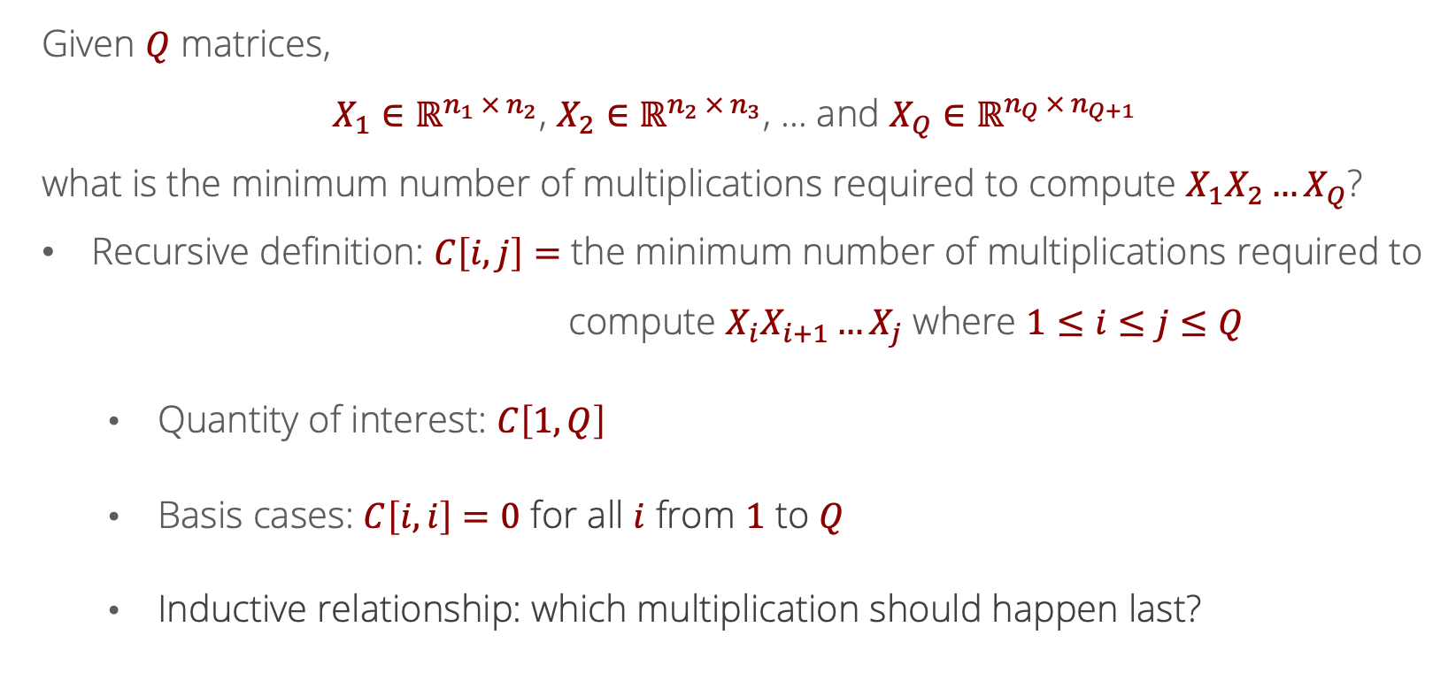

Recurrence Relation for Matrix Multiplication
Given $Q$ matrices,
$X_{1}∈ℝ^{n_{1} × n_{2}}$, $X_{2}∈ℝ^{n_{2} × n_{3}}$, … and $X_{Q}∈ℝ^{n_{Q} × n_{Q+1}}$
what is the minimum number of multiplications required to compute $X_{1}X_{2}…X_{Q}$?
Recursive definition: $C\left[i,j\right]=$ the minimum number of multiplications required to
compute $X_{i}X_{i+1}…X_{j}$ where $1≤i≤j≤Q$
  Quantity of interest: $C\left[1,Q\right]$
  Basis cases: $C\left[i,i\right]=0$ for all $i$ from $1$ to $Q$
  Inductive relationship: which multiplication should happen last?

Slide 10
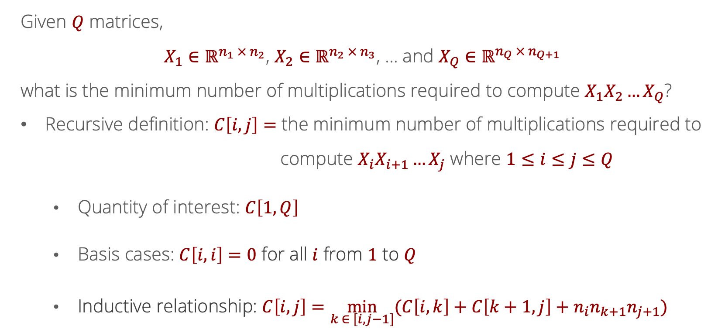
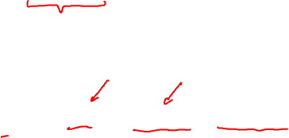
Recurrence Relation for Matrix Multiplication
Given $Q$ matrices,
$X_{1}∈ℝ^{n_{1} × n_{2}}$, $X_{2}∈ℝ^{n_{2} × n_{3}}$, … and $X_{Q}∈ℝ^{n_{Q} × n_{Q+1}}$
what is the minimum number of multiplications required to compute $X_{1}X_{2}…X_{Q}$?
Recursive definition: $C\left[i,j\right]=$ the minimum number of multiplications required to
compute $X_{i}X_{i+1}…X_{j}$ where $1≤i≤j≤Q$
  Quantity of interest: $C\left[1,Q\right]$
  Basis cases: $C\left[i,i\right]=0$ for all $i$ from $1$ to $Q$
  Inductive relationship: $C\left[i,j\right]=\min_{k ∈ \left[i,j−1\right]}{(C\left[i,k\right]+C\left[k+1,j\right]}+n_{i}n_{k+1}n_{j+1})$

Slide 11

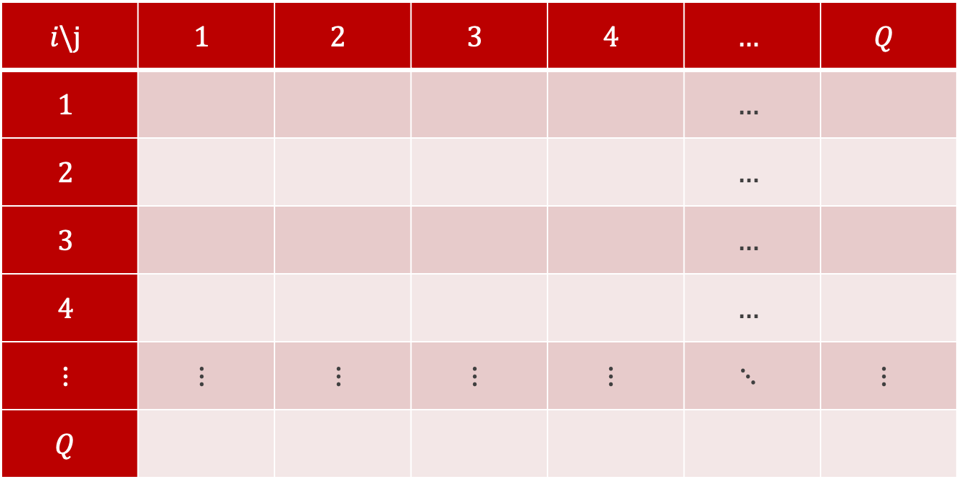

Defining a Data Structure
$$i\backslash j$$ | $$1$$ | $$2$$ | $$3$$ | $$4$$ | $$…$$ | $$Q$$
$$1$$ |  |  |  |  | $$…$$
$$2$$ |  |  |  |  | $$…$$
$$3$$ |  |  |  |  | $$…$$
$$4$$ |  |  |  |  | $$…$$
$$⋮$$ | $$⋮$$ | $$⋮$$ | $$⋮$$ | $$⋮$$ | $$⋱$$ | $$⋮$$
$$Q$$
$$C=$$

Slide 12

Defining a Data Structure
$$i\backslash j$$ | $$1$$ | $$2$$ | $$3$$ | $$4$$ | $$…$$ | $$Q$$
$$1$$ |  |  |  |  | $$…$$ | GOAL
$$2$$ |  |  |  |  | $$…$$
$$3$$ |  |  |  |  | $$…$$
$$4$$ |  |  |  |  | $$…$$
$$⋮$$ | $$⋮$$ | $$⋮$$ | $$⋮$$ | $$⋮$$ | $$⋱$$ | $$⋮$$
$$Q$$
$$C=$$

Slide 13

Defining a Data Structure
$$i\backslash j$$ | $$1$$ | $$2$$ | $$3$$ | $$4$$ | $$…$$ | $$Q$$
$$1$$ | $$0$$ |  |  |  | $$…$$ | GOAL
$$2$$ |  | $$0$$ |  |  | $$…$$
$$3$$ |  |  | $$0$$ |  | $$…$$
$$4$$ |  |  |  | $$0$$ | $$…$$
$$⋮$$ | $$⋮$$ | $$⋮$$ | $$⋮$$ | $$⋮$$ | $$⋱$$ | $$⋮$$
$$Q$$ |  |  |  |  |  | $$0$$
$$C=$$

Slide 14
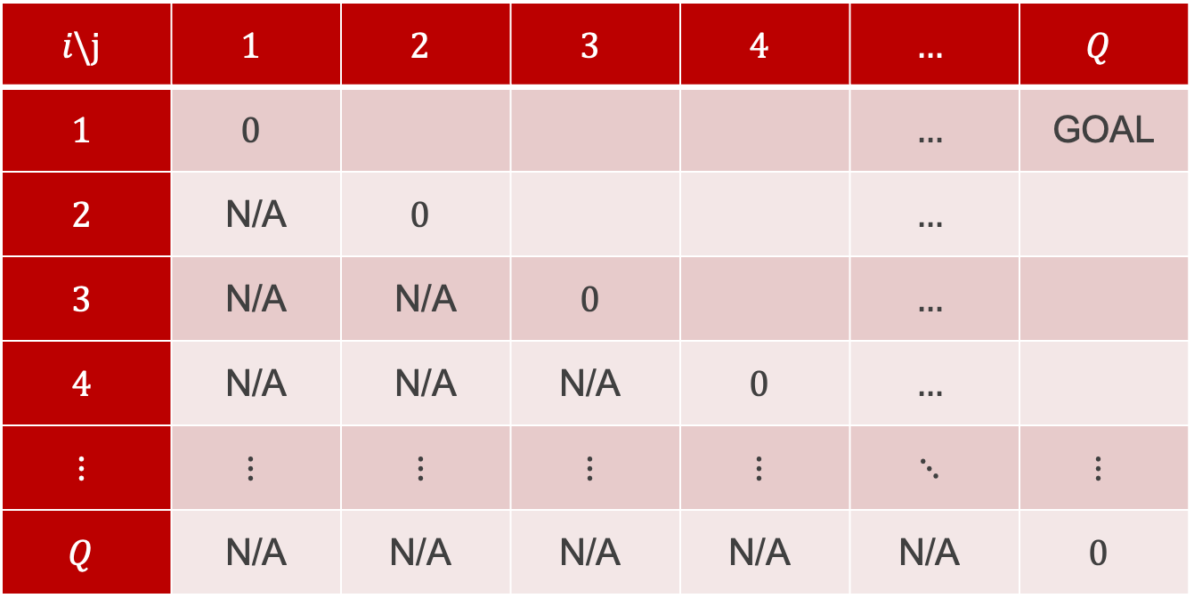

Defining a Data Structure
$$i\backslash j$$ | $$1$$ | $$2$$ | $$3$$ | $$4$$ | $$…$$ | $$Q$$
$$1$$ | $$0$$ |  |  |  | $$…$$ | GOAL
$$2$$ | N/A | $$0$$ |  |  | $$…$$
$$3$$ | N/A | N/A | $$0$$ |  | $$…$$
$$4$$ | N/A | N/A | $$\text{N/A}$$ | $$0$$ | $$…$$
$$⋮$$ | $$⋮$$ | $$⋮$$ | $$⋮$$ | $$⋮$$ | $$⋱$$ | $$⋮$$
$$Q$$ | N/A | $$\text{N/A}$$ | $$\text{N/A}$$ | $$\text{N/A}$$ | $$\text{N/A}$$ | $$0$$
$$C=$$

Slide 15
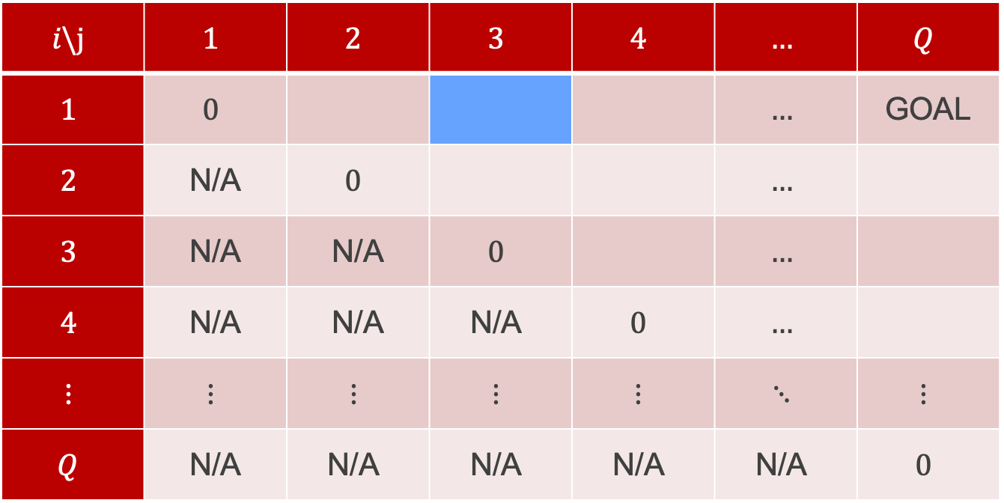
Defining a Data Structure
What is the best way to multiply $X_{1}X_{2}X_{3}$?
$$i\backslash j$$ | $$1$$ | $$2$$ | $$3$$ | $$4$$ | $$…$$ | $$Q$$
$$1$$ | $$0$$ |  |  |  | $$…$$ | GOAL
$$2$$ | N/A | $$0$$ |  |  | $$…$$
$$3$$ | N/A | N/A | $$0$$ |  | $$…$$
$$4$$ | N/A | N/A | $$\text{N/A}$$ | $$0$$ | $$…$$
$$⋮$$ | $$⋮$$ | $$⋮$$ | $$⋮$$ | $$⋮$$ | $$⋱$$ | $$⋮$$
$$Q$$ | N/A | $$\text{N/A}$$ | $$\text{N/A}$$ | $$\text{N/A}$$ | $$\text{N/A}$$ | $$0$$
$$C=$$

Slide 16
Defining a Data Structure
Either $\left(X_{1}X_{2}\right)X_{3}$ or $X_{1}\left(X_{2}X_{3}\right)$
$$i\backslash j$$ | $$1$$ | $$2$$ | $$3$$ | $$4$$ | $$…$$ | $$Q$$
$$1$$ | $$0$$ |  |  |  | $$…$$ | GOAL
$$2$$ | N/A | $$0$$ |  |  | $$…$$
$$3$$ | N/A | N/A | $$0$$ |  | $$…$$
$$4$$ | N/A | N/A | $$\text{N/A}$$ | $$0$$ | $$…$$
$$⋮$$ | $$⋮$$ | $$⋮$$ | $$⋮$$ | $$⋮$$ | $$⋱$$ | $$⋮$$
$$Q$$ | N/A | $$\text{N/A}$$ | $$\text{N/A}$$ | $$\text{N/A}$$ | $$\text{N/A}$$ | $$0$$
$$C=$$

Slide 17
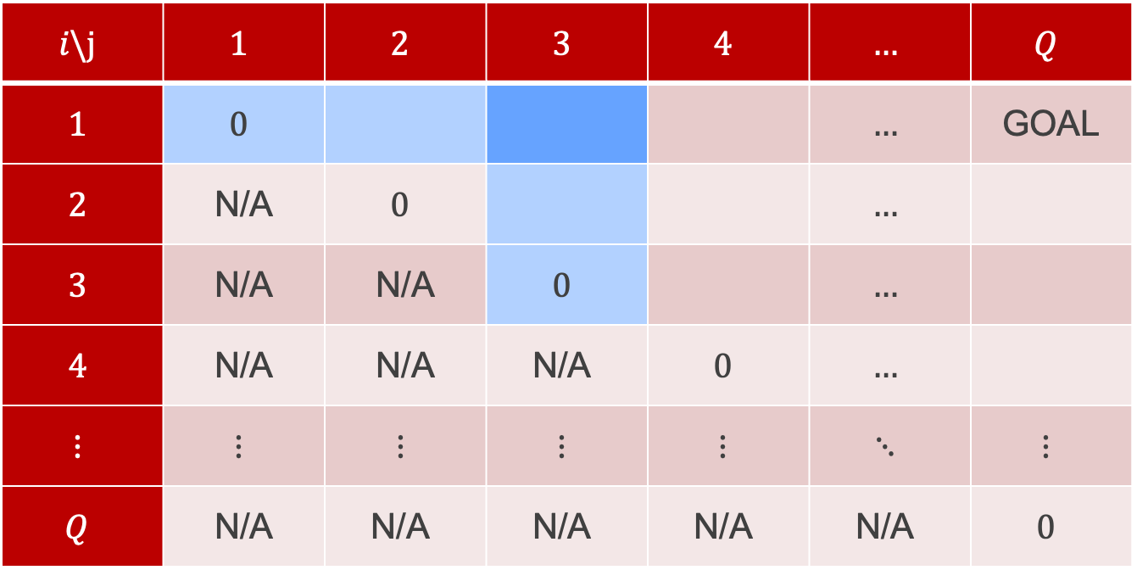
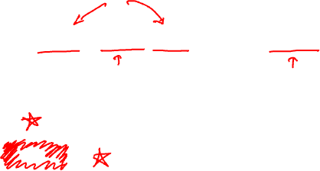
Defining a Data Structure
$$C\left[1, 3\right]=\min{(C\left[1,1\right]+C\left[2,3\right]+n_{1}n_{2}n_{4},C\left[1,2\right]+C\left[3,3\right]+n_{1}n_{3}n_{4}})$$
$$i\backslash j$$ | $$1$$ | $$2$$ | $$3$$ | $$4$$ | $$…$$ | $$Q$$
$$1$$ | $$0$$ |  |  |  | $$…$$ | GOAL
$$2$$ | N/A | $$0$$ |  |  | $$…$$
$$3$$ | N/A | N/A | $$0$$ |  | $$…$$
$$4$$ | N/A | N/A | $$\text{N/A}$$ | $$0$$ | $$…$$
$$⋮$$ | $$⋮$$ | $$⋮$$ | $$⋮$$ | $$⋮$$ | $$⋱$$ | $$⋮$$
$$Q$$ | N/A | $$\text{N/A}$$ | $$\text{N/A}$$ | $$\text{N/A}$$ | $$\text{N/A}$$ | $$0$$
$$C=$$

Slide 18
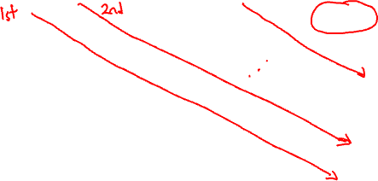
Defining a Data Structure
  $$C\left[i,j\right]=\min_{k ∈ \left[i,j−1\right]}{(C\left[i,k\right]+C\left[k+1,j\right]}+n_{i}n_{k+1}n_{j+1})$$
$$i\backslash j$$ | $$1$$ | $$2$$ | $$3$$ | $$4$$ | $$…$$ | $$Q$$
$$1$$ | $$0$$ |  |  |  | $$…$$ | GOAL
$$2$$ | N/A | $$0$$ |  |  | $$…$$
$$3$$ | N/A | N/A | $$0$$ |  | $$…$$
$$4$$ | N/A | N/A | $$\text{N/A}$$ | $$0$$ | $$…$$
$$⋮$$ | $$⋮$$ | $$⋮$$ | $$⋮$$ | $$⋮$$ | $$⋱$$ | $$⋮$$
$$Q$$ | N/A | $$\text{N/A}$$ | $$\text{N/A}$$ | $$\text{N/A}$$ | $$\text{N/A}$$ | $$0$$
$$C=$$

Slide 19
Backtracking
So far, we only computed the value of the optimal solution
(what is the smallest number of operations we can use to multiply the matrices)
What we wanted to know was the optimal ordering itself
How to recover this?

Slide 20
Defining a Data Structure
  $$C\left[i,j\right]=\min_{k ∈ \left[i,j−1\right]}{(C\left[i,k\right]+C\left[k+1,j\right]}+n_{i}n_{k+1}n_{j+1})$$
$$i\backslash j$$ | $$1$$ | $$2$$ | $$3$$ | $$4$$ | $$…$$ | $$Q$$
$$1$$ | $$0$$ |  |  |  | $$…$$ | GOAL
$$2$$ | N/A | $$0$$ |  |  | $$…$$
$$3$$ | N/A | N/A | $$0$$ |  | $$…$$
$$4$$ | N/A | N/A | $$\text{N/A}$$ | $$0$$ | $$…$$
$$⋮$$ | $$⋮$$ | $$⋮$$ | $$⋮$$ | $$⋮$$ | $$⋱$$ | $$⋮$$
$$Q$$ | N/A | $$\text{N/A}$$ | $$\text{N/A}$$ | $$\text{N/A}$$ | $$\text{N/A}$$ | $$0$$
What was the optimal k?
$$C=$$

Slide 21
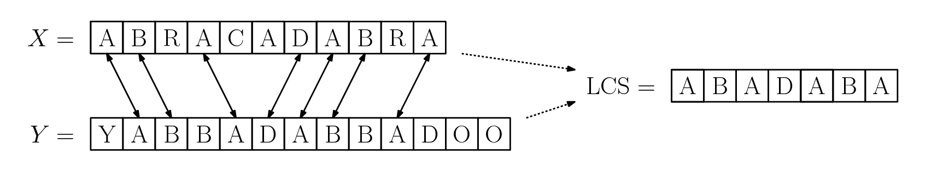
Longest common subsequence

Slide 22
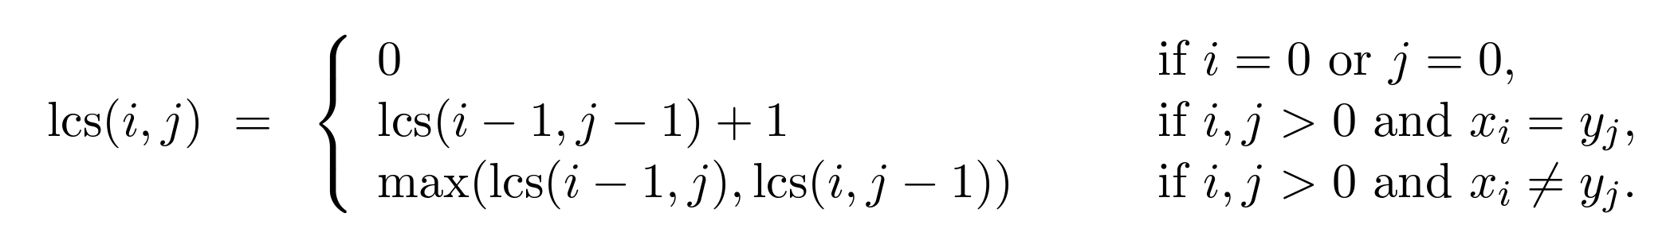
Longest common subsequence
Dynamic programming solution: subproblems are the LCS between X[1:i] and Y[1:j] (the first i letters of X and the first j letters of Y)

Slide 23
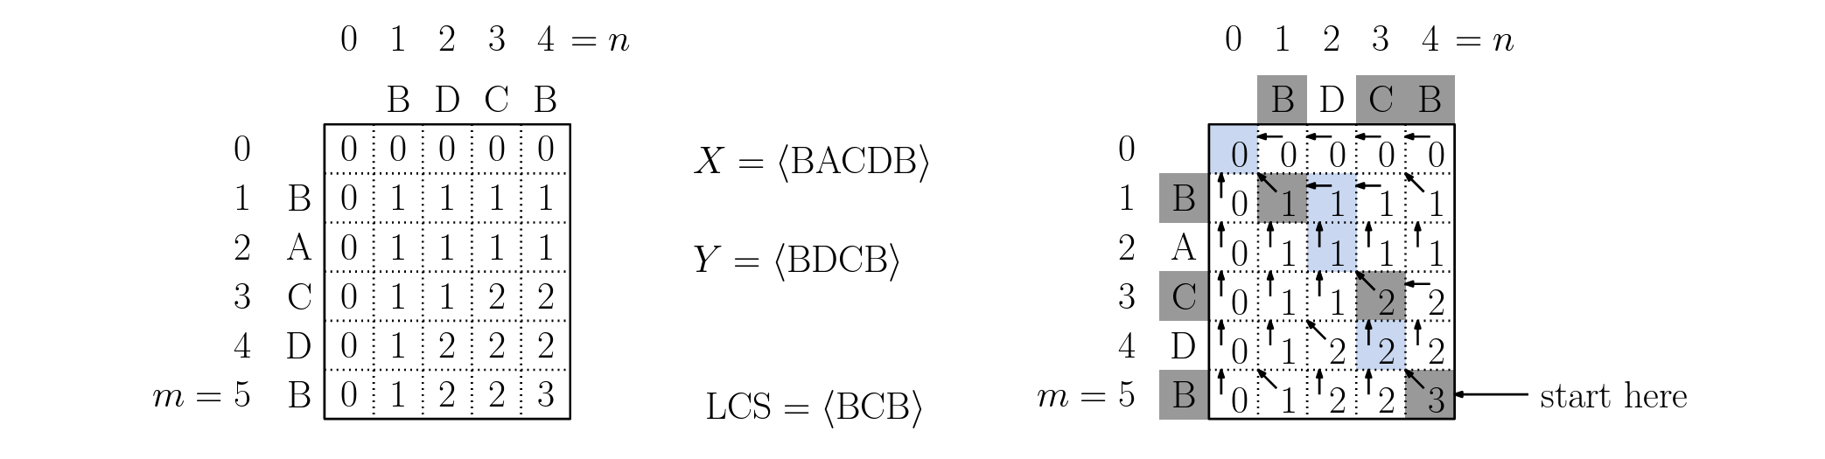
Longest common subsequence
Backtracking to extract the sequence: navigate backwards through the table
If X[i] == X[j]: print out that letter, move to (i-1, j-1)
Otherwise, move to whichever previous entry (i-1, j) or (i, j-1) has a bigger entry

Slide 24
Edit distance
A close cousin of LCS: how many single-letter edits does it take to turn 𝑋 into 𝑌?
Allowed edits: insert a letter, delete a letter, or substitute one letter for another
Example: SUNDAY → SATURDAY takes 3 edits
X
S
–
–
U
N
D
A
Y
Y
S
A
T
U
R
D
A
Y
ins
ins
sub
Uses: spell-checking, DNA sequence alignment, record linkage
What should the subproblems be? What is the recurrence?

Slide 25
Edit distance: recurrence
Subproblems: 𝐷[𝑖, 𝑗] = edit distance between 𝑋[1:𝑖] and 𝑌[1:𝑗]
Base cases: 𝐷[𝑖, 0] = 𝑖 (delete everything), 𝐷[0, 𝑗] = 𝑗 (insert everything)
Inductive relationship: look at the last letter of each string
{
𝐷[𝑖−1, 𝑗] + 1
delete 𝑋[𝑖]
𝐷[𝑖, 𝑗] = min
𝐷[𝑖, 𝑗−1] + 1
insert 𝑌[𝑗]
𝐷[𝑖−1, 𝑗−1] + (1 if 𝑋[𝑖] ≠ 𝑌[𝑗] else 0)
substitute or match
Compare to LCS: same table and neighbors, different combining rule
Runtime: 𝑂(𝑛𝑚) table entries × 𝑂(1) work each = 𝑂(𝑛𝑚)

Slide 26
Edit distance: filling the table
 | ∅ | S | H | I | N | E
∅
R
A
I
N
𝑋 = RAIN (rows), 𝑌 = SHINE (columns)

Slide 27
Edit distance: filling the table
 | ∅ | S | H | I | N | E
∅ | 0 | 1 | 2 | 3 | 4 | 5
R | 1 | 1 | 2 | 3 | 4 | 5
A | 2 | 2 | 2 | 3 | 4 | 5
I | 3 | 3 | 3 | 2 | 3 | 4
N | 4 | 4 | 4 | 3 | 2 | 3
𝑋 = RAIN (rows), 𝑌 = SHINE (columns)
𝐷[4, 5] = 3
Backtracking (shaded path), just like LCS:
R → S substitute
A → H substitute
I, N match (free)
+ E insert

Slide 28
Memoization
So far, we have implemented “sweeping” algorithms that iteratively “sweep” an index or pair of indices forward
Alternative: add an extra data structure to a recursive algorithm to act as memory when we encounter a subproblem we’ve seen before

Slide 29
Memoization
def fibonacci_memo(n, A):
if(A[n] != -1):
return A[n]
if (n = 0 or n = 1):
A[n] = 1
return 1
else:
A[n] = fibonacci(n-1) + fibonacci(n-2)
return A[n]
def fibonacci(n):
A = int[n+1];
for(int i = 0; i <= n; i++)
A[i] = -1;
return fibonacci_memo(n, A)

Slide 30
Memoization
def lcs(x, y):
A = int[len(x)+1, len(y)+1];
<initialize A with -1s>
return lcs_memo(x, y, len(x), len(y), A)

Slide 31
Memoization
def lcs_memo(x, y, i, j, A):
if(A[i,j] != -1):
return A[i,j]
if(i ==0 or j == 0):
A[i,j] = 0
elif x[i] == y[j]:
A[i,j] = 1 + lcs_memo(x, y, i-1, j-1, A)
else:
A[i,j] = max(lcs_memo(x,y,i-1,j,A), lcs_memo(x,y,i,j-1,A))
return A[i,j]

Slide 32
Coin change
Given coin values 𝑐₁, …, 𝑐_{𝑘} and an amount 𝑛, make exactly 𝑛 with as few coins as possible (unlimited supply of each coin)
Example: coins {1, 3, 4}, amount 6
Greedy idea: always take the biggest coin that still fits
How many coins does greedy use?
A: 1
B: 2
C: 3
D: 4
1
3
4

Slide 33
Coin change: greedy fails
4
1
1
Greedy
= 3 coins
3
3
Optimal
= 2 coins
Greedy commits to the 4 before seeing that it leaves an awkward remainder of 2
DP fix: try every possible first coin, and reuse the best answers for the smaller amounts that remain
Smaller amounts recur many times (6−3 = 3, 6−1−1−1 = 3, …), so store them

Slide 34
Coin change: DP solution
Subproblems: 𝐶[𝑣] = fewest coins that add up to amount 𝑣, for 𝑣 = 0, 1, …, 𝑛
Base case: 𝐶[0] = 0
Inductive relationship: the last coin used is some 𝑐_{𝑖} ≤ 𝑣
𝐶[𝑣] = 1 + min_{𝑖 : 𝑐𝑖 ≤ 𝑣} 𝐶[𝑣 − 𝑐_{𝑖}]
𝑣 | 0 | 1 | 2 | 3 | 4 | 5 | 6
𝐶[𝑣] | 0 | 1 | 2 | 1 | 1 | 2 | 2
last coin | – | 1 | 1 | 3 | 4 | 1 | 3
Coins {1, 3, 4}. Recover the coins by following “last coin”: 6 → 3 → 0, i.e. 3 + 3
Runtime: 𝑂(𝑛𝑘). It grows with the value of 𝑛

Slide 35
Coin change: memoized
def min_coins(coins, n):
A = [-1] * (n+1)
return coins_memo(coins, n, A)
def coins_memo(coins, v, A):
if A[v] != -1:
return A[v]
if v == 0:
A[v] = 0
else:
A[v] = 1 + min(coins_memo(coins, v - c, A)
for c in coins if c <= v)
return A[v]

Slide 36
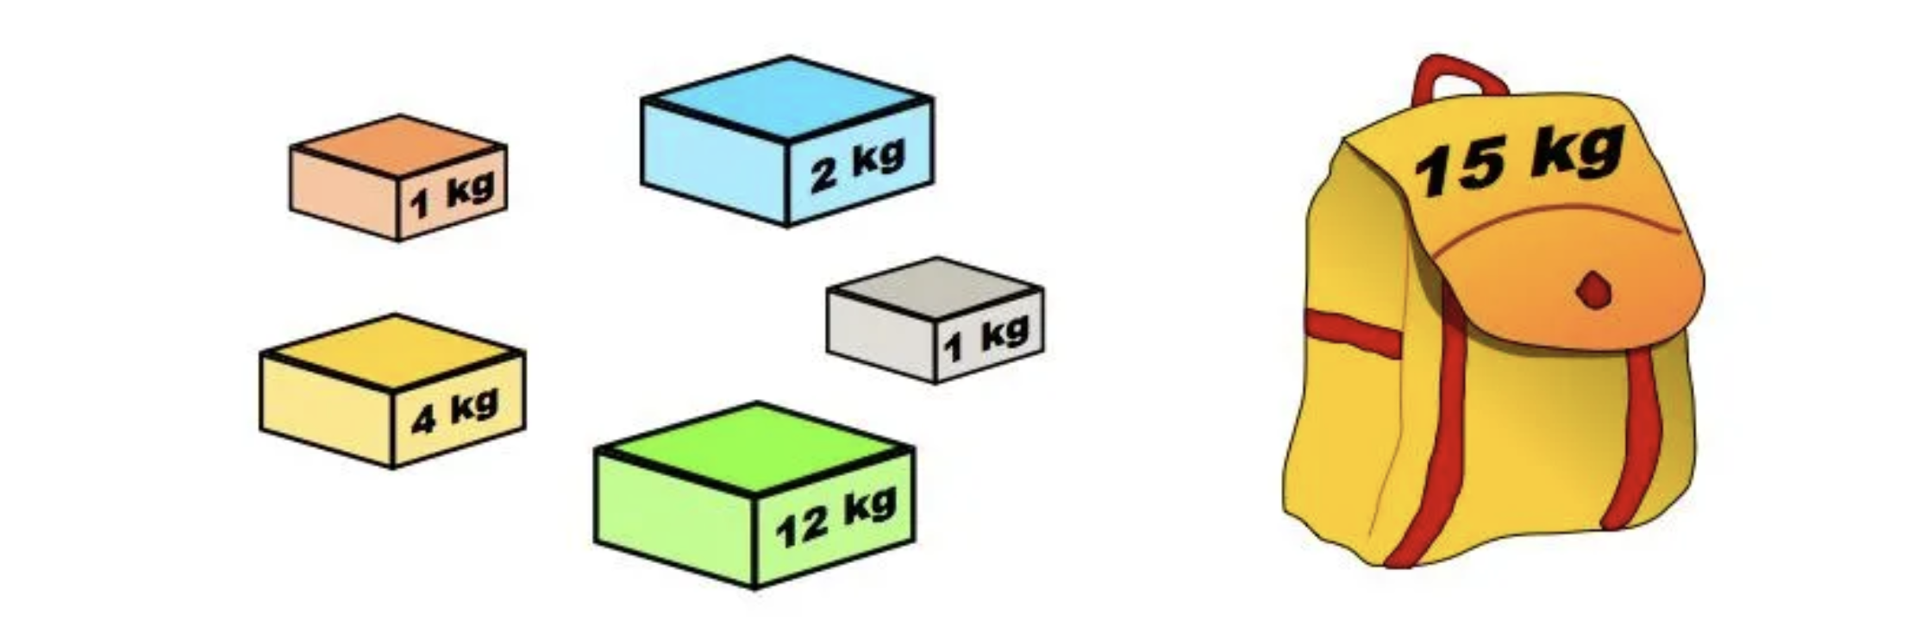
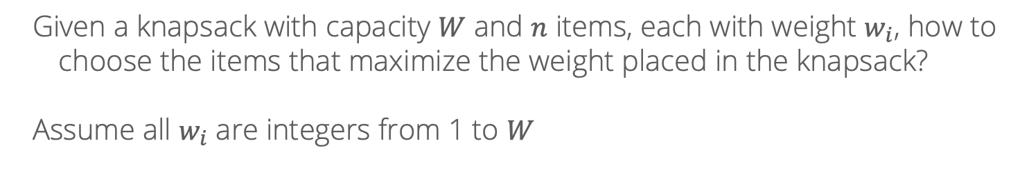
Knapsack problem
Given a knapsack with capacity $W$ and $n$ items, each with weight $w_{i}$, how to choose the items that maximize the weight placed in the knapsack?
Assume all $w_{i}$ are integers from 1 to $W$

Slide 37
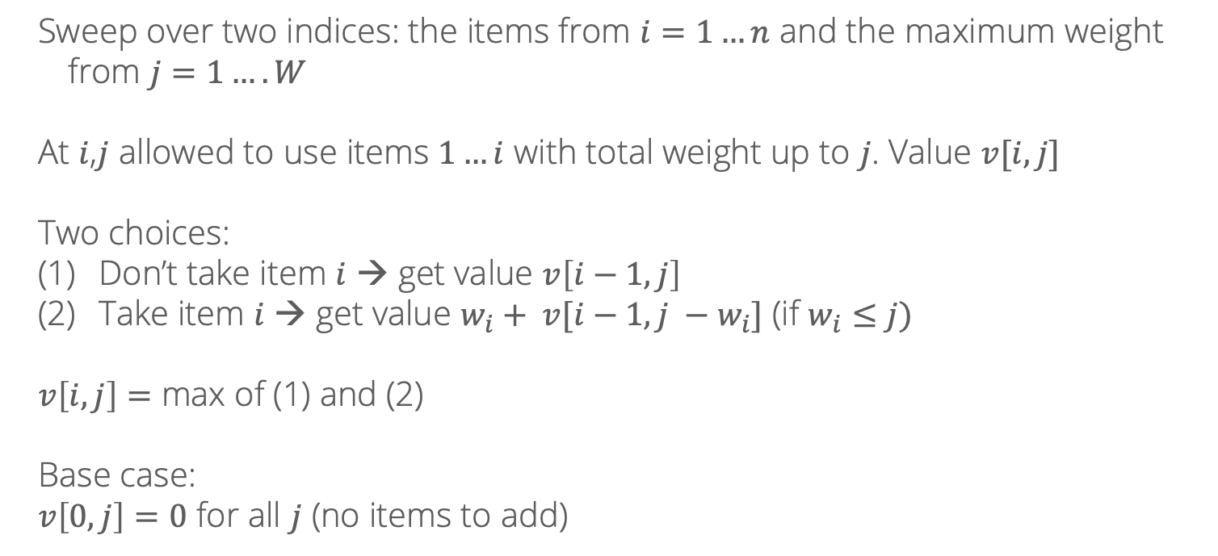
DP solution
Sweep over two indices: the items from $i=1…n$ and the maximum weight from $j=1….W$
At $i$,$j$ allowed to use items $1…i$ with total weight up to $j$. Value $v[i,j]$
Two choices:
Don’t take item $i$ → get value $v\left[i−1, j\right]$
Take item $i$ → get value $w_{i}+ v[i−1, j −w_{i}]$ (if $w_{i}≤j)$
$v\left[i,j\right]=$ max of (1) and (2)
Base case:
$v\left[0, j\right]=0$ for all $j$ (no items to add)

Slide 38
Rounding
What if the items don’t have integer weights?
0.5 kg
1.33 kg
9.843 kg
0.7 kg
2.78 kg
10.16 kg

Slide 39
Rounding
Idea: round weights up to the nearest 0.1 and the total capacity down
0.5 kg
1.4 kg
9.8 kg
0.7 kg
2.8 kg
10.2 kg

Slide 40
Rounding
Idea: round weights up to the nearest 0.1 and the total capacity down
5 kg
14 kg
98 kg
7 kg
28 kg
102 kg
Now, rescale everything by multiplying by 10

Slide 41
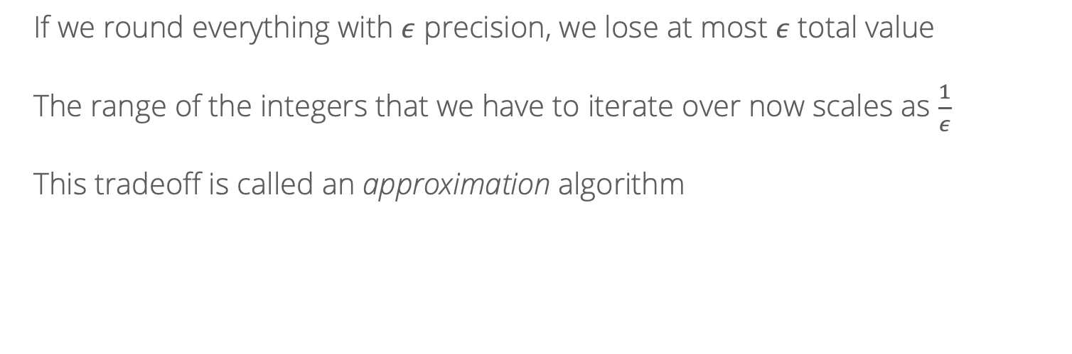
Rounding
If we round everything with $ε$ precision, we lose at most $ε$ total value
The range of the integers that we have to iterate over now scales as $\frac{1}{ε}$
This tradeoff is called an approximation algorithm

Slide 42
DP in ML: sequence labeling
Part-of-speech tagging: give each word a tag (N = noun, V = verb, …)
A model scores each choice (e.g., log-probabilities):
emit(𝑠, 𝑤): how well tag 𝑠 fits word 𝑤
trans(𝑠′, 𝑠): how well tag 𝑠 follows tag 𝑠′
Goal: the tagging (path) with the highest total score
fish
can
swim
N
N
N
V
V
V

Slide 43
The Viterbi algorithm
Subproblems: 𝑉[𝑡, 𝑠] = best score of any tagging of words 1…𝑡 that ends in tag 𝑠
Base case: 𝑉[1, 𝑠] = emit(𝑠, 𝑤₁)
Inductive step: the best path to (𝑡, 𝑠) comes from some tag 𝑠′ at time 𝑡−1
𝑉[𝑡, 𝑠] = emit(𝑠, 𝑤_{𝑡}) + max_{𝑠′} ( 𝑉[𝑡−1, 𝑠′] + trans(𝑠′, 𝑠) )
Also store the argmax: 𝐵[𝑡, 𝑠] = the best previous tag 𝑠′
Answer: max_{𝑠} 𝑉[𝑇, 𝑠], then follow 𝐵 backwards to read off the tags (just like recovering the best 𝑘 in matrix chain)
Runtime: 𝑇𝑆 entries × 𝑆 choices each = 𝑂(𝑇𝑆²), versus 𝑆^{𝑇} paths for brute force

Slide 44
Viterbi: example
Emission scores
Transitions (row→col)
𝑉[𝑡, 𝑠] (best previous tag)
 | fish | can | swim
N | 3 | 3 | 1
V | 2 | 2 | 3
 | N | V
N | −2 | 2
V | 0 | 1
 | fish | can | swim
N | 3 | 5 (← V) | 8 (← V)
V | 2 | 7 (← N) | 11 (← V)
fish
can
swim
e.g. 𝑉[can, V] = 2 + max(3 + 2, 2 + 1) = 7
Best tagging: fish/N can/V swim/V, score 11
Tagging each word by its best emission alone gives N N V, which scores only 9. The transitions matter!
N
N
N
V
V
V

