Slide 1
Computational Foundations for ML (10-607):
Computationational Complexity
Bryan Wilder
* Slides borrowed from prior offerings by Professors H. Heidari, M. Gormley, P. Virtue, & G. Gordon.

Slide 2

Warmup/review
Is $2^{2n}∈O\left(2^{n}\right)?$
Is $\log{n^{3}}∈O(\log{n})$?
Is $n\log{n∈O(n)}$?
(n+1)² ∈ O(0.001n²)

Slide 3
Likelihood
Computational complexity
Last time: defined computational complexity notions, tools to establish big-O relationships
Today: analyzing the runtime of specific algorithms

Slide 4
How fast is this code?
15 int search(int x, int[] A, int n)
16 {
17 for (int i = 0; i < n; i++)
18 {
19 if (A[i] == x) {
20 return i;
21 }
22 }
23 return -1;
24 }
Notes:
Slide credit: CMU 15-122

Slide 5
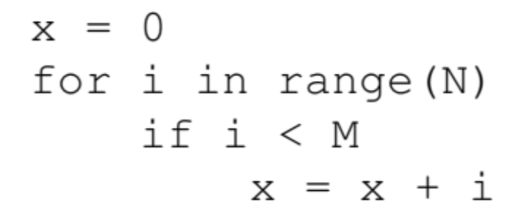

Slide 6
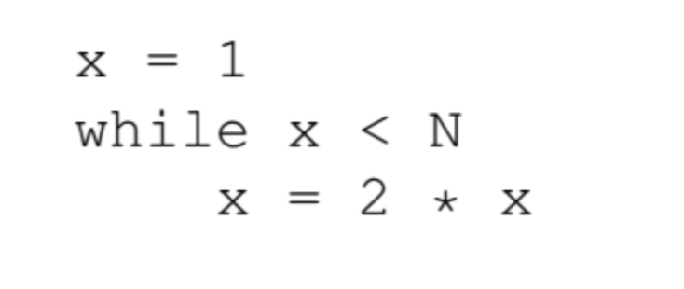

Slide 7
total = 0
for i in range(n):
for j in range(n):
for k in range(10):
if i % 2 == 0 and j % 3 == 0:
total += 1
else:
total /= 2

Slide 8
total = 0
for i in range(n):
for j in range(i):
for k in range(10):
if i % 2 == 0 and j % 3 == 0:
total += 1
else:
total /= 2

Slide 9
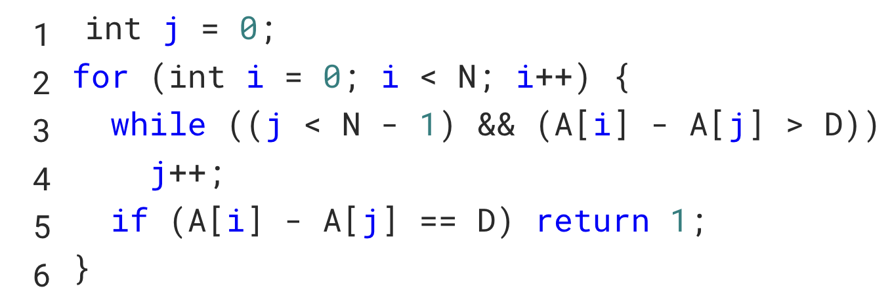
Given is a sorted array A. Determine whether it contains two elements with the difference D. Consider the following code solving this problem:

Slide 10
How many operations are required to compute the L2 norm of a vector?
def norm(a):
ss=0
for i in range(len(a)):
ss = ss + a[i]*a[i]
norm = np.sqrt(ss)
return norm

Slide 11
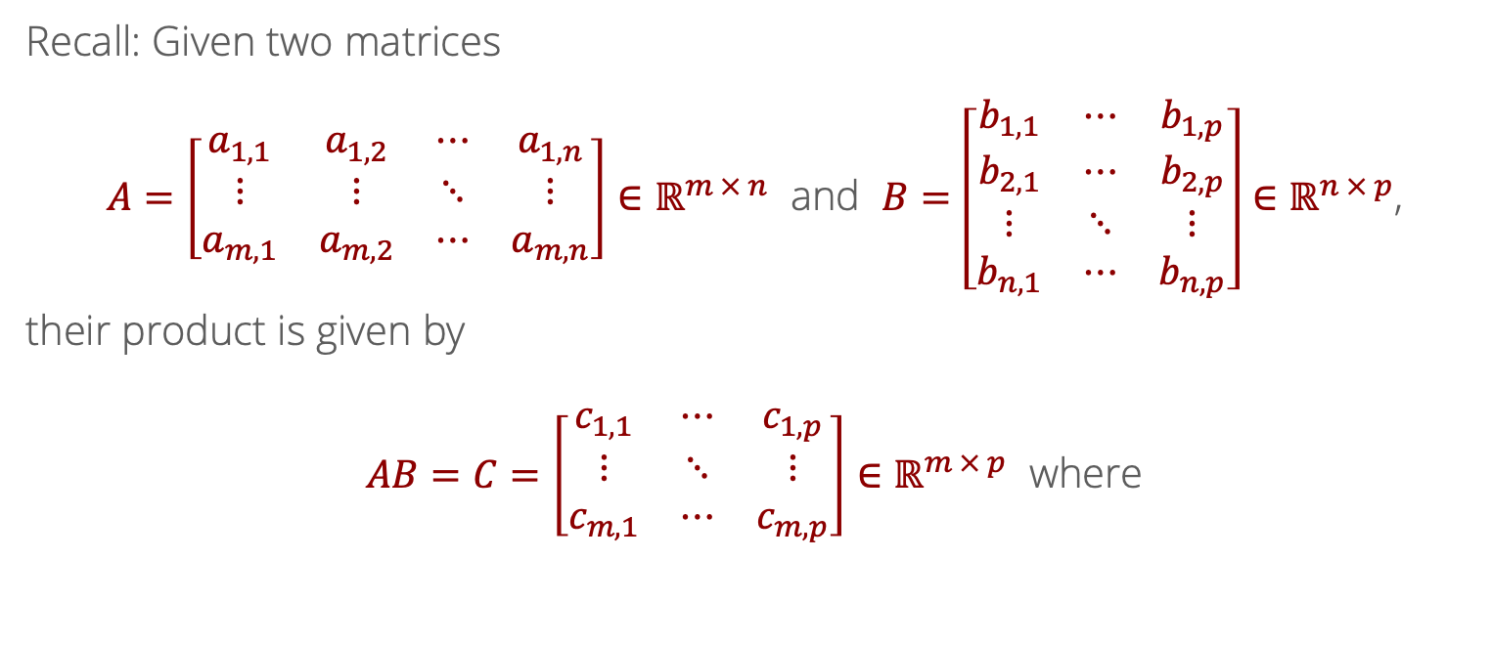
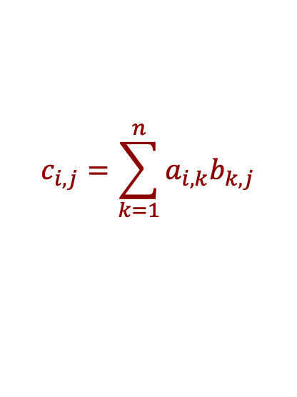
Likelihood
Matrix Multiplication
Recall: Given two matrices
$A=\left[\begin{matrix}a_{1,1} & a_{1,2} & ⋯ & a_{1,n} \\ ⋮ & ⋮ & ⋱ & ⋮ \\ a_{m,1} & a_{m,2} & ⋯ & a_{m,n}\end{matrix}\right]∈ℝ^{m × n}$ and $B=\left[\begin{matrix}b_{1,1} & ⋯ & b_{1,p} \\ b_{2,1} & ⋯ & b_{2,p} \\ ⋮ & ⋱ & ⋮ \\ b_{n,1} & ⋯ & b_{n,p}\end{matrix}\right]∈ℝ^{n × p}$,
their product is given by
$AB=C=\left[\begin{matrix}c_{1,1} & ⋯ & c_{1,p} \\ ⋮ & ⋱ & ⋮ \\ c_{m,1} & ⋯ & c_{m,p}\end{matrix}\right]∈ℝ^{m × p}$ where
$$c_{i,j}=\sum_{k=1}^{n}{a_{i,k}b_{k,j}}$$

Slide 12
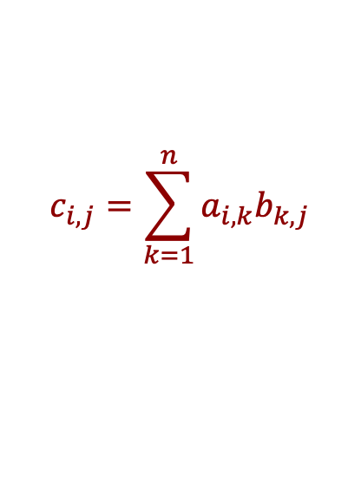
What is the computational cost of computing $AB$?
Recall: Given two matrices
$A=\left[\begin{matrix}a_{1,1} & a_{1,2} & ⋯ & a_{1,n} \\ ⋮ & ⋮ & ⋱ & ⋮ \\ a_{m,1} & a_{m,2} & ⋯ & a_{m,n}\end{matrix}\right]∈ℝ^{m × n}$ and $B=\left[\begin{matrix}b_{1,1} & ⋯ & b_{1,p} \\ b_{2,1} & ⋯ & b_{2,p} \\ ⋮ & ⋱ & ⋮ \\ b_{n,1} & ⋯ & b_{n,p}\end{matrix}\right]∈ℝ^{n × p}$,
their product is given by
$AB=C=\left[\begin{matrix}c_{1,1} & ⋯ & c_{1,p} \\ ⋮ & ⋱ & ⋮ \\ c_{m,1} & ⋯ & c_{m,p}\end{matrix}\right]∈ℝ^{m × p}$ where
$$c_{i,j}=\sum_{k=1}^{n}{a_{i,k}b_{k,j}}$$

Slide 13
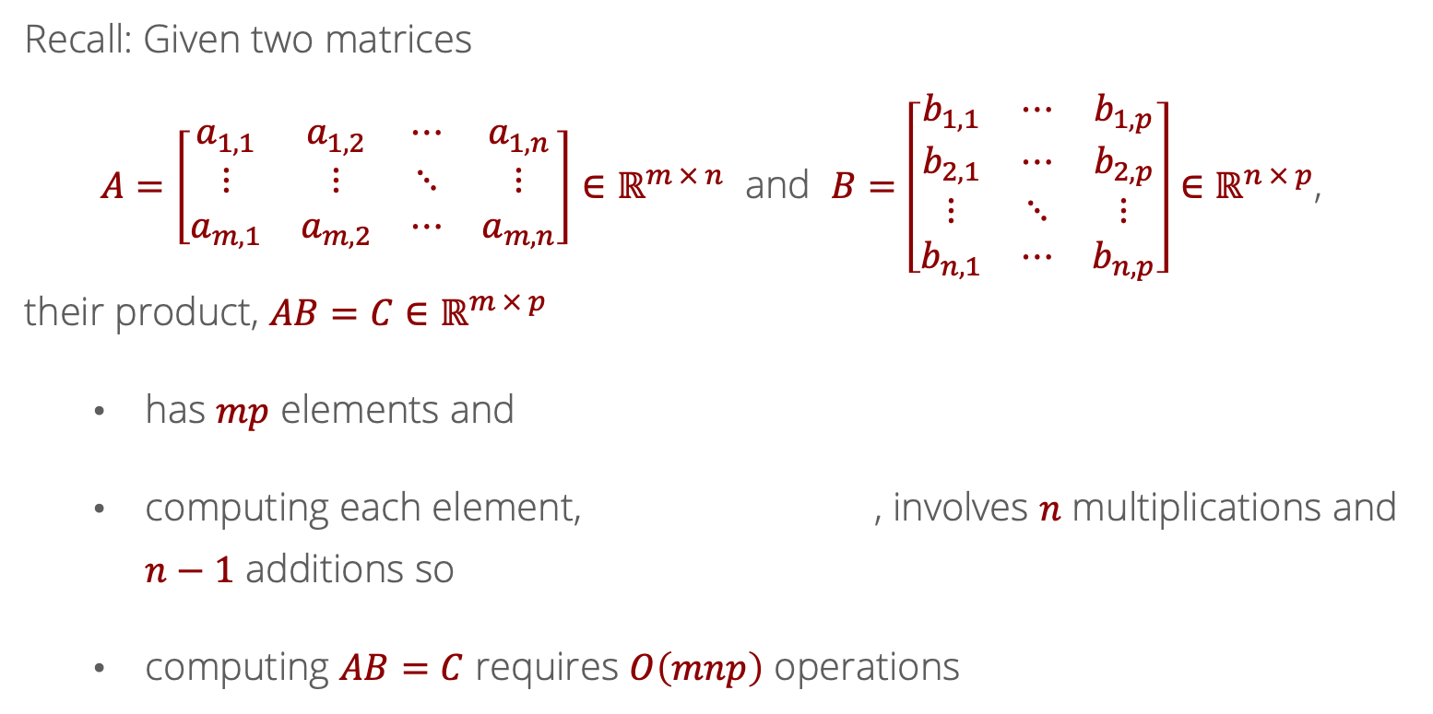
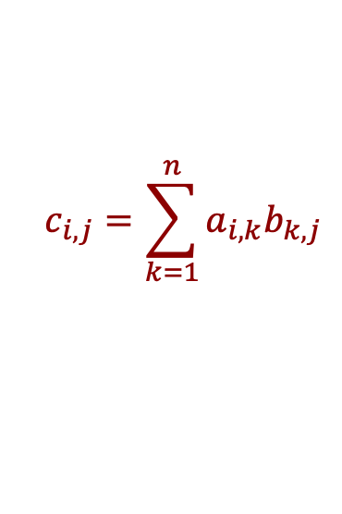
What is the computational cost of computing $AB$?
Recall: Given two matrices
$A=\left[\begin{matrix}a_{1,1} & a_{1,2} & ⋯ & a_{1,n} \\ ⋮ & ⋮ & ⋱ & ⋮ \\ a_{m,1} & a_{m,2} & ⋯ & a_{m,n}\end{matrix}\right]∈ℝ^{m × n}$ and $B=\left[\begin{matrix}b_{1,1} & ⋯ & b_{1,p} \\ b_{2,1} & ⋯ & b_{2,p} \\ ⋮ & ⋱ & ⋮ \\ b_{n,1} & ⋯ & b_{n,p}\end{matrix}\right]∈ℝ^{n × p}$,
their product, $AB=C∈ℝ^{m × p}$
has $mp$ elements and
computing each element, , involves $n$ multiplications and $n−1$ additions so
computing $AB=C$ requires $O\left(mnp\right)$ operations
$$c_{i,j}=\sum_{k=1}^{n}{a_{i,k}b_{k,j}}$$

Slide 14
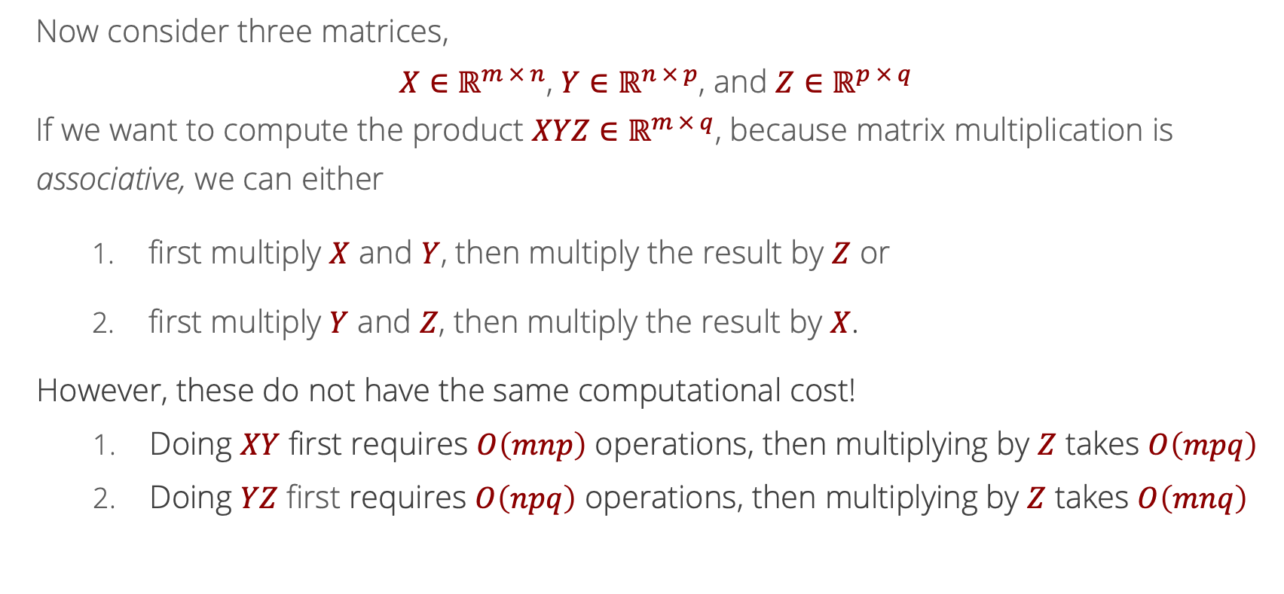
Likelihood
Multiple Matrix Multiplications
Now consider three matrices,
$X∈ℝ^{m × n}$, $Y∈ℝ^{n × p}$, and $Z∈ℝ^{p × q}$
If we want to compute the product $XYZ∈ℝ^{m × q}$, because matrix multiplication is associative, we can either
first multiply $X$ and $Y$, then multiply the result by $Z$ or
first multiply $Y$ and $Z$, then multiply the result by $X$.
However, these do not have the same computational cost!
Doing $XY$ first requires $O\left(mnp\right)$ operations, then multiplying by $Z$ takes $O\left(mpq\right)$
Doing $YZ$ first requires $O\left(npq\right)$ operations, then multiplying by $Z$ takes $O\left(mnq\right)$

Slide 15
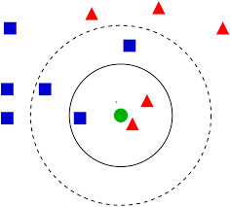

Nearest neighbors
Given points $x_{1}…x_{n}$ in $R^{d}$, find the $k$ nearest neighbors (in Euclidean norm) to $x_{1}$
Typical use case: k-nearest neighbor (knn) classifier
ML model which predicts the majority among the k closest examples in the training data
https://www.analyticsvidhya.com/blog/2018/03/introduction-k-neighbours-algorithm-clustering/

Slide 16

Basic algorithm
Given points $x_{1}…x_{n}$ in $R^{d}$, find the $k$ nearest neighbors (in Euclidean norm) to $x_{1}$
distance = [0]*n
nearest = [-1]*k
for i = 2…n:
for j = 1…d:
distance[i] += (x[i][j] – x[1][j])**2
for j = 1…k:
if nearest[j] == -1 or distance[i] < nearest[j]:
nearest[j] = distance[i]
break
return nearest

Slide 17
Basic algorithm
Given points $x_{1}…x_{n}$ in $R^{d}$, find the $k$ nearest neighbors (in Euclidean norm) to $x_{1}$
distance = [0]*n
nearest = [-1]*k
for i = 2…n:
for j = 1…d:
distance[i] += (x[i][j] – x[1][j])**2
for j = 1…k:
if nearest[j] == -1 or distance[i] < nearest[j]:
nearest[j] = distance[i]
break
return nearest
What is the runtime of this algorithm?
What are the parameters describing input size?

Slide 18

Alternate algorithm
Given points $x_{1}…x_{n}$ in $R^{d}$, find the $k$ nearest neighbors (in Euclidean norm) to $x_{1}$
distance = [0]*n
for i = 2…n:
for j = 1…d:
distance[i] += (x[i][j] – x[1][j])**2
distance.sort()
return distance[1:k+1]

Slide 19

Refinement
Given points $x_{1}…x_{n}$ in $R^{d}$, find the $k$ nearest neighbors (in Euclidean norm) to $x_{1}$
distance = [0]*n
for i = 2…n:
for j = 1…d:
distance[i] += (x[i][j] – x[1][j])**2
return smallest(distance, k)

Slide 20
Warm-up for Next Lecture
A recursive function calls itself.
def recursiveFunction():
if (this is the base case):
do something non-recursive
else:
do something recursive
Example: complete the recursive function for the factorial.
Notes:
def factorial(int n):
if ___________:
return ___________
return ___________________

Slide 21
Warm-up for Next Lecture
Example: a recursive implementation of binary search.
bool binarySearch(list data, int key) {
return binarySearch2(data, key, 0, len(data)-1);
}
bool binarySearch2(list data, int key, int first, int last) {
// TODO base case
int mid = (first + last) // 2;
if (data[mid] == key)
return true;
else if (data[mid] > key)
return binarySearch2(data, key, first, mid-1);
else
return binarySearch2(data, key, mid+1, last)
}

