Slide 1
Computational Foundations for ML (10-607):
Data structures: lists and more
Bryan Wilder
* Slides borrowed from prior offerings by Professors H. Heidari, M. Gormley, P. Virtue, & G. Gordon.

Slide 2
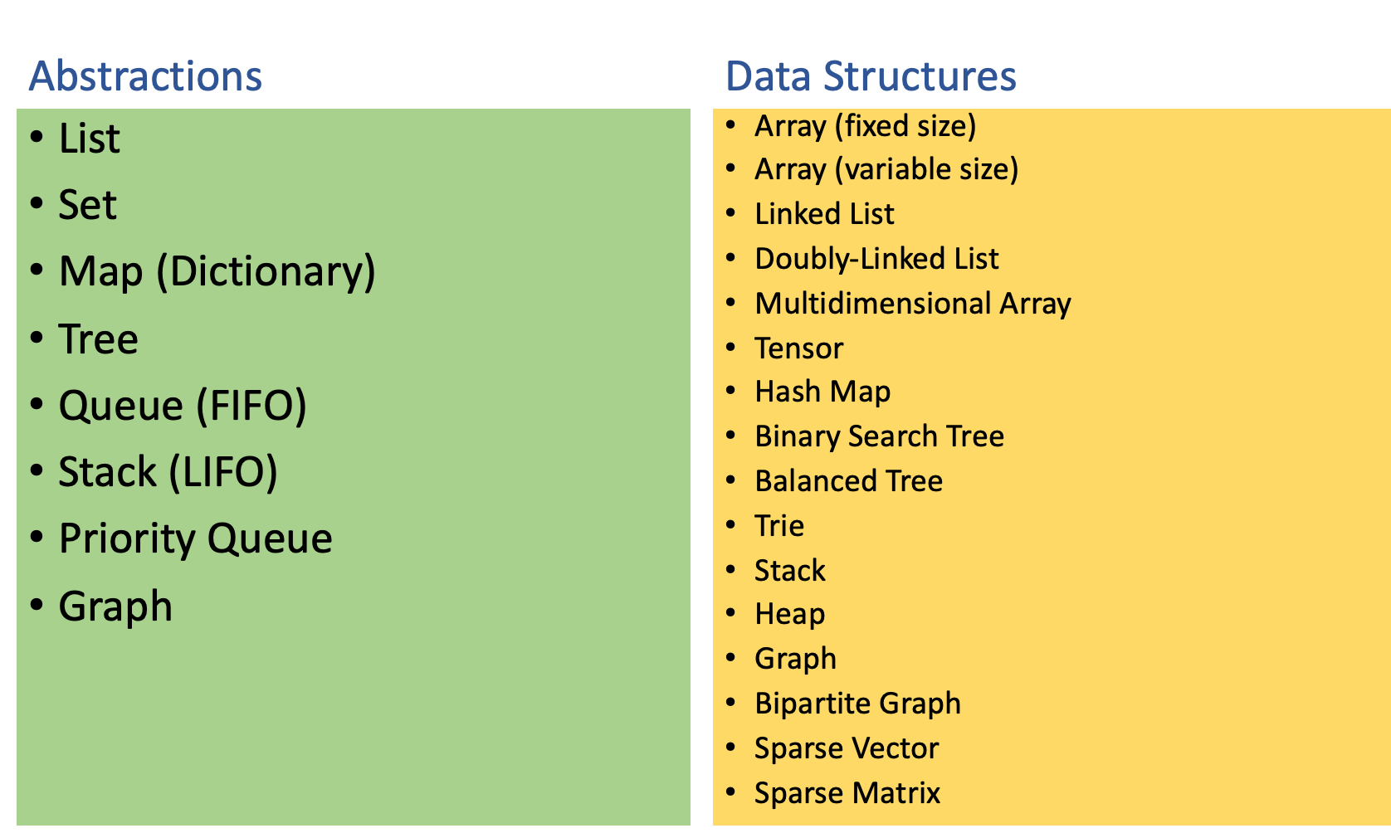
Abstractions vs. Data Structures

Slide 3
Today
”List” as an abstract data type
Two implementations of lists
Stacks and Queues
Sorting with list data structures
Notes:
def factorial(int n):
if ___________:
return ___________
return ___________________

Slide 4
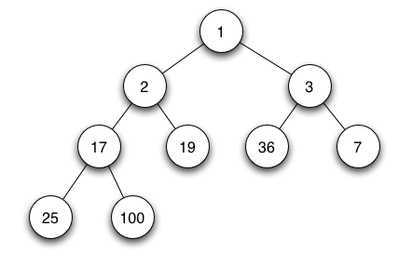
Min/max heap
Images from https://en.wikipedia.org/wiki/Binary_heap
Always maintain a complete/balanced tree! Height log(n)

Slide 5
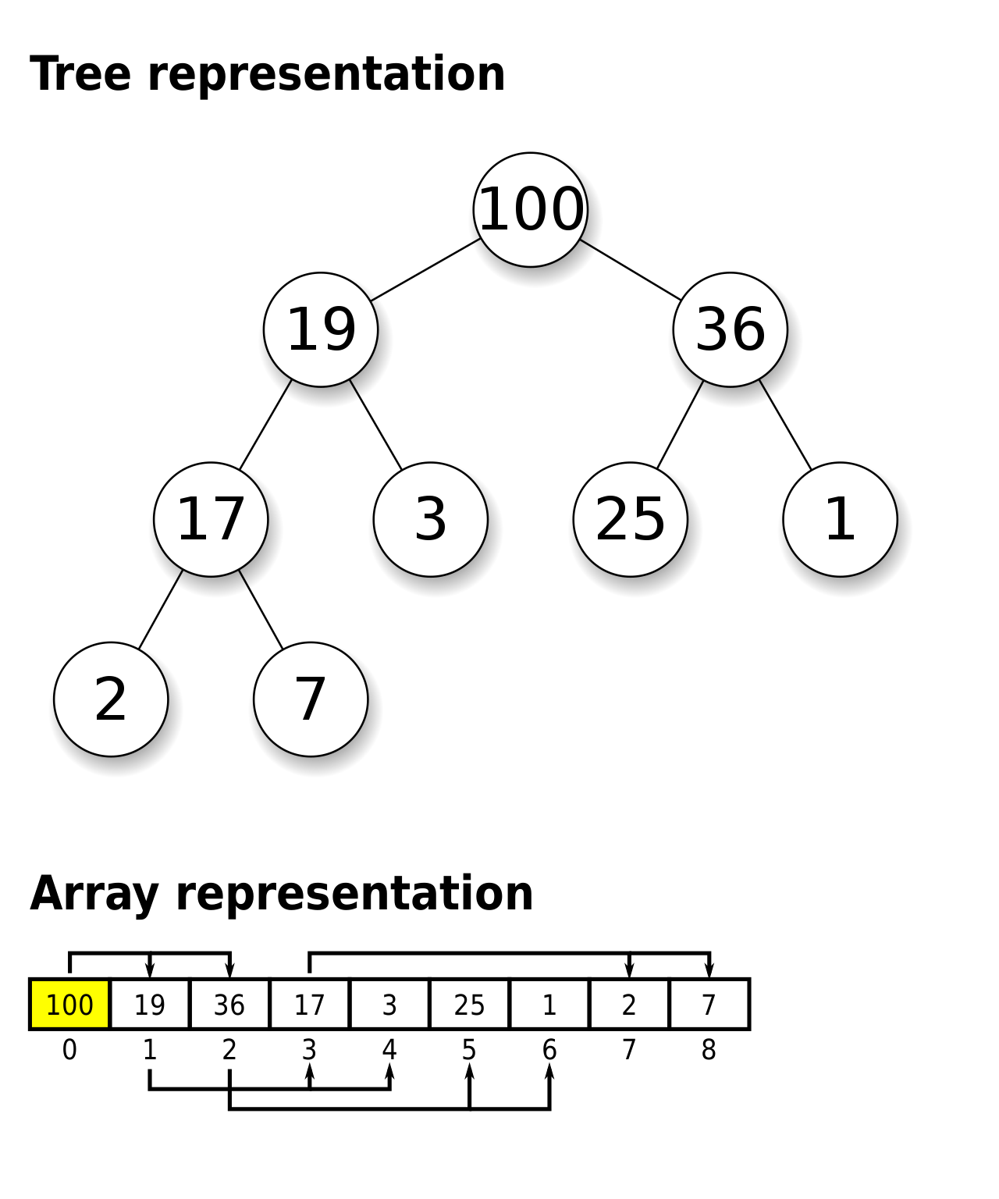
Max heap
Implemented with an array
Node i has children in spots 2i+1 and 2i+2
Enforces balanced tree by design

Slide 6
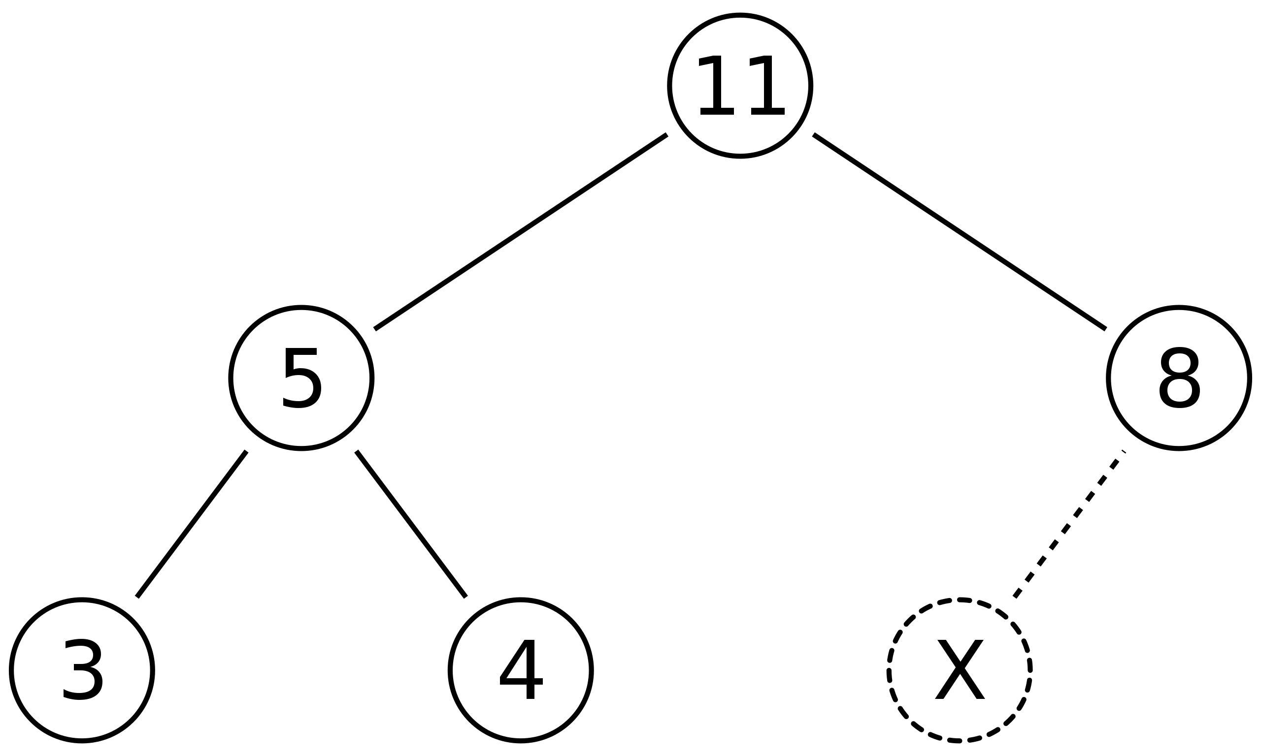
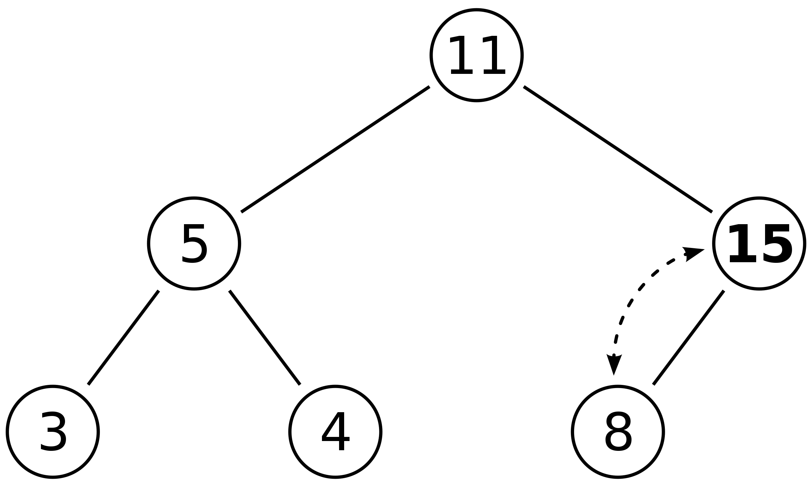
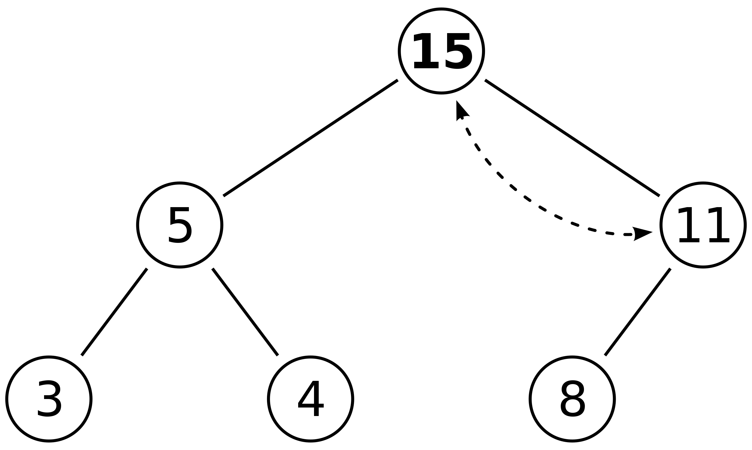
Insert: bubble up
Insert 15 in spot marked “X”
Worst case time O(log n)

Slide 7
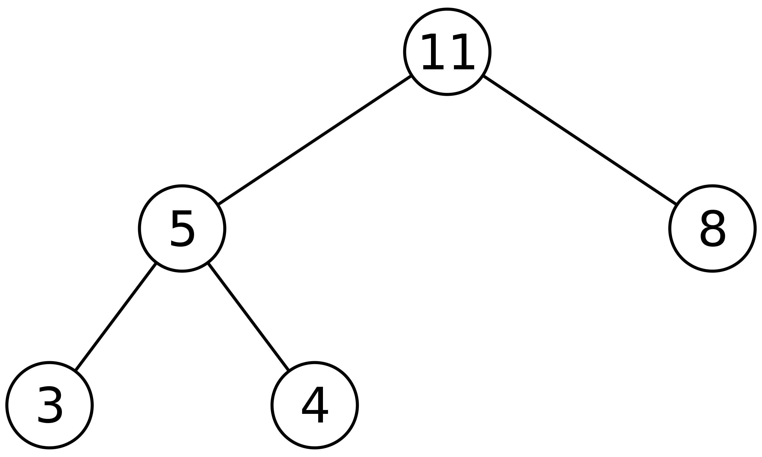
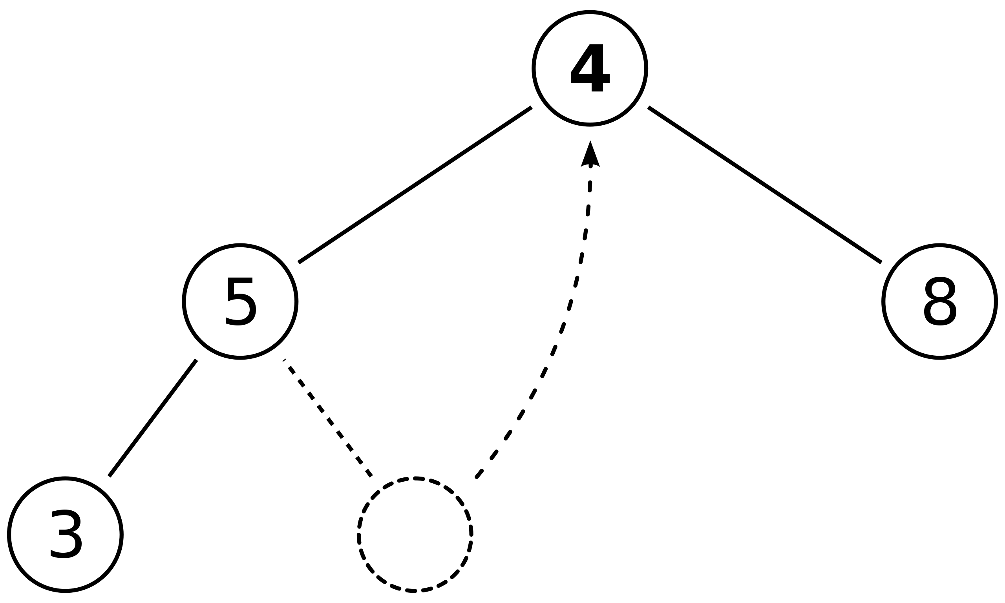
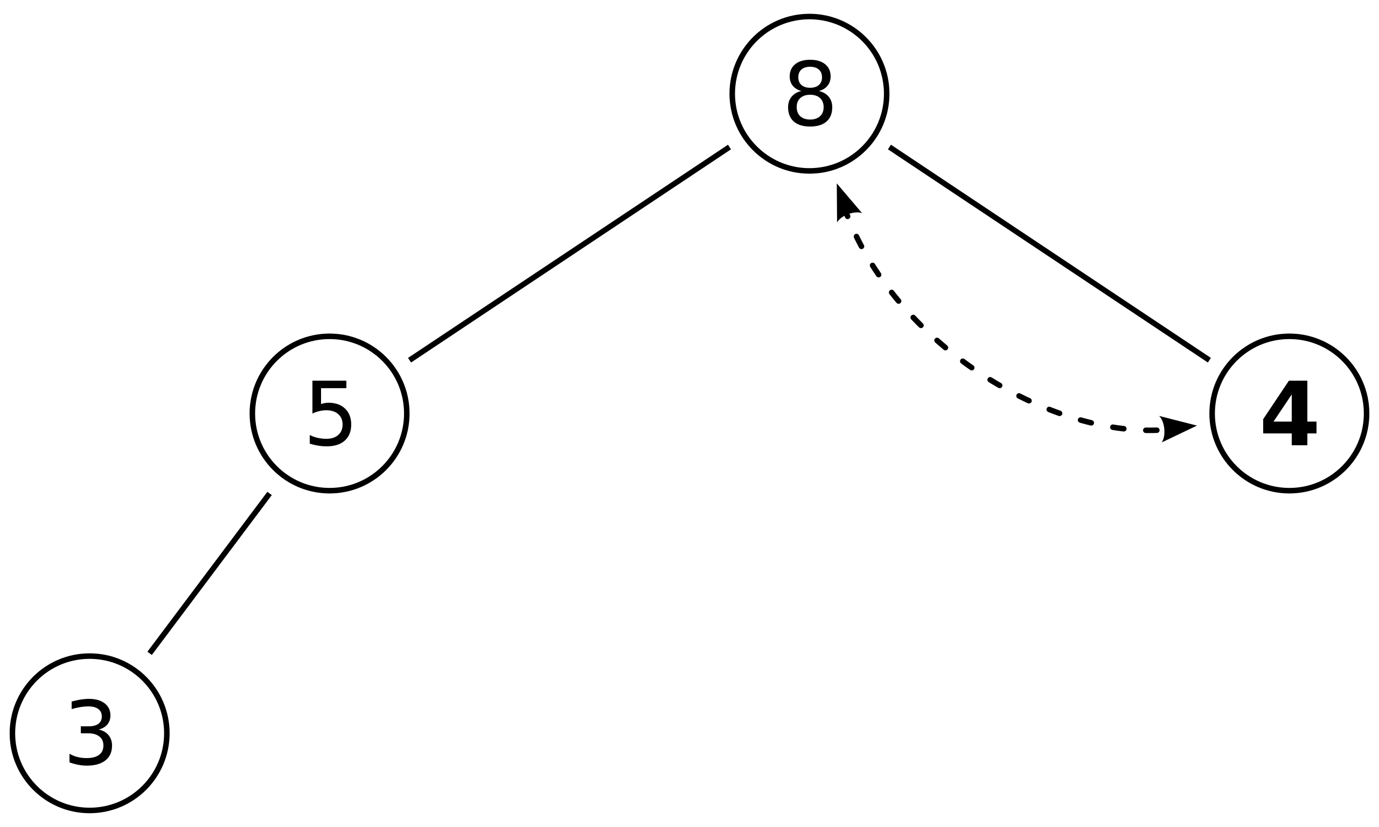
Extract: bubble down
Remove the root node and return it
Replace the root with the last node (last array element)
Move that element into position
Worst case time O(log n)

Slide 8
Uses of heaps: priority queue
Imagine a list of tasks with different priorities
You want to be able to do two things:
Add a new task with a given priority
Find and remove the top priority task
Implementation: heap

Slide 9
Uses of heaps: heapsort
Given an array of numbers
Turn it into a heap (time O(n log n), improvable to O(n))
Repeatedly remove the root of the heap and swap it with the last element of the heap

Slide 10
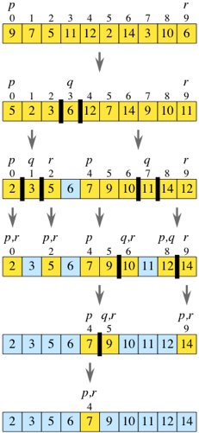
Quicksort
Most commonly used sorting algorithm in practice for arrays
Recursive structure like mergesort
Pick a “pivot element” arbitrarily (say the last element)
Put everything < pivot in the first half and everything > pivot in the second half
Recursively sort the left and right halves

Slide 11
Quicksort
Most commonly used sorting algorithm in practice for arrays
Recursive structure like mergesort
Pick a “pivot element” arbitrarily (say the last element)
Put everything < pivot in the first half and everything > pivot in the second half
Recursively sort the left and right halves

Slide 12
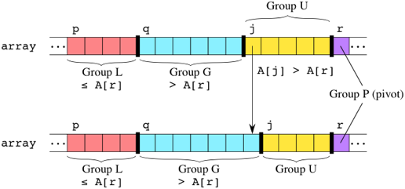
Quicksort: partitioning
Maintain three regions: elements less than pivot, elements greater than pivot, and those not yet processed. At each step, take the next unprocessed element and put it in the right place
Case 1: A[j] > pivot

Slide 13
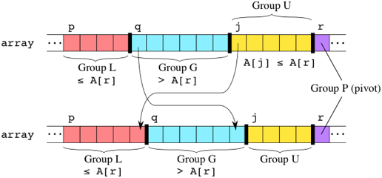
Quicksort: partitioning
Maintain three regions: elements less than pivot, elements greater than pivot, and those not yet processed. At each step, take the next unprocessed element and put it in the right place
Case 2: A[j] <= pivot
Total time: O(n) to partition an array slice of n elements

Slide 14
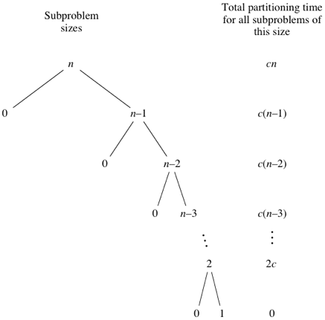

Quicksort: worst vs average case runtime
Worst case: pivot element is always the smallest or largest value!
O(n) levels, and work O(i) at level (i)
O($n^{2}$) total runtime

Slide 15
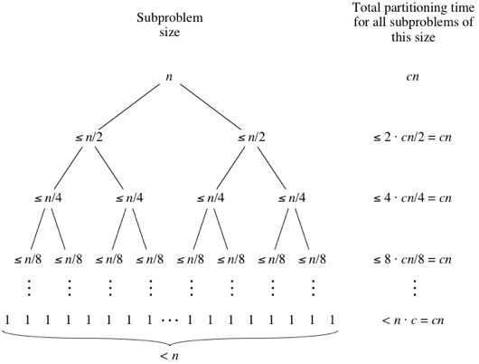
Quicksort: worst vs average case runtime
Best case: same as mergesort. The pivot element evenly divides the list.
Can be shown that this is the average-case runtime on a random list, or if the pivot element is chosen at random.
Why is quicksort better than mergesort in practice?

