Slide 1
Trees
10-607: Computational Foundations for Machine Learning

Slide 2
Announcements
Single homework for weeks 5/6 (no assignment due this Sunday)
No recitation/OH Wed-Fri this week

Slide 3

Commonly missed questions, HW 3

Slide 4
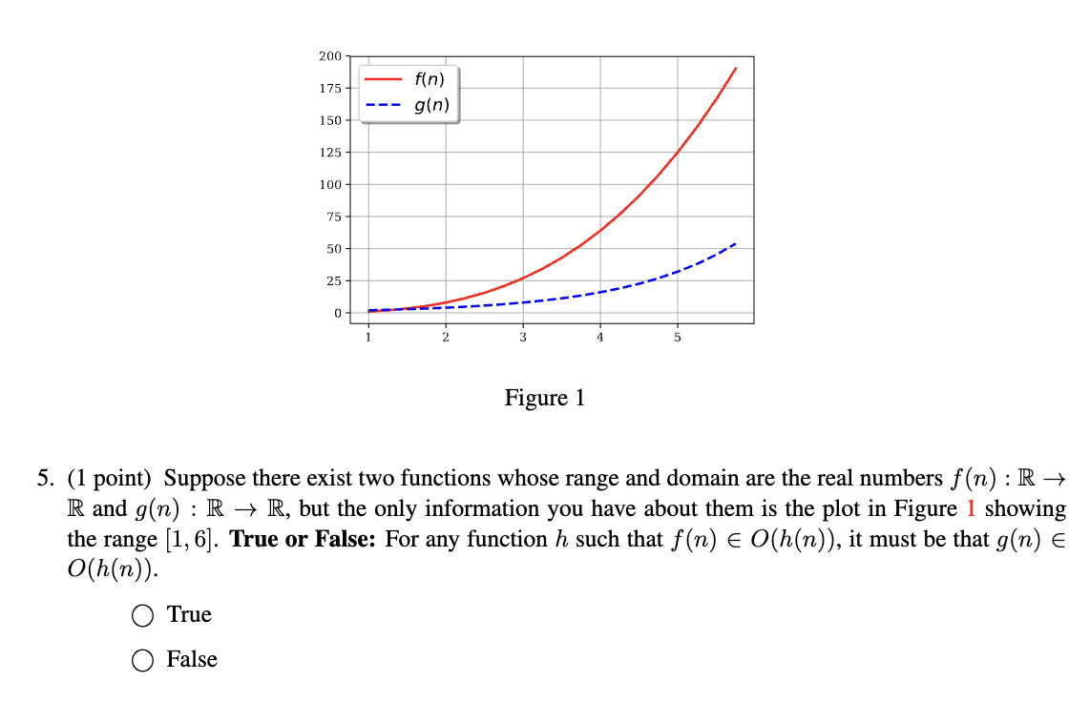
Commonly missed questions, HW 3

Slide 5
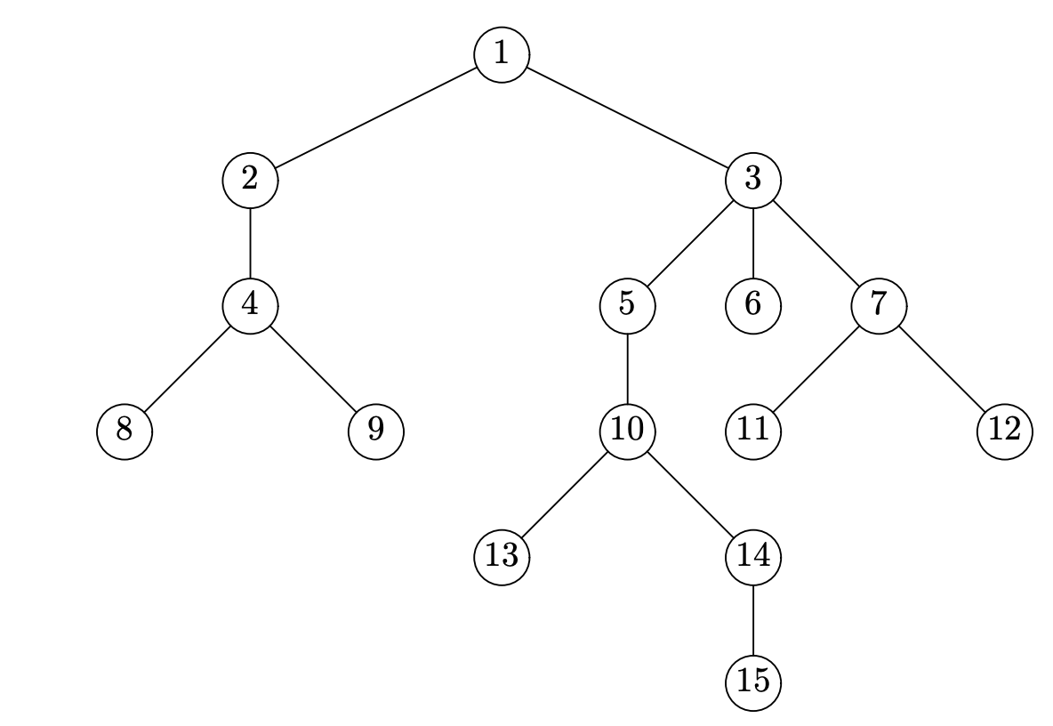
Trees

Slide 6
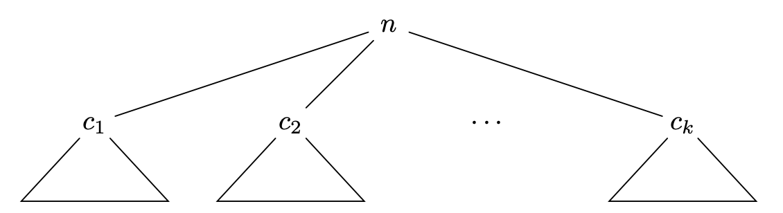
Trees
Recursively defined

Slide 7
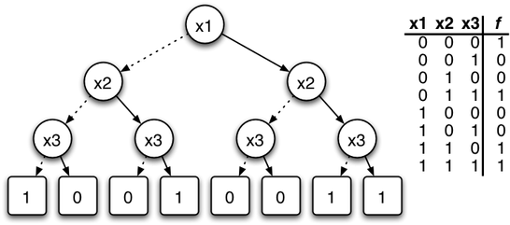
ML application: decision trees

Slide 8
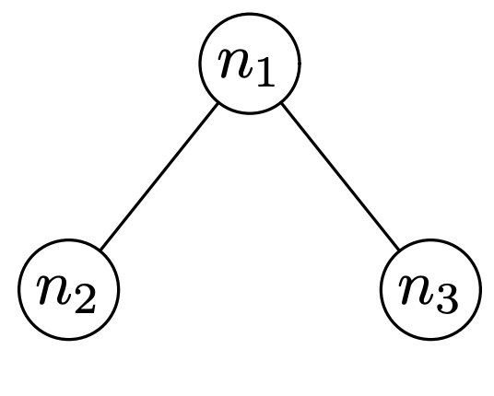
Binary trees
Special case of a tree where:
all nodes have at most two children
We distinguish between the left and right child

Slide 9
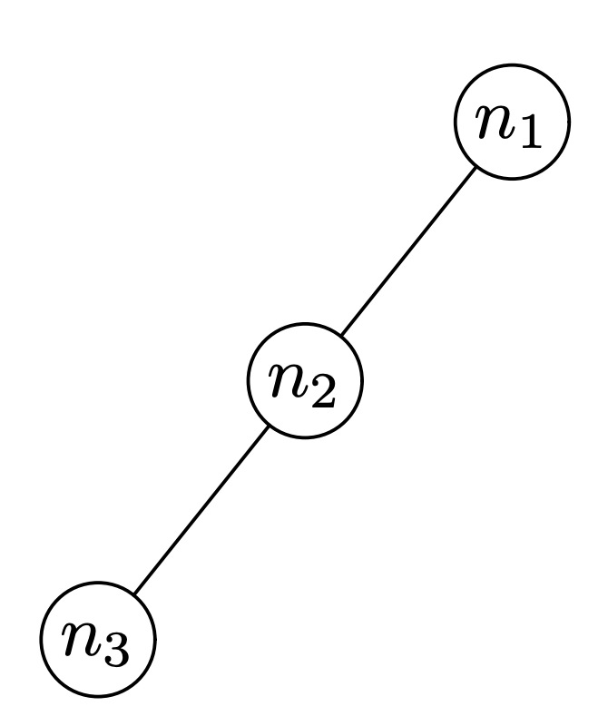
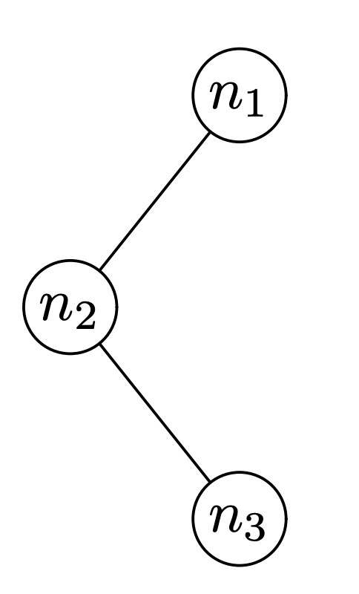
Binary trees
Different trees:

Slide 10
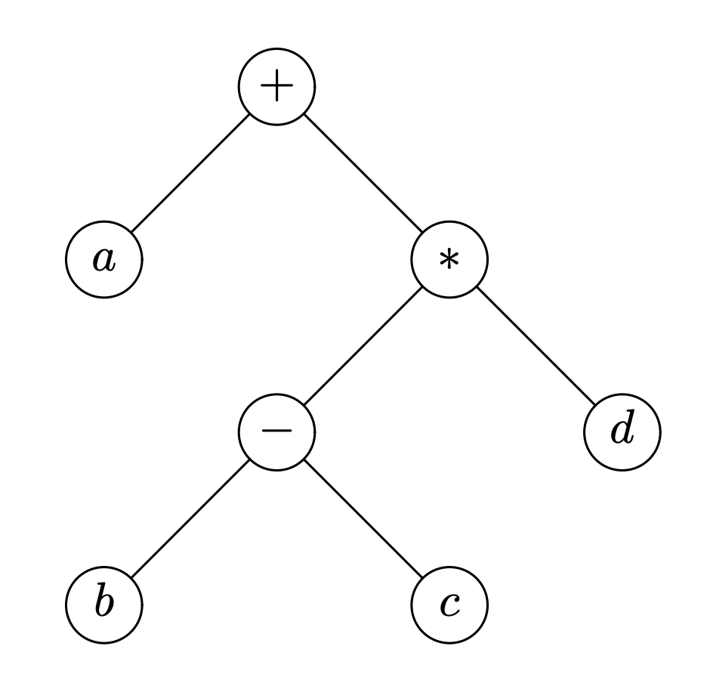
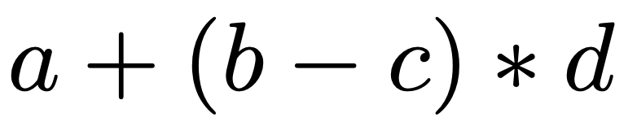
Representing arithmetic expressions

Slide 11
Binary trees
class BTree:
def __init__(self, v, l=None, r=None):
assert type(l) == BTree or l==None
assert type(r) == BTree or r==None
self.value = v
self.left = l
self.right = r
def is_leaf(self):
return self.left==None and self.right==None
# make a binary tree, starting with subtrees
D = BTree('D',BTree('C'),BTree('E'))
B = BTree('B',BTree('A'),D)
I = BTree('I',BTree('H'))
G = BTree('G',None,I)
BT = BTree('F',B,G)
Draw the tree this code creates.

Slide 12
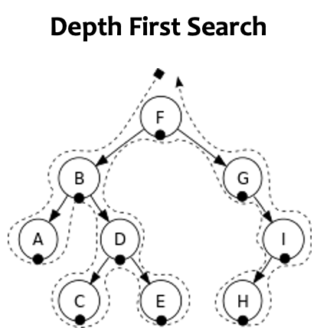
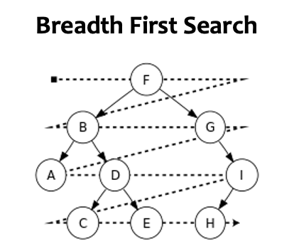
Tree Search

Slide 13
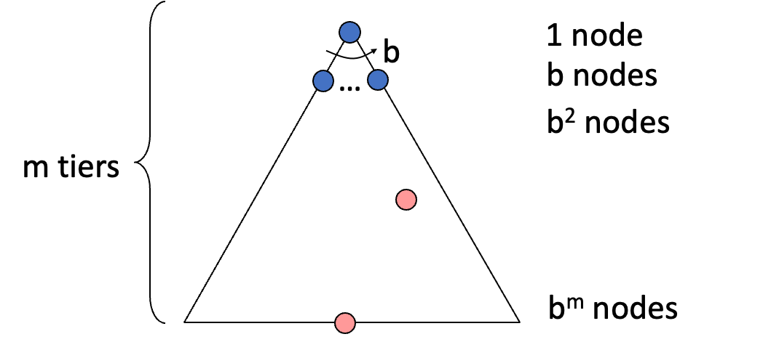
Properties of Search Algorithm
Completeness: Guaranteed to find a solution if one exists?
Optimality: Guaranteed to find the least cost path?
Time complexity
Space complexity
Cartoon of search tree:
  b is the branching factor
  m is the maximum depth
  solutions at various depths
Number of nodes in entire tree?
  1 + b + b² + …. b^{m} = O(b^{m})

Slide 14
Depth-First Search (DFS)
def Depth_first_search_iterative(root):
s = [] # use a list as a stack
s.append(root)
while (len(s)>0):
t=s.pop()
if t == None:
continue
print(t.value)
s.append(t.right)
s.append(t.left)

Slide 15
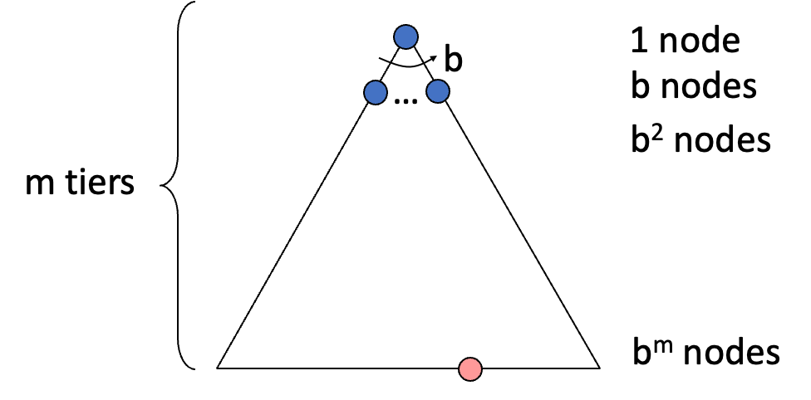
Depth-First Search (DFS)
What nodes does DFS expand?
  Some left prefix of the tree.
  Could process the whole tree!
  If m is finite, takes time O(b^{m})
How much space does the frontier take?
  Only has siblings on path to root, so O(bm)
Is it complete?
  m could be infinite, so only if we prevent cycles (graph search)
Is it optimal?
  No, it finds the “leftmost” solution, regardless of depth or cost

Slide 16
Breadth-First Search (BFS)
def Breadth_first_search_iterative(root):
s = [] # use a list as a queue
s.append(root)
while (len(s)>0):
t=s.pop(0) # now this is a queue
if t == None:
continue
print(t.value)
s.append(t.left)
s.append(t.right)

Slide 17
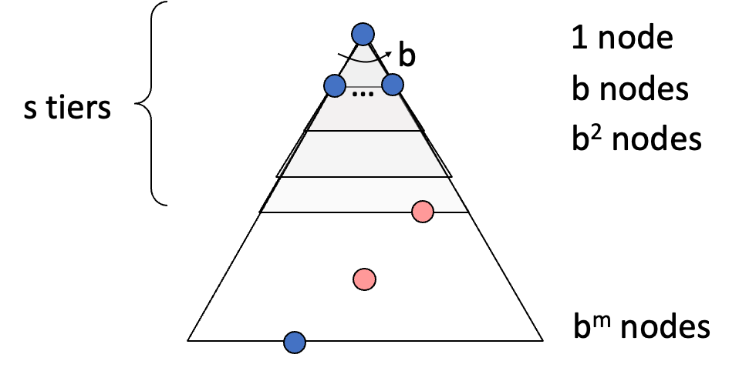
Breadth-First Search (BFS)
What nodes does BFS expand?
  Processes all nodes above shallowest solution
  Let depth of shallowest solution be s
  Search takes time O(b^{s})
How much space does the frontier take?
  Has roughly the last tier, so O(b^{s})
Is it complete?
  s must be finite if a solution exists, so yes!
Is it optimal?
  Only if costs are all the same (more on costs later)

Slide 18
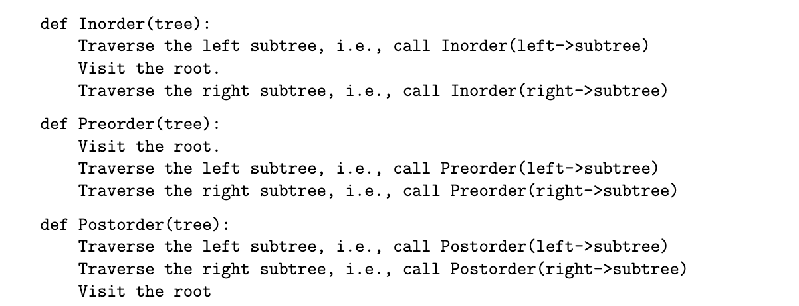
Variants of DFS

Slide 19
Binary search trees
For each node, left subtree is all < the node and right subtree is all >
5
10
2
7
7
12
4
3
9
3

Slide 20
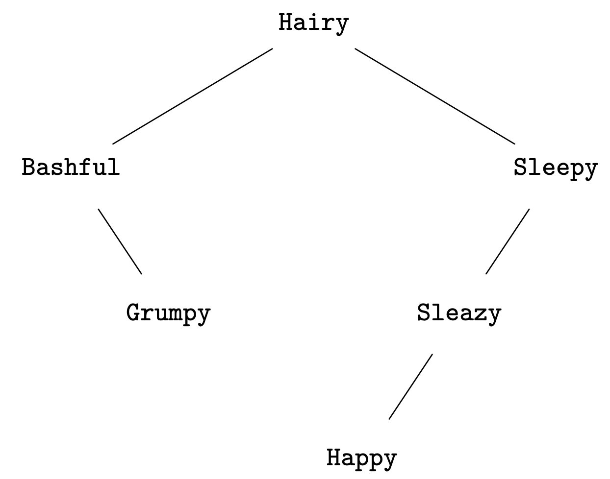
Binary search trees
Not just numbers

Slide 21
Binary search trees
Must hold at every level of the tree
5
8
4
7
7
10
8
3
9
3

Slide 22


Common operations
Lookup
10
9?
12?
7
11
3
9

Slide 23
Common operations
Insert
10
10
7
7
11
11
3
9
3
9
8

Slide 24
Algorithms for BST operations
Insertion
Recursive algorithm
insert(x, root node T)
If tree T consists of a single node v, make x the left child if < T and right child if > T
Otherwise, if x < v call insert(x, T->left), otherwise call insert(x, T->right)

Slide 25
Common operations
Delete
5
5
4
4
7
7
3
8
3

Slide 26
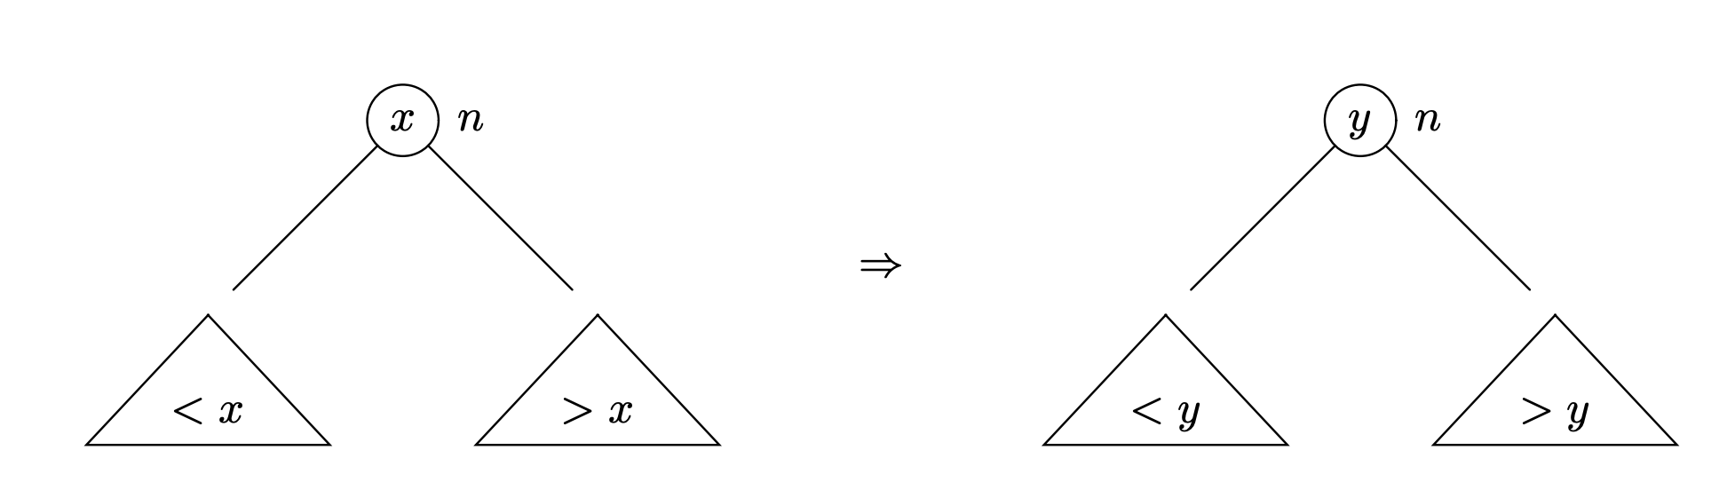
Deletion: one algorithm
If x is a leaf node, remove it
To delete internal node x, find the smallest element of the right subtree, y. Move y into the position where x was originally.

Slide 27
Running time
How long do inserts, lookups, and deletions take?
Introduce a measure of tree size/balance: height
Height of tree T is the maximum number of edges that must be traversed to go from the root to any other node in the tree

Slide 28
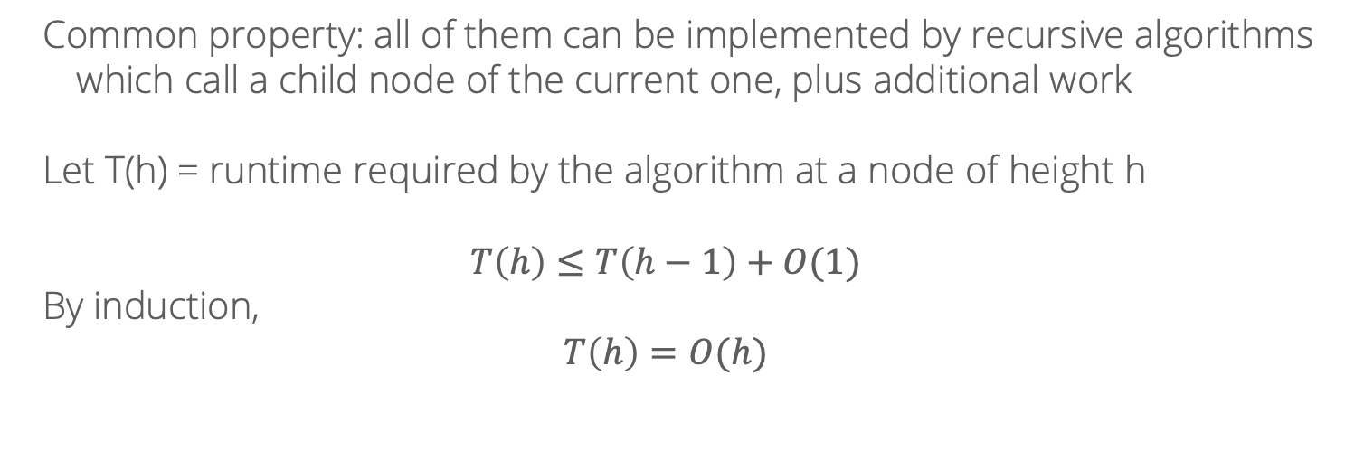
Running time
How long do inserts, lookups, and deletions take?
Common property: all of them can be implemented by recursive algorithms which call a child node of the current one, plus additional work
Let T(h) = runtime required by the algorithm at a node of height h
$$T\left(h\right)≤T\left(h−1\right)+O(1)$$
By induction,
$$T\left(h\right)=O(h)$$

Slide 29
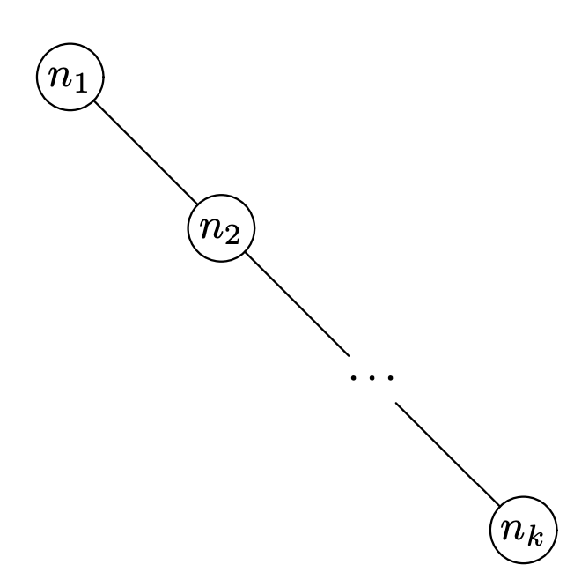
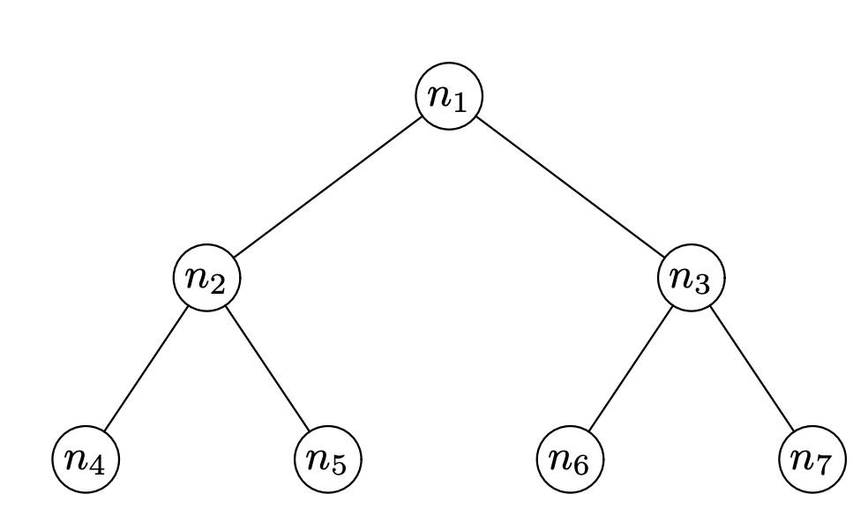


Running time
How tall can binary trees be?
Worst case, for $n$ notes, $O(n)$
Best case, for $n$ notes, $O(\log{n})$

Slide 30
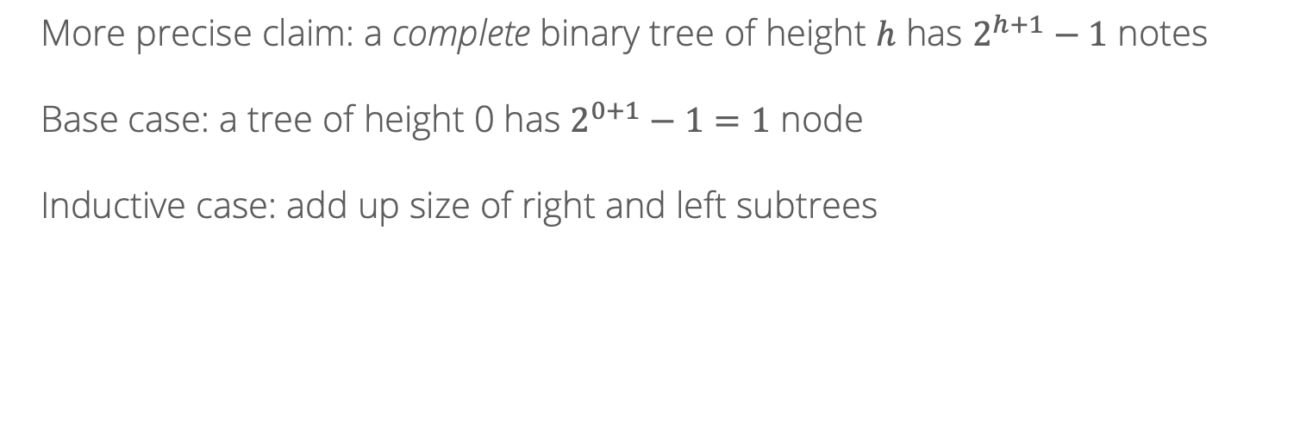
Running time
More precise claim: a complete binary tree of height $h$ has $2^{h+1}−1$ notes
Base case: a tree of height 0 has $2^{0+1}−1=1$ node
Inductive case: add up size of right and left subtrees

Slide 31
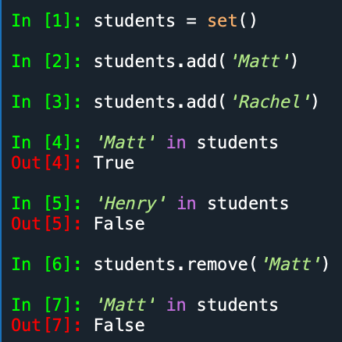
Sets
Common use case for a BST: implement a set data structure

