Slide 1
Computational Foundations for ML (10-607):
Recursion
Bryan Wilder
* Slides borrowed from prior offerings by Professors H. Heidari, M. Gormley, P. Virtue, & G. Gordon.

Slide 2
Warm-up from last time
A recursive function calls itself.
def recursiveFunction():
if (this is the base case):
do something non-recursive
else:
do something recursive
Example: complete the recursive function for the factorial.
Notes:
def factorial(int n):
if ___________:
return ___________
return ___________________

Slide 3
Poll 1
I’m thinking of a number between 1 and 64. After each guess, I’ll tell you if you’re correct or if my number is higher or lower.
What is the maximum number of guesses you’ll need to play this game?
A: 6
B: 7
C: 32
D: 64

Slide 4
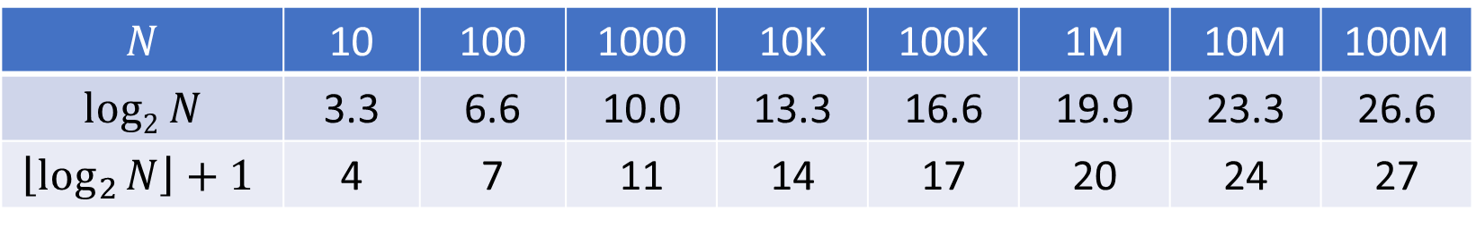
Guess a Number
I’m thinking of a number between 1 and N. After each guess, I’ll tell you if you’re correct or if my number is higher or lower.
What is the maximum number of guesses you’ll need to play this game?
$$N$$ | 10 | 100 | 1000 | 10K | 100K | 1M | 10M | 100M
$$log2 N$$ | 3.3 | 6.6 | 10.0 | 13.3 | 16.6 | 19.9 | 23.3 | 26.6
$$\left\lfloor \log_{2}{N}\right\rfloor +1$$ | 4 | 7 | 11 | 14 | 17 | 20 | 24 | 27

Slide 5
Classic CS problem: Searching

Slide 6
Imagine storing sorted data in an array
How long does it take us to find a number we are looking for?
0 | 1 | 2 | 3 | 4 | 5 | 6 | 7 | 8 | 9 | 10
2 | 7 | 8 | 13 | 25 | 29 | 33 | 51 | 89 | 90 | 95
Slide credit: http://www.peerinstruction4cs.org/2013/07/13/cs2-in-c-peer-instruction-materials/

Slide 7
Imagine storing sorted data in an array
How long does it take us to find a number we are looking for?
If you start at the front and proceed forward, each item you examine rules out 1 item
0 | 1 | 2 | 3 | 4 | 5 | 6 | 7 | 8 | 9 | 10
2 | 7 | 8 | 13 | 25 | 29 | 33 | 51 | 89 | 90 | 95
Slide credit: http://www.peerinstruction4cs.org/2013/07/13/cs2-in-c-peer-instruction-materials/

Slide 8
Imagine storing sorted data in an array
0 | 1 | 2 | 3 | 4 | 5 | 6 | 7 | 8 | 9 | 10
2 | 7 | 8 | 13 | 25 | 29 | 33 | 51 | 89 | 90 | 95
If instead we jump right to the middle, one of three things can happen:
The middle one happens to be the number we were looking for, yay!
We realize we went too far
We realize we didn’t go far enough
Ruling out HALF the options in one step is so much faster than only ruling out one!
Slide credit: http://www.peerinstruction4cs.org/2013/07/13/cs2-in-c-peer-instruction-materials/

Slide 9
Imagine storing sorted data in an array
0 | 1 | 2 | 3 | 4 | 5 | 6 | 7 | 8 | 9 | 10
2 | 7 | 8 | 13 | 25 | 29 | 33 | 51 | 89 | 90 | 95
If instead we jump right to the middle, one of three things can happen:
The middle one happens to be the number we were looking for, yay!
We realize we went too far
We realize we didn’t go far enough
Ruling out HALF the options in one step is so much faster than only ruling out one!
Slide credit: http://www.peerinstruction4cs.org/2013/07/13/cs2-in-c-peer-instruction-materials/

Slide 10
Binary search
0 | 1 | 2 | 3 | 4 | 5 | 6 | 7 | 8 | 9 | 10
2 | 7 | 8 | 13 | 25 | 29 | 33 | 51 | 89 | 90 | 95
Let’s say the answer was C, “we didn’t go far enough”
We ruled out the entire first half, and now only have the second half to search
We could start at the front of the second half and proceed forward…
Slide credit: http://www.peerinstruction4cs.org/2013/07/13/cs2-in-c-peer-instruction-materials/

Slide 11
Binary search
0 | 1 | 2 | 3 | 4 | 5 | 6 | 7 | 8 | 9 | 10
2 | 7 | 8 | 13 | 25 | 29 | 33 | 51 | 89 | 90 | 95
Let’s say the answer was C, “we didn’t go far enough”
We ruled out the entire first half, and now only have the second half to search
We could start at the front of the second half and proceed forward…but why do that when we know we have a better way?
Jump right to the middle of the region to search
Slide credit: http://www.peerinstruction4cs.org/2013/07/13/cs2-in-c-peer-instruction-materials/

Slide 12
Binary search
0 | 1 | 2 | 3 | 4 | 5 | 6 | 7 | 8 | 9 | 10
2 | 7 | 8 | 13 | 25 | 29 | 33 | 51 | 89 | 90 | 95
Let’s say the answer was C, “we didn’t go far enough”
We ruled out the entire first half, and now only have the second half to search
We could start at the front of the second half and proceed forward…but why do that when we know we have a better way?
Jump right to the middle of the region to search
RECURSION!!

Slide 13
Binary search
bool binarySearch(list data, int key) {
return binarySearch2(data, key, 0, len(data)-1);
}
bool binarySearch2(list data, int key, int first, int last) {
// TODO base case
int mid = (first + last) // 2;
if (data[mid] == key)
return true;
else if (data[mid] > key)
return binarySearch2(data, key, first, mid-1);
else
return binarySearch2(data, key, mid+1, last)
}

Slide 14
Poll 2
What is the time complexity of binary search?
A: O(1)
B: O(N)
C: O(N/2)
D: O(log N)
E: None of the above

Slide 15
Recursion Examples
List sum
# Problem: sum all of the numbers in a given list
def listSum(L):
# Base Case: the list is empty, so the sum is 0
if (len(L) == 0):
return 0
else:
# Recursive Case: assume we already know the sum of the entire list
# after the first element. Add that sum to the first element.
return L[0] + listSum(L[1:])
print(listSum([2,3,5,7,11])) # 28
Slide credit: CMU 15-112

Slide 16
Recursion Examples
Power
# Problem: raise the number base to the given exponent
def power(base, expt):
# assume expt is non-negative integer
if (expt == 0):
return 1
else:
return base * power(base, expt-1)
print(power(2,5)) # 32
Slide credit: CMU 15-112

Slide 17
Recursion Examples
Power – Multiple base cases!
def power(base, expt):
# This version allows for negative exponents
# It still assumes that expt is an integer, however.
if (expt == 0):
return 1
elif (expt < 0): # new recursive case!
return 1.0 / power(base, abs(expt))
else:
return base * power(base, expt-1)
print(power(2,5)) # 32
print(power(2,-5)) # 1/32 = 0.03125
Slide credit: CMU 15-112

Slide 18
Recursion in memory

Slide 19
Iterative vs Recursive
Factorial
Iterative
def factorial(n):
result = 1
for i in range(2, n + 1):
result *= i
return result
print(factorial(5))
Recursive
def factorial(n):
if (n < 2):
return 1
else:
return n * factorial(n - 1)
print(factorial(5))

Slide 20
How does this look in memory?
Memory
Stack
long factorial(int n) {
if (n == 0) {
return 1;
}
return n * factorial(n-1);
}
int main() {
int n = 4;
long result;
result = factorial(n);
cout << result << endl;
}
Heap
0

Slide 21
How does this look in memory?
Memory
main()
long factorial(int n) {
if (n == 0) {
return 1;
}
return n * factorial(n-1);
}
int main() {
int n = 4;
long result = 0;
result = factorial(n);
cout << result << endl;
}
n:
4
result:
0
Heap
0

Slide 22
The “stack” part of memory is a stack
Function call: push
Return: pop

Slide 23
“Stack” part of memory is a stack
Memory
main()
long factorial(int n) {
if (n == 0) {
return 1;
}
return n * factorial(n-1);
}
int main() {
int n = 4;
long result = 0;
result = factorial(n);
cout << result << endl;
}
n:
4
result:
0
factorial()
n:
4

Slide 24
“Stack” part of memory is a stack
Memory
main()
long factorial(int n) {
if (n == 0) {
return 1;
}
return n * factorial(n-1);
}
int main() {
int n = 4;
long result = 0;
result = factorial(n);
cout << result << endl;
}
n:
4
result:
0
factorial()
n:
4
factorial()
n:
3
factorial()
n:
2
factorial()
n:
1
factorial()
n:
0

Slide 25
“Stack” part of memory is a stack
Memory
main()
long factorial(int n) {
if (n == 0) {
return 1;
}
return n * factorial(n-1);
}
int main() {
int n = 4;
long result = 0;
result = factorial(n);
cout << result << endl;
}
n:
4
result:
0
factorial()
n:
4
factorial()
n:
3
factorial()
n:
2
factorial()
n:
1
1
factorial()
n:
0

Slide 26
“Stack” part of memory is a stack
Memory
main()
long factorial(int n) {
if (n == 0) {
return 1;
}
return n * factorial(n-1);
}
int main() {
int n = 4;
long result = 0;
result = factorial(n);
cout << result << endl;
}
n:
4
result:
0
24
factorial()
n:
4
6
factorial()
n:
3
2
factorial()
n:
2
1
factorial()
n:
1

Slide 27
“Stack” part of memory is a stack
Memory
main()
long factorial(int n) {
if (n == 0) {
return 1;
}
return n * factorial(n-1);
}
int main() {
int n = 4;
long result = 0;
result = factorial(n);
cout << result << endl;
}
n:
4
result:
24

Slide 28
What can go wrong?
Memory
Stack
long factorial(int n) {
if (n == 0) {
return 1;
}
return n * factorial(n-1);
}
int main() {
int n = 4;
long result = 0;
result = factorial(n);
cout << result << endl;
}
STACK SIZE LIMIT
Heap
0

Slide 29
Demo: Stack of elephants
Memory
Stack
STACK SIZE LIMIT
Heap
0

Slide 30
Demo: Stack of elephants
Memory
main()
void stack_of_elephants(
int num, int size) {
if (num == 0) {
return;
}
int elephant_array[size]
stack_of_elephants(num-1, size);
}
int main() {
int num = 10;
int size = 50;
stack_of_elephants(num, size)
}
num:
10
size:
50
stack_of_elephants
num:
10
size:
50
STACK SIZE LIMIT

Slide 31

Demo: Stack of elephants
Memory
main()
void stack_of_elephants(
int num, int size) {
if (num == 0) {
return;
}
int elephant_array[size]
stack_of_elephants(num-1, size);
}
int main() {
int num = 10;
int size = 50;
stack_of_elephants(num, size)
}
num:
10
size:
50
STACK SIZE LIMIT

Slide 32
Demo: Stack of elephants
Memory
main()
void stack_of_elephants(
int num, int size) {
if (num == 0) {
return;
}
int elephant_array[size]
stack_of_elephants(num-1, size);
}
int main() {
int num = 10;
int size = 50;
stack_of_elephants(num, size)
}
num:
10
size:
50
STACK SIZE LIMIT

Slide 33
Sorting
Given an array of numbers, how do we sort if most efficiently?
Compare two approaches.
First up: relatively simple iterative algorithm, “insertion sort”

Slide 34
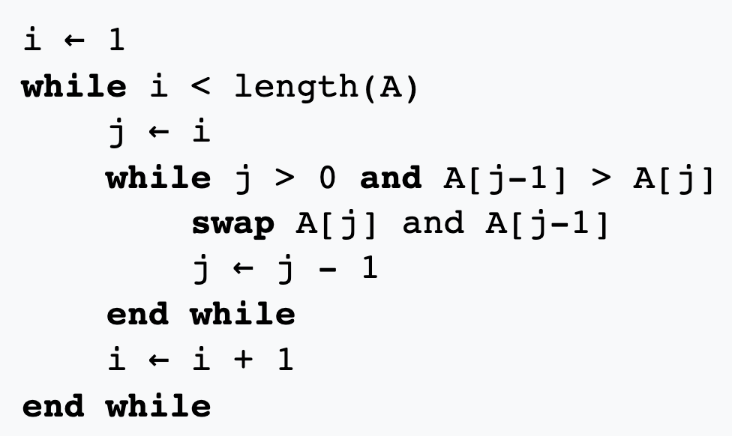
Insertion sort
Idea: maintain that the list is sorted up to position i-1. Insert element i into the right place.

Slide 35
Insertion sort
Idea: maintain that the list is sorted up to position i-1. Insert element i into the right place.
Runtime?

Slide 36
Insertion sort
Idea: maintain that the list is sorted up to position i-1. Insert element i into the right place.
Runtime?
Can we do better?

Slide 37
Merge sort
def mergesort(L):
if (len(L) < 2):
return L
else:
mid = len(L)//2
left = mergesort(L[:mid])
right = mergesort(L[mid:])
return merge(left, right)
print(mergesort([1,5,3,4,2,0]))

Slide 38
merge operation
def merge(A, B):
C = [ ]
i = j = 0
while ((i < len(A)) or (j < len(B))):
if ((j == len(B)) or ((i < len(A)) and (A[i] <= B[j]))):
C.append(A[i])
i += 1
else:
C.append(B[j])
j += 1
return C

Slide 39
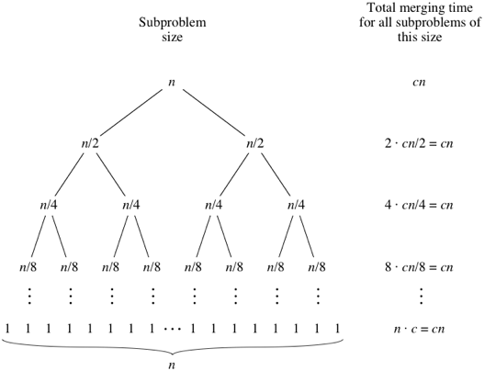
Runtime

Slide 40
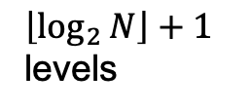
Runtime
$\left\lfloor \log_{2}{N}\right\rfloor +1$ levels

Slide 41
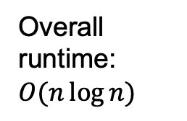
Runtime
$\left\lfloor \log_{2}{N}\right\rfloor +1$ levels
Overall runtime: $O(n\log{n})$

Slide 42
“Divide and conquer”
Break a problem down into smaller examples of the same problem
Once it’s small enough, “easy” solution
Combined solutions together

