Slide 1
Computational Foundations for ML (10-607):
Discrete optimization
Bryan Wilder
* Slides borrowed from prior offerings by Professors H. Heidari, M. Gormley, P. Virtue, & G. Gordon.

Slide 2
Today
Reminders:
Final quiz this Friday during recitation time slot (2-3pm)
Final HW due Sunday
Please raise regrade requests etc promptly
Today: more search and discrete optimization

Slide 3
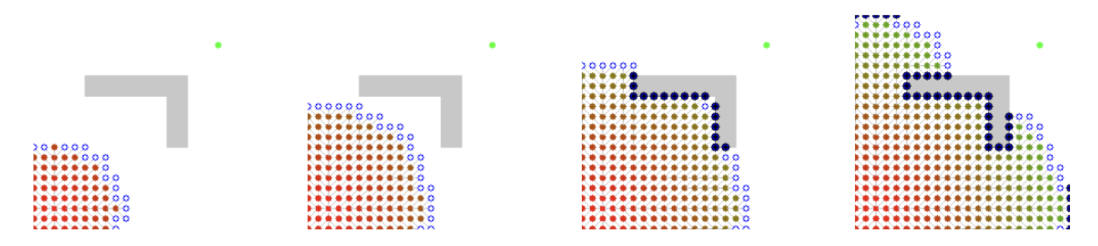
Example of Dijkstra’s algorithm
Notes:
def factorial(int n):
if ___________:
return ___________
return ___________________

Slide 4
When can we do better?
Dijkstra’s is an uniformed search algorithm: it makes no assumptions about the structure of the graph
An informed algorithm makes more assumptions, and does better if those assumptions are correct

Slide 5
Example: A* search
Dijkstra’s explores nodes in order of their minimum distance so far
A* search adds another term: a heuristic which provides an estimate of the distance to the destination:
dist[v] + heuristic(v)
Common example of a heuristic on graphs representing locations: the straight-line distance

Slide 6
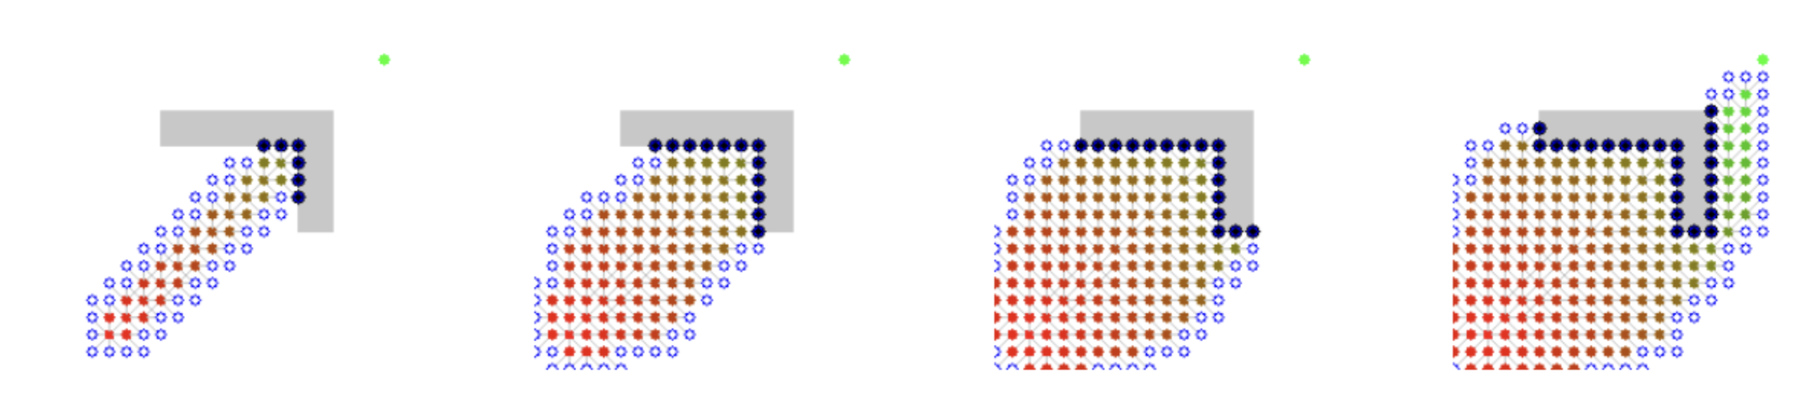
Top: Dijkstra. Bottom: A*

Slide 7
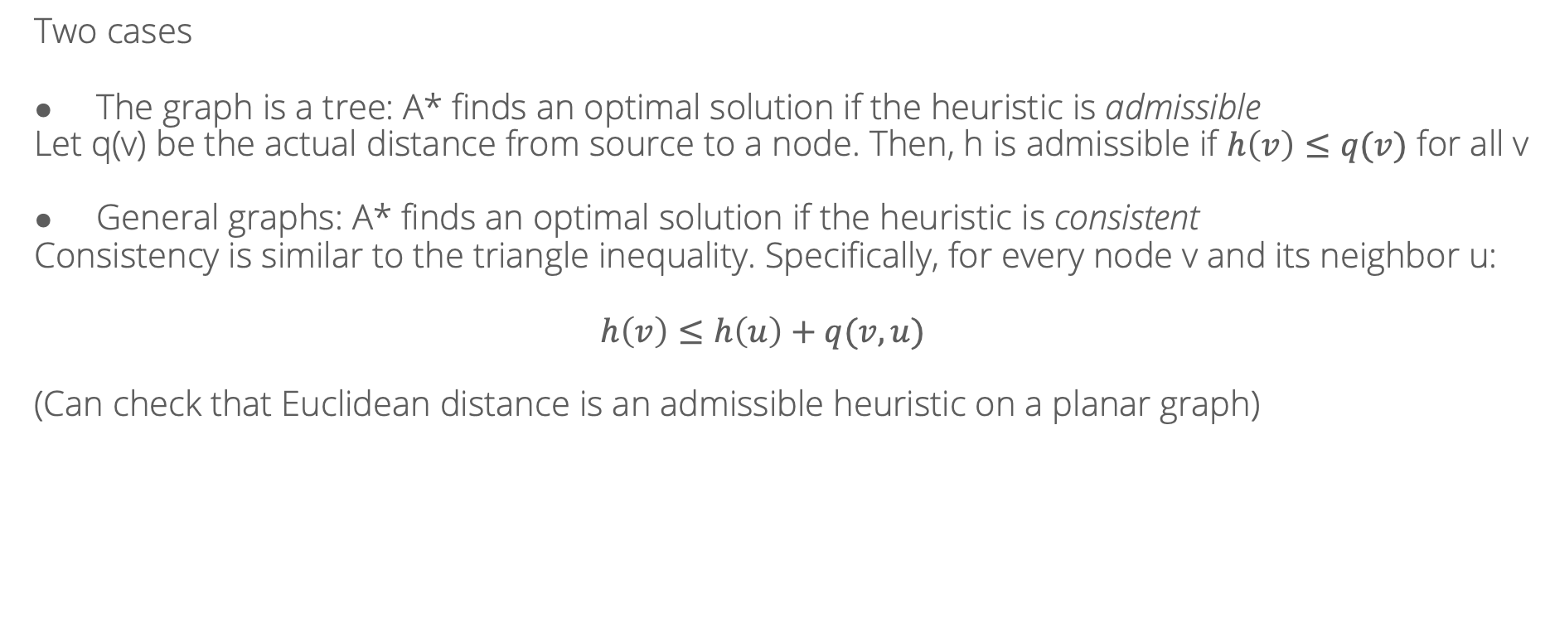
When does A* find an optimal solution?
Two cases
The graph is a tree: A* finds an optimal solution if the heuristic is admissible
Let q(v) be the actual distance from source to a node. Then, h is admissible if $h\left(v\right)≤q(v)$ for all v
General graphs: A* finds an optimal solution if the heuristic is consistent
Consistency is similar to the triangle inequality. Specifically, for every node v and its neighbor u:
$$h\left(v\right)≤h\left(u\right)+q(v, u)$$
(Can check that Euclidean distance is an admissible heuristic on a planar graph)

Slide 8
Greedy search
What if we just took the “best” node in every step?
This would be simply expanding the node with the best value of the heuristic
Doesn’t seem to work very well…

Slide 9
Greedy search
However, we’ve seen other cases of “greedy” algorithms that worked well
For example, Kruskal’s algorithm for finding a minimum spanning tree
What distinguishes these examples?

Slide 10
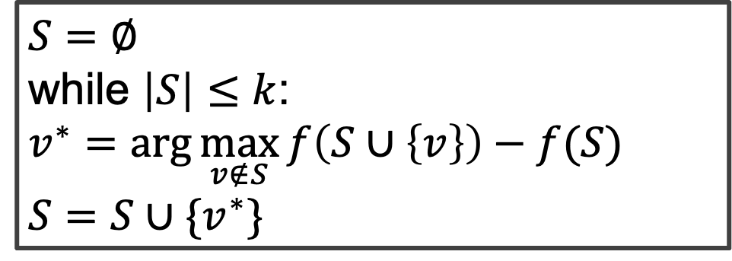

Greedy algorithms
Common setting: budget-constrained optimization
$$\max_{\left|S\right|≤k}{f(S)}$$
$$S=∅$$
while $\left|S\right|≤k$:
$$v^{∗}=\arg{\max_{v∉S}{f\left(S∪\left\{v\right\}\right)−f(S)}}$$
$$S=S∪\{v^{∗}\}$$

Slide 11
Example: feature selection
Feature selection for ML models: suppose I want to select k feature to include in order to maximize accuracy.
S = set of features chosen
f(S) = accuracy of a model trained on features S
Greedy algorithm = “forward stepwise regression”

Slide 12
When do greedy algorithms work?
For some problems, greedy algorithms are quite effective (and fast)
For some, they reach bad “local optima”
When should we expect them to work?

Slide 13





Complements and substitutes
Consider the problem of making a sandwich

Slide 14

Complements and substitutes
f( ) = 1
f( ) = 2
f( ) = 2
f( ) = 2.5
Substitutes

Slide 15
Complements and substitutes
f( ) = 1
f( ) = 1
f( ) = 3
Complements

Slide 16
When do greedy algorithms work?
Intuition: greedy algorithms work well for problems with no complements, only substitutes
(formal property called “submodularity”)
Complements require planning ahead: neither item is good on its own

Slide 17
General frameworks for optimization
So far: many examples of specific algorithms for particular tasks
Some principles about search: when is greedy search appropriate, vs best-first with heuristics, vs all-out dynamic programming?
Now, another set of general techniques which exploit a different set of principles about when problems are easy or hard

Slide 18
Linear programming

Slide 19
Example: fractional knapsack

Slide 20
Example: bipartite matching

Slide 21
Example: max flow

Slide 22
Example: shortest path

Slide 23
What is not a LP?

Slide 24
Solving LPs: geometric intuition

Slide 25
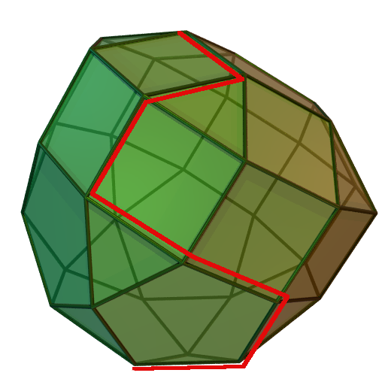
Solving LPs: the simplex algorithm
Idea: start at any vertex
If this vertex is not optimal, it is connected by an edge to some vertex with a better value
Follow that edge; repeat until nothing better is possible

Slide 26
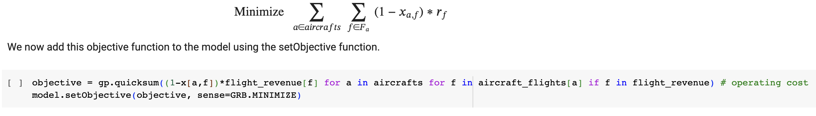
Solving LPs in practice
Very specialized software exists, e.g. Gurobi
Can expect to efficiently solve problems with tens of thousands of variables
Express in a modeling language within Python

Slide 27
Extension: quadratic programming

Slide 28
Interior point methods

Slide 29
Extension: integer programming

