Slide 1
Computational Foundations for ML (10-607):
Continuous optimization
Bryan Wilder
* Slides borrowed from prior offerings by Professors H. Heidari, M. Gormley, P. Virtue, & G. Gordon.

Slide 2
Today
Today:
(1) wrap up search
(2) Continuous optimization: algorithmic properties of gradient descent and improvements to it
Reminder: final quiz Fri 2-3pm

Slide 3
Search
So far: many search strategies (BFS, DFS, Dijkstra’s algorithm, A*)
In weighted graphs, Dijkstra’s will always find shortest paths
A* will do so with an admissible/consistent heuristic
Now: controllable tradeoff between computation and optimality

Slide 4
Beam search
Key idea: only process the most promising k nodes in each step; discard the others
“Promising” defined via a heuristic as in A*
Q = [source]
while Q is not empty:
new_Q = []
for node v in Q:
for u in neighbors(v):
if u == goal:
return
if not visited[u]:
visited[u] = True
new_Q.append(u)
Q = select_top_k(new_Q, heuristic)

Slide 5
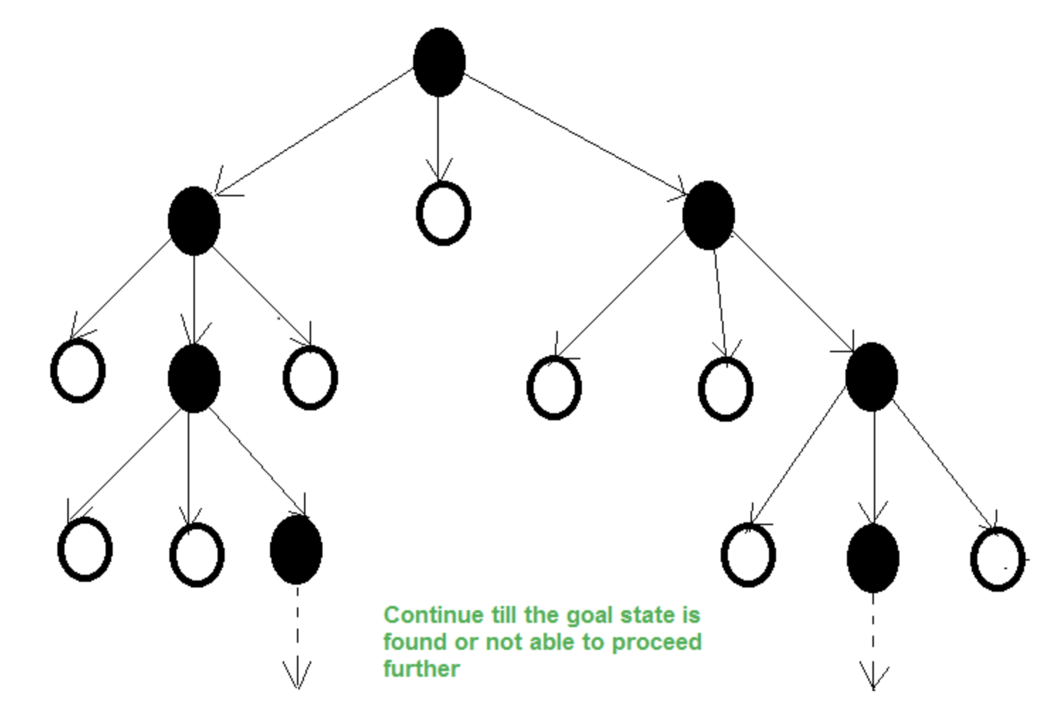

Slide 6
Beam search
Sacrifices worst-case optimality: the nodes on the optimal path might get pruned away due to the beam width limit
Improves memory usage
Works well if the heuristic is well-aligned with nodes that will actually appear on the optimal path

Slide 7
Beam search: applications
Commonly used in decoding step for language models
Model has a next-word probability distribution given previous words:
p(word 3 = ”chased”|word 1 = “the”, word 2 = “dog”)
In generation, the goal is to find the sequence with the largest overall probability

Slide 8
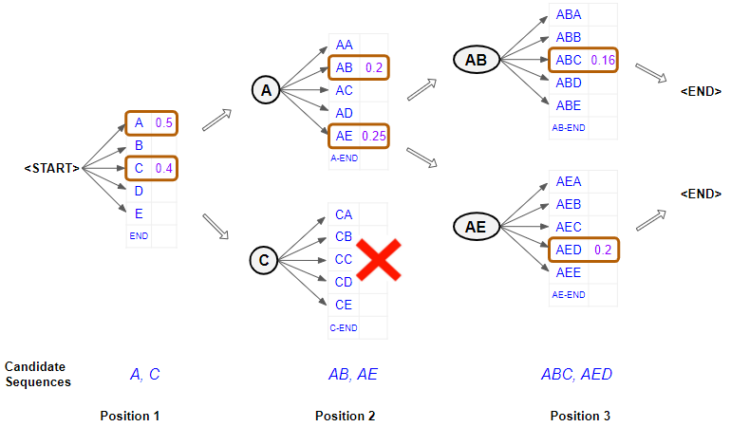
Beam search in language models
Heuristic = joint probability of sequence so far
Greedy search: choose the highest-probability token one at a time
Beam search: select the k best sequences to continue at each step

Slide 9
Continuous optimization
Earlier, we talked about algorithms for constrained optimization
Linear programming, quadratic programming
Oftentimes in ML applications, there are no constraints, but different challenges arise
Today: gradient descent and improved versions of it for machine learning

Slide 10
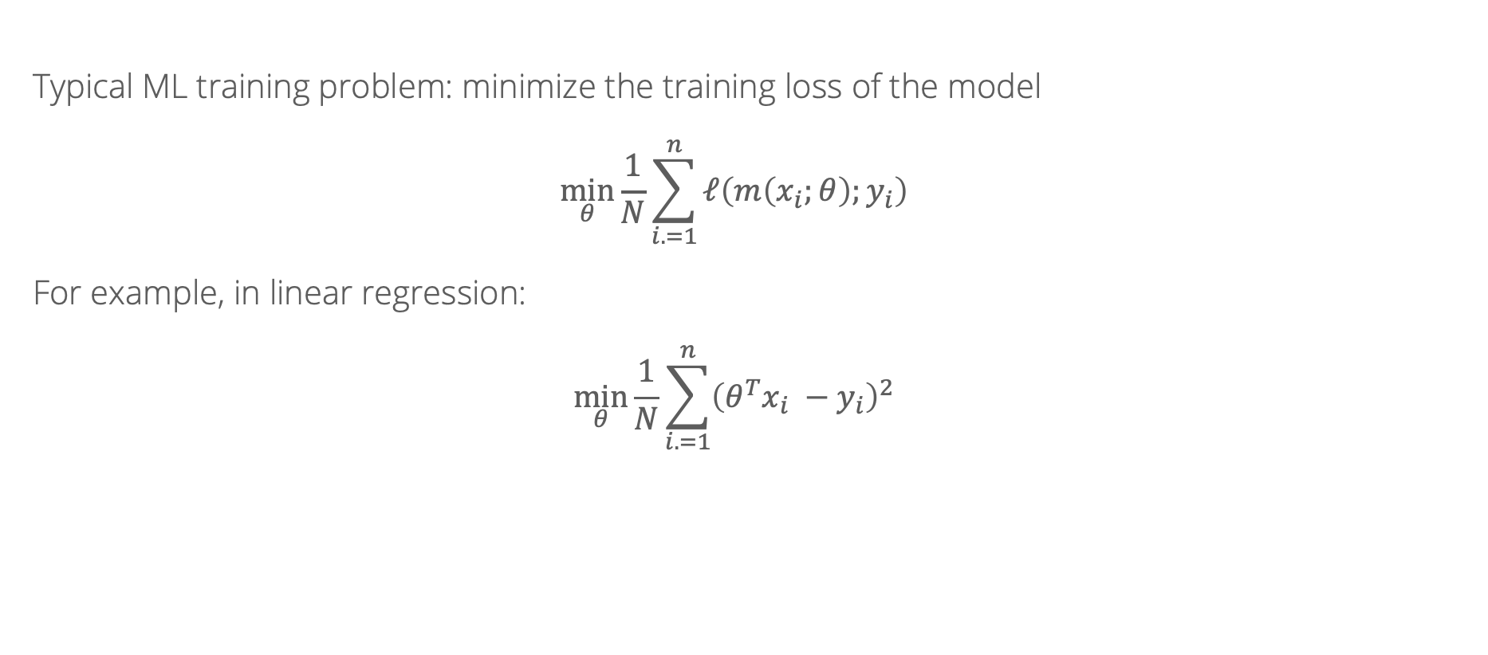
Gradient descent
Typical ML training problem: minimize the training loss of the model
$$\min_{θ}{\frac{1}{N}\sum_{i. =1}^{n}{ℓ\left(m\left(x_{i};θ\right);y_{i}\right)}}$$
For example, in linear regression:
$$\min_{θ}{\frac{1}{N}\sum_{i. =1}^{n}{{\left({θ^{T}x}_{i} −y_{i}\right)}^{2}}}$$

Slide 11

Gradient descent: review
For a function $f(θ)$, solves the problem $\min_{θ}{f(θ)}$ by iterating
$$θ_{t}= θ_{t−1} −γ∇_{θ}f(θ)$$
Provably converges to the minimizer for convex functions
For functions with multiple local optima, converges to one of them
(Notebook illustration)

Slide 12
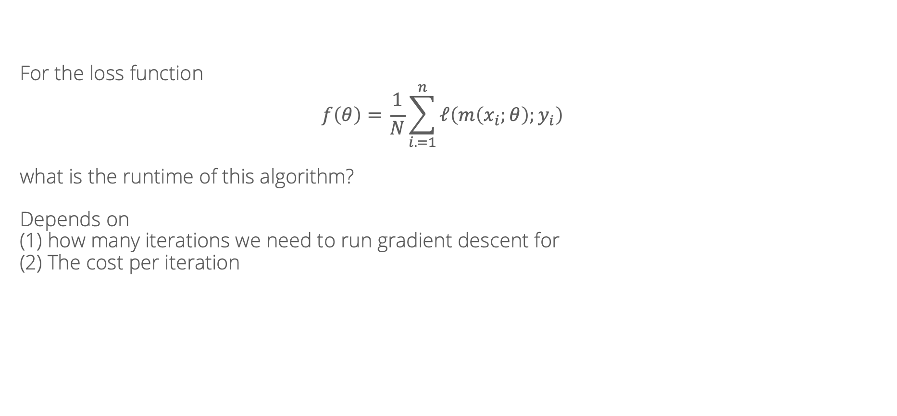
Algorithmic properties of gradient descent
For the loss function
$$f\left(θ\right)={\frac{1}{N}\sum_{i. =1}^{n}{ℓ\left(m\left(x_{i};θ\right);y_{i}\right)}}$$
what is the runtime of this algorithm?
Depends on
(1) how many iterations we need to run gradient descent for
(2) The cost per iteration

Slide 13
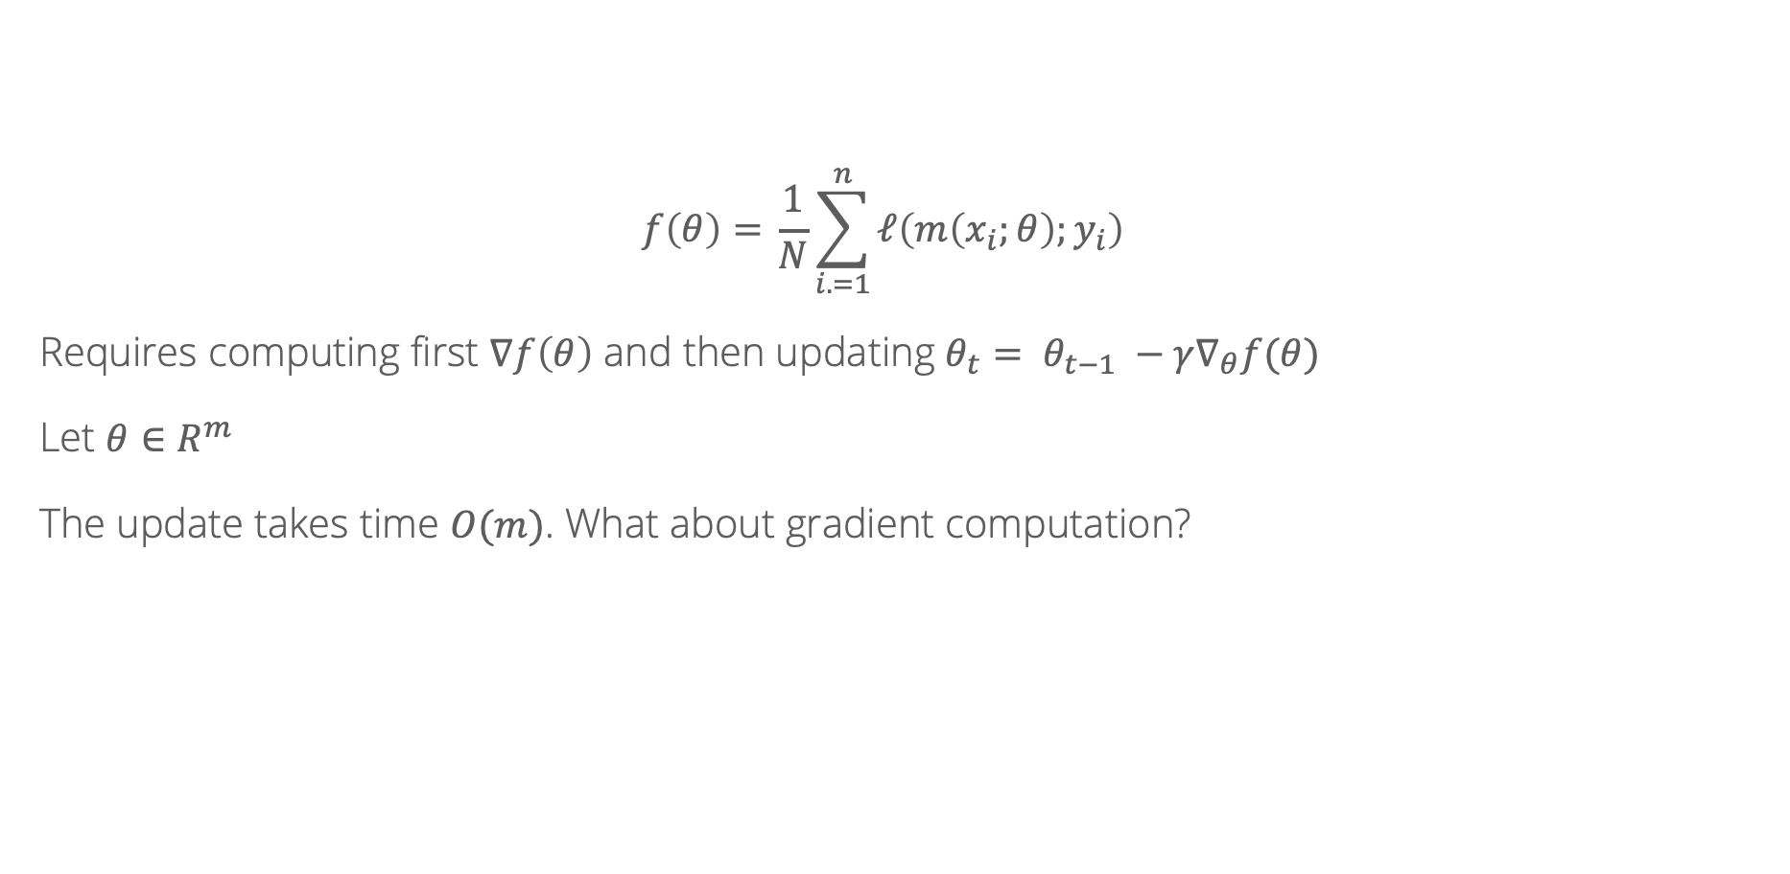
Cost per iteration
$$f\left(θ\right)={\frac{1}{N}\sum_{i. =1}^{n}{ℓ\left(m\left(x_{i};θ\right);y_{i}\right)}}$$
Requires computing first $∇f\left(θ\right)$ and then updating $θ_{t}= θ_{t−1} −γ∇_{θ}f(θ)$
Let $θ∈R^{m}$
The update takes time $O(m)$. What about gradient computation?

Slide 14
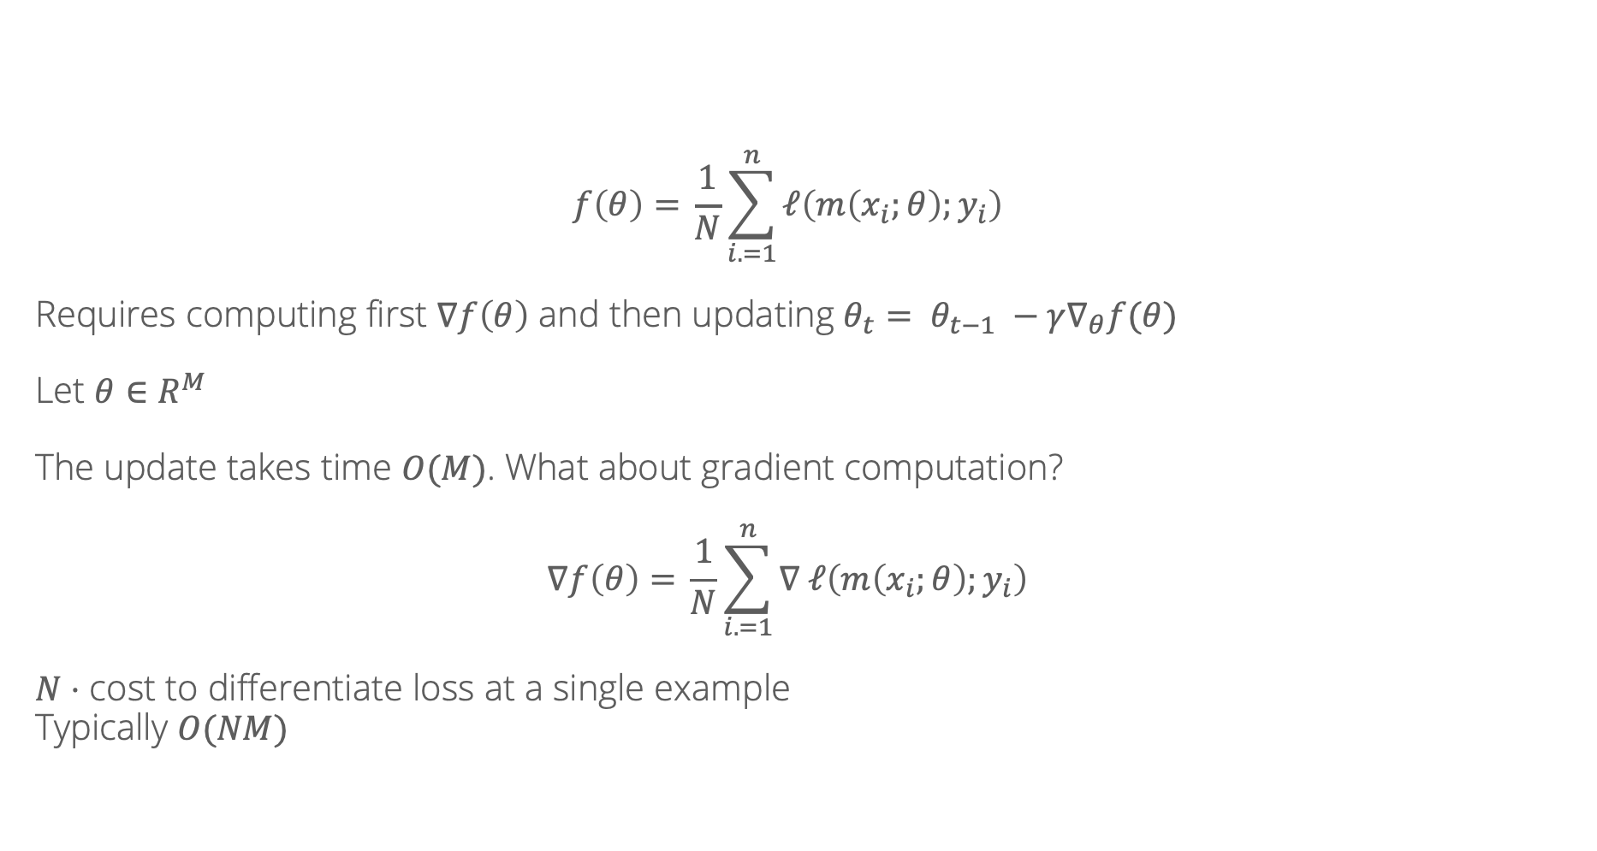
Cost per iteration
$$f\left(θ\right)={\frac{1}{N}\sum_{i. =1}^{n}{ℓ\left(m\left(x_{i};θ\right);y_{i}\right)}}$$
Requires computing first $∇f\left(θ\right)$ and then updating $θ_{t}= θ_{t−1} −γ∇_{θ}f(θ)$
Let $θ∈R^{M}$
The update takes time $O(M)$. What about gradient computation?
$$∇f\left(θ\right)={\frac{1}{N}\sum_{i. =1}^{n}{∇ ℓ\left(m\left(x_{i};θ\right);y_{i}\right)}}$$
$N⋅$ cost to differentiate loss at a single example
Typically $O(NM)$

Slide 15

Cost per iteration
What can we do to bring down the cost per iteration?
Doing work proportional to $M$ seems unavoidable
But what about $N$?

Slide 16

Stochastic gradient descent
Main idea: can view $\frac{1}{N}\sum_{i=1}^{n}{∇ ℓ\left(m\left(x_{i};θ\right);y_{i}\right)}$ as an expectation over a particular distribution
$$\frac{1}{N}\sum_{i=1}^{n}{∇ ℓ\left(m\left(x_{i};θ\right);y_{i}\right)}=E_{x, y∼P_{N}}\left[∇ ℓ\left(m\left(x;θ\right);y\right)\right]$$
We can approximate expectations by samples – even a single sample is unbiased!

Slide 17
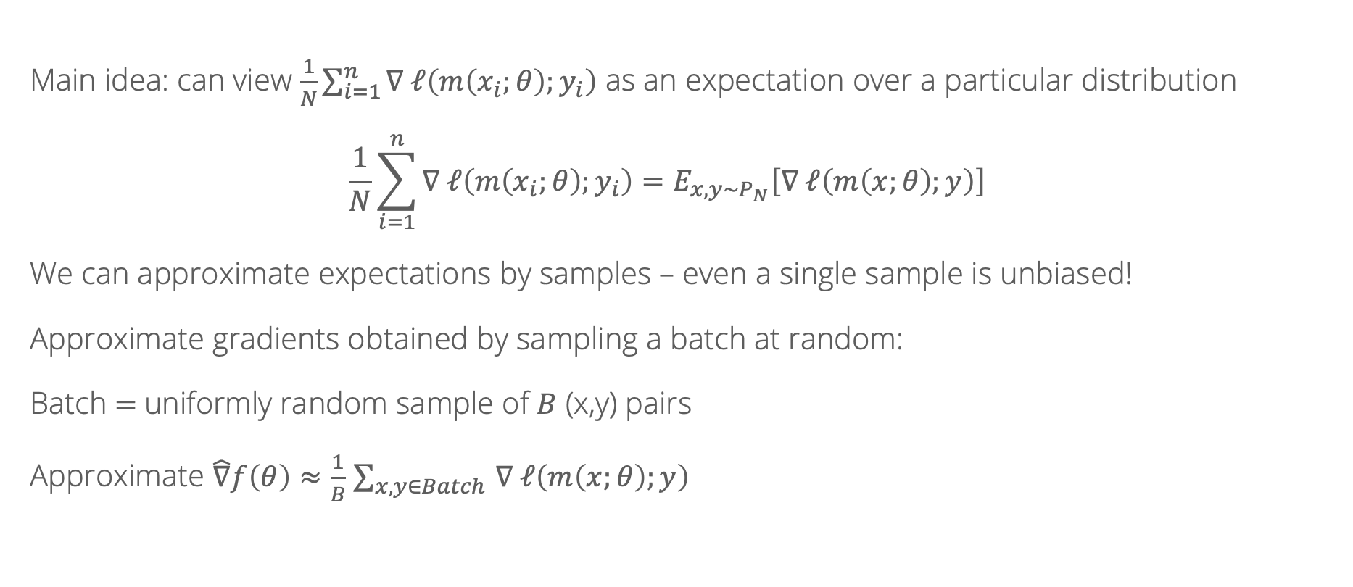
Stochastic gradient descent
Main idea: can view $\frac{1}{N}\sum_{i=1}^{n}{∇ ℓ\left(m\left(x_{i};θ\right);y_{i}\right)}$ as an expectation over a particular distribution
$$\frac{1}{N}\sum_{i=1}^{n}{∇ ℓ\left(m\left(x_{i};θ\right);y_{i}\right)}=E_{x, y∼P_{N}}\left[∇ ℓ\left(m\left(x;θ\right);y\right)\right]$$
We can approximate expectations by samples – even a single sample is unbiased!
Approximate gradients obtained by sampling a batch at random:
Batch $=$uniformly random sample of $B$ (x,y) pairs
Approximate $\hat{∇}f\left(θ\right)≈\frac{1}{B}$ $\sum_{x, y∈Batch }{∇ ℓ\left(m\left(x;θ\right);y\right)}$

Slide 18

Stochastic gradient descent
Always have that $E\left[\hat{∇}f\left(θ\right)\right]=∇f(θ)$
(unbiased)
Therefore, $E\left[{\left(\hat{∇}f\left(θ\right) − ∇f\left(θ\right)\right)}^{2}\right]$ = $Var\left[\hat{∇}f\left(θ\right)\right]$
Can be shown that $Var\left[\hat{∇}f\left(θ\right)\right]= \frac{Var\left[∇f\left(x_{i}, y_{i}\right)\right]}{√B}$
Bigger batch: lower variance, better approximate gradients
But, runtime scales as $O(BM)$

Slide 19
Number of iterations
What can we do to make the number of iterations better?
Where does gradient descent sometimes waste effort?
(Notebook)

Slide 20

Momentum
Idea: building in momentum from previous steps helps reduce oscillation caused by sudden changes
Introduce a new quantity $g_{t}$ and parameter $η$ updated as
$$g_{t}={η⋅g}_{t−1}+∇f(θ_{t})$$
And change the main update to $θ_{t}= θ_{t−1} −γg_{t}$

Slide 21
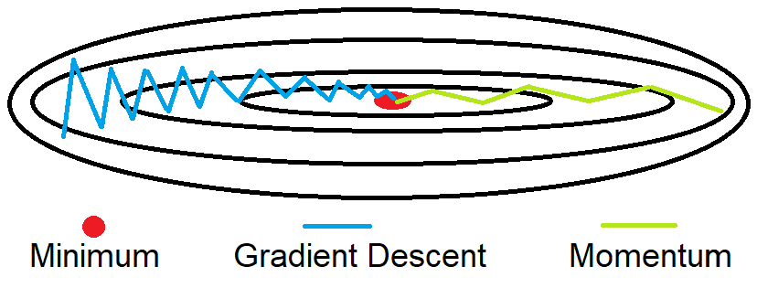

Slide 22
Recall: Stochastic Gradient Descent w/ Momentum

Slide 23
Recall: Stochastic Gradient Descent w/ Momentum

Slide 24
Recall: Stochastic Gradient Descent w/ Momentum

Slide 25
Adaptive learning rates
Oftentimes, different parameters are “differently scaled”, making it hard to use a single learning rate/step size across all of them
We’d like to move fast in parameters with gentle but consistent gradients. When gradients are large and rapidly changing, move more slowly
Modern neural networks are usually trained with adaptive learning rate methods which change the learning rate for each parameter individually based on how large/consistent the gradients are

Slide 26
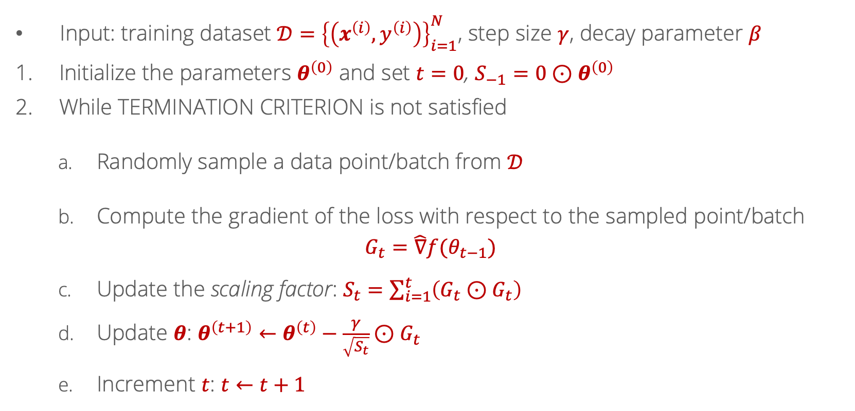
Adagrad
Input: training dataset $𝒟={\left\{\left(x^{\left(i\right)},y^{\left(i\right)}\right)\right\}}_{i=1}^{N}$, step size $γ$, decay parameter $β$
Initialize the parameters $θ^{\left(0\right)}$ and set $t=0$, $S_{−1}=0⊙θ^{\left(0\right)}$
While TERMINATION CRITERION is not satisfied
Randomly sample a data point/batch from $𝒟$
Compute the gradient of the loss with respect to the sampled point/batch
$$G_{t}=\hat{∇}f(θ_{t−1})$$
Update the scaling factor: $S_{t}=\sum_{i=1}^{t}{\left(G_{t}⊙G_{t}\right)}$
Update $θ$: $θ^{\left(t+1\right)}←θ^{\left(t\right)}−\frac{γ}{\sqrt{S_{t}}}⊙G_{t}$
Increment $t$: $t←t+1$

Slide 27
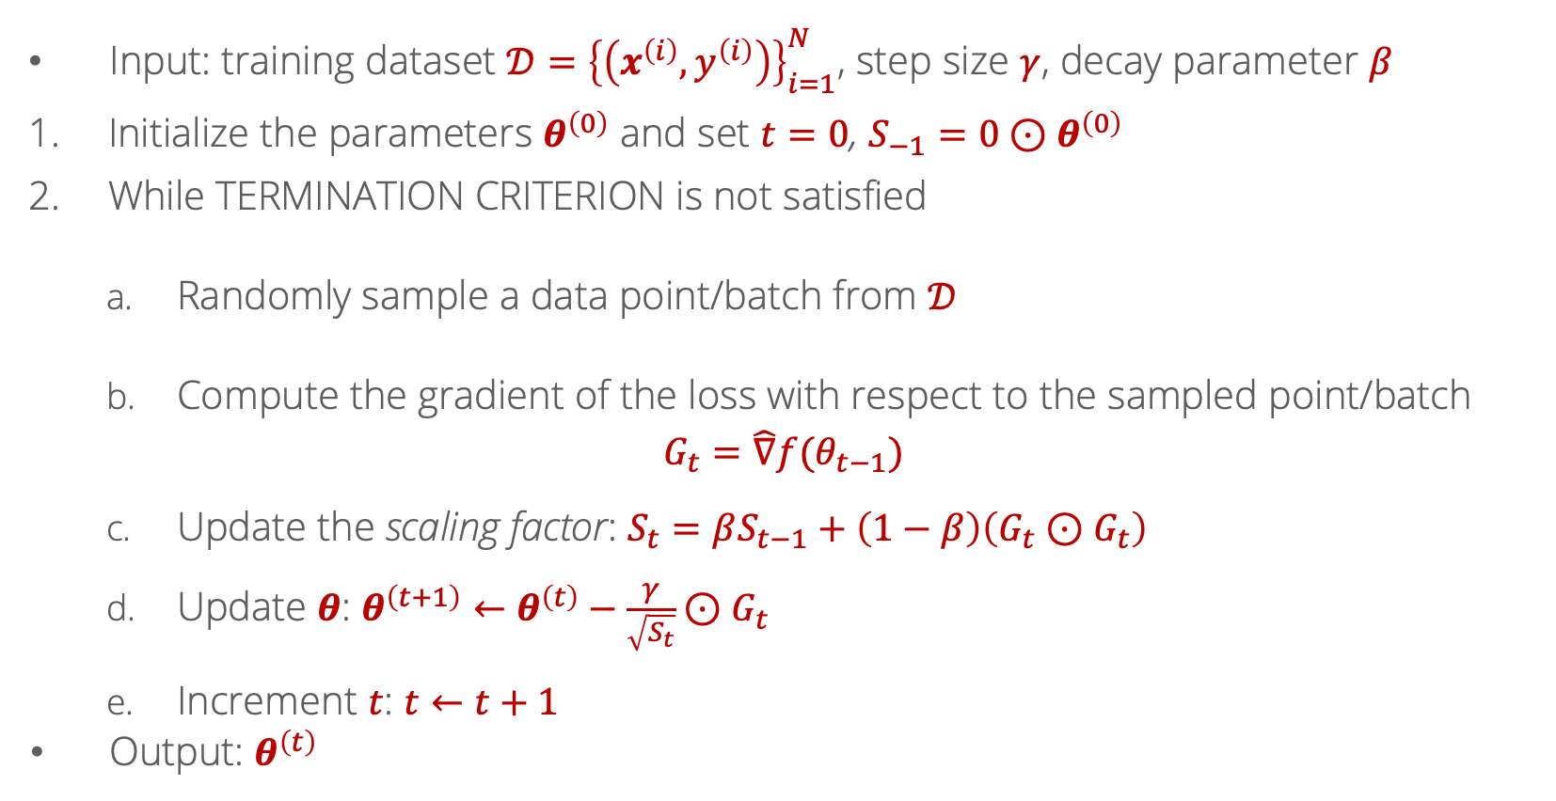
Root Mean Square Propagation (RMSProp)
Input: training dataset $𝒟={\left\{\left(x^{\left(i\right)},y^{\left(i\right)}\right)\right\}}_{i=1}^{N}$, step size $γ$, decay parameter $β$
Initialize the parameters $θ^{\left(0\right)}$ and set $t=0$, $S_{−1}=0⊙θ^{\left(0\right)}$
While TERMINATION CRITERION is not satisfied
Randomly sample a data point/batch from $𝒟$
Compute the gradient of the loss with respect to the sampled point/batch
$$G_{t}=\hat{∇}f(θ_{t−1})$$
Update the scaling factor: $S_{t}=βS_{t−1}+\left(1−β\right)\left(G_{t}⊙G_{t}\right)$
Update $θ$: $θ^{\left(t+1\right)}←θ^{\left(t\right)}−\frac{γ}{\sqrt{S_{t}}}⊙G_{t}$
Increment $t$: $t←t+1$
Output: $θ^{\left(t\right)}$

Slide 28
Visualization
Source: https://imgur.com/a/Hqolp#2dKCQHh

