Slide 1
Computational Foundations for ML (10-607):
Proof Techniques: induction
Bryan Wilder
* Slides borrowed from prior offerings of the course by Professors M. Gormley, P. Virtue, & G. Gordon.

Slide 2
Proof techniques
Last week: propositional logic as a formalization of arguments
This week: more sophisticated strategies for establishing formal proofs

Slide 3
Proof techniques
Last week: propositional logic as a formalization of arguments
This week: more sophisticated strategies for establishing formal proofs
We will also move beyond propositional logic (e.g., proving statements about more common mathematical objects like numbers, sums, functions, etc., not just binary variables)
Focus is still on rigorous justification for each step of proofs, but no longer at such a low level

Slide 4
Proof by induction
Today: a technique called proof by induction
Used to establish properties that hold over an entire sequence of inputs
Example: For every n ∈ N, 1+2+... +n = n(n+1)/2.
This is a statement that needs to be proved for every value of n

Slide 5
Proof by Induction
The basic principle: let P(n) be a statement for n ∈ N such that
P(n) is true for n = 1.
P(m) is true implies that P(m + 1) is true.
Then P(n) is true for all n ∈ N.

Slide 6
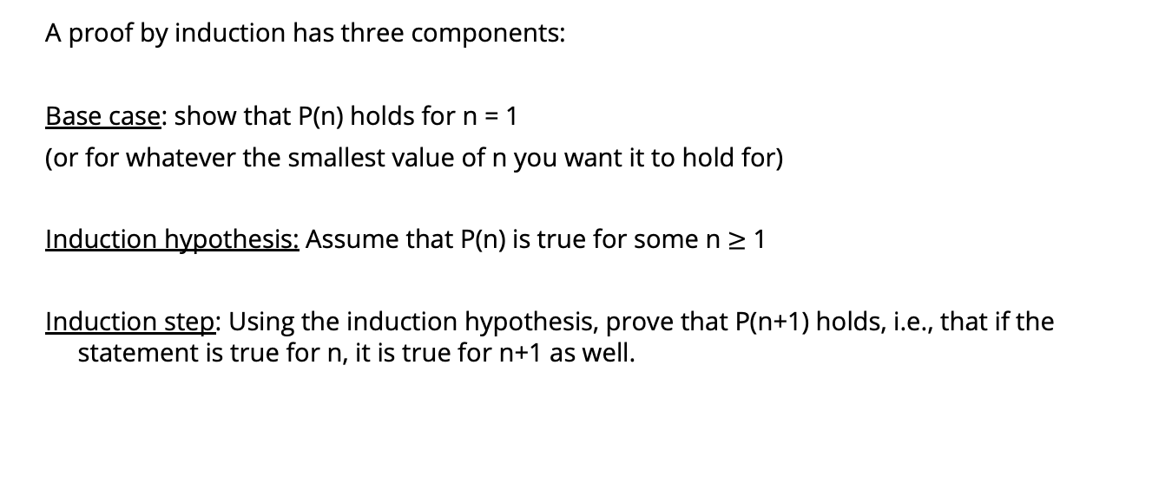
Proof by induction
A proof by induction has three components:
Base case: show that P(n) holds for n = 1
(or for whatever the smallest value of n you want it to hold for)
Induction hypothesis: Assume that P(n) is true for some n $≥$ 1
Induction step: Using the induction hypothesis, prove that P(n+1) holds, i.e., that if the statement is true for n, it is true for n+1 as well.

Slide 7
Example
Example: For every n ∈ N, 1+2+... +n = n(n+1)/2.

Slide 8
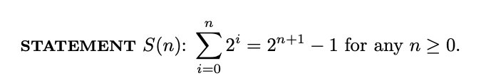
Notes:
See 2.3 of http://infolab.stanford.edu/~ullman/focs/ch02.pdf

Slide 9
Proof by Induction
Fibonacci numbers are defined by f₀ = 0, f₁ = f₂ = 1 and the recursion relation
f_{n+1} = f_{n} + f_{n−1} for all n ≥ 1.
Exercise: f₁ + f₃ + f₅ + . . . + f_{2n−1} = f_{2n} for all n ≥ 1.
Exercise: Show that f_{n+1} < (7/4)^{n} for all n ≥ 1.

Slide 10
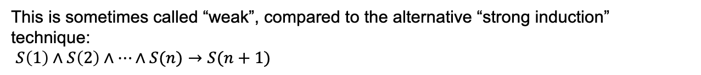
Strong induction
The format we’ve seen so far: argue that if a statement holds for $n$, it must hold for $n+1$: $S\left(n\right)→S(n+1)$
This is sometimes called “weak”, compared to the alternative “strong induction” technique:
$S\left(1\right)∧S\left(2\right)∧…∧S(n)→S(n+1)$

Slide 11
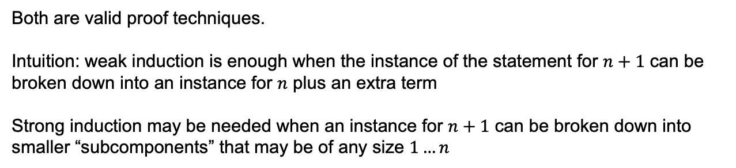
Strong vs Weak Induction
Weak induction: use $S\left(n\right)$ to prove $S(n+1)$
Strong induction: use $S\left(1\right)…S(n)$ to prove $S(n+1)$
Both are valid proof techniques.
Intuition: weak induction is enough when the instance of the statement for $n+1$ can be broken down into an instance for $n$ plus an extra term
Strong induction may be needed when an instance for $n+1$ can be broken down into smaller “subcomponents” that may be of any size $1…n$

Slide 12
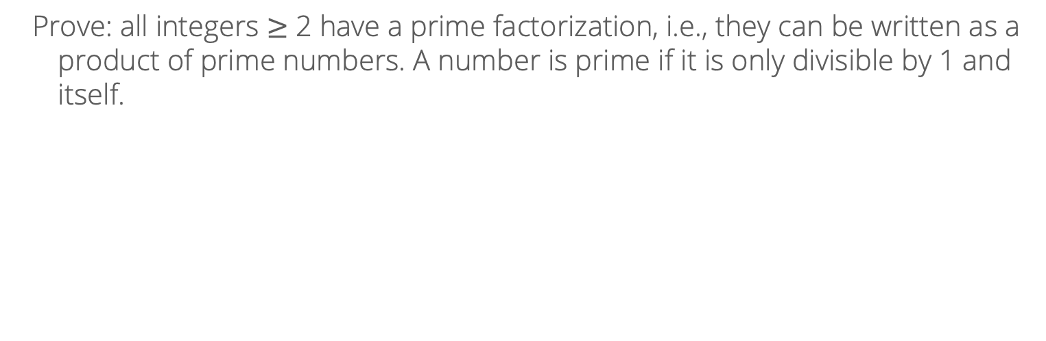
Example of strong induction
Prove: all integers $≥$ 2 have a prime factorization, i.e., they can be written as a product of prime numbers. A number is prime if it is only divisible by 1 and itself.

Slide 13
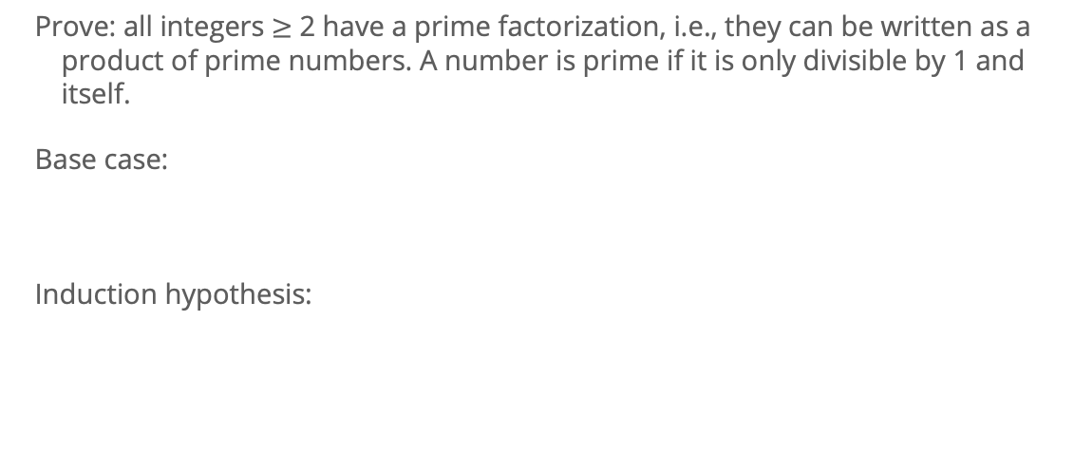
Example of strong induction
Prove: all integers $≥$ 2 have a prime factorization, i.e., they can be written as a product of prime numbers. A number is prime if it is only divisible by 1 and itself.
Base case:
Induction hypothesis:

Slide 14
Example of strong induction
Induction step:

Slide 15
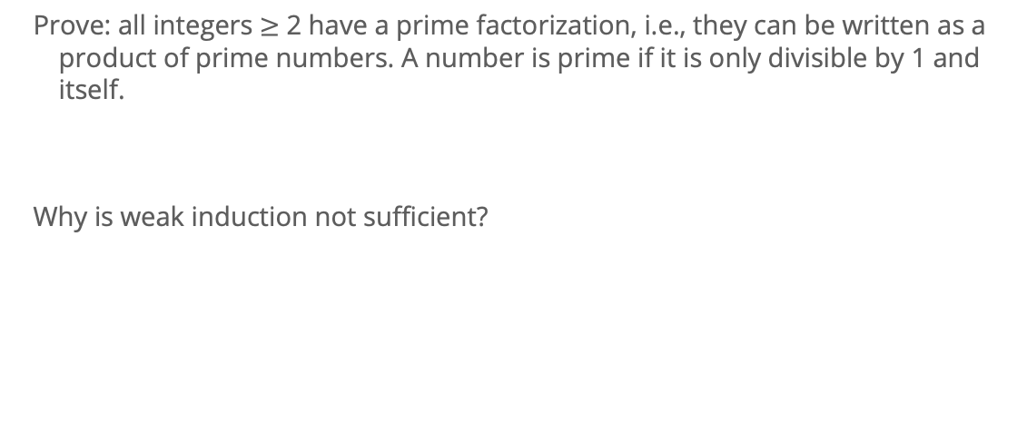
Example of strong induction
Prove: all integers $≥$ 2 have a prime factorization, i.e., they can be written as a product of prime numbers. A number is prime if it is only divisible by 1 and itself.
Why is weak induction not sufficient?

Slide 16
Example of a proof
Next, example of a “real” proof used to establish a classic result in ML
(and which uses induction)

Slide 17
Plan
Perceptron Background
ML Data, Tasks, Notation
Vectors, dot products
Geometry with linear functions
Perceptron (and the sign() function)
Decision boundaries and errors
Perceptron Algorithm
Perceptron Mistake Bound Theory
Background: projections, distances, and margin

Slide 18
Shapes in higher dimensions
What are these linear (affine) shapes called for 1-D, 2-D, 3-D, n-D input?
 | x ∈ R¹ | x ∈ R² | x ∈ R³ | x ∈ R^{n}
y = w^{T}x + b | Line | Plane | Hyperplane | Hyperplane
w^{T}x + b = 0 | Point | Line | Plane | Hyperplane
w^{T}x + b ≥ 0 | Half-line | Half-plane | Half-space | Half-space

Slide 19
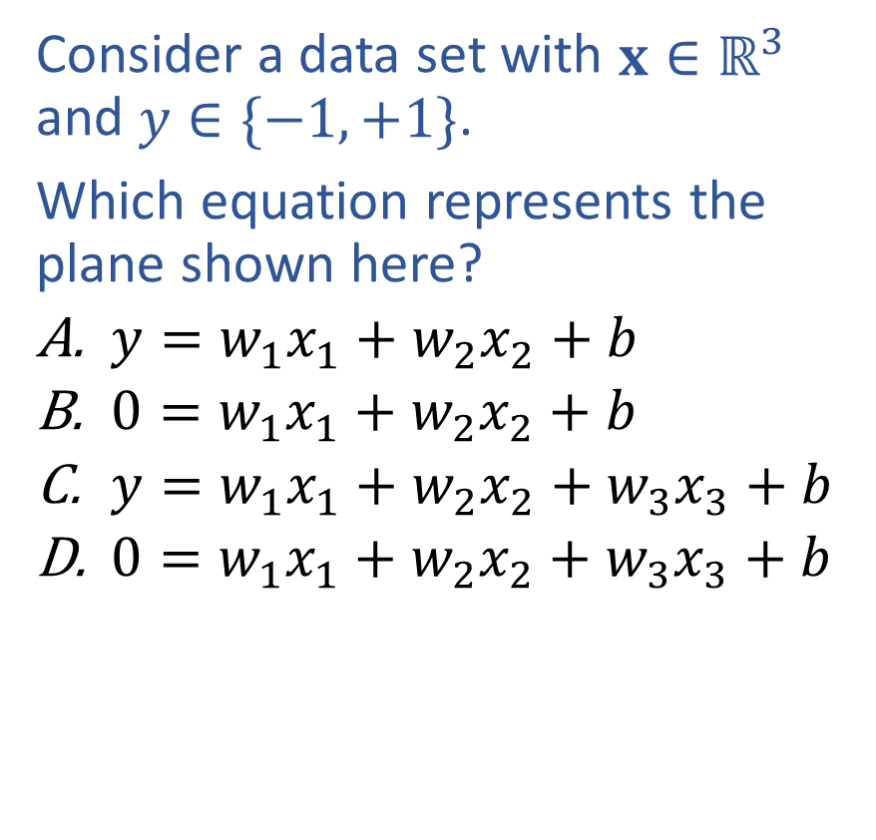
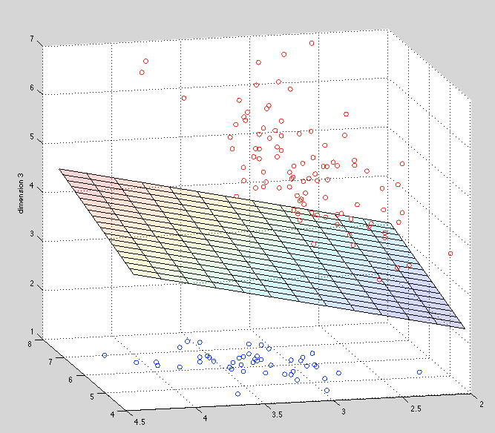
Warm-up Exercise

Slide 20
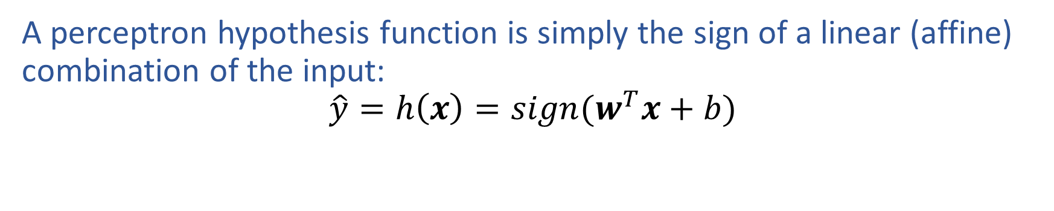
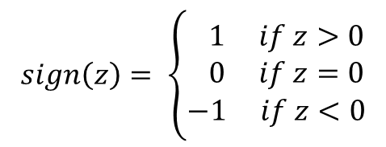
Perceptron

Slide 21
Dot Product
How does the dot product relate to linear decision boundary?

Slide 22
Perceptron Algorithm
Sketch of algorithm
Initialize w=0
Loop
Given a point x predict y ̂=sign(w^{T}x)
Given actual label y:
If y≠y ̂
If y=+1, w←w+x
If y=-1, w←w-x

Slide 23






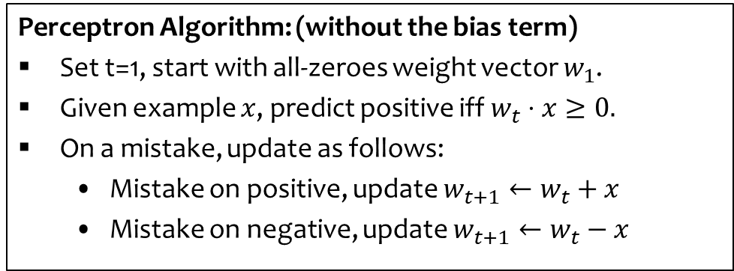




Perceptron Algorithm: Example
Example:
X

-
X
+

-
+
X

+
-
Slide credit: CMU MLD Nina Balcan

Slide 24
Perceptron Algorithm
Sketch of algorithm
Initialize w=0
Loop
Given a point x predict y ̂=sign(w^{T}x)
Given actual label y:
If true y≠y ̂
If true y=+1, w←w+x
If true y=-1, w←w-x

Slide 25
Perceptron Algorithm
Sketch of algorithm
Initialize θ=0
Loop
Given a point x predict y ̂=sign(θ^{T}x)
Given actual label y:
If true y≠y ̂
If true y=+1, θ←θ+x
If true y=-1, θ←θ-x

Slide 26
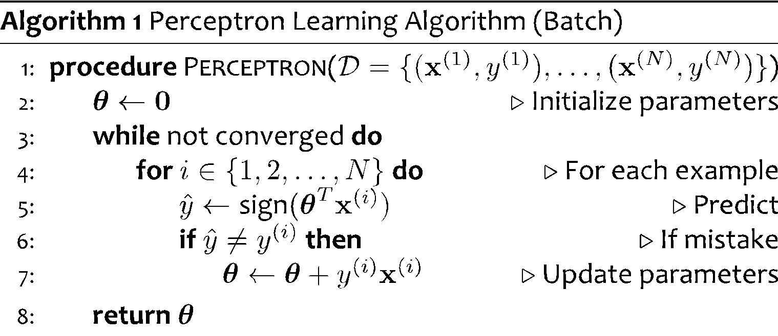
Perceptron Algorithm
Learning for Perceptron also works if we have a fixed training dataset, D.
Slide credit: CMU MLD Matt Gormley

Slide 27
Perceptron Algorithm
Learning for Perceptron also works if we have a fixed training dataset, D.
Implementation Trick: same behavior as our “add on positive mistake and subtract on negative mistake” version, because y^{(i)} takes care of the sign
Slide credit: CMU MLD Matt Gormley

Slide 28
Plan
Perceptron Background
ML Data, Tasks, Notation
Vectors, dot products
Geometry with linear functions
Perceptron (and the sign() function)
Decision boundaries and errors
Perceptron Algorithm
Perceptron Mistake Bound Theory
Background: projections, distances, and margin

Slide 29
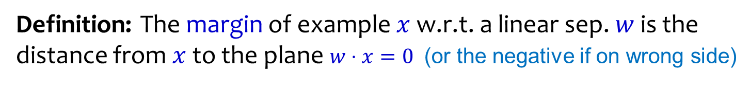


Geometric Margin
‘
w
Slide credit: CMU MLD Nina Balcan

Slide 30
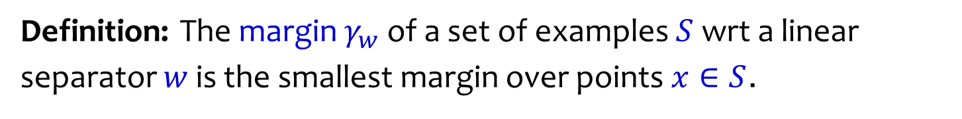
Geometric Margin
‘
+
+
+
+
w
+
-
+
-
+
-
-
-
+
-
-
-
-
Slide credit: CMU MLD Nina Balcan

Slide 31
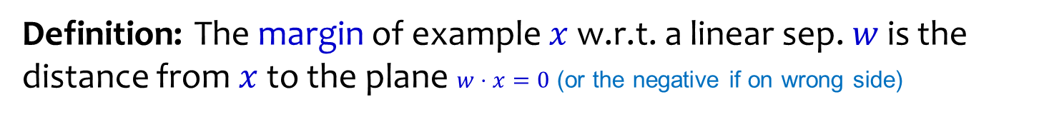
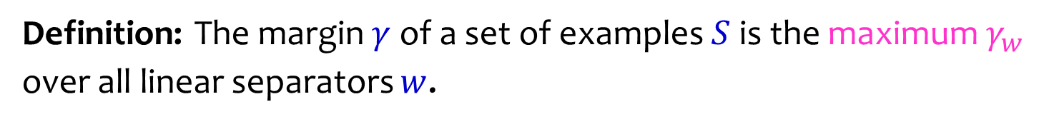
Geometric Margin
+
w
+
-
+
-
+
-
-
-
+
-
-
-
-
Slide credit: CMU MLD Nina Balcan

Slide 32
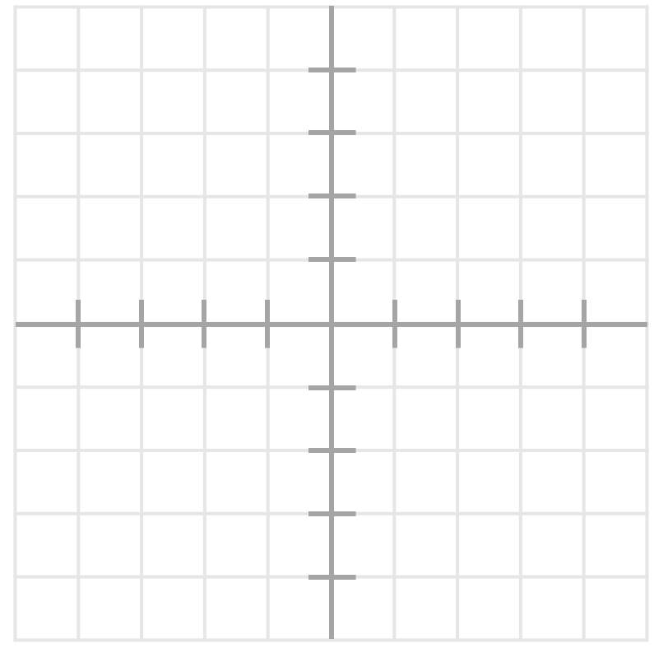
Geometric Margin
What is the margin for this dataset?

Slide 33
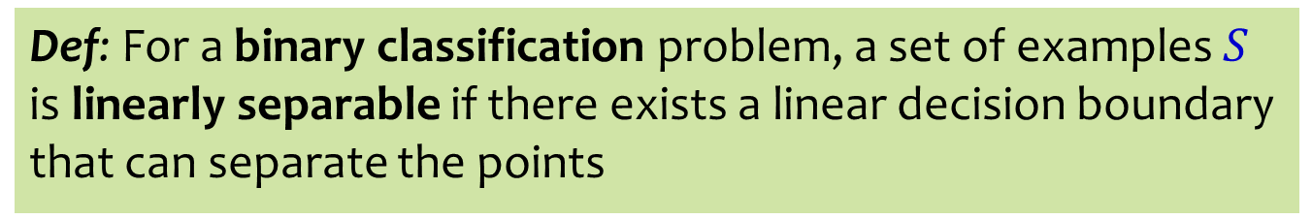
Linear Separability
Case 1:
Case 2:
Case 3:
Case 4:
+
-
+
+
-
-
+
+
+
+
+
-
+
Slide credit: CMU MLD Matt Gormley

Slide 34
ANALYSIS OF PERCEPTRON

Slide 35
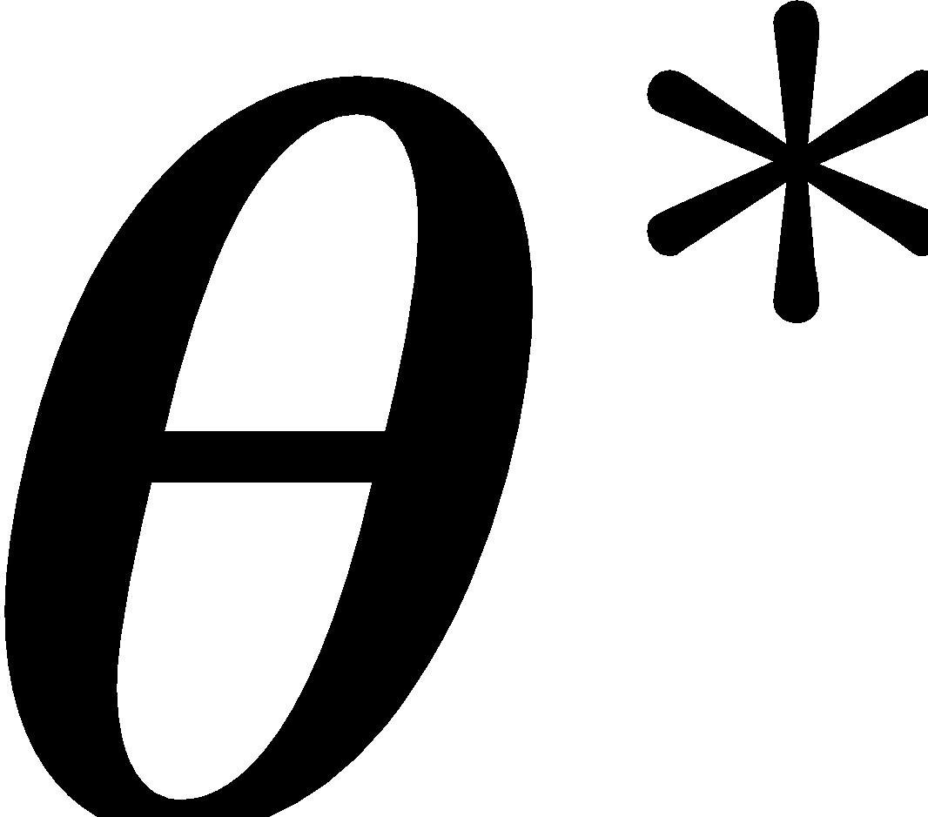
Analysis: Perceptron
Perceptron Mistake Bound
(Normalized margin: multiplying all points by 100, or dividing all points by 100, doesn’t change the number of mistakes; algo is invariant to scaling.)
+
+
+
+
Slide credit: CMU MLD Nina Balcan and Matt Gormley
γ
+
γ
+
-
+
-
+
-
-
-
R
-
-
-
-

Slide 36
Analysis: Perceptron
Perceptron Mistake Bound
(Normalized margin: multiplying all points by 100, or dividing all points by 100, doesn’t change the number of mistakes; algo is invariant to scaling.)
+
+
+
+
Slide credit: CMU MLD Nina Balcan and Matt Gormley
Def: We say that the (batch) perceptron algorithm has converged if it stops making mistakes on the training data (perfectly classifies the training data).
Main Takeaway: For linearly separable data, if the perceptron algorithm cycles repeatedly through the data, it will converge in a finite # of steps.
γ
+
γ
+
-
+
-
+
-
-
-
R
-
-
-
-

Slide 37
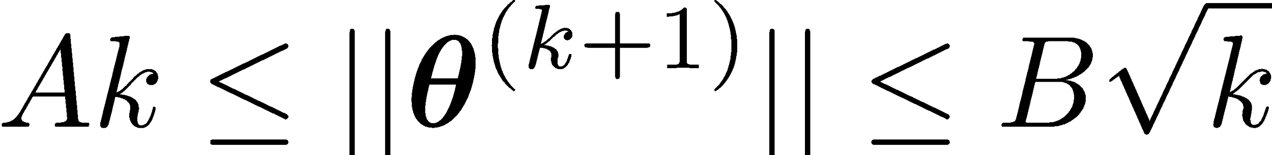
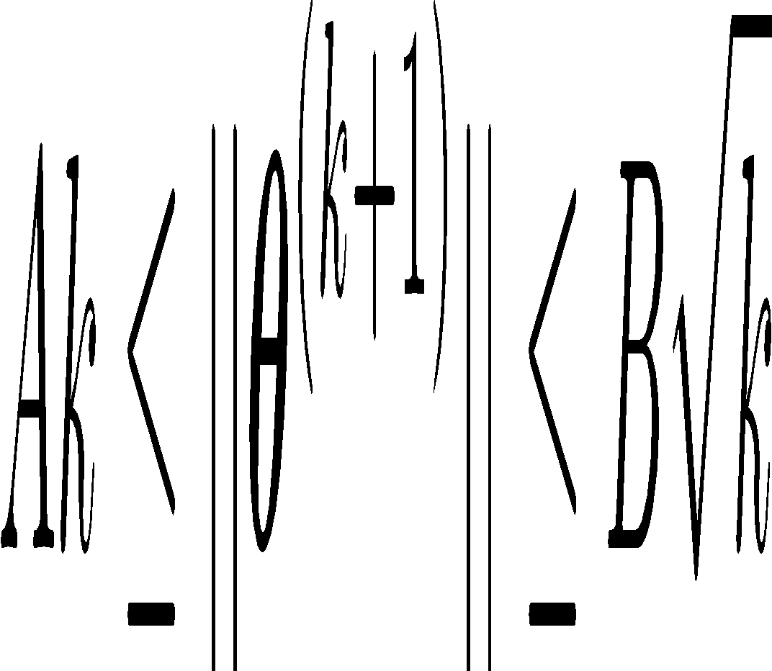
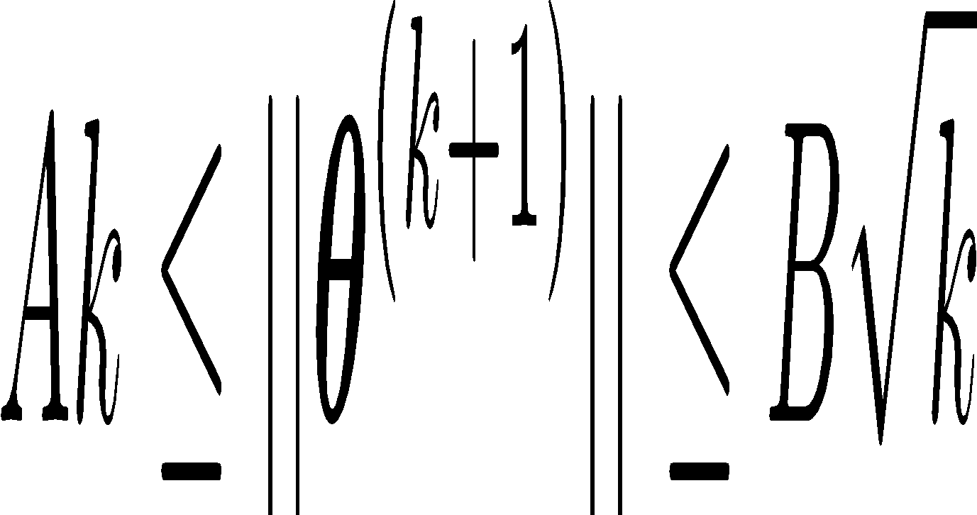
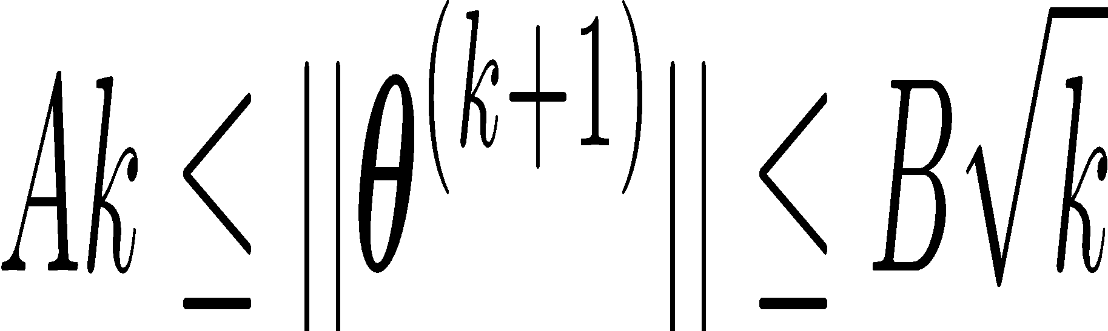
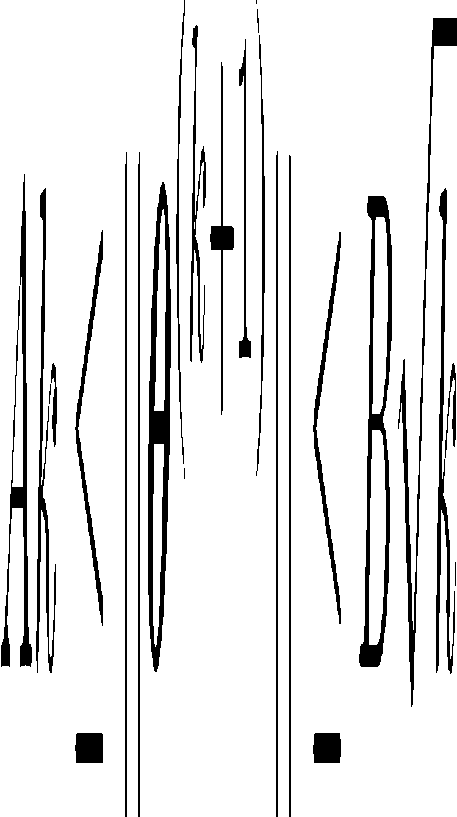
Analysis: Perceptron
Proof of Perceptron Mistake Bound:
We will show that there exist constants A and B s.t.

Slide 38
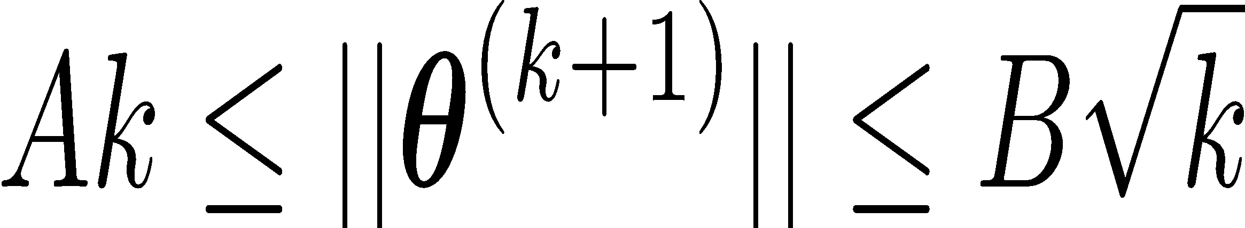
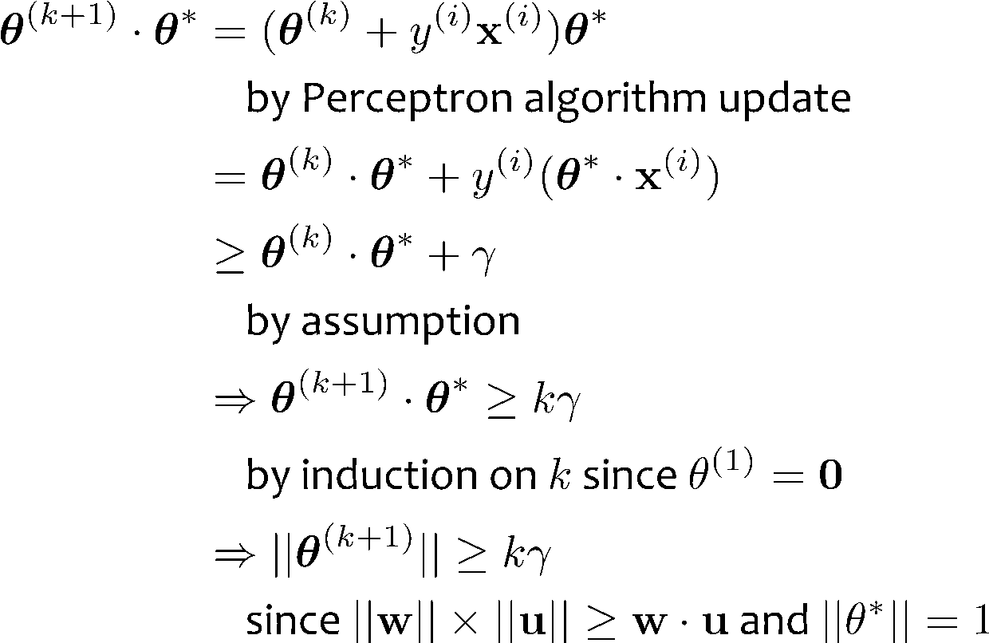
Analysis: Perceptron
Proof of Perceptron Mistake Bound: Part 1: for some A,
Cauchy-Schwartz inequality
Notes:
Intuition \theta is gradually approaching \theta*
Part 1: The dot product of \theta and \theta* increases rapidly O(k)
Part 2: The norm of \theta increases slowly \Omega(\sqrt(k))

Slide 39
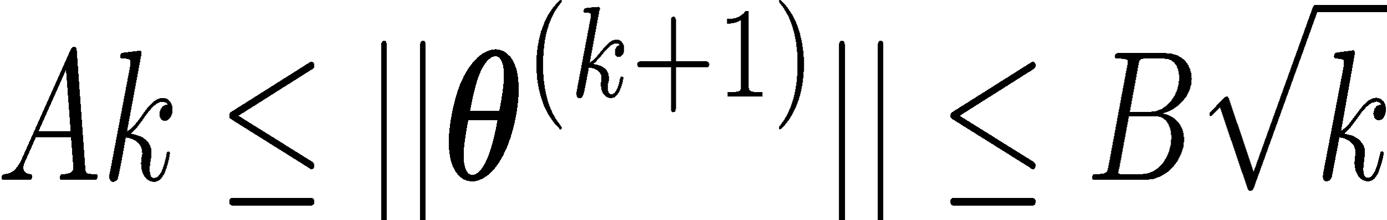
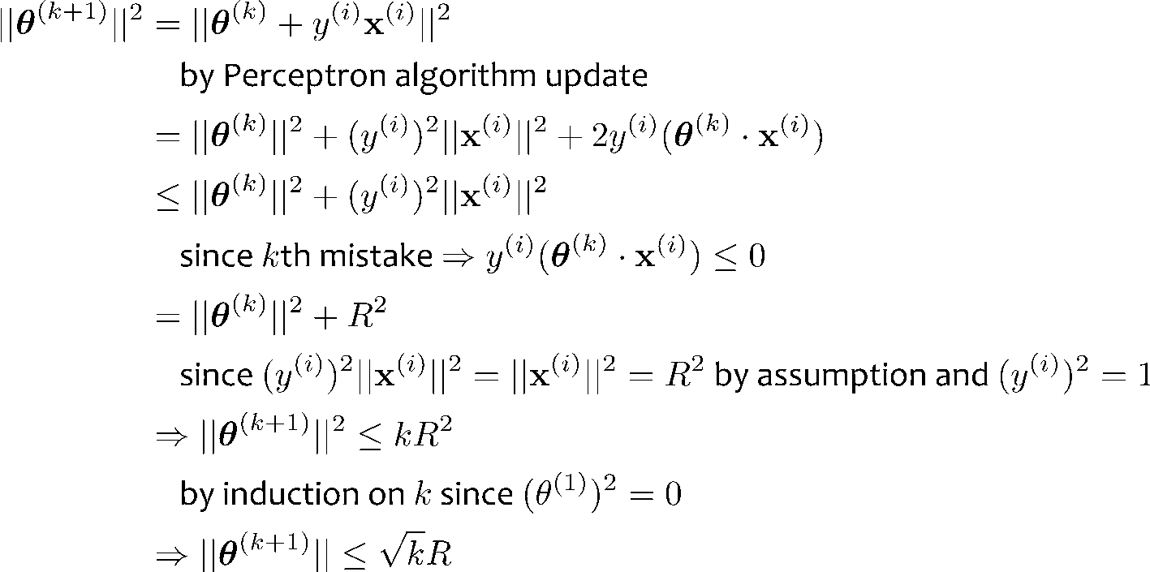
Analysis: Perceptron
Proof of Perceptron Mistake Bound: Part 2: for some B,
Notes:
Intuition \theta is gradually approaching \theta*
Part 1: The dot product of \theta and \theta* increases rapidly O(k)
Part 2: The norm of \theta increases slowly \Omega(\sqrt(k))

Slide 40
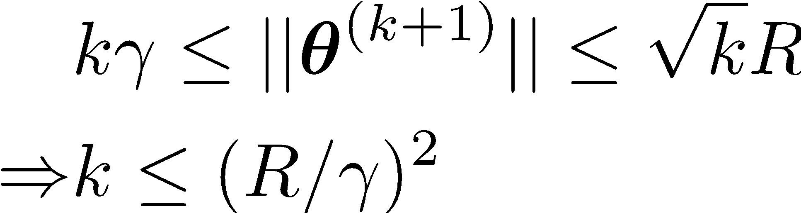
Analysis: Perceptron
Proof of Perceptron Mistake Bound: Part 3: Combining the bounds finishes the proof.
The total number of mistakes must be less than this

