Slide 1
Computational Foundations for ML (10-607):
Proof Techniques
Bryan Wilder
* Slides borrowed from prior offerings of the course by Professors M. Gormley, P. Virtue, & G. Gordon.

Slide 2
Lecture Overview
Proof by Construction
Proof by Cases
Proof by Contradiction
Proof by Contraposition

Slide 3
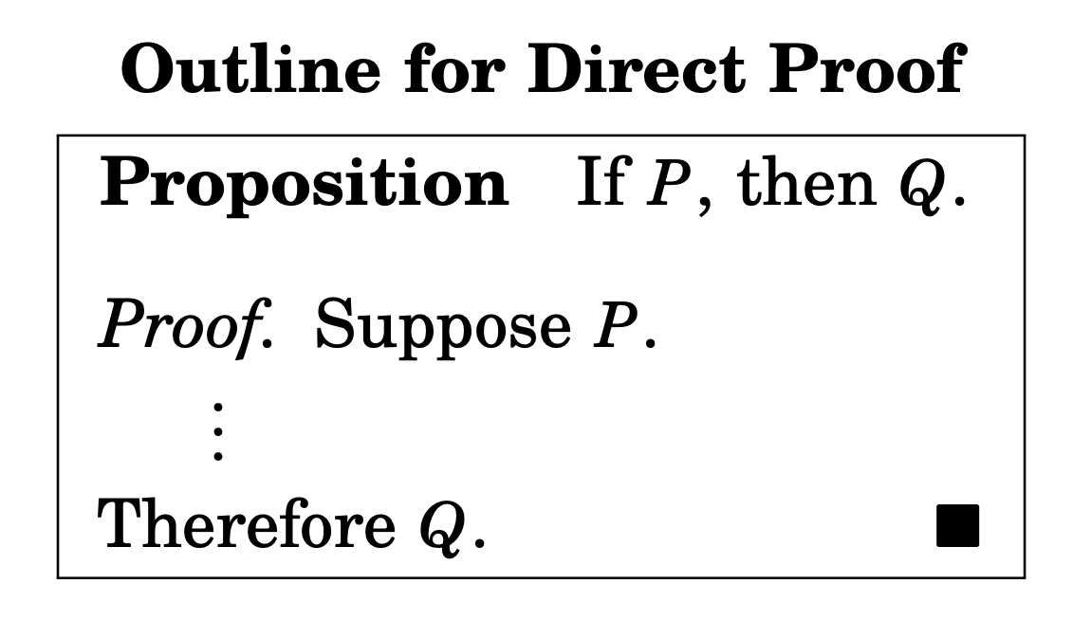
Proof by Construction
Establish P ⇒ Q directly.
Assume that P is true.
Use P to show that Q must be true.
Notes:
Also called direct proof

Slide 4
Proof by Construction
Example: If a, b ∈ Z are consecutive (i.e., b = a+1), then the sum a + b is odd.

Slide 5
Proof by construction
Example: Let a,b and c be integers. If a | b and b | c, then a | c.
Notes:
b = k_1 a, c = k_2 b. c = k_2 k_1 a. Since k_2 k_1 \in N, a | c

Slide 6
Proof by Cases
A proof that the set of cases is exhaustive.
A proof of each of the cases.
Notes:
Also called proof by exhaustion

Slide 7
Proof by Cases
Exercise: If q ∈ N is not divisible by 3, then q² ≡ 1 (mod 3).

Slide 8
Proof by Cases
Exercise: For any n ∈ N, n and n² have the same parity (both even or both odd).

Slide 9
Proof by contradiction
To prove p, start by assuming (not p), and show that this leads to a contradiction
Exercise: Prove that there are infinitely many prime numbers.
Notes:
Consider any finite list of prime numbers 𝑝1,𝑝2,⋯,𝑝𝑛.�1,�2,⋯,��. It will be shown that at least one additional prime number not in this list exists. Let 𝑃� be the product of all the prime numbers in the list: 𝑃=𝑝1𝑝2...𝑝𝑛�=�1�2...��. Let 𝑞=𝑃+1�=�+1. Then let us check if 𝑞� is prime or not:
(1)(1): If 𝑞� is prime, then there is at least one more prime than is in the list.
(2)(2): If 𝑞� is not prime, then some prime factor 𝑝� divides 𝑞�. If this factor 𝑝� were on our list, then it would divide 𝑃� (since 𝑃� is the product of every number on the list); but 𝑝� divides 𝑃+1=𝑞�+1=�. If 𝑝� divides 𝑃� and 𝑞�, then 𝑝� would have to divide the difference of the two numbers, which is (𝑃+1)−𝑃=1(�+1)−�=1. Since no prime number divides 1,𝑝1,� cannot be on the list. This means that at least one more prime number exists beyond those in the list.

Slide 10
Proof by contradiction
To prove p, start by assuming (not p), and show that this leads to a contradiction
Exercise: The number √2 is rational.
Notes:
https://math.stackexchange.com/questions/1020278/understanding-the-proof-of-sqrt2-is-irrational-by-contradiction#:~:text=The%20proof%20starts%20with%20assuming,cannot%20be%20a%20rational%20number.

Slide 11
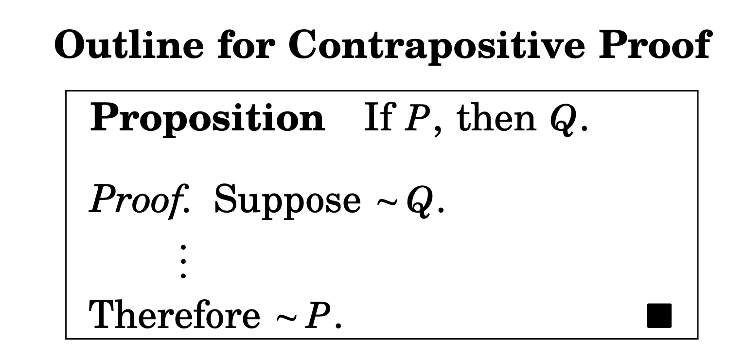
Proof by Contraposition
Law of contrapositive (A⇒B)⇔(¬B⇒¬A)
Show (¬B⇒¬A) and conclude (A⇒B)

Slide 12
Proof by Contraposition
Example: Let a, b ∈ Z. If ab is even, then either a is even or b is even (or both).
Notes:
Case A is odd: suppose b odd as well (2k_1 + 1)(2k_2 + 1) = 4k_1k_2+2k_1+2k_2 + 1 -> ab is odd.

Slide 13
Proof by Contraposition
Example: If a, b ∈ Z s.t. a+b is even, then a and b have the same parity.

Slide 14
Example: Suppose x, y ∈ R. If y³ + yx² ≤ x³ + x y², then y ≤ x.

Slide 15
A more complex contrapositive
n is an even number if there exists an integer k such that n = 2k
What is the contrapositive?

Slide 16
Disproof by example
One example is not sufficient to prove a statement.
One counterexample is sufficient to disprove it.

Slide 17
Disproof by example
Example: Let a, b ∈ Z. If a is odd and b is odd, then a+b is odd.
Exercise: For every n ∈ Z, the integer f (n) = n² − n+11 is prime.

