Slide 1
Computational Foundations for ML (10-607):
Proof Techniques: induction
Bryan Wilder
* Slides borrowed from prior offerings of the course by Professors M. Gormley, P. Virtue, & G. Gordon.

Slide 2
Proof techniques
Last week: propositional logic as a formalization of arguments
This week: more sophisticated strategies for establishing formal proofs

Slide 3
Proof techniques
Last week: propositional logic as a formalization of arguments
This week: more sophisticated strategies for establishing formal proofs
We will also move beyond propositional logic (e.g., proving statements about more common mathematical objects like numbers, sums, functions, etc., not just binary variables)
Focus is still on rigorous justification for each step of proofs, but no longer at such a low level

Slide 4
Proof by induction
Today: a technique called proof by induction
Used to establish properties that hold over an entire sequence of inputs
Example: For every n ∈ N, 1+2+... +n = n(n+1)/2.
This is a statement that needs to be proved for every value of n

Slide 5
Proof by Induction
The basic principle: let P(n) be a statement for n ∈ N such that
P(n) is true for n = 1.
P(m) is true implies that P(m + 1) is true.
Then P(n) is true for all n ∈ N.

Slide 6
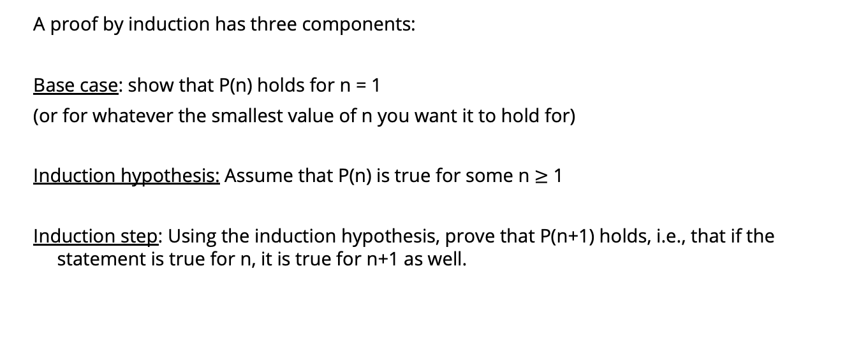
Proof by induction
A proof by induction has three components:
Base case: show that P(n) holds for n = 1
(or for whatever the smallest value of n you want it to hold for)
Induction hypothesis: Assume that P(n) is true for some n $≥$ 1
Induction step: Using the induction hypothesis, prove that P(n+1) holds, i.e., that if the statement is true for n, it is true for n+1 as well.

Slide 7
Example
Example: For every n ∈ N, 1+2+... +n = n(n+1)/2.

Slide 8
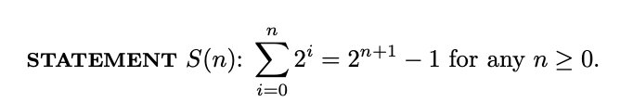
Example
Notes:
See 2.3 of http://infolab.stanford.edu/~ullman/focs/ch02.pdf

Slide 9
Example
Fibonacci numbers are defined by f₀ = 0, f₁ = f₂ = 1 and the recursion relation
f_{n+1} = f_{n} + f_{n−1} for all n ≥ 1.
Exercise: f₁ + f₃ + f₅ + . . . + f_{2n−1} = f_{2n} for all n ≥ 1.
Exercise: Show that f_{n+1} < (7/4)^{n} for all n ≥ 1.

Slide 10
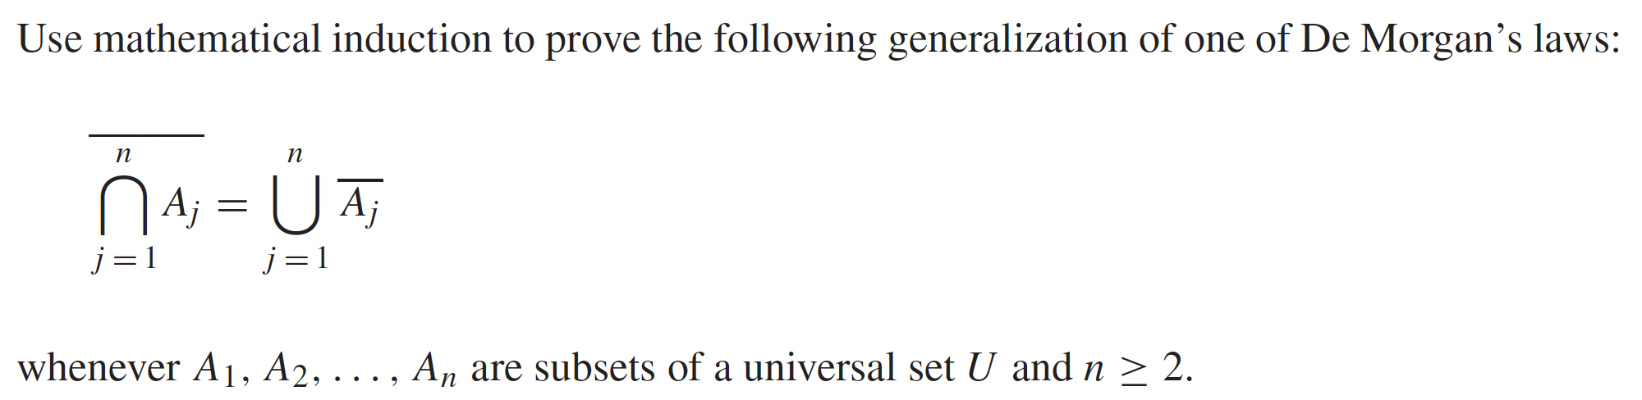
Example
Notes:
Rosen 5.1 example 11

Slide 11
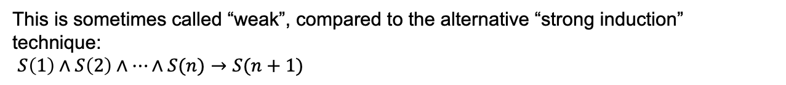
Strong induction
The format we’ve seen so far: argue that if a statement holds for $n$, it must hold for $n+1$: $S\left(n\right)→S(n+1)$
This is sometimes called “weak”, compared to the alternative “strong induction” technique:
$S\left(1\right)∧S\left(2\right)∧…∧S(n)→S(n+1)$

Slide 12
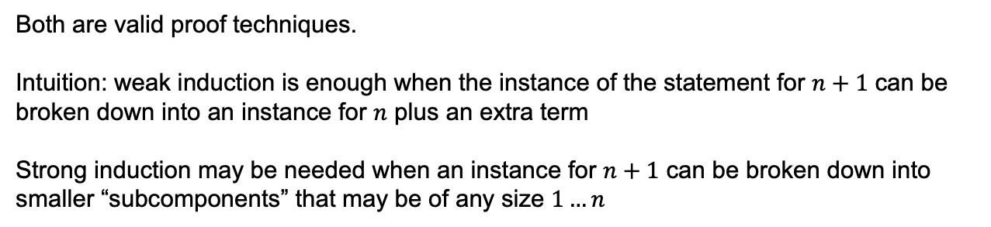
Strong vs Weak Induction
Weak induction: use $S\left(n\right)$ to prove $S(n+1)$
Strong induction: use $S\left(1\right)…S(n)$ to prove $S(n+1)$
Both are valid proof techniques.
Intuition: weak induction is enough when the instance of the statement for $n+1$ can be broken down into an instance for $n$ plus an extra term
Strong induction may be needed when an instance for $n+1$ can be broken down into smaller “subcomponents” that may be of any size $1…n$

Slide 13
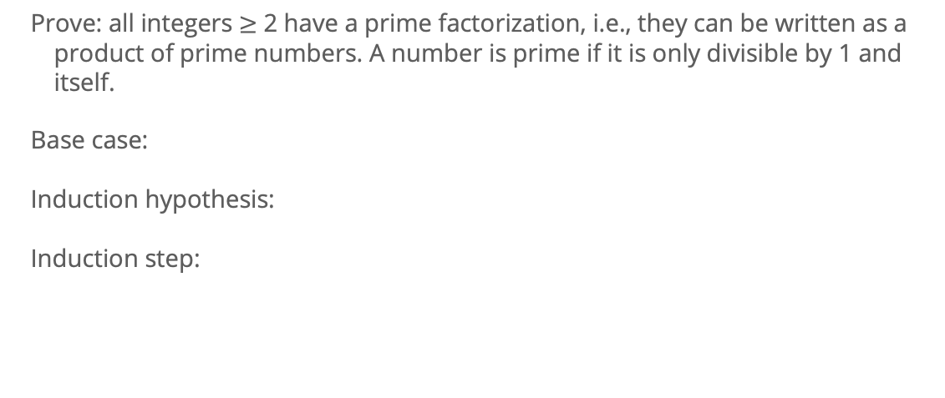
Example of strong induction
Prove: all integers $≥$ 2 have a prime factorization, i.e., they can be written as a product of prime numbers. A number is prime if it is only divisible by 1 and itself.
Base case:
Induction hypothesis:
Induction step:

Slide 14
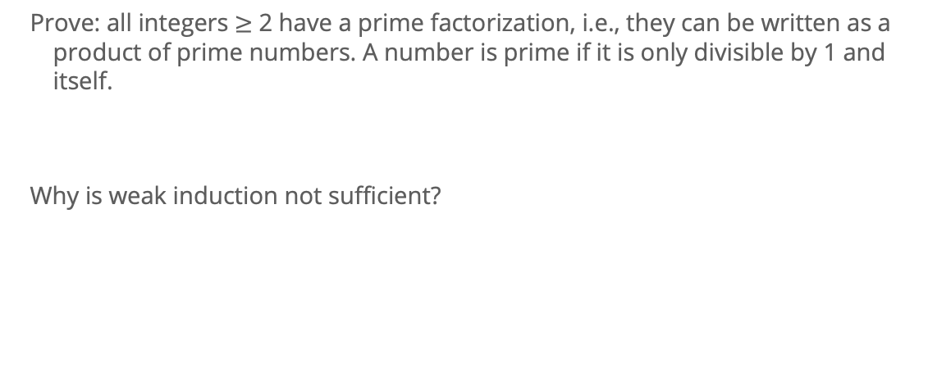
Example of strong induction
Prove: all integers $≥$ 2 have a prime factorization, i.e., they can be written as a product of prime numbers. A number is prime if it is only divisible by 1 and itself.
Why is weak induction not sufficient?

Slide 15
Strong induction example #2
Consider a game in which two players take turns removing any positive number of matches they want from one of two piles of matches. The player who removes the last match wins the game. Show that if the two piles contain the same number of matches initially, the second player can always guarantee a win.
Notes:
Rosen 5.2, Example 3

