Slide 1
Computational Foundations for ML (10-607):
Data types: trees and lists
Bryan Wilder
* Slides borrowed from prior offerings by Professors H. Heidari, M. Gormley, P. Virtue, & G. Gordon.

Slide 2
Announcements
Quiz on Wednesday: computational complexity, big-O , recursion, dynamic programming & memoization
Single homework for weeks 5/6 (no assignment due this Sunday)

Slide 3
Today
Data structures: how is information stored?
Different choices make it easier to look up information, modify it, implement different algorithms

Slide 4
Today
Trees
Lists
Next time: stacks and queues

Slide 5
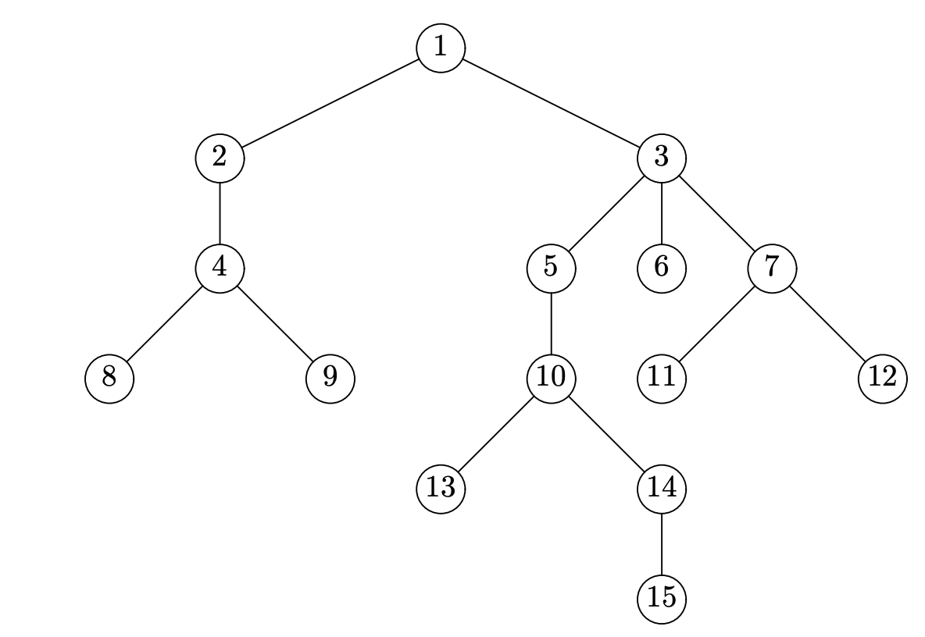
Trees

Slide 6
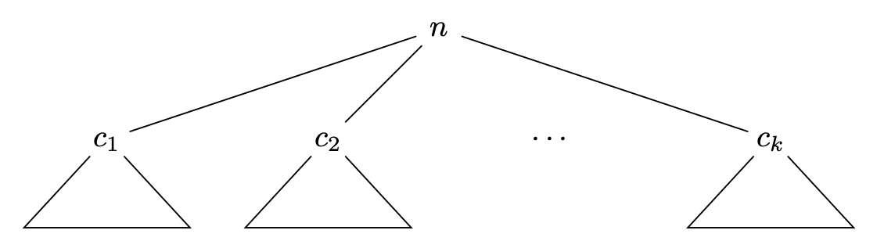
Trees
Recursively defined

Slide 7
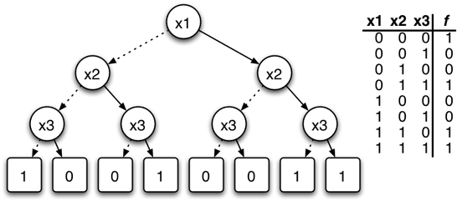
ML application: decision trees

Slide 8
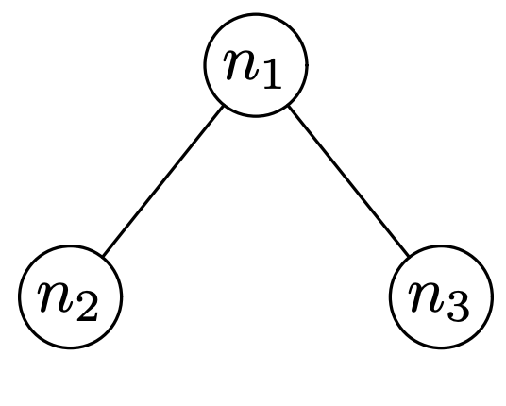
Binary trees
Special case of a tree where:
all nodes have at most two children
We distinguish between the left and right child

Slide 9
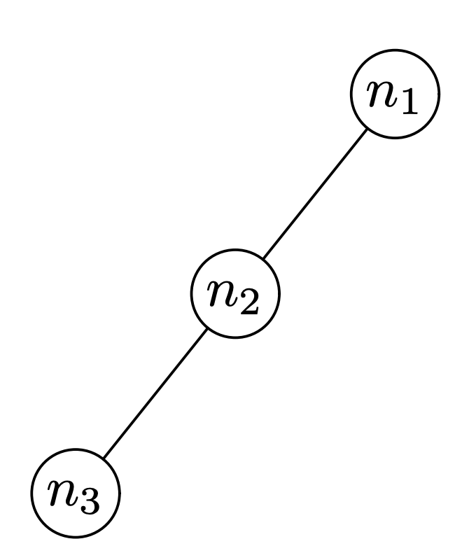
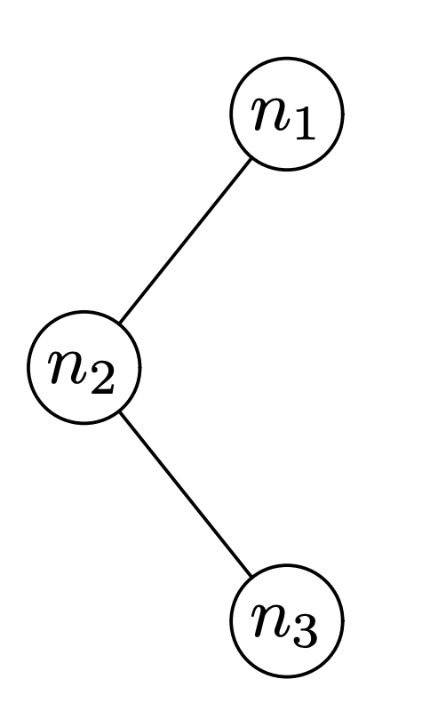
Binary trees
Different trees:

Slide 10
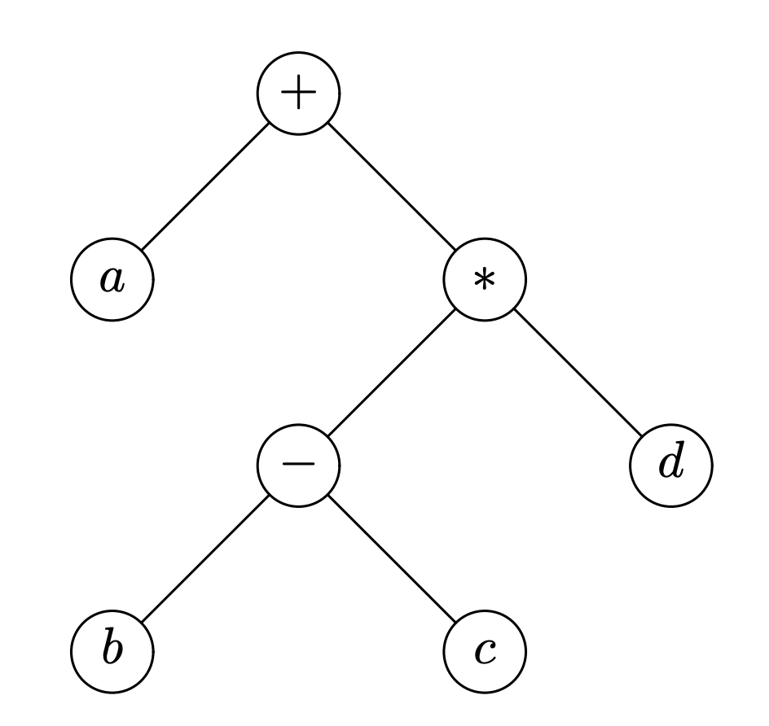
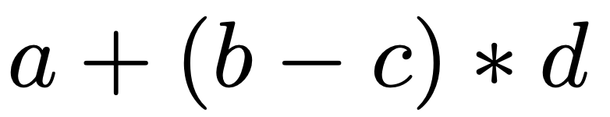
Representing arithmetic expressions

Slide 11
Binary trees
class BTree:
def __init__(self, v, l=None, r=None):
assert type(l) == BTree or l==None
assert type(r) == BTree or r==None
self.value = v
self.left = l
self.right = r
def is_leaf(self):
return self.left==None and self.right==None
# make a binary tree, starting with subtrees
D = BTree('D',BTree('C'),BTree('E'))
B = BTree('B',BTree('A'),D)
I = BTree('I',BTree('H'))
G = BTree('G',None,I)
BT = BTree('F',B,G)
Draw the tree this code creates.

Slide 12
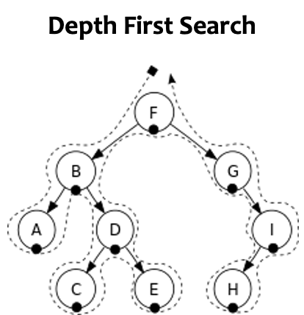
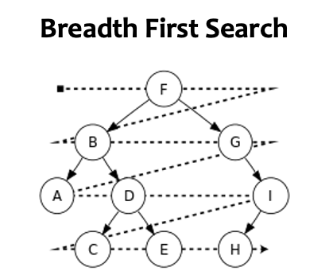
Tree Search

Slide 13
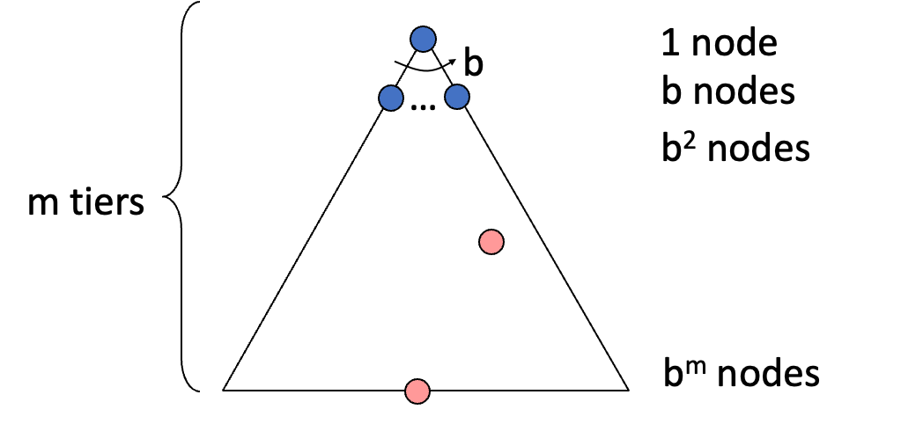
Properties of Search Algorithm
Completeness: Guaranteed to find a solution if one exists?
Optimality: Guaranteed to find the least cost path?
Time complexity
Space complexity
Cartoon of search tree:
b is the branching factor
m is the maximum depth
solutions at various depths
Number of nodes in entire tree?
1 + b + b² + …. b^{m} = O(b^{m})

Slide 14
Depth-First Search (DFS)
def Depth_first_search_iterative(root):
s = [] # use a list as a stack
s.append(root)
while (len(s)>0):
t=s.pop()
if t == None:
continue
print(t.value)
s.append(t.right)
s.append(t.left)

Slide 15
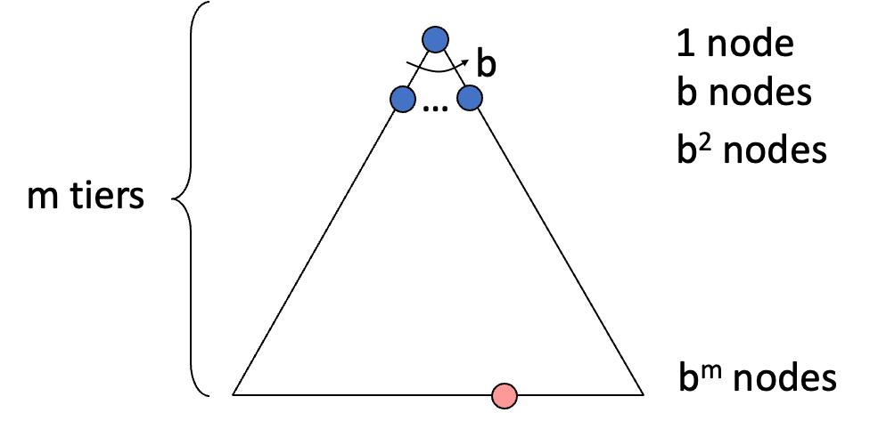
Depth-First Search (DFS)
What nodes does DFS expand?
Some left prefix of the tree.
Could process the whole tree!
If m is finite, takes time O(b^{m})
How much space does the frontier take?
Only has siblings on path to root, so O(bm)
Is it complete?
m could be infinite, so only if we prevent cycles (graph search)
Is it optimal?
No, it finds the “leftmost” solution, regardless of depth or cost

Slide 16
Breadth-First Search (BFS)
def Breadth_first_search_iterative(root):
s = [] # use a list as a queue
s.append(root)
while (len(s)>0):
t=s.pop(0) # now this is a queue
if t == None:
continue
print(t.value)
s.append(t.left)
s.append(t.right)

Slide 17
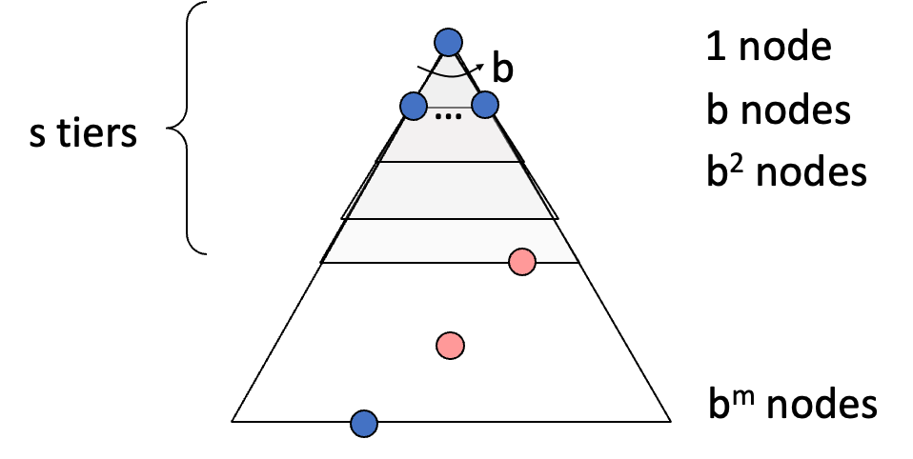
Breadth-First Search (BFS)
What nodes does BFS expand?
Processes all nodes above shallowest solution
Let depth of shallowest solution be s
Search takes time O(b^{s})
How much space does the frontier take?
Has roughly the last tier, so O(b^{s})
Is it complete?
s must be finite if a solution exists, so yes!
Is it optimal?
Only if costs are all the same (more on costs later)

Slide 18
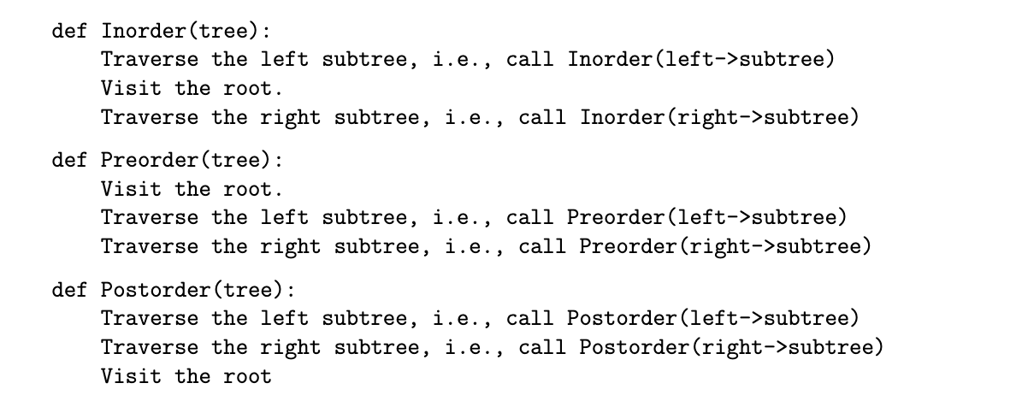
Variants of DFS

Slide 19
Binary search trees
For each node, left subtree is all < the node and right subtree is all >
5
10
2
7
7
12
4
3
9
3

Slide 20
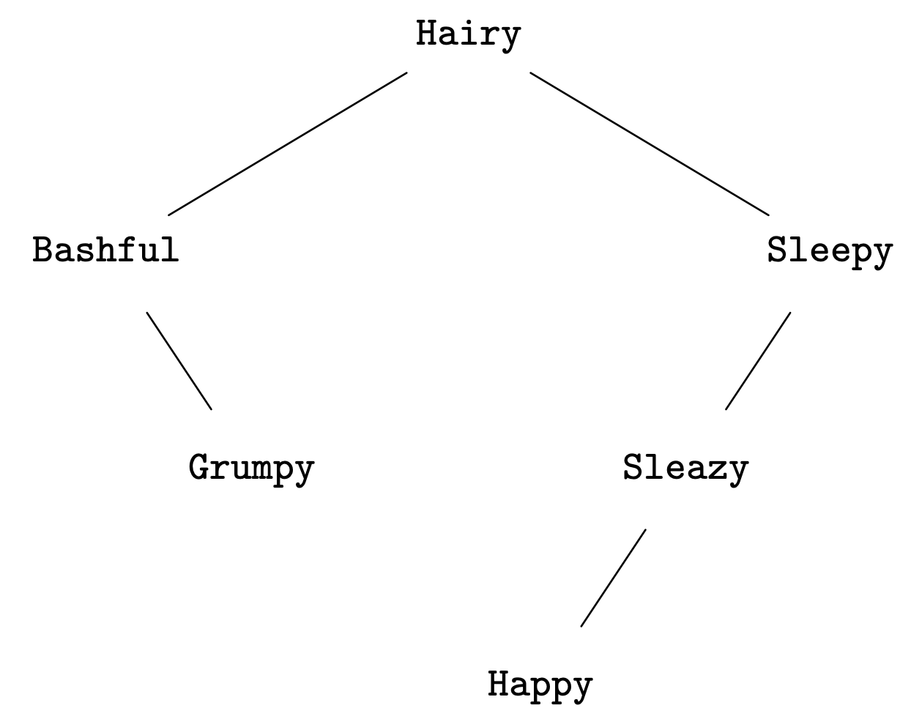
Binary search trees
Not just numbers

Slide 21
Binary search trees
Must hold at every level of the tree
5
8
4
7
7
10
8
3
9
3

Slide 22


Common operations
Lookup
10
9?
12?
7
11
3
9

Slide 23
Common operations
Insert
10
10
7
7
11
11
3
9
3
9
8

Slide 24
Algorithms for BST operations
Insertion
Recursive algorithm
insert(x, root node T)
If tree T consists of a single node v, make x the left child if < T and right child if > T
Otherwise, if x < v call insert(x, T->left), otherwise call insert(x, T->right)

Slide 25
Common operations
Delete
5
5
4
4
7
7
3
8
3

Slide 26
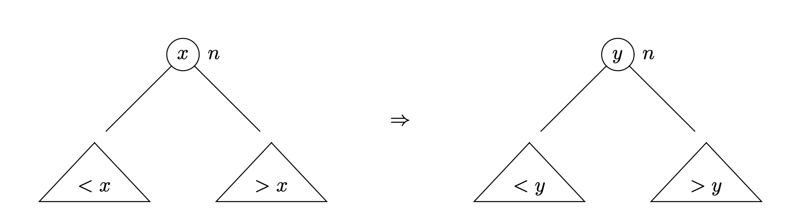
Deletion: one algorithm
If x is a leaf node, remove it
To delete internal node x, find the smallest element of the right subtree, y. Move y into the position where x was originally.
10
7
11
3
9
8

Slide 27
Running time
How long do inserts, lookups, and deletions take?
Introduce a measure of tree size/balance: height
Height of tree T is the maximum number of edges that must be traversed to go from the root to any other node in the tree

Slide 28
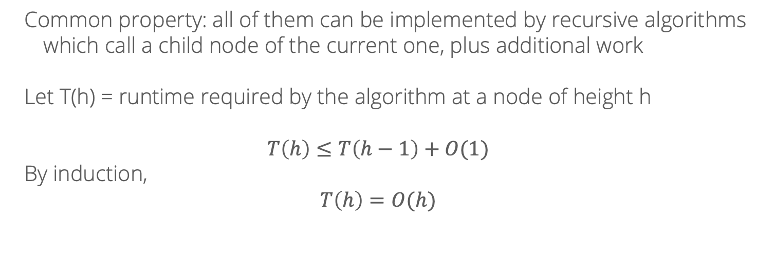
Running time
How long do inserts, lookups, and deletions take?
Common property: all of them can be implemented by recursive algorithms which call a child node of the current one, plus additional work
Let T(h) = runtime required by the algorithm at a node of height h
$$T\left(h\right)≤T\left(h−1\right)+O(1)$$
By induction,
$$T\left(h\right)=O(h)$$

Slide 29
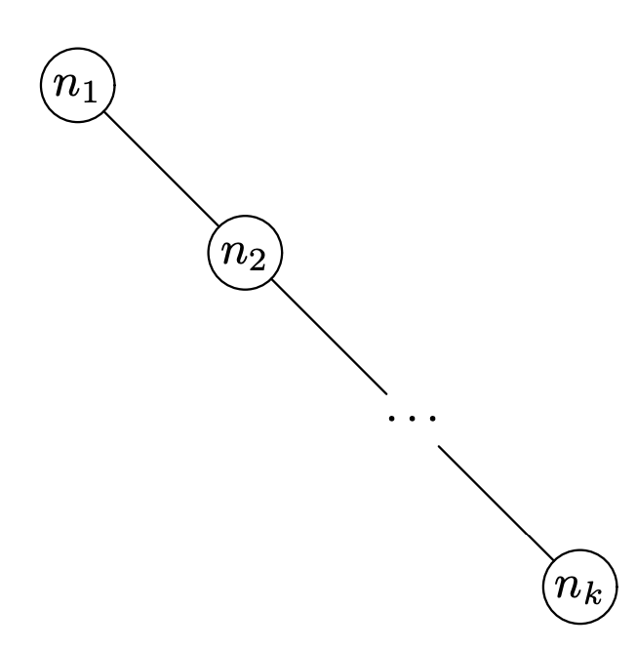
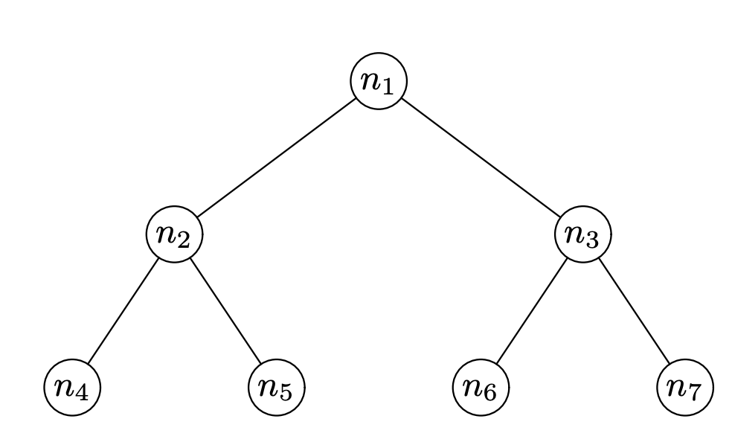


Running time
How tall can binary trees be?
Worst case, for $n$ notes, $O(n)$
Best case, for $n$ notes, $O(\log{n})$

Slide 30
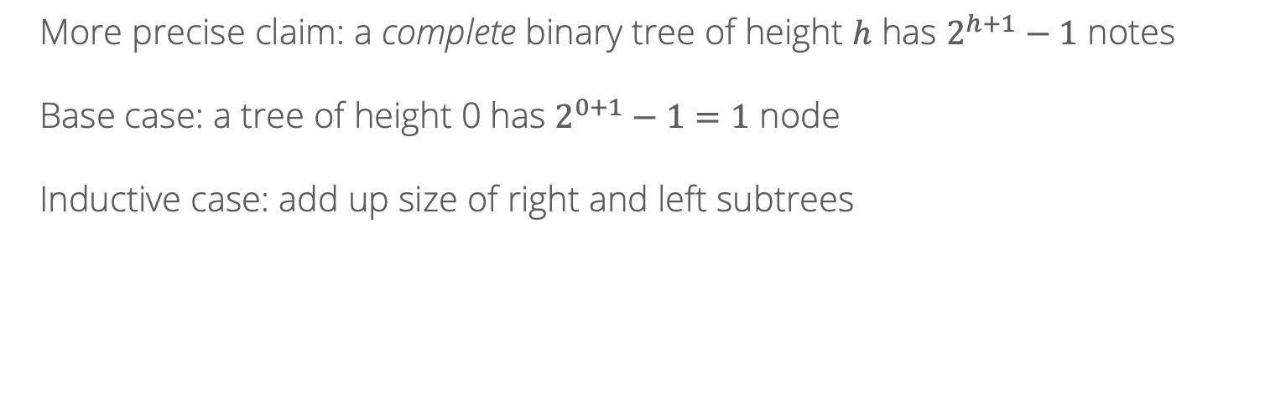
Running time
More precise claim: a complete binary tree of height $h$ has $2^{h+1}−1$ notes
Base case: a tree of height 0 has $2^{0+1}−1=1$ node
Inductive case: add up size of right and left subtrees

Slide 31
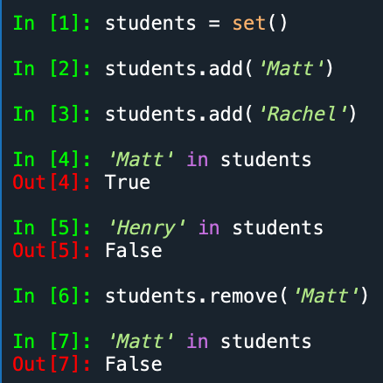
Sets
Common use case for a BST: implement a set data structure

Slide 32
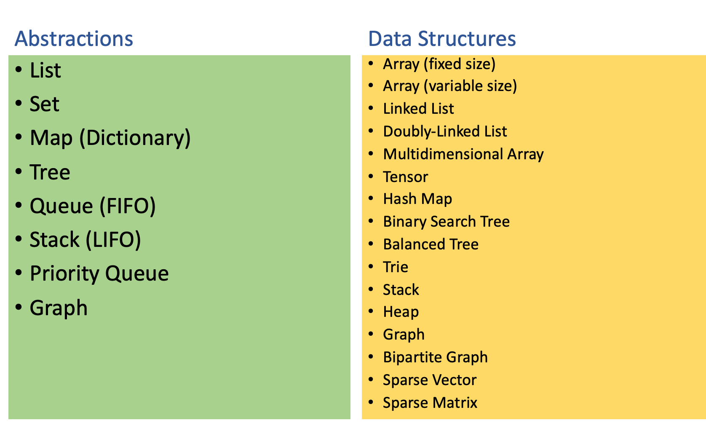
Abstractions vs. Data Structures

Slide 33
Lists
Lists are an abstract data type which implement an ordered collection of items via three operations:
Insert at position i
Access item at position i
Delete item at position i
Today: two different implementations of a list:
Arrays
Linked lists

Slide 34
Arrays
Implement a list via contiguous block of memory
10 | -5 | 2 | 4 | 5
Index 0:
Memory address
N: end of current list
MAX: total memory allocation

Slide 35
Arrays: access
To access at position i: if i < MAX, look up (memory address 0) + i*(size of data type)
Runtime: O(1)
10 | -5 | 2 | 4 | 5
Index 0:
Memory address
N: end of current list
MAX: total memory allocation

Slide 36
Arrays: insert
Append to end: O(1)
A[N] = value; N += 1
Insert in middle: O(N)
10 | -5 | 2 | 4 | 5 | New
Index 0:
Memory address
Increment N
MAX: total memory allocation

Slide 37
Arrays: delete
Delete last value: O(1)
N -= 1
Delete in middle: O(N)
10 | -5 | 2 | 4 | 5 | New
Index 0:
Memory address
Decrement N
MAX: total memory allocation

Slide 38
Linked list
Value: 5 | Pointer
Value: -1 | Pointer
Value: 3 | Pointer: NULL
head
class LLElement:
int value
LLElement next = None

Slide 39
Linked list
Value: 5 | Pointer
Value: -1 | Pointer
Value: 3 | Pointer: NULL
head
Access: O(N)
Insert: O(N) at an index…but O(1) if you have the pointer already
Delete: O(N)
But can we improve? (Double linked list)

Slide 40
Heaps
Lists aren’t the only thing we can do with arrays!
Example of a very different abstract data type, implemented also using an array: heap
Heaps represent something in between sorted and unsorted data…
Not fully sorted (so cheaper to maintain)
But, easier to search through than an unsorted array

Slide 41
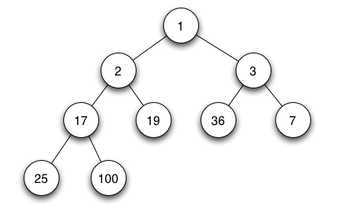
Min/max heap
Images from https://en.wikipedia.org/wiki/Binary_heap
Always maintain a complete/balanced tree! Height log(n)

Slide 42
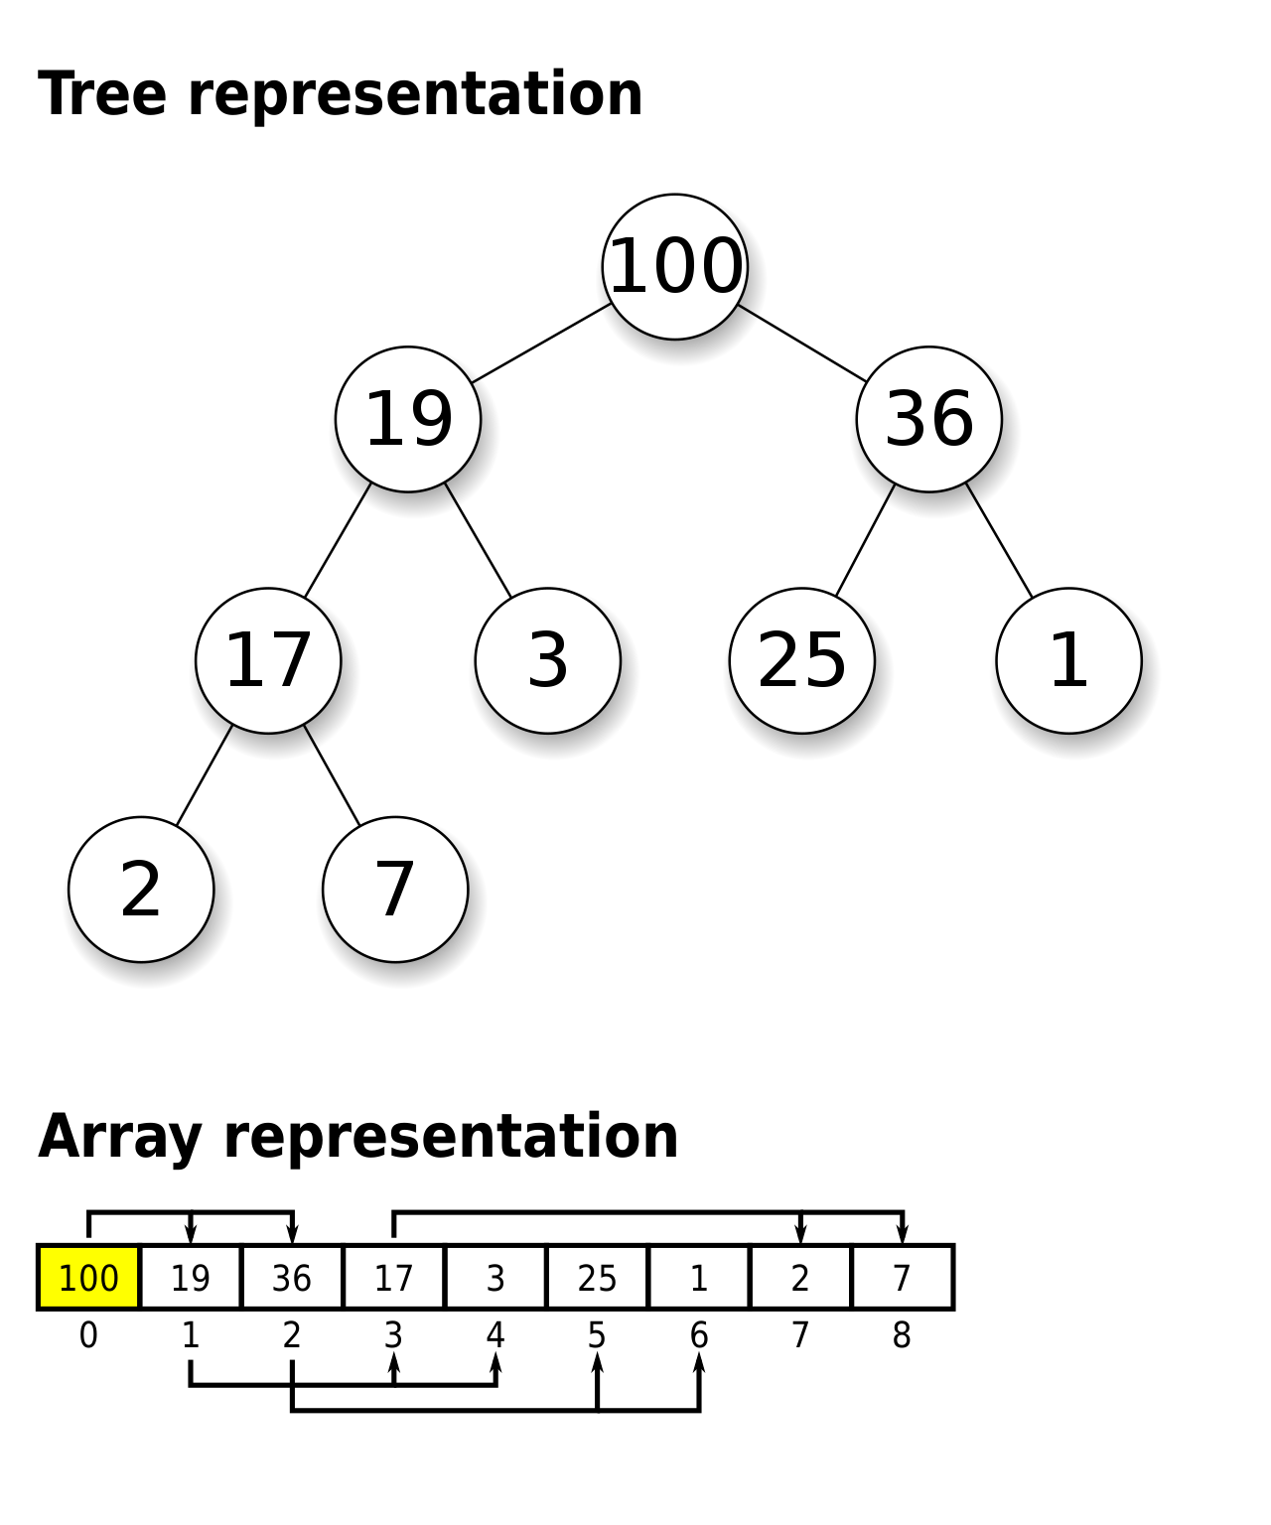
Max heap
Implemented with an array
Node i has children in spots 2i+1 and 2i+2
Enforces balanced tree by design

Slide 43
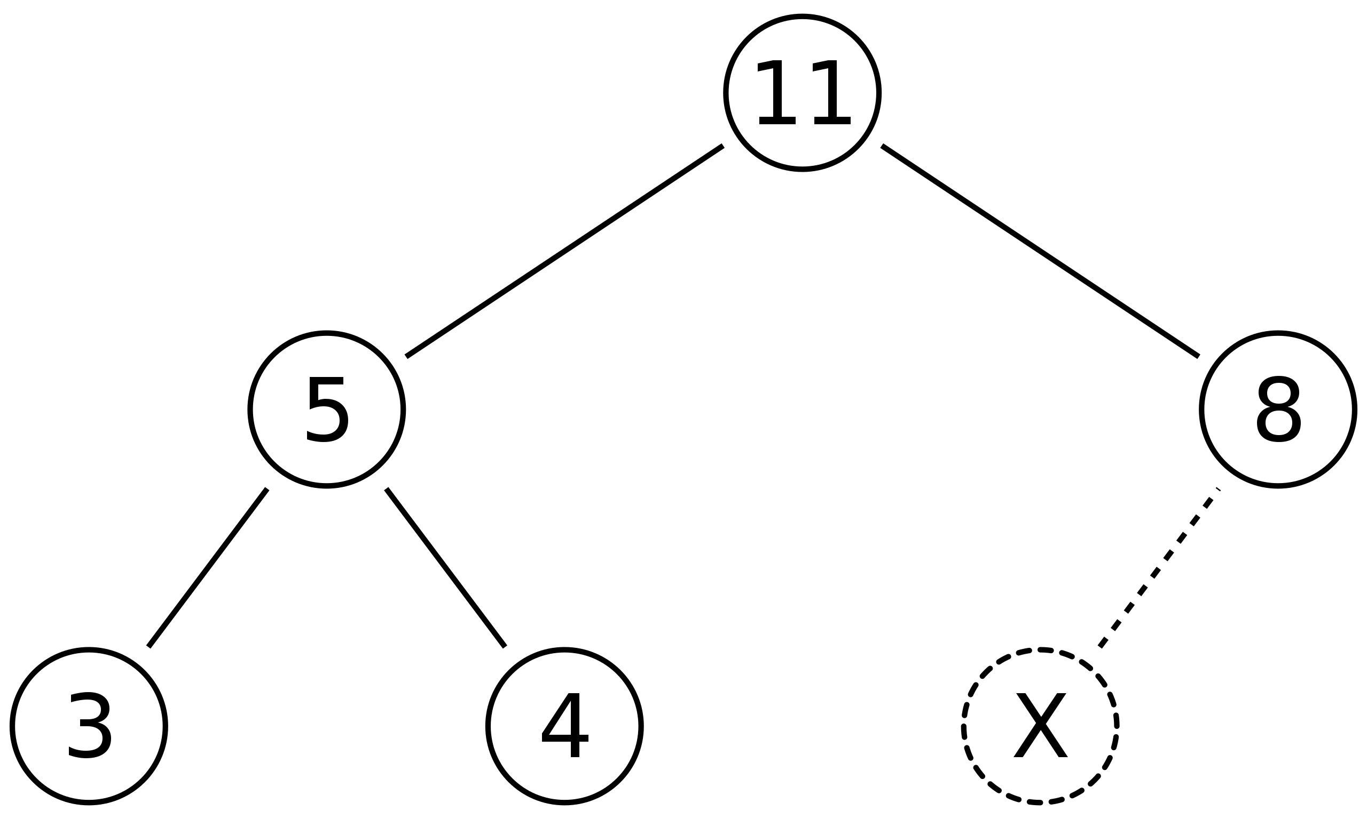
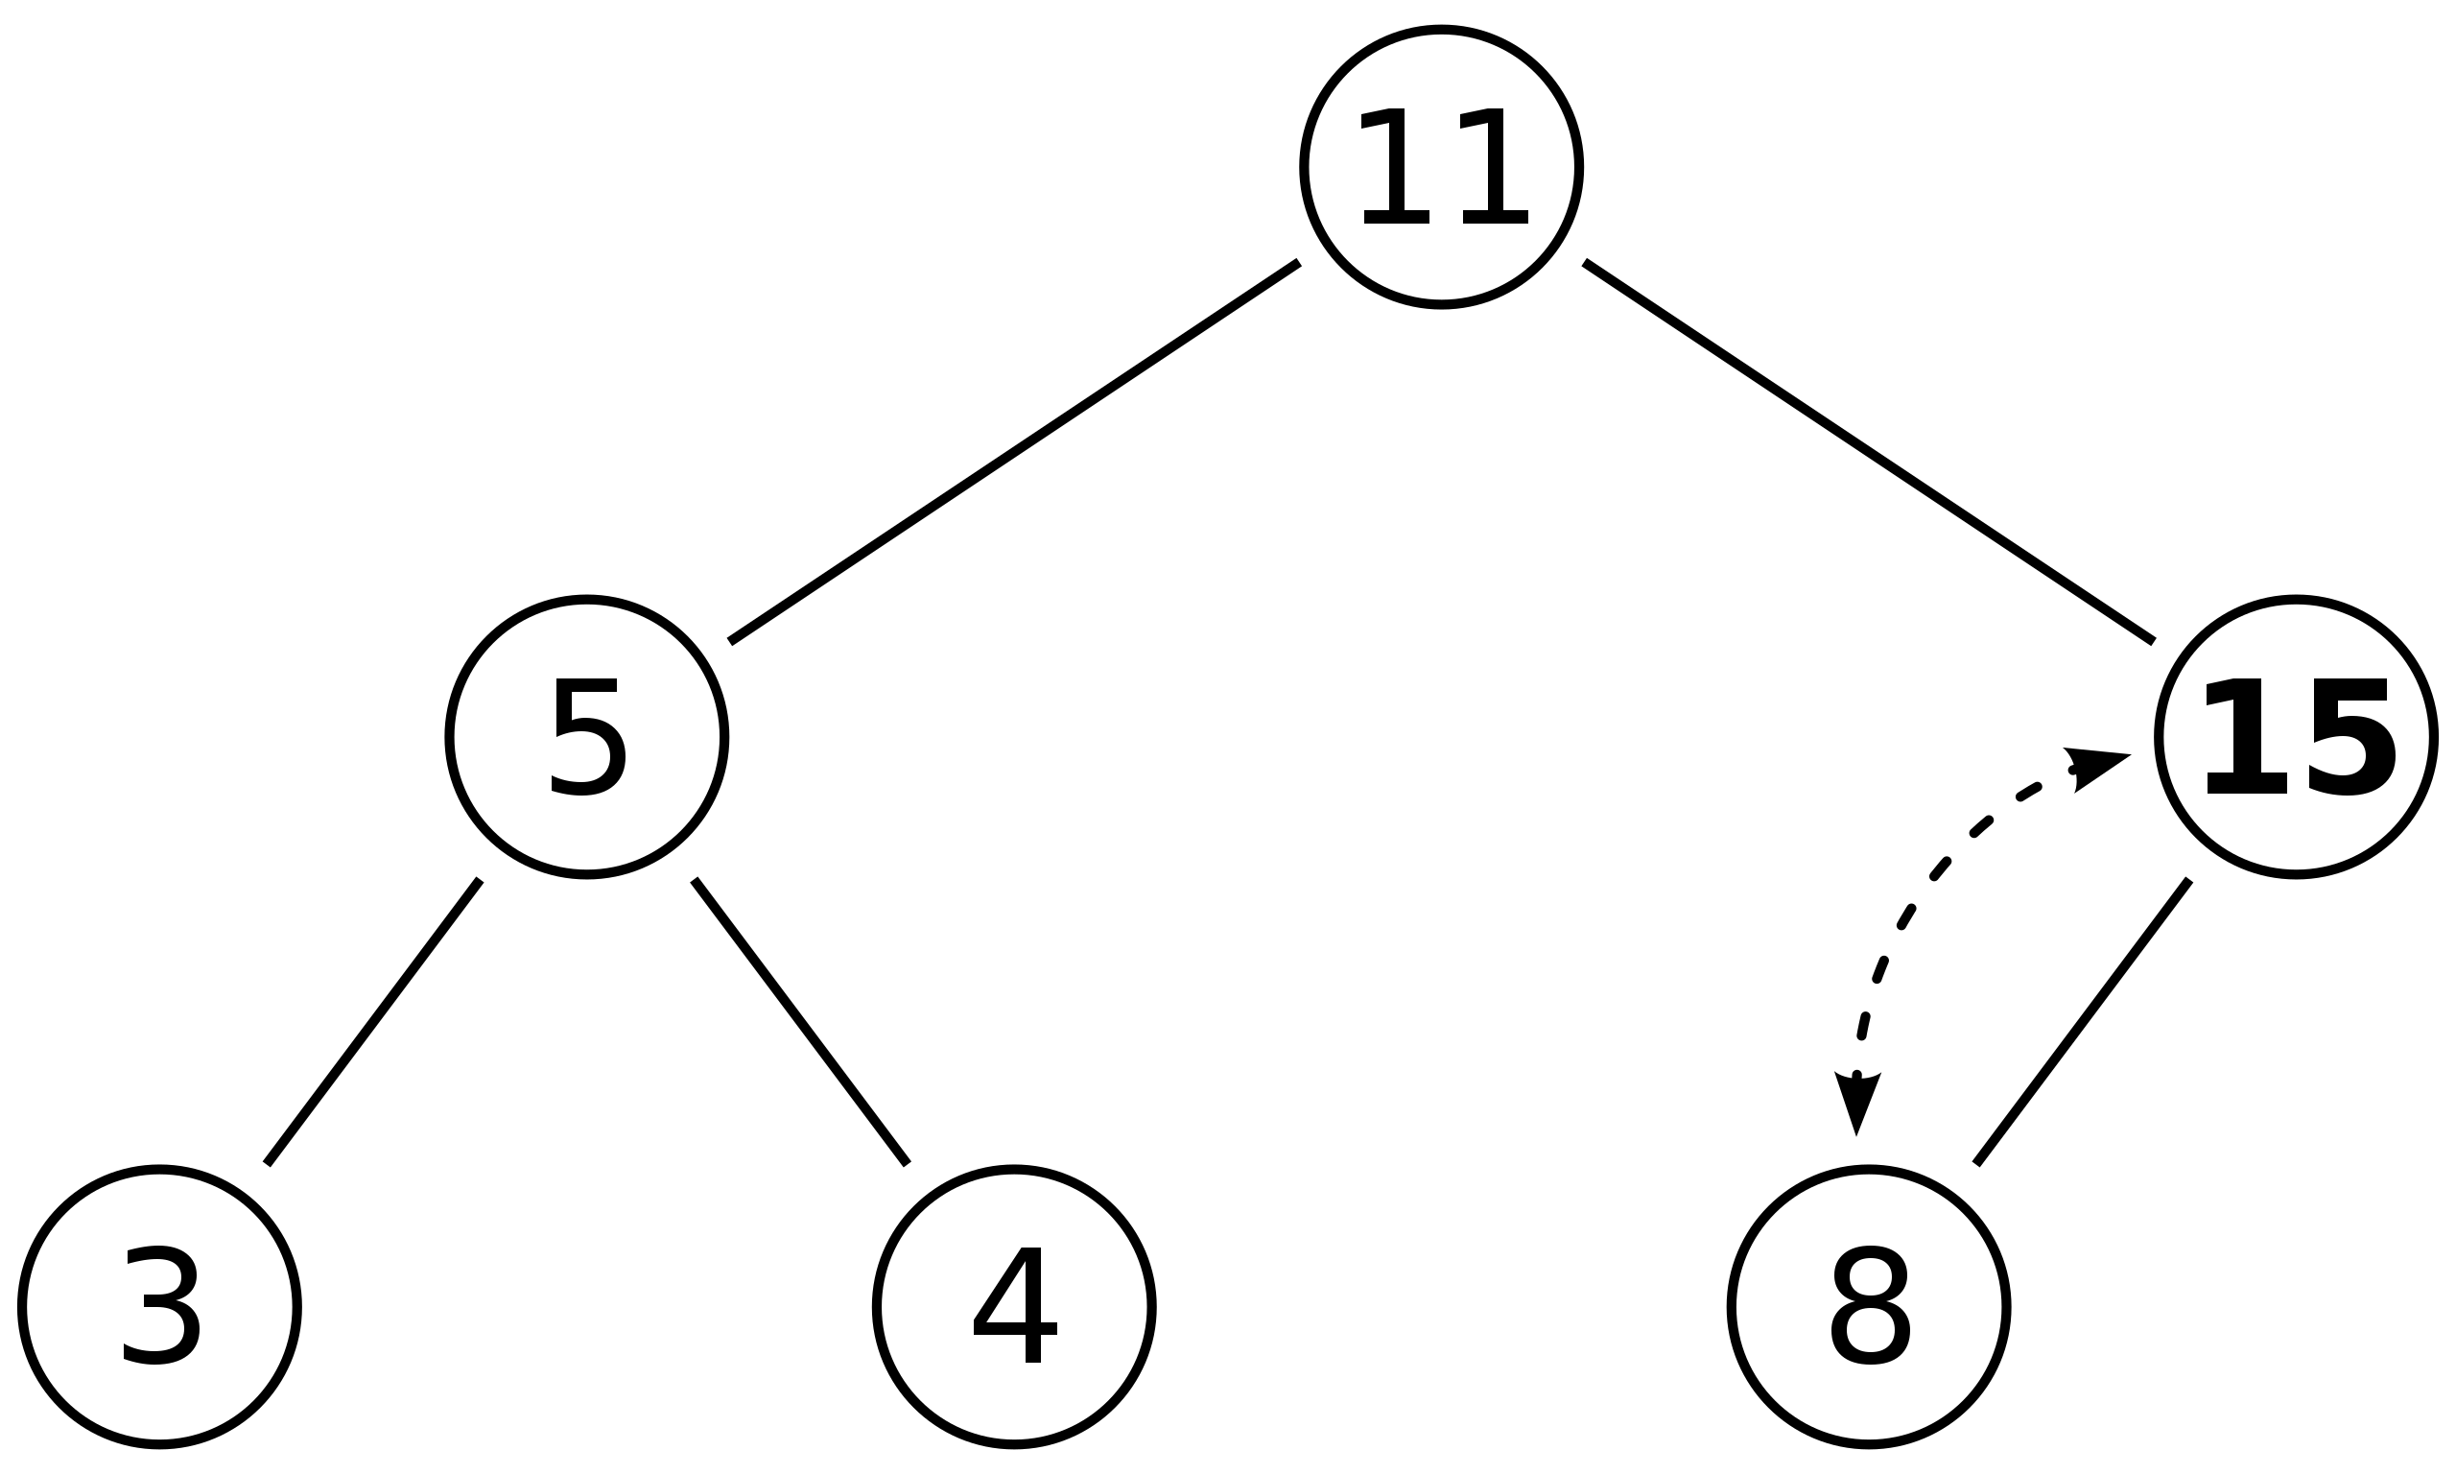
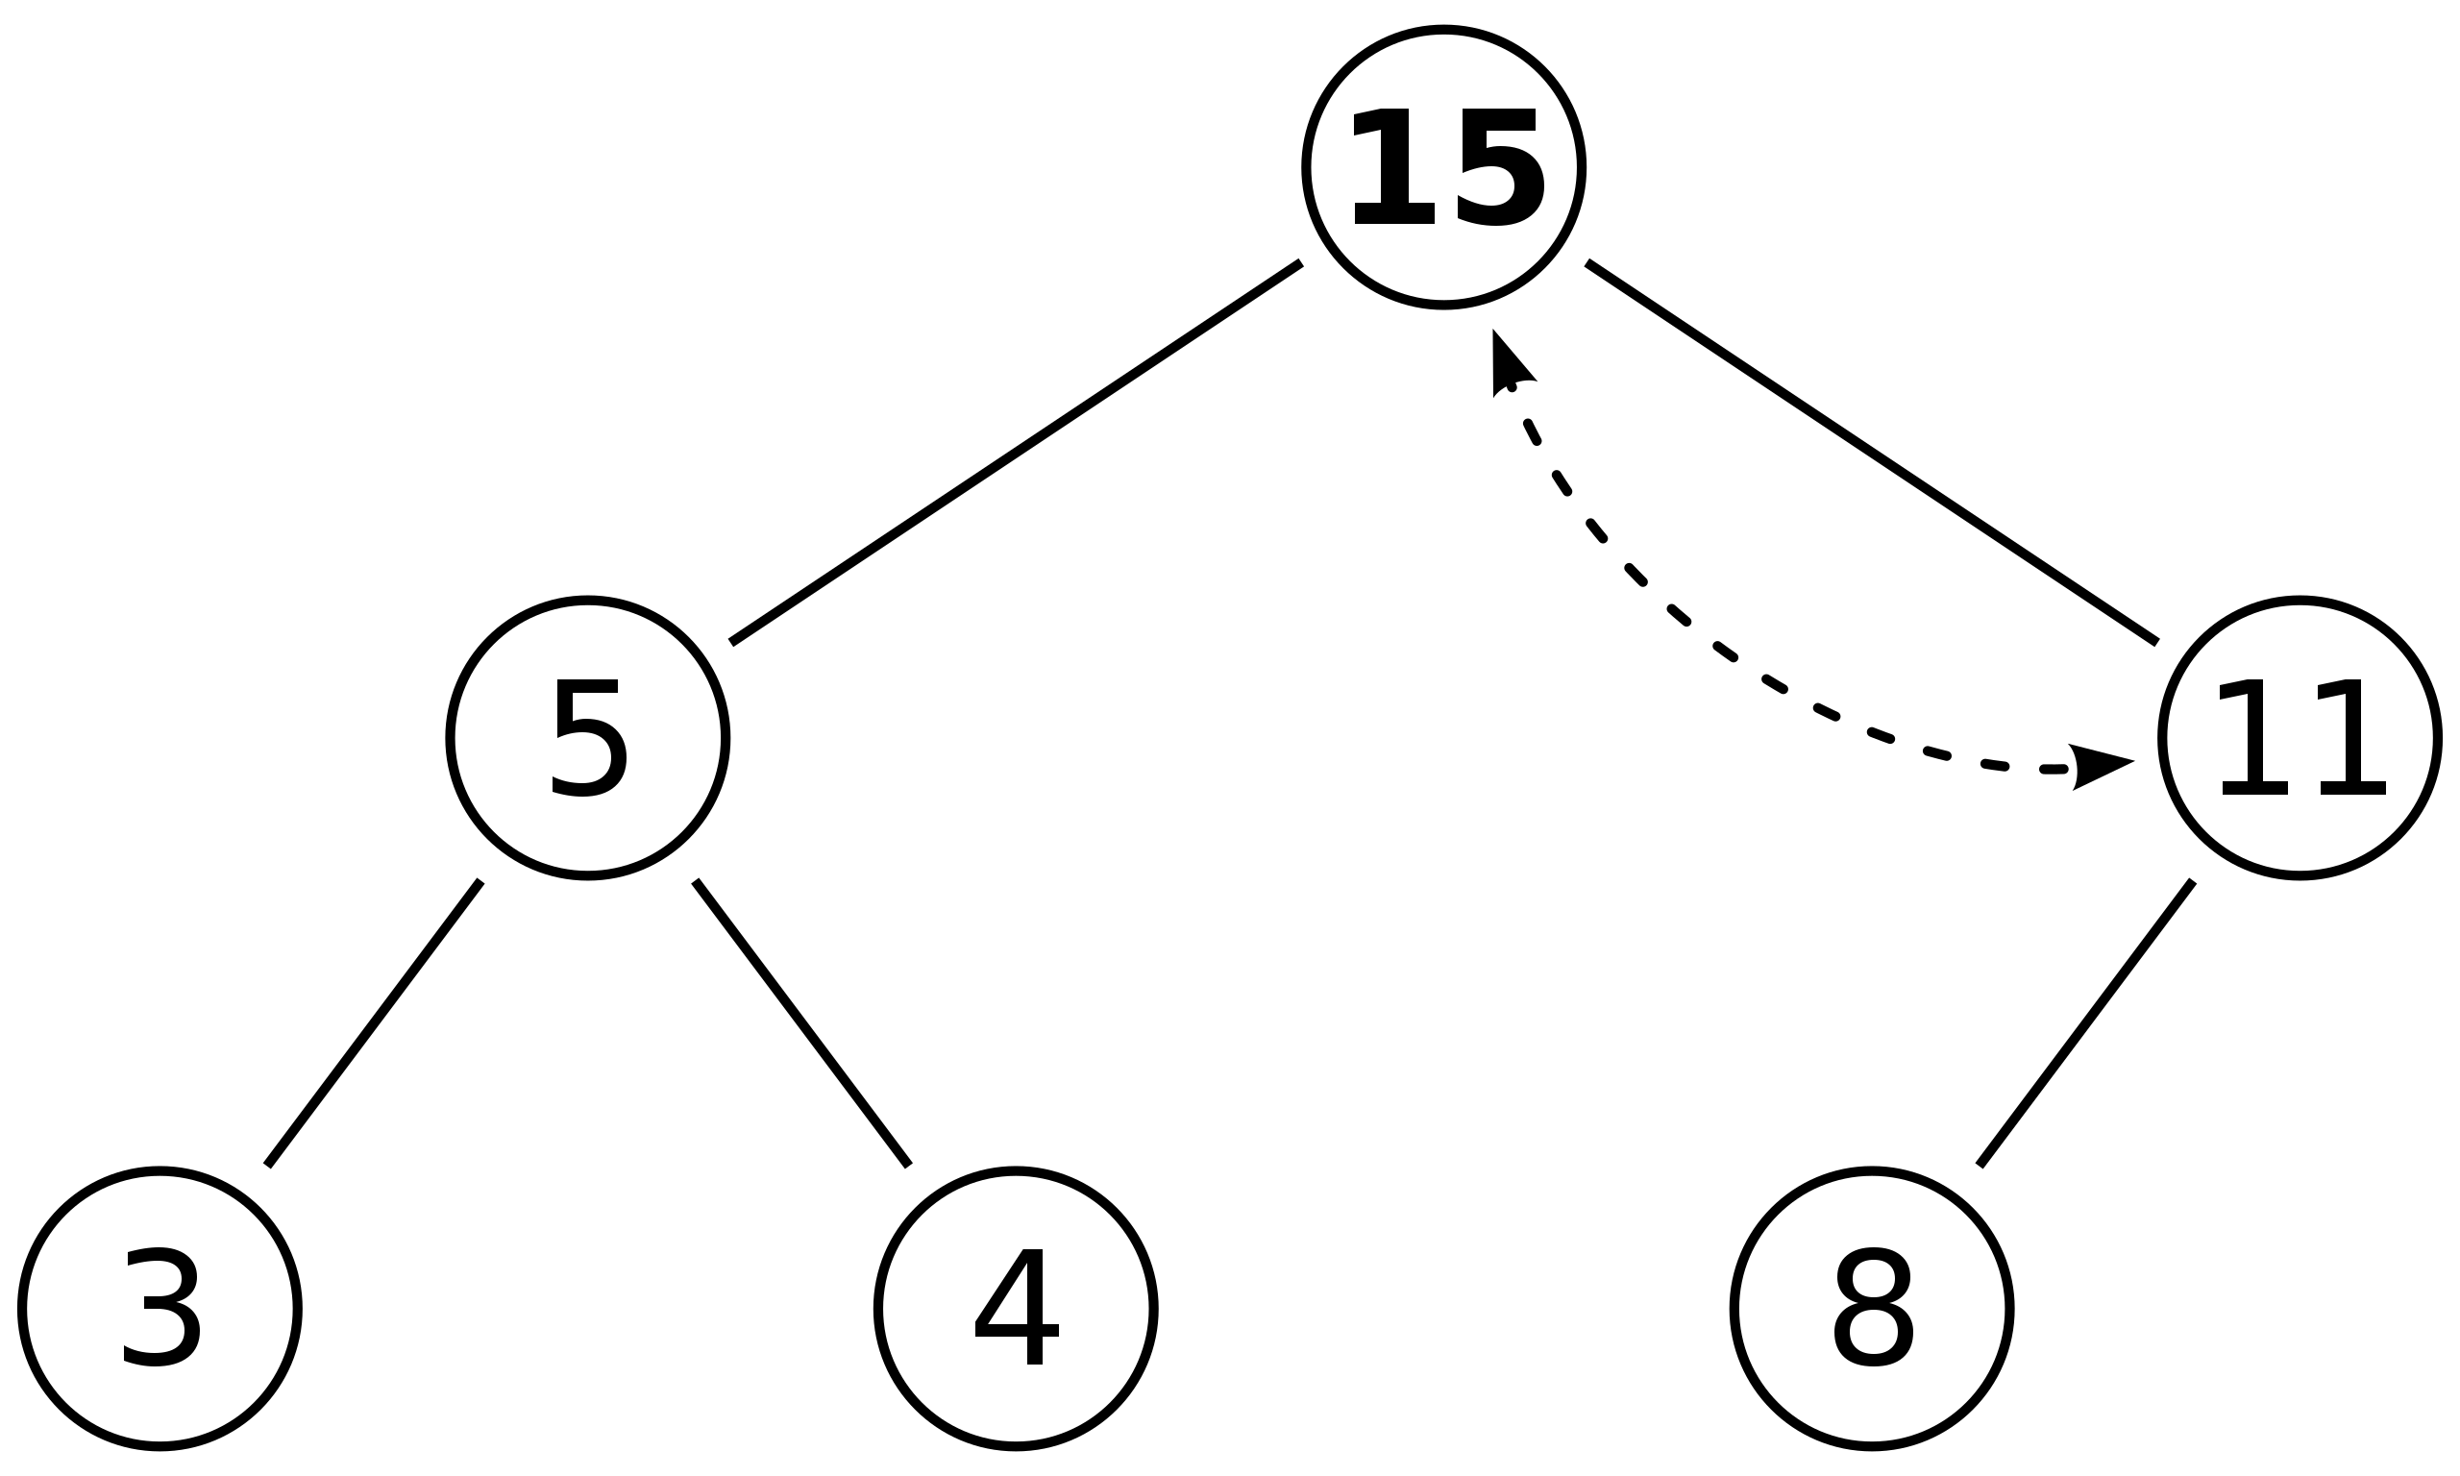
Insert: bubble up
Insert 15 in spot marked “X”
Worst case time O(log n)

Slide 44
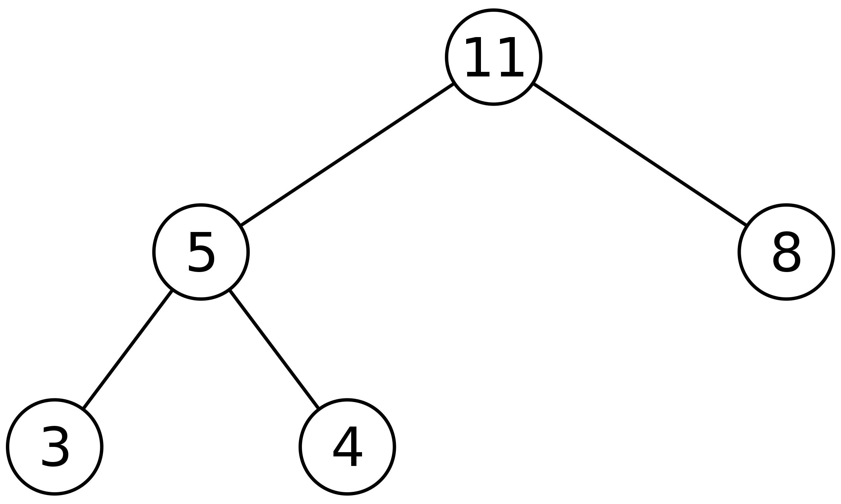
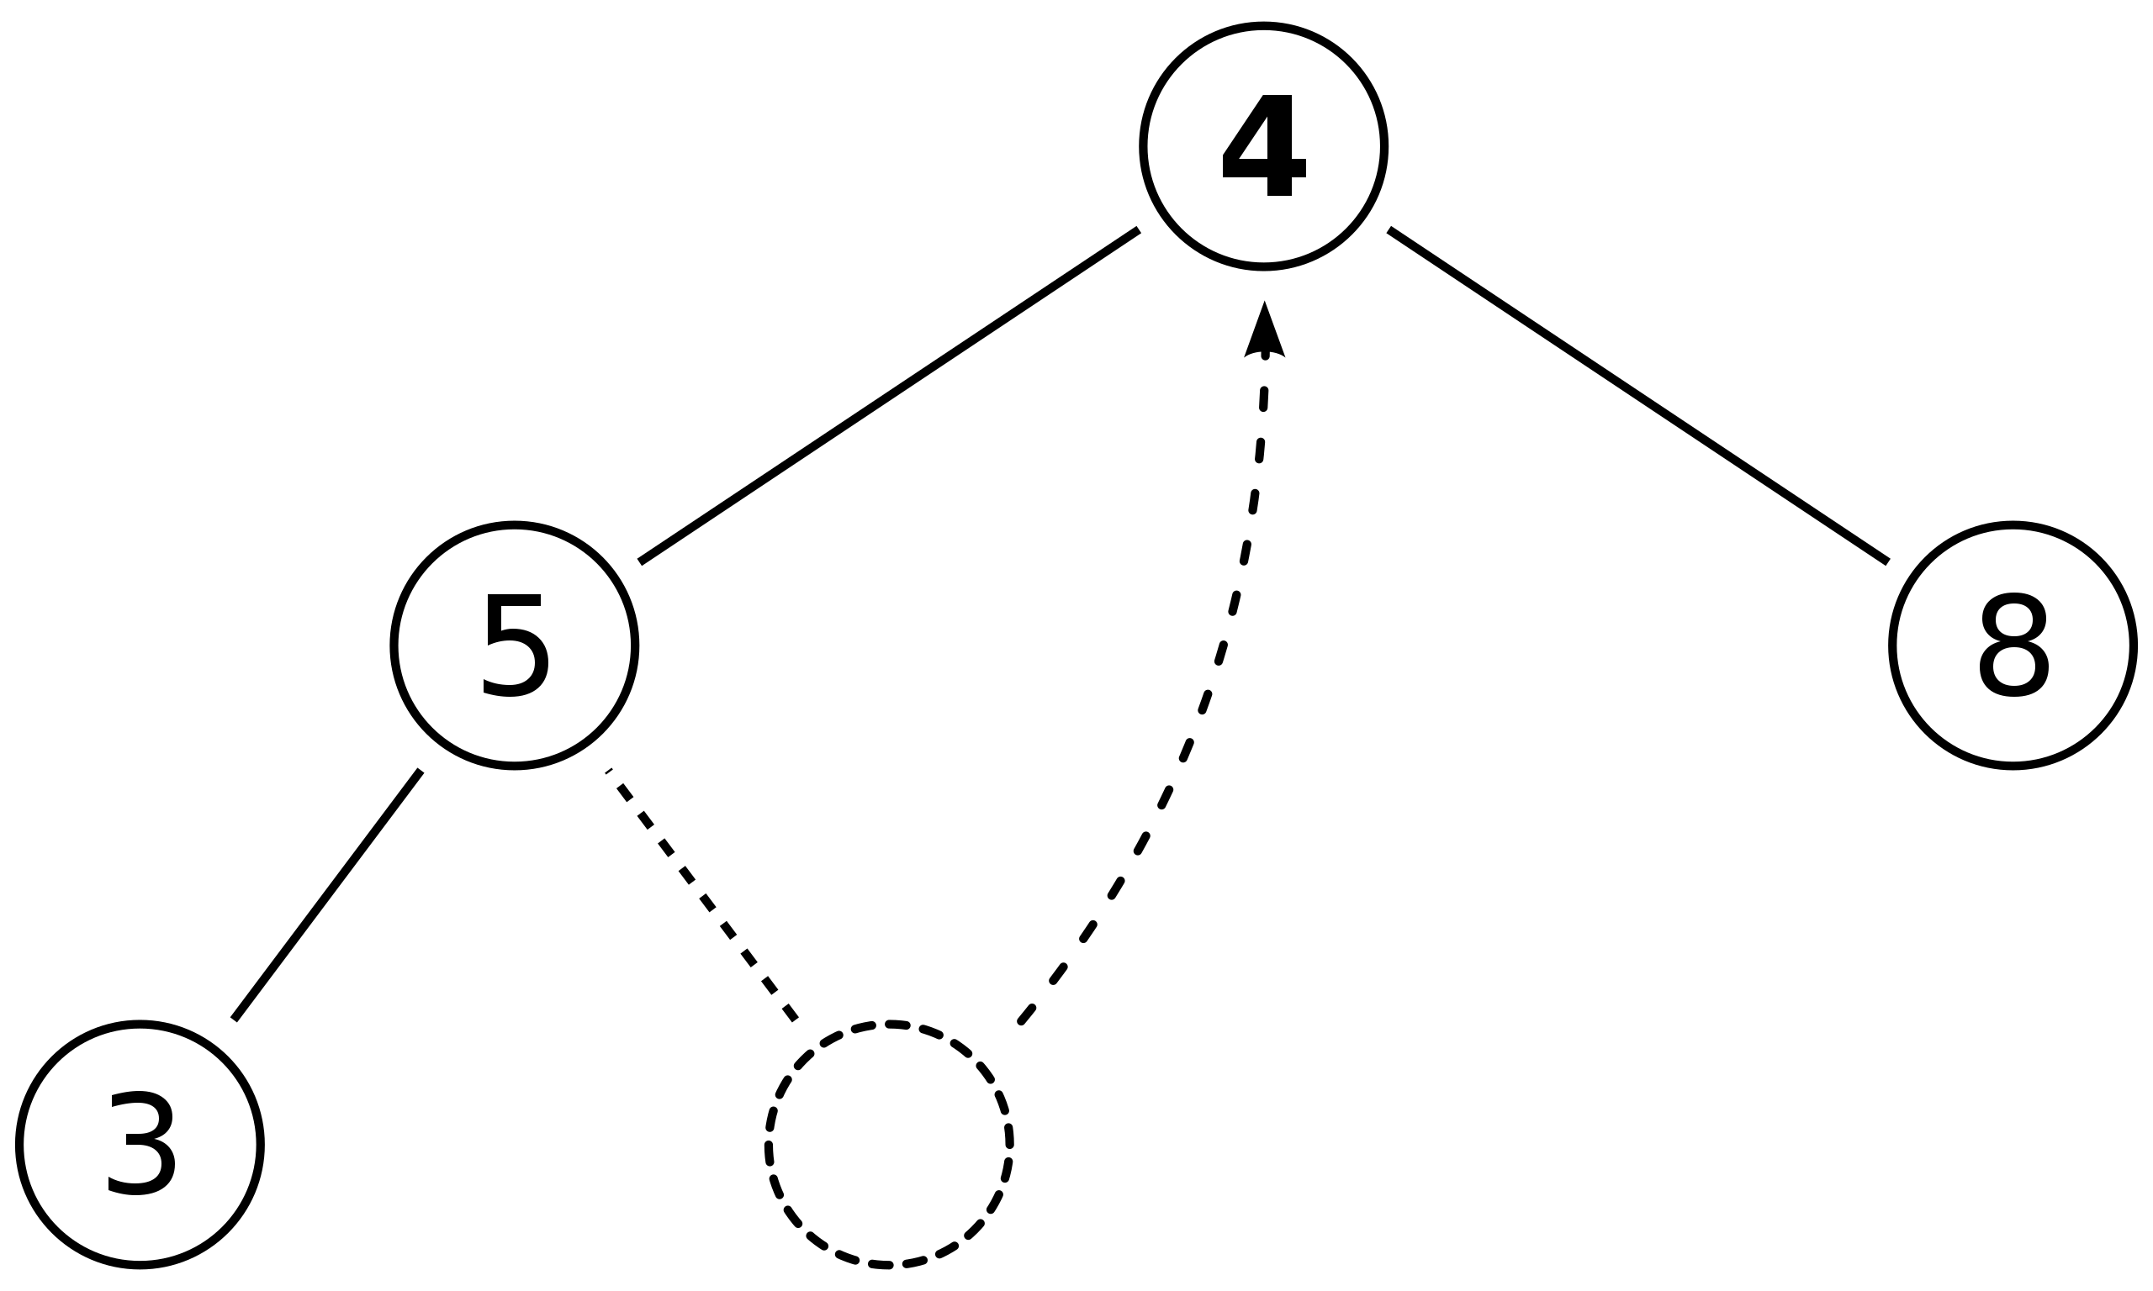
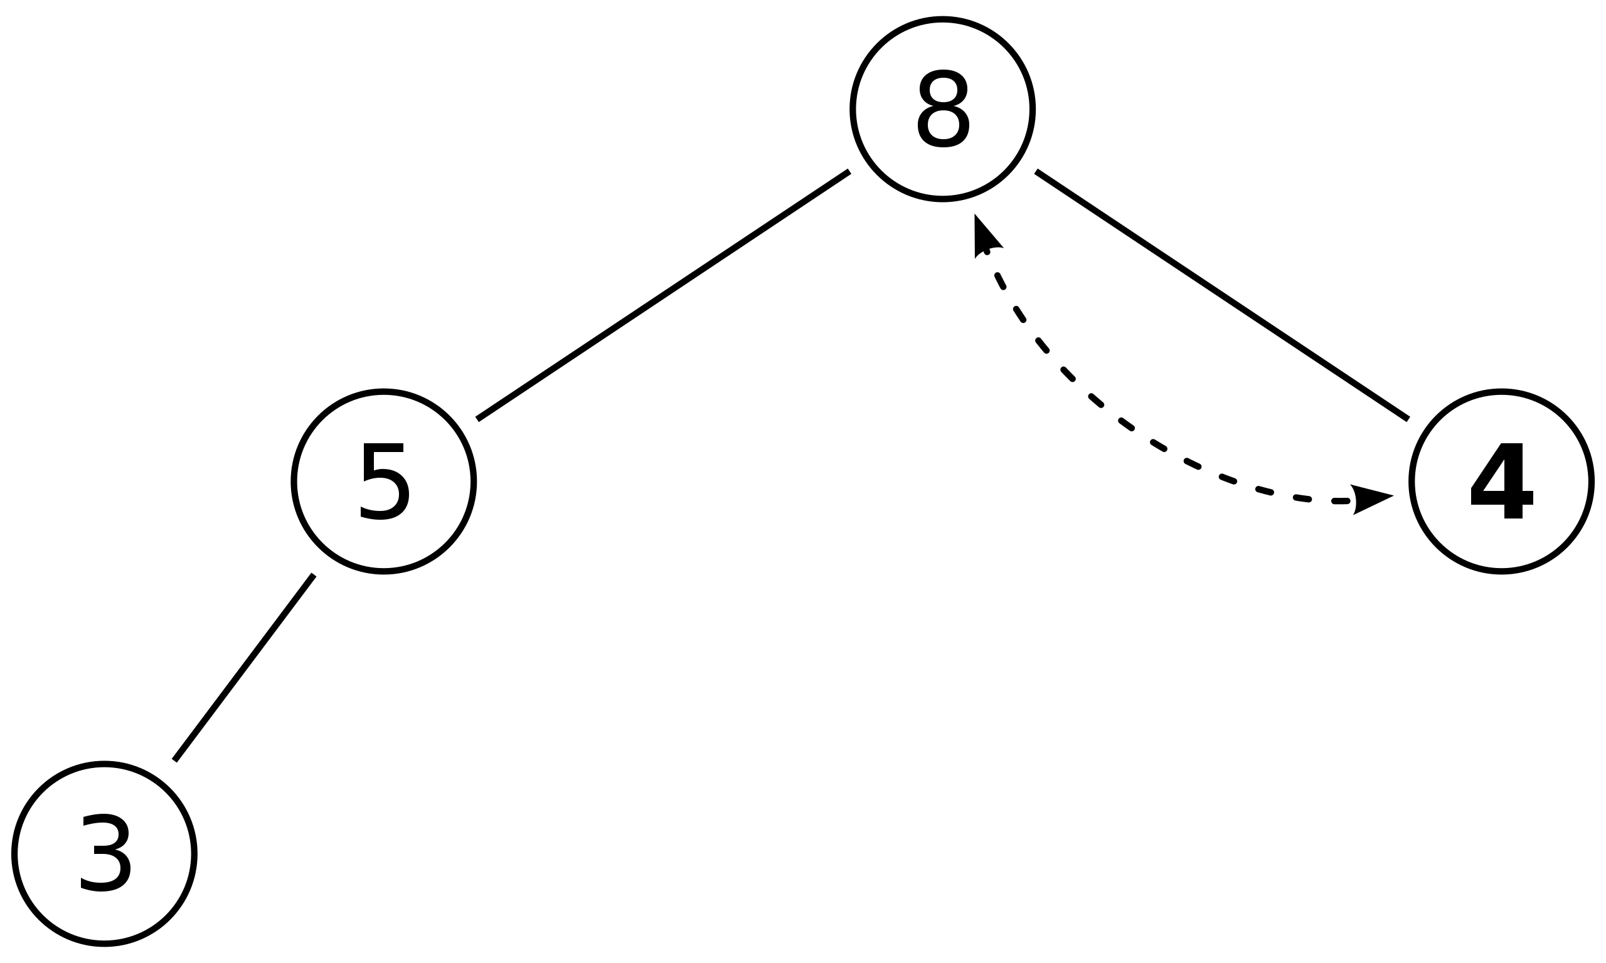
Extract: bubble down
Remove the root node and return it
Replace the root with the last node (last array element)
Move that element into position
Worst case time O(log n)

Slide 45
Uses of heaps: priority queue
Imagine a list of tasks with different priorities
You want to be able to do two things:
Add a new task with a given priority
Find and remove the top priority task
Implementation: heap

Slide 46
Uses of heaps: heapsort
Given an array of numbers
Turn it into a heap (time O(n log n), improvable to O(n))
Repeatedly remove the root of the heap and swap it with the last element of the heap

