Slide 1
Computational Foundations for ML (10-607):
Proof Techniques: induction
Bryan Wilder
* Slides borrowed from prior offerings of the course by Professors M. Gormley, P. Virtue, & G. Gordon.

Slide 2
Proof by induction
Today: a technique called proof by induction
Used to establish properties that hold over an entire sequence of inputs
Example: For every n ∈ N, 1+2+... +n = n(n+1)/2.
This is a statement that needs to be proved for every value of n

Slide 3
Proof by Induction
The basic principle: let P(n) be a statement for n ∈ N such that
P(n) is true for n = 1.
P(m) is true implies that P(m + 1) is true.
Then P(n) is true for all n ∈ N.

Slide 4
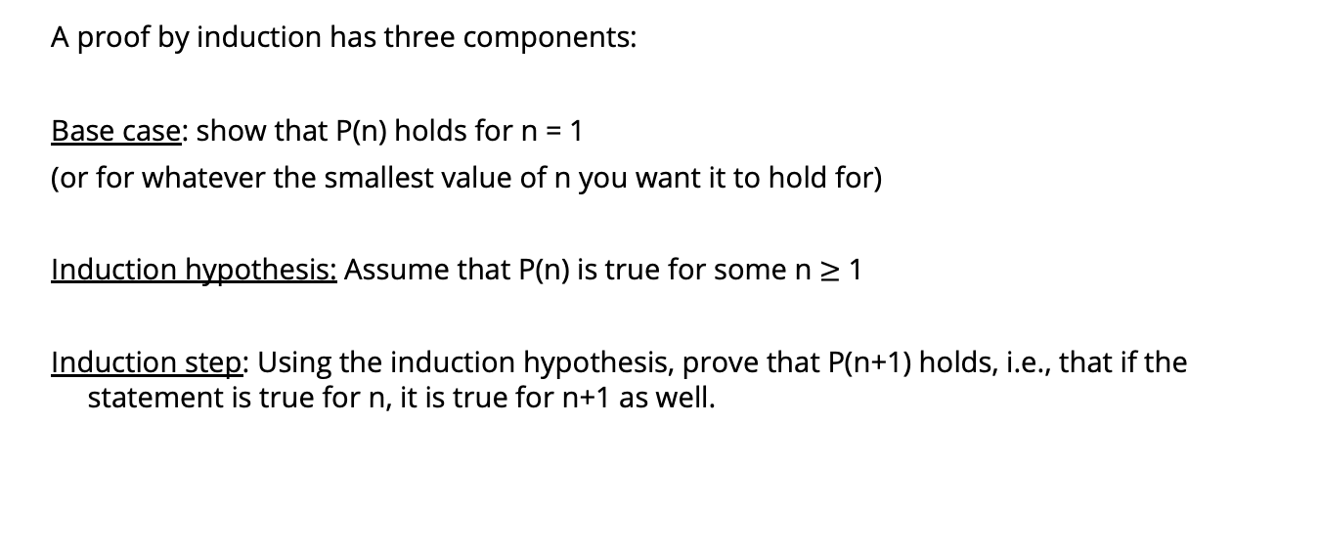
Proof by induction
A proof by induction has three components:
Base case: show that P(n) holds for n = 1
(or for whatever the smallest value of n you want it to hold for)
Induction hypothesis: Assume that P(n) is true for some n $≥$ 1
Induction step: Using the induction hypothesis, prove that P(n+1) holds, i.e., that if the statement is true for n, it is true for n+1 as well.

Slide 5
Example
Example: For every n ∈ N, 1+2+... +n = n(n+1)/2.

Slide 6
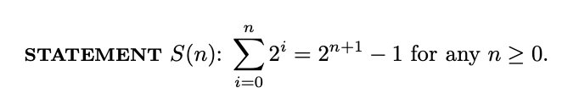
Example
Notes:
See 2.3 of http://infolab.stanford.edu/~ullman/focs/ch02.pdf

Slide 7
Example
Fibonacci numbers are defined by f₀ = 0, f₁ = f₂ = 1 and the recursion relation
f_{n+1} = f_{n} + f_{n−1} for all n ≥ 1.
Exercise: Show that f₁ + f₃ + f₅ + . . . + f_{2n−1} = f_{2n} for all n ≥ 1.
Exercise: Show that f_{n+1} < (7/4)^{n} for all n ≥ 1.

Slide 8
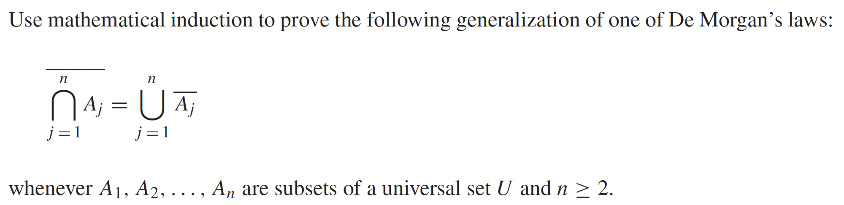
Example
Notes:
Rosen 5.1 example 11

Slide 9
Where’s the mistake?
Theorem. All horses are the same color.
Proof. We’ll induct on the number of horses.
Base case: 1 horse. Clearly with just 1 horse, all horses have the same color.
Now, for the inductive step: we’ll show that if it is true for any group of N horses, that all have the same color, then it is true for any group of N+1 horses.
Given any set of N+1 horses, if you exclude the last horse, you get a set of N horses. By the inductive step these N horses all have the same color. But by excluding the first horse in the pack of N+1 horses, you can conclude that the last N horses also have the same color. Therefore all N+1 horses have the same color..
https://math.hmc.edu/funfacts/all-horses-are-the-same-color/

Slide 10
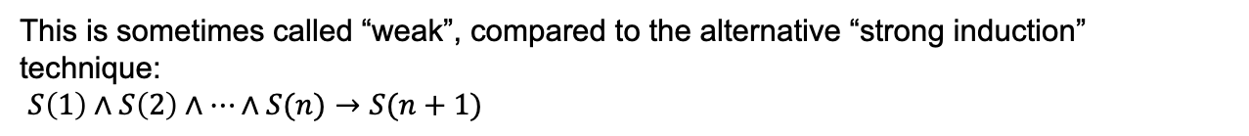
Strong induction
The format we’ve seen so far: argue that if a statement holds for $n$, it must hold for $n+1$: $S\left(n\right)→S(n+1)$
This is sometimes called “weak”, compared to the alternative “strong induction” technique:
$S\left(1\right)∧S\left(2\right)∧…∧S(n)→S(n+1)$

Slide 11
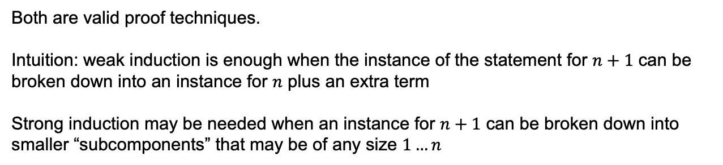
Strong vs Weak Induction
Weak induction: use $S\left(n\right)$ to prove $S(n+1)$
Strong induction: use $S\left(1\right)…S(n)$ to prove $S(n+1)$
Both are valid proof techniques.
Intuition: weak induction is enough when the instance of the statement for $n+1$ can be broken down into an instance for $n$ plus an extra term
Strong induction may be needed when an instance for $n+1$ can be broken down into smaller “subcomponents” that may be of any size $1…n$

Slide 12
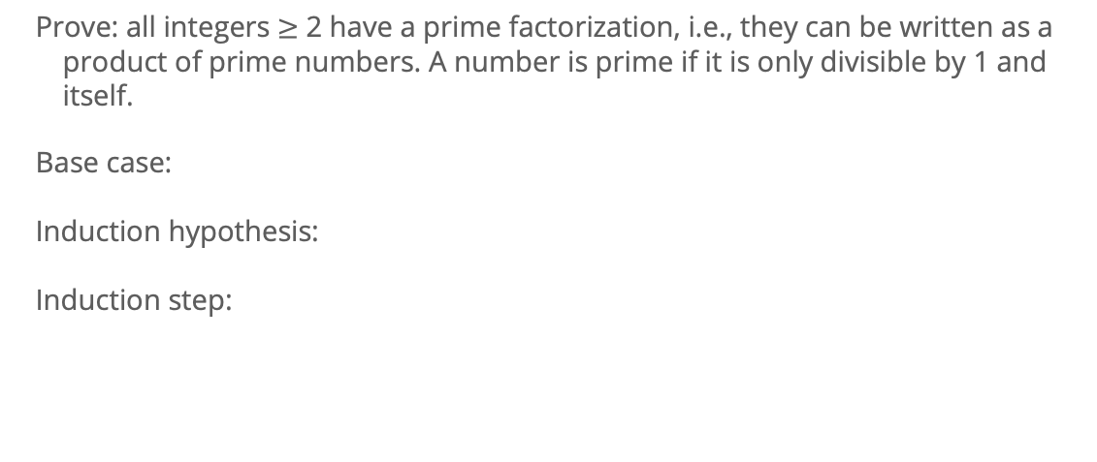
Example of strong induction
Prove: all integers $≥$ 2 have a prime factorization, i.e., they can be written as a product of prime numbers. A number is prime if it is only divisible by 1 and itself.
Base case:
Induction hypothesis:
Induction step:

Slide 13
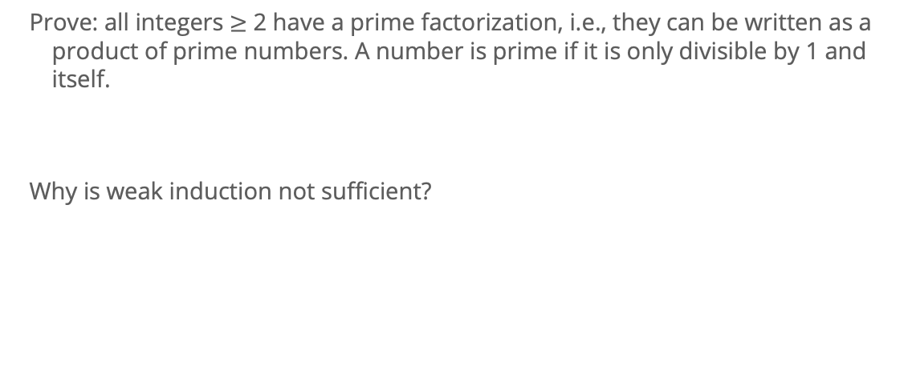
Example of strong induction
Prove: all integers $≥$ 2 have a prime factorization, i.e., they can be written as a product of prime numbers. A number is prime if it is only divisible by 1 and itself.
Why is weak induction not sufficient?

Slide 14
Strong induction example #2
Consider a game in which two players take turns removing any positive number of matches they want from one of two piles of matches. The player who removes the last match wins the game. Show that if the two piles contain the same number of matches initially, the second player can always guarantee a win.
Notes:
Rosen 5.2, Example 3

Slide 15
Show that any integer amount ≥ 60 cents can be changed using 6-cent and 11-cent coins. Equivalently, any integer n ≥ 60 can be expressed as n = 6a + 11b, where a and b are nonnegative integers.
Do we need strong induction? Is weak sufficient?
Notes:
Let P(n) denote the proposition that an amount of n cents can be changed using 6-cent and 11-cent coins. In other words, P(n): n = 6a + 11b where a, b are nonnegative integers. Base Step: For n = 60, 60 = 6 (10) + 11 (0). Thus, P(60) is true. Induction Step: We assume P(n) (for n ≥ 60) and consider how to extend P(n) to P(n+1). If P(n) uses at least one 11-cent coin, then replace one 11-cent coin with two 6-cent coins. On the other hand, if P(n) does not use any 11-cent coins, then because n ≥ 60, P(n) must use at least nine 6-cent coins. In this case, replace nine 6-cent coins with five 11-cent coins.
http://faculty.kfupm.edu.sa/ics/darwish/stuff/induction_handout.pdf

