Slide 1
Computational Foundations for ML (10-607):
Data types: heaps, stacks, queues
Bryan Wilder
* Slides borrowed from prior offerings by Professors H. Heidari, M. Gormley, P. Virtue, & G. Gordon.

Slide 2
Heaps
Lists aren’t the only thing we can do with arrays!
Example of a very different abstract data type, implemented also using an array: heap
Heaps represent something in between sorted and unsorted data…
Not fully sorted (so cheaper to maintain)
But, easier to search through than an unsorted array

Slide 3
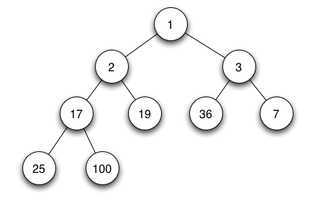
Min/max heap
Images from https://en.wikipedia.org/wiki/Binary_heap
Always maintain a complete/balanced tree! Height log(n)

Slide 4
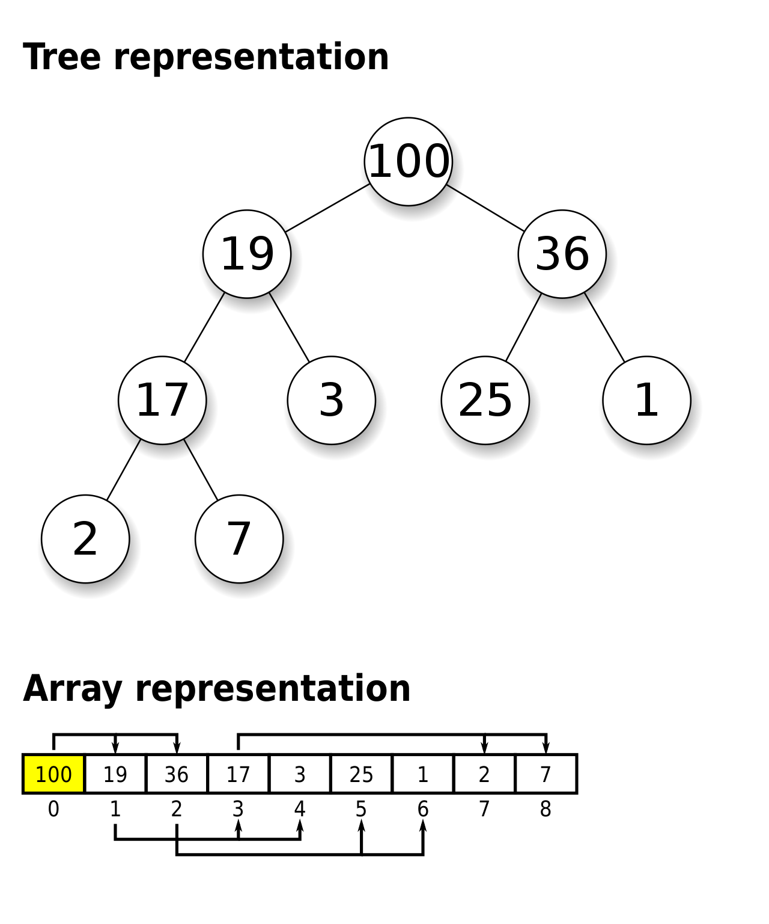
Max heap
Implemented with an array
Node i has children in spots 2i+1 and 2i+2
Enforces balanced tree by design

Slide 5
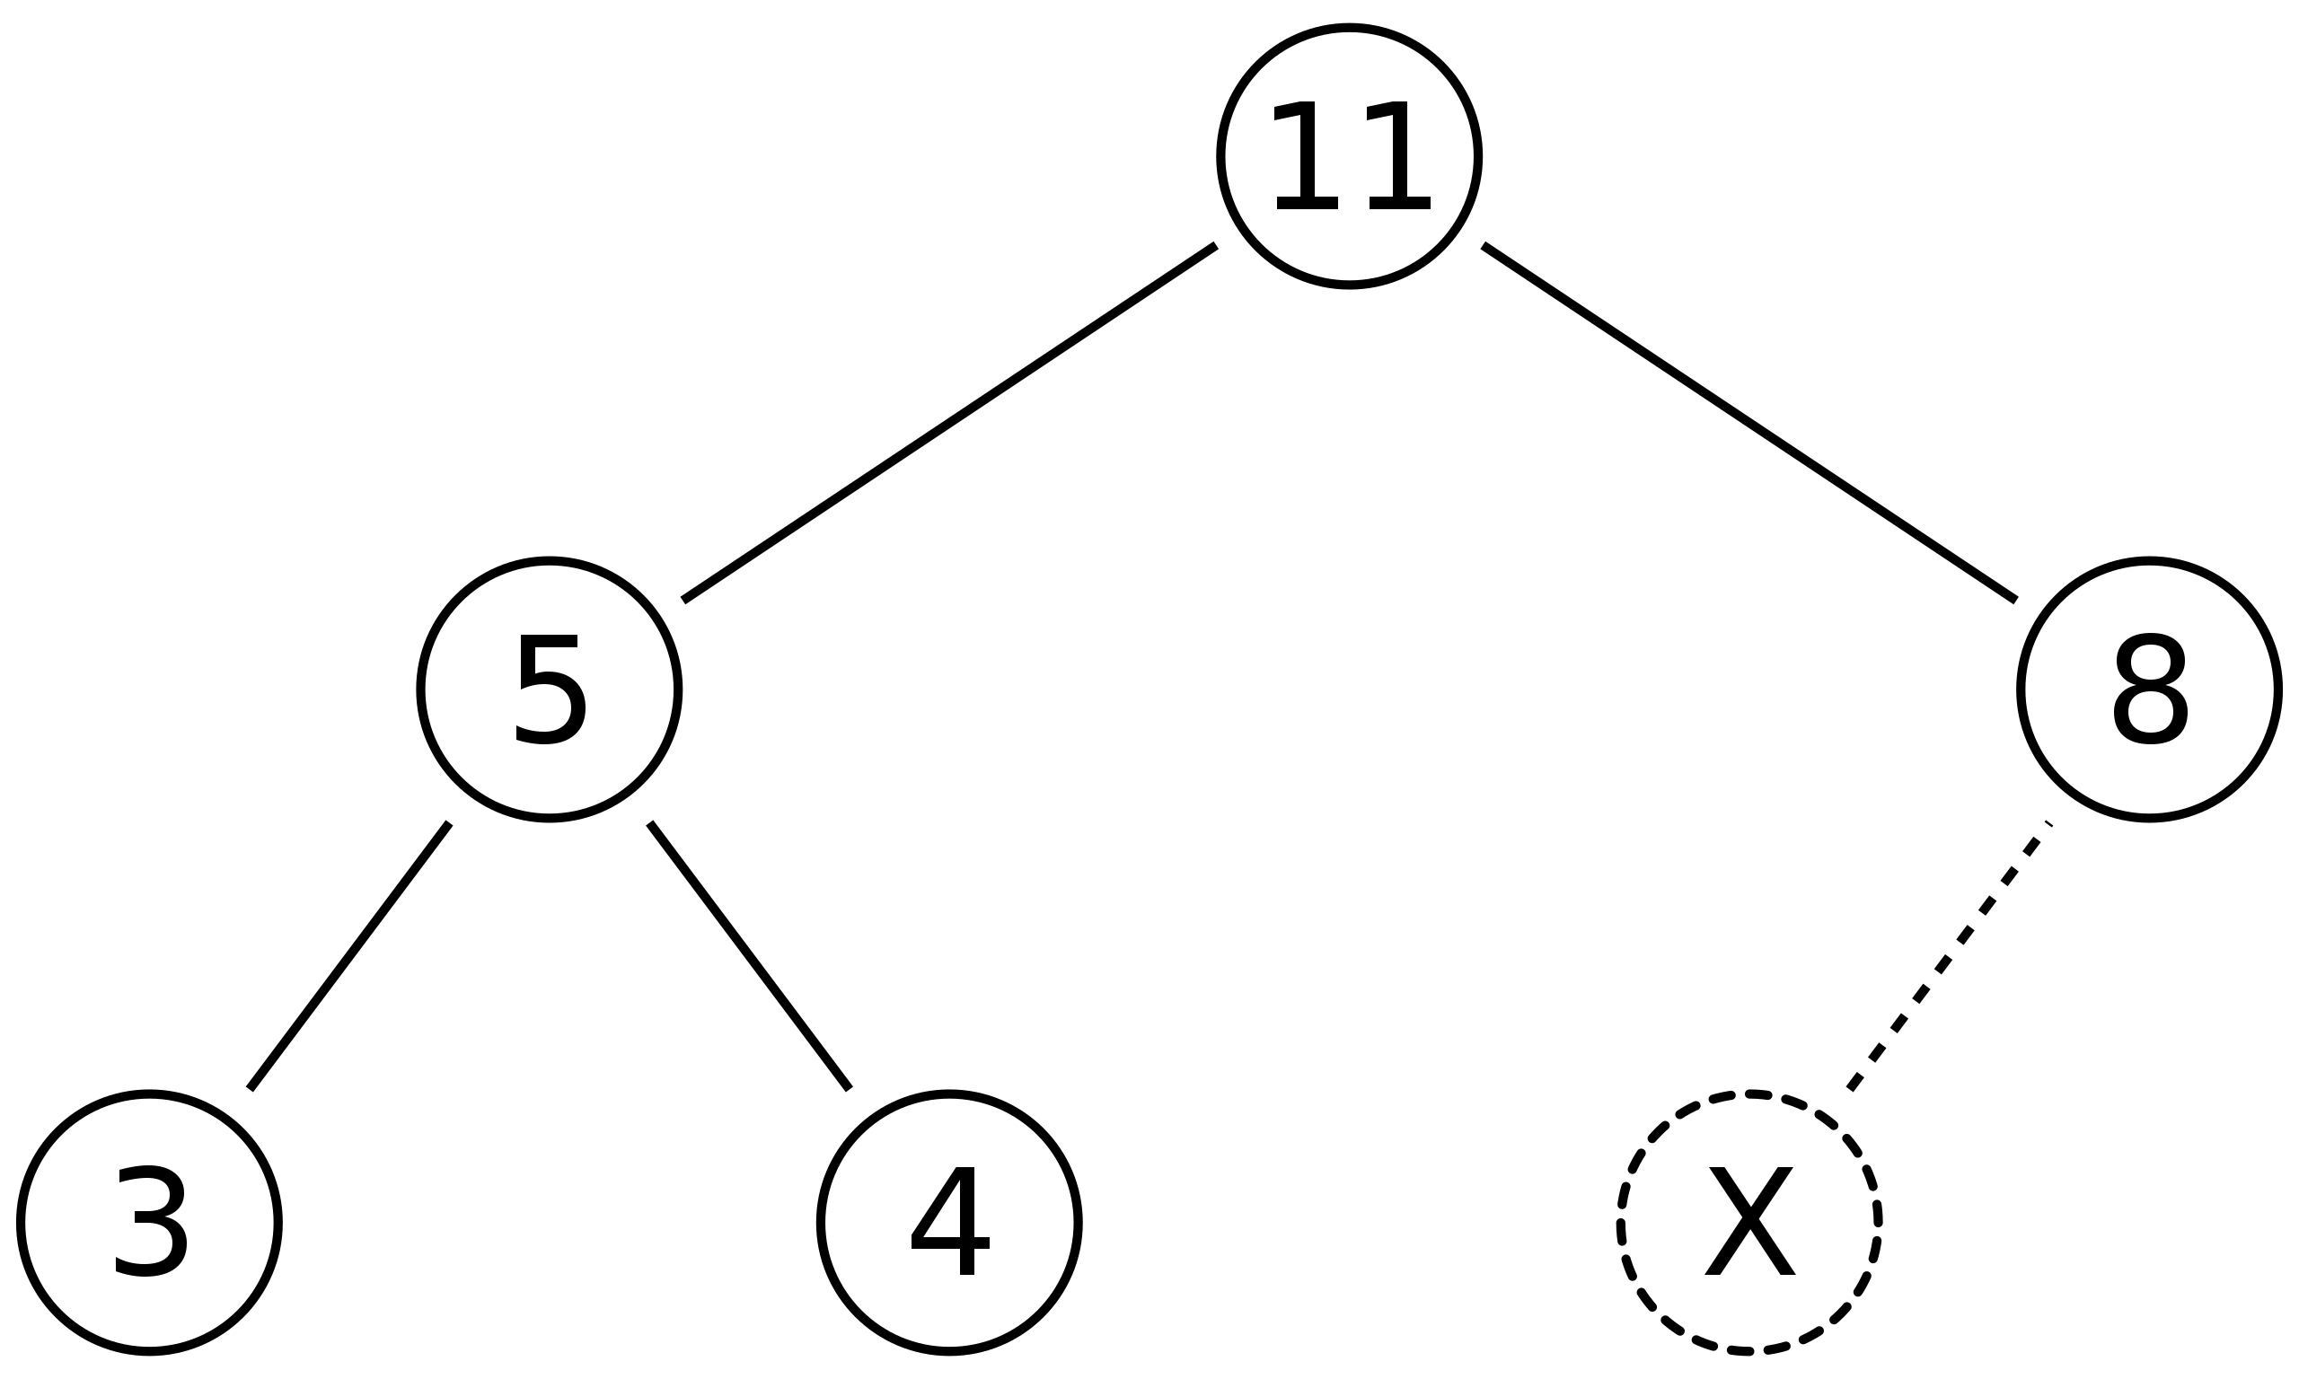
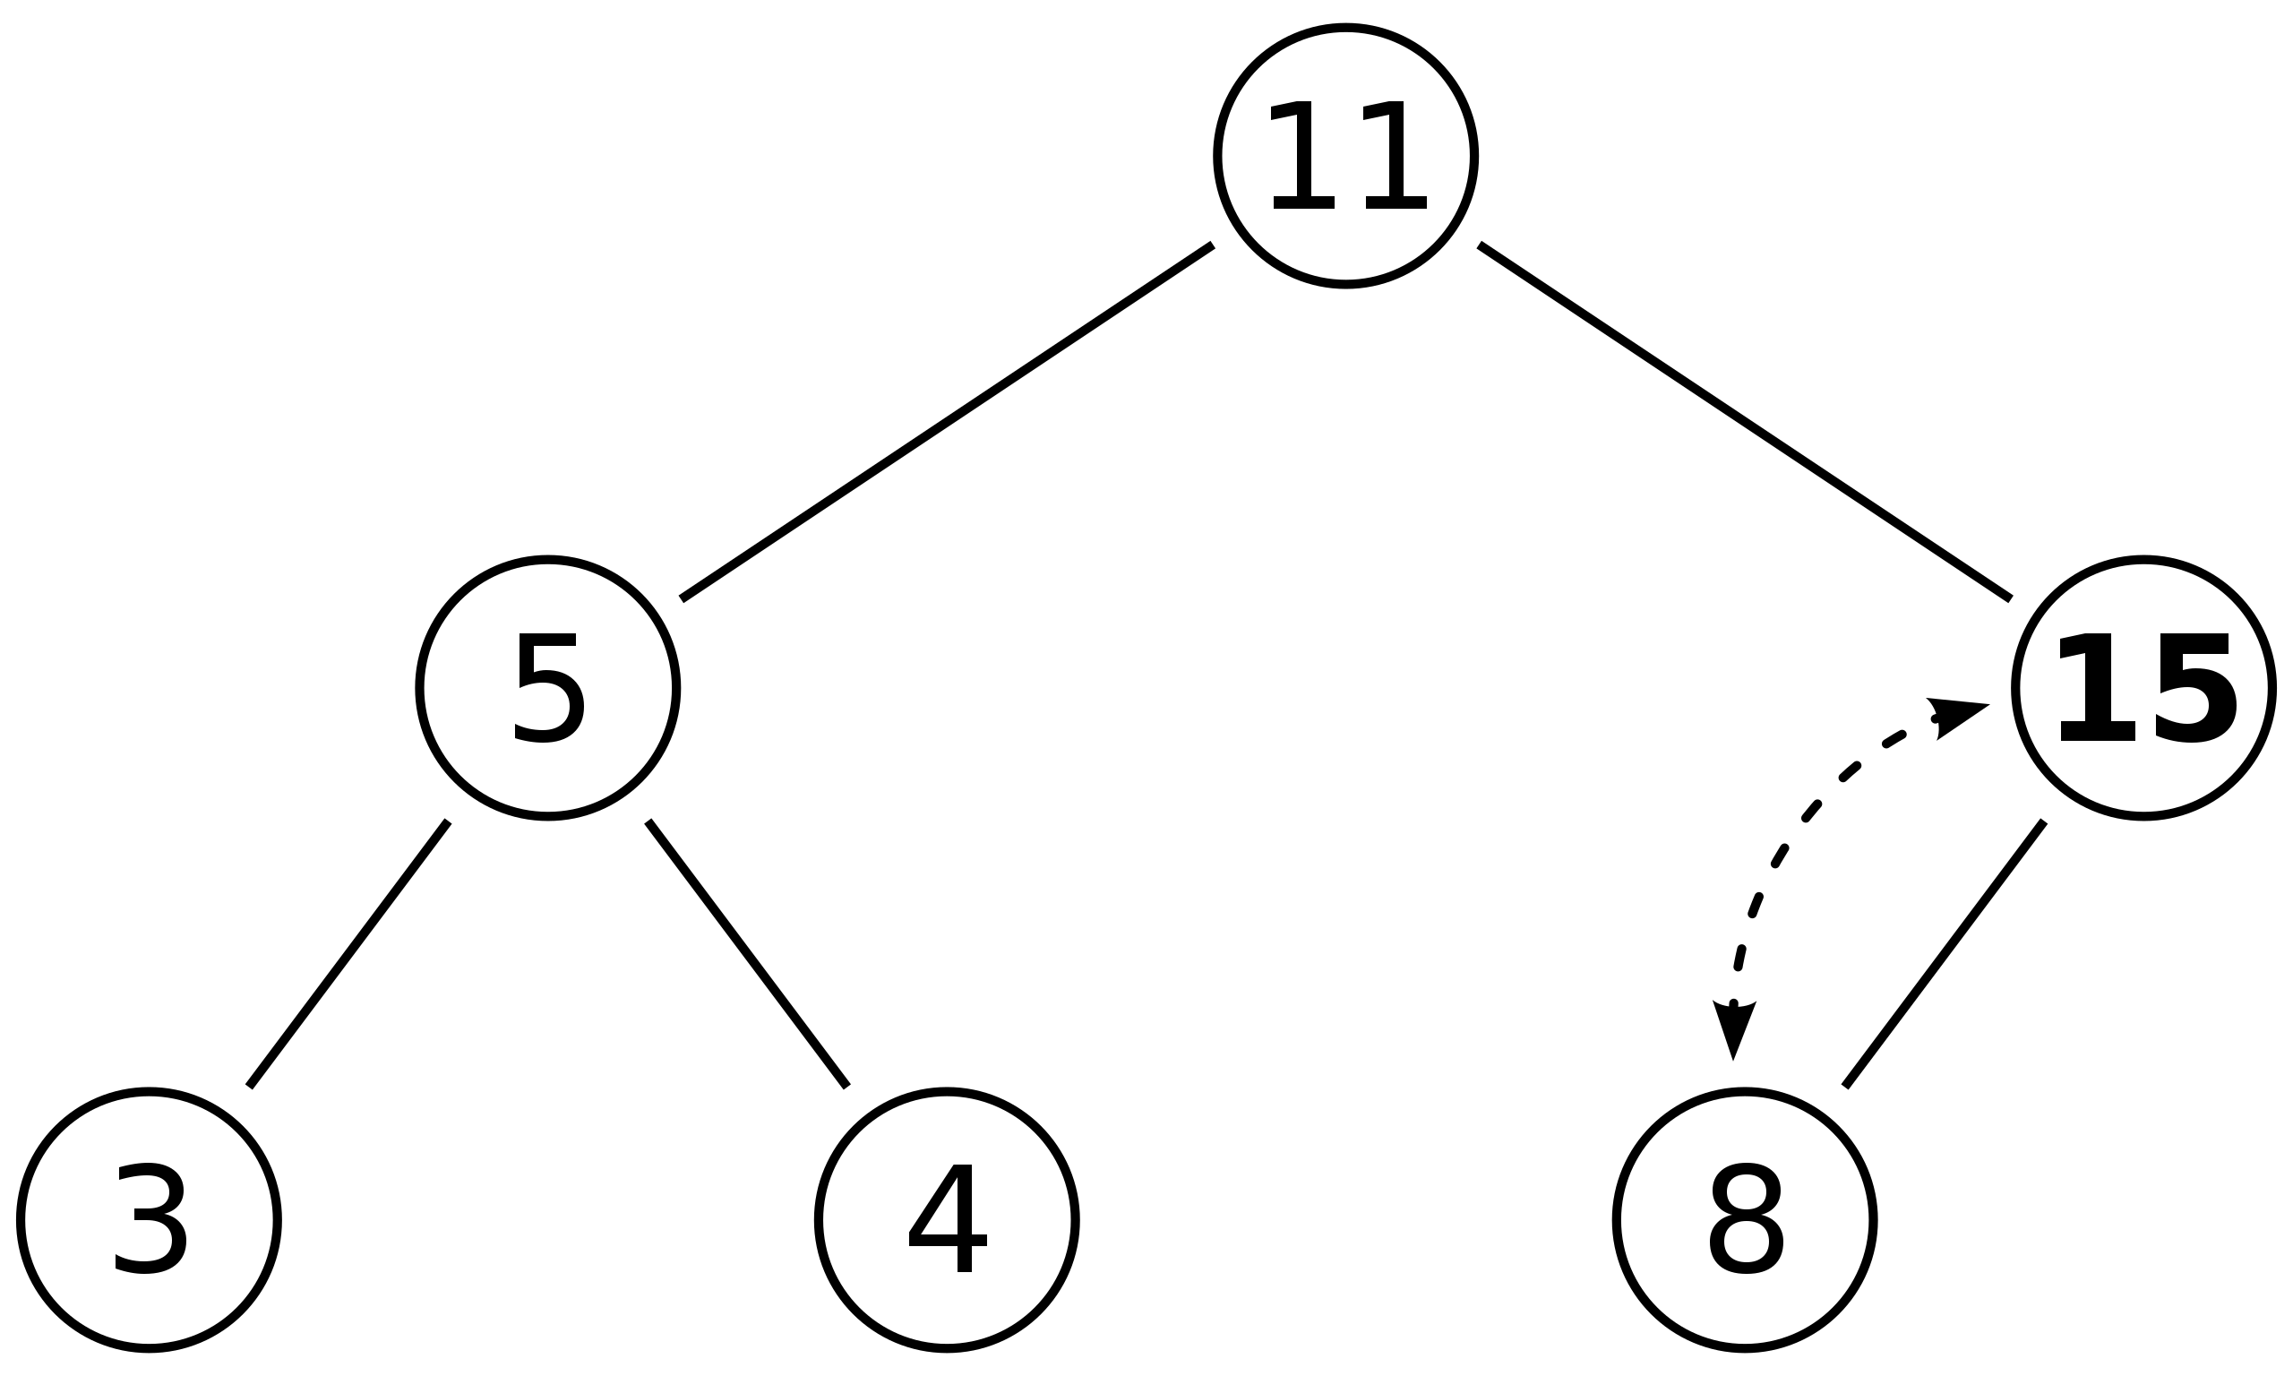
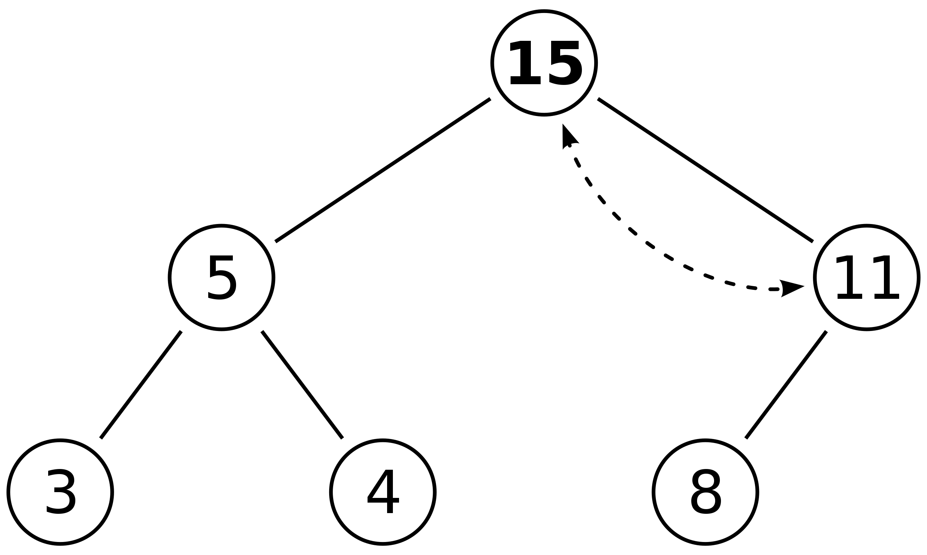
Insert: bubble up
Insert 15 in spot marked “X”
Worst case time O(log n)

Slide 6
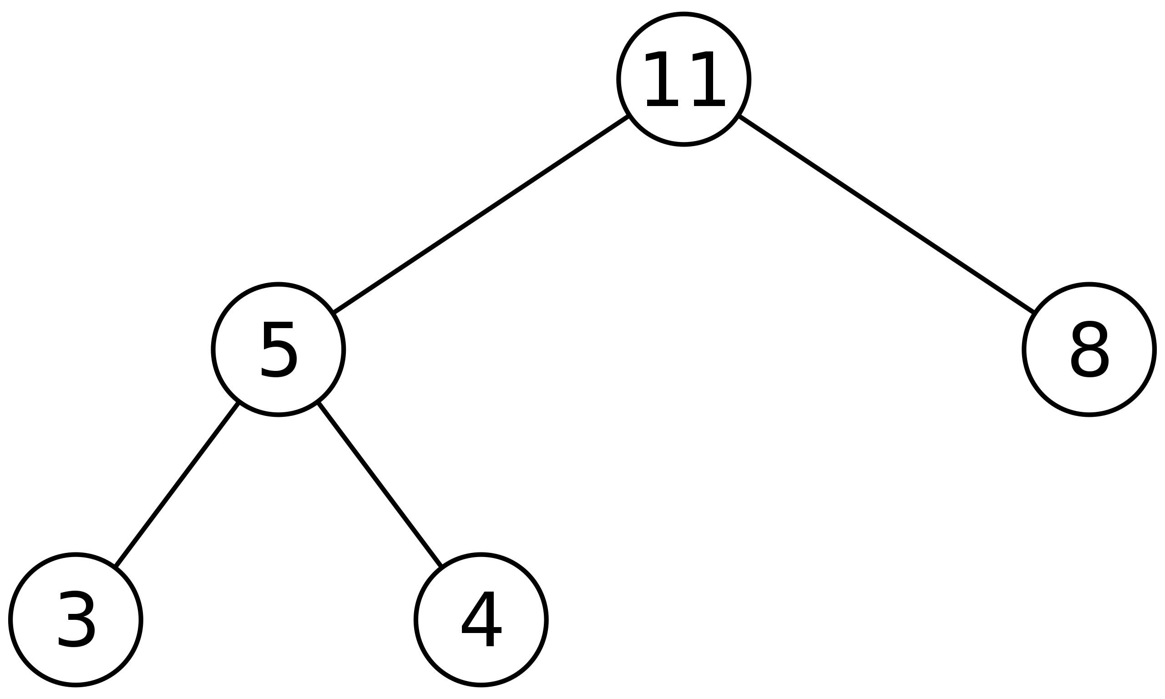
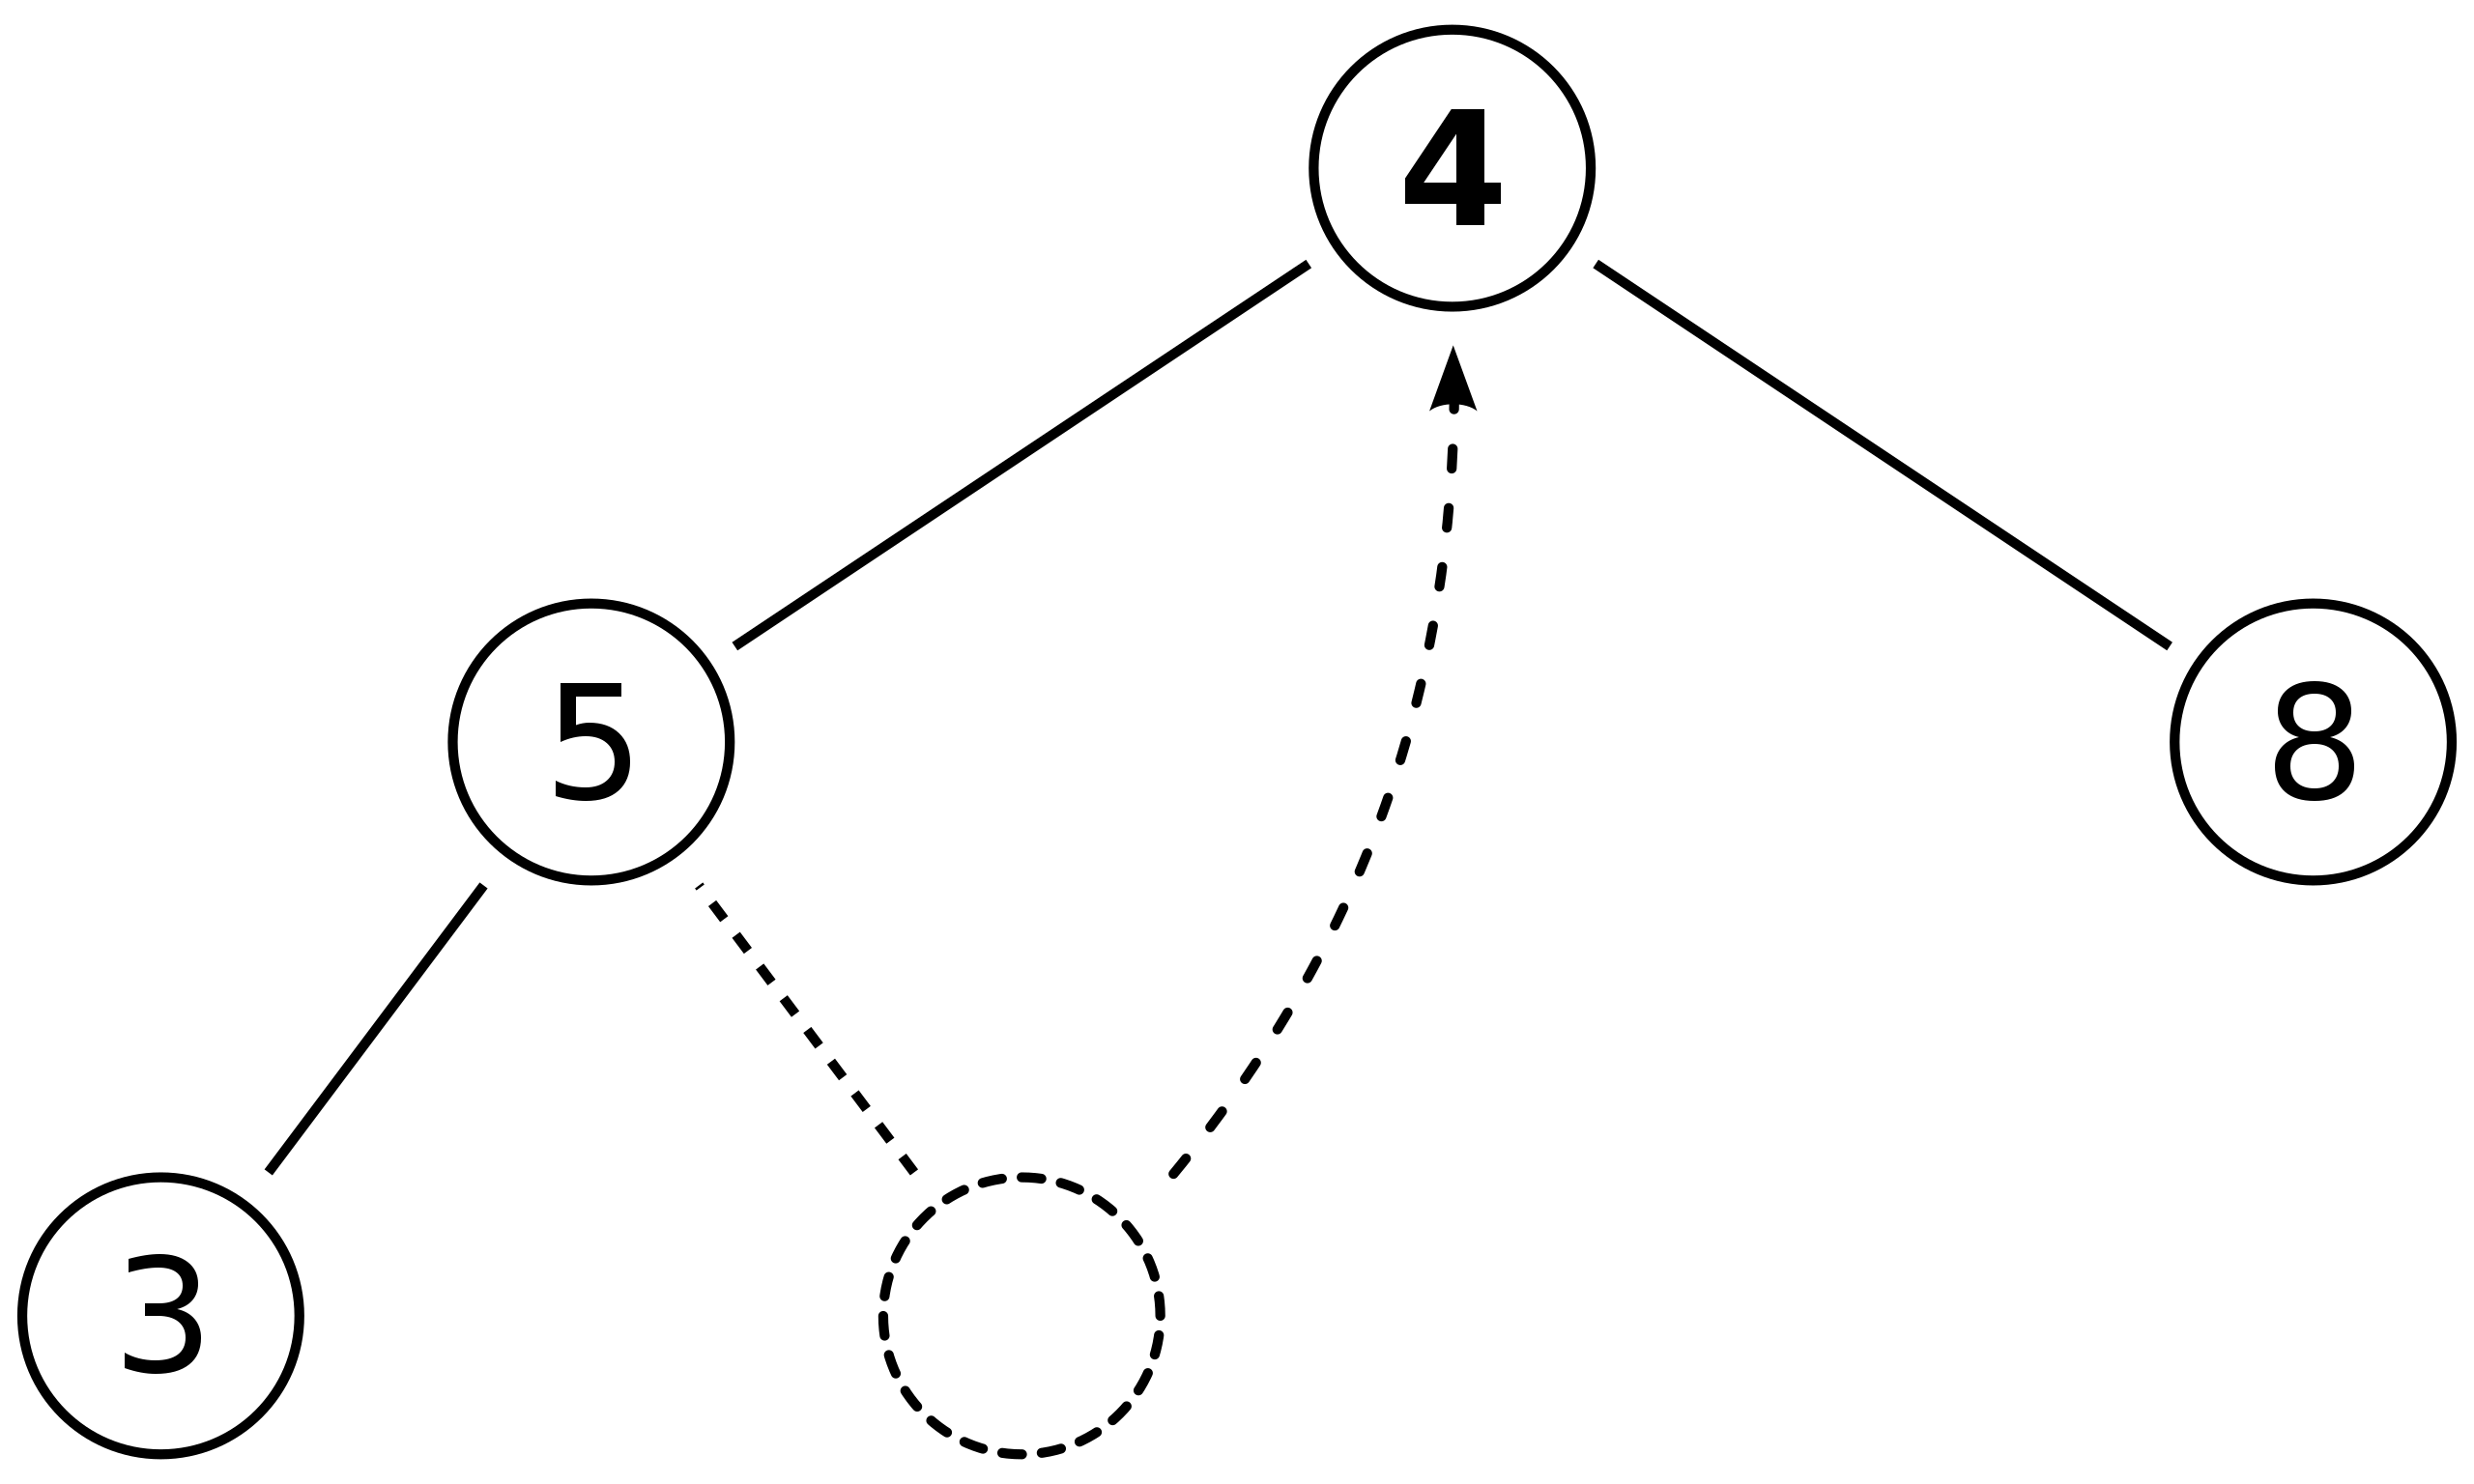
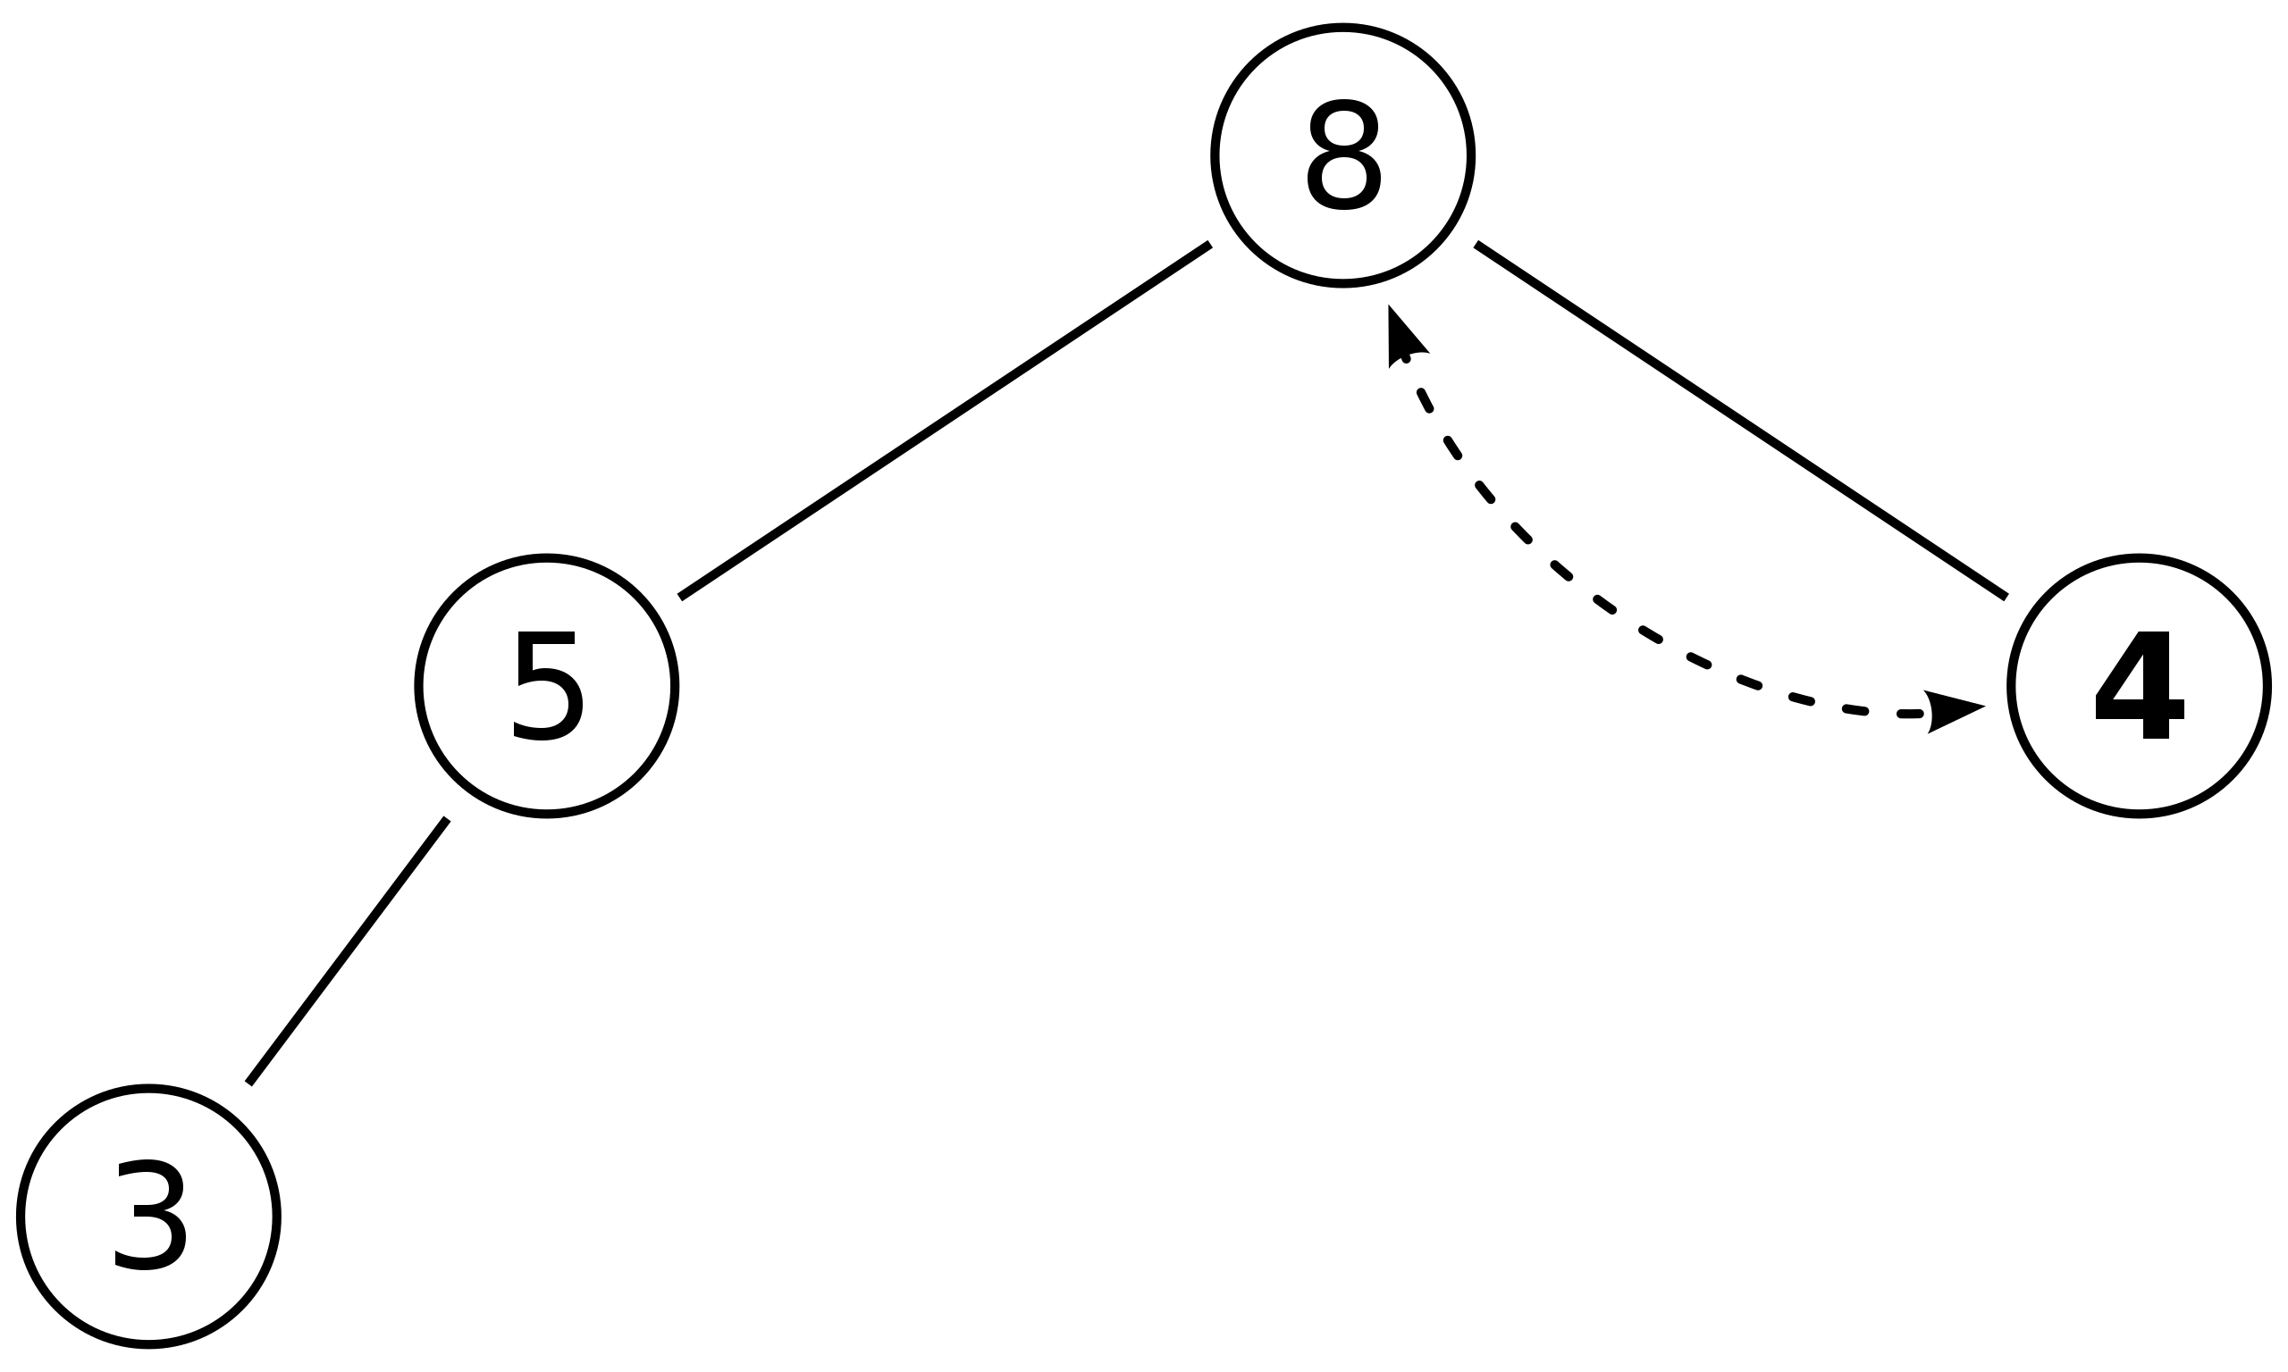
Extract: bubble down
Remove the root node and return it
Replace the root with the last node (last array element)
Move that element into position
Worst case time O(log n)

Slide 7
Uses of heaps: priority queue
Imagine a list of tasks with different priorities
You want to be able to do two things:
Add a new task with a given priority
Find and remove the top priority task
Implementation: heap

Slide 8
Uses of heaps: heapsort
Given an array of numbers
Turn it into a heap (time O(n log n), improvable to O(n))
Repeatedly remove the root of the heap and swap it with the last element of the heap

Slide 9
Stacks and queues
Fundamental data structures for managing “to-do lists”
Stack: “last in, first out”
Queue: “first in, first out”

Slide 10
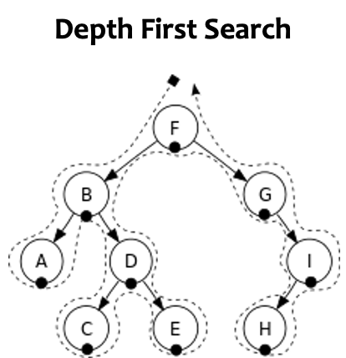
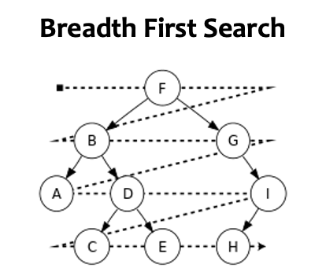
Tree Search

Slide 11
Stacks
Two operations:
Push: add something to the top of the sack
Pop: remove and return the top element of the stack

Slide 12
Implementing stacks
Via an array:
10
Top of stack

Slide 13
Implementing stacks
Via an array:
Push: insert at end of array, move pointer for “top” element. O(1) runtime
10 | 5
Top of stack

Slide 14
Implementing stacks
Via an array:
Pop: return element at “top” index, decrement top. O(1) runtime
Return : 5
10
Top of stack

Slide 15
Implementing stacks
Via a linked list
Push: add a new element to the head of the list. Time: O(1)
Value: 10 | Pointer
head

Slide 16
Implementing stacks
Via a linked list
Push: add a new element to the head of the list. Time: O(1)
Value: 5 | Pointer
Value: 10 | Pointer
head

Slide 17
Implementing stacks
Via a linked list
Push: add a new element to the head of the list. Time: O(1)
Pop: return the “head” element, set head pointer to the next . Time: O(1)
Return : 5
Value: 5 | Pointer
Value: 10 | Pointer
head

Slide 18
Queues
Two operations:
Enqueue: add something to the end of the stack
Dequeue: remove and return the first element of the stack

Slide 19
Implementing queues
Via arrays:
Enqueue: insert at end of list, time O(1)
10
Start of queue
End of queue

Slide 20
Implementing queues
Via arrays:
Enqueue: insert at end of list, time O(1)
10 | 5
Start of queue
End of queue

Slide 21
Implementing queues
Via arrays:
Enqueue: insert at end of list, time O(1)
Dequeue: delete at beginning of list. Time O(n)!
10 | 5
Start of queue
End of queue

Slide 22
Implementing queues
Via (modified) linked list where we maintain pointer to both head element and the tail element: Both O(1)
Value: 10 | Pointer
Value: 5 | Pointer: Null
head
tail

