Slide 1
Computational Foundations for ML (10-607):
Graphs
Bryan Wilder
* Slides borrowed from prior offerings by Professors H. Heidari, M. Gormley, P. Virtue, & G. Gordon.

Slide 2
Today
What are graphs?
Data structures to represent graphs
Algorithms on graphs: spanning trees, search, and shortest paths
Notes:
def factorial(int n):
if ___________:
return ___________
return ___________________

Slide 3
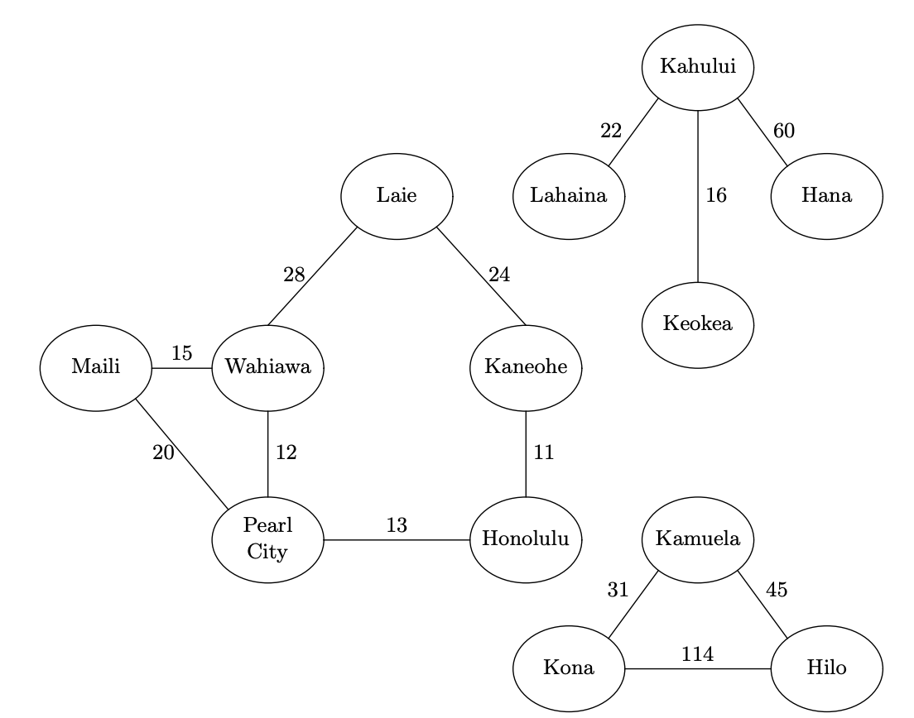

Slide 4
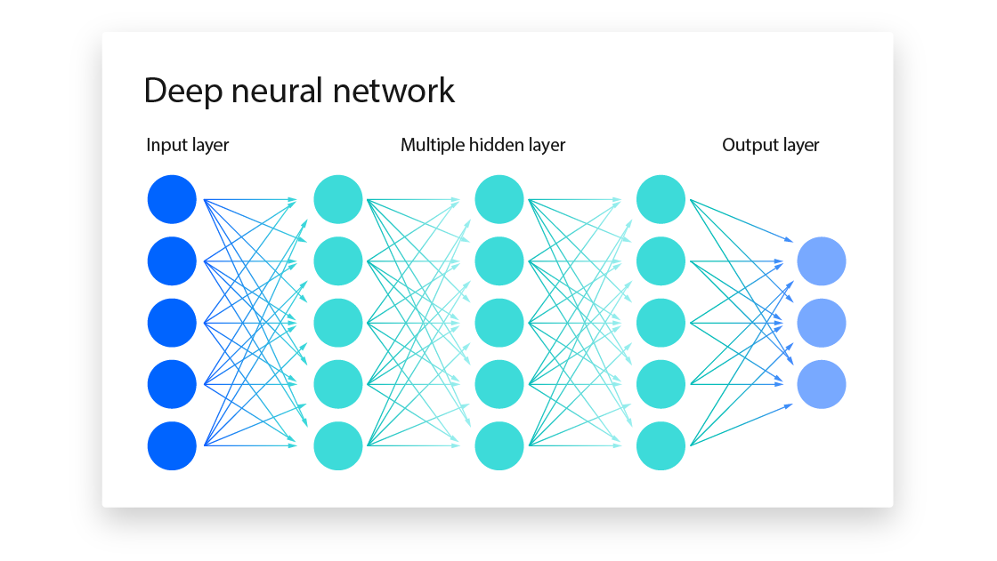

Slide 5
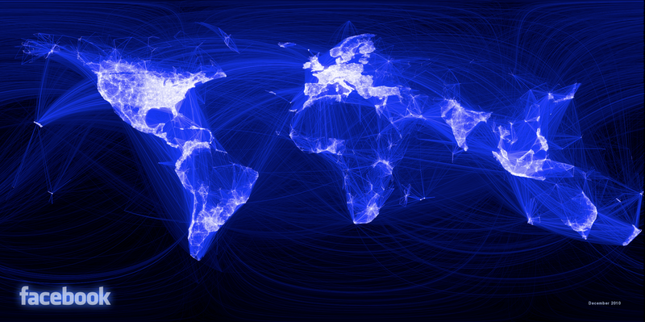

Slide 6
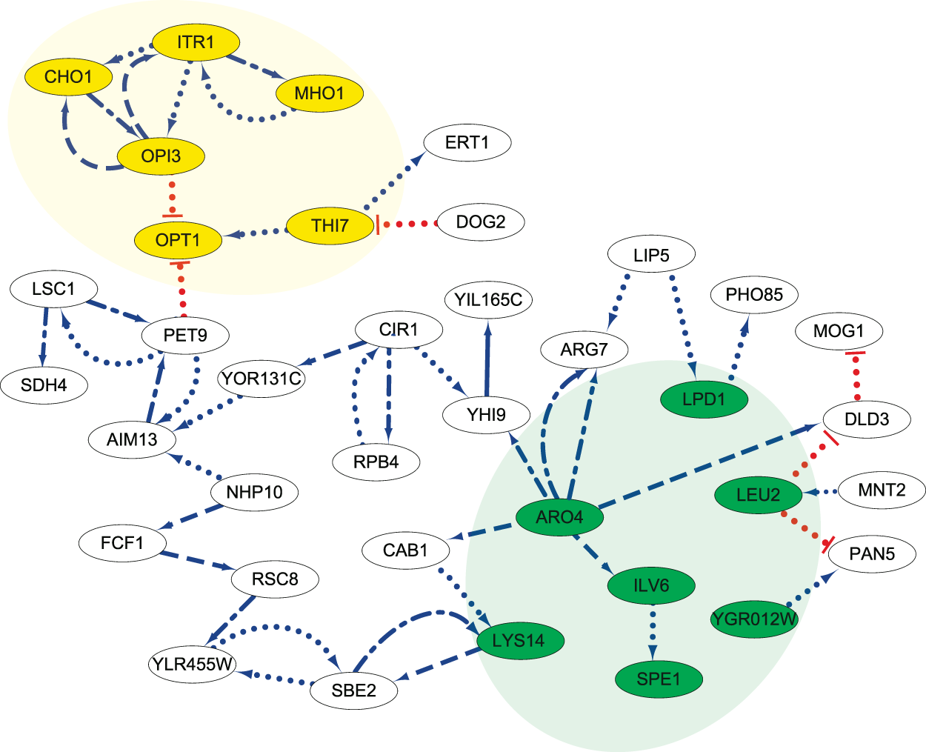
Gene regulatory networks

Slide 7
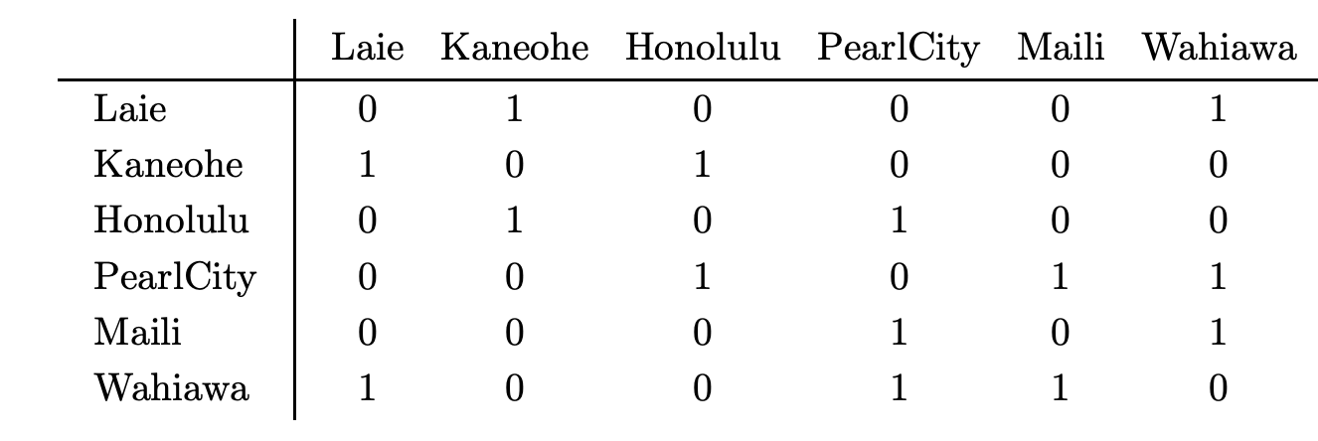
Adjacency matrix

Slide 8
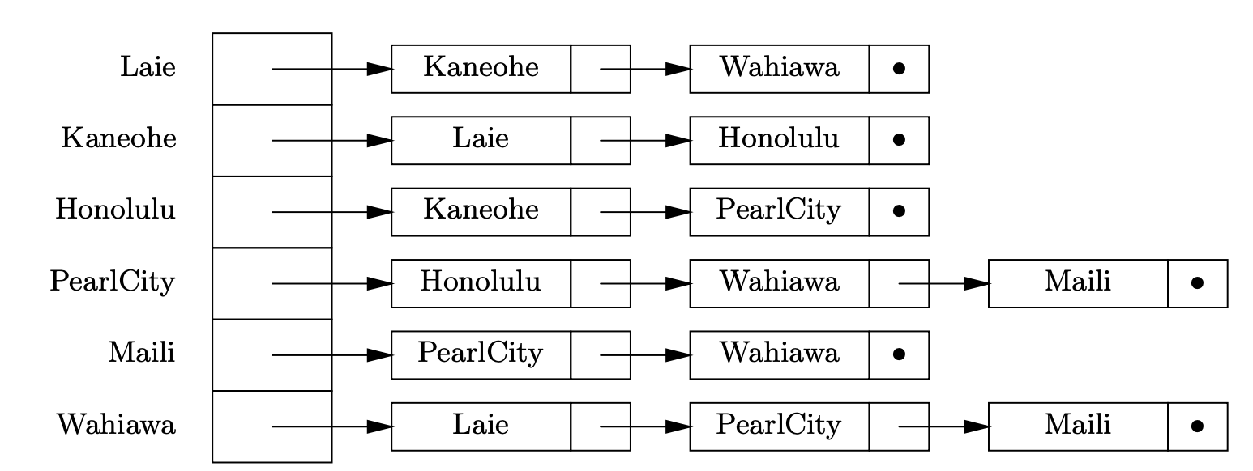
Adjacency list

Slide 9
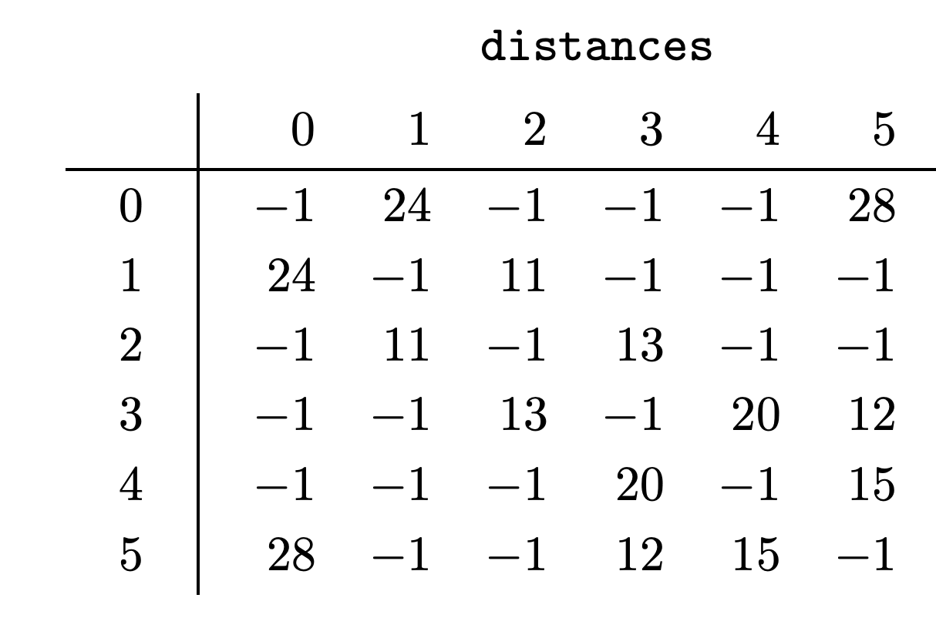
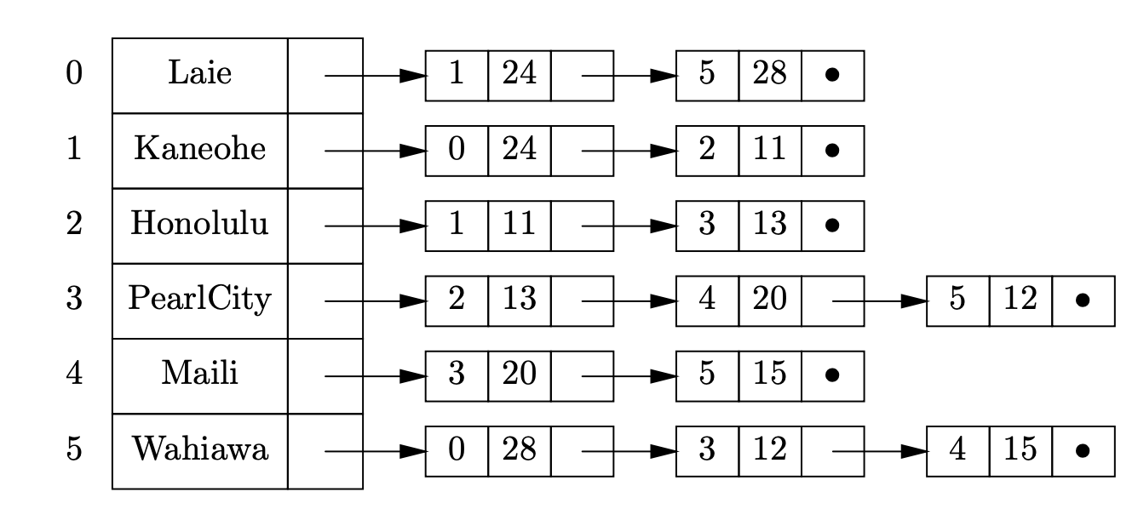
With edge weights

Slide 10
Algorithmic tasks on graphs
How do quickly search graphs, find important substructures, plan paths, etc?
Many well-developed algorithms for such problems
Here: three examples
Minimum spanning trees
Search
Shortest paths

Slide 11
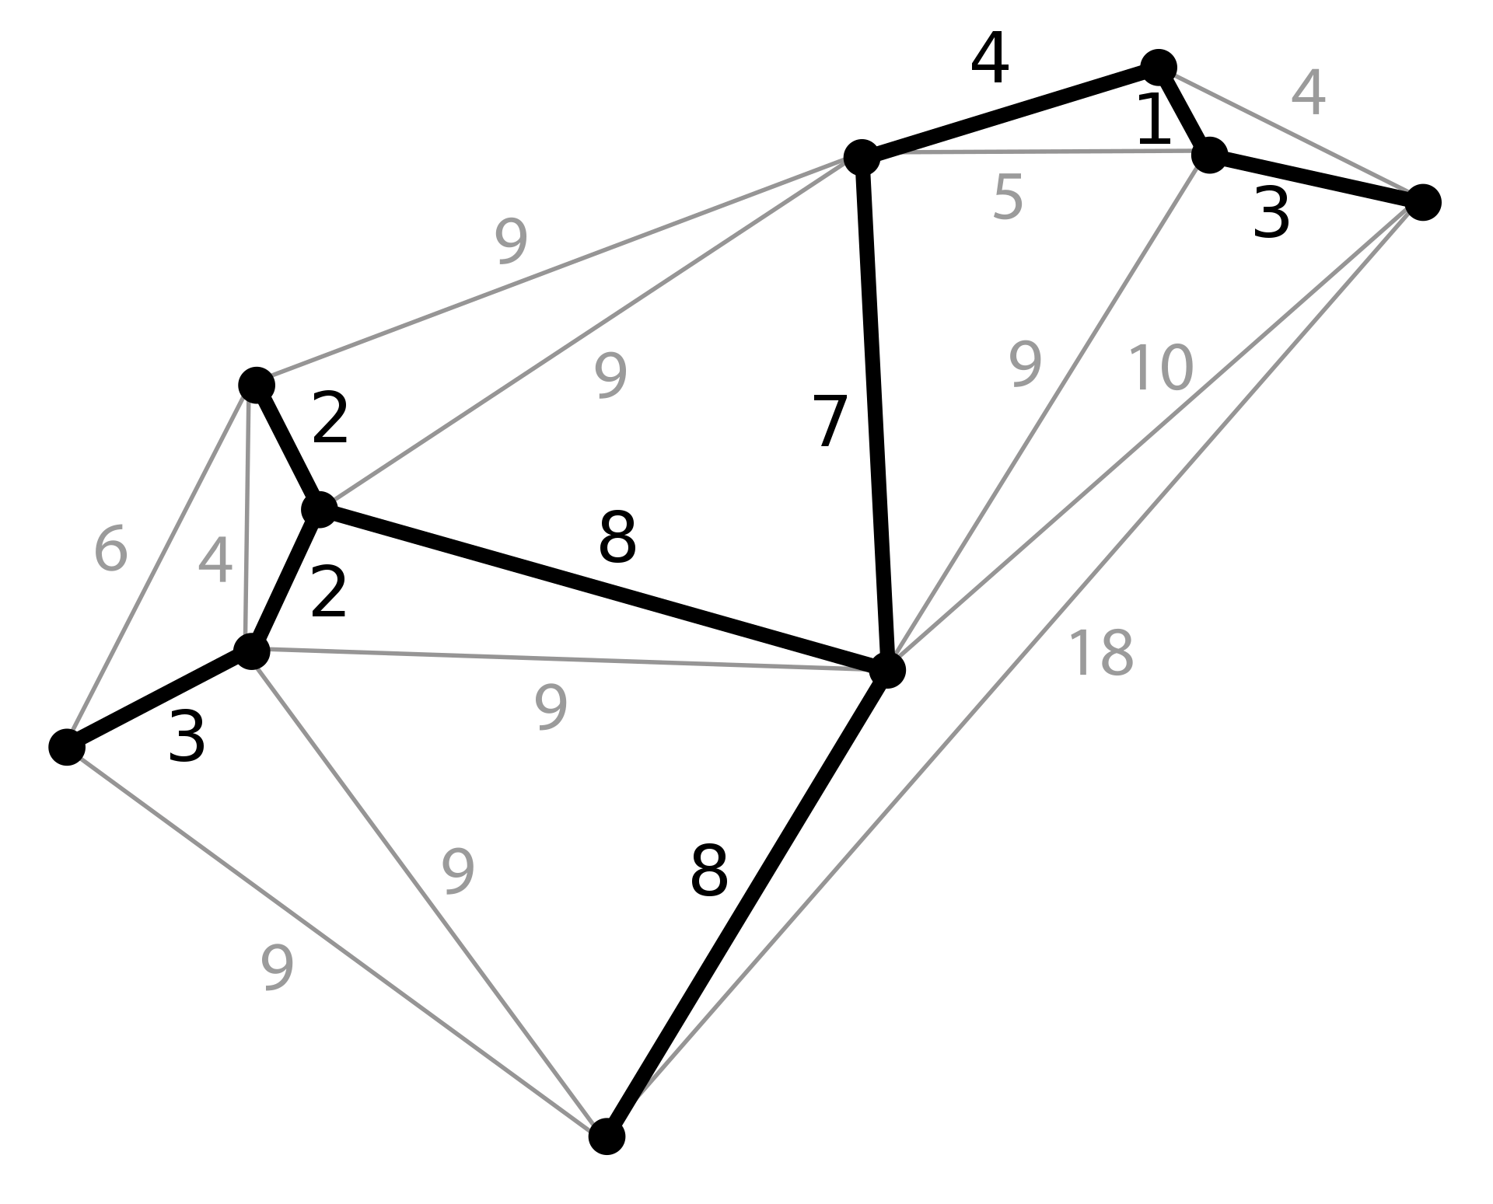
Spanning trees
A subset of the original edges of the graph
Which contains no cycles (making it a tree)
And which connects every node in the graph
Minimum spanning tree has the smallest total sum of edge weights
Useful for network design (e.g., laying out cables for internet connections)
Also common as a subroutine in other graph problems

Slide 12
Prelude: connected components
How to efficiently compute the connected components of a graph?
Want to be able to quickly determine which component a given node belongs to, and whether two nodes belong to the same component

Slide 13
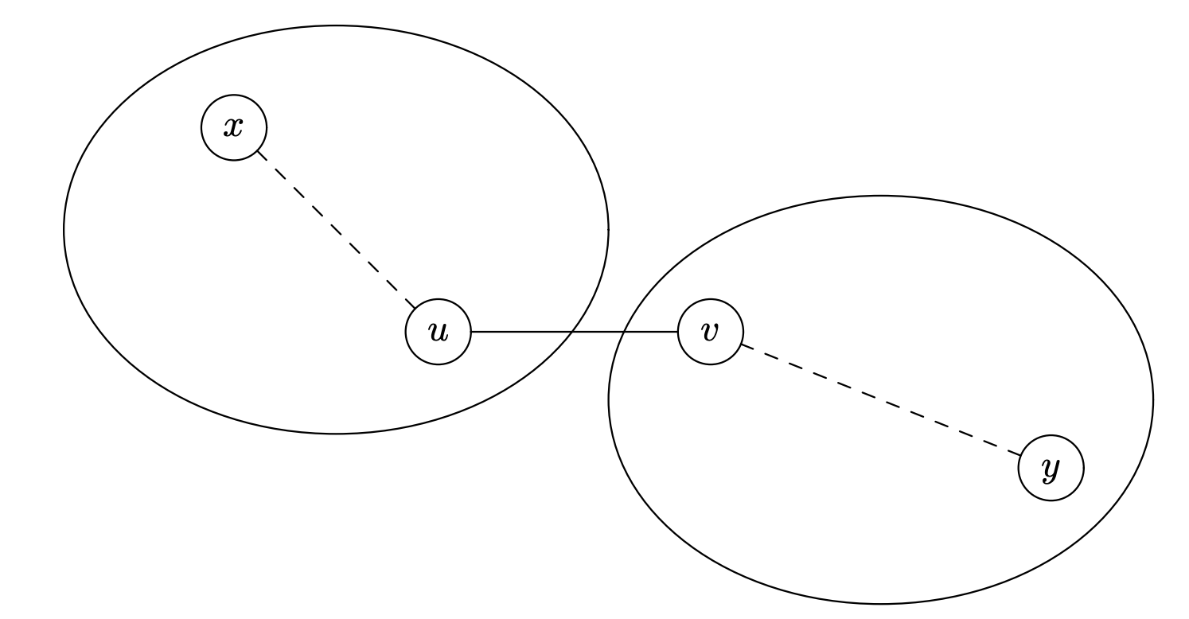
Prelude: connected components
Idea: start with each node in its own component and then merge components as we process each edge
Accomplish this by representing connected components as trees

Slide 14

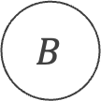
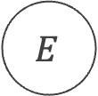

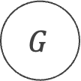


Prelude: connected components
$$A$$
Idea: start with each node in its own component and then merge components as we process each edge
Accomplish this by representing connected components as trees
$$B$$
$$C$$
$$D$$
$$E$$
$$F$$
$$G$$

Slide 15
Running time
$$A$$
Idea: start with each node in its own component and then merge components as we process each edge
Accomplish this by representing connected components as trees
$$B$$
$$C$$
$$D$$
$$E$$
$$F$$
$$G$$

Slide 16
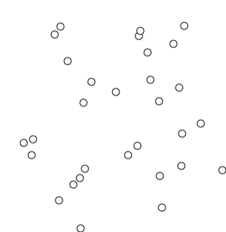
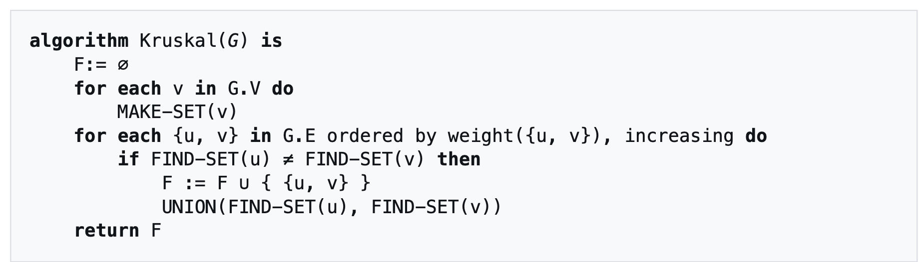
Back to spanning trees: Kruskal’s algorithm
Run the connected components algorithm, but sort the edges by cost first
Whenever we find an edge that links two differenåt components, add it to the spanning tree

Slide 17







Breadth first search
$$A$$
$$B$$
$$C$$
$$D$$
$$E$$
$$F$$
$$G$$

Slide 18
Recall: Breath-First Search on Trees
$$A$$
Uses a queue data structure as opposed to a stack
Tree traversal:
$$B$$
$$C$$
$$D$$
$$E$$
$$F$$
$$G$$

Slide 19
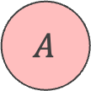
Recall: Breath-First Search on Trees
$$A$$
Uses a queue data structure as opposed to a stack
Tree traversal:
A – B – C – D – E – F – G
$$B$$
$$C$$
$$D$$
$$E$$
$$F$$
$$G$$

Slide 20
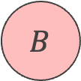
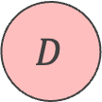
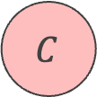
Recall: Breath-First Search on Trees
$$A$$
Uses a queue data structure as opposed to a stack
Tree traversal:
A – B – C – D – E – F – G
$$B$$
$$C$$
$$D$$
$$E$$
$$F$$
$$G$$

Slide 21
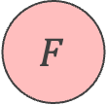
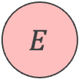
Recall: Breath-First Search on Trees
$$A$$
Uses a queue data structure as opposed to a stack
Tree traversal:
A – B – C – D – E – F – G
$$B$$
$$C$$
$$D$$
$$E$$
$$F$$
$$G$$

Slide 22

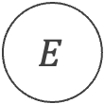
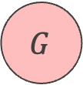
Recall: Breath-First Search on Trees
$$A$$
Uses a queue data structure as opposed to a stack
Tree traversal:
A – B – C – D – E – F – G
$$B$$
$$C$$
$$D$$
$$E$$
$$F$$
$$G$$

Slide 23
Recall: Breath-First Search on Graphs?
$$A$$
Uses a queue data structure as opposed to a stack
Nodes visited
A – B – C – D – E – F – G
$$B$$
$$C$$
$$D$$
$$E$$
$$F$$
$$G$$

Slide 24
Recall: Breath-First Search on Graphs?
$$A$$
Uses a queue data structure as opposed to a stack
Nodes visited
A – B – C – D – A – E – A – D – F …
$$B$$
$$C$$
$$D$$
$$E$$
$$F$$
$$G$$

Slide 25
Recall: Breath-First Search on Graphs?
$$A$$
Uses a queue data structure as opposed to a stack
Nodes visited
A – B – C – D – A – E – A – D – F …
$$B$$
$$C$$
$$D$$
$$E$$
$$F$$
$$G$$

Slide 26
Recall: Breath-First Search on Graphs?
$$A$$
Uses a queue data structure as opposed to a stack
Nodes visited
A – B – C – D – A – E – A – D – F …
$$B$$
$$C$$
$$D$$
$$E$$
$$F$$
$$G$$

Slide 27
Recall: Breath-First Search on Graphs?
$$A$$
Uses a queue data structure as opposed to a stack
Nodes visited
A – B – C – D – A – E – A – D – F … – G
$$B$$
$$C$$
$$D$$
$$E$$
$$F$$
$$G$$

Slide 28
Recall: Breath-First Search on Graphs
$$A$$
Uses a queue data structure as opposed to a stack
Maintain a list of previously visited nodes and check if a node has been visited before adding it to the queue
Nodes visited
A – B – C – D – E – F - G
$$B$$
$$C$$
$$D$$
$$E$$
$$F$$
$$G$$

Slide 29
Recall: Breath-First Search on Graphs
$$A$$
Uses a queue data structure as opposed to a stack
Maintain a list of previously visited nodes and check if a node has been visited before adding it to the queue
Nodes visited
A – B – C – D – E – F - G
$$B$$
$$C$$
$$D$$
$$E$$
$$F$$
$$G$$

Slide 30

Recall: Breath-First Search on Graphs
$$A$$
Uses a queue data structure as opposed to a stack
Maintain a list of previously visited nodes and check if a node has been visited before adding it to the queue
Nodes visited
A – B – C – D – E – F - G
$$B$$
$$C$$
$$D$$
$$E$$
$$F$$
$$G$$

Slide 31
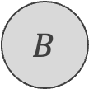


Recall: Breath-First Search on Graphs
$$A$$
Uses a queue data structure as opposed to a stack
Maintain a list of previously visited nodes and check if a node has been visited before adding it to the queue
Nodes visited
A – B – C – D – E – F - G
$$B$$
$$C$$
$$D$$
$$E$$
$$F$$
$$G$$

Slide 32
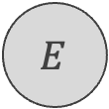
Recall: Breath-First Search on Graphs
$$A$$
Uses a queue data structure as opposed to a stack
Maintain a list of previously visited nodes and check if a node has been visited before adding it to the queue
Nodes visited
A – B – C – D – E – F - G
$$B$$
$$C$$
$$D$$
$$E$$
$$F$$
$$G$$

Slide 33

Recall: Breath-First Search on Graphs
$$A$$
Uses a queue data structure as opposed to a stack
Maintain a list of previously visited nodes and check if a node has been visited before adding it to the queue
Nodes visited
A – B – C – D – E – F - G
$$B$$
$$C$$
$$D$$
$$E$$
$$F$$
$$G$$

Slide 34

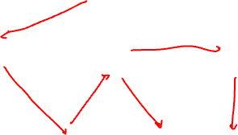
Recall: Depth-First Search on Graphs
$$A$$
Uses a stack data structure as opposed to a queue
Maintain a list of previously visited nodes and check if a node has been visited before adding it to the queue
Nodes visited
A – B – E – C– D – G - F
$$B$$
$$C$$
$$D$$
$$E$$
$$F$$
$$G$$

Slide 35
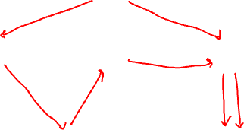
Recall: Depth-First Search vs Breadth-First Search?
$$A$$
Finding the shortest path between two nodes in a graph:
What is the shortest path from A to G?
Use pointers to parent nodes to keep track of the path
DFS finds A – B – E – C– D – G…
BFS finds A – D – G!
$$B$$
$$C$$
$$D$$
$$E$$
$$F$$
$$G$$

Slide 36
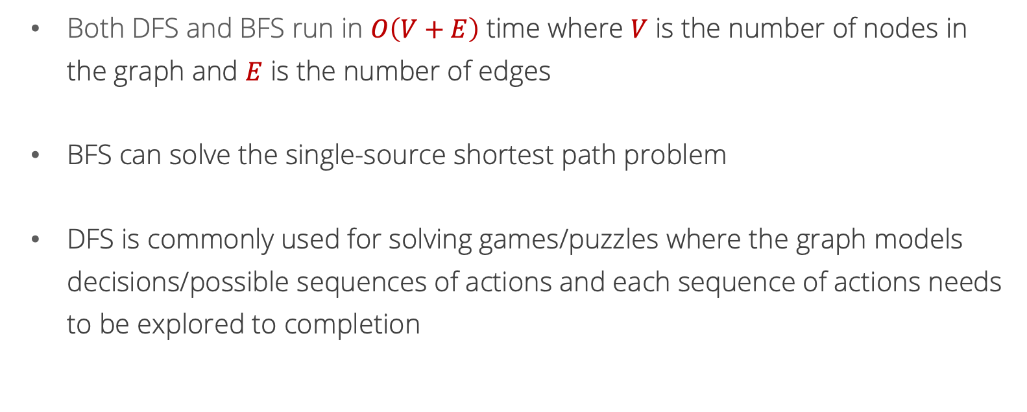
Recall: Depth-First Search vs Breadth-First Search
Both DFS and BFS run in $O\left(V+E\right)$ time where $V$ is the number of nodes in the graph and $E$ is the number of edges
BFS can solve the single-source shortest path problem
DFS is commonly used for solving games/puzzles where the graph models decisions/possible sequences of actions and each sequence of actions needs to be explored to completion

Slide 37
Shortest paths
BFS finds the shortest path from a single source to a single target in an unweighted graph
What about edge weights?
What if we want paths between multiple nodes?

Slide 38
Dijkstra’s algorithm
Finds shortest paths between a single source node and all other nodes in the graph
Works for graphs with nonnegative edge weights

Slide 39
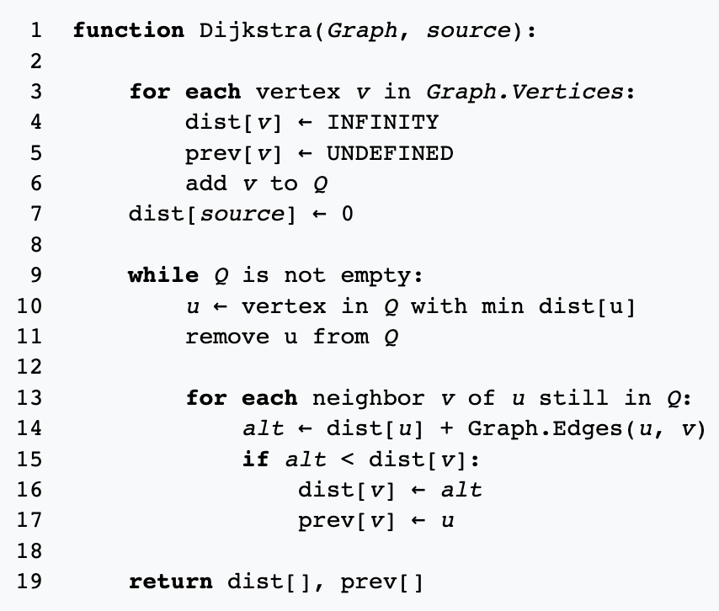

Slide 40
Running time?
Put all vertices in a min heap
Remove root from heap
Update priority for v in heap

Slide 41
Correctness?

Slide 42
Floyd’s algorithm
What if we want shortest paths between all pairs of nodes?
Running Dijkstra’s on every node: O(|V|(|E| + |V|) log |V|)
And what if there are negative edge weights (but no negative cycles)?

Slide 43

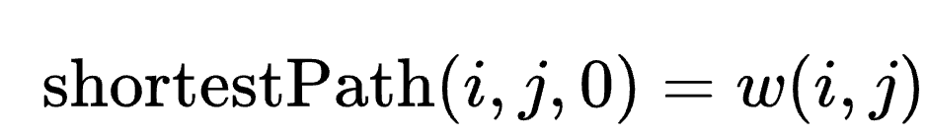
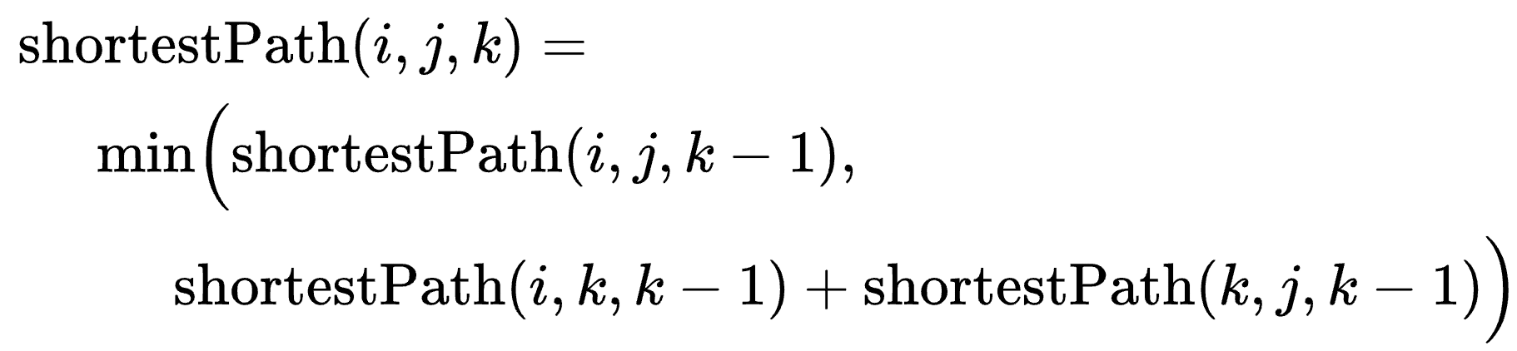
Floyd’s algorithm
Dynamic programming algorithm
Suppose that we have already computed shortestPath(i, j, k-1). What could shortestPath(i, j, k) be?
Don’t use node k. shortestPath(i, j, k) = shortestPath(i, j, k-1)
Use node k. Take shortest path from i to k, and then shortest path from k to j.
= length of shortest path from i to j using only nodes {1…k}

Slide 44
