Slide 1
Computational Foundations for ML (10-607):
Computationational Complexity
Bryan Wilder
* Slides borrowed from prior offerings by Professors H. Heidari, M. Gormley, P. Virtue, & G. Gordon.

Slide 2
Announcement
Quiz 1 on Wednesday
First 40 min of class
Covers material from first two weeks (not including today): propositional logic, predicates and quantifiers, proof techniques

Slide 3
Motivation
Consider a simple computational task:
Given an array A and an integer x, determine whether A contains x.

Slide 4
Key Questions
Given a single algorithm, will it complete on a given input in a reasonable amount of time/space?
Given two algorithms which one is better?

Slide 5
Outline
Computational Complexity
The running time of an algorithm
Counting operations
Big-O notation
Complexity classes

Slide 6
Running Time
The number of time units it takes for an algorithm to run as a function of its input size.
Example:
Searching an array of length n
running time T(n)
worst-case
average

Slide 7
How fast is this code?
15 int search(int x, int[] A, int n)
16 {
17 for (int i = 0; i < n; i++)
18 {
19 if (A[i] == x) {
20 return i;
21 }
22 }
23 return -1;
24 }
Notes:
Slide credit: CMU 15-122

Slide 8
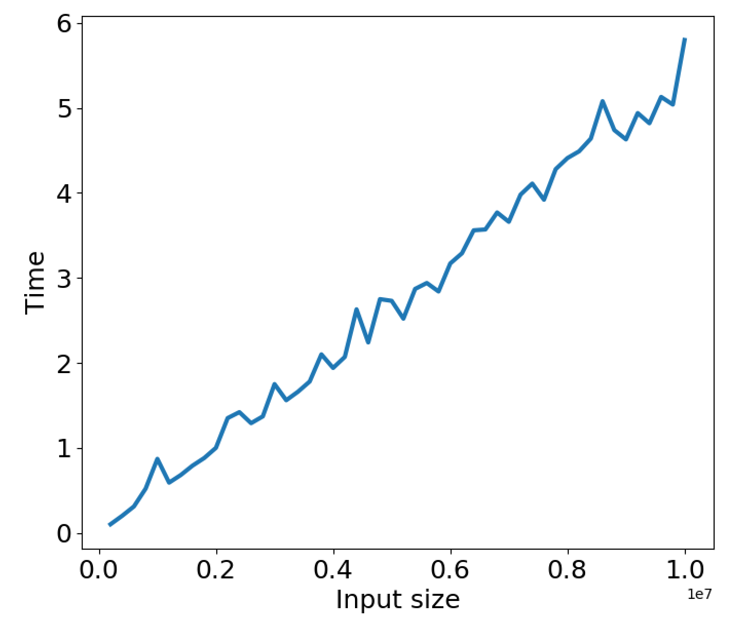
How fast is this code?
Notes:
Slide credit: CMU 15-122

Slide 9
Need a better way to measure running-time…
Permanent
Independent of hardware or other running processes, etc.
General
Applicable to a large class of programs/algorithms/problems
Resources: time, space
Mathematically rigorous
Useful
Not for actual run time,
But help us select best algorithm for the task

Slide 10
How many statements are executed?
If x is not in A…
how times are these statements executed?
i = 0
i < n
if (A[i] == x)
i++
return -1
15 int search(int x, int[] A, int n)
16 {
17 for (int i = 0; i < n; i++)
18 {
19 if (A[i] == x) {
20 return i;
21 }
22 }
23 return -1;
24 }

Slide 11
How many operations are executed?
If x is not in A…
how operations are executed?
i = 0
i < n
if (A[i] == x)
i++
return -1
15 int search(int x, int[] A, int n)
16 {
17 for (int i = 0; i < n; i++)
18 {
19 if (A[i] == x) {
20 return i;
21 }
22 }
23 return -1;
24 }

Slide 12
How many operations are executed?
Basic operations:
Arithmetic operations (e.g. + or **)
Logical operations (e.g., and)
Comparison operations (e.g., < or ==)
Structure accessing operations (e.g. array indexing like A[i])
Simple assignment such as copying a value into a variable
Calls to library functions that don’t depend on size of input (e.g., print)
Control Statements (e.g. if X>5)
Be careful with function calls that scale with the size of the input

Slide 13
Exercise
How many program operations are required to compute:
L2 norm of vector
Vector dot product
Matrix-vector multiplication
Matrix-matrix multiplication
Frobenius norm of matrix
def norm(a):
ss=0
for i in range(len(a)):
ss = ss + a[i]*a[i]
norm = np.sqrt(ss)
return norm

Slide 14
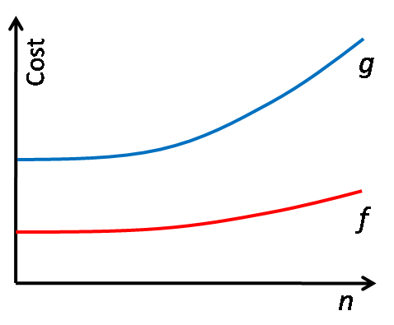
Comparing functions of n
f is better than g if for all n
f(n) ≤ g(n).

Slide 15
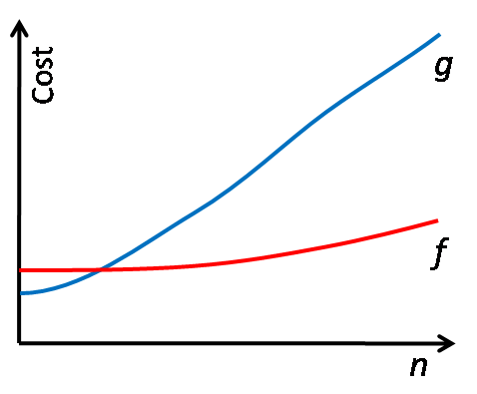

Comparing functions of n
f is better than g if for all n
f(n) ≤ g(n).

Slide 16
Comparing functions of n
f is better than g if
there exists n₀ such that for all n>n₀
f(n) ≤ g(n).

Slide 17
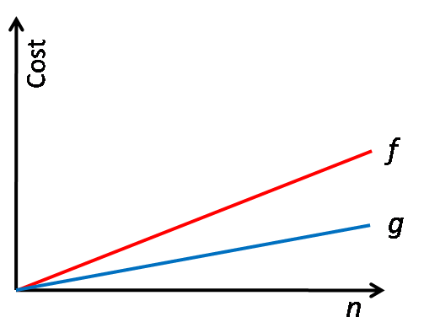
Comparing functions of n
f is better than g if
there exists n₀ such that for all n>n₀
f(n) ≤ g(n).

Slide 18
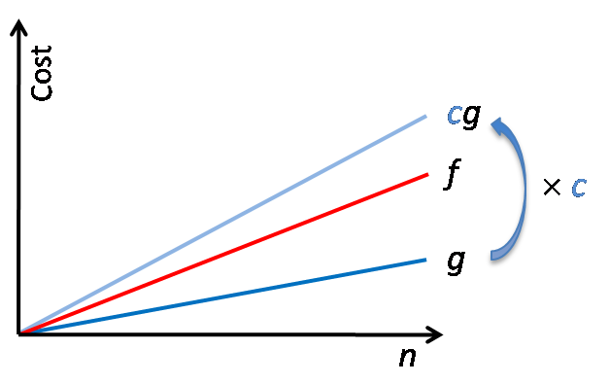
Comparing functions of n
f is better than g if
there exists n₀ such that for all n>n₀
f(n) ≤ g(n).

Slide 19
Comparing functions of n
f is better than g if
there exists n₀ and c such that
for all n>n₀, f(n) ≤ c g(n).

Slide 20
Comparing functions of n
The set of all functions f s.t.
there exists n₀ and c such that
for all n>n₀, f(n) ≤ c g(n).
Definition of Big O of g

Slide 21
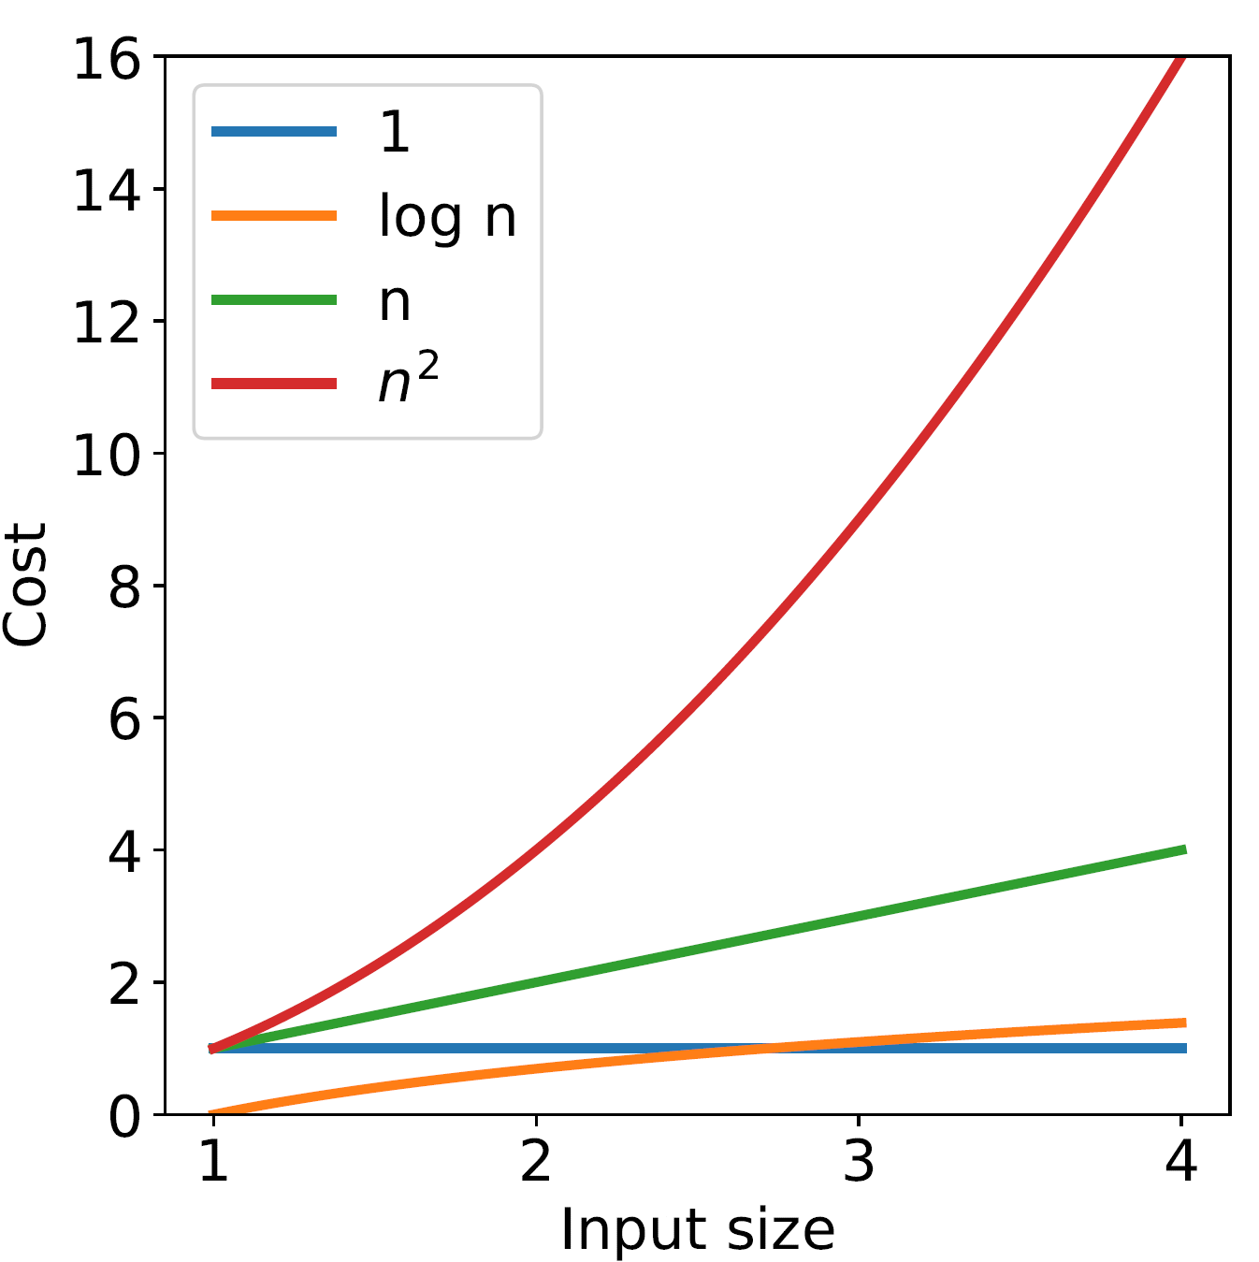
Big-O Example
Does O(n²) includes:
f₁(n) = 1?
f₂(n) = log(n)?
f₃(n) = n?
f₄(n) = n²?
f₅(n) = n⁵?

Slide 22
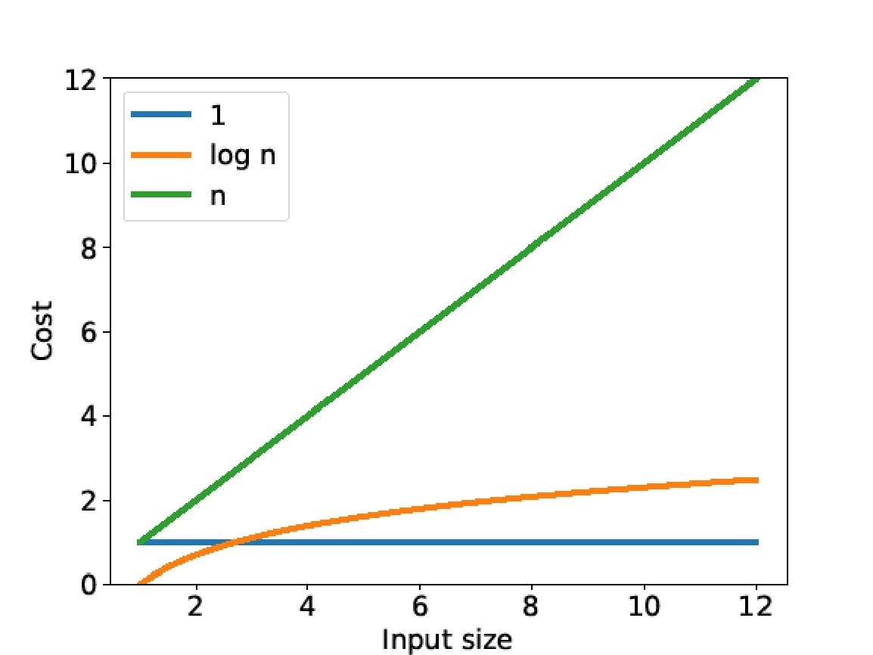
Complexity Classes

Slide 23
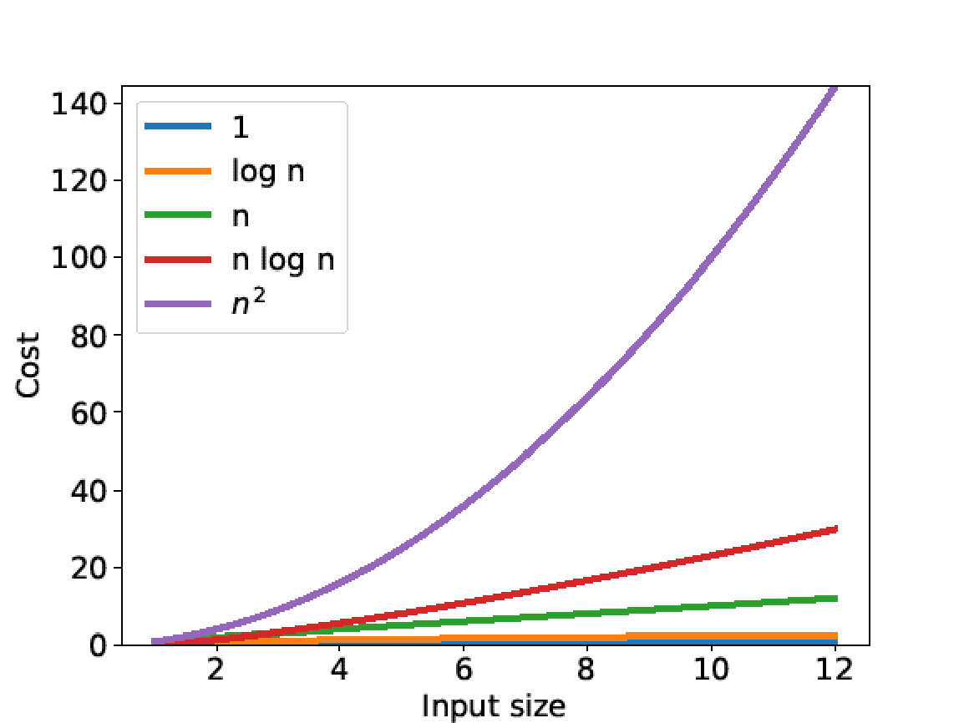
Complexity Classes

Slide 24
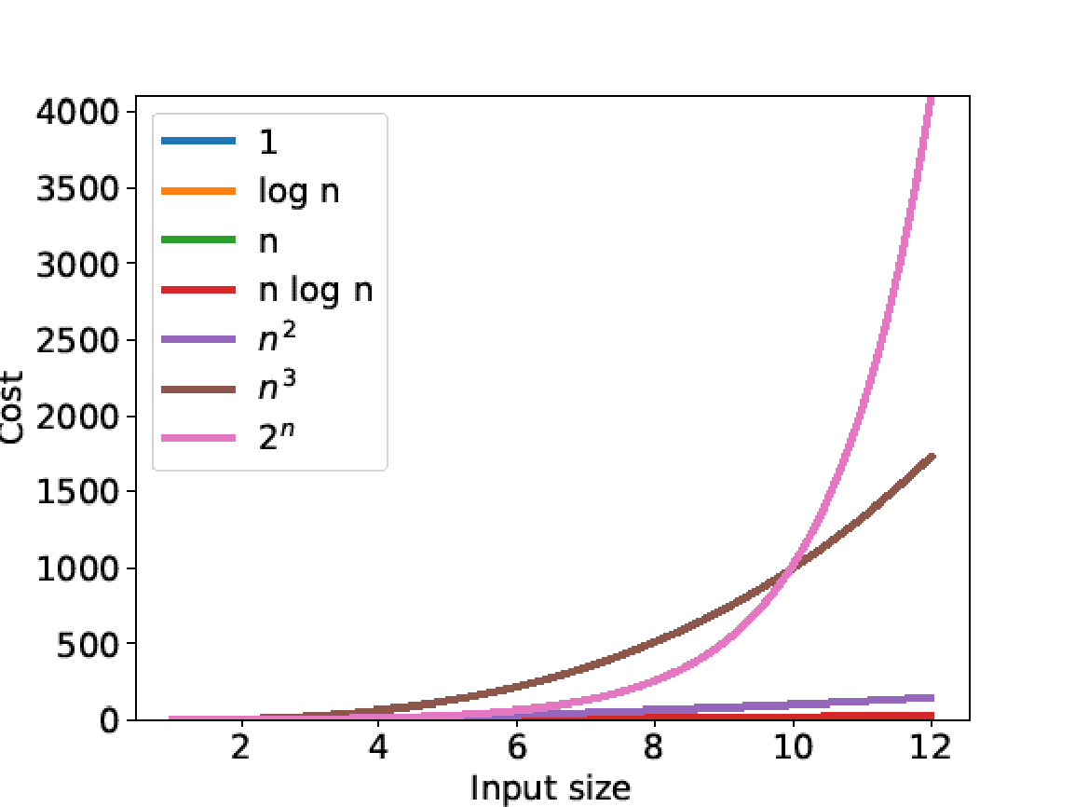
Complexity Classes

Slide 25
Complexity class | Conventional name
O(1) | Constant
O(log n) | Logarithmic
O(n) | Linear
O(n log n) | Linearithmic, log-linear, or quasilinear
O(n²) | Quadratic
O(n³) | Cubic
O(k^{n}) | Exponential

Slide 26
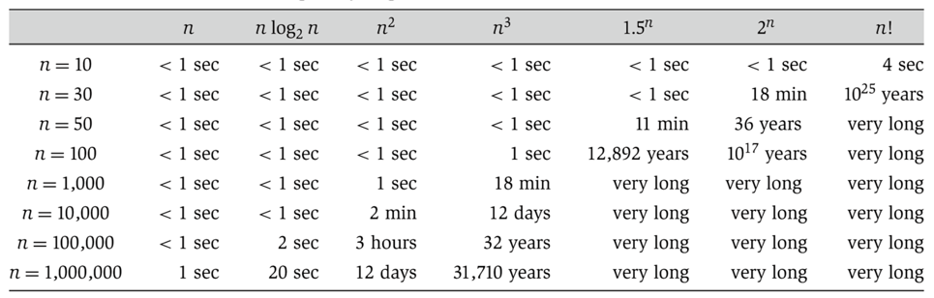

Complexity Classes
Can determine whether or not a problem can be solved at all!
Notes:
Slide credit: Algorithm Design, Tardos, Kleinberg (table), UC Berkeley CS 61B, Hug (slide)

Slide 27
Complexity Classes
Example: determine the complexity class of
3n² - 2n + 25
30000n² + 2n - 25
0.00000000001n² + 123456789n
10n log₁₇n + 25n – 17

Slide 28

Is $2^{n}∈O\left(2^{2n}\right)?$
Is $\log{n^{3}}∈O(\log{n})$?
Is $n\log{n∈O(n)}$?

Slide 29
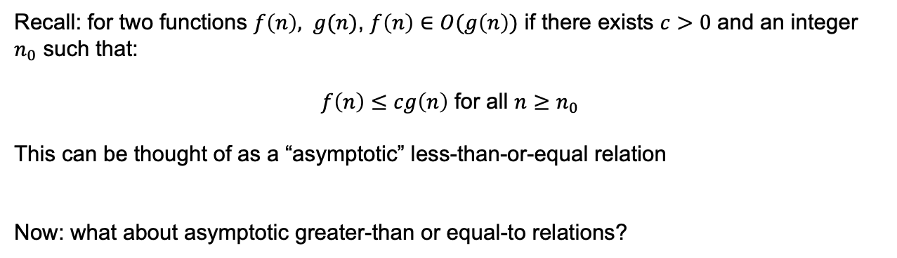
Complexity
Recall: for two functions $f\left(n\right), g(n)$, $f\left(n\right)∈O(g\left(n\right))$ if there exists $c>0$ and an integer $n_{0}$ such that:
$f\left(n\right)≤cg\left(n\right)$ for all $n≥n_{0}$
This can be thought of as a “asymptotic” less-than-or-equal relation
Now: what about asymptotic greater-than or equal-to relations?

Slide 30
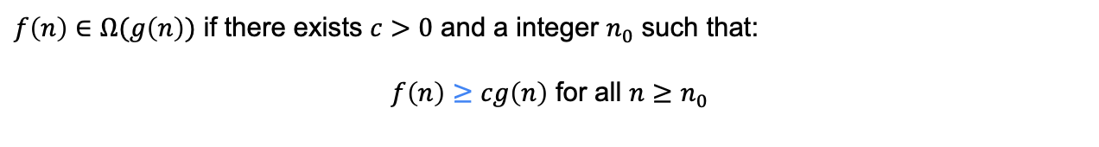

Big-$Ω$
$f\left(n\right)∈Ω(g\left(n\right))$ if there exists $c>0$ and a integer $n_{0}$ such that:
$f\left(n\right)≥cg\left(n\right)$ for all $n≥n_{0}$

Slide 31
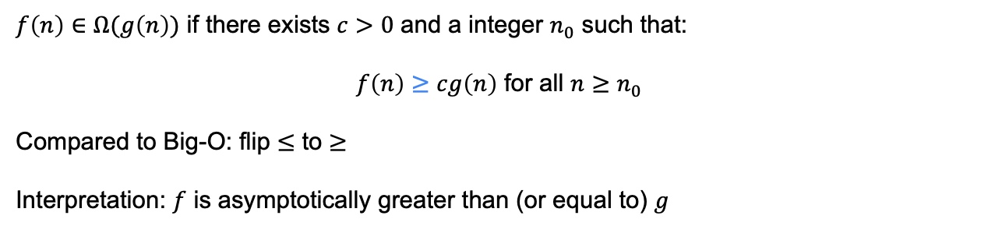
Big-$Ω$
$f\left(n\right)∈Ω(g\left(n\right))$ if there exists $c>0$ and a integer $n_{0}$ such that:
$f\left(n\right)≥cg\left(n\right)$ for all $n≥n_{0}$
Compared to Big-O: flip $≤$ to $≥$
Interpretation: $f$ is asymptotically greater than (or equal to) $g$

Slide 32
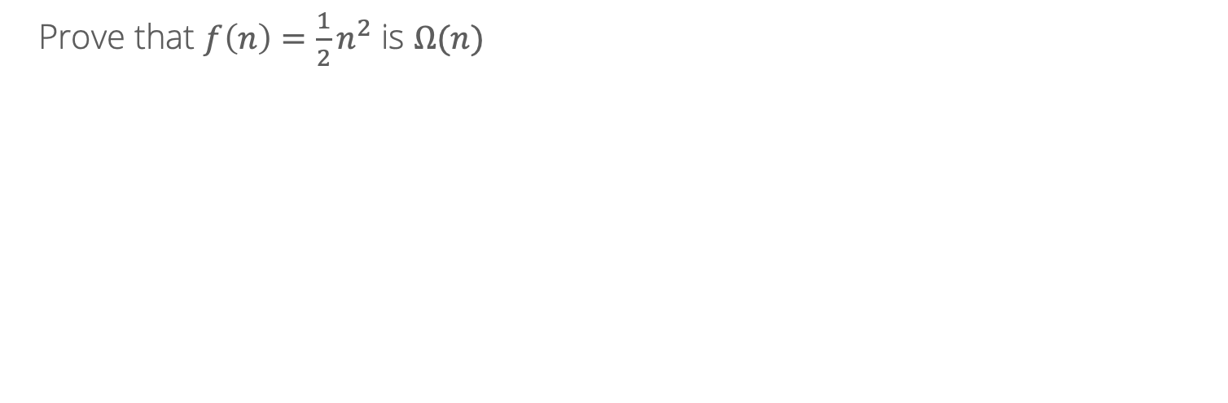

Big-$Ω$ example
Prove that $f\left(n\right)={\frac{1}{2}n}^{2}$ is $Ω(n)$

Slide 33
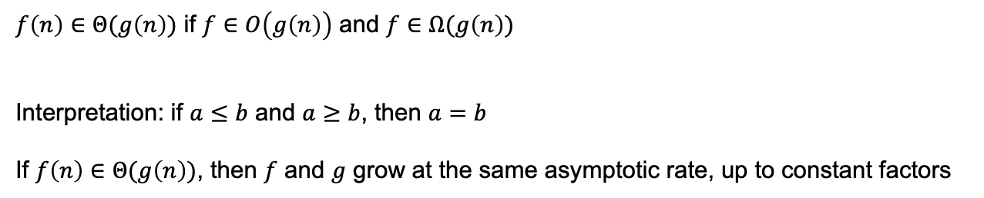

Big-$Θ$
$f\left(n\right)∈Θ(g\left(n\right))$ if $f∈O\left(g\left(n\right)\right)$ and $f∈Ω(g\left(n\right))$
Interpretation: if $a≤b$ and $a≥b$, then $a=b$
If $f\left(n\right)∈Θ(g\left(n\right))$, then $f$ and $g$ grow at the same asymptotic rate, up to constant factors

Slide 34
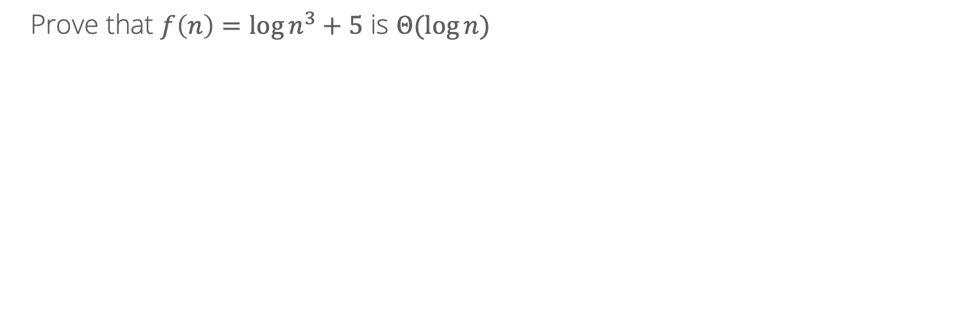

Big-$Θ$ example
Prove that $f\left(n\right)=\log{n^{3}}+5$ is $Θ(\log{n})$

Slide 35
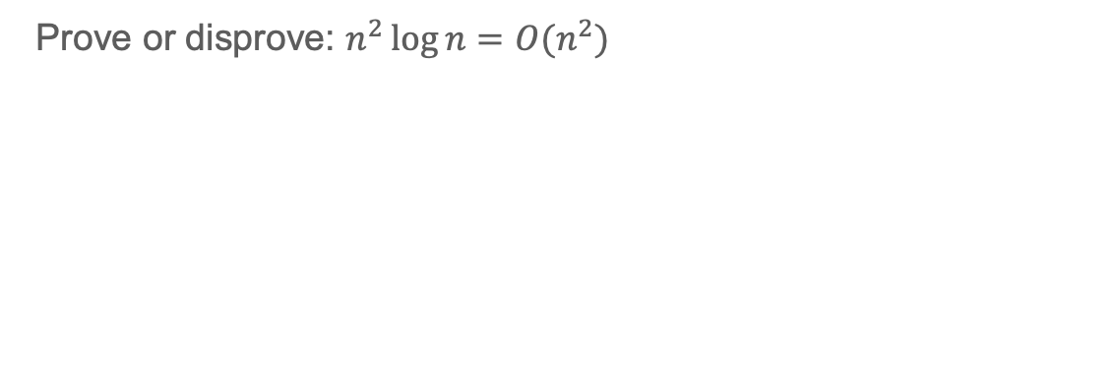
Disproving Big-O runtimes
Prove or disprove: $n^{2}\log{n}=O(n^{2})$
Notes:
Suppose that there exist constants n^2 log n <= c n2 -> log n < c. So for n > e^c, this doesn’t hold, which is a contraction.

