Slide 1

Midterm + calibration
Bryan Wilder

Slide 2
Reminders
Coming up:
Next Tuesday: each team discusses changes they’ve made and final modeling decisions
No need to review all slides from scratch
Talk about the difference from before
Also Tuesday: midterm available
No class the following Thursday (March 2)

Slide 3
Midterm
Take-home
Use of any resources (slides, papers, etc) is allowed
No cooperation or communication is allowed with any other person
This is an individual assignment
Due by Friday (midnight) on Canvas; typed or scanned

Slide 4
Midterm
While take-home, we don’t expect it to take more than ~2-3 hours
Focus on applying concepts covered in the lectures and the project

Slide 5
Example topics
Given a description of a business or policy problem, propose a specific problem formulation
Explain what model evaluation and selection setup you would use
Give examples of baselines or features you would try
Interpret different performance metrics (ROC curve, PR curve, calibration curve, etc); explain when you might prefer models with different performance characteristics
Identify different censoring or missing data scenarios and identify potential solutions
Throughout: emphasis on explaining your reasoning, assumptions, etc

Slide 6
Midterm
Discussion questions from lectures are good examples
Feel free to come talk to me or Ananya if there are topics you want to brush up on

Slide 7
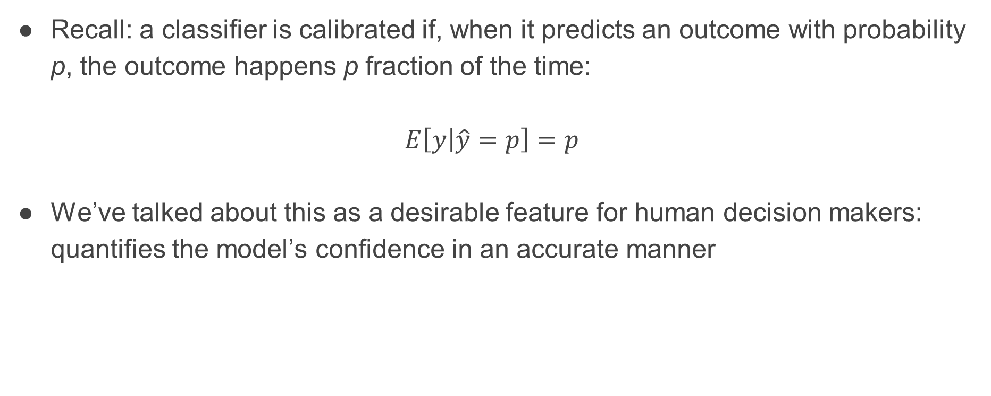
Discussion: calibration and what it means
Recall: a classifier is calibrated if, when it predicts an outcome with probability p, the outcome happens p fraction of the time:
$$E\left[y | \hat{y}=p\right]=p$$
We’ve talked about this as a desirable feature for human decision makers: quantifies the model’s confidence in an accurate manner

Slide 8
Limits of calibration: example 1
Suppose that we are predicting whether it rains tomorrow
It rains 50% of days in Pittsburgh
Consider a classifier that predicts 50% every single day – calibrated!

Slide 9
Limits of calibration: example 2
Consider a less trivial predictor
Suppose that when this classifier predicts p = 0.3:
On very cloudy days (1/3 of the time): It rains with p = 0.6
On sunny days (1/3 of the time): It never rains (p = 0)
On in-between days (1/3 of the time): It rains with p = 0.3
Is this model calibrated? (Slido #10718)

Slide 10
Limits of calibration: example 2
Consider a less trivial predictor
Suppose that when this classifier predicts p = 0.3:
On very cloudy days (1/3 of the time): It rains with p = 0.6
On sunny days (1/3 of the time): It never rains (p = 0)
On in-between days (1/3 of the time): It rains with p = 0.3
In total: it rains p = 0.3 when we predict p = 0.3. Calibrated!

Slide 11
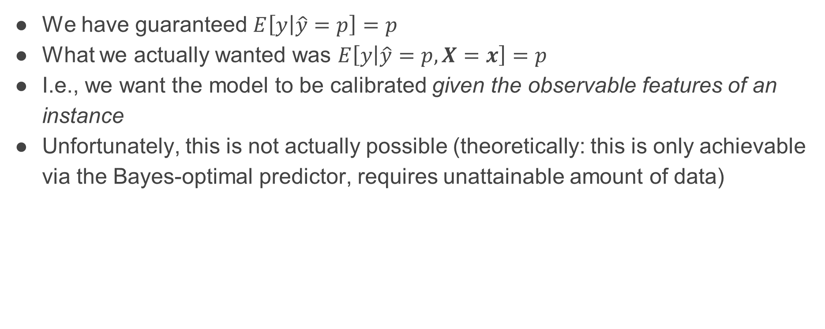
Limits of calibration
We have guaranteed $E\left[y | \hat{y}=p\right]=p$
What we actually wanted was $E\left[y | \hat{y}=p, X=x\right]=p$
I.e., we want the model to be calibrated given the observable features of an instance
Unfortunately, this is not actually possible (theoretically: this is only achievable via the Bayes-optimal predictor, requires unattainable amount of data)

Slide 12
Limits of calibration
Given that we can’t have calibration conditioned on features, even for calibrated classifiers, people will have to form judgments about when to trust them!
Someone could notice: this model is terrible on sunny days
Providing actionable uncertainty quantification is an active research area

Slide 13

Strategies
Potential workaround: can’t generally guarantee calibration conditioned on X, but could we guarantee it conditioned on a limited set of attributes?
E.g., $E\left[y | \hat{y}=p, Level of cloud cover\right]=p$
This is typically possible via separately calibrating the model for each level of the discrete feature

Slide 14
Connection to fairness
Calibration conditioned on demographic group is one way of thinking about fairness: for each group, model’s predicted probability is “unbiased”

Slide 15
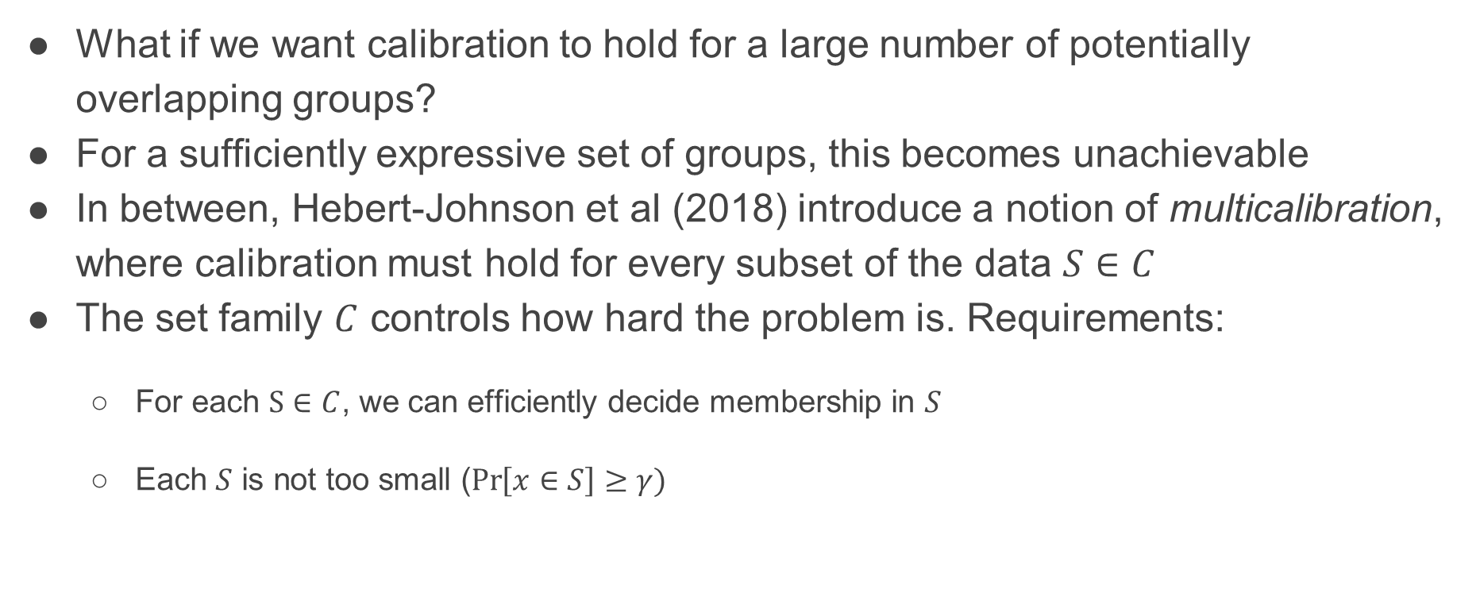
Extension: multicalibration
What if we want calibration to hold for a large number of potentially overlapping groups?
For a sufficiently expressive set of groups, this becomes unachievable
In between, Hebert-Johnson et al (2018) introduce a notion of multicalibration, where calibration must hold for every subset of the data $S∈C$
The set family $C$ controls how hard the problem is. Requirements:
For each $S∈C$, we can efficiently decide membership in $S$
Each $S$ is not too small ($\operatorname{Pr}\left[x∈S\right]≥γ)$

Slide 16
Calibration
Takeaway: uncertainty quantification is hard!
Defining what we want is nonobvious, and it may be statistically or computationally difficult to guarantee
Nevertheless, a very important component of reliable ML pipelines

