Slide 1

Imputation and censoring
Bryan Wilder

Slide 2
Reminders
Coming up:
Project update next week
Next Thursday: paper reflection

Slide 3
Today
Finish up missing data/imputation
Censoring and survival analysis

Slide 4
Missing values
Real datasets always have missing data
First question: do you know when data is missing? Or is it just…not there
NEVER drop all the rows with missing data
What are you going to do at test time with an entity with missing data shows up?
Strategies for handling missingness depend on belief about distribution shift in missingness between training data and deployment

Slide 5
Missing values
Models for missingness:
Missing completely at random: uniform probability of missingness
Missing at random: Pr[missingness] captured by observed features
Missing not at random: none of the above
Similar to causal inference: assumptions cannot be verified by data alone ☹

Slide 6
Missing values
Handling missingness depends on your goals
Statistical inference: recover the correct value of a parameter (e.g., the mean of a covariate or a coefficient in a linear regression model)
ML: predict unseen examples
In inference, it is theoretically acceptable to throw away missing data if either (a) data is missing completely at random or (b) your model includes all variables the probability of missingness depends on
In prediction, missingness is part of the distribution and will likely be present at test time as well

Slide 7
Imputation
Impute (Fill in) missing values based on why you think they may be missing and what you want the model to do with those missing values
Typically, also add binary feature (dummy) for missing vs not missing in case “missingness” is predictive of the outcome
This requires that the reasons features are missing be similar at train and test time

Slide 8
Imputing Missing Values: Some Options
Central Tendency: Mean / Median / Mode
ML methods that handle missing data (e.g., xgboost)
Others
Regression
k-Nearest Neighbor
Multiple Imputation

Slide 9
Imputing – Central Tendency
Simple to calculate and computationally fast
Often a reasonable starting point
May be able to capture more nuance by using other, correlated data to help fill in missing values
Under-represents variance/covariance of data

Slide 10
Imputing – ML Methods with Missing Data Handling
Some models have built-in handling of missing data, such as xgboost (which decides which direction to send missing values at each split)
May not be the best modeling method for your problem, don’t want to be locked into certain type of model
Nevertheless, worth exploring performance of other imputation methods even when using these models as well

Slide 11
Imputing – Regression
Make use of information in correlated features, more flexible than central tendency
However, may not be flexible enough to capture complex relationships or interactions
May be somewhat more computationally expensive
Generally will still underestimate variation in data

Slide 12
Imputing – k-Nearest Neighbor
More flexible option, capture more complexity in relationships in data
Difficult to choose appropriate distance metric, value of k
More computationally expensive than other methods of imputation
Requires entire training set to calculate imputed values for new examples

Slide 13
Imputing – Multiple Imputation
Create multiple “complete” datasets with different values using different regression models (e.g., R package mice)
Helps analyze sensitivity to handling of missing values
Much more computationally expensive, both for imputation and downstream modeling
Can provide better representation of variability in data

Slide 14
Missing Value Tips
Do not remove rows or columns with missing values (unless there is a really really really good reason)
Missingness can be a useful predictor: create a flag even if you impute a value
Data can be missing for different reasons and missingness for each row/column/cell may need to be handled differently
Only use data from the past for imputation

Slide 15
Censoring
A special kind of missing data
In particular, when an outcome is missing because we stop observing an entity after some point in time, or don’t observe the exact time when an event happens
In general, missing outcomes are very difficult to handle; censoring is a special case where we can say something

Slide 16
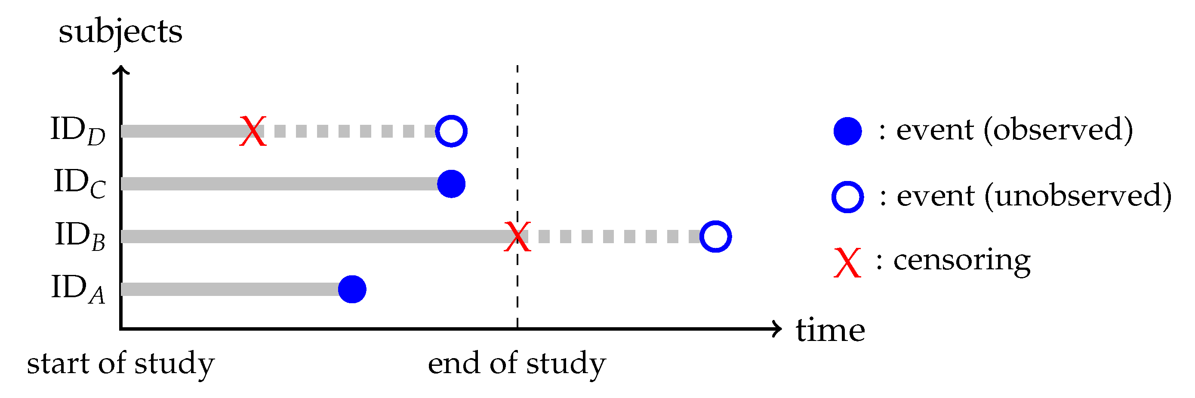
Censoring
Most common form: right-censoring
https://www.mdpi.com/2504-4990/1/3/58

Slide 17
Slido
#10718, remember to enter your name

Slide 18
Examples
You only collect outcomes for some period of time
People are lost to follow up (drop out of a study, move to a different state, switch to a competitor’s service, etc)

Slide 19
Impact on modeling
Censored observations are partially missing: we don’t know the label, but we know the time t when someone was lost to followup
This is still informative: event did not happen by time t
How do we make use of that information to improve our model?

Slide 20
Survival analysis
Changes focus from binary classification (did event happen or not) to a regression (time until event happens, which might be infinity if it never does)
Sometimes time-to-event is itself the question of interest
Time to recurrence of a medical issue, time until a customer makes a purchase, etc.
Sometimes modeling as time-to-event is important because it allows us to use information about censored outcomes

Slide 21
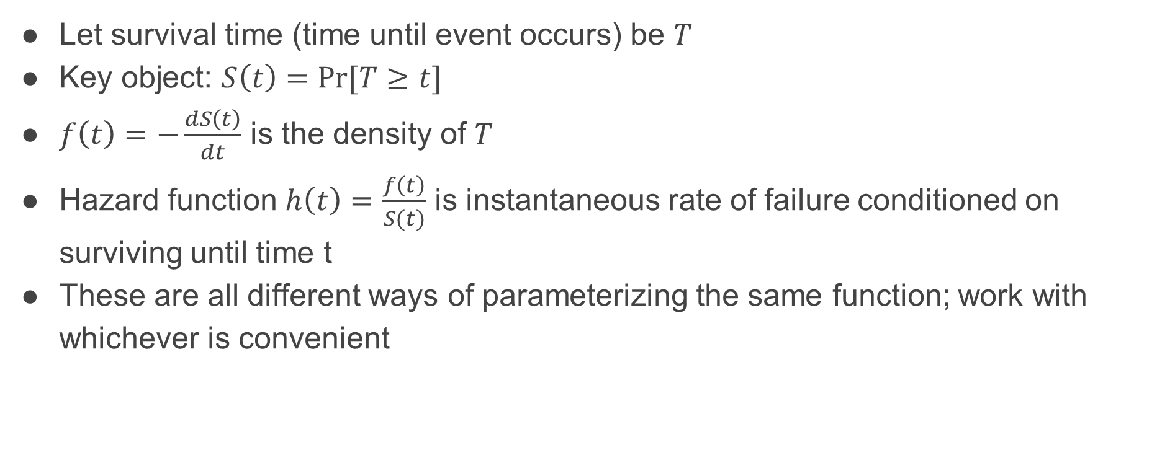
Survival analysis
Let survival time (time until event occurs) be $T$
Key object: $S\left(t\right)=\operatorname{Pr}{[T≥t]}$
$f\left(t\right)=−\frac{dS\left(t\right)}{dt}$ is the density of $T$
Hazard function $h\left(t\right)=\frac{f\left(t\right)}{S(t)}$ is instantaneous rate of failure conditioned on surviving until time t
These are all different ways of parameterizing the same function; work with whichever is convenient

Slide 22
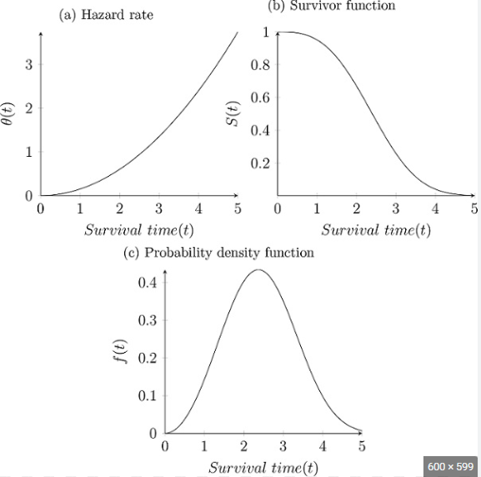
https://methods.sagepub.com/foundations/event-history-and-survival-analysis

Slide 23
Survival analysis
Aim is to infer one of these functions (typically the hazard function); others can be backed out
Framework: maximum likelihood estimation
Key principle: only count individual i towards the likelihood during times that you would observe an event if it happened

Slide 24

Likelihood function
$$ℓ\left(t\right)= \left\{\begin{aligned}\operatorname{Pr}\left[T=t\right]if event was observed \\ \operatorname{Pr}{[T≥t]} if subject was censored at T\end{aligned}\right.$$
Let $δ_{i}$ be 1 if a subject is observed, 0 if censored. Complete likelihood:
$$ℓ=\prod_{i=1}^{N}{f{\left(t_{i}\right)}^{δ_{i}}S{\left(t_{i}\right)}^{1−δ_{i}}}$$

Slide 25

General idea
Propose a model with parameters (typically specified in terms of a model for hazard function $h)$
Fit the parameters via maximum likelihood

Slide 26

General idea
Two main families
“Accelerated failure time” models (AFT): $h$ is some known density (log-normal, Weibull, etc) with free parameters (the mean, variance, etc.) that are a function of the features (linear, xgboost, etc)

Slide 27

General idea
Two main families
“Accelerated failure time” models (AFT): $h$ is some known density (log-normal, Weibull, etc) with free parameters (the mean, variance, etc.) that are a function of the features (linear, xgboost, etc)
Fit the parameters of that distribution to maximize the likelihood

Slide 28

Cox proportional hazards model
Very common in applied literatures
Semi-parametric model
$h\left(t, X\right)=h_{0}\left(t\right)\exp{(β^{′}x)}$
$h_{0}\left(t\right)$ is the baseline hazard rate, and is allowed to be totally nonparametric
$\exp{(β^{′}x)}$ means that the features scale the hazard rate in a log-linear way

Slide 29

Cox proportional hazards model
Interpretation similar to logistic regression
“Hazard ratio”: $e^{β}$ is the increase the hazard rate attributable to feature $x$

Slide 30
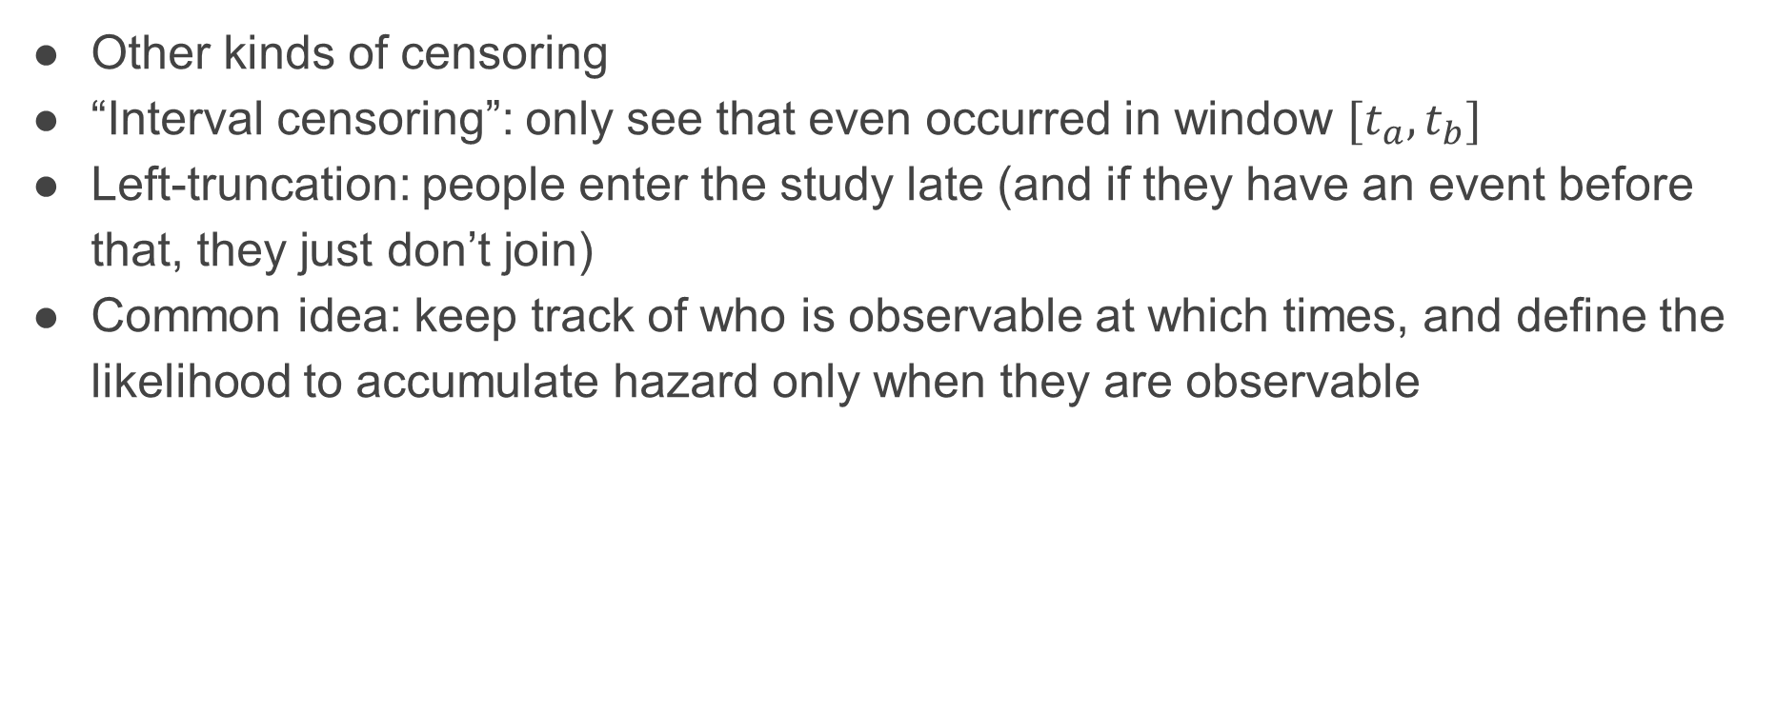
Extensions
Other kinds of censoring
“Interval censoring”: only see that even occurred in window $[t_{a}, t_{b}]$
Left-truncation: people enter the study late (and if they have an event before that, they just don’t join)
Common idea: keep track of who is observable at which times, and define the likelihood to accumulate hazard only when they are observable

