Slide 1
Field trials
Bryan Wilder
CMU

Slide 2
Motivation
What we can measure on historical data: predictive performance
What we (usually) care about: did some decision improve?
Treatment effects – did the intervention work for people who received it?
How do human decision makers interact with ML? Do they even use it?
Gap between short-term outcomes (e.g., clicking an ad) and long-term (e.g. purchasing)
Often, only way to get at these questions is to try things in the real world

Slide 3
Evaluation challenges
How do we look at a trial of deploying a system and tell whether it worked?
Today: designing and analyzing randomized trials
Thursday: observational causal inference

Slide 4
Randomized trials
We have a set of units (entities/individuals)
For each of them flip a coin:
Heads: decision is made for them using the new system we want to evaluate
Tails: decision is made using a comparison system (e.g. status quo)
Afterwards: look at difference in outcomes between the two groups

Slide 5
Randomized trials
Tech: A/B tests (expose incoming users randomly to different interface designs etc, measure retention/purchasing/other outcomes)
Medicine: clinical trials of new drugs

Slide 6
Today
Why is randomization so important?
Overview of design criteria for randomized trials
Overview of analysis of randomized trials
Disclaimer: this is necessarily a brief overview to highlight some of the biggest things to be aware of

Slide 7
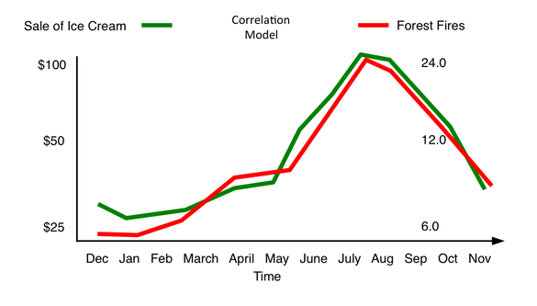
Why is randomization important?
Does ice cream cause forest fires?
https://www.decisionskills.com/blog/how-ice-cream-kills-understanding-cause-and-effect

Slide 8
Other variables (e.g. heat)
Other variables (e.g. heat)
Ice cream
Forest fires
Forest fires
Ice cream
Ice cream
Forest fires
Forest fires
Suppose you just observe examples (ice cream sold, # forest fires). Can you distinguish these generative models?
Slido #10718; remember to enter your name

Slide 9
Why is randomization important
In general, it is observationally impossible to rule out unobserved variables that induce a correlation between treatment and outcome without there being a causal relationship
Randomization: introduces an exogenous source of variation, i.e., uncorrelated with these unobserved variables

Slide 10

Why randomization is important
Other variables (e.g. heat)
Give people free ice cream
Ice cream
Forest fires
?
More forest fires?

Slide 11
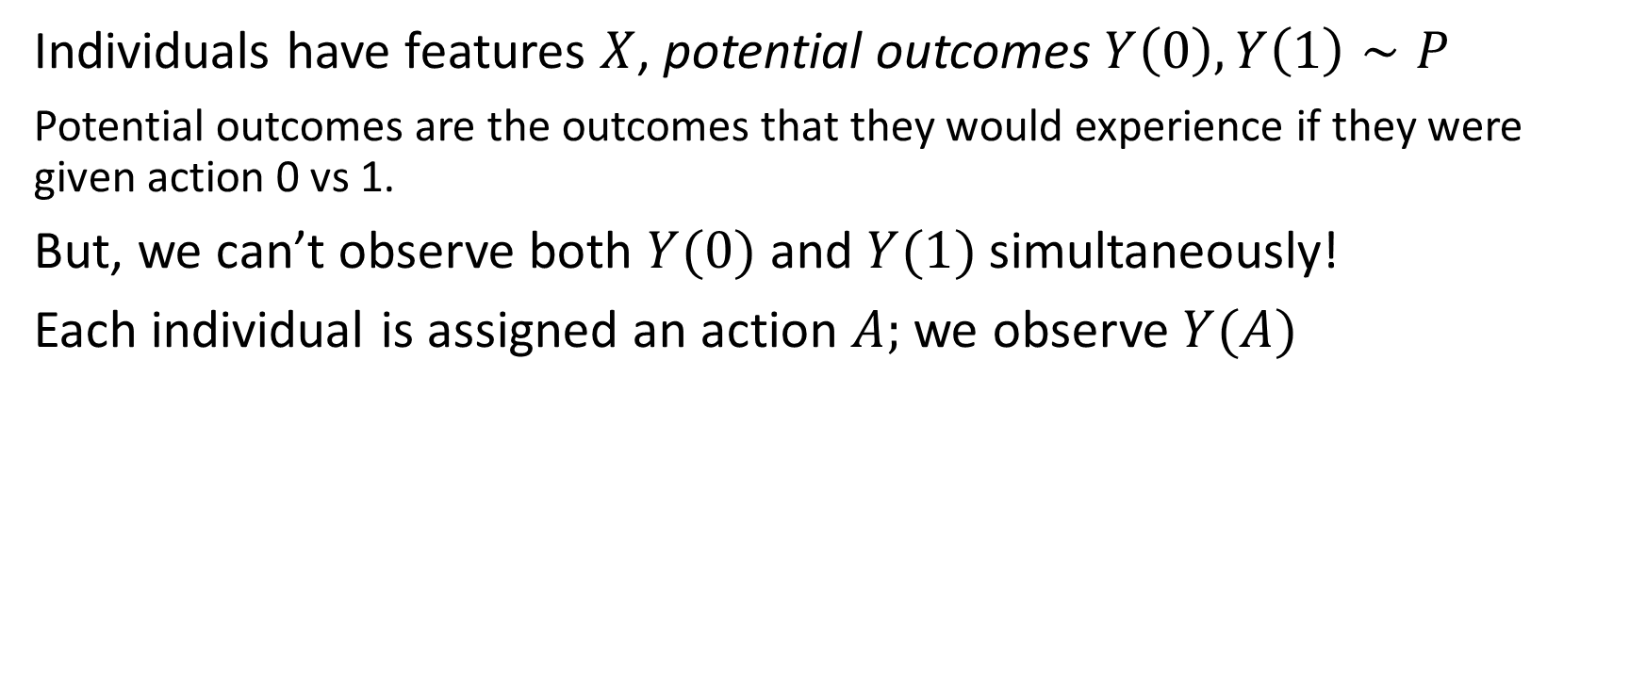
Some notation
Individuals have features $X$, potential outcomes $Y\left(0\right), Y\left(1\right)∼P$
Potential outcomes are the outcomes that they would experience if they were given action 0 vs 1.
But, we can’t observe both $Y(0)$ and $Y(1)$ simultaneously!
Each individual is assigned an action $A;$ we observe $Y(A)$

Slide 12

Some notation
Our goal: estimate $E[Y\left(1\right)−Y\left(0\right)]$ (“average treatment effect”)
(“Average change in probability of readmission in patients where the clinician uses the AI alerting system”)
(“Average change in $ spent for users who see ad A instead of B”)

Slide 13

Challenge
We observe ${\left\{\left(X_{i}, A_{i}, Y_{i}\right)\right\}}_{i=1}^{N}$ collected according to some baseline policy
We can calculate $E\left[Y\left(1\right)\right|A=1]$ and $E[Y(0)|A=0]$
But confounding happens when $E\left[Y\left(1\right)\right|A=1]$ $≠$ $E\left[Y\left(1\right)\right]!$

Slide 14
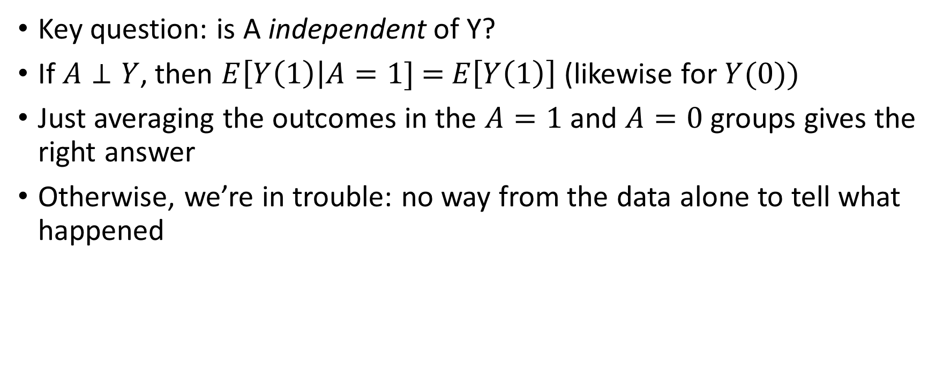
Confounding, formally
Key question: is A independent of Y?
If $A⊥Y$, then $E\left[Y\left(1\right)\right|A=1]$ $=$ $E\left[Y\left(1\right)\right]$ (likewise for $Y(0))$
Just averaging the outcomes in the $A=1$ and $A=0$ groups gives the right answer
Otherwise, we’re in trouble: no way from the data alone to tell what happened

Slide 15
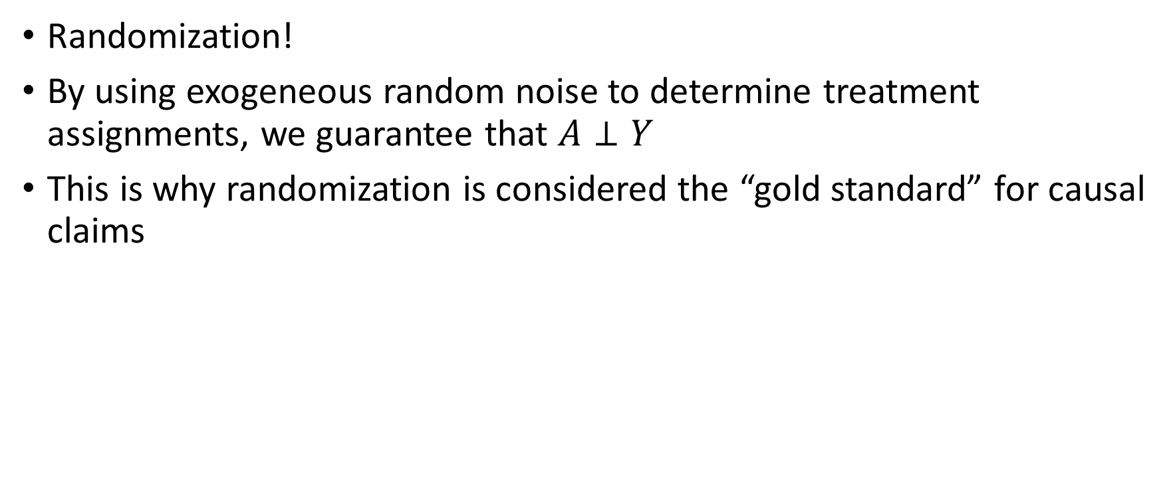
How to eliminate confounding?
Randomization!
By using exogeneous random noise to determine treatment assignments, we guarantee that $A⊥Y$
This is why randomization is considered the “gold standard” for causal claims

Slide 16
Today
Why is randomization so important?
Overview of design criteria for randomized trials
Overview of analysis of randomized trials

Slide 17
Designing RCTs
Key questions
Is randomization feasible/ethical?
Can I measure the outcome of interest?
How many samples do I need?
Will randomization answer the right question?

Slide 18
Is randomization feasible/ethical?
In some settings, randomization may be inappropriate (e.g., if we believe one option is much worse, or would harm participants)
In some settings, it is impractical (too operationally difficult, etc)

Slide 19
Is randomization feasible/ethical?
Can try to limit downside as much as possible before conducting RCT
E.g., implement system operationally and write down decisions it would have made (but don’t actually act on them)
See if major problems are evident
But, not possible to avoid risks entirely

Slide 20
Can I measure the outcome of interest?
Randomization doesn’t help if your outcome variable is meaningless
Classic problem: we care about a long-term outcome (is someone homeless after 5 years?) but can’t wait that long
Solution: surrogate outcome (are they homeless after 6 months?)
Trial can’t answer whether this is a good surrogate: need other data or domain knowledge

Slide 21
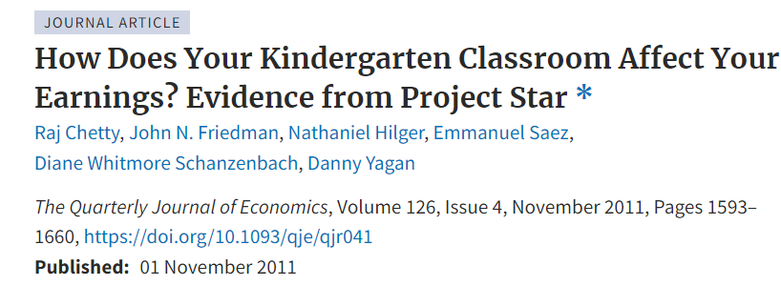
Can I measure the outcome of interest?
Classic example: what is the impact of smaller class sizes on educational outcomes?
Impact on test scores fades out within a few years
But, kids with smaller class sizes have higher income as adults!
(Potential mechanism: non-cognitive skills like effort and initiative)

Slide 22
Will a randomized trial answer the right question?
Back to example: what is the difference in readmission risks for patients where a clinician uses an AI alerting system
Outcomes may not just depend on whether the system is used for a single patient: maybe if it’s used for all patients, the consequences are different (positive: maybe clinicians have less attention fatigue; negative: maybe clinicians tend to over-rely on it)
In general: maybe we are interested in the equilibrium consequences of using a system all the time, not the marginal consequences of using it for a single case

Slide 23
Spillovers
Another example: spillovers occur when one person’s treatment status impacts other people
E.g. providing financial assistance to one person will likely have an impact on the rest of their household, family, friends, etc
RCT at the individual level may suffer from contamination, where people who are treated impact the untreated group

Slide 24
Spillovers
Slido #10718

Slide 25
Will a randomized trial answer the right question?
Sometimes, it is necessary to change the unit of randomization (entire hospitals, households, towns, etc)
“Cluster-randomized”
Obviously this is much harder and requires implementing a trial on a much larger scale
Important to at least be aware of the limitations of randomized trials at an individual level

Slide 26
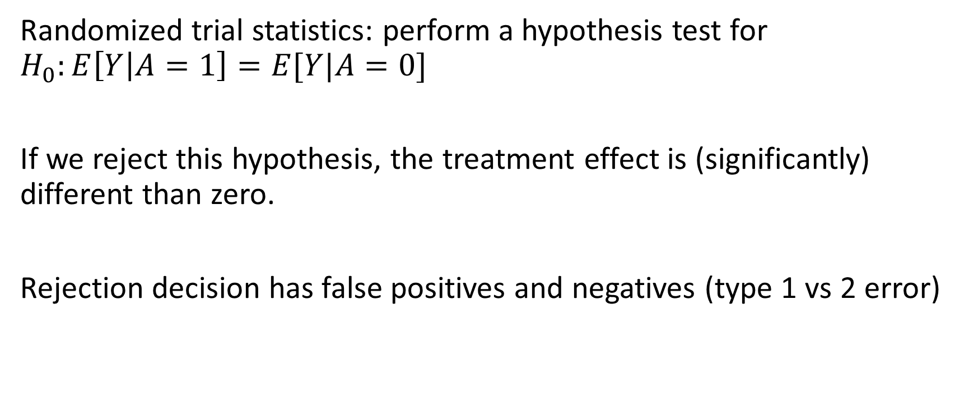
How many samples do I need?
Randomized trial statistics: perform a hypothesis test for $H_{0}:E\left[Y | A=1\right]=E[Y|A=0]$
If we reject this hypothesis, the treatment effect is (significantly) different than zero.
Rejection decision has false positives and negatives (type 1 vs 2 error)

Slide 27
How many samples do I need?
False positive: conclude there is a significant effect when there actually is not
False negative: fail to detect a significant effect which actually exists
Power: probability of finding an effect if one exists (true positive rate)

Slide 28
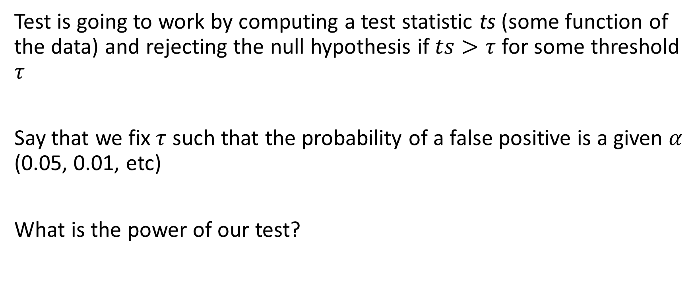
How many samples do I need?
Test is going to work by computing a test statistic ts (some function of the data) and rejecting the null hypothesis if $ts>τ$ for some threshold $τ$
Say that we fix $τ$ such that the probability of a false positive is a given $α$ (0.05, 0.01, etc)
What is the power of our test?

Slide 29
How many samples do I need?
What is the power of the test?
Depends on the sample size and effect size
It is relatively easier to detect a very large effect (fewer samples needed) and harder to detect a small effect
Key question for design: choosing a large enough sample size to have higher power under plausible effect sizes you want to detect

Slide 30
How many samples do I need?
There are lots of formulas, calculators, etc
Usually, you will have to guess a value for (1) the difference in means (2) the standard deviation of the outcome (pooled across groups)
This is estimated based on prior studies, guesses on what is a “large” or “small” effect in your domain, etc.
Then, crank through a formula based on a normal approximation of the sampling distribution of the estimator

Slide 31
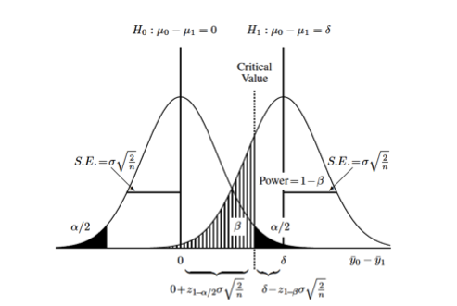
How many samples do I need?

Slide 32
Today
Why is randomization so important?
Overview of design criteria for randomized trials
Overview of analysis of randomized trials

Slide 33
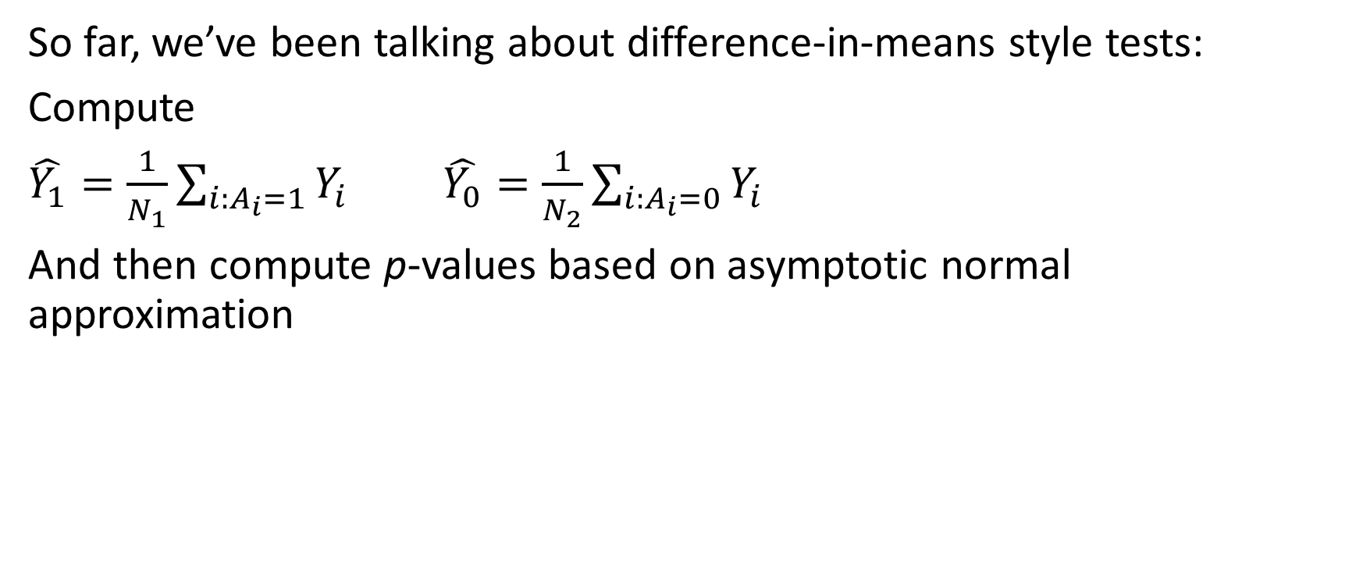
Analysis of randomized trials
So far, we’ve been talking about difference-in-means style tests:
Compute
$\hat{Y_{1}}=\frac{1}{N_{1}}\sum_{i:A_{i}=1}{Y_{i}}$ $\hat{Y_{0}}=\frac{1}{N_{2}}\sum_{i:A_{i}=0}{Y_{i}}$
And then compute p-values based on asymptotic normal approximation

Slide 34
Analysis of randomized trials
Difference-in-means: always unbiased, asymptotically correct, simple, etc
Can we do better?

Slide 35

Analysis of randomized trials
Difference-in-means: always unbiased, asymptotically correct, simple, etc
Can we do better?
So far, we haven’t used the covariates $X$ at all!

Slide 36
Analysis of randomized trials
Covariates carry information about the outcome
When sample size is sufficiently large, covariates will be balanced across groups
For finite sample size, there will be differences between groups: one group may have more people who were predisposed towards a particular outcome

Slide 37
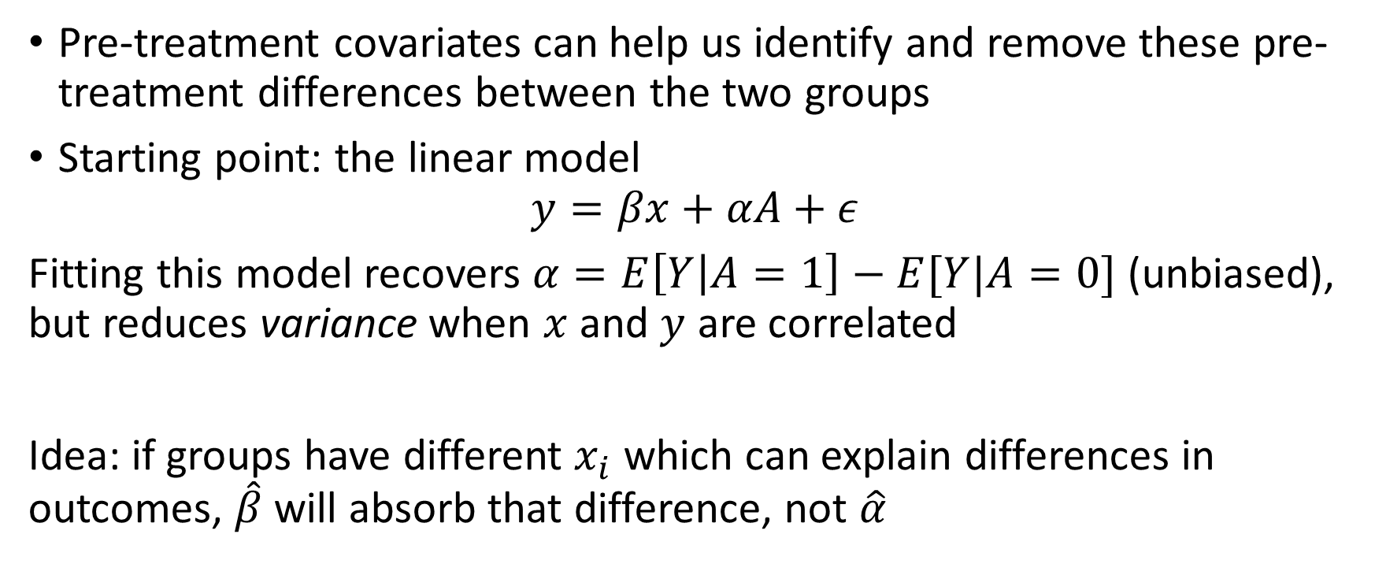
Analysis of randomized trials
Pre-treatment covariates can help us identify and remove these pre-treatment differences between the two groups
Starting point: the linear model
$$y=βx+αA+ε$$
Fitting this model recovers $α=E\left[Y | A=1\right]−E[Y|A=0]$ (unbiased), but reduces variance when $x$ and $y$ are correlated
Idea: if groups have different $x_{i}$ which can explain differences in outcomes, $\hat{β}$ will absorb that difference, not $\hat{α}$

Slide 38
Analysis of randomized trials
Complications: unbiased-ness of OLS is a very specific property of linear models (holding even if the model is misspecified)
Does not hold when the model is nonlinear (e.g., fitting a logistic regression for a binary outcome)
Fitting generalized linear models is still very common (may be necessary when outcome is binary, count data, etc), but does introduce some amount of bias
Recent focus in causal inference: developing improved estimators (e.g., doubly-robust) which circumvent this issue

