Slide 1
Observational causal inference
Bryan Wilder
CMU

Slide 2
Motivation
What we can measure on historical data: predictive performance
What we (usually) care about: did some decision improve?
Treatment effects – did the intervention work for people who received it?
How do human decision makers interact with ML? Do they even use it?
Gap between short-term outcomes (e.g., clicking an ad) and long-term (e.g. purchasing)
Often, only way to get at these questions is to try things in the real world

Slide 3
Motivation
Last time: designing and analyzing randomized trials
But what if we can’t randomize?

Slide 4
“Quasi-experimental” settings
We didn’t actually do an experiment
But, we hope that there was some “natural” variation in what treatment people were exposed to

Slide 5

Recall
Other variables (e.g. heat)
Give people free ice cream
Ice cream
Forest fires
?
More forest fires?

Slide 6
Natural experiment?
Other variables (e.g. heat)
Earthquake destroys the ice-cream factory :(
Ice cream
Forest fires
?
More forest fires?

Slide 7
“Quasi-experimental” settings
Look for exogenous sources of variation in treatment assignment
As usual: data alone cannot prove whether exogeneity holds
Requires domain expertise, additional assumptions, etc
Today: examples of common research designs and settings in which they apply

Slide 8
Pre/post designs
Attempt #1: Record outcomes for people under historical policy on days 1…t. On day t+1, switch to the new policy
Compare outcomes before and after day t

Slide 9
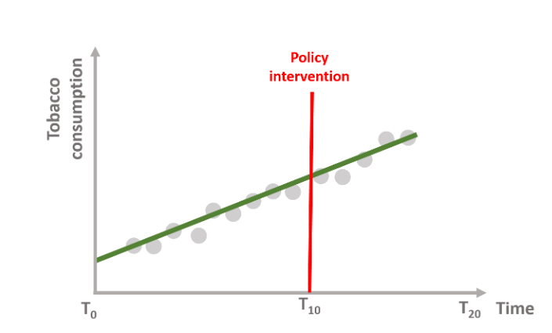
Pre/post designs
Attempt #1: Record outcomes for people under historical policy on days 1…t. On day t+1, switch to the new policy
Compare outcomes before and after day t
What could go wrong?

Slide 10
Attempt #1: Interrupted time series
What if we fit the pre-existing trend and remove it?
E.g., fit a linear model for the overall time trend, and subtract out that portion
Then, compare the difference from the trend pre/post intervention
This is an interrupted time series analysis

Slide 11
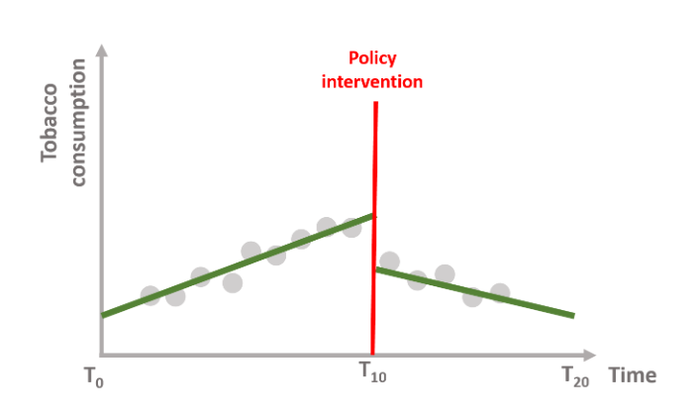
https://ds4ps.org/pe4ps-textbook/docs/p-020-time-series.html

Slide 12
Attempt #1: Interrupted time series
Issue: breaks down when there are a lot of short-term changes (don’t know what to attribute to the intervention and what would have happened anyway)
More broadly: requires an assumption that the no-treatment counterfactual can be extrapolated from the previous history; likely only true for relatively simple trends (e.g., linear or simple seasonal patterns)

Slide 13
Attempt #2: Differences-in-differences
What if we could identify a group of “similar” places/institutions/etc that did not adopt the new intervention?
If they had a similar pre-intervention trend, then we can compare change over time in treated group vs change over time in control group?
Differences-in-differences: (1) compute difference within unit over time (2) take differences of those differences between units

Slide 14
https://diff.healthpolicydatascience.org/

Slide 15
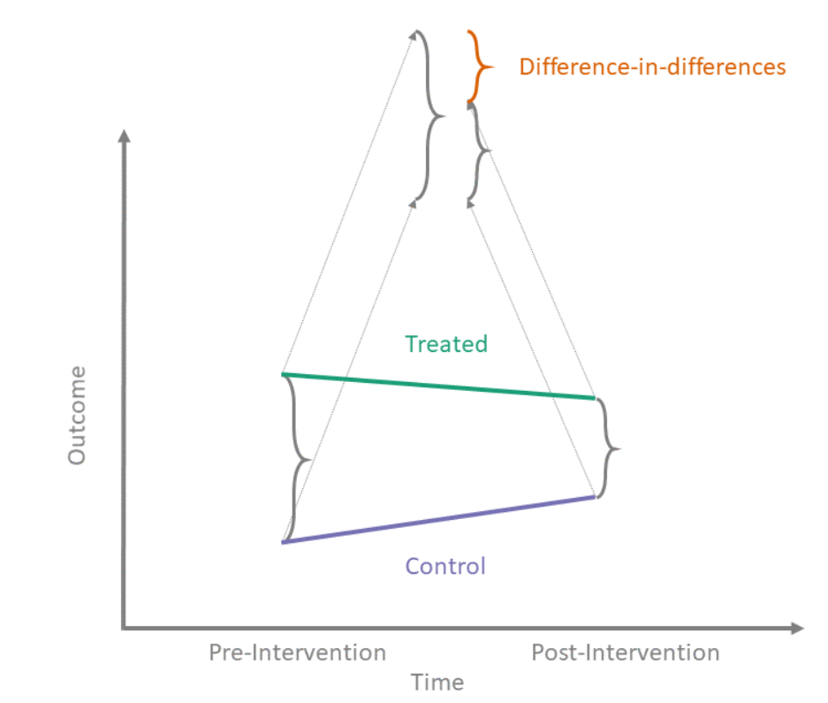
https://diff.healthpolicydatascience.org/

Slide 16
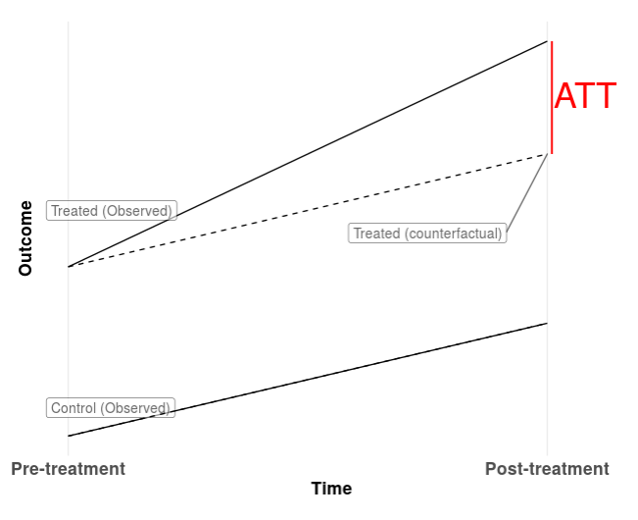
Treatment effect
https://diff.healthpolicydatascience.org/

Slide 17
What is this trying to estimate?
Average treatment effect on the treated
What is the difference in outcomes for the treated unit compared to if they did not experience the intervention?

Slide 18
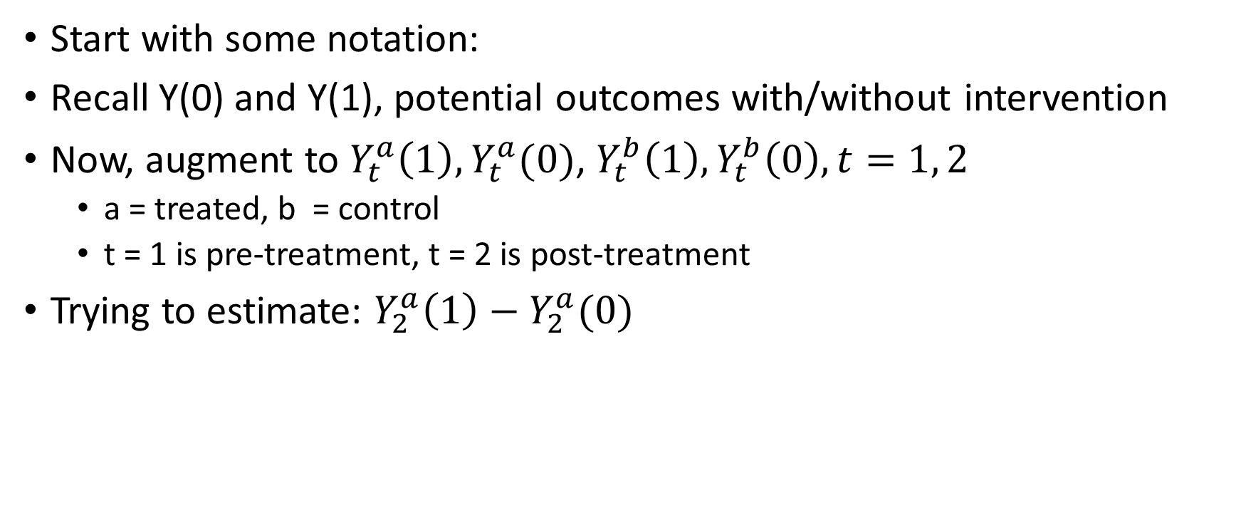
Formalization
Start with some notation:
Recall Y(0) and Y(1), potential outcomes with/without intervention
Now, augment to $Y_{t}^{a}\left(1\right), Y_{t}^{a}(0)$, $Y_{t}^{b}\left(1\right), Y_{t}^{b}\left(0\right), t=1, 2$
a = treated, b = control
t = 1 is pre-treatment, t = 2 is post-treatment
Trying to estimate: $Y_{2}^{a}\left(1\right)−Y_{2}^{a}(0)$

Slide 19

What assumptions are being made?
Arrow of time: $Y_{1}^{a}\left(1\right)=Y_{1}^{a}(0)$ since time 1 is pre-treatment

Slide 20

What assumptions are being made?
Parallel trends: control group represents what would have happened in treatment group without the intervention
Formally: ${E[Y}_{2}^{a}\left(0\right)−Y_{1}^{a}(0)]{= E[Y}_{2}^{b}\left(0\right)−Y_{1}^{b}(0)]$

Slide 21
Actual treatment effect
Estimated treatment effect
Assumed counterfactual
Actual counterfactual
Actual counterfactual
https://diff.healthpolicydatascience.org/

Slide 22
When do we expect parallel trends to hold
When the policy change was for some reason exogeneous!
Confounding = units that adopt the policy change were different in some unobserved way (their counterfactual trend was different than non-adopters)
Everything depends on how good the control group is

Slide 23
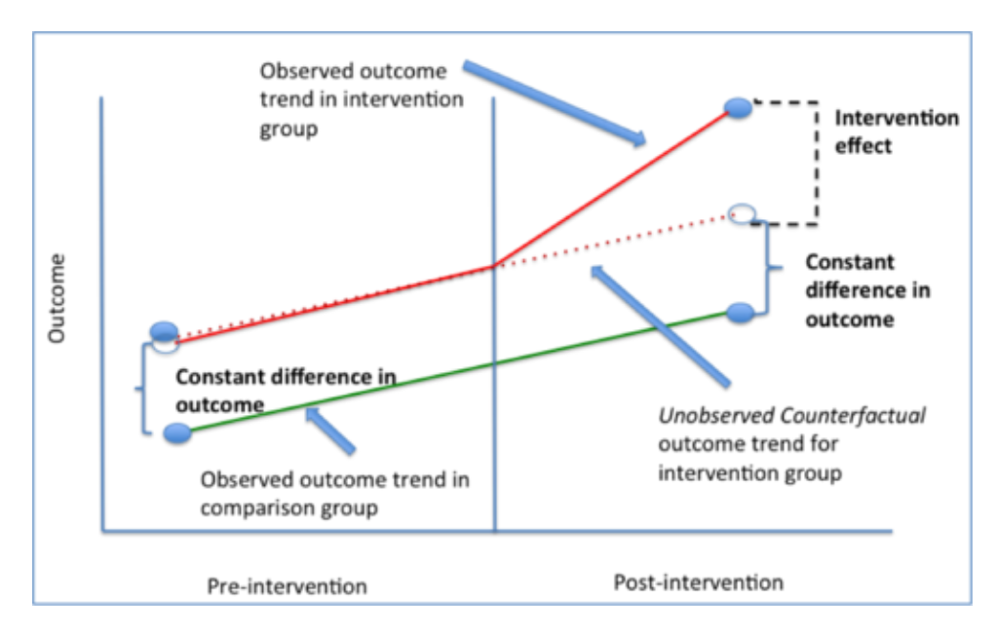
Testing parallel trends
Suppose we observe parallel trends in several pre-intervention time periods…
Does this imply that the parallel trends assumption holds?
Slido #10718, remember to enter your name

Slide 24
When do we expect parallel trends to hold
Diff-in-diff is a systematic way of comparing your post-intervention outcome to a control group
This comparison is not meaningful unless the control group is comparable!
Can look at whether parallel trends held pre-treatment etc to falsify
However, whether it holds in the counterfactual is not verifiable

Slide 25

Estimation
Most basic setting: two-way fixed effect estimator
Fit a linear model
$$y_{it}=α_{i}+δ_{t}+βD_{it}+ε_{it}$$
Error
Indicator for i being in treatment group + t being post-treatment
Outcome in unit i at time t
Coefficient for location i
Coefficient for time t
Interpret $β$ as the treatment effect

Slide 26
Instrumental variables
Another quasi-experimental setting
Look for an event which randomly shocks the treatment variable
Or, sometimes construct one experimentally

Slide 27
Natural experiment?
Other variables (e.g. heat)
Earthquake destroys the ice-cream factory :(
Ice cream
Forest fires
?
More forest fires?

Slide 28
Instrumental variables
Other variables (e.g. heat)
Earthquake
Ice cream
Forest fires
?
More forest fires?
“After ice cream production was shocked by an earthquake, did forest fires change?”

Slide 29
Instrumental variables
Other variables (e.g. heat)
Earthquake
Ice cream
Forest fires
?
More forest fires?
Problem: what if earthquakes cause forest fires through other channels?

Slide 30
Instrumental variables
Another variable Z which is correlated with treatment assignment A
Does not impact Y through any path except Z -> A -> Y
“Exclusion restriction”
This assumption is…wait for it…untestable!

Slide 31
Instrumental variables
Exclusion restrictions require a great deal of domain knowledge to establish
Good instruments found “in the wild” will likely sound kind of ridiculous
If it sounds like the instrument and the outcome are naturally related, that probably means the exclusion restriction doesn’t hold

Slide 32
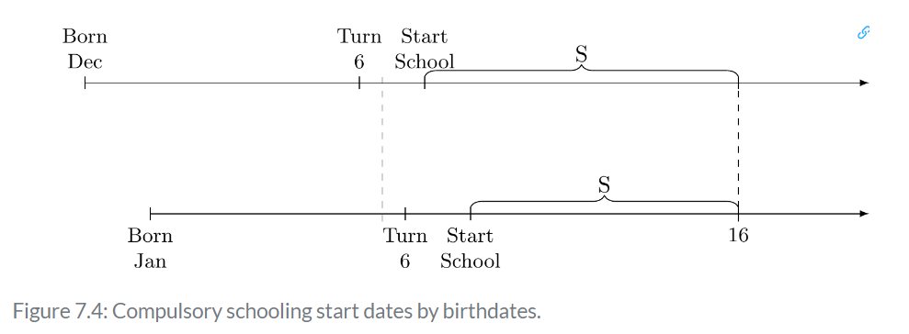
Example: the impact of years of education on adult earnings
In 20th century US, the usual rule is that kids have to stay in school until age 16
Discontinuity in when you start school depending on whether born before or after Dec 31
https://mixtape.scunning.com/07-instrumental_variables

Slide 33
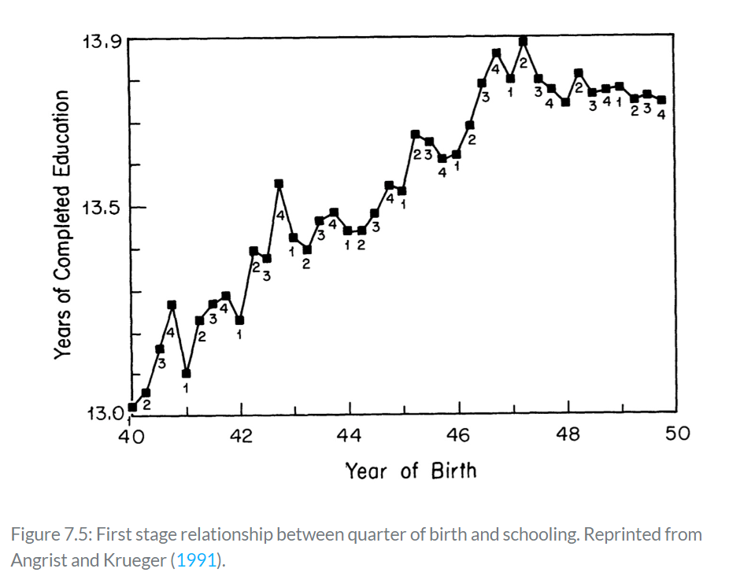

Slide 34
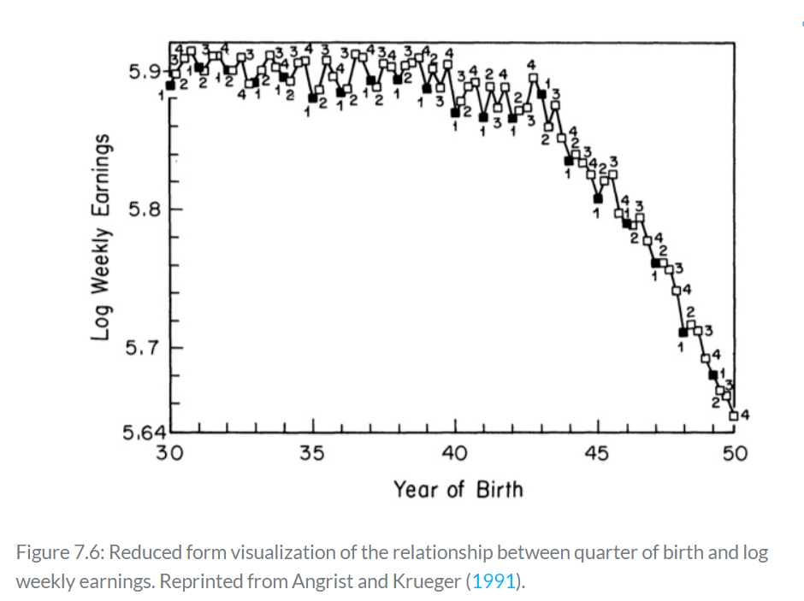

Slide 35
Example
What makes this a reasonable instrument?
Exact date of birth seems pretty random
No obvious channel for exact date of birth to impact adult earnings
Measurable impact of date of birth on amount of schooling

Slide 36
Which of the following are valid instruments?
Continuing the theme of “estimating the impact of education on earnings”
Slido #10718, remember to enter your name

Slide 37
Other caveats
Reduced statistical power (compared to randomized experiment)
Only some treatment decisions got flipped by the instrument
“Weak” vs “Strong” instruments
Effectively, our sample size is (potentially) a lot smaller

Slide 38
Other caveats
Only estimating effects for the population of people whose treatment decisions were changed by the instrument
When treatment effects are heterogeneous, that may not be the same thing as the entire population!
We estimate the icecream-forest fire relationship for people supplied by icecream factories in earthquake-prone locations
More generally, this population is referred to as the “compliers”

Slide 39
Estimation
Typical framework: two stage least squares
First stage: linear regression to predict treatment from the instrument
Second stage: predict outcome from the first stage predictions
I.e., use the amount of variation in the treatment that can be predicted from the instrument

Slide 40
Constructing good instruments
The best instruments are not found in nature at all
Rather, experiments can create instruments in settings where direct treatment assignment is untenable
Example: encouragement IV

Slide 41
Constructing good instruments
Encouragement IV: randomize units to receive an encouragement to adopt the treatment
E.g., flip a coin to decide who receives a letter/incentive/etc asking them to consider adopting something
No one has to adopt, so no fully random assignment
However, exclusion restriction is guaranteed to be satisfied via randomization
Only worry is strength (are enough people convinced to adopt?) which is empirically testable

