Slide 1
Uncertainty quantification
Bryan Wilder
CMU

Slide 2
Reminders
Presentations start next class session
Similar format: 20-25 minutes, describe the method itself and results of implementing it on your dataset
Writeup due along with the final reflection on April 28
Final reflection: 2-3 pages
What would you do differently on the first assignment?
More generally, what would you take away from this class? Lessons, beliefs revised, new research ideas, new ways of approaching projects, etc.
Be specific!

Slide 3
Motivation
Knowing when we don’t know things is important
Safety critical domains: taking the wrong action would have bad consequences; better to let a human take over
Understand when more data is needed
Allow decision makers to put a correct amount of faith in the point estimate

Slide 4
Uncertainty quantification
Broad area of machine learning (and beyond)
Roots in classical statistics and engineering questions
New flavor of these questions in the ML setting

Slide 5
Uncertainty quantification
This class:
Provide a broad overview/taxonomy of what we mean by uncertainty
Talk about what kinds of objectives we might want UQ methods to satisfy
Introduce the main “families” of UQ methods

Slide 6
Coming up
Three presentation days that cover the details and implementation of (some of) these methods
Day 1: Frequentist methods 1 (calibration)
Day 2: Frequentist methods 2 (prediction sets)
Day 3: Bayesian methods

Slide 7

What do we mean by uncertainty?
Suppose that we see data $\left\{\left(x_{1}, y_{1}\right), …\left(x_{n}, y_{n}\right)\right\}$
We see a new $x_{test}$
How much can we say about $y_{test}$?

Slide 8
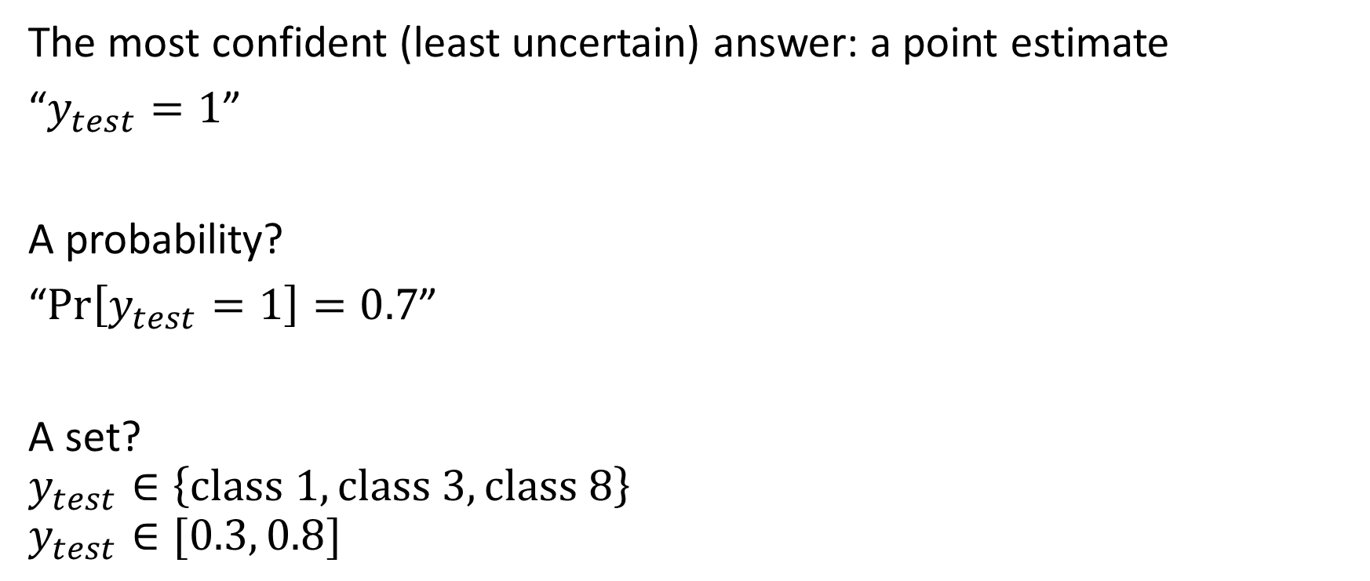
What do we mean by uncertainty?
The most confident (least uncertain) answer: a point estimate
“$y_{test}=1$”
A probability?
“$\operatorname{Pr}\left[y_{test}=1\right]=0.7$”
A set?
$$y_{test}∈\left\{class 1, class 3, class 8\right\}$$
$$y_{test}∈[0.3, 0.8]$$

Slide 9
Epistemic vs aleatoric uncertainty
Long-standing distinction in philosophy, sometimes helpful to reason about uncertainty in statistical/ML settings
Aleatoric uncertainty = irreducible variation in the process generating the outcomes (e.g., randomness in a coin flip)
Epistemic uncertainty = uncertainty because you don’t know the right model of the world (you don’t know what the bias of the coin is)

Slide 10
Slido question
Think about the differences between these quantities
#10718, remember to enter your name

Slide 11
Epistemic vs aleatoric uncertainty
This is relative to the specific model of the problem
Maybe if you enlarged the feature set, “aleatoric” uncertainty would reduce (if I told you a lot of information about how the coin is positioned, maybe you could predict the outcome?)
Just a sometimes-useful construct to think about what kind of uncertainty our models are quantifying

Slide 12
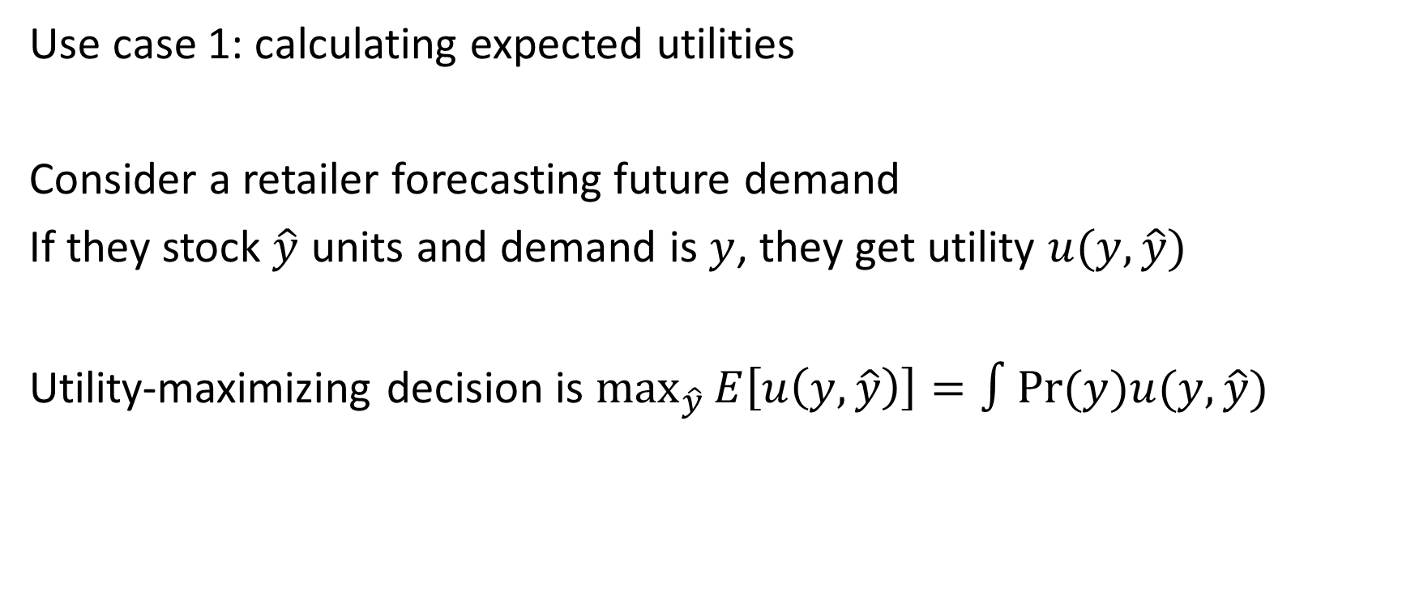
When do we want different descriptions?
Use case 1: calculating expected utilities
Consider a retailer forecasting future demand
If they stock $\hat{y}$ units and demand is $y$, they get utility $u(y, \hat{y})$
Utility-maximizing decision is $\max_{\hat{y}}{E\left[u\left(y, \hat{y}\right)\right]=∫Pr⁡(y})u(y, \hat{y})$

Slide 13
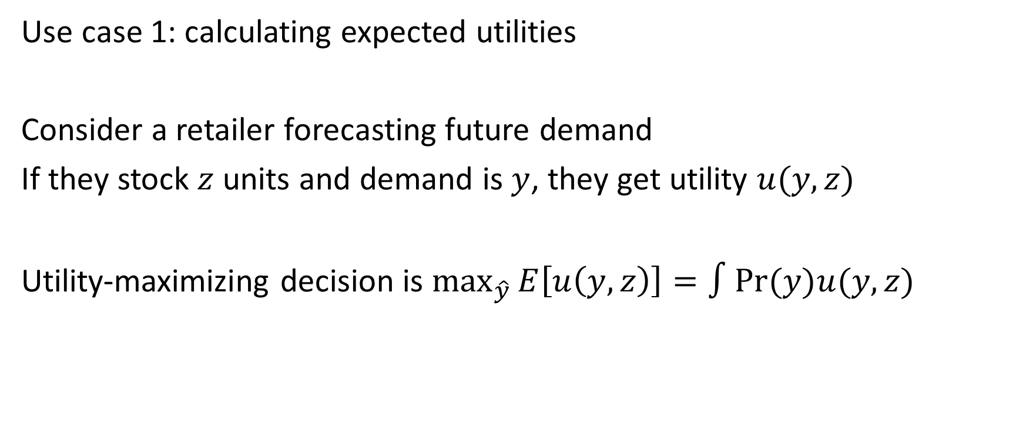
When do we want different descriptions?
Use case 1: calculating expected utilities
Consider a retailer forecasting future demand
If they stock $z$ units and demand is $y$, they get utility $u(y,z)$
Utility-maximizing decision is $\max_{\hat{y}}{E\left[u\left(y, z\right)\right]=∫Pr⁡(y})u(y,z)$
Requires a probability

Slide 14
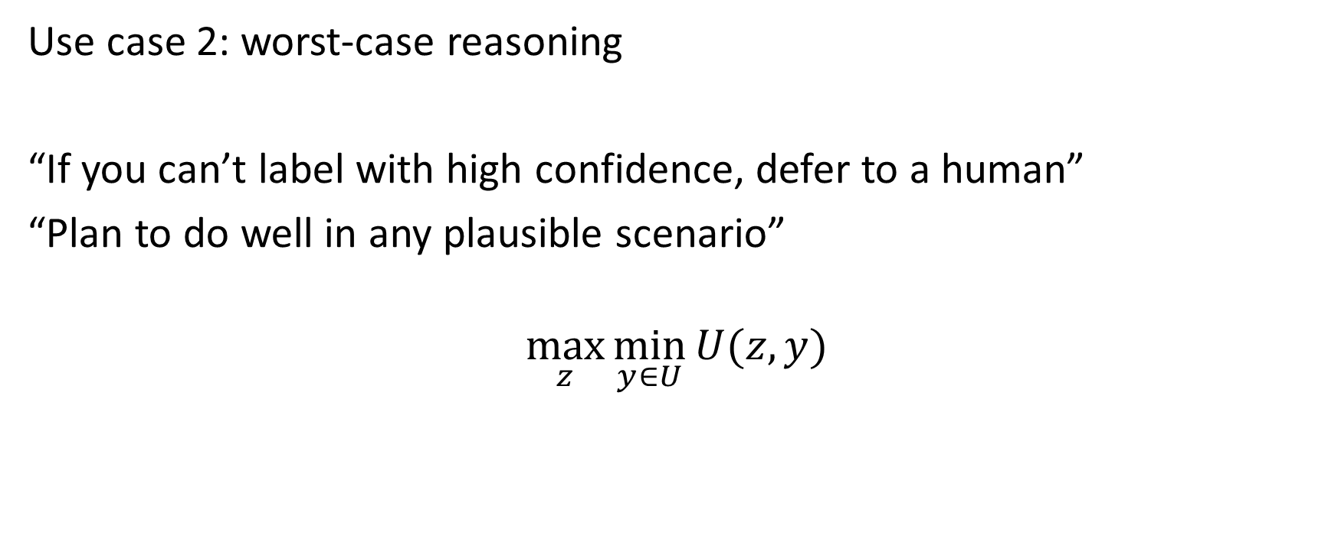
When do we want different descriptions?
Use case 2: worst-case reasoning
“If you can’t label with high confidence, defer to a human”
“Plan to do well in any plausible scenario”
$$\max_{z}{\min_{y∈U}{U(z, y)}}$$

Slide 15
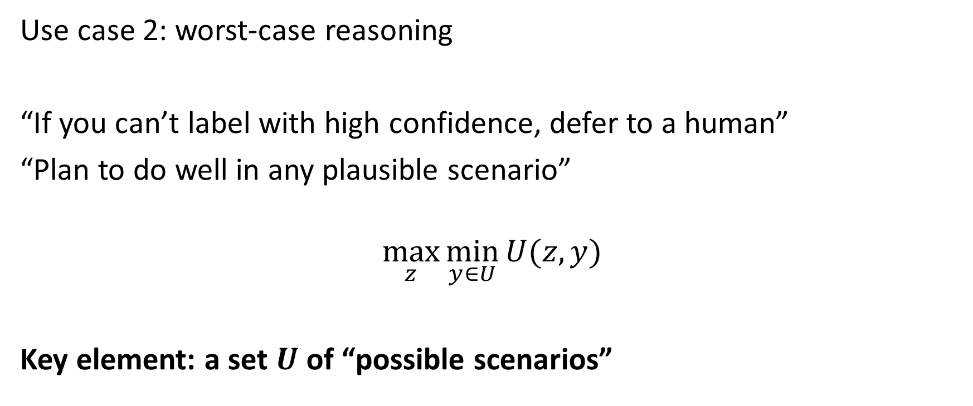
When do we want different descriptions?
Use case 2: worst-case reasoning
“If you can’t label with high confidence, defer to a human”
“Plan to do well in any plausible scenario”
$$\max_{z}{\min_{y∈U}{U(z, y)}}$$
Key element: a set $U$ of “possible scenarios”

Slide 16
When do we want different descriptions?
Full probability distributions are very powerful: given one, you can (by definition) figure out how to maximize your utility for any utility function
However, producing them is very hard
Often times, it may require making assumptions we don’t want to
It may be easier, and sufficient, to just identify a set of possibilities that contains the truth

Slide 17
Families of methods
Broadly, two families mapping onto this distinction:
Bayesian methods: produce a full distribution over the output
Frequentist methods: produce an set (e.g. confidence interval)

Slide 18

Bayesian vs frequentist inference
Suppose that we see data $\left(x_{1}, y_{1}\right), …\left(x_{n}, y_{n}\right)$

Slide 19

Bayesian vs frequentist inference
Suppose that we see data $\left(x_{1}, y_{1}\right), …\left(x_{n}, y_{n}\right) ∼P(x, y|θ)$

Slide 20
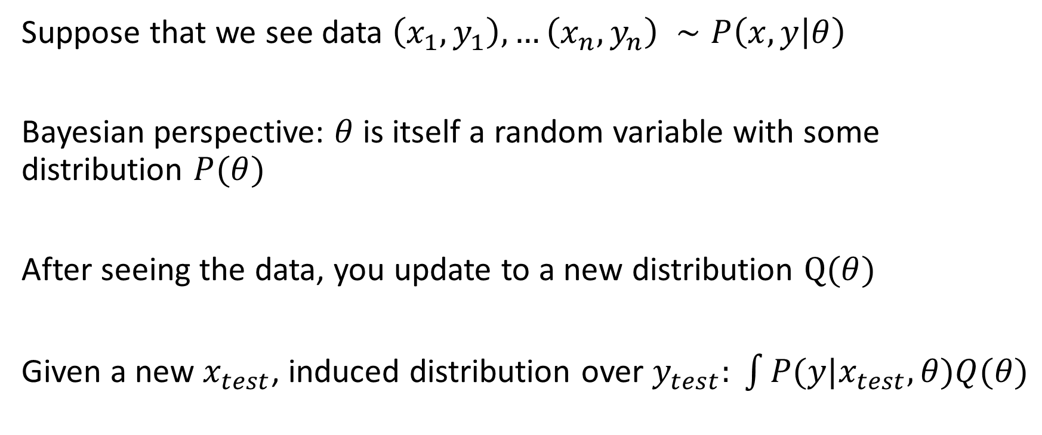
Bayesian vs frequentist inference
Suppose that we see data $\left(x_{1}, y_{1}\right), …\left(x_{n}, y_{n}\right) ∼P\left(x, y | θ\right)$
Bayesian perspective: $θ$ is itself a random variable with some distribution $P(θ)$
After seeing the data, you update to a new distribution $Q(θ)$
Given a new $x_{test}$, induced distribution over $y_{test}: \int{P(y|x_{test}, θ)Q(θ)}$

Slide 21
Bayesian vs frequentist inference
Suppose that we see data $\left(x_{1}, y_{1}\right), …\left(x_{n}, y_{n}\right) ∼P\left(x, y | θ\right)$
Bayesian perspective: $θ$ is itself a random variable with some distribution $P(θ)$
After seeing the data, you update to a new distribution $Q(θ)$
Given a new $x_{test}$, induced distribution over $y_{test}: \int{P(y|x_{test}, θ)Q(θ)}$
Predictive posterior distribution

Slide 22
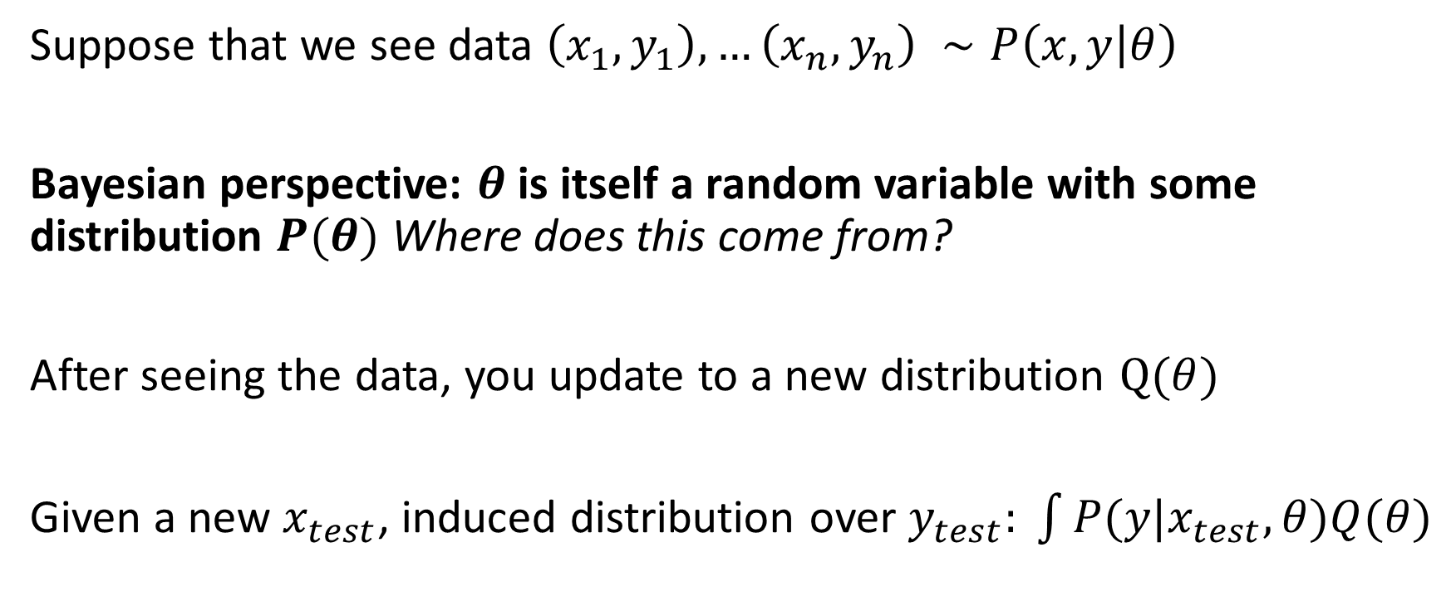
Bayesian vs frequentist inference
Suppose that we see data $\left(x_{1}, y_{1}\right), …\left(x_{n}, y_{n}\right) ∼P\left(x, y | θ\right)$
Bayesian perspective: $θ$ is itself a random variable with some distribution $P(θ)$ Where does this come from?
After seeing the data, you update to a new distribution $Q(θ)$
Given a new $x_{test}$, induced distribution over $y_{test}: \int{P(y|x_{test}, θ)Q(θ)}$
Predictive posterior distribution

Slide 23
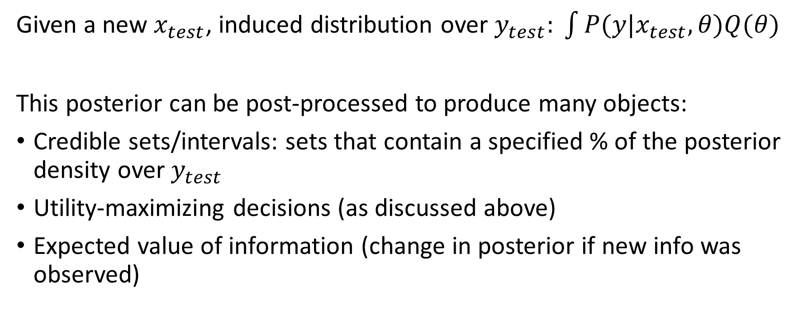
Bayesian vs frequentist inference
Given a new $x_{test}$, induced distribution over $y_{test}: \int{P(y|x_{test}, θ)Q(θ)}$
This posterior can be post-processed to produce many objects:
Credible sets/intervals: sets that contain a specified % of the posterior density over $y_{test}$
Utility-maximizing decisions (as discussed above)
Expected value of information (change in posterior if new info was observed)

Slide 24
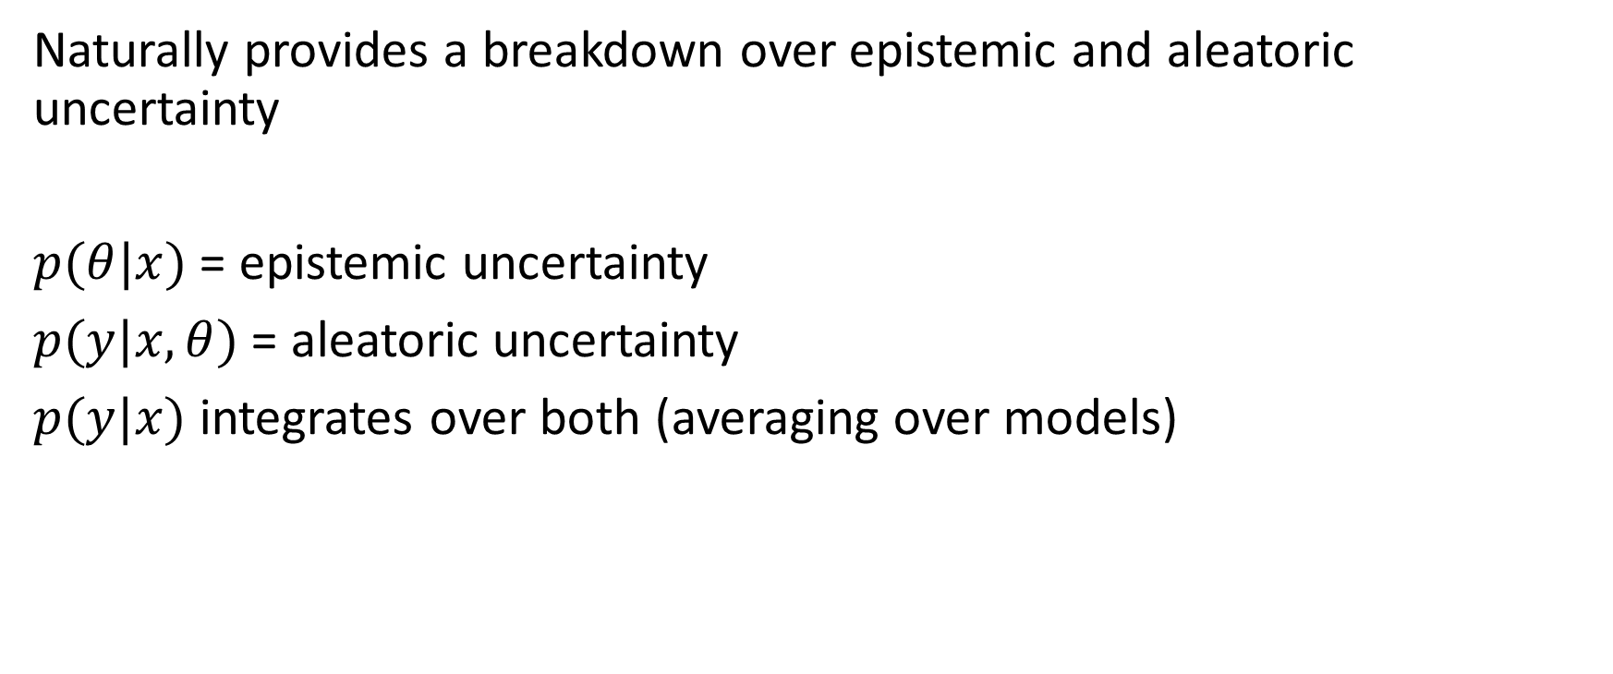
Bayesian vs frequentist inference
Naturally provides a breakdown over epistemic and aleatoric uncertainty
$p(θ|x)$ = epistemic uncertainty
$p(y|x, θ)$ = aleatoric uncertainty
$p(y|x)$ integrates over both (averaging over models)

Slide 25
Bayesian vs frequentist inference
Having probabilistic beliefs requires you to specify a prior
Bayesian beliefs are “subjective”: what does the agent believe are the probabilities of different outcomes after seeing new data?
Not well-defined if you didn’t have any beliefs to start with!

Slide 26
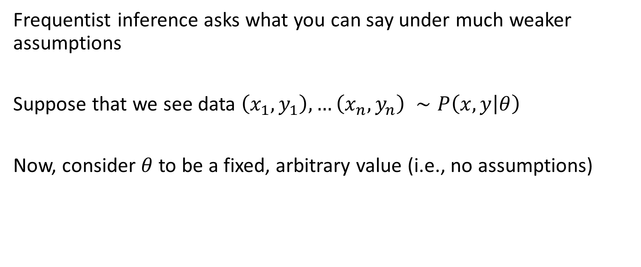
Bayesian vs frequentist inference
Frequentist inference asks what you can say under much weaker assumptions
Suppose that we see data $\left(x_{1}, y_{1}\right), …\left(x_{n}, y_{n}\right) ∼P\left(x, y | θ\right)$
Now, consider $θ$ to be a fixed, arbitrary value (i.e., no assumptions)

Slide 27
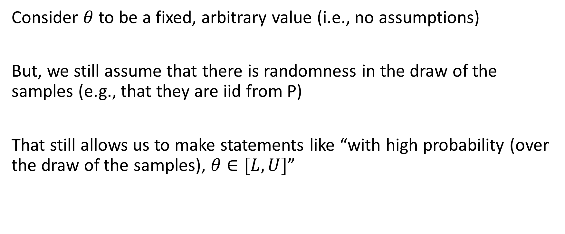
Bayesian vs frequentist inference
Consider $θ$ to be a fixed, arbitrary value (i.e., no assumptions)
But, we still assume that there is randomness in the draw of the samples (e.g., that they are iid from P)
That still allows us to make statements like “with high probability (over the draw of the samples), $θ∈[L, U]$”

Slide 28
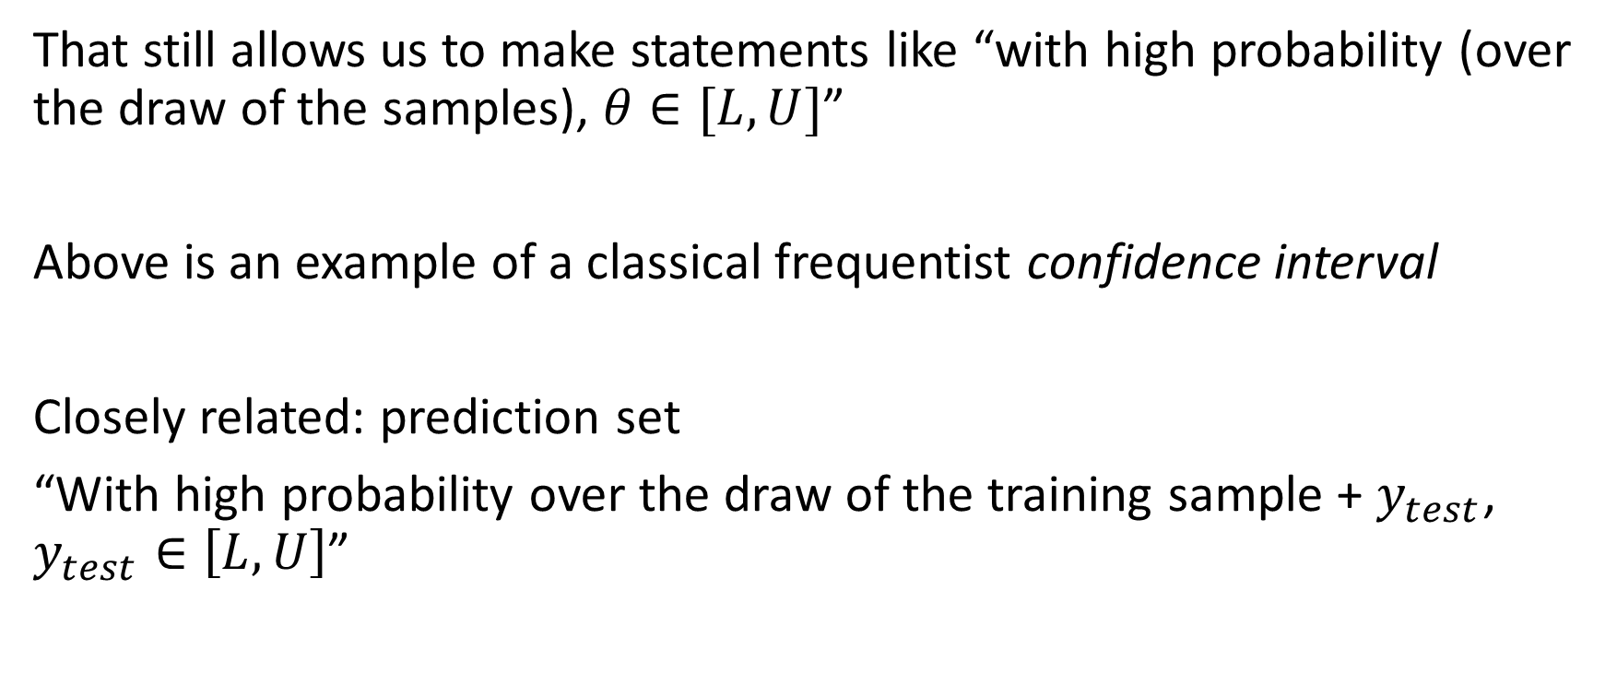
Bayesian vs frequentist inference
That still allows us to make statements like “with high probability (over the draw of the samples), $θ∈[L, U]$”
Above is an example of a classical frequentist confidence interval
Closely related: prediction set
“With high probability over the draw of the training sample + $y_{test}$, $y_{test}∈\left[L, U\right]$”

Slide 29
Bayesian vs frequentist inference
While frequentist methods are assumption-lighter (in many settings), they do not naturally provide as many other derivative products:
Breakdown in aleatoric vs epistemic uncertainty?
Utility-maximizing decision?
How likely is any particular item in the prediction set?

Slide 30
Slido question
Which would you choose to adopt right now?
For concreteness, suppose that you were doing this as part of the class project scenario

Slide 31
Bayesian methods in ML
Long history, and modern progress
Main challenge is inference: computing posterior distributions is very challenging
Historical approaches: sampling (e.g. MCMC), optimizing an approximation to the posterior (e.g. variational inference)
Often necessitates approximations of various kinds

Slide 32
Frequentist methods
Classical perspective: understand asymptotic properties of the sampling distribution of an estimator
Other recent developments, e.g. bootstrap
Repeatedly resample with replacement from your data
Estimate your parameter on the new sample
Return percentiles of this distribution as a confidence interval

Slide 33
Frequentist methods
Challenge: ML models are hard to reason about
They tend to overfit
Difficult to control their behavior under realistic theoretical conditions
Modern progress: methods which are more black-box/agnostic about what the underlying model is doing (sometimes by being a little less data-efficient)

