Slide 1
ML Formulation, Baselines, and Metrics
Bryan Wilder

Slide 2
Things to remember
Group formation:
You should be in a group channel on Slack
If you are not, come talk to me after class and we will place you
We are not sure who has/is planning to drop the course
Group assignments will be finalized today (groups may have members added)

Slide 3
Things to remember
Due Next Week:
Tuesday – project update assignment (Formulation and Baselines)
Readings for Tuesday – Model Selection/”Validation” strategies

Slide 4
Moving from Scope to Analytical Formulation

Slide 5
Turning the project goals/scope into an ML problem
Scoping defines the goals and approach at a high level, the analytical formulation maps this scope to an ML problem and analytical approach
Should be as detailed and specific as possible, making it possible to code it without ambiguity
The analytical formulation should be guided by –– and map back to –– how the system you’re building will be deployed and used

Slide 6
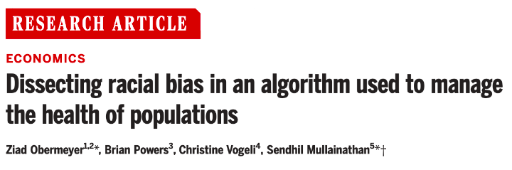
CASE STUDY

Slide 7
Formulation Decisions
In the Obermeyer et al. reading, what formulation decision is the focus of the paper?
Sli.do #10718
sli.do/10718
(Remember to enter your name)

Slide 8
Analytical Formulation
How often is the recommendation/decision being made?
Who/what is included in the cohort?
What is the output?
What outcome are you predicting/estimating?
For what purpose?
On the first day of every semester, for all the students who are currently enrolled in an undergraduate degree program, can we identify the 100 highest risk students who are likely to not graduate college within 5 years of their college start to prioritize for proactive academic or other interventions?

Slide 9
Decisions we need to make: what is the cohort
The cohort is the set of entities for which you would like to make a prediction/decision
Defined by a set of characteristics and timeframe
What event puts someone into the set you would like to make predictions about?
Everyone in your database?
“Active” entities (active users, active drivers, etc?)
People who joined recently?

Slide 10
Cohort definition example
Suppose that we are trying to predict COVID-19 mortality, and we have a dataset of all patients who visited a large health system in the last year.
Possible cohorts:
Patients who have a first visit of any kind with COVID diagnosis
Patients who visit the emergency room with COVID
Patients who had an outpatient COVID visit in the last 2 days
Patients with at least one chronic condition who were admitted to the hospital with COVID in the last 12 hours
…

Slide 11
Decisions we need to make: outcome definition
Outcome definition is critical
Obermeyer example: difference between “healthcare utilization” as outcome and “health state”
Most outcomes a proxies for something else that you really care about – how good a proxy is it? Is it equally good for all individuals?

Slide 12
Analytical Formulation Examples

Slide 13
Analytical Formulation
When and How often is the recommendation / decision being made?
Every time ACDHS gets eviction filing data (weekly), for all individuals who have interacted with ACDHS in the 12 months who are not currently homeless and have had an eviction filing in the last 4 months, can we identify the 50 individuals at highest risk of entering into homelessness in the next 12 months to prioritize for distribution of rental assistance?
Who/what is included in the cohort?
What is the output?
What outcome are you predicting/estimating?
For what purpose?

Slide 14
Analytical Formulation
When and How often is the recommendation / decision being made?
On the 1st of every month, for all individuals who have interacted with our system in the last 3 years, can we identify the 100 and 30 individuals who are at highest risk to die by suicide or overdose in the next 6 months to recommend for proactive behavioral health outreach?
Who/what is included in the cohort?
What is the output?
What outcome are you predicting/estimating?
For what purpose?

Slide 15
Analytical Formulation
When and How often is the recommendation / decision being made?
Every day, for all first time defendants with low-level, nonviolent ordinance violation cases, can we identify the top 5% of people at highest risk of not completing their probation terms to restructure their terms in order to support better outcomes and prevent new cases.
Who/what is included in the cohort?
What is the output?
What outcome are you predicting/estimating?
For what purpose?

Slide 16
Analytical Formulation
When and How often is the recommendation / decision being made?
For every time the doctor finishes taking notes during a patient visit, for all adult patients who come through the emergency department, can we identify up to 10 possible ICD-10 categories* that correspond to the patient’s condition to provide appropriate and timely interventions
*Categories are the first three characters of the ICD-10 code.
Who/what is included in the cohort?
What is the output?
What outcome are you predicting/estimating?
For what purpose?

Slide 17
Analytical Formulation
When and How often is the recommendation / decision being made?
Every year, when new aerial data arrives, for all blocklots in Baltimore City, can we identify 1,000 blocklots with a “high” level of roof damage to prioritize for demo or stabilization inspection in the next year?
Who/what is included in the cohort?
What is the output?
What outcome are you predicting/estimating?
For what purpose?

Slide 18
Decisions we need to make: Baselines
So far: what are we trying to do?
Next: how do we tell if it worked?
First question: what is the appropriate comparison to evaluate effectiveness of your ML model?

Slide 19
Baseline Options
Common Sense
What they do today
What they could do today easily (without any or very simple ML involved)
Prior/Base Rate
What expected value would you get if you just choose at random (based on the data distribution)?

Slide 20
Example
For COVID-19 mortality prediction, what would be a reasonable baseline method that doesn't require using any ML?

Slide 21
Example
For COVID-19 mortality prediction, what would be a reasonable baseline method that doesn't require using any ML?
Sort patients by age
Sort patients by age + (# comorbidities)
Sort patients by # healthcare encounters in last year
Sort patients by value of a chosen lab measurement on admission

Slide 22
Baseline Considerations
How much better than baselines does our system need to be in order to deploy?
Important to compare performance against the base rate/prior, but this prior rarely represents a “common sense” baseline
Good baselines should provide an ordering to sort the entities
Heuristic rules (or shallow decision trees) might reflect current practice, but can yield a small number of unique scores with lots of ties
In many real-world problems, a good baseline can be difficult to beat

Slide 23
Decisions we need to make: evaluation metrics
How do you tell whether models or baselines are good?
Metrics quantify the goodness of a set of model outputs
Need to be carefully matched to project goals
This starts with the definition of labels
Metrics determine how different kinds of errors are weighed – all mistakes are not equally costly

Slide 24
Metrics: classification
Predictions are often scores between 0 and 1
We need to first turn them into 0 or 1 by selecting a threshold
Predicted Class
 | Yes | No
Yes | True Positives (TP) | False Negatives (FN)
No | False Positives (FP) | True Negatives (TN)
Actual Class
Notes:
Not comparable, not probabilities

Slide 25
Evaluation – Metrics (at a threshold k)
Accuracy = (TP + TN) / (TP + TN + FP + FN)
Precision (aka PPV: Positive Predictive Value) = TP / (TP + FP)
Recall (aka Sensitivity, TPR) = TP / (TP + FN)
Specificity = TNR
Predicted
 | Yes | No
Yes | True Positives (TP) | False Negatives (FN)
No | False Positives (FP) | True Negatives (TN)
Actual

Slide 26
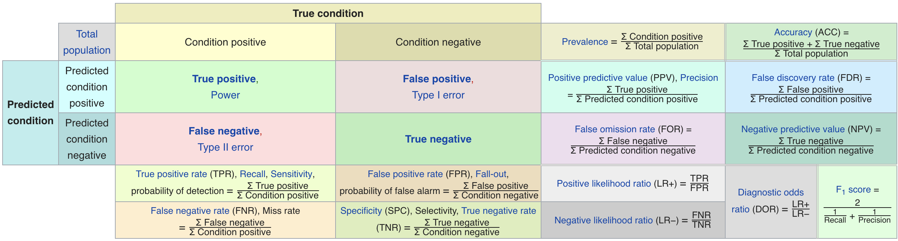
Confusion Matrix-based Metrics Cheatsheet
Source: https://en.wikipedia.org/wiki/Sensitivity_and_specificity

Slide 27
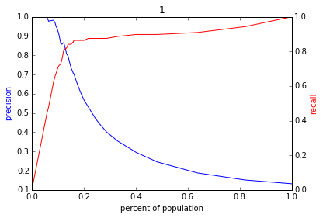
Varying the Threshold
Score
1 .9 .8 .7 .6 .5 .4 .3. .2 .1
| | | | | | | | | |
Baseline

Slide 28
ROC Curve
Receiver Operator Characteristic Curve

Slide 29
AUC (Area Under Curve)
Overall measure of performance
1 if all 1s are ranked above all 0s
0 if all 0s are above all 1s

Slide 30
Calibration
When you predict probability p, does the outcome happen p fraction of the time?
Not the same thing as accuracy: predicting the base rate is always calibrated (if it rains 30% of days, predict 30% on every single day)
Accuracy = sharpness + calibration

Slide 31
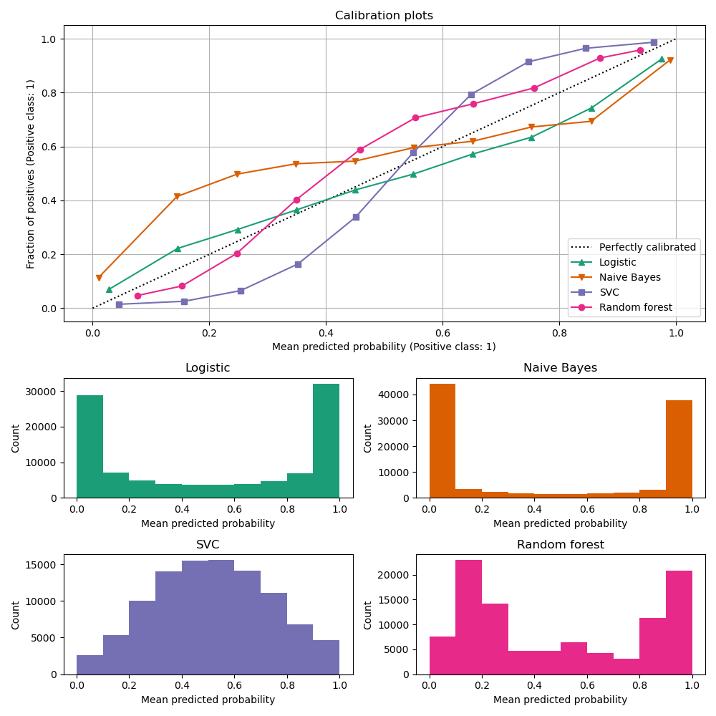
Calibration
Example (from scikit-learn, https://scikit-learn.org/stable/modules/calibration.html)
Which model is overconfident?
Slido #10718

Slide 32
Which model is overconfident?
sli.do #10718
sli.do/10718

Slide 33
Calibration
Example (from scikit-learn, https://scikit-learn.org/stable/modules/calibration.html)
When might you prefer one model over another?

Slide 34
Considerations
Do you care about the entire curve -> AUC
Do you only care about top items -> Precision/Recall at top k
Are false positives/negatives more costly -> focus on sensitivity vs specificity
Do decision-makers need to weigh probabilities -> calibration

Slide 35
Metrics: regression
Key question with metrics: how do we weight different errors.
Questions for regression problems:
Do we care about absolute size of error? Relative error? (MAE vs MAPE)
Bigger deviations disproportionately worse (e.g. MSE)?
Is underpredicting or overpredicting worse?

Slide 36
Things to remember
Due Next Week:
Tuesday – project update assignment (Formulation and Baselines)
Readings for Tuesday

