Slide 1

Human-AI interaction part 2
Bryan Wilder

Slide 2
Reminders
Coming up:
Next week Tuesday: hands-on review of modeling results
Each team will walk through their slides
This is not graded
Point is to discuss what choices you’ve made, what seems to be working, what you might revise, as a class
Give everyone ideas for how to revise their pipeline

Slide 3
Today
Continued/broader discussion of human-AI interaction

Slide 4
In context
Last time: focus on “interpretability/explainability”
Interpretability has been the subject of a vast literature, and typically dominates discussions of human-AI interaction
However, it is far from the only consideration, and often divorced from specific goals

Slide 5
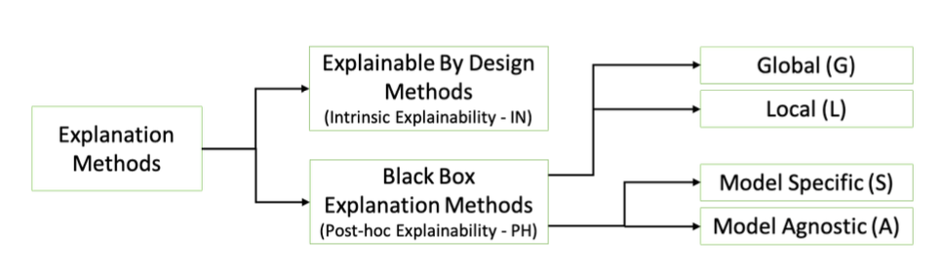
Many Approaches to Model Explanations
Bodria et al, arxiv:2102.13076v1

Slide 6
Why do we want Interpretability?
Debugging the Model
Improving human performance using ML decision aid
Creating and increasing trust and adoption
Selecting appropriate actions/interventions
Legal Recourse
Goals for what counts as “interpretable” are often ill-defined or conflicting

Slide 7
How would you evaluate an interpretability method?
Discussion

Slide 8
Common interpretability evaluation strategies
Most common strategy:
Metrics on the fidelity of explanation model (closeness to the original model) and its complexity (how many rules/variables/etc are used to provide the explanation)
Challenge: not clear how these metrics relate to any desirable feature of human-AI interactions

Slide 9
Common interpretability evaluation strategies
Second most common strategy: User studies with subjects most available for research (e.g. workers on Amazon Mechanical Turk)
Ask these workers to rate explanations (how intuitive, did they increase trust in model, etc)
Test performance of the workers on some task

Slide 10
Common interpretability evaluation strategies
Least common evaluation strategy: testing model + explanations in intended use case
This requires asking experts to interact with the system and evaluating their performance
Experts are hard to get a hold of

Slide 11
Examples of evaluations of human-AI decisions
Two examples from the readings for today
Evaluation (with mechanical turk workers) of impact of providing confidence and explanations for ML model
Biomedical evaluation of an explainable prediction model

Slide 12
Impact of confidence and explanations
Reading for today: Zhang et al
Prediction task using a standard ML dataset (income prediction). Asked Mechanical Turk workers to make predictions, potentially with access to a ML model
Tested impact of providing confidence level of the model for each input
Test impact of providing an explanation of the model’s predictions for each input

Slide 13
Slido
#10718, remember to enter your name
What is the main finding of this paper of the impact of explanations and confidence levels on human’s predictive accuracy?

Slide 14
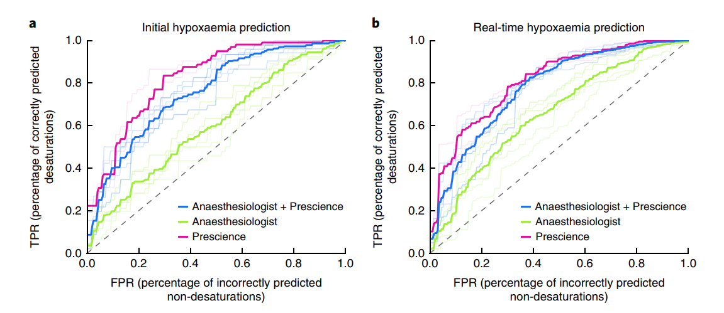
Second example
Problem: predicting hypoxia for patients during surgery
Asked anesthesiologists to make predictions, potentially using ML (augmented with explanations from SHAP)

Slide 15
A wider lens
Humans using AI as part of their toolbox/team to accomplish some task
What properties of AI help AI make better decisions?

Slide 16
Settings
Full automation
Triage (humans look at some instances, AI others)
Decision aid (human makes eventual decision, but looks at model as one input)

Slide 17
Full automation
ML system directly makes decisions in an autonomous manner (potentially within constraints)
Most common with frequent decisions (where regular human input is infeasible) which are individually low-stakes (consequences of ML misbehaving are limited)
Example: advertising

Slide 18
Full automation
Questions for human-AI interaction
What constraints are put on the system?
How is it inspected or monitored?
How do people tell if something is going wrong and needs to be changed?

Slide 19
Triage settings
Aim: predict which instances benefit from human assistance
Motivated by settings where human attention is expensive (requires input from experts like doctors or other specialists)
Maybe some examples are “easy” and can be resolved by the model? But hard ones should still get human attention

Slide 20
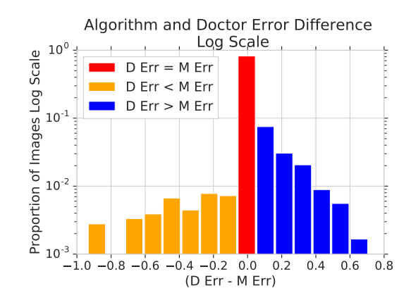
Triage example
Diagnosis of diabetic retinopathy from images
Many ML models developed; competitive with human experts
In low-resource settings, potentially value in automating easy diagnoses
Raghu et al (2018)

Slide 21
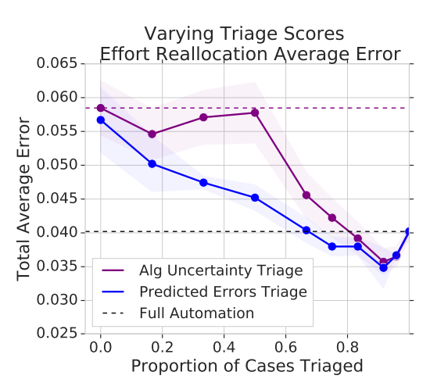
Triage example
Proposed methods: send high-uncertainty images to doctor; train a separate model to predict instances where human would be more accurate
Improves over either human or ML alone
Raghu et al (2018)

Slide 22
Triage settings
Evaluation: is the system able to successfully distinguish instances that need human input?
How does it compare to full-automation or only-human baselines?
Ideal: complementarity, that we can leverage distinct strengths of humans and ML
Does the human see the ML prediction even if the instance is assigned to the human? Becomes an instance of the “decision support” problem

Slide 23
Decision support
Human sees the ML prediction and uses it in their decision-making process
Possible motivations: high stakes, information that only the human sees, many objectives/constraints to integrate, …
Question: what information from the model will result in the best decisions?

Slide 24
Decision support
Question: what information from the model will result in the best decisions?
Model explanations are one possible answer…but only one and it’s not obvious that they’re the most important

Slide 25
Decision support
Model confidence – how much should I weight the model’s input on this instance?
If well-calibrated, helps people use ML more effectively
Later, we will cover methods for uncertainty quantification in more detail

Slide 26
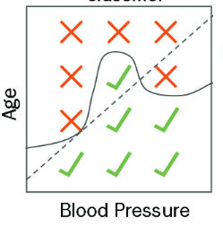
Decision support: mental models
Humans using these models form mental models of them
Learn what kinds of settings they are more or less accurate or helpful for
Error region
Human’s model of error region boundary
Bansal et al (2019)

Slide 27
Decision support: mental models
Potentially, models will perform better if it is easier for humans to form useful mental models of them
Bansal et al identify two quantities: parsimony (how complex is it to describe a boundary between errors and correct predictions) and stochasticity (how well does the boundary separate the two regions)
Some experimental evidence that team performance is better when errors are easier to understand for humans

Slide 28
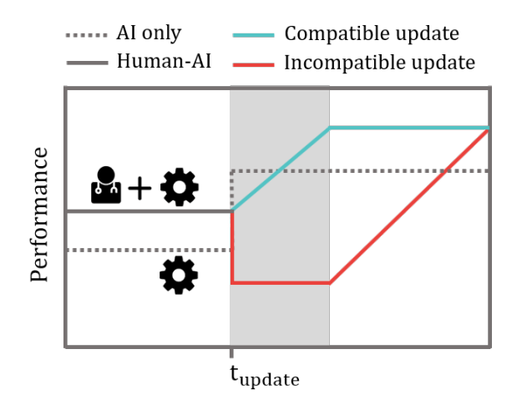
Model updates
What happens we change and update ML models over time?
Are those mental models still accurate?
Bansal et al (2019)

Slide 29
Model updates
Potentially, there is a benefit to updating ML models in ways that generate compatible mental models
Suggestion: introduce a term in the loss which penalizes introducing new mistakes
If the old model got something right, the new model should too (while hopefully improving in some places as well)

Slide 30
Things to keep in mind
This area is far from settled; difficult to describe a set of standard “best practices”
No real substitute for being able to talk to your users
Try to elicit what exactly their goals are; why do they want particular kinds of information?
If quantifiable, measure performance directly for the task of interest

