Slide 1

Hyperparameter tuning +
Human-AI interaction part 1
Bryan Wilder

Slide 2
Reminders
Coming up:
Thursday: paper reflection
Next week Tuesday: hands-on review of modeling results
Each team will walk through their slides
This is not graded
Point is to discuss what choices you’ve made, what seems to be working, what you might revise, as a class
Give everyone ideas for how to revise their pipeline

Slide 3
Today
Brief module: practical hyperparameter tuning guide
Human-AI interaction part 1

Slide 4
Hyperparameters
Essentially all ML models have them
Depth of decision tree, strength of regularization for LASSO, number of hidden units in neural network…
Practical performance can depend heavily
Ease of hyperparameter tuning makes or breaks methods

Slide 5
Hyperparameters
General procedure: define separate validation and test sets
For each possible set of hyperparameters, train model with those hyperparameters, evaluate on validation set, select hyperparameters with best validation performance
Validation set performance now does not accurately reflect out of sample performance since we optimized against it
Separate test set for final evaluation

Slide 6
Hyperparameters
Strategies for hyperparameter search
Manual: try different things, see what works on validation set, try new things
Grid search: try all combinations, discretizing continuous parameters
Random search: subsample combinations to try
More sophisticated strategies: active research area (Bayesian optimization etc).

Slide 7
Hyperparameters
One meta-algorithm:
Prior knowledge + manual search to define parameters of grid
See what the bounds for a “reasonable” setting of each variable are
Then, grid search or random if grid is too large

Slide 8
Hyperparameters
What hyperparameters should you vary?
Decision trees?
LASSO?
Neural networks?

Slide 9
Hyperparameters
What hyperparameters should you vary?
Decision trees?
Maximum depth (2…5? 10?), splitting criterion (i.e., loss function)
LASSO?
Regularization parameter. Common implementations will do k-fold cross validation within the train set to trace out the complete path of loss wrt that parameter
Neural networks?
Many: # layers, # hidden units, learning rate, regularization strength, early stopping, activation functions, loss function, …

Slide 10
Human-AI interaction
Today: interpretability/explainability
Thursday: broader perspectives, criticisms, models for human-AI interaction

Slide 11
Interpretability

Slide 12
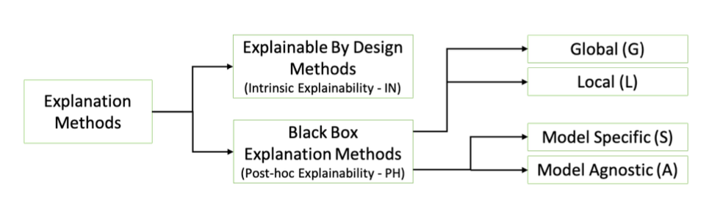
Many Approaches to Model Explanations
Bodria et al, arxiv:2102.13076v1

Slide 13
Why do we want Interpretability?
Debugging the Model
Improving human performance using ML decision aid
Creating and increasing trust and adoption
Selecting appropriate actions/interventions
Legal Recourse
Goals for what counts as “interpretable” are often ill-defined or conflicting

Slide 14
Prelude: feature importances
Goal: explain the overall behavior of the model, not interpreting individual predictions
E.g., feature importances: on average, what features are playing a really important role in prediction?
For linear models, just look at coefficients
For other ML models, less clear how to measure (won’t be constant across different points)

Slide 15
Feature importances
For specific features, can do ablations (“What if we didn’t have that feature”?)
Measure accuracy with and without
In general, this would require retraining the model (slow/expensive)
Common move: instead of retraining, replace the feature with other inputs

Slide 16
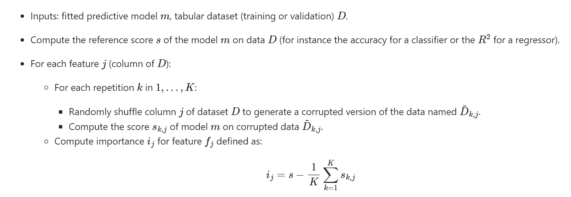
Permutation feature importance
Variation on ablating a feature entirely that doesn’t require retraining
Fairly common; this description from sklearn:

Slide 17
Explainability methods
“Explainable by design”
Black-box

Slide 18
“Explainable by design”
Starting point: some models are pretty easy to interpret by themselves
Linear (logistic) regression/LASSO
Shallow decision trees
People can see what features are used, how important each is, how modifying features would impact predictions, etc.

Slide 19
Explainability vs Accuracy?
Accuracy
Explainability

Slide 20
Explainability vs Accuracy?
Accuracy
2-Deep Decision Tree
Explainability

Slide 21
Explainability vs Accuracy?
Deep Neural Net
Accuracy
2-Deep Decision Tree
Explainability

Slide 22
Explainability vs Accuracy?
Deep Neural Net
Accuracy
Pareto Frontier
2-Deep Decision Tree
Explainability

Slide 23
Explainability vs Accuracy?
Deep Neural Net
Explainable ML Goal
Accuracy
Pareto Frontier
2-Deep Decision Tree
Explainability

Slide 24
Optimized scoring rules
Recent work: can we formulate other model classes with easy interpretation?
One example: learning optimal versions of simple scoring rules

Slide 25
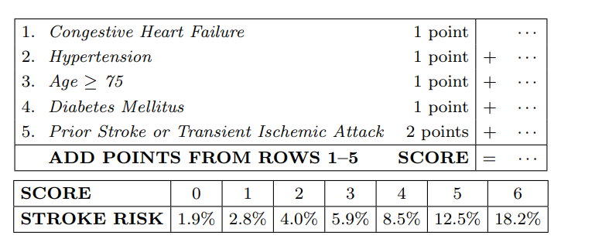
Optimized scoring rules
What is a scoring rule?
Assigns point values to different features; calculate the sum for a given individual
Commonly implemented in practice: here is a real example in medicine
https://users.cs.duke.edu/~cynthia/docs/WagnerPrizeCurrent.pdf

Slide 26
Optimized scoring rules
Where do these come from? In practice, expert committees etc.
But these are really predictive models! Why not learn them from data?
Proposed approach: solves an optimization problem where the variables are the (integer) number of points for each feature
https://users.cs.duke.edu/~cynthia/docs/WagnerPrizeCurrent.pdf

Slide 27
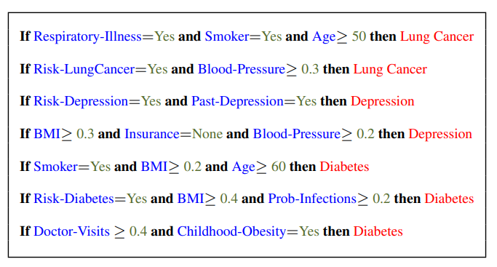
Decision sets
Alternate approach with similar motivation
Decision sets are a list of independently applied rules mapping features values to outcome:
Again, can solve a discrete optimization problem to find the “best” one
https://cs.stanford.edu/people/jure/pubs/interpretable-kdd16.pdf

Slide 28
Slido
Slide #10718, remember to enter your name
Which do you think is a “better” approach? E.g., which would you try first for most problems?

Slide 29
Pros and cons
Pros:
No gap between explanation and model
Easy to build trust/adoption with practitioners – similar to guidelines or best practices they may already be using
Often perform fairly well
Cons:
Don’t always perform (as) well
Commits you to a specific/limited range of modeling choices
Doesn’t extend easily beyond tabular data
Need to do feature engineering “by hand”

Slide 30
Black-box explanations
Arbitrary ML model
After training the model: look for an “explanation” of the model (global) or a specific prediction of the model (local)
What counts as an explanation?

Slide 31
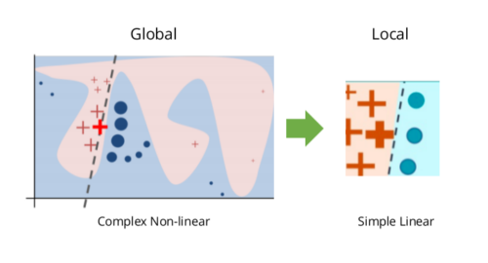
LIME
We think some basic class of models is “interpretable”, e.g. linear models
Try and (locally) approximate predictions with that simpler model class
Sample perturb inputs; weight by distance to original point; fit linear model
https://c3.ai/glossary/data-science/lime-local-interpretable-model-agnostic-explanations/

Slide 32
LIME
Interpretation: if I change the features a little bit, how would response change?
Advantages: linear models are (often) easy to interpret
Disadvantages: model may not have good linear approximation; I may care about feature perturbations that are not local
https://c3.ai/glossary/data-science/lime-local-interpretable-model-agnostic-explanations/

Slide 33
SHAP
Measures a “Shapley value”
Concept from game theory: how much is a given player adding?
This may depend on what other players are present!
In ML land: if features A and feature B are similar, neither of them adds that much if we have the other. But, losing both of them would be bad
Idea in Shapley values: average the marginal contribution of a player (feature) to all possible subsets of other players (features)

Slide 34
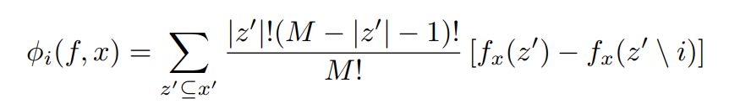
SHAP
Normalize by number of subsets of this size
Difference in model predictions for input x if we include vs exclude feature i
Importance of feature i, more model f on input x
All subsets of features

Slide 35
SHAP: common implementation
Sample presence/absence of each feature (instead of brute force over all subsets)
Consider features A, B, C, D
On one sample: evaluate prediction given features {A, C, D} (but not B)
But, the model expects feature B and we don’t want to retrain the model over and over
Solution: impute B with a random value from the train set (as in permutation features)

Slide 36
SHAP: interpretation
Asking “what direction was the prediction moved by including feature i”
Trying to do so in a way that is less explicitly linear/local
Trying to account for complementarities or substitutes in different features
This may or may not always be the question you care about

Slide 37
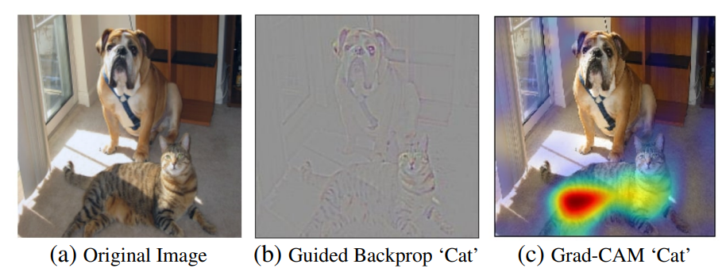
GradCam
Targeted at vision models (e.g. CNN)
Highlights regions in an image that are “important” for prediction
Main idea: compute gradients of class probabilities wrt convolutional activations
https://arxiv.org/pdf/1610.02391.pdf

Slide 38
GradCam
One use case for this debugging/catching undesired behavior: if highlighted regions are irrelevant, something bad may have happened (e.g., in medical imaging, picking up on the font of a timestamp in an xray)
https://arxiv.org/pdf/1610.02391.pdf

Slide 39
Evaluating Explainable ML Methods
How easy is the method to apply to a new setting (either with an existing implementation or from the description in the paper)?
Are there parameters you need to choose? If so, how do you find good values and how sensitive are the results to these choices?
Do the explanations “make sense”? Are they internally consistent? Do they seem consistent with what you know about the context and the data?
Are the explanations useful? Would they actually improve outcomes for the given use case?
Do you have to make any trade-offs to improve interpretability (e.g., computational time, model accuracy?)

